Slide 1
Systematic Managed Floating
Jeffrey Frankel
Harpel Professor of Capital Formation and Growth
Harvard Kennedy School, Harvard University
4th Asian Monetary Policy Forum
Singapore, 26 May, 2017
under the auspices of the Asian Bureau of Finance and Economic Research (ABFER),
with support from the University of Chicago Booth School of Business,
the National University of Singapore Business School
and the Monetary Authority of Singapore (MAS).

Slide 2
Countries’ choice of exchange rate regimes
A majority neither freely float nor firmly peg.
Intermediate exchange rate regimes, then.
  But, in practice, they also seldom obey well-defined
  target zones or basket pegs. Many are “murky” or “flaky.”
  Proposed: a regime of “systematic managed floating,”
  where the central bank regularly responds to changes
  in total exchange market pressure
    by allowing some fraction to be reflected as Δ exchange rate,
    and the remaining fraction to be absorbed as Δ FX reserves.
Introductory motivation:
  Consider the external shocks hitting EMEs since 2003.

Slide 3




Asian central bank reactions to 2010 inflows:
Korea & Singapore mostly took them in the form of reserve gains,
while India & Malaysia mostly took them
in the form of currency appreciation.
FX reserve gains vs. currency appreciation
more-managed floating
less-managed floating
Source: GS Global ECS Research, Goldman Sachs ,10/13/2010. Data: Haver Analytics and Bloomberg

Slide 4

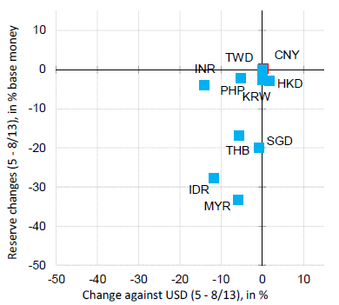
Reactions to outflows in “Taper Tantrum,” May-Aug., 2013.
Again Singapore intervened, India & Philippines mostly depreciated.
FX reserve loss vs. currency depreciation
less-managed floating
more-managed floating

Slide 5
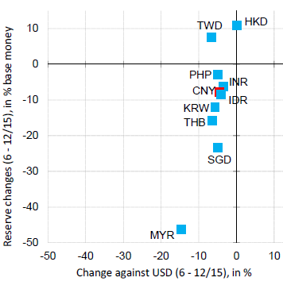

Reactions to outflows in “China Tantrum,” July-Dec. 2015.
Again, Singapore mostly gave up FX reserves.
& the Philippines mostly depreciated.
FX reserve loss vs. currency depreciation
less-managed floating
more-managed
floating

Slide 6
Why choose a systematically managed float?
Textbook view: intermediate regimes allow
an intermediate degree of monetary independence, including freedom from external shocks, in return for
an intermediate degree of exchange rate flexibility.
But -- four challenges:
  (a) “the corners hypothesis,”
  (b) “dilemma vs. trilemma,”
  (c) “intervention ineffectiveness” and
  (d) “exchange rate disconnect.”

Slide 7
Challenge (a): Corners Hypothesis
“Intermediate regimes are increasingly unviable.”
  “Countries are forced to move to corners: free float or firm fix.”
An impressive pedigree,
  including: Eichengreen (1994), CFR (1999), Summers (1999), Meltzer (2000), and Fischer (2001).
But,
  theoretically, there are perfectly well-developed theories
  of intermediate regimes,
    e.g., target zones: Krugman (1991); and
  empirically, “managed floats” are now the biggest category
    though many of them remain murky.
    Ghosh, Ostry, & Qureshi (2015).
    Ilzetzki, Reinhart and Rogoff (2017).

Slide 8
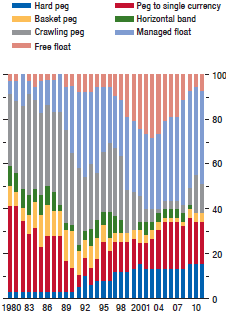

“Managed floats” have been rising as a share of EM exchange rate regimes
Distribution of Exchange Rate Regimes in Emerging Markets, 1980-2011 (% of total)
}
Ghosh, Ostry & Qureshi (2015)

Slide 9
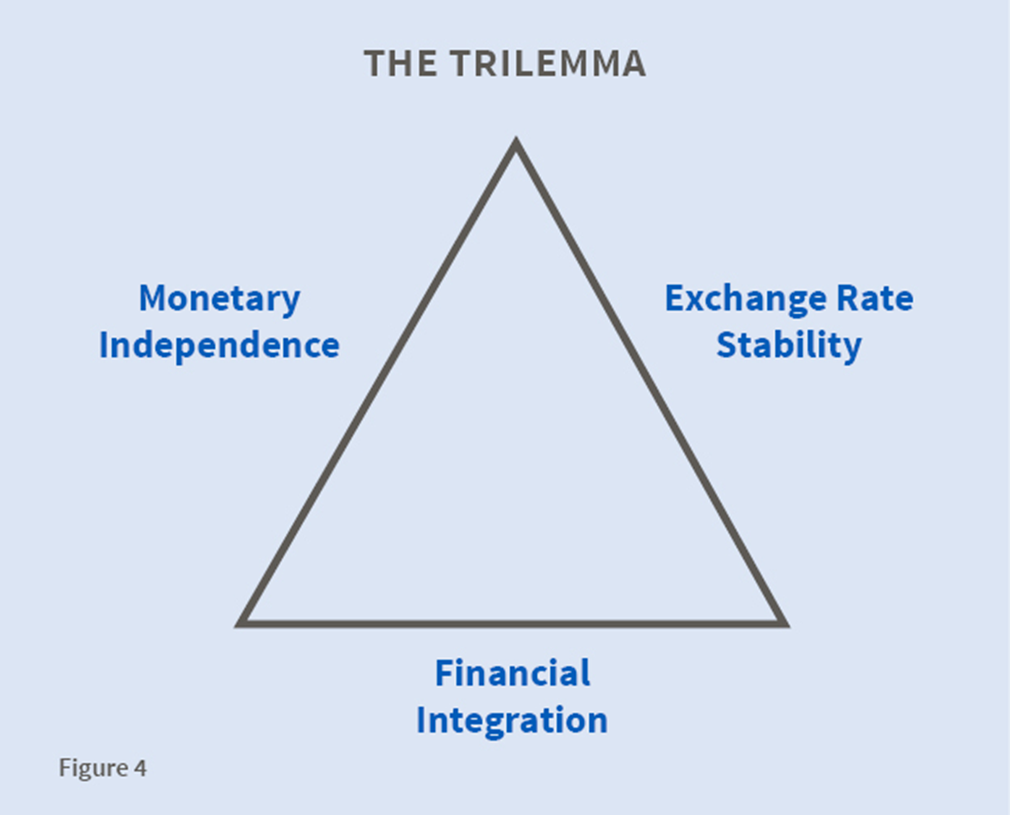
The Trilemma or “Impossible Trinity”
At each corner of the triangle, it is possible to obtain 2 attributes.
But not all 3..
•
Full capital controls
•
•
•
Pure Float
Firm fix
Intermediate regime
=> (a) Forced to choose between corners?
No. Triangles have sides!

Slide 10
Challenge (b): “Dilemma not trilemma”
Challenge to trilemma from Rey (2014)
  and Agrippino & Rey (2014), Farhi & Werning (2014), Edwards (2015).
Claim: Floating rates don’t offer insulation from external shocks
  such as VIX⬆.
The triangle collapses into a single line segment, running from “monetary independence via controls” to “open capital markets,”
  with the choice of exchange rate regime not relevant.
•
•
Monetary
independence
Monetary
dependence
Full capital controls
Open capital markets
But floating does allow some monetary independence:
  Aizenman, Chinn, & Ito (2010, 2011), Di Giovanni & Shambaugh (2008),
  Klein & Shambaugh (2012, 2015), Obstfeld (2015), Obstfeld, Shambaugh & Taylor (2005), Shambaugh (2004), and Frankel, Schmukler & Servén (2004).

Slide 11
Challenge (c): “FX intervention is powerless to affect nominal exchange rates”
“unless it is non-sterilized,
    in which case it is just another kind of monetary policy.”
These days, G-7 countries don’t intervene.
But major EMEs do have managed floats.
  Studies of EMEs tend to show intervention has effects:
    Fratzscher et al (2016), Adler, Lisack & Mano (2015),
    Adler & Tovar (2011), Blanchard, Adler, & de Carvalho
    Filho (2015), Daude, Levy-Yeyati & Nagengast (2014),
    and Disyatat & Galati (2007). Survey by Menkhoff (2013).

Slide 12
Challenge (d): “Exchange rate disconnect”
Claim: The nominal exchange rate has no implications for real economic factors such as the real exchange rate, trade, or output.
Empirical studies often fail to find correlations between
nominal exchange rates and real fundamentals.
    E.g., Flood & Rose (1999), Devereux & Engel (2002) and Rose (2011).
Many theoretical models say that shocks have the same effect
on the real exchange rate
  regardless whether the currency floats,
    in which case the shock appears in the nominal exchange rate,
  or is fixed,
    in which case the same shock shows up in price levels instead.
  E.g., Real Business Cycle models.
We will see if we can reject the null hypothesis that the exchange rate regime doesn’t matter for the real exchange rate.

Slide 13
Three approaches to identifying which countries are systematic managed floaters
1) Regressions to estimate CB reaction function for intervention
  An advantage of using data from Turkey:
  Can compare the use of intervention data vs. reserve changes.
2) Frankel-Wei-Xie regression of Δs against EMP
where EMP ≡ Exchange Market Pressure ≡ (Δs + ΔRes /MB).
  An advantage: allows anchor to have whatever reference currency
  or basket of currencies the data support.
3) Simple-minded correlation (Δs , ΔRes /MB),
  where s ≡ log (value of currency); Res ≡ FX reserves; MB ≡ monetary base
  Advantages:
    Very easy
    Don’t have to presume anything about direction of causality.
An advantage of all 3: Look at both Δs and ΔRes to figure regime,
  Not just Var(Δs).

Slide 14
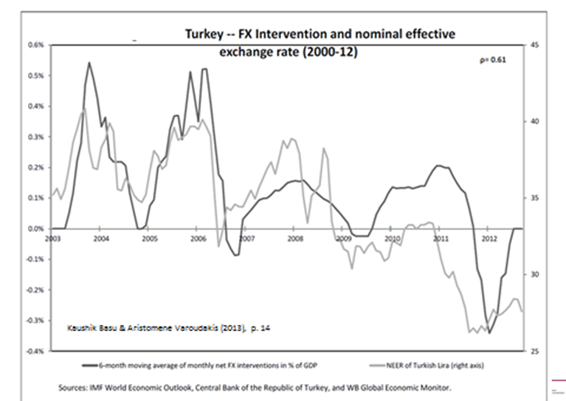
(1) Case study: Turkey’s intervention data have been found to support a systematic reaction function
Basu and Varoudakis (2013)
Also Frömmel and Midiliç (2016)

Slide 15
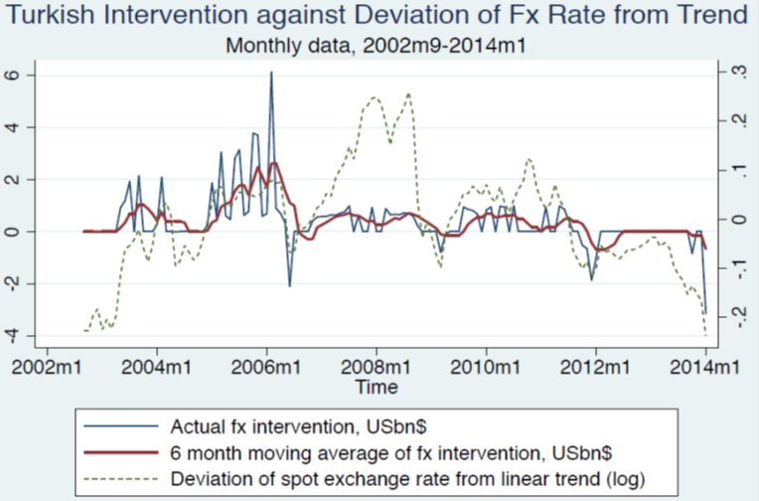
The two separate measures of intervention look quite different, as expected, though highly correlated.
Figure 5: Foreign Exchange Actions by Turkey: Intervention Data vs. Reserve Changes

Slide 16
Check that Turkey CB reaction to exchange rate is systematic, whether using intervention data or Δ FX reserves.
FX acquisition =
c + a (s _{t} – s_{trend}) + ß (s _{t} – s _{t-1}) + δ (Res/GDP)_{t} + ψ (inflation – target).
The dependent variable, “FX acquisition,”
is measured first by FX intervention data and then by changes in FX reserves.
Regression to estimate reaction function of Turkey’s central bank
t-statistics are reported | ______Measure of FX Reserve Accumulation____
Independent Variable | ________Intervention_______ |  |  | __Δ Reserves_
s _{t} – s_{trend} | 3.6 *** | 2.7 ** | 2.7 *** | 1.8*
s _{t} – s _{t-1} | 2.3 ** |  | 1.6 | 4.5 ***
Reserves/ GDP |  | -2.9 *** | -2.6 *** | 1.2
constant | 4.3 *** | 3.4 *** | 3.1 *** | -0.8
Table 4.3. 133 monthly observations: 2003m1-2014m1
t-statistic significant at: *** 1% level ** 5 % level * 10 % level

Slide 17
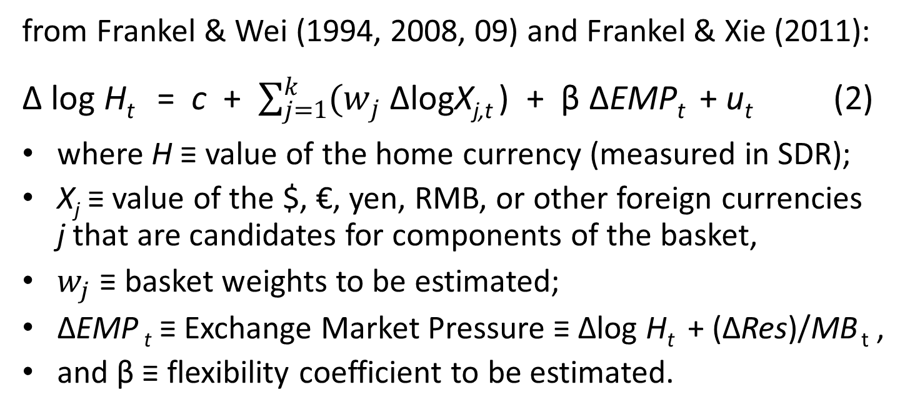
(2) Technique to estimate flexibility parameter and currency weights at the same time
from Frankel & Wei (1994, 2008, 09) and Frankel & Xie (2011):
Δ log H_{t} = c + $\sum_{j=1}^{k}{(w_{j}}$ ΔlogX_{j,t} ) + β ΔEMP_{t} + u_{t} (2)
where H ≡ value of the home currency (measured in SDR);
X_{j} ≡ value of the $, €, yen, RMB, or other foreign currencies
j that are candidates for components of the basket,
$w_{j}$ ≡ basket weights to be estimated;
ΔEMP _{t} ≡ Exchange Market Pressure ≡ Δlog H_{t} + (ΔRes)/MB _{t} ,
and β ≡ flexibility coefficient to be estimated.
If β=1 => pure float;
β=0 & high R² => fixed exchange rate;
0<β<1 & high R² => systematic managed float.

Slide 18
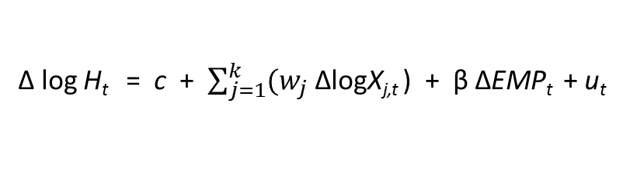
India shows systematic managed float in sub-periods
Δ log H_{t} = c + $\sum_{j=1}^{k}{(w_{j}}$ ΔlogX_{j,t} ) + β ΔEMP_{t} + u_{t}
where EMP _{t} ≡ Δlog H_{t} + (ΔRes)/MB _{t}
Table 3. Identifying Break Points in India's Exchange Rate Regime (M1:2000-M5:2009)
 | (1) | (2) | (3) | (4) | (5) | (6)
VARIABLES | 1/14/2000-10/27/2000 | 11/3/2000-6/17/2001 | 6/24/2001-12/31/2001 | 1/14/2002-9/23/2003 | 9/30/2003-2/25/2007 | 3/4/2007-5/6/2009
US dollar | 0.77*** | 0.92*** | 0.66*** | 0.91*** | 0.72*** | 0.59***
 | (0.06) | (0.04) | (0.08) | (0.04) | (0.06) | (0.10)
Euro | 0.12*** | 0.10*** | 0.23*** | 0.03 | 0.06 | 0.32***
 | (0.03) | (0.03) | (0.07) | (0.03) | (0.05) | (0.07)
Jpn yen | 0.09*** | 0.04* | 0.05 | 0.03 | 0.24*** | 0.02
 | (0.02) | (0.02) | (0.05) | (0.02) | (0.06) | (0.07)
△EMP | 0.44*** | 0.04 | 0.46*** | 0.06 | 0.15*** | 0.37***
 | (0.06) | (0.04) | (0.10) | (0.04) | (0.05) | (0.07)
Observations | 42 | 32 | 28 | 88 | 172 | 109
R² | 0.98 | 0.98 | 0.98 | 0.98 | 0.86 | 0.78
Br. Pound | 0.02 | -0.06 | 0.06 | 0.03 | -0.01 | 0.08
*** p<0.01, ** p<0.05, * p<0.1 (Robust s.e.s in parentheses.) All data are weekly.

Slide 19
Thailand shows systematic managed float throughout.
Table 2. Identifying Break Points in Thailand’s Exchange Rate Regime (M1:1999-M5:2009)
 | (1) | (2) | (3) | (4)
VARIABLES | 1/21/1999-8/5/2001 | 8/12/2001-9/9/2006 | 9/16/2006-3/25/2007 | 4/1/2007-5/6/2009
US dollar | 0.62*** | 0.61*** | 0.80*** | 0.70***
 | (0.09) | (0.04) | (0.28) | (0.05)
Euro | 0.26*** | 0.17*** | -0.08 | 0.19***
 | (0.08) | (0.06) | (0.59) | (0.04)
Jpn yen | 0.15*** | 0.25*** | 0.16 | 0.04
 | (0.04) | (0.03) | (0.30) | (0.03)
△EMP | 0.20*** | 0.06*** | 0.50*** | 0.03**
 | (0.05) | (0.02) | (0.17) | (0.01)
Constant | -0.00** | 0.00 | -0.01 | -0.00
 | (0.00) | (0.00) | (0.00) | (0.00)
Observations | 129 | 257 | 27 | 108
R² | 0.66 | 0.76 | 0.64 | 0.90
Br. Pound | -0.02 | -0.04 | 0.12 | 0.07
*** p<0.01, ** p<0.05, * p<0.1 (Robust s.e.s in parentheses.) All data are weekly.

Slide 20
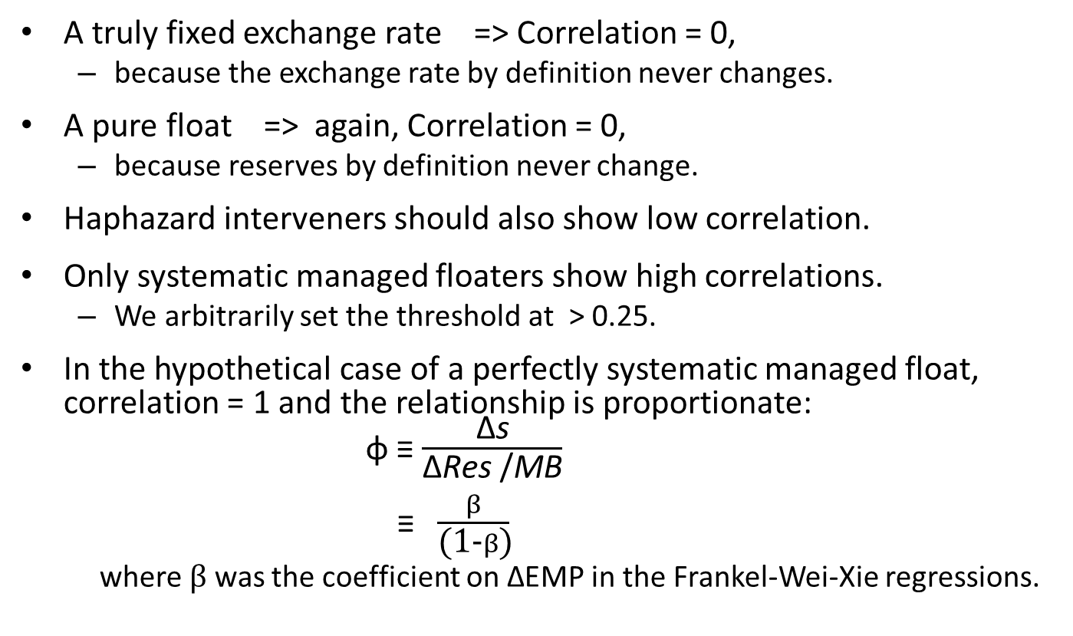
(3) Simple-minded Correlation (Δs , ΔRes /MB),
A truly fixed exchange rate => Correlation = 0,
  because the exchange rate by definition never changes.
A pure float => again, Correlation = 0,
  because reserves by definition never change.
Haphazard interveners should also show low correlation.
Only systematic managed floaters show high correlations.
  We arbitrarily set the threshold at > 0.25.
In the hypothetical case of a perfectly systematic managed float, correlation = 1 and the relationship is proportionate:
φ ≡ $\frac{\text{Δ}\text{s}}{\text{Δ}\text{Res}\text{ /}\text{MB}}$
≡$\frac{β}{\text{(1-}β\text{)}}$
  where $β$ was the coefficient on $\text{Δ}$EMP in the Frankel-Wei-Xie regressions.

Slide 21
Table 1: Simple-minded correlation between Δ s and (Δ Res)/MB. (Jan.1997 - Dec.2015)
Asia/Pac. commodity- exporters
Australia | 0.176
Bahrain | 0
Brunei | 0.045
Indonesia | -0.006
Kazakhstan | 0.151
Kuwait | -0.103
Mongolia | 0.189
New Zealand | 0.220
PNG | 0.241
Qatar | 0
Saudi A. | -0.032
UAE | 0.044
Other Asian economies
Hong Kong | 0.045
India | 0.445
Korea, Rep. | 0.553
Malaysia | 0.269
Philippines | 0.302
Singapore | 0.607
Thailand | 0.264
Turkey | 0.295
Vietnam | 0.114
Other commodity exporters
Brazil | 0.288
Canada | 0.102
Chile | 0.101
Colombia | 0.210
Peru | 0.276
Russia | 0.264
South Africa | 0.274
)
Corr. < 0.25:
firm fixers,
Corr. > 0.25: Systematic managed floaters
& free floaters,
& miscellaneous.
s ≡ log of the exchange rate defined as the $ price of the domestic currency.

Slide 22
The final exercise: Does the regime choice matter?
Does it make a difference for the real exchange rate?
Null hypothesis:
Shocks produce the same real exchange rate regardless:
  They show up in nominal exchange rate under floating,
  in price level if exchange rate is fixed.
Alternative hypothesis: A positive external shock
  will lead to real appreciation, under floating;
  the same under systematic managed floating, though smaller;
  no real appreciation, if nominal exchange rate is fixed.
Our econometric tests use two external shock measures
  For emerging markets: the VIX;
  For commodity exporters: a country-specific index of global prices for the basket of oil, minerals, and agricultural products it exports.

Slide 23
Effects of Shocks on Real Exchange Rates
Adverse shock => real depreciation, for all 7 systematic managed floaters;
but not for the firm fixer, Hong Kong.
A: Effect of VIX Shocks on Real Exchange Rates among Asia Non-Commodity-Exporters
 | (1) | (2) | (3) | (4) | (5) | (6) | (7) | (8)
VARIABLES | H Kong | India | Korea, R | Malaysia | Philippines | Singapore | Thailand | Turkey
Log of VIX | 0.002 | -0.006* | -0.047*** | -0.009* | -0.011*** | -0.005*** | -0.011*** | -0.019***
 | (0.004) | (0.003) | (0.009) | (0.005) | (0.003) | (0.002) | (0.003) | (0.006)
REER Lag | 0.993*** | 0.987*** | 0.874*** | 0.935*** | 0.996*** | 0.997*** | 0.970*** | 0.955***
 | (0.008) | (0.012) | (0.027) | (0.028) | (0.007) | (0.005) | (0.024) | (0.016)
Constant | 0.027 | 0.080 | 0.703*** | 0.326** | 0.053 | 0.028 | 0.171 | 0.254***
 | (0.035) | (0.056) | (0.141) | (0.126) | (0.033) | (0.026) | (0.112) | (0.077)
Observatns | 227 | 227 | 227 | 227 | 227 | 227 | 227 | 227
R2 | 0.990 | 0.968 | 0.928 | 0.904 | 0.986 | 0.992 | 0.954 | 0.956
Robust standard errors in parentheses; *** p<0.01, ** p<0.05, * p<0.1

Slide 24
A majority of firm-fixers show no effect on the RER, including oil-exporters:
P: Effect of Commodity Shocks on RERs among Firm-fixing Oil-Exporters
 | (13) | (14) | (17) | (18) | (20) | (9)
VARIABLES | Bahrain | Brunei | Kuwait | Qatar | Saudi A. | UAE
Commodity Price Indices | -0.002 | 0.004*** | 0.003* | 0.002 | 0.004** | -0.030
 | (0.004) | (0.001) | (0.002) | (0.003) | (0.002) | (0.020)
REER Lag | 0.979*** | 0.980*** | 0.996*** | 1.001*** | 1.015*** | 0.942***
 | (0.021) | (0.008) | (0.010) | (0.013) | (0.010) | (0.049)
Constant | 0.100 | 0.094** | 0.022 | -0.003 | -0.069 | 0.273
 | (0.095) | (0.039) | (0.049) | (0.059) | (0.048) | (0.233)
Observatns | 227 | 227 | 227 | 156 | 227 | 107
R2 |  | 0.982 | 0.976 | 0.978 | 0.980 | 0.936
†
Robust standard errors in parentheses; *** p<0.01, ** p<0.05, * p<0.1
† Brunei is an exception: a highly significant effect, perhaps because its hard peg is to Singapore.

Slide 25
All four floaters show significant RER effects of commodity prices.
C: Effect of Commodity Shocks on RERs among Asia/Pacific Commodity-Exporters
 | (1) | (2) | (10) | (11) | (16) | (21)
VARIABLES | Australia | New Zeald | Indonesia | Papua NG | Kazakhstan | Mongolia
Commodity Price Indices | 0.038*** | 0.086** | 0.091*** | 0.025*** | 0.014*** | 0.044***
 | (0.015) | (0.042) | (0.033) | (0.006) | (0.005) | (0.015)
REER Lag | 0.944*** | 0.955*** | 0.890*** | 0.963*** | 0.958*** | 0.946***
 | (0.019) | (0.022) | (0.041) | (0.013) | (0.018) | (0.025)
Constant | 0.269*** | 0.244** | 0.535*** | 0.187*** | 0.198** | 0.264**
 | (0.092) | (0.114) | (0.197) | (0.062) | (0.084) | (0.118)
Observations | 226 | 226 | 227 | 227 | 227 | 227
R2 | 0.983 | 0.975 | 0.908 | 0.973 | 0. 965 | 0.968
Robust standard errors in parentheses; *** p<0.01, ** p<0.05, * p<0.1

Slide 26
Among other commodity exporters,
Commodity shocks have no significant RER effect in the firm-fixer (Ecuador)
but do in most of the managed floaters.†
B: Effect of Commodity Shocks on RERs among Non-Asia Commodity-Exporters
 | (4) | (3) | (6) | (7) | (8) | (5) | (15) | (19)
VARIABLES | Brazil | S. Africa | Colombia | Ecuador | Peru | Chile | Canada | Russia
Commodity Price Indices | 0.144*** | 0.000 | 0.011 | 0.010 | 0.008** | 0.012* | 0.013*** | 0.033**
 | (0.052) | (0.010) | (0.008) | (0.010) | (0.004) | (0.006) | (0.004) | (0.016)
REER Lag | 0.952*** | 0.970*** | 0.981*** | 0.965*** | 0.970*** | 0.960*** | 0.939*** | 0.926***
 | (0.017) | (0.021) | (0.016) | (0.036) | (0.013) | (0.014) | (0.019) | (0.028)
Constant | 0.229*** | 0.138 | 0.091 | 0.170 | 0.138** | 0.170*** | 0.279*** | 0.349***
 | (0.079) | (0.095) | (0.077) | (0.170) | (0.059) | (0.064) | (0.086) | (0.130)
Observatns | 227 | 227 | 227 | 227 | 227 | 227 | 227 | 227
R2 | 0.973 | 0.928 | 0.963 | 0.935 | 0.965 | 0.949 | 0.984 | 0.974
Robust standard errors in parentheses; *** p<0.01, ** p<0.05, * p<0.1
† South Africa is an exception. But it shows a positive effect in IV regressions on the BoP.

Slide 27
Summary of conclusions
The paper offers the idea of a “systematic managed float,”
  defined as systematic intervention as a proportion of total
  Exchange Market Pressure: ΔEMP _{t} ≡ Δ s_{t} + (ΔRes)/MB _{t}
identified as countries with
Correlation between Δ s and (Δ Res)/MB > 0.25;
  supplemented by regression of Δ s against Δ EMP,
    a technique which allows baskets as anchors, not just $.
  and by regression of fx intervention against s for Turkey,
    which allows a check on Δ FX Reserves vs. intervention data.
7 examples of systematic managed floaters in Asia:
India, S.Korea, Malaysia, Philippines, Singapore, Thailand & Turkey
4 more among commodity-exporters:
Brazil, Peru, Russia & South Africa.

Slide 28
The choice of exchange rate regime matters.
Null hypothesis:
external shocks like the VIX and global commodity prices
lead to the same Real Exchange Rate regardless of regime.
Alternative hypothesis:
  External shocks are reflected in the RER for systematic
  managed floaters, more often than for firm-fixers,
  and more often for free-floaters than for managed floaters.
  Note: The paper offers no hypothesis about murky others.
Qualifications are needed,
  including a need for refinement of time series estimation
  and results that are not uniformly consistent…
But the findings generally support the alternative hypothesis.

