Slide 1
Fiscal Pro-cyclicality and Optimistic Forecasts
Jeffrey Frankel
Harpel Professor of Capital Formation & Growth Harvard University
Workshop on
Fiscal Policy and Adjustment: Issues and Policy Implications LAC, World Bank, May 9, 2018+

Slide 2
Fiscal policy has two jobs (macroeconomically).
Long run: keep enough budget discipline
on average to ensure debt is sustainable.
Medium run: keep fiscal policy counter-cyclical.
  Or, if counter-cyclical is too difficult,
  at least don’t allow it to be pro-cyclical.

Slide 3

Pro-cyclicality
Fiscal policy has historically tended
to be pro-cyclical in most developing countries, thereby worsening ups & downs in the economic cycle.
Correlation of income & spending mostly positive:
  Cuddington (1989), Gavin & Perotti (1997), Tornell & Lane (1999), Kaminsky, Reinhart & Végh (2004), Talvi & Végh (2005), Alesina, Mendoza & Oviedo (2006), Campante & Tabellini (2008), Ilzetski & Végh (2008), Medas & Zakharova (2009), Erbil (2011), Céspedes & Velasco (2014), Bova, Carcenac & Guerguil (2014), Avellan & Vuletin (2015), Végh, Lederman & Bennett (2017).
Tax policy tends to be pro-cyclical as well:
  Végh & Vuletin (2015).

Slide 4
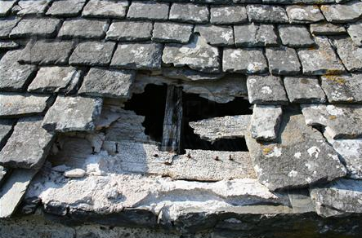
Why do leaders fail to take advantage of boom times to strengthen the budget?
People don’t see the need to “fix the hole
in the roof when the sun is shining.”
  They may see the mistake
  when the storm hits,
    but then it is too late.
My claim: Official forecasts
are over-optimistic in boom periods,
rationalizing the failure to act
  according to data from 33 countries.

Slide 5

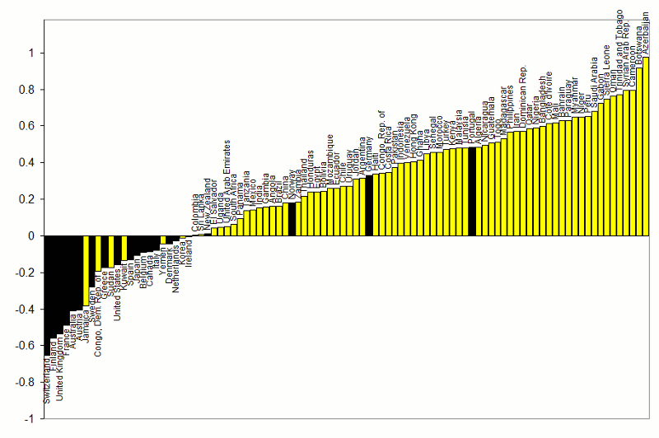



Correlations between Gov.t Spending & GDP
1960-1999
procyclical
“Grafico de Peñarol”
adapted from Kaminsky, Reinhart & Végh (2004)
}
countercyclical
G always used to be pro-cyclical
for most developing countries.

Slide 6

The procyclicality of fiscal policy, cont.
An important development --
some developing countries were able
to break the historic pattern after 2000:
  taking advantage of the boom of 2002-2008
    to run budget surpluses & build reserves,
  thereby earning the ability to expand
  fiscally in the 2008-09 crisis.
  Chile, Costa Rica, Botswana, Malaysia, S. Korea…
Subsequently, some went back to full pro-cyclicality,
  e.g., Argentina, Brazil, & Ecuador.
6
Notes:
6
keep

Slide 7

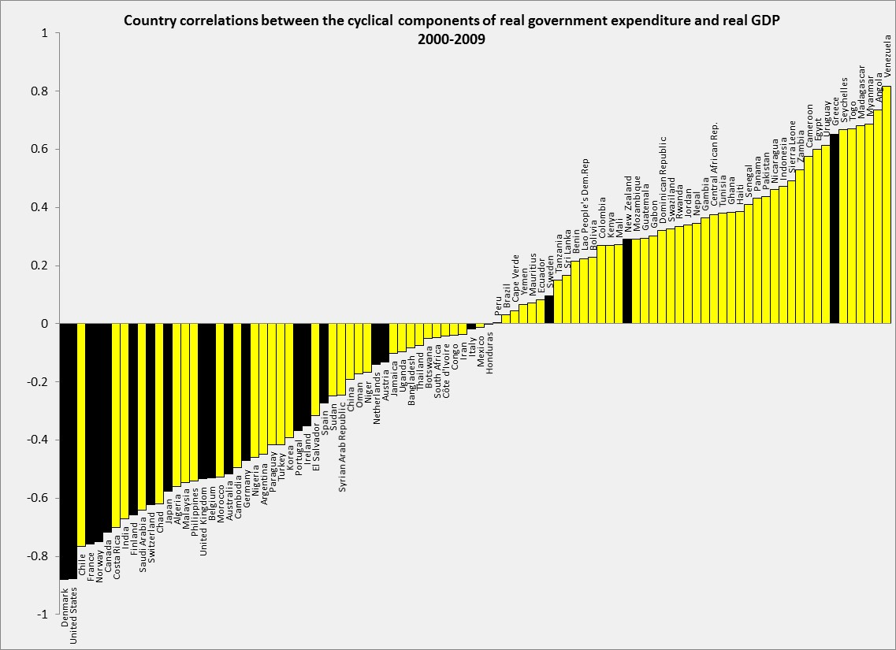



Correlations between Government spending & GDP
2000-2009
Adapted from Frankel, Végh & Vuletin (JDE, 2013)
In the decade 2000-2009,
about 1/4 developing countries
switched to countercyclical fiscal policy:
Negative correlation of G & GDP.
DEVELOPING: 43% (or 32 out of 75) countercyclical. Was 17% (or 13 out of 75) in 1960-99.
ADVANCED: 86% (or 18 out of 21) countercyclical. Was 80% (or 16 out of 20) in 1960-99.
Thanks to Guillermo Vuletin

Slide 8

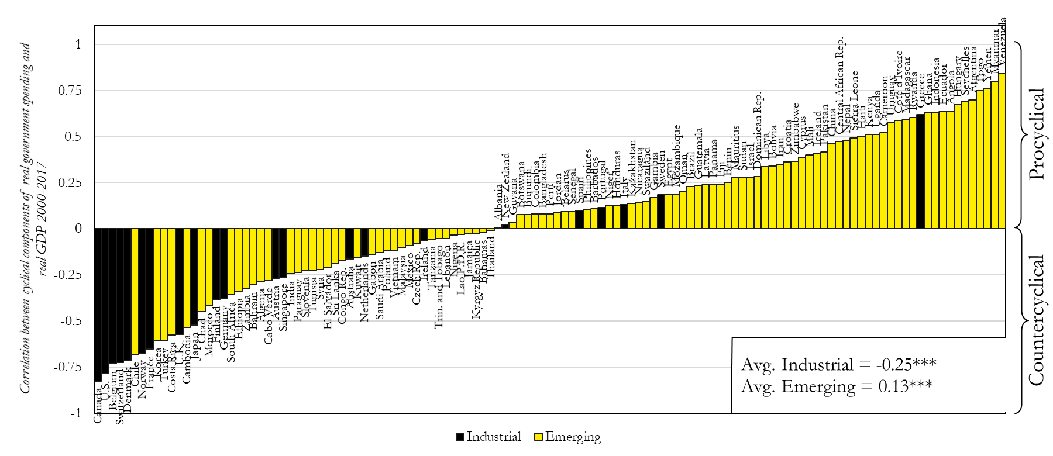



Update of Correlation (Govt spending, GDP):
2000-17
}
After 2010, back-sliding among some countries.
Thanks to Luis Morano.
Cyclical components of both real GDP and real Government Spending are calculated by Hodrick-Prescott filter,
using 6.25 as smoothing parameter and extracting the cyclical components from the series of the level.

Slide 9
Who achieves countercyclical fiscal policy?
Countries with “good institutions”
1960-2009
IQ
Corr(G,GDP)
Corr(G,GDP) = 0.81 – 1.02 (average IQ)
(.09)*** (.15)***
Frankel, Végh & Vuletin; JDE, 2013.
”On Graduation from Fiscal Procyclicality.”
Average Institutional Quality

Slide 10
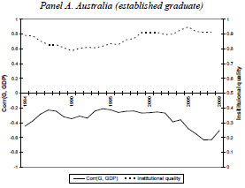
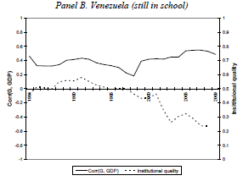
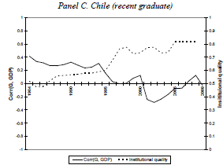



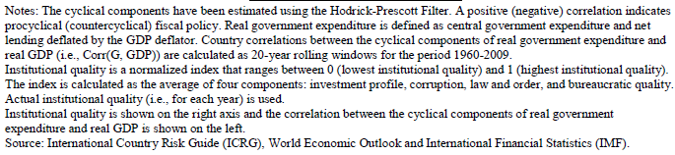
The quality of institutions varies, not just across countries, but also across time.
1984-2009
Worsened institutions;
More-cyclical spending.
Improved institutions;
Less-cyclical spending.
IQ
Good institutions;
Countercyclical spending
Corr
IQ
Corr
Corr
IQ
Frankel, Végh
& Vuletin, 2013.

Slide 11


Advanced countries can suffer pro-cyclicality too.
i) The euro periphery.
ii) The US.

Slide 12
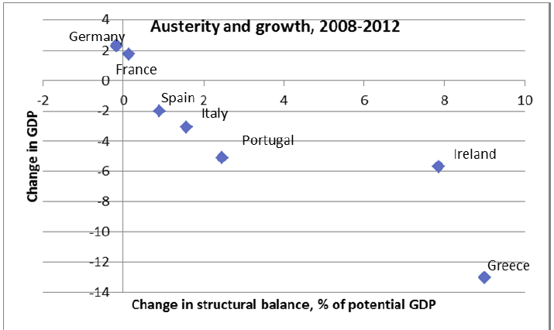



(i) Pro-cyclical fiscal policy in Europe:
When the euro crisis hit in 2009,
the bigger fiscal contractions went with the bigger recessions.
Source: P.Krugman, 10 May 2012.

Slide 13
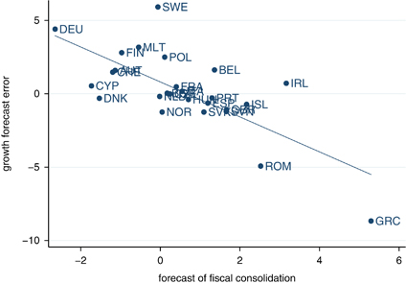
Effects of austerity were worse than the Troika had assumed.
Why? A different kind of over-optimism:
The evidence: the bigger the fiscal contraction, the bigger
the GDP loss relative to what had been officially forecast in 2010.
Europe: Growth Forecast Errors vs. Fiscal Consolidation Forecasts
Blanchard & Leigh, 2014, “Growth Forecast Errors and Fiscal Multipliers,”American Economic Review.
Note: Figure plots forecast error for real GDP growth in 2010 & 2011 relative to forecasts made in
the spring of 2010, on forecasts of fiscal consolidation for 2010 & 2011 made in spring of year 2010.

Slide 14
With austerity, debt/GDP ratios continued to rise sharply:
Declining GDP outweighed progress on reduction of budget deficits
(Fatas & Summers, 2018).
.

Slide 15

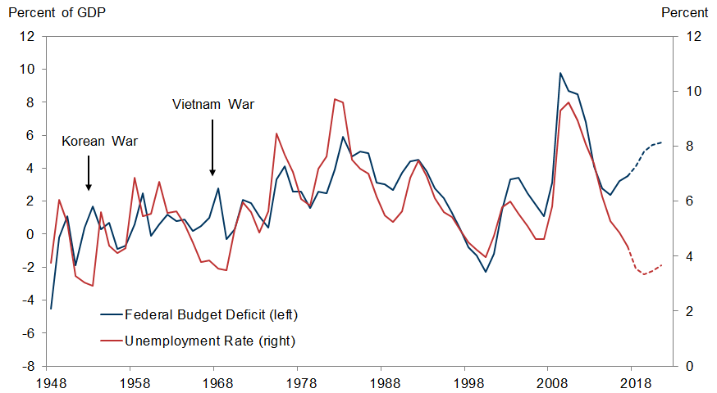
(ii) US fiscal policy
Departing from history, especially in peacetime, the budget deficit
has been raised sharply
though the economy is at full employment.
BD
u
Source: Goldman Sachs Global Investment Research, May 12, 2018 Data: Dept. of Labor & OMB

Slide 16
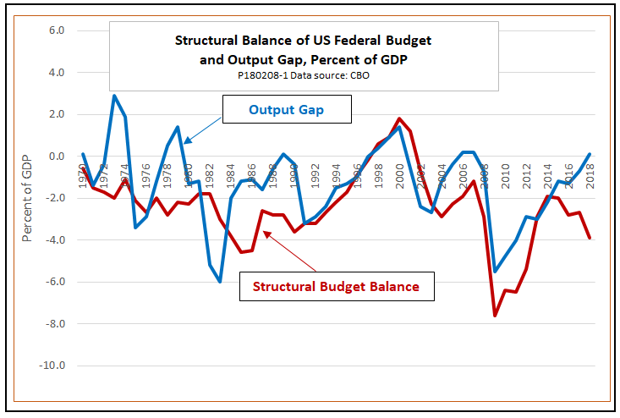
In Dec. 2017, the government cut taxes sharply although the US economy was already operating at its potential.
Ed Dolan, Feb. 8, 2018

Slide 17
American “fiscal conservatives” have behaved pro-cyclically before
 | Conservative leaders | Fiscal action: discipline or laxity? | Cyclicality?
Aug.1988 thru 1990 | G HW Bush | Promised “read my lips, no new taxes” | Boom, so pro-cyclical
Sept. 1990 | G HW Bush | Agreed with Congress to raise taxes & cut spending | Recession, so pro-cyclical
June 1993 | Congressional Republicans | Voted against Clinton’s budget balance law (extension of GHWB’s) | Boom, so pro-cyclical
May 2003 | G W Bush | More tax cuts and more spending. | Boom, so pro-cyclical.
Feb. 2009 | Congressional Republicans | Voted against Obama fiscal stimulus | Recession, so pro-cyclical
Dec. 2017 | Trump | Tax cut, followed by spending increase | Boom, so pro-cyclical

Slide 18
Three kinds of over-optimism
 | Belief | Optimistic policy action | Unintended consequence
Commodity exporters | Booms will continue into the future | Can afford to run deficits during boom. | Pro-cyclical fiscal policy.
Euro-crisis Troika | “Expansionary austerity” | Spending cuts would not hurt GDP much. | Debt/GDP ↑.
American fiscal conservatives | Supply side economics | Tax cuts will boost GDP a lot: Budget deficit ↓. | Budget deficit ↑.

Slide 19

How can countries avoid pro-cyclical fiscal policy?
What are “good institutions,” exactly?
Rules?
  Budget deficit ceilings (SGP) or debt brakes?
    Have been tried by many countries:
      > 97 IMF members.
      Usually fail.
  Rules for cyclically adjusted budgets?
    Countries can more likely stick with them. But…
Rules don’t address a major problem:
  Over-optimism in official forecasts
    of GDP growth rates, tax receipts & budgets.

Slide 20
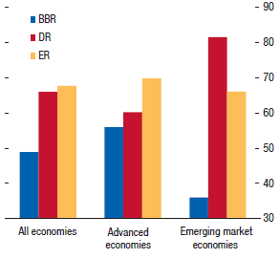

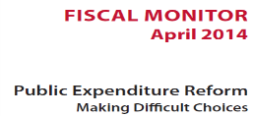

Countries with Balanced Budget Rules frequently violate them.
BBR: Balanced
Budget Rules
DR: Debt Rules
ER: Expenditure Rules
Compliance
< 50%
International Monetary Fund, 2014

Slide 21
Over-optimism in official forecasts
Statistically significant findings among 33 countries
  Frankel (2011, 2012).
Official forecasts on average
are overly optimistic, for:
  (1) GDP &
  (2) budgets.
The bias toward optimism is:
  (3) stronger the longer
  the forecast horizon;
  (4) greater in booms.

Slide 22
Implication of forecast bias for actual budgets
Over-optimistic in growth forecasts
leads to over-optimism in tax revenue
    and so to over-optimism in budget forecasts.
Can lead to pro-cyclical fiscal policy:
  If the boom is forecast to last indefinitely,
  there is no apparent need to retrench.

Slide 23
Mistakes in GDP forecasts tend to cause mistakes in tax revenue forecasts
LAC country forecasts for 2016
Andrew Powell, IDB, Nov. 2017 LACEA, Buenos Aires.
“Fiscal Challenges in Latin America and the Caribbean.”

Slide 24
The optimism bias
is significantly greater in booms
and at longer horizons.
Budget balance forecast error as % of GDP
Variables | 1 year ahead | 2 years ahead | 3 years ahead
GDP gap | 0.093*** | 0.258*** | 0.289***
 | (0.019) | (0.040) | (0.063)
Constant | 0.201 | 0.649*** | 1.364***
 | (0.197) | (0.231) | (0.348)
Observations | 398 | 300 | 179
R² | 0.033 | 0.113 | 0.092
RMSE | 2.25 | 2.73 | 3.10
*** p<0.01 (Robust standard errors in parentheses, clustered by country.)
GDP gap is lagged: it lines up with the year in which forecast was made, not the year being forecast.
Frankel (2011)

Slide 25

What institutions might help address the problem of bias in fiscal forecasts?
BD rules don’t help.
  Europe’s SGP worsens forecast bias for euro members.
    Frankel & Schreger (2013)
Evidence suggesting possible solutions:
  (1) Private sector forecasts can help.
  (2) The case of Chile’s fiscal institutions.

Slide 26
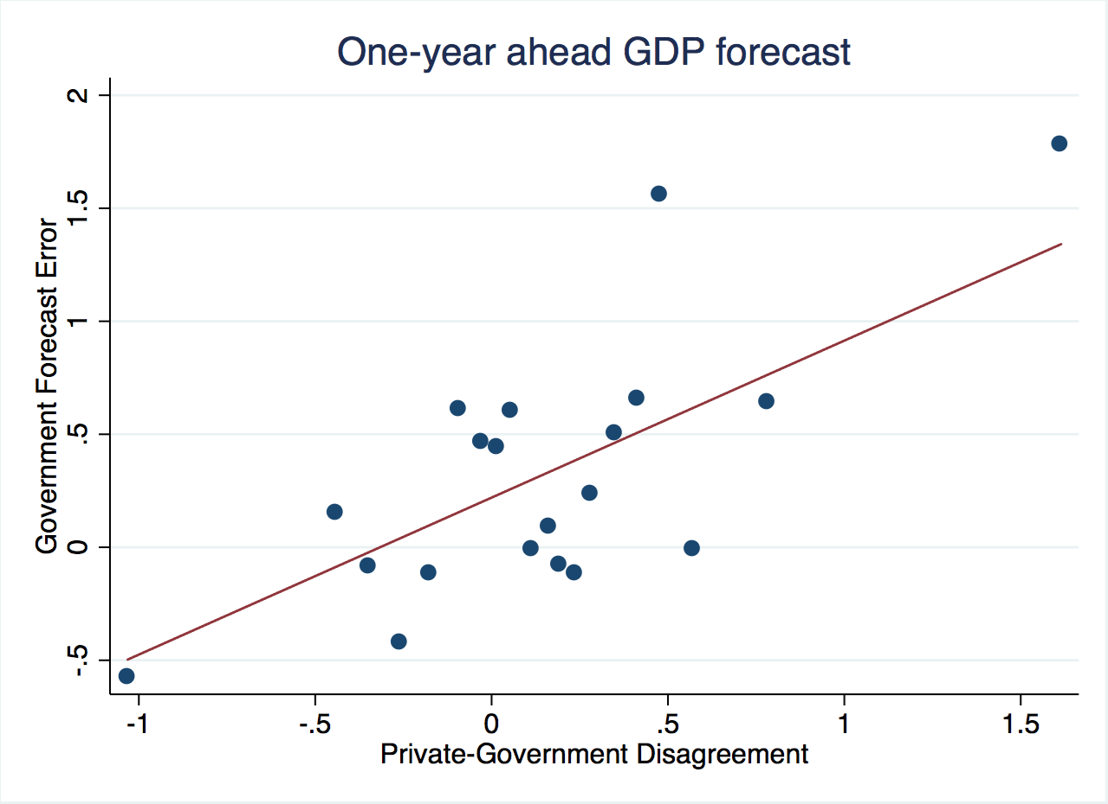
(1) Private forecasts can help
Frankel & Schreger (2016)
When official forecasts of GDP are more optimistic
than private forecasts, on average they are too optimistic.

Slide 27
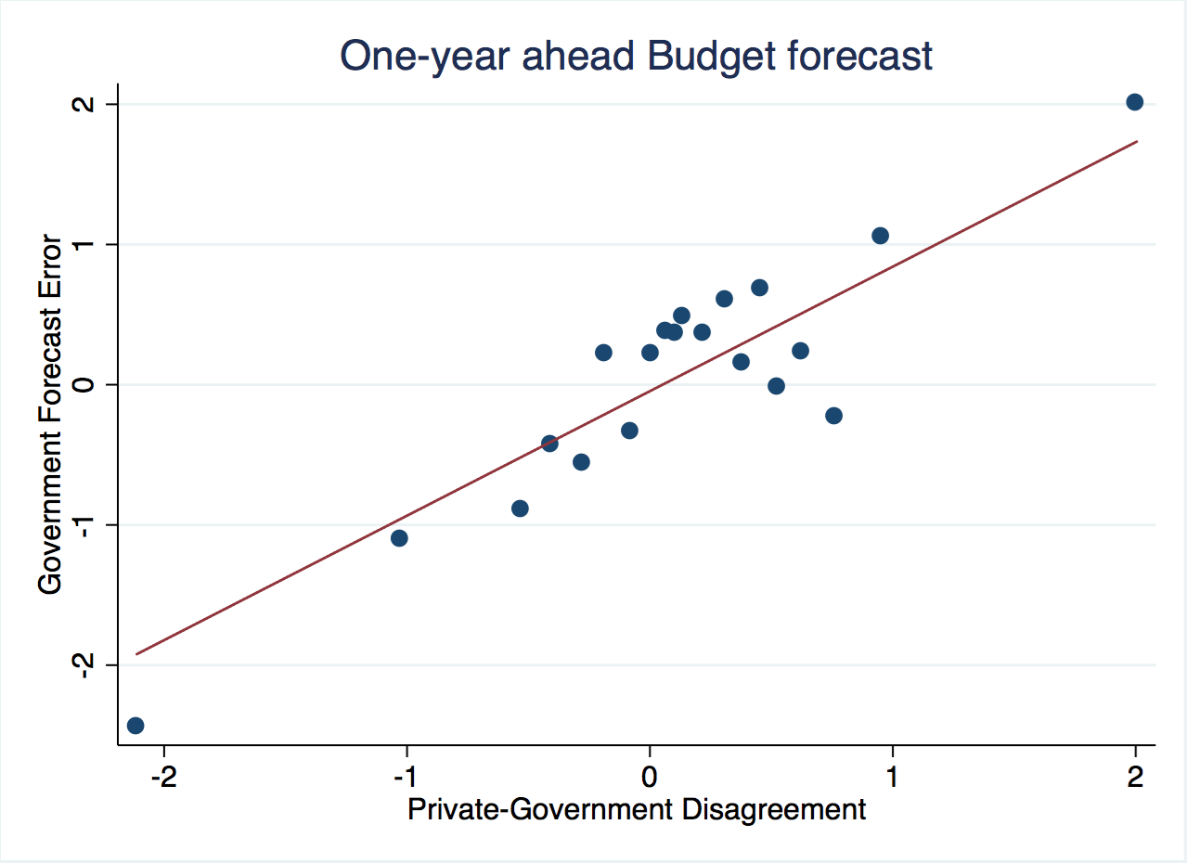
When official forecasts of budget balance are more optimistic
than private forecasts, on average they are too optimistic.
Frankel & Schreger (2016)

Slide 28
Frankel & Schreger (2016)
conclusions regarding private forecasts:
Incorporating private sector forecasts into the budget process could help countries stick to fiscal rules.
Official forecasters are more over-optimistic than private forecasters judged by average outcomes for budget balances & real GDP.
While euro area governments would never forecast violations
of the 3% deficit/GDP cap in the SGP during the period 1999-2009, private sector forecasters would.
Official forecasts could do better over time
by putting some weight on private forecasts.

Slide 29

(2) The case of Chile
Chile’s fiscal institutions appear to have overcome the problem of over-optimism - Frankel (2013)
In 2000 Chile instituted its structural budget rule.
The institution was formalized in law in 2006.
The structural budget surplus must…
  be targeted, at 0 as of 2008,
  where structural is defined by output &
  copper price equal to their long-run trend values.
I.e., in a boom the government can only spend increased revenues that are deemed permanent;
any temporary copper bonanzas must be saved.

Slide 30
Chilean fiscal institutions, continued
Chile did not show bias toward optimism
in forecasts of the budget, growth or copper price.
The key innovation that allowed Chile
to achieve countercyclical fiscal policy:
  not just a structural budget rule in itself,
  but rather a regime that entrusts to two panels
  of independent experts estimation of
  the long-run trends of copper prices & GDP.

Slide 31
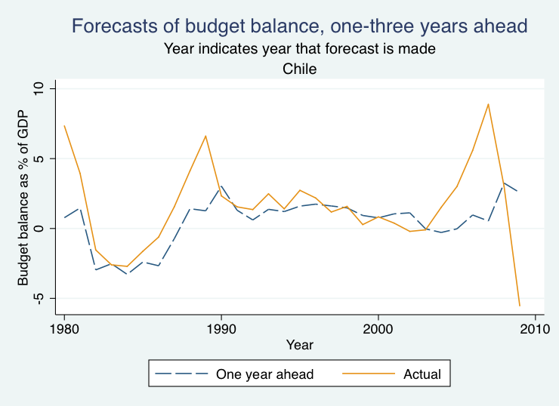

Unlike the rest of the panel of 33 countries,
Chile’s official forecasts were not over-optimistic.
Forecasts of budget balance vs. actual

Slide 32
The Pay-off
Chile’s fiscal position strengthened immediately:
  Public saving rose from 2.5 % of GDP in 2000 to 7.9 % in 2005
  allowing national saving to rise from 21 % to 24 %.
Government debt fell sharply as a share of GDP
and the sovereign spread gradually declined.
By 2006, Chile achieved a sovereign debt rating of A,
    several notches ahead of Latin American peers.
By 2007, it had become a net creditor.
By Dec. 2007, Chile’s sovereign rating had climbed to A+,
    ahead of some advanced countries.
=> It was able to respond to the 2008-09 recession
  via fiscal expansion.

Slide 33
List of relevant references by the author
“Bias in Official Fiscal Forecasts: Can Private Forecasts Help?”
with Jesse Schreger, NBER Working Paper 22349, 2016.
“On Graduation from Fiscal Pro-cyclicality,” with Carlos Végh & Guillermo Vuletin, Journal of Development Economics, 100, 1, 2013; pp. 32-47.
“A Solution to Fiscal Pro-cyclicality: The Structural Budget Institutions Pioneered by Chile,” in Fiscal Policy and Macroeconomic Performance, Luis Felipe Céspedes & Jordi Galí, eds. (Central Bank of Chile: Santiago), 2013, pp. 323-391.
"Over-optimistic Official Forecasts and Fiscal Rules in the Eurozone,"
with J. Schreger; Review of World Economy, 2013. .
"Over-optimism in Forecasts by Official Budget Agencies and Its Implications," Oxford Review of Economic Policy, 2011, 536-562.
“A Lesson From the South for Fiscal Policy in the US and Other Advanced Countries,” Comparative Economic Studies, 2011, 407-430.
“Snake-Oil Tax Cuts,” 2008, HKS RWP 08-056.

