Slide 1


Global economic challenges for Donald Trump
Jeffrey Frankel
Harpel Professor of Capital Formation & Growth
Harvard University
American Enterprise Institute
Monday, December 5, 2016, 10:00 am - 12:00 pm

Slide 2
Quadrennial panels offer
“Advice for the new Administration”
I feel the need this year to acknowledge
that advice from us “experts” and “elites”
is unwanted by Mr. Trump and his supporters.
  Just to show that we understand.
That said, the incoming Administration will encounter international events and constraints that it did not figure on in the campaign.
  It is a common pattern,
  though much more extreme this time.

Slide 3
International trade, the US deficit, and the Chinese exchange rate were big issues in the campaign.
Let’s start with Mr. Trump’s promise immediately
to name China a manipulator of its currency.
He may have to confront the reality that if China moved to a freely market-determined exchange rate, as he & other US politicians have urged, the RMB would weaken, not strengthen:
  For more than two years, the PBoC has been intervening
  to fight RMB depreciation, not to encourage it.
    It has sold dollars and bought RMB, not the other way around. [See graph]
  Similarly, China has recently tightened controls on capital outflows,
    not inflows.
  If it stops, the RMB will weaken further,
  which would help China’s net exports to the US,
    not reduce them.

Slide 4
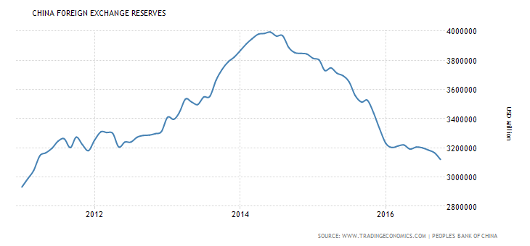
    Since mid-2014, the People’s Bank of China has been selling foreign exchange reserves and buying RMB,
    to resist depreciation, not the other way around
    as it had over the preceding 10 years.
China’s reserves peaked at $3,993 billion in June of 2014.
Since then it has spent $872 billion defending the RMB (as of Oct. 2016).

Slide 5
The US trade balance
Little-known fact: The US trade deficit has been narrowing for the last 10 years as a share of GDP
  [See graph.]
Mr. Trump’s policies are likely to put the
trade deficit back on a deteriorating path,
  even if he doesn’t stop China from intervening
  in the foreign exchange market.

Slide 6
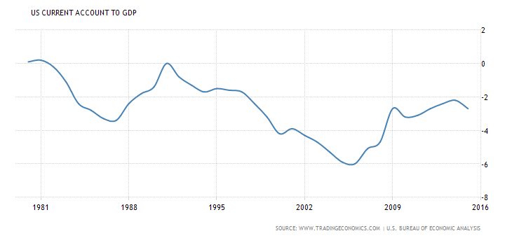
The US trade deficit as a share of GDP
has narrowed over the last ten years.

Slide 7
Mr. Trump’s policies are likely to set the trade deficit back on a deteriorating path.
Plans for fiscal expansion:
  massive tax cuts
  and spending increases
    including military and infrastructure investment.
It is hard to predict the carryover from
campaign statements to actual policies.
  But Congress is likely to support this sort of fiscal expansion.
  It would repeat what Ronald Reagan and George W. Bush did.
The budget deficit would reduce national savings,
which would worsen the current account deficit.
  An example of the “twin deficits” we saw under Reagan & Bush.

Slide 8
  What causal channel would widen the trade deficit?
Fiscal expansion would put upward pressure on interest rates, especially since we are already essentially at full employment.
  The Fed had already been expected to raise interest rates Dec. 14.
  Recent developments augur more interest rate hikes in 2017 & 2018.
  The new Administration will probably oppose the increases
    notwithstanding that the candidate has attacked the Fed for keeping interest rates too low.
    One hopes the Fed’s independence will hold, as it did under Volcker.
That will also put upward pressure on the dollar:
  Because higher interest rates attract a capital inflow, as in the classic Mundell-Fleming model (BD ↑ => NS↓ => i rate ↑ => $ ↑)
  Mr. Trump is doing more to depreciate other currencies
  against the $ than currency manipulation does.
Indeed the increases in US interest rates and the value
of the dollar are already underway, ever since the election.
[See graph.]

Slide 9
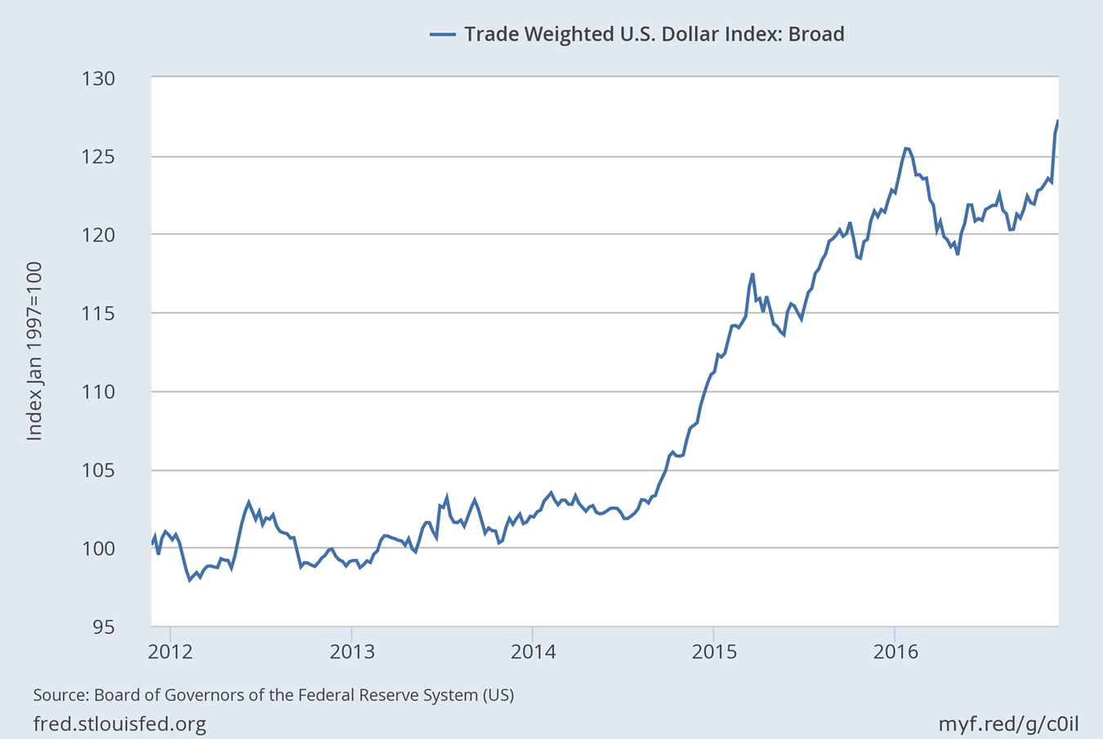

After the election the dollar appreciated against a broad set of currencies.
Nov. 9, 2016
Nov. 8: 122.8
Nov. 25: 127.9
https://fred.stlouisfed.org/series/TWEXB

Slide 10
“How does the importance of free trade fit in and can the US continue its leadership in promoting trade?”
In the long run, a reversal of US-led globalization will damage
both our economy & our geopolitical position.
Would a sharp increase in import tariffs, even if inconsistent with
our international obligations, at least improve the trade balance?
  It is possible, in the short term.
  But even then, at full employment it would not much boost output or jobs.
  Moreover the fall in imports is likely to be offset by a fall in exports:
    If Mexicans’ income falls, their imports from us will fall.
    If our inputs of labor-intensive auto parts from Mexico fall,
    our exports of finished autos may fall.
    If Mexico retaliates against our tariffs by raising its own,
    as it is entitled to do, our exports to it will fall.
The net effect depends on the macroeconomics already considered: a fiscal expansion would likely to worsen the trade balance.

Slide 11
Global economic challenges for Donald Trump
Jeffrey Frankel

Slide 12
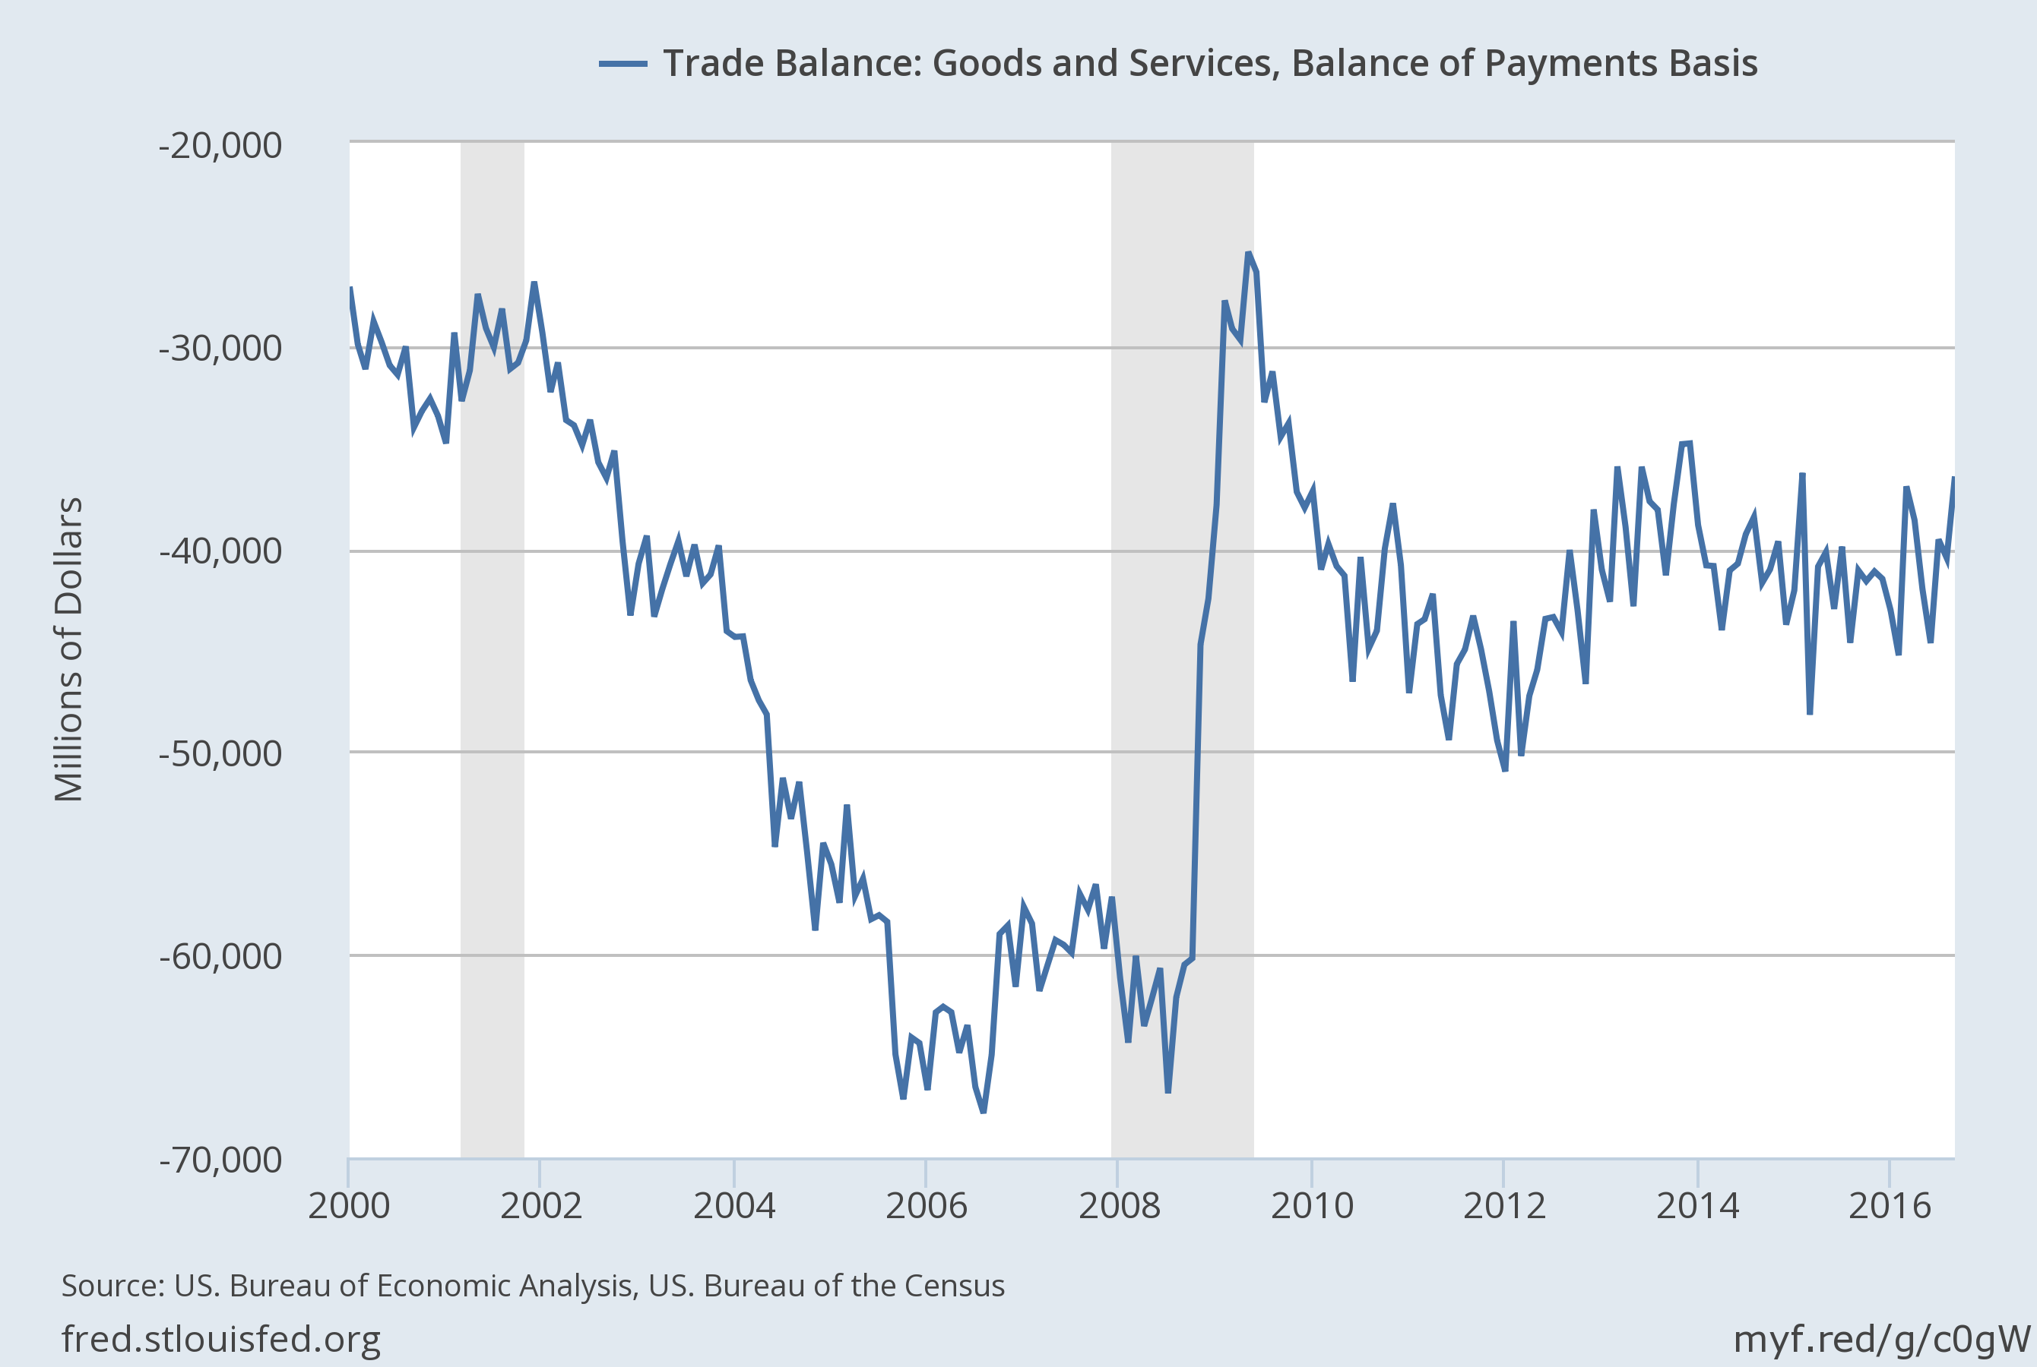

Appendix: The big improvement the trade balance
came in the recession of 2007-09.

