Slide 1

The Next Economic Crisis
Jeffrey Frankel
Harpel Professor of Capital Formation and Growth, Harvard University
AEI Jackson Hole Retreat
Jackson Hole, Wyo.
August 13, 2018

Slide 2
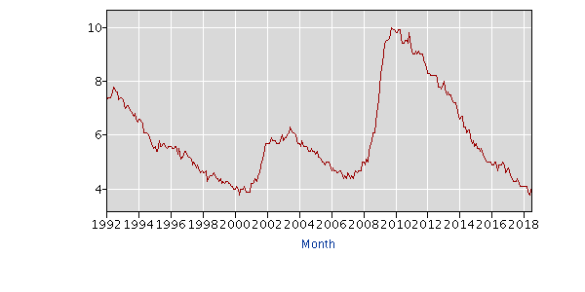
The economic statistics have been good.
The expansion has been long-lived.
  If it continues another year, it will equal
  the record 10-year expansion in the 1990s.
Unemployment is low
  3.9% in July,
  as low as in 2000.
GDP growth has been relatively strong:
  BEA estimated 2nd-Q 2018 growth at 4.1%,
  the highest quarter since 4.9% in 2014.
But sooner or later there will be a new recession.
I worry that when it comes, it will be severe.

Slide 3
What could set off a downturn in the coming years?
One possibility:
  Because the US stock market is high, historically,
    e.g., by the CAPE ratio,
  and global corporate debt is also high, historically,
  a negative shock could send securities tumbling.
What sort of shock?
  A return of inflation is one good candidate.
  Trade war escalation is another.

Slide 4
Why do I worry the next recession could be severe? Because policy is currently pro-cyclical rather than counter-cyclical.
Admittedly it is hard to get counter-cyclical timing right;
  but that is no excuse for adopting pro-cyclical policy.
(1) Especially fiscal policy;
(2) But also macro-prudential policy;
(3) And monetary policy.

Slide 5
(1) Pro-cyclical fiscal policy
We are now undergoing the most radically pro-cyclical fiscal expansion since WWII
  => budget deficit > $1 tr. by 2020 (CBO):
  Tax cuts
    Corporate tax reform was needed. But should have been revenue-neutral
  Rapid spending increases.
When the next recession comes, we won’t have “fiscal space”
to respond, having already used up our ammunition.
  Such destabilizing fiscal policy is traditional in developing countries, exacerbating their booms & busts.
    Well-documented, e.g., by Kaminsky, Reinhart & Végh (2005).
Another reason, besides cyclical timing, why this is an especially bad time to push up the budget deficit:
  The retirement of the baby boom generation means that
  big deficits in Social security and Medicare are coming.

Slide 6
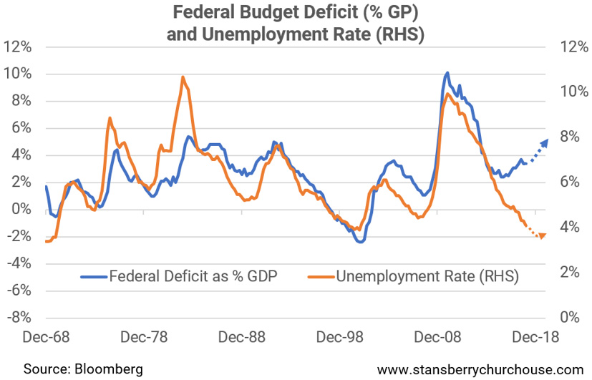
Fiscal policy, continued
Usually taxes fall & govt. spending rises in response to recessions.
Now, for the 1st time since WWII, fiscal policy has turned
strongly expansionary at a time of full employment.
Budget deficit (% GDP)
Unemployment
Data source: Bloomberg
“This is how the world’s biggest economy goes broke…” Tama Churchouse, Feb.26, 2018. www.stansburychurchouse.com

Slide 7
(2) Pro-cyclical financial regulation
The wrong way to do it: relaxing financial regulation at the height of financial booms
  and then tightening it in response to financial crashes.
  Exacerbates the swings.
Other countries do this better.
  E.g. Asians’ macroprudential policy is countercyclical:
    They raise bank reserve requirements and tighten homeowners’ loan-to-value ceilings in a boom,
    and loosen them when there is a financial downturn,
    rather than the other way around.
(See appendix.)

Slide 8
(3) Even pro-cyclical monetary policy
Some criticized the Fed in 2010 for easy money
  even though unemployment was still above 9%.
  Now President Trump says he is “not thrilled” (July 19)
  about the Fed raising interest rates,
    even though unemployment is below 4%.
  That is arguing for pro-cyclical monetary policy.
In past recessions, the Fed has responded by
cutting interest rates around 500 basis points,
  helping to moderate those recessions.
But it won’t be able to do it next time,
  if interest rates at the peak are only 200 basis points.
  Martin Feldstein favors more Fed tightening.
    July 26 in the WSJ: “raising the rate when the economy is strong will give the Fed room to respond in the next economic downturn with a significant reduction”. That is counter-cyclical monetary policy.

Slide 9
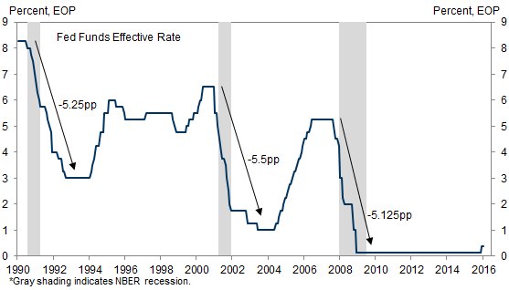
The Fed responded to each of the last 3 recessions by cutting the interest rate more than 500 basis points. Next time?
Monetary policy
Data source: FRB
US Economics Analyst: From ZLB to ELB , GS, Feb. 26, 2016.

Slide 10

As I put it before the last recession:
“The future downturn is likely to be far worse than the recent one… It is impossible to say when the next recession will come. But when it does, it is likely to be worse… Why? Precisely because we will enter it at a time when the budget deficit and national debt are already alarmingly high. Thus when the next recession hits, we will not have luxury of being able to cut taxes and increase spending…”
"A Debate on the Deficit," The Means to Prosperity: Fiscal Policy Reconsidered, P.G.Berglund & M.Vernengo, eds. (Routledge, 2005). Also The Forward, 11/19/2003; Cato Journal, Summer 2007; WSJ 1/21/2008.
https://scholar.harvard.edu/frankel
www.project-syndicate.org/columnist/jeffrey-frankel

Slide 11
Appendix on financial regulation
Reinstate Obama’s fiduciary rule,*
which would have required professional financial advisers, in return for their fees, to put their clients’ interests first when advising them on assets invested through retirement plans.
Resume the good work that the Consumer Financial Protection Bureau* had been doing until now, protecting households who take out
  pay-day loans*, student loans, and car loans*.
  And housing finance, where the 2007-08 crisis originated.
  Mortgage-originators, for example, should be required
  to “keep skin in the game” by risk-retention rules.
  Mortgages should have a 20% minimum down-payment.
I do not favor trying to smash banks into such small pieces as to solve the “too big to fail problem”
  But…
* Would have been de-regulated in Financial Choice Act, passed only by House, June 2017

Slide 12
Appendix on financial regulation, continued
Preserve Dodd-Frank.*
  Its key features – higher capital requirements for banks, the CFPB, SIFI designation, tough stress tests on banks, and enhanced transparency for derivatives – have strengthened the financial system considerably. Undermining or rescinding them would substantially increase the risk of an eventual recurrence of the 2007-2008 financial crisis.
  I was never wedded to the Volcker Rule,* and
  I agree with the objective of cutting banks’ paperwork burden,
    especially on small banks:
  Threshold for “too big to fail” stress-tests needed to be raised;
    $50 billion in assets was too low.
  But $250 billion threshold is probably too high.
  Don’t weaken the “living will” process,
  nor exempt non-banks from annual stress tests.
  To minimize the risk of another financial crisis, keep the supplementary leverage ratio placed on the largest banks
  Bank capital standards should, if anything, be further tightened.
* Would have been de-regulated in Financial Choice Act.

