Slide 1
“Five Trade Fallacies”
Jeffrey Frankel
Harpel Professor of Capital Formation & Growth
Harvard University
Trade Deficits and the Trump Administration
American Enterprise Institute,
Washington DC
September 15, 2017

Slide 2
Fallacy #1: “US trade negotiators have been out-negotiated by those from other countries.”
Wrong.
In most trade negotiations, such as TPP, NAFTA, and the Uruguay Round, the US has been able to get most of what it asked for – as leader of the international order.
Trade agreements have required high-tariff trading partners to reduce barriers against US goods.
US demands have also driven deeper integration
  in such areas as labor rights, the environment, investor-state dispute settlement and intellectual property rights.
How could NAFTA usefully be modernized & expanded? TPP.
One of the funniest things that Trump has said:
"The negotiators for Germany have done a far better job than the negotiators for the US."

Slide 3
Fallacy #2: “Bilateral trade imbalances reflect bad trade agreements.”
Wrong.
If country A runs a bilateral trade deficit with country C,
it generally signifies some combination of 3 causes:
  (i) A currently has a trade deficit overall,
  (ii) C has a trade surplus overall,
  (iii) C needs to earn a structural surplus with countries like A,
  to pay for a structural deficit with, e.g., oil exporters. (See Fig.1.)
If we stop importing consumer electronics from China,
we will import them from other Asian countries.
The guy who cuts my hair insists I pay him with money.
He refuses to accept as payment a lecture in economics.

Slide 4
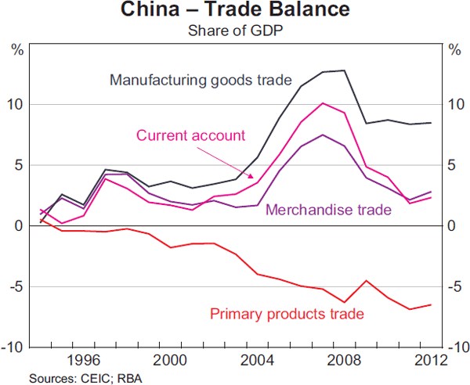
Fig.1: China runs a trade deficit in primary products, offset by a surplus in manufactures.
Source: Reserve Bank of Australia (June 2013)

Slide 5
Fallacy #3: “A trade deficit indicates the absence of a level playing field.”
Wrong.
There is no (positive) correlation between countries’
tariff rates and their trade balances. [See Figure 2.]
Trade deficits are macroeconomic phenomena,
  influenced by national incomes and exchange rates,
  and determined in a deeper sense by national saving & investment.
The US has run current account deficits since 1982
because national saving has been low [see Figure 3],
  both low private saving and low public saving.
  The famous twin deficits: increase in the budget deficit leads to an increase in the trade deficit (e.g., 2001-07).
China, Germany, Japan, & South Korea run current account surpluses because they have high national saving rates.

Slide 6
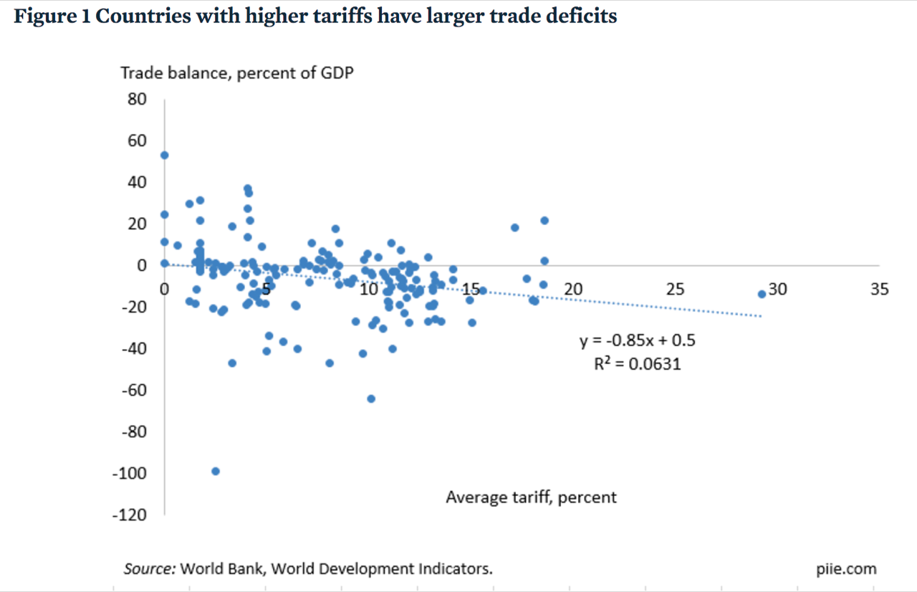
Fig. 2: High tariffs do not improve a country’s trade balance.
Average applied tariffs and average trade balances from 2012 to 2015 for 183 countries
Caroline Freund, PIIE, May 8, 2017 “Public Comment on Trump Administration Report on Significant Trade Deficits.”

Slide 7
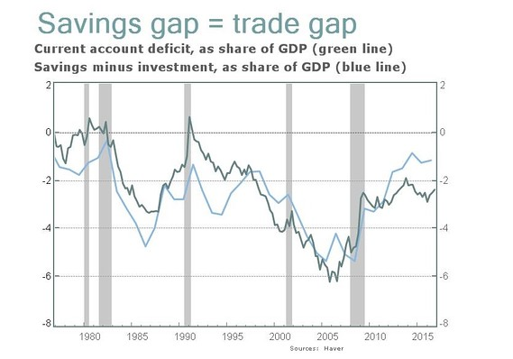
Fig. 3: Current account ≡ national saving - investment
Jeff Sachs, “Opinion: What Trump doesn’t get about the link between U.S. savings and trade deficits,“ Marketwatch, April 21, 2017.

Slide 8
Fallacy #4:
“Trade deficits are bad, subtracting from growth. Cut the trade deficit to add to GDP & create jobs.”
Well, not always wrong.
  An export boost when there is excess capacity in the economy
  can add nicely to output & employment. (We are no longer there.)
  Also chronic current account deficits imply rising international debt
    which, for normal countries, eventually impairs creditworthiness.
But trade deficits are not always bad news
and trade surpluses are not always good news:
  E.g., the rise in the trade deficit in the late 1990s (post-NAFTA)
  accompanied the longest US economic expansion on record.
    Originating in an investment boom,
    it brought unemployment as low as 3.8% by 2000,
    with rising real wages & incomes for the median family.
  Conversely, a sudden trade balance rise is usually due to recession.
    E.g., the US deficit fell by half in 2009. [See Figure 4.]

Slide 9
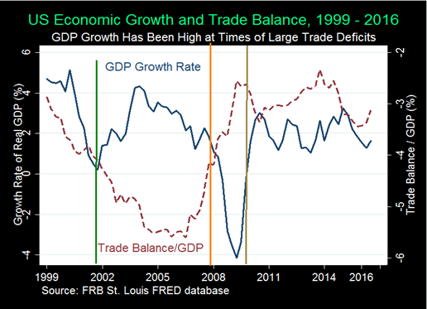
Figure 4: The trade balance need not add to growth.
Indeed the balance “improves” in recessions like 2007-09.
From: Menzie Chinn & Michael Klein, “Is the Trade Deficit a Drag on Growth?” Econofact, Jan.20, 2017

Slide 10
Fallacy #5: “Trade explains the stagnation in US median family income since 2001.
An aggressive trade policy would reduce inequality.”
Probably wrong.
Yes, imports create both winners and losers.
  So do all changes. Keeping out imports does too.
  Take the example of Trump moves against imports of steel & aluminum.
    Even ignoring the flimsy national security claim (under Section 232),
    loss of these imports would raise costs to US manufacturers that use the products as inputs (such as autos). This would both raise the cost of living at home and make US exports less competitive abroad.
  Further costs of import protection: We would lose exports through
    (1) foreign loss of dollar earnings with which to buy goods from us,
    (2) dollar appreciation, and
    (3) foreign retaliation against US products.

Slide 11
Fallacy #5: income distribution, continued ;
Yes, specific industries & localities suffer from import competition.
  But this leaves out two big factors on the “plus“ side:
    trade creates export jobs, paying higher wages than other jobs;
    trade lowers the price of importable consumer goods,
    disproportionately bought by lower-income households.
It is hard to say whether or how much trade
has contributed to rising inequality.
  Probably less than such other factors as:
    technological progress,
    slowed education rates,
    winner-take-all markets,
    assortative mating, and
    increased monopoly power in some industries.
We do not need to know the relative importance
of causes of inequality to know policies to address it.

Slide 12
    #6: “Trade policy threats against China
    (or South Korea!) can serve as ‘bargaining chips’ to help resolve the North Korean nuclear threat.”
Folly (not fallacy).
A deal-maker should know fundamental principles of bargaining:
  One needs to think of what the other country wants.
  Threats and promises require credibility.
    Trump has already squandered his many times over.

Slide 13
Appendices
China’s bilateral imbalances
The US trade balance as saving minus investment
Widening US income inequality.
  The share of US income going to the top is now back to what it was in the 1920s. But why?
  Technology, as reflected in the skilled wage premium.
  The supply of educated workers has not kept up.
  What can be done about it? Ten policies.

Slide 14
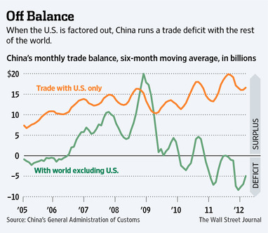
More on Fallacy #2: Bilateral imbalances
China runs bilateral deficit with the US, while importing commodities and other inputs from other countries.

Slide 15
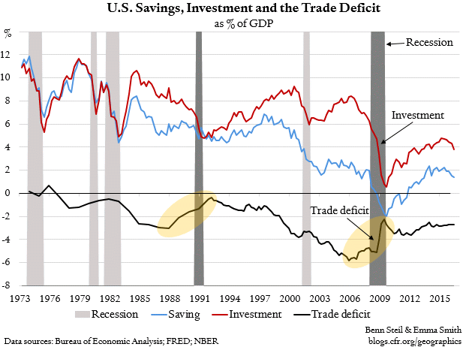
When national saving falls relative to investment, the trade balance falls.
More on Fallacy #3: Trade deficit is a macro phenomenon
Trend: Gap widened, as NS fell relative to I
National
saving
CFR, Oct. 12, 2016

Slide 16
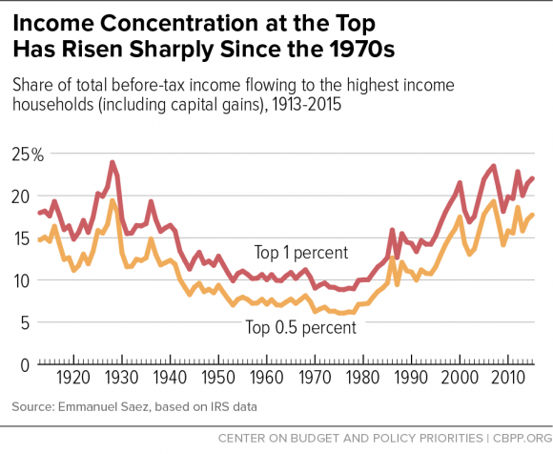
More on #5, Inequality: The share of US income going to the top is now back to what it was in the 1920s.
Chad Stone et al, CBPP, Sept 30, 2016 www.cbpp.org/research/poverty-and-inequality/a-guide-to-statistics-on-historical-trends-in-income-inequality

Slide 17
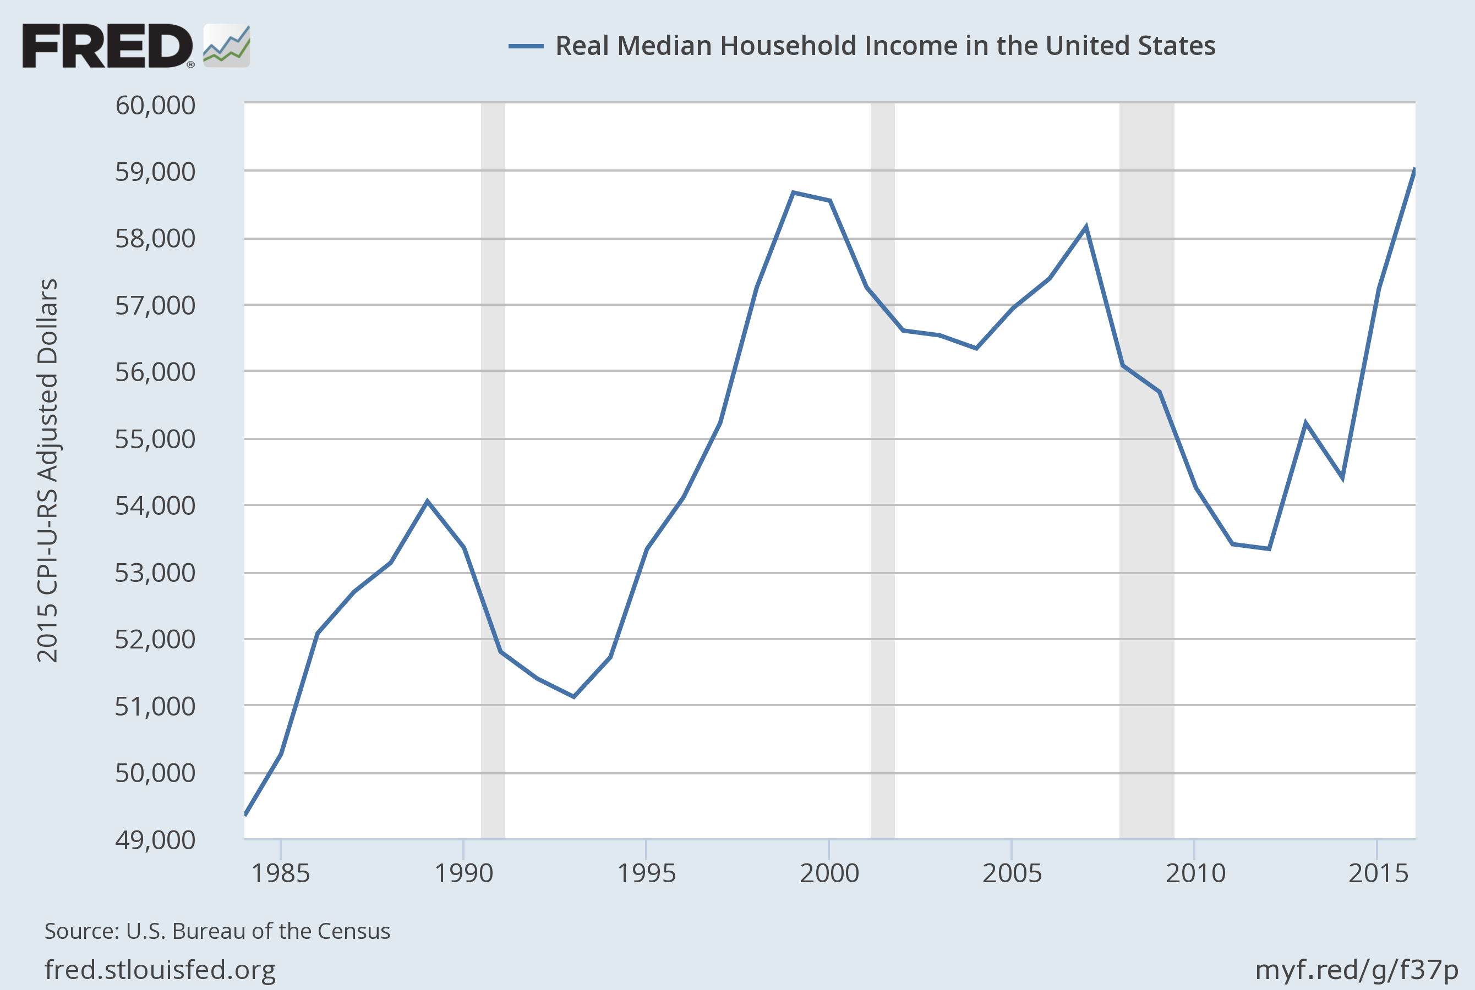
US Real Median Family Income has been flat since 2000,
even with gains in 2015-16
Notes:
Source:
U.S. Bureau of the Census
Release:
Income and Poverty in the United States
Units:
2015 CPI-U-RS Adjusted Dollars, Not Seasonally Adjusted
Frequency:
Annual
Household data are collected as of March.
As stated in the Census's "Source and Accuracy of Estimates for Income, Poverty, and Health Insurance Coverage in the United States: 2011" (http://www.census.gov/hhes/www/p60_243sa.pdf)
Estimation of Median Incomes. The Census Bureau has changed the methodology for computing median income over time. The Census Bureau has computed medians using either Pareto interpolation or linear interpolation. Currently, we are using linear interpolation to estimate all medians. Pareto interpolation assumes a decreasing density of population within an income interval, whereas linear interpolation assumes a constant density of population within an income interval. The Census Bureau calculated estimates of median income and associated standard errors for 1979 through 1987 using Pareto interpolation if the estimate was larger than $20,000 for people or $40,000 for families and households. This is because the width of the income interval containing the estimate is greater than $2,500.
We calculated estimates of median income and associated standard errors for 1976, 1977, and 1978 using Pareto interpolation if the estimate was larger than $12,000 for people or $18,000 for families and households. This is because the width of the income interval containing the estimate is greater than $1,000. All other estimates of median income and associated standard errors for 1976 through 2011 (2012 ASEC) and almost all of the estimates of median income and associated standard errors for 1975 and earlier were calculated using linear interpolation.
Thus, use caution when comparing median incomes above $12,000 for people or $18,000 for families and households for different years. Median incomes below those levels are more comparable from year to year since they have always been calculated using linear interpolation. For an indication of the comparability of medians calculated using Pareto interpolation with medians calculated using linear interpolation, see Series P-60, Number 114, Money Income in 1976 of Families and Persons in the United States (www2.census.gov/prod2/popscan/p60-114.pdf).
U.S. Bureau of the Census,
Real Median Household Income in the United States [MEHOINUSA672N],
retrieved from FRED,
Federal Reserve Bank of St. Louis;
https://fred.stlouisfed.org/series/MEHOINUSA672N,
September 13, 2017.

Slide 18

Widening gap between “skilled” & “unskilled” workers, (defined by college graduation).
Jason Furman, CEA, Oct. 17, 2016, Fig.10.

Slide 19

Trend in years of education slowed during 1981-2012.
Mean Years of Schooling at Age 30, U.S. Native-Born, by Year of Birth, 1876-1982
Trend
1906 – 1981
= 1876+30 to 1951+30.
Trend
1981 – 2012
= 1951+30 to 1982+30.
Jason Furman, CEA, Oct. 17, 2016, Fig.11.

Slide 20
  We do not need to know the relative importance of causes of stagnating median income to know some of the policies to address it. Here are ten:
Expand, don’t reduce, the health-insured population.
Strengthen, don’t weaken, US financial regulation.
Reform the tax system (staying revenue-neutral)
  Expand the EITC, not the estate tax exemption.
  Make the payroll tax more progressive, not less.
  Corporate: lower the tax rate, but offset by eliminating deductions.
Put social security on a sound footing.
Improve education, esp. universal pre-school education.
Increase infrastructure spending.
Address the long-term rise in household debt.
Energy:
  Start a carbon tax; don’t subsidize fossil fuels.
  But allow fracking (regulated).
Keep US global economic leadership, including trade agreements.
Consider wage insurance.

