Slide 1
“How have some economies managed to weather
the Covid-19 shock better than others?”
Jeffrey Frankel
Harpel Professor of Capital Formation & Growth,
Harvard University
American Enterprise Institute
Monday, September 21, 2:00 pm.
Virtual Event on “A global asset price bubble in a weak world economy”
www.aei.org/events/webinar-a-global-asset-price-bubble-in-a-weak-world-economy

Slide 2
Major points
Although health & economic impacts of the pandemic have spread
to virtually every part of the globe, severity has varied widely,
  across continents and across countries,
  and not always in ways that would have been predicted.
  It’s not too early to draw some lessons.
Surprisingly, death rates have been worse in the US than among most Emerging Market / Developing Economies (EMDEs).
  But economic impacts will be more extensive among EMDEs.
  In particular, they lack fiscal space to respond.
The trade-off between health & the economy is illusory.

Slide 3
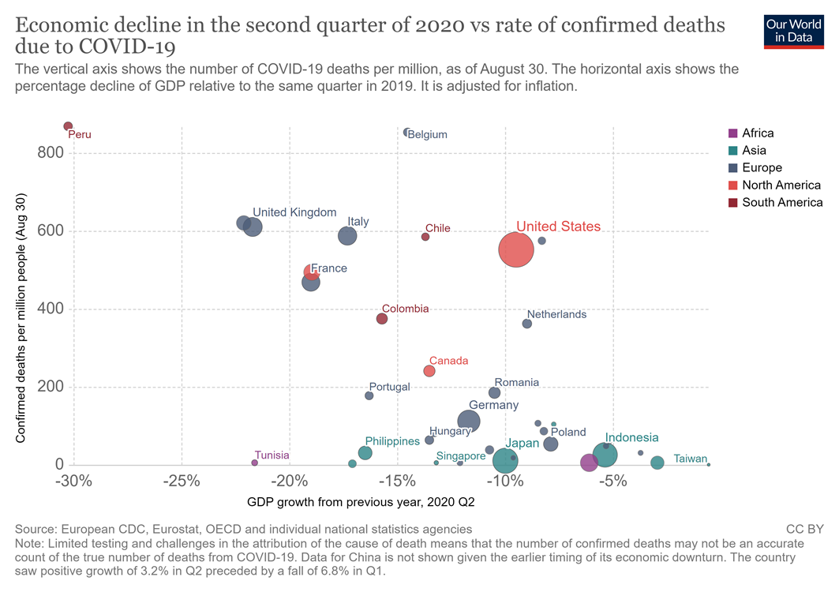
No sign of a trade-off between economic growth & health.
To the contrary.
Confirmed deaths per million
people.
(Aug. 30)
“Which countries have protected both health and the economy
in the pandemic?”
Joe Hasell, Sept. 2020
GDP growth, 2020 Q2 (from previous year)

Slide 4
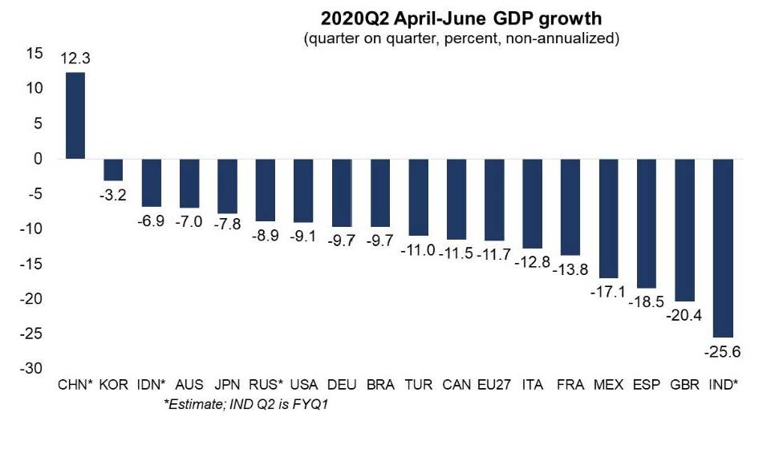
Of the G-20, India’s economy was the worst-hit in Q2, followed by UK, Spain & Mexico. China a& Korea did the best.
Source: IMF, Sept. 2, 2020

Slide 5
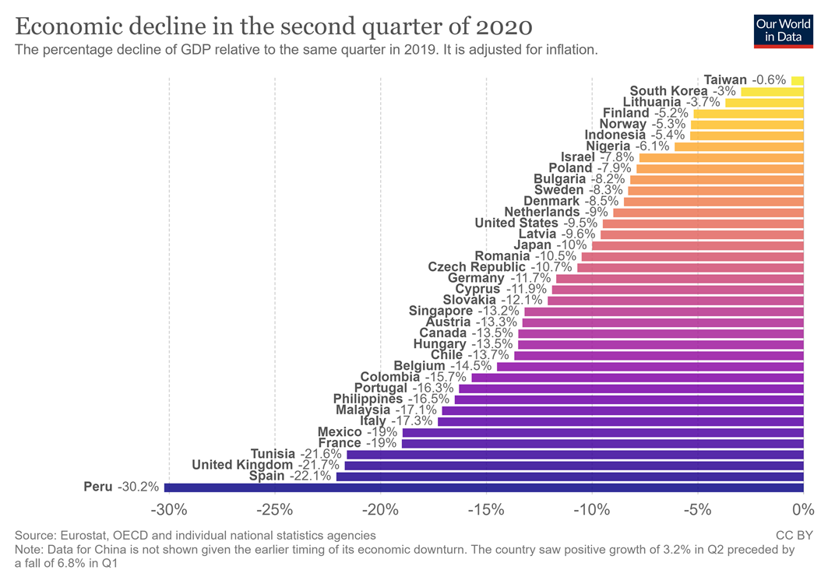
Peru’s recession has been even worse than Spain & UK; while Taiwan has suffered the least, followed by South Korea.
“Which countries have protected both health and the economy
in the pandemic?”
Joe Hasell, Sept. 2020.

Slide 6
Why differences across continents in Covid-19?
Why has Latin America been hit so badly (≈ ½ global summer deaths)?
  Big densely populated cities, informal workers, internal migrants;
  Inequality, inadequate public health systems.
Why have East & SE Asia done the best?
  In part: cultural willingness to wear masks or quarantine;
  Recent experience with epidemics => good habits of response,
    vs. Western Hemisphere & Europe.
Why has Africa apparently done better than expected?
  Again, experience with epidemics => habits of response;
  Low population density;
  Young population.

Slide 7
Why differences within continents?
Air hubs are hit 1st (Milan, London, NYC, Johannesburg).
Within Latin America, 3 doing esp. badly: Brazil, Mexico, & Nicaragua.
  Why? Poor political leadership.
    The 3 presidents repeatedly deny seriousness of the coronavirus,
    discourage testing and mask-wearing.
  Vs., e.g., Uruguay is doing it right
    => many tests, few cases.
  But then: in cases like Peru it is hard to say what they have done wrong,
    and yet suffering badly.
Within Europe.
  UK leadership did not take the situation seriously enough. UK has done poorly.
  Vs. Germany’s leaders did take it seriously. Has done well.

Slide 8
Economic impact
The economic outlook will overall be worse in EMDEs,
  in particular, due to lack of fiscal space,
  relative to the US & Europe which have been able to respond
  with unprecedented fiscal spending & monetary expansion.
Initially (Feb. 20-March 16) global investors switched to “risk off”
  and pulled out of EMDEs.
EM asset prices recovered in spring/summer,
  spurred by aggressive Fed easing.
But how long before the financial environment turns against EMDEs?

Slide 9
Possible lessons for policy, so far in the pandemic
Countries suffer worse, overall, where governments downplay Covid-19,
  e.g., suppressing statistics, failing to promote masks & testing,
  or re-opening early after a shut-down,
  whether for economic or political motivations.
The presumed trade-off between protecting health
and protecting the economy is illusory,
  despite the beliefs of some political leaders.

Slide 10
Appendix graphs: EMDE difficulties financing deficits
Fiscal response less in Low-Income vs. Advanced Economies.
High debt & high spreads limit fiscal space.
Capital outflows followed February 2020 shock.
“Risk off” from February.
EM asset prices have recovered. For now.
Downgrades of sovereign debt.
Official flows have helped.
IMF financing.

Slide 11
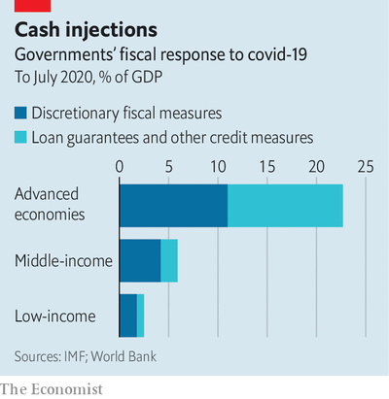
1. While the spending response in Advanced Economies has been massive, Low-Income Countries lack the fiscal space.
“A sigh of relief, a gasp for breath,” The Economist, August 1, 2020.

Slide 12
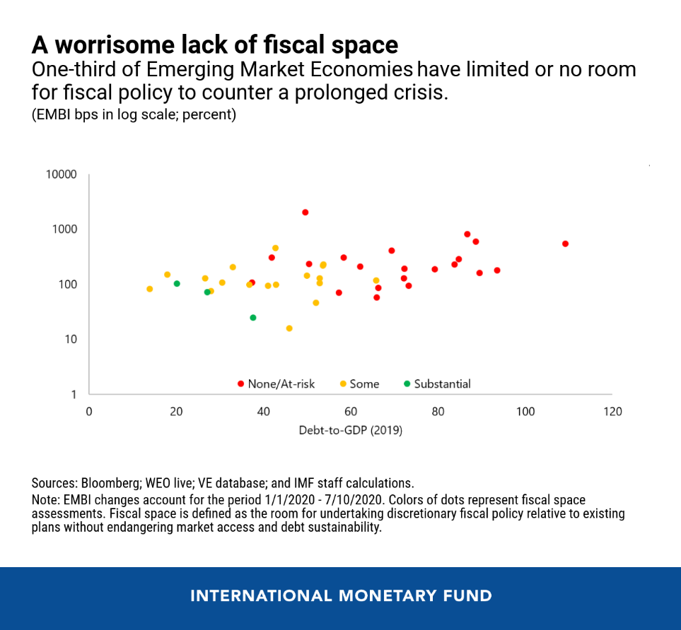
2. Little space to run budget deficits, among those EMDEs that entered 2020 with high Debt/GDPs
& that saw higher sovereign spreads
when the Covid-19 recession hit.
“COVID-19 Response in Emerging Market Economies: Conventional Policies and Beyond,” IMF blog, Aug. 6, 2020

Slide 13
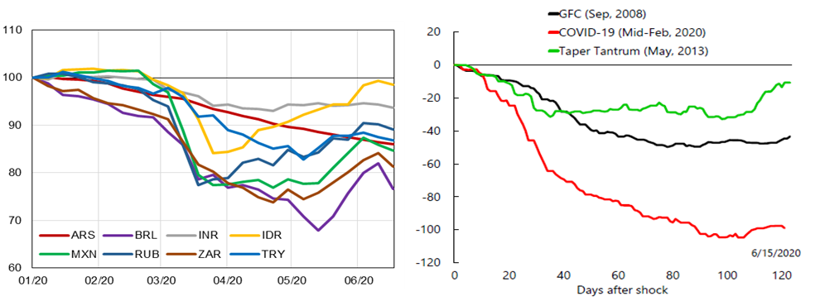
3. Portfolio outflows from EMs when the Covid-19 crisis hit exceeded outflows in the 2008 GFC or 2013 Taper Tantrum.
Portfolio flows, USD bn
G20 High-Level Ministerial Conference: Tackling the COVID-19 Crisis – Restoring Sustainable flows of Capital and Robust Financing for Development, 8 July 2020, Session II Issues Note, Figure 1B. Data Sourc3: IIF

Slide 14
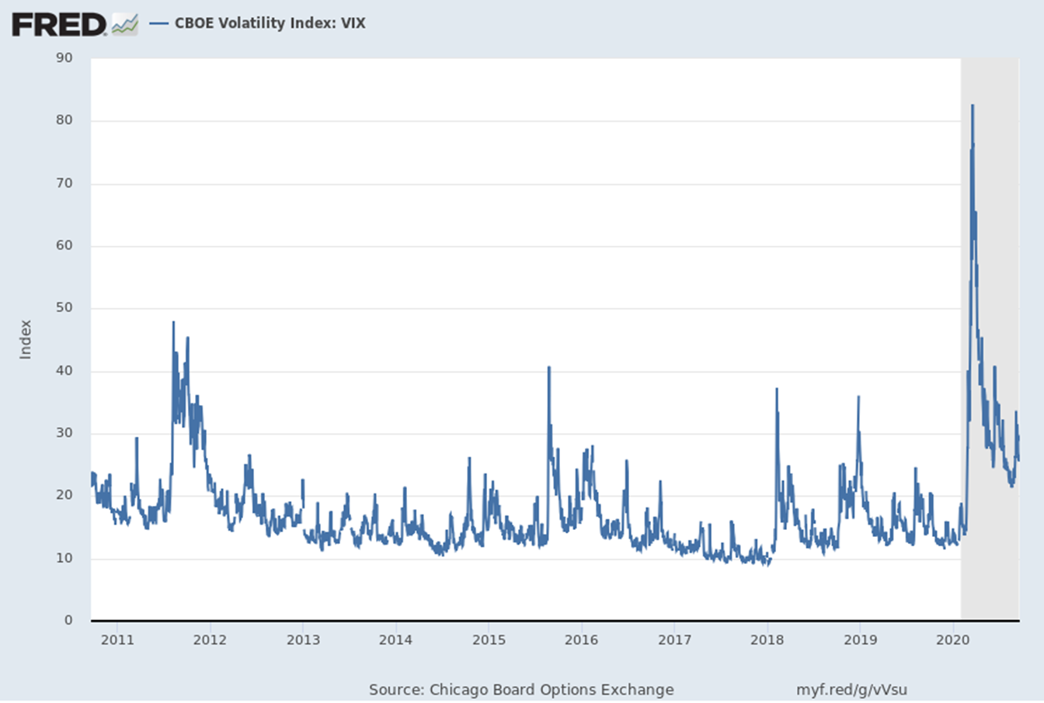
4. “Risk off” -- the VIX rose sharply from Feb. 20 to March 16, 2020 --
hit EM assets, among others.
2010 - Sept. 17, 2020

Slide 15
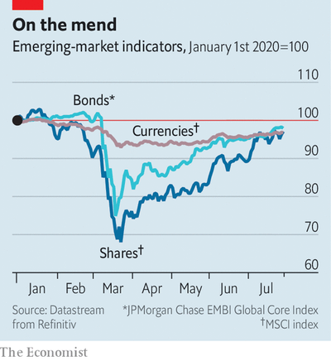
5. Since March, EM asset prices have recovered.
But can it last?
“A sigh of relief, a gasp for breath,”
The Economist, August 1, 2020.

Slide 16
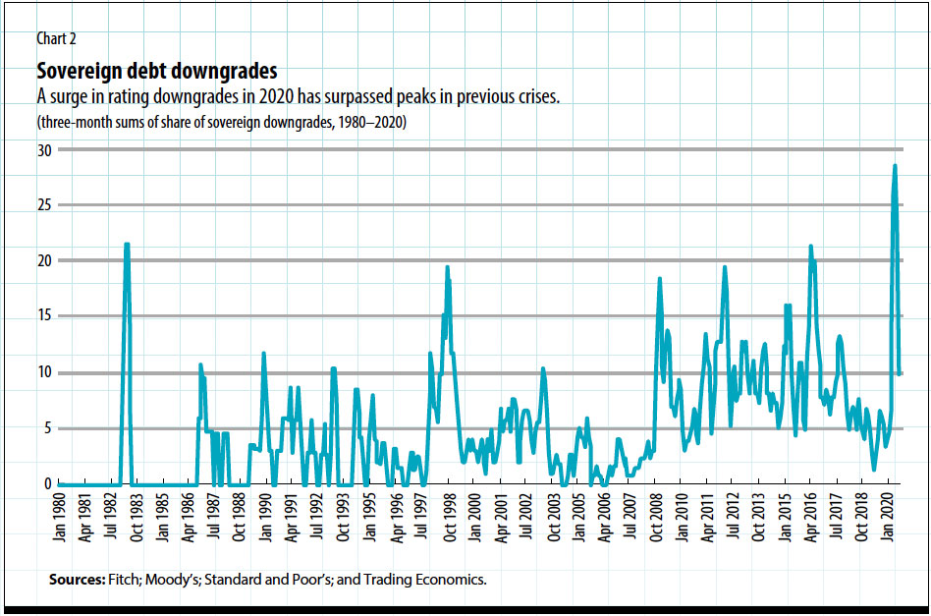
6. Downgrades of sovereign debts in 2020 exceed
1982 intl.debt crisis, 1997-98 Asia crisis, 2008-09 GFC, etc.
J.Bulow, C.Reinhart, K.Rogoff & C.Trebesch, “The Debt Pandemic,” Finance & Development, Fall 2020.

Slide 17
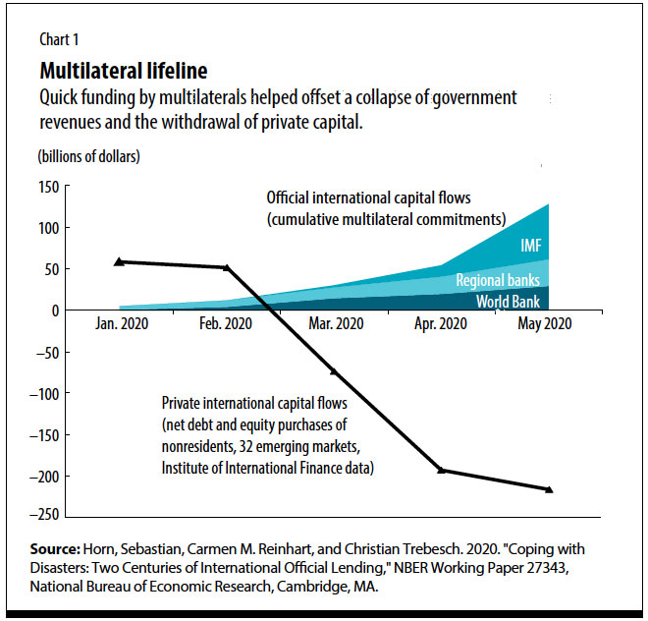
7. When the EMDEs lost private capital inflows, official flows helped.
J.Bulow, C.Reinhart, K.Rogoff & C.Trebesch, “The Debt Pandemic,” Finance & Development, Fall 2020.

Slide 18
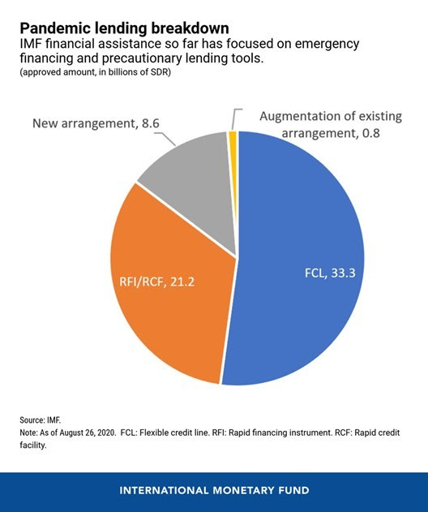
8. The IMF has provided financial assistance to about 80 countries as of September,
mainly through emergency lending
and precautionary lending tools.
IMF Lending During the Pandemic and Beyond, IMF, Sept. 17, 2020

