Slide 1
Economic Trends Amid COVID-19
Bank of China Board Training Session
April 29, 2020 (Beijing Time)
Professor Jeffrey Frankel
Harvard University

Slide 2
Outline
I. Historical severity of the crisis
II. The rapid sequence of events so far
III. Policy response by governments
IV. Forecast of GDP growth: World Economic Outlook
V. Shape of the recovery: “V”, “U”, or “W”?

Slide 3
I. Historical severity of the crisis
The developments of 2020 are much worse, even, than
pandemics like the H1N1 virus of 2009 (“Swine flu”)
or recessions like the 2007-09 Global Financial Crisis.
For adequate precedents we have to go back
to the first half of the 20th century:
the global influenza pandemic of 1918-19
and the Great Depression of the 1930s.

Slide 4
II. The rapid sequence of events so far
1. Spread of virus, usually followed by shutdowns:
  China (lockdown began in Wuhan, January 23);
  then other East Asia;
  Italy,
  then other Europe;
  US, starting with the East & West coasts;
  Developing Countries.

Slide 5
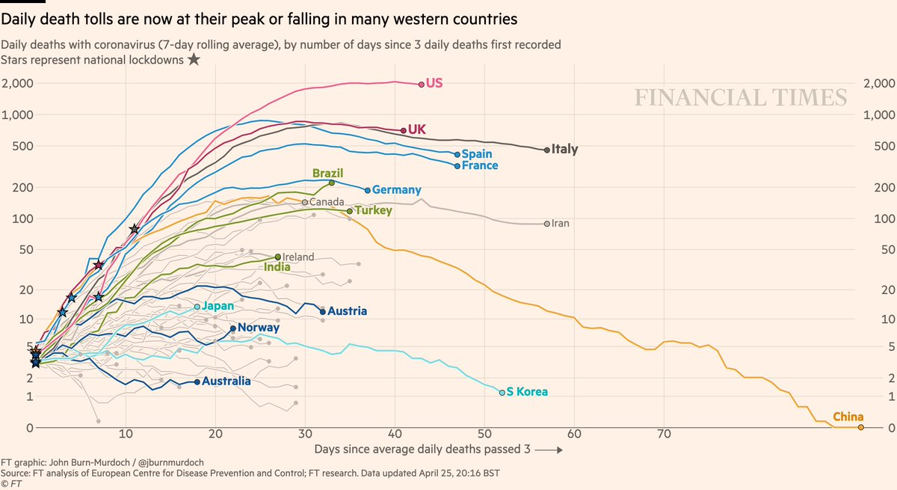
Reported deaths have peaked in Italy & Spain. UK & US may be next.
https://www.ft.com/coronavirus-latest
Note: Excess mortality in 14 countries runs about 60% above reported Covid19 death tolls. www.ft.com/content/6bd88b7d-3386-4543-b2e9-0d5c6fac846c

Slide 6
2. “Risk off” in global financial markets
  Perceived risk, as measured by the VIX (CBOE Volatility Index)
  was below 14.0 as late as Feb. 14,
  but then rose, to 70 in mid-March.
  => Investors turned risk-averse:
    pulled out of equites (Feb. 24-March 23),
    then corporate bonds (esp. junk bonds & EM securities, March 10-23).
  They moved into safe-haven currencies,
    particularly the US $,
      which on March 23 reached its highest value since 2002.

Slide 7
Investors shifted out of corporate bonds & equities.
IMF WEO, April 2020. Figure 1.2. Advanced Economies: Monetary and Financial Market Conditions

Slide 8
Investors pulled out of Emerging Market bonds.
(EMBI Sovereign Spreads, basis points)
IMF WEO, April 2020.

Slide 9
Investors pulled out of Emerging Market equities.
(Jan.1, 2019 = 100)
IMF WEO, April 2020. Figure 1.3.

Slide 10
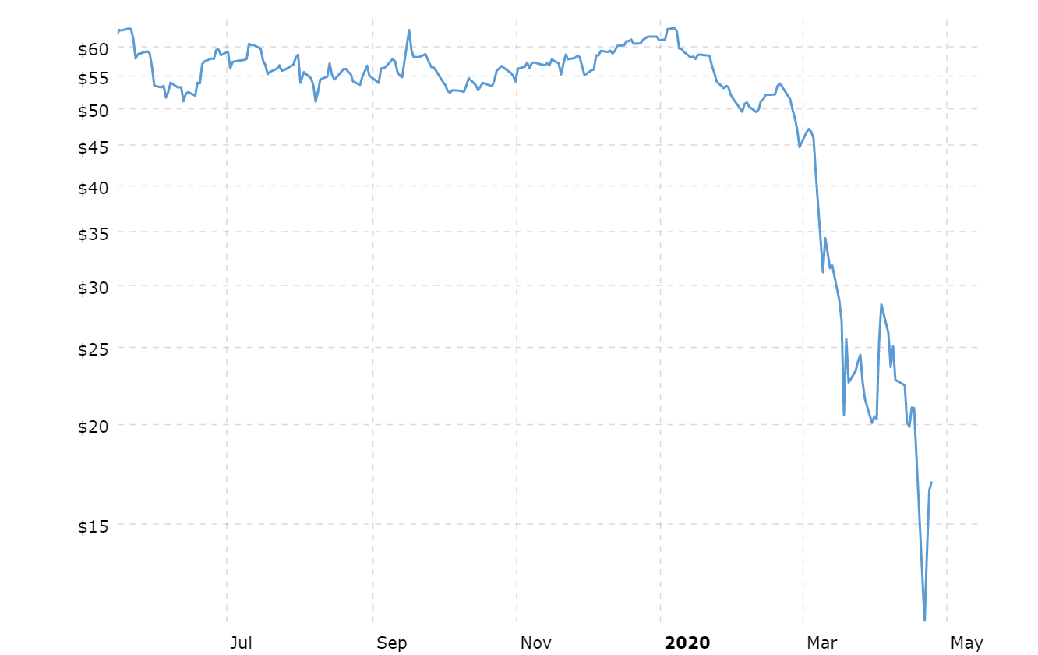
3. Collapse of oil prices
started February 26.
On April 20, price of WTI < 0.
The losers: Middle East & Russia
and some in Latin America & Africa.
For many developing countries, a fall in commodity export prices
comes on top of:
  a sudden stop to capital inflows,
  declining remittances,
  and the terrible challenges of Covid-19 itself spreading to countries with health care systems that are inadequate even at the best of times.
WTI Crude Oil Price,
Macrotrends, April 24, 2020

Slide 11
Impact of the Covid-19 outbreak on oil & commodity prices
%
%
IMF WEO, April 2020. Figure 1.SF.1

Slide 12
4. It is rare that one can predict recession before the numbers are in. But this time: most countries are in recession. Worse than 2008-09.
(IMF baseline forecast)
IMF WEO, April 2020, Figure 1.5. World Growth in GDP per Capita and Recession

Slide 13
III. Policy response by governments
1. In most countries, officials did not take Covid-19 seriously enough,
  especially those with insufficient awareness of past history of pandemics.
  China released the genetic code for the new coronavirus in early January.
  WHO declared Public Health Emergency of International Concern January 30.
  But countries like the US & UK did not use the time to prepare.
  They should have launched testing campaigns & ordered equipment.
  President Trump was in denial. E.g., Feb. 26: “…when you have 15 people,
  and the 15 within a couple of days is going to be down to close to zero,
  that’s a pretty good job we’ve done.”

Slide 14
2. By now, however, most countries have responded with:
  public health measures
  and appropriate macroeconomic stimulus:
    fiscal relief & stimulus measures (in US, March 27)
    and monetary expansion
      going even beyond the Unconventional Monetary Policies of 2008-09.

Slide 15
IV. Forecast of GDP growth:
IMF’s World Economic Outlook, April 14
lowered its forecast for global growth in 2020 sharply,
  by 6.3% pts. from the January forecast,
  to an unprecedented –3.0% worldwide.
That averages -1.0 % in EM & developing countries
and -6.1% in advanced economies (expected mostly in Q2)
  including -5.9% in US 2020 GDP.
    US Q1 report from BEA April 29 may show a fall of only ≈ 4-5% q/q, per annum.
    US Q2 ≈ almost -40%, q/q compounded per annum.
    Goldman-Sachs forecasts US unemployment ≈ 15% in Q3.
IMF’s base case is probably still too optimistic, due to downside risks.

Slide 16
The IMF base case is a 2020 recession much worse than 2008.
IMF World Economic Outlook, April 2020

Slide 17
Even EM & Developing Economies show negative growth.
IMF World Economic Outlook, April 2020

Slide 18
Trade is falling even more sharply than GDP.
IMF World Economic Outlook, April 2020

Slide 19
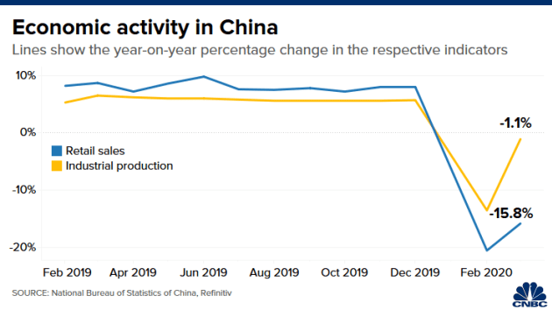
V. What shape of recovery: “V”, “U”, or “W”?
1. V-shaped recovery in the global economy is not likely.
  At first, V bounce-backs seemed plausible.
  Natural disasters usually follow that pattern.
  E.g., China’s 2003 SARS is estimated to have cost 2% growth in Q2,
  but didn’t show up in the year’s overall GDP.
  Indeed, China itself reports that
  Industrial Production bounced back
  in March 2020 from its February plunge.
  But a V is too optimistic, for the aggregate world economy.

Slide 20
2. More likely, at best, is a U-shaped recovery:
60% of business leaders expect “U” shape
  -- World Ec. Forum, April 24.
Certain segments of the economy go back to work,
  perhaps in shifts,
while others remain shut down longer…
at least until we achieve massive, frequent, convenient, free testing
  + contact-tracing
  + reliable tests for anti-bodies;
and perhaps even until a vaccine is available,
which we are told will take 1 ½ years at best,
  or an effective treatment.

Slide 21
3. I worry about a W-shaped recovery, arising from policy mistakes.
Two possible mistakes are illustrated by events of the inter-war period.
Mistake #1: Leaders sound the “all-clear” signal on contagion too soon.
  Some politicians have shown an excessive bias towards optimism.
    This over-optimism has already done harm by delaying action.
    It can do more harm if they try to re-open the economy prematurely.
  The 1918-19 global influenza pandemic is an informative precedent.
    American cities instituted public health interventions in 1918.
    Those cities that let up early suffered a 2nd or 3rd wave of flu, with more deaths.

Slide 22
Mistake #2: Abandoning economic stimulus too soon,
  resulting in a renewed downturn.
  The best precedent in the US is 1936-37.
    The Roosevelt Treasury prematurely curbed federal spending
      & raised taxes to restore a balanced budget.
    The Fed too tightened in 1936.
    As a result, the US went back into severe recession in 1937-38.
  This could easily happen again,
    perhaps as the result of partisan politics in 2021
    together with the budget reality for 2020. CBO, April 24:
      US budget deficit ≈ $3.7 trillion
      & Debt/GDP ≈ 101% .
Conclusion:
A W-shaped pattern, i.e., relapses in health & the economy,
  could result from early withdrawal
    either of public health measures
    or of economic stimulus.

Slide 23
Economic Trends Amid COVID-19
Bank of China Board Training Session
Professor Jeffrey Frankel
Harvard University

