Slide 1
Who needs a Business Cycle Dating Committee? Isn’t a recession simply two consecutive quarters
of negative GDP growth?
Prof. Jeffrey Frankel, HKS
Macroeconomic Policy Seminar,
Harvard Economics Department
Feb. 14, 2023

Slide 2
Outline
Motivation:
How should recessions be declared in real time?
Two disadvantages of using the NBER BCDC
Two advantages of the NBER,
vs. a 2-negative-quarters rule
The negative-quarters rule in other countries

Slide 3
(I) Motivation:
How should recessions be declared in real time?
This talk is based in part on “Business cycle dating committees: US Perspective,“ Seminar on Business Cycle Dating, CIDE, Mexico City, Oct. 30-31, 2019.
The question asked each time the NBER BCDC declares a turning point:
“Who needs a committee to identify recessions? I thought the criterion
was simply two consecutive quarters of falling GDP.”
The NBER BCDC is officially recognized on BEA’s website:
“The designation of a recession is the province of a committee
of experts at the National Bureau of Economic Research (NBER),
a private non-profit research organization.”
Weighing pros & cons, I personally favor the committee
approach over the automatic rule, at least for the US.

Slide 4
Current Members of NBER Business Cycle Dating Committee
Robert Hall, Stanford University, Chair, 1978-
Robert J. Gordon, Northwestern University, 1978-
James Poterba, MIT, 2008-
Valerie Ramey, UC, San Diego, 2017-
Christina Romer, UC , Berkeley, 2003-2008, 2010-
David Romer, UC, Berkeley, 2003-2009, 2010-
James Stock, Harvard University, 2009-2012, 2016-
Mark W. Watson, Princeton University, 2009-
Past Members
Ben Bernanke, Princeton University, 2000-2002
Martin Feldstein, Harvard Univ., 1978-1982, 1984-2019
Jeffrey Frankel, Harvard Univ., 1993-1996, 1999-2019
Benjamin Friedman, Harvard University, 1978-1991
N. Gregory Mankiw, Harvard University, 1991-2000
… + four others.

Slide 5
“Hook” to recent events
In Q1 & Q2 of 2022, US growth < 0
  as measured by the most widely used measure of GDP.
When the BEA released 2nd quarter growth, July 28, 2022,
many inferred that the US was in recession.
It was explained that the NBER is the official arbiter of turning points,
  and that the Committee was unlikely to declare a recession:
    almost all other indicators remained positive.
But some critics accused the Biden Admin of “moving the goal posts.”

Slide 6
Indicators used by the BCDC
Most important:
GDP
  not just the expenditure-side measure (“GDE”),
  but also the income-side (GDI).
  Esp. the two averaged (“Gross Domestic Output”)
Employment
  Nonfarm payroll
  Also as measured by the household survey.
Also:
  real personal income less transfers (PILT),
  real personal consumption expenditures,
  wholesale-retail sales adjusted for price changes,
  & industrial production.
  Everything else.
Source - Business Cycle Dating Procedures: Frequently Asked Questions, NBER

Slide 7
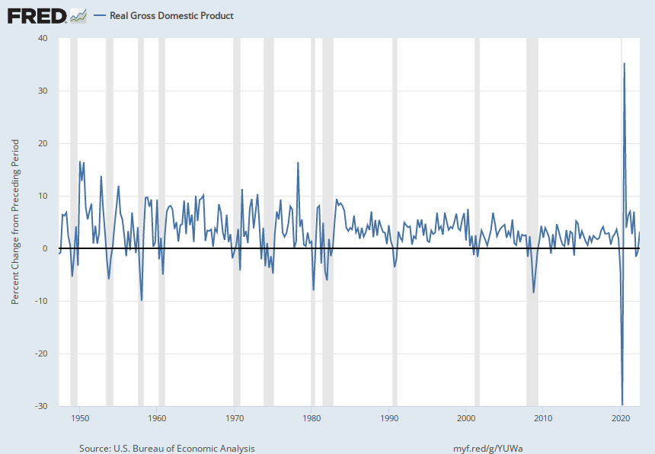
NBER-declared recessions do have high overlap with the 2-negative quarters rule
US real GDP growth rate, 1947 Q2 -2022 Q3
but not always…
Notes:
Source:
U.S. Bureau of Economic Analysis
Release:
Gross Domestic Product
Units:
Percent Change from Preceding Period, Seasonally Adjusted Annual Rate
Frequency:
Quarterly
BEA Account Code: A191RLGross domestic product (GDP) is the value of the goods and services produced by the nation's economy less the value of the goods and services used up in production. GDP is also equal to the sum of personal consumption expenditures, gross private domestic investment, net exports of goods and services, and government consumption expenditures and gross investment. Real values are inflation-adjusted estimates—that is, estimates that exclude the effects of price changes.For more information about this series, please visit the Bureau of Economic Analysis.
U.S. Bureau of Economic Analysis,
Real Gross Domestic Product [A191RL1Q225SBEA],
retrieved from FRED,
Federal Reserve Bank of St. Louis;
https://fred.stlouisfed.org/series/A191RL1Q225SBEA,
January 18, 2023.

Slide 8
(II) Two disadvantages of using the NBER BCDC.
  #1 Long lag from turning point to when the committee declares it.
  Typical public reaction to an NBER announcement: “These geniuses are just telling us what everyone in the real world has known a long time.”
  Counter-argument 1: One cannot reliably identify a recession with a short lag,
    especially because the data are revised.
    The BCDC waits until it is reasonably sure that it won’t have to retract a call.
  Counter-argument 2: When it comes to troughs, polls show public perceptions lag the end of the recession by longer still. (E.g., elections of 1992 & 2014.)
  Counter-argument 3 (the best): there exists an entire industry of pundits
  & forecasters whose job is to “shoot from the hip,”
    i.e., to be faster than everyone else in declaring a recession.
    The NBER wouldn’t play a useful role by joining in that competition.
    Its role is to be definitive, rather than fast.

Slide 9
The 12 business cycle turning points declared by the NBER Business Cycle Dating Committee, with lags
Turning Point Date |  | Announcement Date | Lag (months)
April 2020 (Q3 2020) | Trough | July 19, 2021 | 3
March 2020 (Q4 2019) | Peak | June 8, 2020 | 2
10.2

Slide 10
Two disadvantages of using the NBER BCDC.
  #2 An unelected unaccountable panel of professors lacks legitimacy.
  Counter-argument: The reputation of the NBER is strong enough
  that its impartiality has seldom been questioned. So far.
  And, for the record, no political considerations arose in 25 years of deliberations.
  Nevertheless, it is easy to see how this could become a problem
    as with 2022 H1.

Slide 11
Committees in other countries
  A lack of legitimacy & transparency may explain why, in countries with an academic panel modeled on the BCDC but not officially anointed, their declarations of turning points receive virtually no public attention.
    CEPR-EABCN Euro Area Business Cycle Dating Committee.
    Canada (CD Howe Institute Business Cycle Council)
    French BCDC, Spanish BCDC, & Brazilian ECDC.
  In Japan, the President of ESRI, advised by its Committee on Business Cycle Indicators, also considers a variety of variables
  to determine recession dates
    sometimes with a lag of two years.
    But ESRI lies within the Cabinet Office of Japan’s government.

Slide 12
(III) Two advantages of the NBER over a 2-quarter rule
What purpose is served by having a definitive system
for determining turning points?
  A common accepted chronology, that is not subsequently revised, is useful:
  For research by macroeconomists & economic historians,
  claims by politicians & media pundits regarding recessions,
  voters’ judgments.
#1. Revisions in the data, especially GDP.
  Substantial. E.g., Mankiw & Shapiro (1986).
    In US: Advance, Second, Third, July, then each subsequent July for 5 years.
    Over 1996-2021, mean absolute revision from Advance to Third = 0.6 %-point p.a.
  Under an automatic GDP rule, the revisions can mean that recessions are declared, then erased. E.g., the UK recession of 2011-12, erased in July 2013..

Slide 13
Dating the Great Recession in real time
  12/2/2008, when the NBER announced that the 2008 contraction had begun
  with a peak in Dec 2007, BEA still reported the expenditure measure of GDP higher in both the 1st & 2nd quarters of 2008 than the last quarter of 2007.
  The Committee based the call on other indicators, such as job loss & GDI.
  Much later, the Commerce Department revised its statistics:
  The final estimates reassuringly show that GDP was in fact lower
  in the 1st two quarters of 2008 than in the last quarter of 2007.
  Even though the announcement of the beginning of the recession was greeted as long overdue when it was made, one would have had to wait another 1 ½ years to get that crucial revision from BEA if one had stuck with the “2 quarters of negative growth” rule.

Slide 14
Two advantages of the NBER over a 2-quarter rule
#2 Even leaving aside revisions, the two-consecutive-quarter growth
rule can give an ambiguous answer, or the wrong answer.
Can give an ambiguous answer: Measures of GDP differ.
  The income-side measure can give a different answer from the expenditure side
  E.g., substantially different in US recently. GDI grew in 2022 H1, while “GDP” fell.
  Experts consider GDI to be as good or better than the expenditure measure (“GDE”).
    More correlated with other indicators such as employment.
    Subsequent revisions tend to move GDE in the direction of GDI.
    E.g., CEA (1997), Fixler & Nalewaik (2007, 09), Landefeld (2010), Nalewaik (2010, 11, 12).
  An average of GDE & GDI is probably better than either alone.
    Used by the NBER BCDC since 2008, called GDO by the CEA & published by BEA since 2015.
  Some statistical formulas based on both GDE & GDI are perhaps still more accurate.
    Philadelphia Fed’s “GDPplus” -- Aruoba, et al (2016)
    “GDP++” from the KOF Swiss Economic Institute -- Jacobs, et al. (2022)
    Statistics Canada
      “treats these discrepancies [GDE vs. GDI] to obtain a consistent [overall] GDP figure.” .

Slide 15
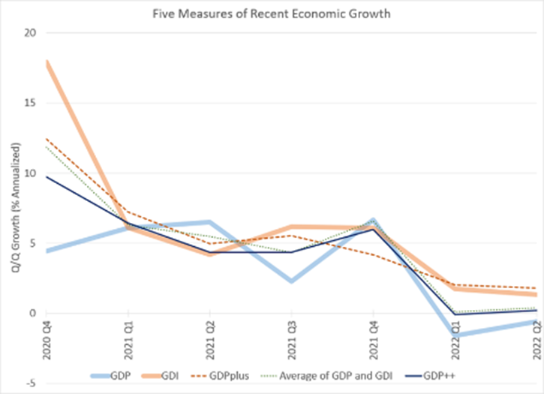
GDI growth > 0 in 2022 H1, despite “GDP” growth < 0
Five Measures of Recent Economic Growth 2020 Q4 – 2022 Q2
Source: Menzie Chinn, Econbrowser
Δ GDI > 0
Δ GDE < 0

Slide 16
Two advantages of the NBER over a 2-quarter rule
#2 Even leaving aside revisions, the two-consecutive-quarter growth rule
can give an ambiguous answer or the wrong answer.
Can give the “wrong” answer: What if a GDP downturn clearly indicates
a recession, but does not meet the two-quarter rule?
  (i) Negative quarters that aren’t consecutive.
    E.g., the US in the first 3 quarters of 2001: down, up, down. No recession?
      Other indicators, like employment & GDI => recession.
    The case seems especially clear if 3 quarters comprise:
    big fall, small rise, then another fall.
    Italy 2011-14 (See graph)
    Or Ireland 2008 -13 (See graph).
  (ii) A single very severe negative quarter. E.g., Covid recession of 2020.

Slide 17
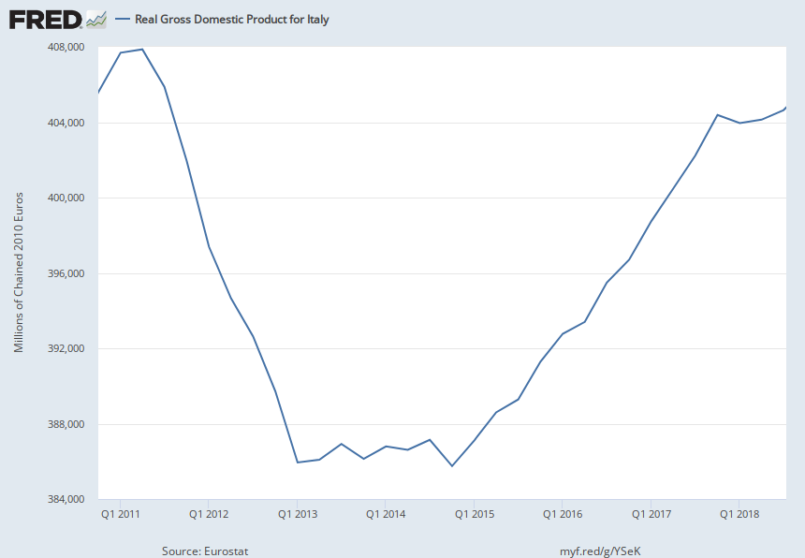
(i) The 2-quarter rule says an Italian recession began in 2011 Q3 & ended 2013 Q2
Level of real GDP for Italy, 2011-2018
Q3 2011
2017
      Surely, it did not end until Q4 2014.
Q2 2013
Q4 2014
Notes:
Source:
Eurostat
Release:
National Accounts - GDP (Eurostat)
Units:
Millions of Chained 2010 Euros, Seasonally Adjusted
Frequency:
Quarterly
Eurostat unit ID: CLV10_MNACEurostat item ID = B1GQEurostat country ID: ITSeasonally and calendar adjusted data.For euro area member states, the national currency series are converted into euros using the irrevocably fixed exchange rate. This preserves the same growth rates than for the previous national currency series. Both series coincide for years after accession to the euro area but differ for earlier years due to market exchange rate movements.Copyright, European Union, http://ec.europa.eu, 1995-2016.Complete terms of use are available at http://ec.europa.eu/geninfo/legal_notices_en.htm#copyright
Eurostat,
Real Gross Domestic Product for Italy [CLVMNACSCAB1GQIT],
retrieved from FRED,
Federal Reserve Bank of St. Louis;
https://fred.stlouisfed.org/series/CLVMNACSCAB1GQIT,
January 17, 2023.

Slide 18
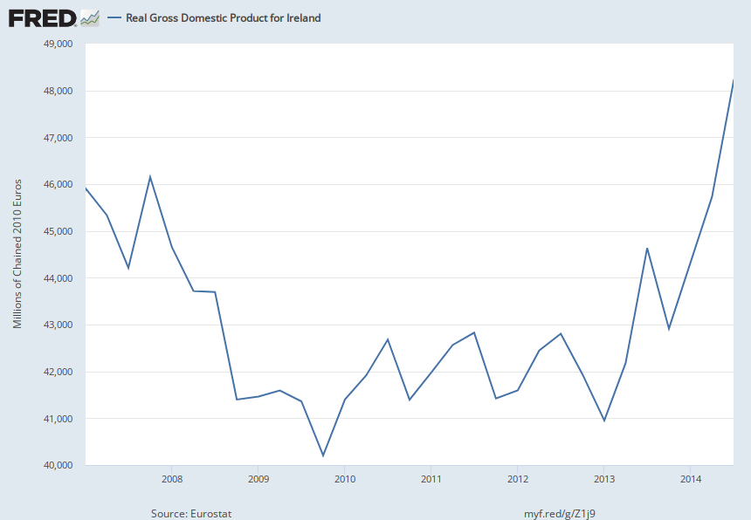
The 2-quarter rule says an Irish recession began in Q1 2008 & ended Q1 2009
Level of real GDP for Ireland, 2007-2014
2014
I’d say it ended Q1 2013
Q1 2008
Q1 2013
Q1 2009
Q1 2007- Q3 2014 not S.A.
https://fred.stlouisfed.org/series/CLVMNACNSAB1GQIE
Notes:
Source:
Eurostat
Release:
National Accounts - GDP (Eurostat)
Units:
Millions of Chained 2010 Euros, Not Seasonally Adjusted
Frequency:
Quarterly
Eurostat unit ID: CLV10_MNACEurostat item ID = B1GQEurostat country ID: IEFor euro area member states, the national currency series are converted into euros using the irrevocably fixed exchange rate. This preserves the same growth rates than for the previous national currency series. Both series coincide for years after accession to the euro area but differ for earlier years due to market exchange rate movements.Copyright, European Union, http://ec.europa.eu, 1995-2016.Complete terms of use are available at http://ec.europa.eu/geninfo/legal_notices_en.htm#copyright
Eurostat,
Real Gross Domestic Product for Ireland [CLVMNACNSAB1GQIE],
retrieved from FRED,
Federal Reserve Bank of St. Louis;
https://fred.stlouisfed.org/series/CLVMNACNSAB1GQIE,
January 20, 2023.

Slide 19
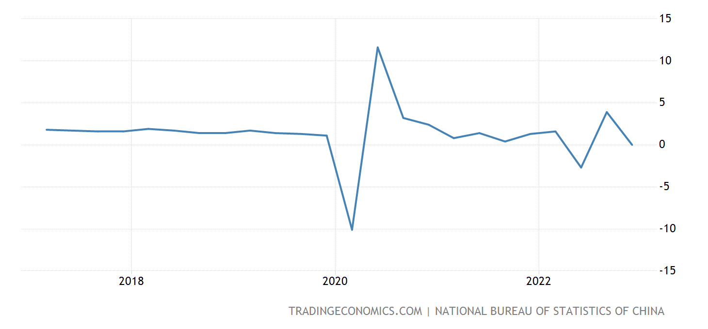
(ii) China’s covid-19 recession lasted only 1 quarter
Real GDP growth rate for China, 2017-2022
Q1 2020

Slide 20
(IV) The negative-quarters rule in other countries
  1) Some advanced economies grow so slowly that even
  a slight slackening can put them into negative territory.
  Japan
    Its growth has averaged only 1% p.a. in recent decades.
    That helps explain why…
    by the 2-quarter rule, it had 5 recessions during the decade, 2007-2016 (see graph).
    Perhaps that is why Japan does not use the 2-quarter rule.
    Instead, Japan’s ESRI determined only 2 recessions during this period.
  EU may be getting there too.
    Italy’s 2022 GDP is the same as it was in 2005.

Slide 21
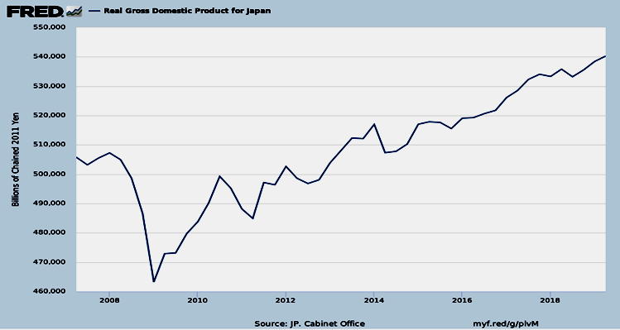
By the 2-quarter-GDP rule, Japan had 5 recessions during 2008-16.
Real GDP for Japan, 2007-2019
Officially, Japan had only 2 recessions during this period
Feb. 2008 –
March 2009
March- Nov. 2012

Slide 22
The negative-quarters rule in other countries
2) Some EMDEs grow so rapidly that even a large slackening
does not put them into negative GDP territory.
  Especially those that still have non-negligible population growth.
  E.g., Bangladesh: GDP growth hasn’t been < 0 since 1975. (see graph)
  China: growth high for 5 decades, 1970-2019.
    China had not had growth < 0 since 1993 (until 2020).
    even an 8-%-pt fall in GDP growth (from 14% in 2007 to 6% in 2009)
    was not enough to cause Chinese output to shrink in absolute terms.
www.focus-economics.com/blog/fastest-growing-economies-in-the-world

Slide 23
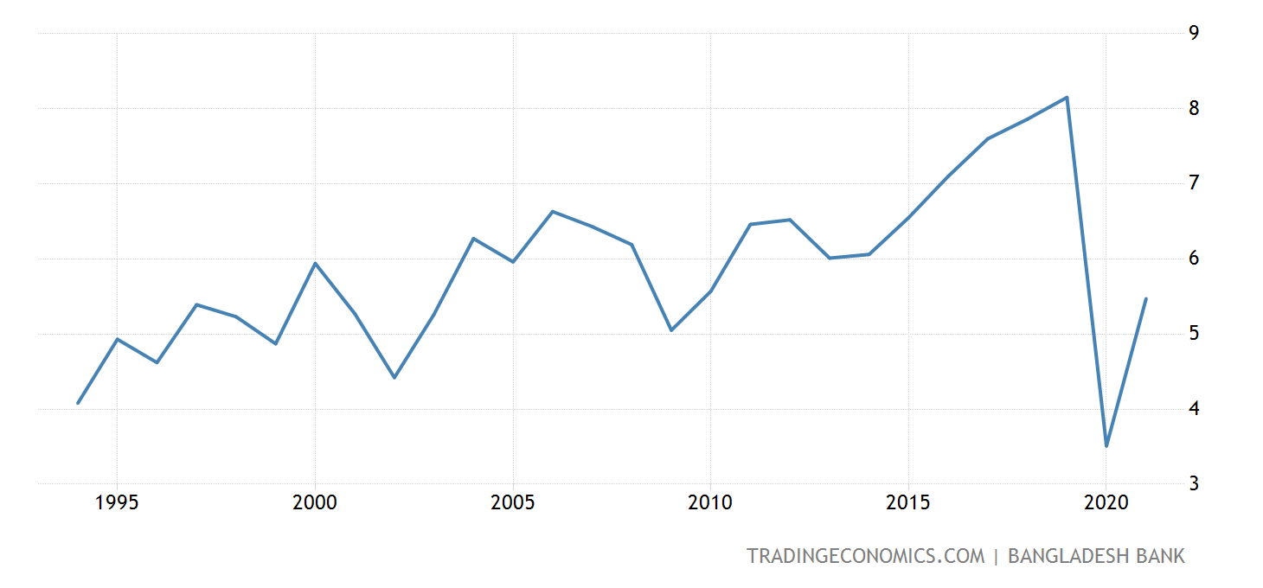
Bangladeshi growth averages 6 ½ %; ^{Ϯ}
it hasn’t been < 0 since 1975; not < 2.0% since 1980
Real GDP growth rate for Bangladesh, annual, 1994-2022
June 2019-June 2020
3.4%, record low > 0 ^{Ϯ Ϯ}
GDP not available quarterly
Ϯ June 2007- June 2022.
Ϯ Ϯ CEIC.

Slide 24
“Global recession?”
  Much talk about one in 2023.
  But how is it defined? As two quarters of negative growth?
  Global GDP never fell, between 1960 and 2007. (See graph)
  Some suggest using growth in GDP/capita.
    But that no longer helps much.

Slide 25
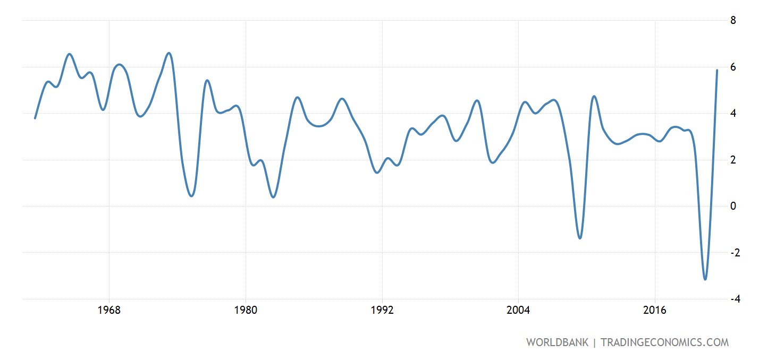
Definition of Global Recession? World growth did not go negative
even in 1974 or 1982, though it did in 2009 & 2020;
It has fallen below 2.0% more often.
World GDP growth (annual %), 1960-2021
%
https://tradingeconomics.com/world/gdp-growth-annual-percent-2010-wb-data.html

Slide 26

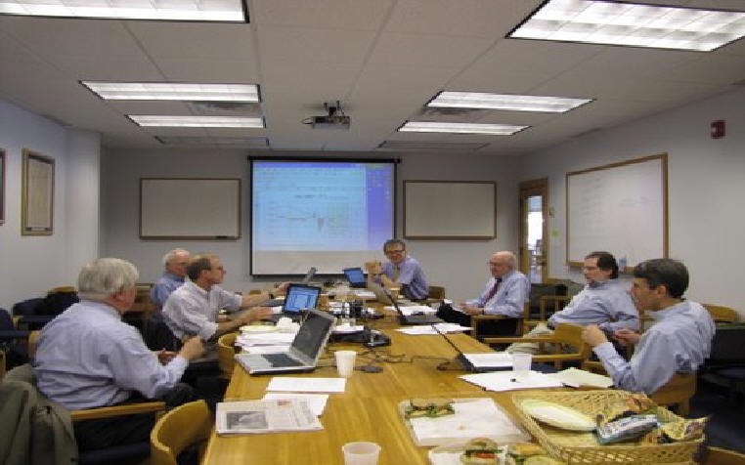
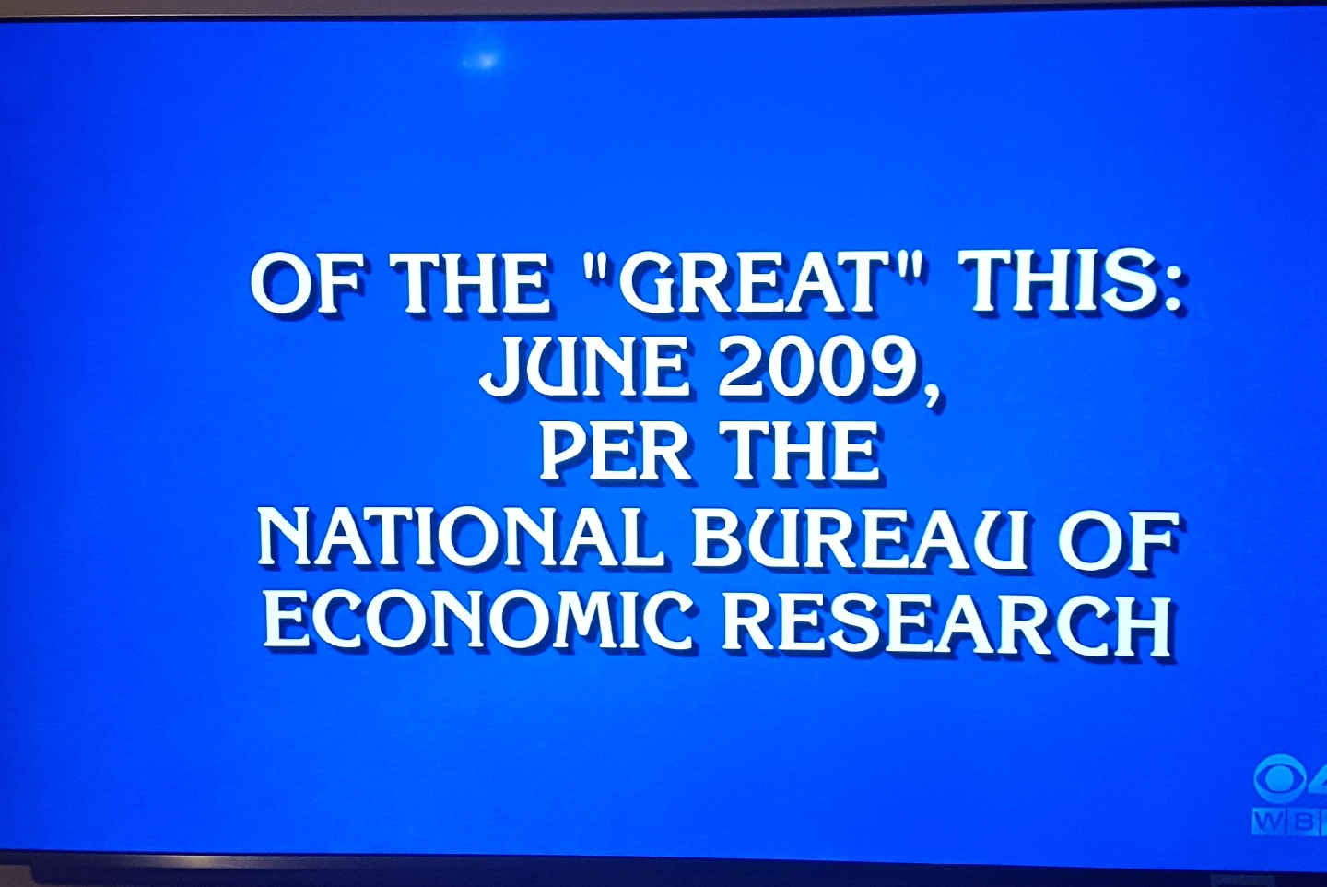
Thank you
Seven white men in blue shirts
“The Dating Game”
Jeopardy question: “What is a recession?”

Slide 27
History of the NBER’s dating of peaks & troughs
Appendices
The NBER was founded in 1920.
  Its Business Cycle chronology goes back to 1854.
  Burns & Mitchell (1946)
  Three requirements: duration, depth, & diffusion within the economy.
  During its first 50 years, the dating received little real-time attention.
Martin Feldstein established a committee in 1978.
  The first press release dates from July 27, 1979.
  The NBER President, currently Jim Poterba, designates committee members.
  The membership of the committee varies between 6 and 10.
  Bob Hall has been chairman of the committee since 1978.

Slide 28
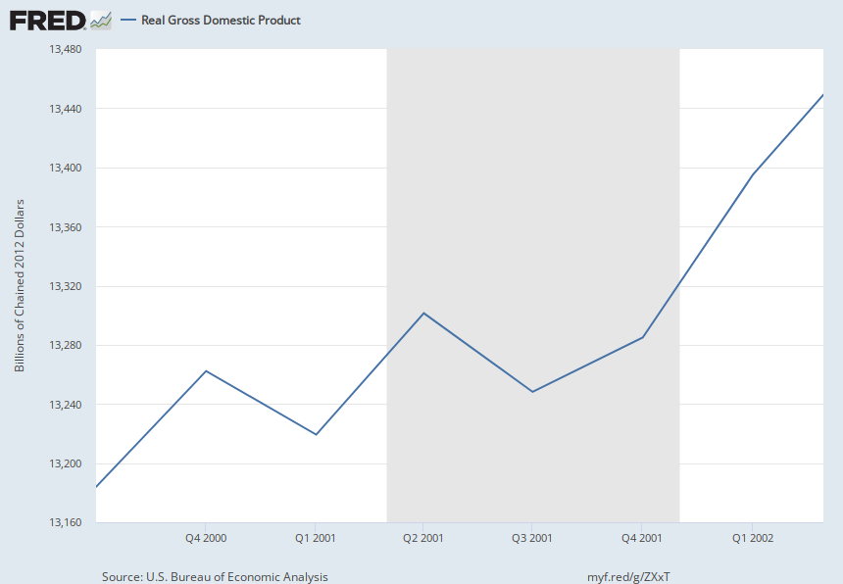
The 2-consecutive- quarter rule says the US did not experience a recession in 2001
Level of real GDP for US, 2000-2002
Nov. 2001
March 2001
Notes:
Source:
U.S. Bureau of Economic Analysis
Release:
Gross Domestic Product
Units:
Billions of Chained 2012 Dollars, Seasonally Adjusted Annual Rate
Frequency:
Quarterly
BEA Account Code: A191RXReal gross domestic product is the inflation adjusted value of the goods and services produced by labor and property located in the United States.For more information see the Guide to the National Income and Product Accounts of the United States (NIPA). For more information, please visit the Bureau of Economic Analysis.
U.S. Bureau of Economic Analysis,
Real Gross Domestic Product [GDPC1],
retrieved from FRED,
Federal Reserve Bank of St. Louis;
https://fred.stlouisfed.org/series/GDPC1,
February 12, 2023.

Slide 29
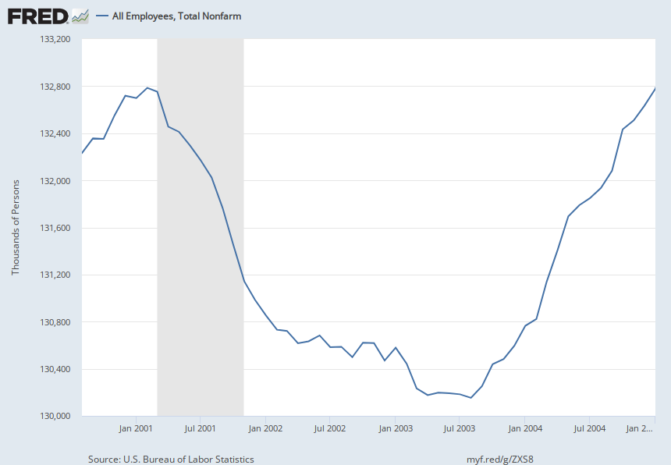
But other indicators, esp. employment,
make clear there was a recession in 2001
Level of US employment, 2000-05
March 2001
Notes:
Source:
U.S. Bureau of Labor Statistics
Release:
Employment Situation
Units:
Thousands of Persons, Seasonally Adjusted
Frequency:
Monthly
All Employees: Total Nonfarm, commonly known as Total Nonfarm Payroll, is a measure of the number of U.S. workers in the economy that excludes proprietors, private household employees, unpaid volunteers, farm employees, and the unincorporated self-employed. This measure accounts for approximately 80 percent of the workers who contribute to Gross Domestic Product (GDP).This measure provides useful insights into the current economic situation because it can represent the number of jobs added or lost in an economy. Increases in employment might indicate that businesses are hiring which might also suggest that businesses are growing. Additionally, those who are newly employed have increased their personal incomes, which means (all else constant) their disposable incomes have also increased, thus fostering further economic expansion.Generally, the U.S. labor force and levels of employment and unemployment are subject to fluctuations due to seasonal changes in weather, major holidays, and the opening and closing of schools. The Bureau of Labor Statistics (BLS) adjusts the data to offset the seasonal effects to show non-seasonal changes: for example, women's participation in the labor force; or a general decline in the number of employees, a possible indication of a downturn in the economy. To closely examine seasonal and non-seasonal changes, the BLS releases two monthly statistical measures: the seasonally adjusted All Employees: Total Nonfarm (PAYEMS) and All Employees: Total Nonfarm (PAYNSA), which is not seasonally adjusted.The series comes from the 'Current Employment Statistics (Establishment Survey).'The source code is: CES0000000001
U.S. Bureau of Labor Statistics,
All Employees, Total Nonfarm [PAYEMS],
retrieved from FRED,
Federal Reserve Bank of St. Louis;
https://fred.stlouisfed.org/series/PAYEMS,
February 12, 2023.

Slide 30
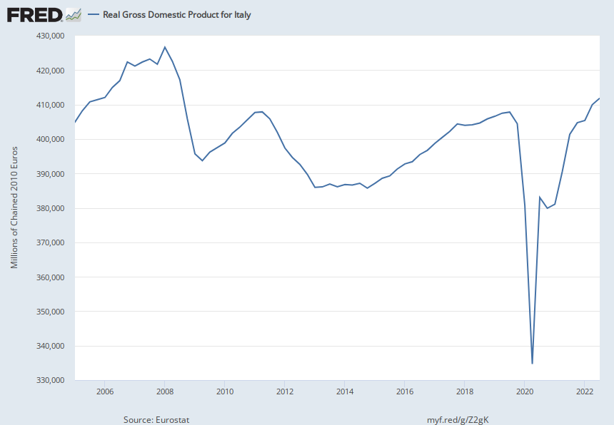
Italy’s 2022 GDP is at the same level as in 2005
Q12005 – Q2 2022
https://fred.stlouisfed.org/series/CLVMNACSCAB1GQIT
Notes:
Source:
Eurostat
Release:
National Accounts - GDP (Eurostat)
Units:
Millions of Chained 2010 Euros, Seasonally Adjusted
Frequency:
Quarterly
Eurostat unit ID: CLV10_MNACEurostat item ID = B1GQEurostat country ID: ITSeasonally and calendar adjusted data.For euro area member states, the national currency series are converted into euros using the irrevocably fixed exchange rate. This preserves the same growth rates than for the previous national currency series. Both series coincide for years after accession to the euro area but differ for earlier years due to market exchange rate movements.Copyright, European Union, http://ec.europa.eu, 1995-2016.Complete terms of use are available at http://ec.europa.eu/geninfo/legal_notices_en.htm#copyright
Eurostat,
Real Gross Domestic Product for Italy [CLVMNACSCAB1GQIT],
retrieved from FRED,
Federal Reserve Bank of St. Louis;
https://fred.stlouisfed.org/series/CLVMNACSCAB1GQIT,
January 17, 2023.

