Slide 1
Shifts in Economic Powers
Jeffrey Frankel
Harpel Professor of Capital Formation & Growth
Harvard Kennedy School, Harvard University
Boston Consulting Group session with
Executive Committee members of Groupama
11:00-12:30 pm, Wednesday, 11 July, 2018

Slide 2
Shifts in Economic Powers
Long-term perspective on the rise & fall of great powers
The rise of China.
  Did its GDP pass the US in 2014?
China's recent slowdown
  Explanations.
Rivals for top international currency status:
  The $, €, & RMB.
Policy mistakes in EU & US.

Slide 3
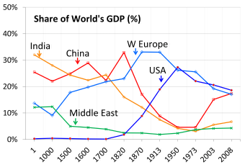

1. The long-term rise & fall of great powers
From 1500 to 1820, China was the world’s largest economy.
PPP basis
The global contribution by major economies from 1 AD to 2008 AD according to estimates
by Angus Maddison, 2007, Contours of the World Economy, I - 2030 AD (Oxford Univ. Press).
Note: Flag is Qing Dynasty’s

Slide 4





In the 19th century:
Within Western Europe,
  the UK economy dominated,
  but was surpassed by Germany’s GDP in 1900.
  According to Graham Allison’s Thucydides Trap,
  the challenge of Germany’s rise led to World War I,
    a worrisome precedent as China’s rise challenges the US.
US GDP passed the UK in 1872,
    an example when the Thucydides Trap was avoided,
  and US surpassed all of Western Europe by 1950.
The Soviet Union was at #2, 1940-1980,
  succeeded by Japan,
    viewed as a juggernaut in the 1980s.

Slide 5
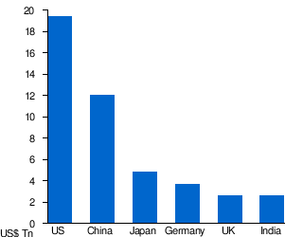
The rankings today
Largest economies by nominal GDP in 2017
Source: IMF estimates (WEO database, April 2018).
Note: At current exchange rates, France may be ahead of India.
Italy, Brazil, Canada, Russia & Korea follow.

Slide 6

Headlines about China’s economy 4 years ago:
2. The rise of China.
Did its GDP pass the US in 2014?
China poised to pass US as world’s leading economic power this year April 30, 2014, Financial Times.
China surpasses U.S. to become largest world economy Dec. 6, 2014, FoxNews.com.
… based on the latest 6-year update from
the World Bank’s International Comparison Program.
But was this right? Is China now bigger than US?

Slide 7
The facts
On the one hand, China’s economic miracle is genuine:
  Growth ≈ 10% p.a. for 3 decades is historic.
  It took the UK about 58 years to double income, starting from 1780
    US: 47 years, from 1839
    Japan: 35 years, from 1885
    Korea: 11 years, from 1966.
  But it took China only around 8 years, from 1987.
On the other hand, China is still a developing country.
  In 2017, its income per capita was only average, globally,
  ranking 79th among 189 countries, between Costa Rica & Brazil.

Slide 8
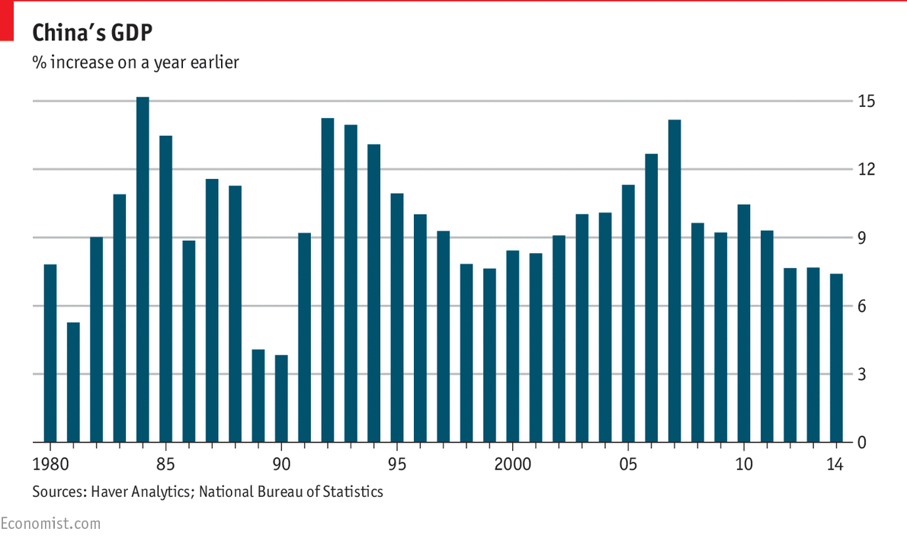
35 years of strong Chinese growth

Slide 9

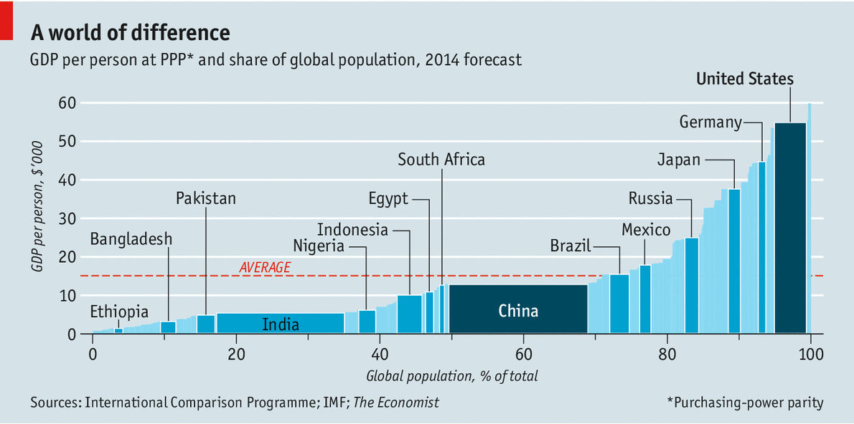


Measuring GDP The dragon takes wing May 3rd 2014 |
New data suggest the Chinese economy is bigger than previously thought.
The claim to rival US size comes, of course, from multiplying a middle income-per-capita times 1.3 billion people.
2014
France
www.economist.com/news/finance-and-economics/21601568-new-data-suggest-chinese-economy-bigger-previously-thought-dragon

Slide 10
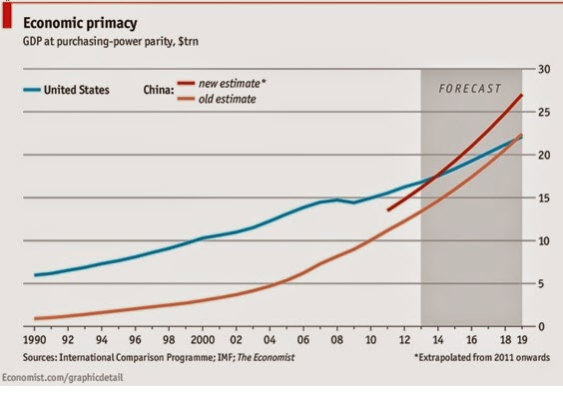
China’s GDP reportedly passed the US in 2014.
But I call that a mis-application of the PPP numbers
from the World Bank’s ICP project.

Slide 11
Use PPP rates to compare income per capita
Use actual exchange rates
to compare GDP
e.g., to judge if:
  governments have successfully raised living standards;
  a country is rich enough to cut pollution;
  the currency is “undervalued,”
  given its income.
e.g., to judge:
  How big is the market,
  from the view of multinational companies?
  How big should a country’s quota be in the IMF?
  How many ships
  can its navy buy?
  How big is the global role
  for its currency?

Slide 12
China GDP has reached US only if measured in PPP terms.

Slide 13
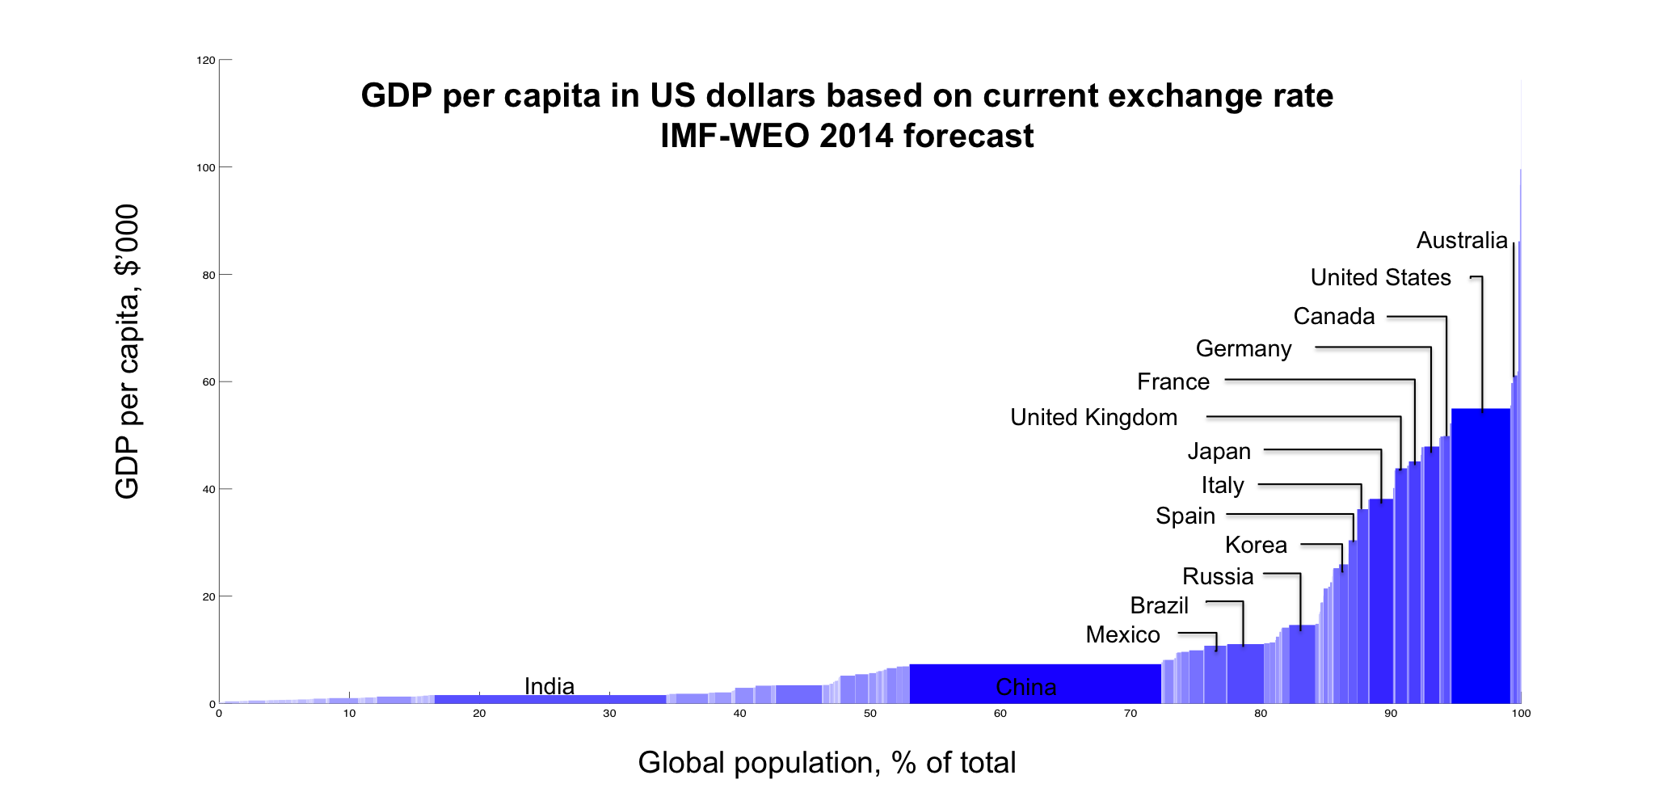
Measuring GDP
Using actual exchange rates gives a different answer:
The US is still 45% bigger than China, even in 2018, 23.3 %/ 16.1%
, 2014
China
Thanks to Qing Yu

Slide 14
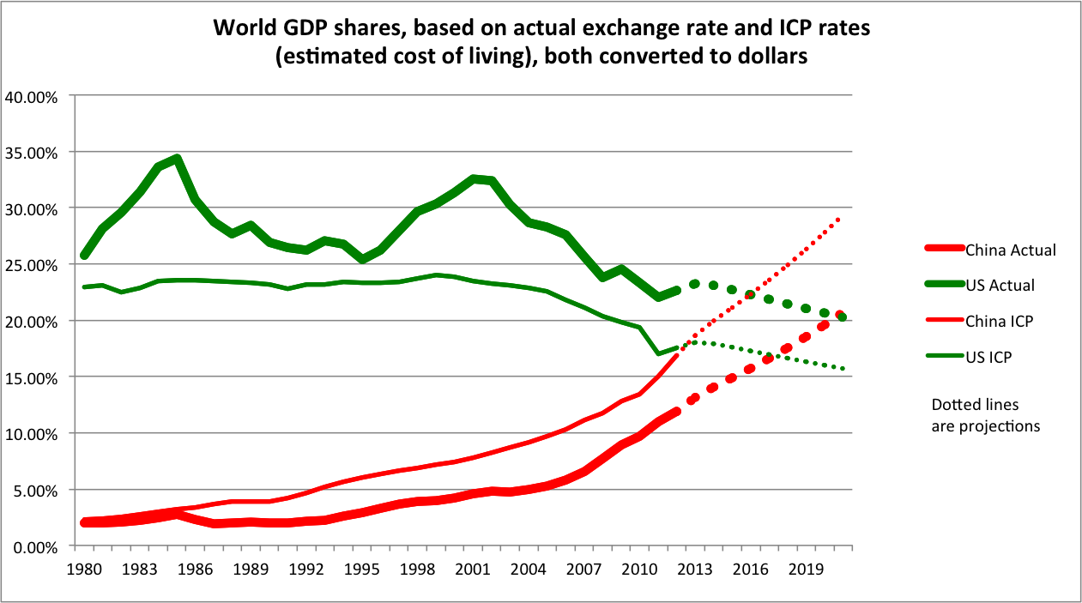
China has not yet overtaken the US.
Author’s
calculations.
(Thanks to Qing Yu.)
The cross-over won’t come before the 2020s.
In 2029, if the growth differential ≈ 4% and there is no real appreciation.

Slide 15
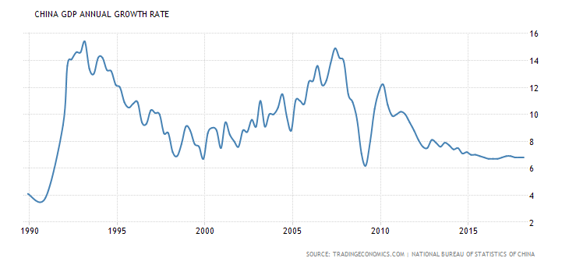
3. China’s recent slowdown
China’s growth has slowed relative to past 10% average.

Slide 16
Reasons for China’s long-term slowdown
Natural convergence
    Technological catch-up;
    Diminishing returns to capital
      Krugman (1994), Young (1994, 1995);
    Rural-urban migration
      Lewis turning point (1954);
    Rising costs of labor & land;
    Services have a lower rate of productivity growth.
Middle-income trap?
      Eichengreen, Park & Shin (2012) *
Regression to the mean
      Prasad (2009), Pritchett & Summers (2014). *
Aging. *
* See appendix.

Slide 17
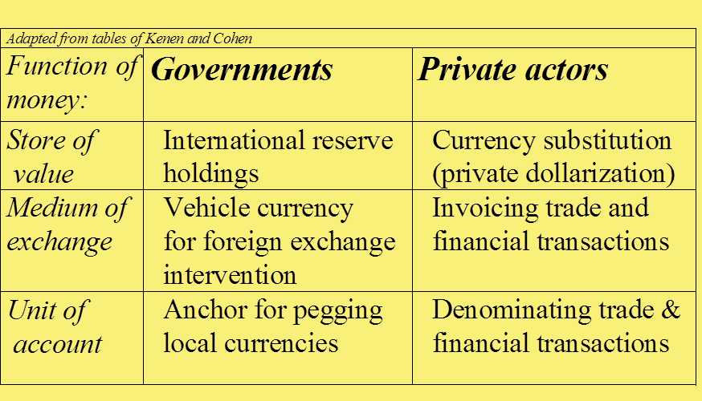
4. Rivals for top international currency status: The $, €, & RMB
An international currency is one used outside its home country. Uses:
Central banks’ holdings of reserves are the most easily quantified,
and probably the most important, of the various measures.

Slide 18
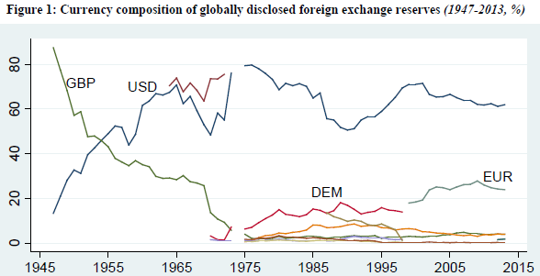
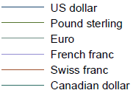
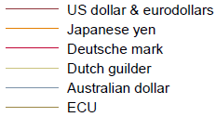
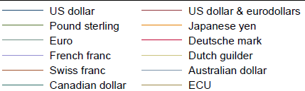
The US $ had passed ₤ by 1955 and has been #1 ever since.
Central bank holdings of FX Reserves, 1947-2013
Eichengreen,
Chitu & Mehl,
2017

Slide 19
Some predicted that the RMB might soon challenge the $ for #1
    carried away, no doubt, by the China’s stunning economic rise.
    E.g., Subramanian (2011a, b) claimed that the RMB
    might overtake the $ by 2020.
    But in fact the RMB still has a long way before it is a top international currency.
      It is just now becoming a normal currency.

Slide 20
The traditional list of criteria for determining international currency status:
Historical inertia, due to network effects that entrench #1
  Vs. the “new view” which says change comes rapidly
    Eichengreen (2011): $ caught up with ₤ in 1924.
Size of the home economy
  approximately equal for the $, €, & RMB
Reputation of the currency for retaining value
  led to mis-predictions in 1990s re the rise of DM & ¥.
Depth/liquidity/openness of home financial market.
    which the RMB is missing;
  including a deep, liquid, integrated government bond market
    which the euro is also missing (not by accident).

Slide 21
In foreign exchange reserves,
By various measures…
In world payments,
The RMB passed the Swiss franc in 2014
to become the 7th most-used currency
  but with a market share of only 1.4 %, still far behind $ & €.
  Source: SWIFT.
New data on Central Bank holdings of RMB revealed, Q IV, 2016:
  The RMB is only in 7th place, well behind Australian $.
  Source: IMF COFER, March 31, 2017.
In foreign exchange trading volume,
Only in 2016 did the RMB break into 8th place
  with a market share of 4%,
  passing the Swedish kronor, but still behind the CHF.
  Source: BIS, Dec. 2016 www.bis.org/publ/rpfx16.htm
…the RMB still lags far behind.

Slide 22

5. Policy mistakes in China, Europe & US.
Policy reforms needed in China
Policy mistakes in the EU & eurozone
Policy mistakes in the US.

Slide 23
(i) China’s government needs some reforms
As recognized by the Chinese themselves,
  e.g., made official at the Third Plenum of 2013
Some reforms have been pursued:
  Anti-corruption drive.
  Shifting composition of GDP
    From Investment & Net Exports, to Consumption
    From Manufacturing to Services.
But others have seen very little progress:
    Rural land rights & hukou system,
    Market orientation,
    Shrink State Owned Enterprises,
    Clean up the environment.
Fiscal expansion, though well-timed (esp. in 2009),
    was allocated too much to heavy investment, e.g., steel capacity.

Slide 24
But China’s economic policy mistakes are out-done by the EU’s & the US.
(ii) Europe
  Pro-cyclical fiscal policy
    An extreme example: Greece
    After 2010, periphery needed structural reform,
      not fiscal austerity.
  Brexit.
  I won’t count refugee policy as a mistake
    because there was no good solution.
  Even if the euro itself was not a mistake,
    I see 9 mistakes in its execution.

Slide 25
Nine mistakes in the execution of European EMU
The euro membership should not have been expanded so quickly.
  19 countries was too many for the Optimum Currency Area test.
The problem of fiscal moral hazard, though correctly identified at Maastricht, had not been effectively addressed,
  especially because of an optimism bias in official forecasts.
Euro-wide banking regulation was omitted.
When capital flowed copiously to periphery countries and interest rate spreads fell almost to zero, this was viewed as a good thing
  rather than as a sign that the moral hazard problem had not been solved.
Too-tight ECB monetary policy, 2008-12.
The failure to send Greece to the IMF early in the crisis, say Jan. 2010.
The failure to write down more of the debt, earlier,
at a time when most was still held by private creditors.
The stubborn belief, esp. in Germany, that fiscal austerity is not contractionary, even in the short run. Result: Debt/GDP ↑.
When Alexis Tsipras became PM in Jan. 2015, he misplayed his hand.

Slide 26
China’s economic policy mistakes are easily out-done by the EU’s & the US, cont.
(iii) The US
  Where would I start?
    Perhaps January 2001.
  But Trump makes Bush look a paragon of competence!
    A repeat of pro-cyclical fiscal policy:
      Taxes are cut & spending is boosted at the peak of the business cycle.
    Pro-cyclical macroprudential policy:
      deregulation at the peak of the financial cycle.
    => the next recession may be a severe one.
    Assaults on health insurance, the environment, etc.
    A reckless trade war.
      which is hurting US producers even in the short run, aside from
      the long-term damage to the postwar liberal multilateral order.

Slide 27
Jeffrey Frankel
Harpel Professor of Capital Formation & Growth
Harvard Kennedy School, Harvard University
Home page: https://scholar.harvard.edu/frankel
Monthly column at Project Syndicate:
www.project-syndicate.org/columnist/jeffrey-frankel
Blog: www.jeffrey-frankel.com/
Twitter: @JFrankelEcon

Slide 28
Appendix I: Reasons for long-term slowdown in China’s growth
Middle-income trap?
Regression to the mean.
Aging.
Is China undergoing a smooth transition
to a slower long-term growth path ?

Slide 29

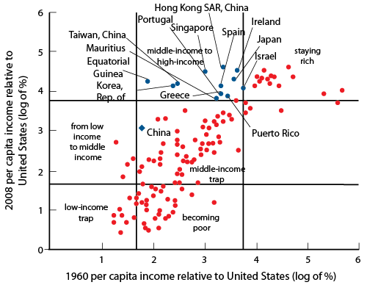
Is there a “middle-income growth trap”?
“Avoiding middle-income growth traps,” Pierre-Richard Agénor, Otaviano Canuto, Michael Jelenic, VoxEU, Dec. 2012
“Formal evidence on growth slowdowns and middle-income traps has suggested that at per capita incomes of about US$ 16,700 in 2005 constant international prices, the growth rate of per capita GDP typically slows from 5.6 to 2.1%.”
Citing Eichengreen, Park & Shin “When Fast Economies Slow Down: International Evidence and Implications for China”, Asian Ec. Papers, 2012.

Slide 30
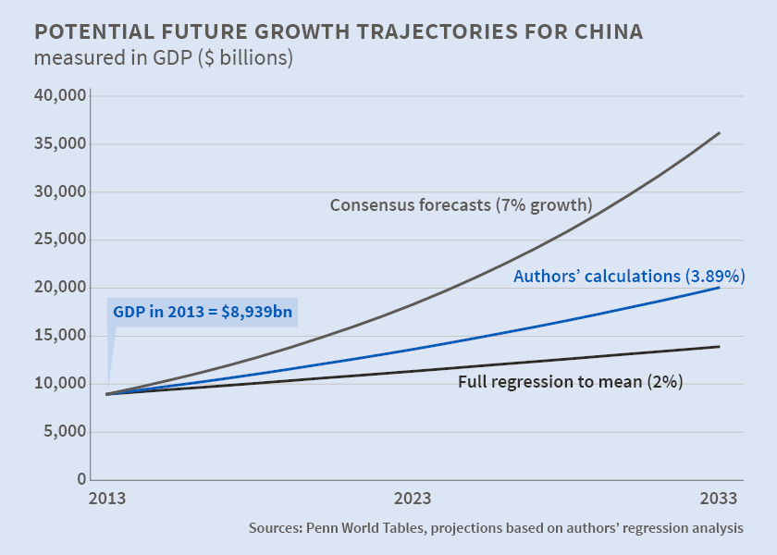
Pritchett & Summers (2014): “Regression to the mean” fits the data better than middle-income trap
“Asiaphoria Meets Regression to the Mean,” NBER WP No. 20573, Lant Pritchett and Lawrence Summers

Slide 31
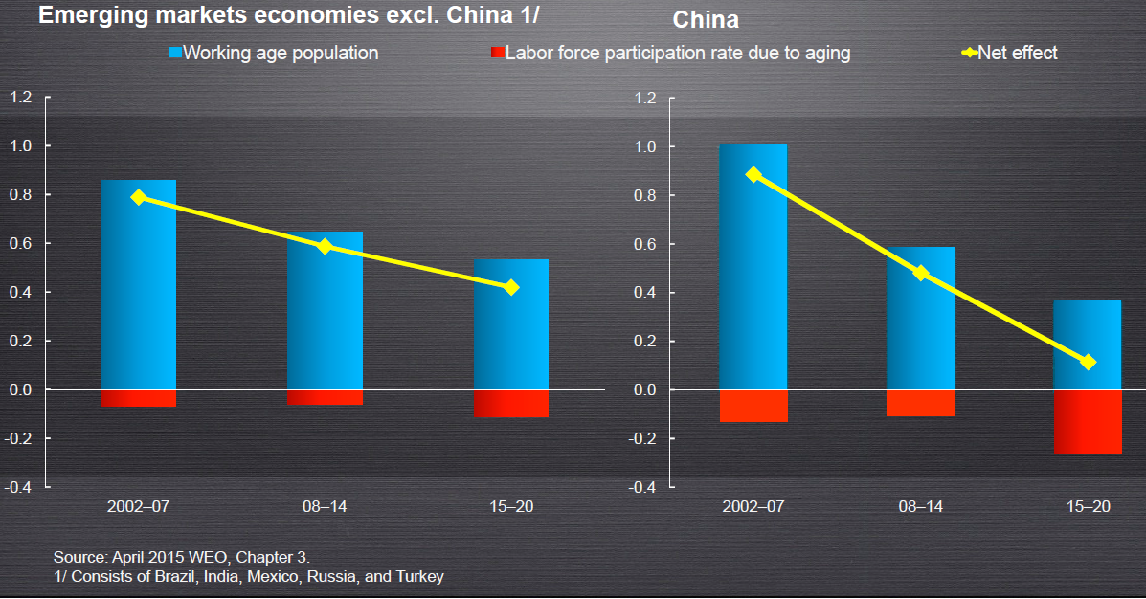



Demographic factors are reducing growth rate in China even more than in other countries

Slide 32
Chinese transition to slower growth path
Hard landing or soft landing?
  High investment in heavy industry is unsustainable.
  Debt
    Leverage becomes unsustainable when growth slows.
    Bad loans in the shadow banking system.
    $-denominated loans especially problematic in EMEs.
  Are financial bubbles-and-crashes a “rite of passage”
  that newly arrived economic powers undergo?
    Holland 1637, England 1720, France 1720,
    US 1929, Japan 1990, Korea 1997.
  So far, the hard landing has been avoided
    despite the financial-market fears of summer 2015.

Slide 33
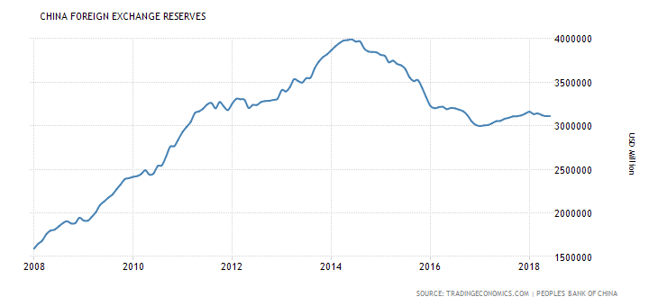
Chinese foreign exchange reserves fell after June 2014.
Through July 2018 DATA SOURCE: PEOPLE’S BANK OF CHINA, via TRADINGECONOMICS.COM

Slide 34
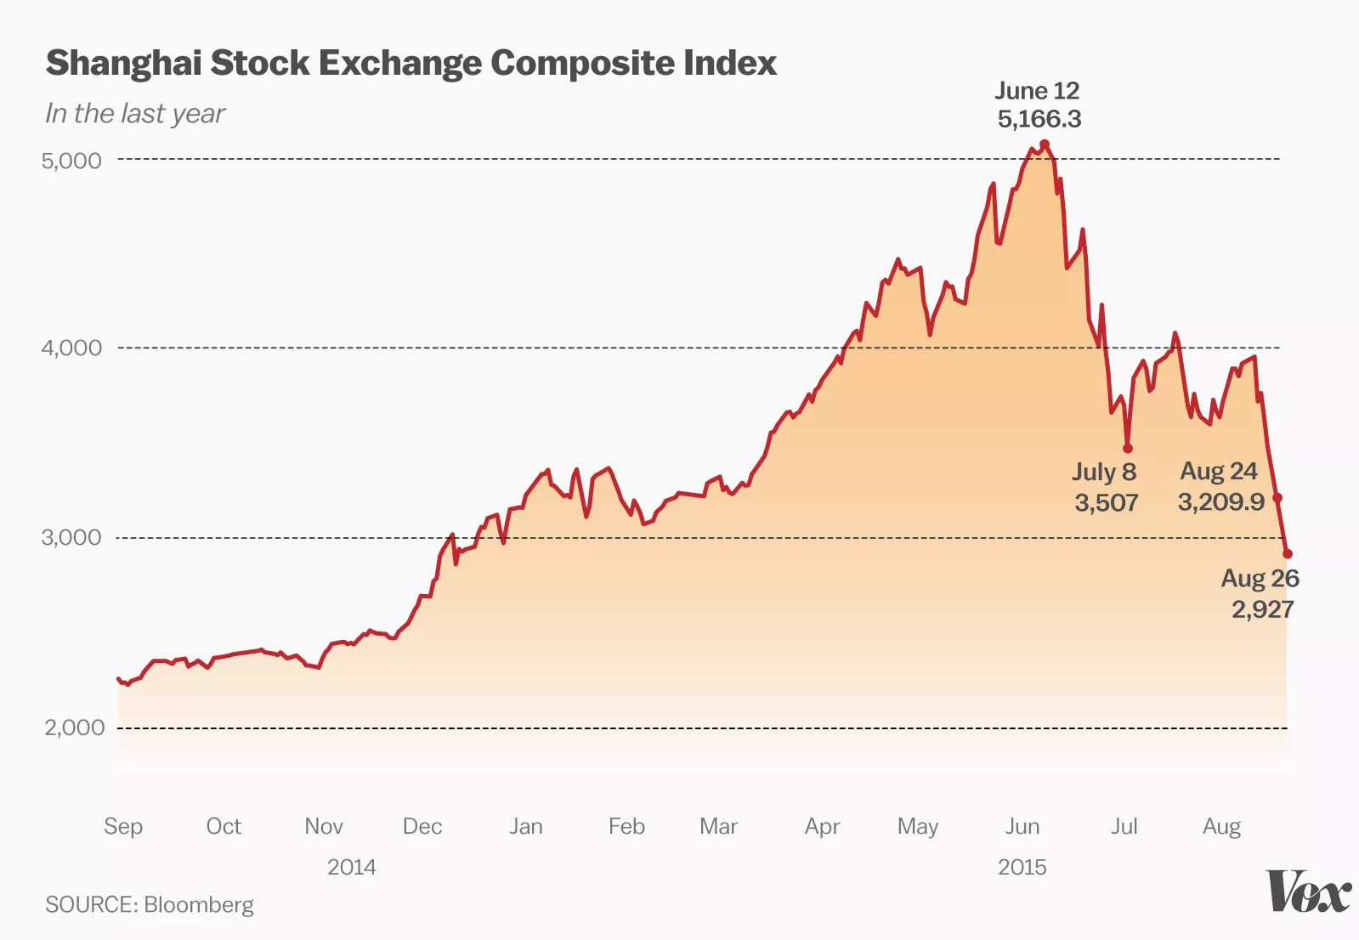
China’s stock market bubble was popped on June 12, 2015.

Slide 35
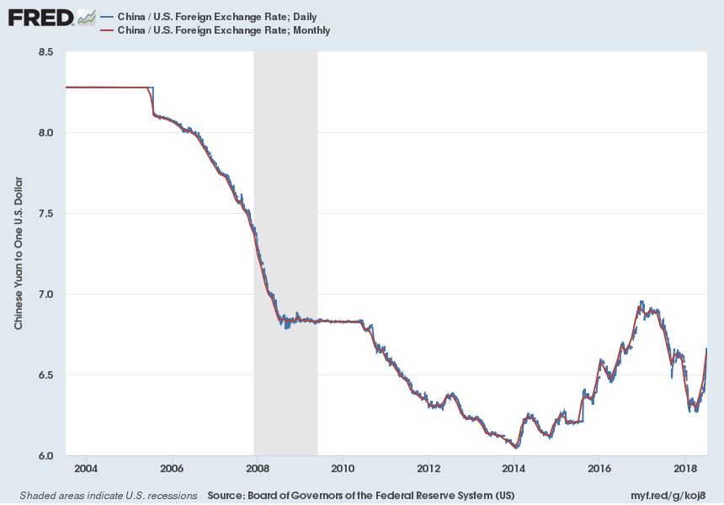
Markets were upset by RMB depreciations in Aug. 2015 & Jan. 2016.
Notes:
Source:
Board of Governors of the Federal Reserve System (US)
Release:
H.10 Foreign Exchange Rates
Units:
Chinese Yuan to One U.S. Dollar, Not Seasonally Adjusted
Frequency:
Daily
Noon buying rates in New York City for cable transfers payable in foreign currencies.
Board of Governors of the Federal Reserve System (US),
China / U.S. Foreign Exchange Rate [DEXCHUS],
retrieved from FRED,
Federal Reserve Bank of St. Louis;
https://fred.stlouisfed.org/series/DEXCHUS,
July 9, 2018.
Source:
Board of Governors of the Federal Reserve System (US)
Release:
G.5 Foreign Exchange Rates
Units:
Chinese Yuan to One U.S. Dollar, Not Seasonally Adjusted
Frequency:
Monthly
Averages of daily figures. Noon buying rates in New York City for cable transfers payable in foreign currencies.This data series is updated from the source files in the Data Download Program (http://www.federalreserve.gov/datadownload/Choose.aspx?rel=h10). The files are updated on a weekly basis every Monday. If Monday is a holiday, the data files are updated the next business day.Monthly values are averages of the daily data available. Preliminary value for the current month is provided by the source even if not all daily values are available for the entire month.Please note that the values reported on the press release may not correspond to the values in the Data Download Program when the press release is published on a day other than Monday. This inconsistency is resolved on the next available weekly release date.
Board of Governors of the Federal Reserve System (US),
China / U.S. Foreign Exchange Rate [EXCHUS],
retrieved from FRED,
Federal Reserve Bank of St. Louis;
https://fred.stlouisfed.org/series/EXCHUS,
July 9, 2018.

Slide 36
Determinants of Reserve Currency Shares
Appendix II:
What determines international currency?
Pre-euro Panel Regression, 1973-98 (182 observations)
Coefficient estimates Standard errors
GDP ratio 0.12 [0.05]
Inflation differential - 0.14 [0.06]
Ex. rate variability - 0.05 [0.03]
FX turnover 0.02 [0.02]
GDP leader 0.03 [0.01]
Lagged share 0.90 [0.03]
Notes: Figures in bold face are significant at the 10% level.
Adj. R²: 0.99
Dependent variable is reserve currency shares in logit form.
Estimated using OLS, no constant.
All variables are in decimal form.
GDP at market terms.
Source: Chinn & Frankel (2007).

Slide 37
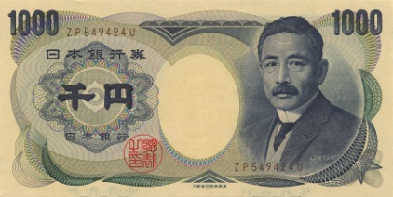
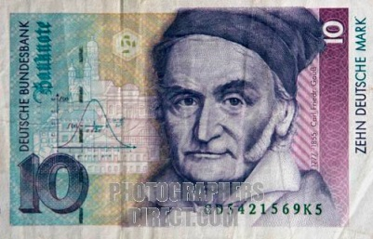
Looking back on the 1990s, one would wonder that anyone expected the DM or yen to challenge the $

Slide 38
China remains far less open financially than the US or UK
De jure financial openness index (Chinn-Ito KAOPEN).
Higher values denote higher financial openness. Source: Chinn (2012).

Slide 39
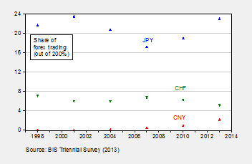


The RMB’s share of FX trading has risen but is still well behind SF, let alone ¥ or ₤.
Courtesy of Menzie Chinn

Slide 40
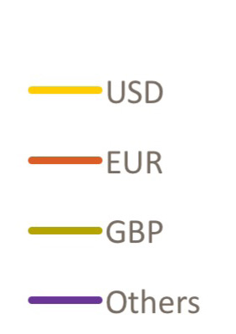
Worldwide International Currency Usage Now
Value share of main currencies in trade activity
Data Source: SWIFT Watch, MT 103
Worldwide Currency Usage and Trends Information paper prepared by SWIFT in collaboration with City of London and Paris EUROPLACE Dec. 2015

Slide 41
References by the speaker underlying this talk
On China’s economy
“Globalization and Chinese Growth: Ends of Trends?” Il Grande Sconvolgimento, edited by Paolo Onofri (Il Mulino: Bologna), 2016. HKS RWP 16-029.
"Misinterpreting Chinese Intervention in Financial Markets," China-US Focus, Sept. 10, 2015.
“China is Not Yet Number 1,” VoxEU, May 9, 2014.
International Currency Rankings
“The latest on the dollar’s international currency status,” VoxEU, Dec. 2013.
“Internationalization of the RMB and Historical Precedents,” Journal of Economic Integration, 2012. Summaries at RIETI & VoxEU, Oct. 2011.
“Will the Euro Eventually Surpass the Dollar as Leading International Reserve Currency?” with M. Chinn, in G7 Current Account Imbalances: Sustainability
and Adjustment, R.Clarida, ed. (U. Chicago Press), 2007.
“Still the Lingua Franca: The Exaggerated Death of the Dollar," Foreign Affairs, 1995
Euro mistakes
German Ordoliberals Vs. American Pragmatists: What Did They Get Right
or Wrong in the Euro Crisis?” in Ordoliberalism: A German Oddity? 2017,
edited by T.Beck & H.Kotz (CEPR: London) Chapter 11, pp. 135-143.
“Causes of Eurozone Crises,” July 2015, Causes of Eurozone crises past and future, edited by Richard Baldwin & Francesco Giavazzi (CEPR: London).

