Slide 1
A Strong Post-COVID Economic Recovery?
Belfer Bullet Points
Tuesday, June 16, 2020
Prof. Jeffrey Frankel
Harpel Professor of Capital Formation and Growth
Belfer Center for Science and International Affairs
Harvard Kennedy School

Slide 2
5 bullet points
The pre-requisites for re-opening are lacking in many places.
Beware the "W“ from premature withdrawal of fiscal measures.
Although the implied run-up in debt/GDP ratios is unprecedented, the US can get away with it.
Whether other advanced countries can get away with rapidly rising debt levels is an open question.
Emerging Market & Developing Economies are facing unsustainable ratios of debt to GDP.

Slide 3
1) The pre-requisites for re-opening are lacking so far
in most states and many foreign countries:
  i) particularly a genuine substantial sustained fall in covid-19 cases,
  ii) plus abundant testing.
Premature re-opening is not just bad for health;
ultimately it will be bad for the economy too.

Slide 4
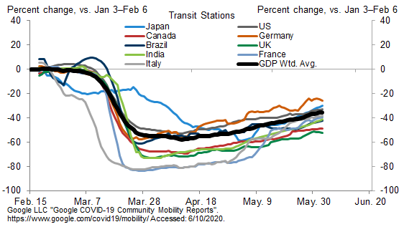
Google Mobility Trackers: Public Transit Visits Are Resuming
Countries have been gradually re-opening
Source: Goldman Sachs Global
Investment Research. June 10, 2020.

Slide 5
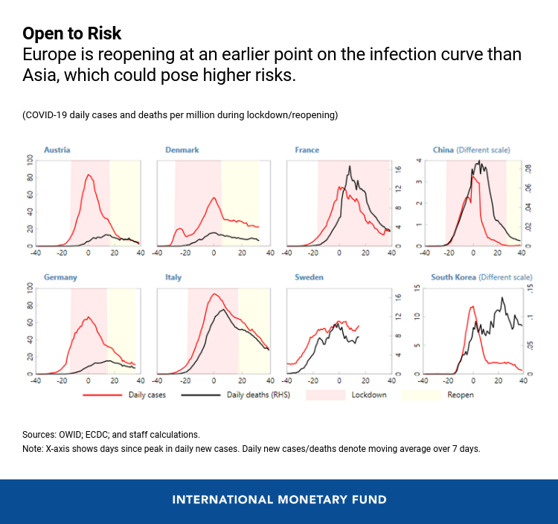
China
re-opened only after cases were way down.
not so much
Changyong Rhee and Poul M. Thomsen, May 12, 2020, IMF
https://blogs.imf.org/2020/05/12/emerging-from-the-great-lockdown-in-asia-and-europe/

Slide 6
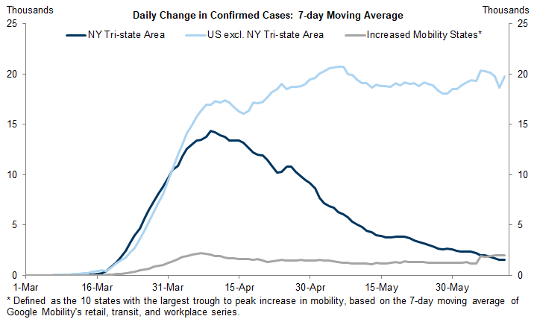
Many US states are opening despite still-rising infection rates.
Data: Google LLC "Google COVID-19 Community Mobility Reports", JHU CSSE. Source: Goldman Sachs Economic Research, June 11, 2020..

Slide 7
Fiscal response: 2020 appropriately exceeds 2009 (esp. in G7 countries).
2020
2009
Advanced
countries
EM countries
FISCAL MONITOR: POLICIES TO SUPPORT PEOPLE DURING THE COVID-19 PANDEMIC, IMF, May 2020
Data sources: IMF 2009a; IMF 2009b; national authorities; and IMF staff estimates as of April 8, 2020. Panel 1 includes above-the-line spending and revenue measures only, weighted by GDP in PPP-adjusted current US dollars. Panel 2 adds below-the-line measures (loans, equity injections) and government guarantees to revenue and expenditure measures adopted in 2020. These are presented in the same panel for ease of reference but are not additive. The decomposition between loans and guarantees is based on available information as of April 8, 2020..

Slide 8
2) Beware the "W":
If governments withdraw fiscal measures prematurely,
the likely result will be a double-dip recession.
A “W” shape.

Slide 9
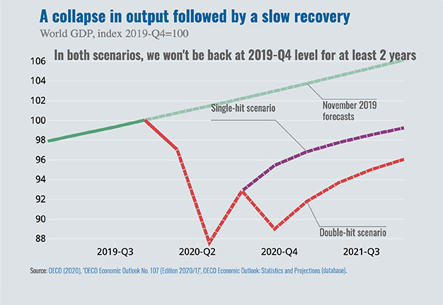


“Nike swoosh” scenario vs. W scenario
OECD Economic Outlook (June 2020)

Slide 10
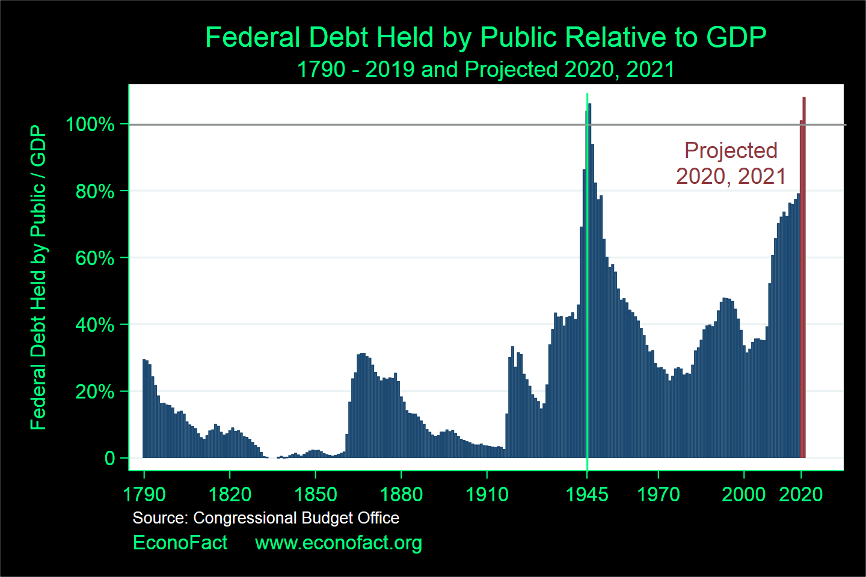
3) The implied run-up in debt/GDP ratios is unprecedented.
The US can get away with it, because the $ & US Treasury bills remain the world's #1 safe-haven assets.
WWII
Coronavirus
recession
Great recession
Depression
Reagan
tax cuts
American
Revolution
WWI
Civil War

Slide 11
Can other countries get away with big fiscal stimulus?
4) Whether other advanced countries like Britain & France can get away with rapidly rising debt levels is an open question.
If the "secular stagnation" view of Larry Summers is correct
and real interest rates will stay low indefinitely, then the main obstacle to borrowing has disappeared.

Slide 12
Can other countries get away with big fiscal stimulus?
5) Most Emerging Market & Developing Economies cannot.
Their levels of debt are unsustainable,
  defined as a future path of ever-rising ratios of Debt to GDP or Exports.
Many are in serious trouble,
  especially those that already had high debt ratios before the pandemic.

Slide 13
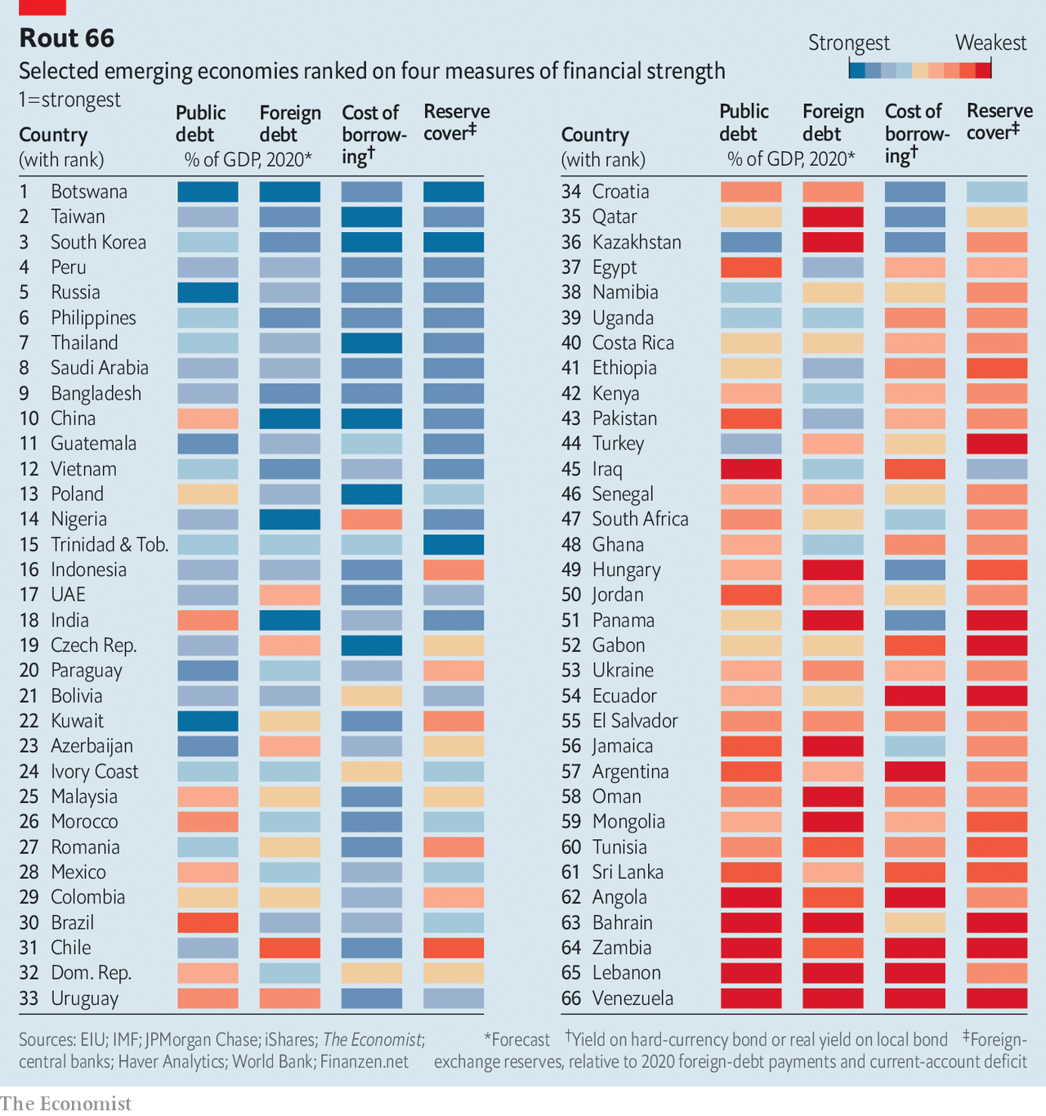
“Which EMs are in most financial peril? – The Economist, May 2, 2020. www.economist.com/briefing/2020/05/02/which-emerging-markets-are-in-most-financial-peri l
Criteria include
Public debt
Foreign debt
Cost of borrowing
ForEx reserves

Slide 14
Appendices
New infections by state
Excess mortality by city
Strategies by country
Covid-19 cases by region

Slide 15
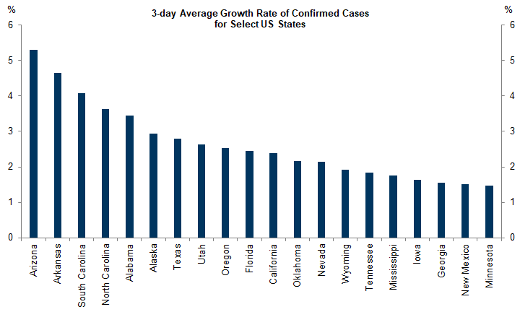
1.New infections, by US state
Source: Goldman Sachs Global Economics Comment: Tracking Coronavirus, June 13

Slide 16
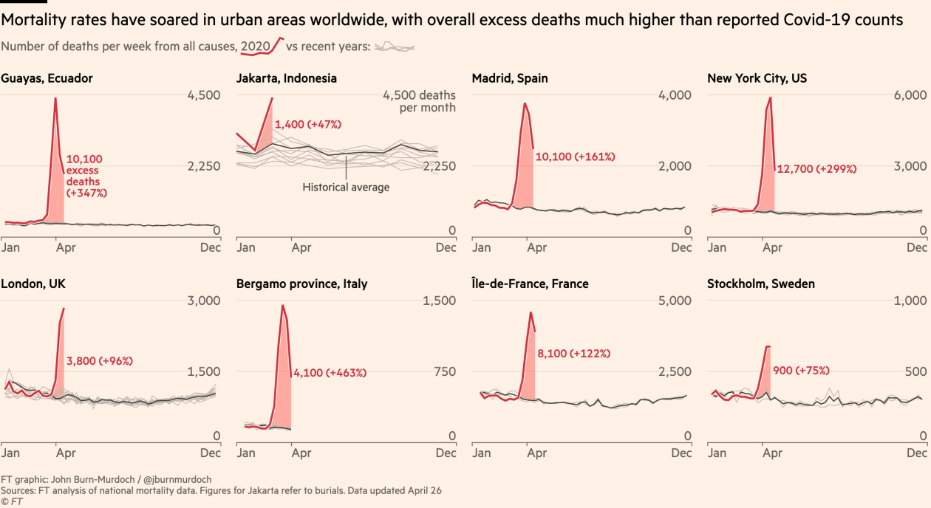
2. Excess mortality statistics show Covid-19 death undercount.
Financial Times

Slide 17
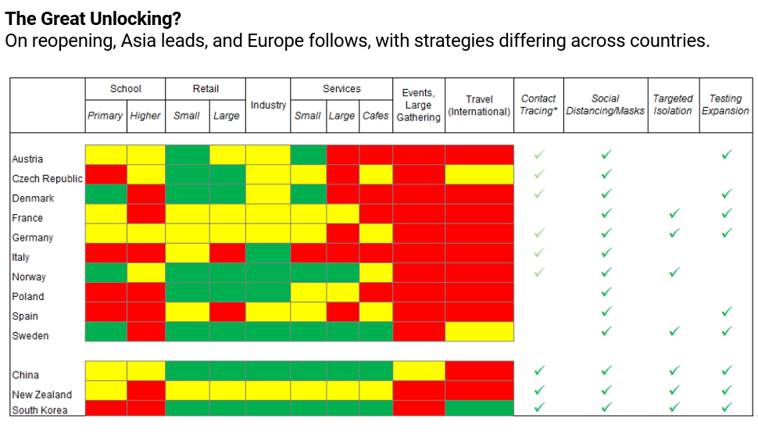
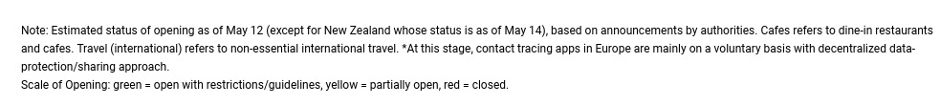
3. Strategies vary widely from country to country
May 12, 2020, IMF.
C.Rhee & P.Thomsen

Slide 18
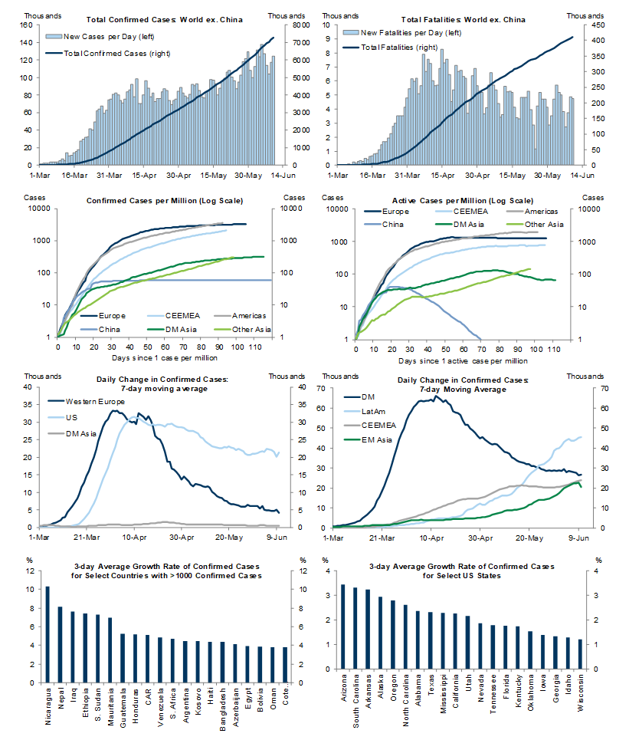
4. Covid-19
cases by
region
Source:
Goldman Sachs
Economic Research,
June 11, 2020

