Slide 1
“Are Capital Inflows Expansionary or Contractionary? Theory, Policy Implications and Some Evidence,” by Olivier Blanchard, Jonathan D. Ostry, Atish R. Ghosh & Marcos Chamon
Comment, Jeff Frankel, Harvard Univ.
IFM, NBER Summer Institute
July 12, 2016

Slide 2
Overview of comments
I am a late-substitute discussant, and
may not do the paper justice.
Three facets of the paper,
  1 Motivation
  2 Model
  3 Empirical
  corresponding to the 3 phrases in the subtitle: “Theory, Policy Implications and Some Evidence.”

Slide 3
Let’s start with the motivation
as posed by the title: whether capital inflows are expansionary or contractionary.
An excellent question.
But when I read the first few sentences, I am soon struck
by how the authors characterize these two possibilities:
“Are capital inflows expansionary or contractionary? [T]here is a striking schizophrenia: Standard models, along Mundell Fleming lines or more modern incarnations, give one answer: For a given monetary policy rate, inflows lead to an appreciation, and thus a contraction in net exports and, in turn, a contraction in output… Emerging market policy makers however have a completely different view. They see capital flows as leading to credit booms and an increase in output…”

Slide 4
Interpreting the “expansion” vs “contraction” views
Which EM policy-makers are they talking about?
The last big surge of capital inflows came in 2010-2012. Many EM policy-makers, particularly in Brazil,
at that time had a complaint that sounds different.
  Brazilian Fin.Min. Mantega coined the phrase “currency wars” as a complaint about dollar depreciation against the real:
  “We’re in the midst of an international currency war, a general weakening of currency. This threatens us because it takes away our competitiveness” (9/27/2010).
  President Rousseff continued the currency war accusation, criticizing US QE as a “monetary tsunami” that had detrimental effects on others via the exchange rate (4/2012).

Slide 5
Interpreting the “expansion” vs “contraction” views, cont.
The Brazilian complaint about inflows sounds like more the position that BOGH attribute, not to EM policy-makers, but to the Mundell-Fleming model (contractionary).
Meanwhile, the Mundell-Fleming model is perfectly capable of giving the opposite effect, that capital inflows lead to an expansion of output in the receiving country.
So I feel a need to try to elucidate before we get past the first three paragraphs.

Slide 6
Endogeneity of capital flows
Obvious point: capital inflows are endogenous.
It would help to be a little more explicit from the beginning about what is the exogenous cause.
If the exogenous cause is a boom in EMs (say an Asian manufacturing boom or a commodity boom) attracting capital flows, then of course it would be wrong to talk about causality running from capital flows to output.
So let’s be more explicit than the authors:
Let’s assume the exogenous cause is US monetary stimulus
  or it could also be a shift to “risk on” as measured by a fall in the VIX.
All of the above happened in 2007-08 and again in 2010-12.

Slide 7
What does Mundell-Fleming actually say?
Besides the 3 classic references in footnote 1
  Fleming (1962), Mundell (1963) & Dornbusch (1976),
two recent references:
  To make the point, Paul Krugman’s 2014 Mundell-Fleming lecture: "Currency regimes, Capital flows, and Crises." IMF Economic Review 62.4.
  To bring it up to date using a New Keynesian model: Carlos Vegh, 2013, Open Economy Macroeconomics in Developing Countries (MIT Press) chapter 14.

Slide 8
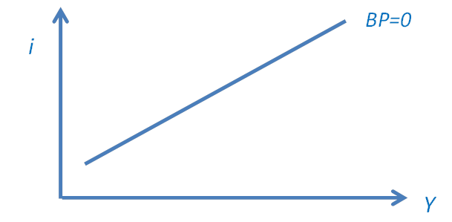
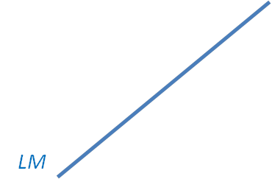
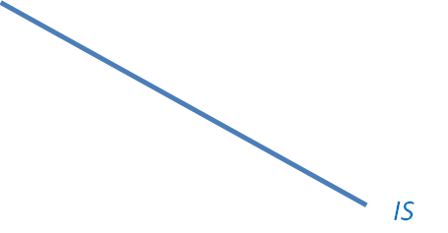
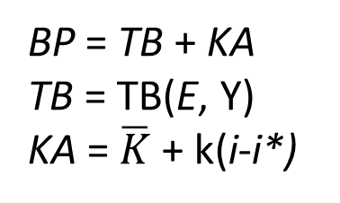
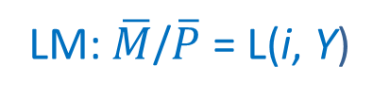
What does Mundell-Fleming actually say?
BP = TB + KA
TB = TB(E, Y)
KA = $\overline{K}$ + k(i-i*)
LM: $\overline{M}$/$\overline{P}$ = L(i, Y)
Do you consider LM obsolete?
For some purposes, replace the LM curve
with another upward sloping relationship:
the Taylor rule (when combined with
the seminal “divine coincidence”
of Blanchard & Gali, 2005).
IS: Y = A( i, Y) + TB

Slide 9
Consider, first, the simplest case: because of perfect capital mobility, k -> ∞ .
The domestic interest rate is tied to the world rate: i=i*.
Now consider an exogenous fall in i*: BP shifts down
S
•
BP
BP'

Slide 10
Two stark polar cases:
If the currency floats, then it must appreciate, leading to
a trade deficit, leftward shift of IS, and a fall in output.
  This is the case that BOGC attribute to Mundell-Fleming.
But there is the opposite polar case of a fixed exchange rate.
  Recall that during the first 30 years of the Mundell-Fleming model, virtually no developing countries were floating;
    even today, no EM countries float cleanly.
  The effect of a capital inflow if the exchange rate is fixed?
  A monetary inflow shifts the LM curve rightward, producing a rise in output.
  This is the case that BOGC almost seem to say is inconsistent
  with the basic Mundell-Fleming model.

Slide 11
k -> ∞ => i=i*.
Two stark polar cases:
1) Float: Appreciation
=> IS shifts left => Y ↓
2) Fixed ex. rate: Money flows in
=> LM shifts right => Y ↑
S
•
BP
LM'
•
•
BP'
A
M
IS'

Slide 12
k -> ∞ => i=i*.
A 3rd intermediate case: half-appreciation and half-inflows.
The IS and LM curves meet in the middle. Y is unchanged.
This is in fact roughly what most major EM countries did, 2010-12.
BP
LM'
•
BP'
I
IS'

Slide 13
Then why were the Brazilians unhappy ?
I think not because the capital inflow made Y
too high or too low, but because it hurt their TB,
a secondary objective.
Incidentally, Brazil should have followed a tighter fiscal policy at that time.
  It could have allowed the achievement of both objectives
  and would have left it in a far better situation today,
  after the boom turned to bust.

Slide 14
Now consider the case where k is finite, due to transactions costs, capital controls, default risk, or currency risk. => BP=0 has some slope.
What does Mundell-Fleming actually say?
BP‘=0
Again, the exogenous capital inflow shifts BP down.

Slide 15
What does Mundell-Flming actually say?
1) Again, float:
appreciation
=> Y ↓
2) And fixed:
money flows in
=> Y ↑
3) Third case is
intermediate
BP‘‘=0
BP‘‘‘=0
•
LM'
BP‘=0
•
•
A
I
M
IS'
IS'

Slide 16
The case where k is finite.
What does Mundell-Fleming actually say?
There is now a 4th option: Sterilized forex intervention
can keep the economy at S,
at least for awhile
•
S
•
BP‘=0
•
•
A
I
M

Slide 17
So if the motivation is whether capital inflows are expansionary or contractionary, then it seems to me that the main focus should be on
what extent countries can and do use the tools:
  foreign exchange intervention,
  sterilization,
  and capital controls.

Slide 18
Briefer comments
  On the authors’ portfolio balance model
  and their empirical work.

Slide 19
What needs to be added to Mundell-Fleming? First: contractionary depreciation
We have certainly learned of things over the last few decades that take us well beyond basic Mundell-Fleming.
At the top of my list, in the EM context:
the possibility that currency appreciation can be expansionary rather than contractionary, via non-TB channels.
There are many possible channels, known for a long time.
The one that achieved most prominence in the currency crises of the late 1990s was the balance sheet effect that results from currency mismatch.
Others include effects via inputs to production,
  particularly imported inputs (like oil or manufactured parts)
  and labor (if there is some rigidity in wages/CPI).

Slide 20
A sample of references on contractionary depreciation
Paul Krugman, 1999.
P.Guidotti, F.Sturzenegger & A.Villar, Economia, 2004.
J.Frankel, IMF Staff Papers, 2005.
Mark Aguiar, JDE, 2005.
R.Bebczuk, A.Galindo & U.Panizza, 2006.
Mihir Desai, C. Fritz Foley & Kristin Forbes, RFS, 2008.
Brent Neiman & Gita Gopinath, AER, 2013.
Sebnem Kalemli-Ozcan, Herman Kami & Carolina Villegas-Sanchez, R.E.Stat, 2016

Slide 21
What needs to be added to Mundell-Fleming? Second: composition of capital inflows
The contribution of the authors’ PB model is to distinguish capital inflows according to the asset acquired.
Yes, this is high on the list of things missing
from the Mundell-Fleming model.
There is an extensive literature on implications of the composition of capital inflows
  It doesn’t seem to be referenced here.
The most common distinction puts short-term banking flows at one end, as building vulnerability to a future crisis, versus equities and direct investment at the other end,
considered safer.
One can build a nice portfolio balance model around that, and perhaps look at the capacity for macroprudential policies to influence the composition.

Slide 22
A sample of references on composition of capital
Andrei Levchenko & Paolo Mauro, 2007, World Bank Ec. Rev., 2007.
Katherine Smith & Diego Valderrama, JDE, 2009.
Fernando Broner, et al, Journal of Monetary Economics, 2013.
John Bluedorn, et al, IMF, 2013.
Laura Alfaro, Sebnem Kalemli‐Ozcan, & Vadym Volosovych, J. of the European Econ. Assoc., 2014.

Slide 23
But the authors have in mind a different decomposition.
For them the key distinction is bonds vs. non-bond assets.
  “Non-bond assets” classify bank credit together with FDI and equities.
What do bank loans and FDI have in common that distinguishes them from bonds?
Their definition of bonds is rather particular: it is the asset whose rate of return is directly controlled by domestic monetary policy.
But I see a difficulty:
There is no asset whose return is controlled by domestic monetary policy under full financial integration and a fixed exchange rate.
So perhaps the theoretical results that are phrased as what happens when capital inflows lower the bond interest rate
really tell us what happens under a fixed rate and non-sterilization.
Yes, if the central bank keeps the policy interest rate high
despite the inflow, the currency appreciates.
But the key point is that the authorities allow the currency
to appreciate, more than the nature of the capital inflows.

Slide 24
Empirical results
19 countries, starting in 2000.
They first test the effects “bond” vs. “non-bond” flows.
and then add to the equation the policies used to react to inflows such as foreign exchange intervention,
which in my view is where the action should be.
They conclude: “overall, we see the set of results as strongly supportive of the distinction between bond and non-bond flows: Bond flows are contractionary. Non-bond flows can be expansionary.”

Slide 25
Endogeneity again
Recall that one likely reason for the capital inflows of 2007-08 and 2010 was a response to rapid growth in EMs.
  The global “China + commodities” boom.
  From an econometric viewpoint, such factors
  would render the inflows endogenous.
The authors realize the need to deal with endogeneity.
  Their solution: “when looking at each country, we use global flows to all emerging market countries as instruments, on the assumption that these are unlikely to be correlated with developments in any particular emerging market country.”
  I don’t accept that the aggregate capital flows to EMs can be viewed as exogenous from the viewpoint of an individual EM,
    in the key sense that it would have to be uncorrelated
    with the error term in the regression. It is not.

Slide 26
Dealing with endogeneity
I am much more sympathetic where they go on to consider the effect of policy responses like fx intervention and use the US T bill rate & VIX as instruments for the capital inflow variable.
These IVs do get at the endogeneity problem
  on a time series dimension.
But it would help to have a cross-section dimension,
and here these instruments don’t help.
  One wants to know whether the countries that foreigners found particularly attractive but that tried to dampen the currency appreciation and its effects via fx intervention were able to do so successfully.
I can think of ways to address the endogeneity on this dimension.
But now I am in danger of fully repeating my comments from
one year ago on another interesting paper co-authored by Olivier.
  Olivier Blanchard, Irineu de Carvalho Filho & Gustavo Adler, “Can Foreign Exchange Intervention Stem Exchange Rate Pressures from Global Capital Flow Shocks?”
  So I will stop here.

