Slide 1
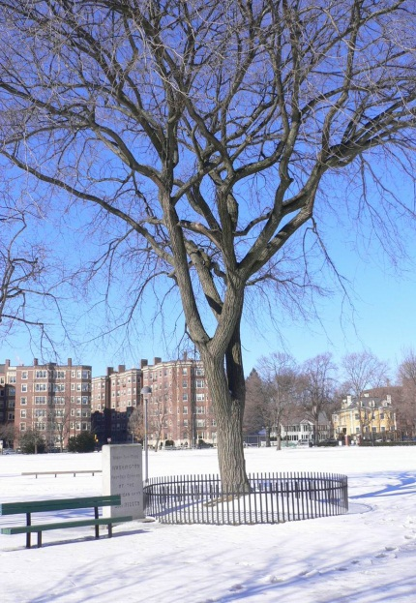


One year of the American Revolution
-- April 1775 to March 1776 – viewed from Cambridge Common.
Graham & Parks School
January 31, 2011

Slide 2
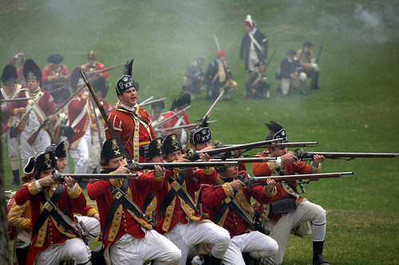
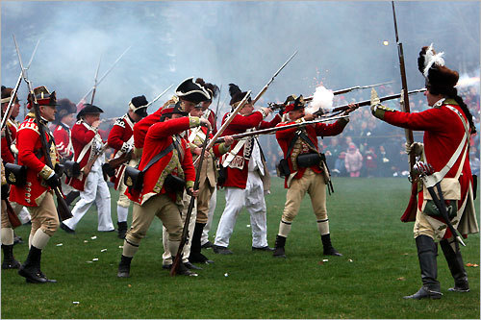
Americans know the Revolution began in Boston
and at the Battles of Lexington & Concord.
But a lot of it happened in Cambridge:
Everything important in the 1st year of the Revolutionary War -- April 1775 to March 1776 -- passed through Cambridge Common !

Slide 3
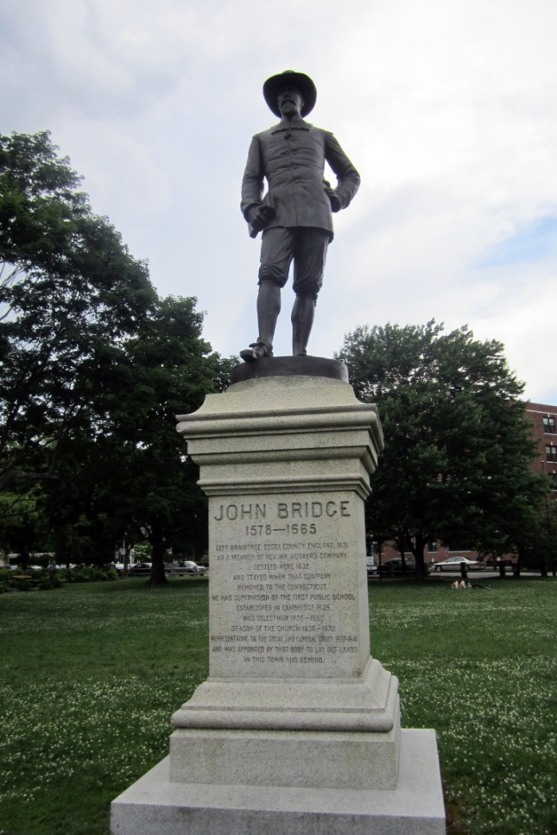
What is Cambridge Common?
A Common was a place where all residents
could graze their cows.
Not long after
the Mayflower,
the Puritans
started the town,
and in 1630
established
the Common.
The Puritan

Slide 4

The Common
In those days, Cambridge Common extended all the way up to present-day Linnaean Street.
In other words,
the land where
Graham & Parks
stands was once
part of the Common!

Slide 5
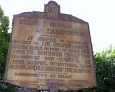

On Linnaean Street,
the oldest house in Cambridge
shows where people’s homes began again.
Cooper-Frost-Austin House

Slide 6
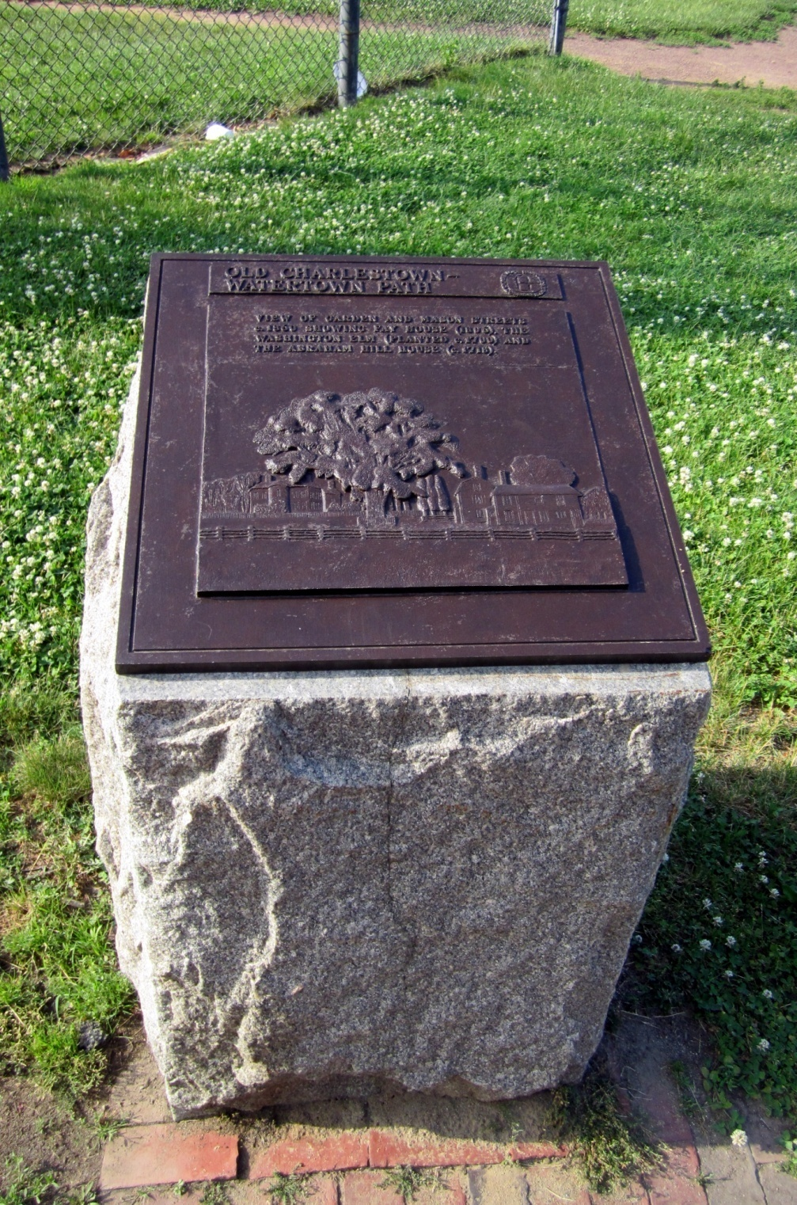
This plaque shows
the view of two houses that were across Garden Street from
the Common
200 years ago.
Imagine you were
a 9-year-old child living in one of them.
What could you have seen from your doorstep
between April 1775
and May 1776?

Slide 7
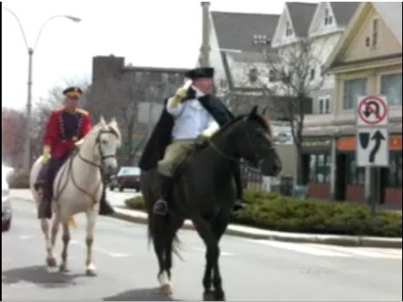
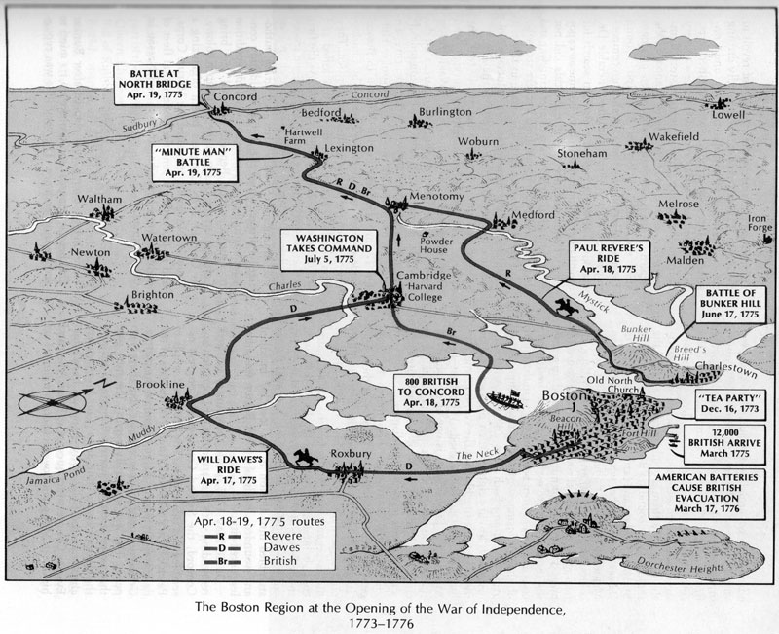
The night of April 18, 1775
William Dawes rode through Cambridge Common, on his way from Boston to Lexington to warn that the British army was coming.
Paul Revere was riding
from Charleston
to do the same.
Revere was supposed to come
through Cambridge too, but had to circle north
to evade a British patrol near present-day Union Square, before meeting up with Dawes.
The British came
through East Cambridge
(Second St. to Gore St.).
Reinforcements came
through the Common.

Slide 8
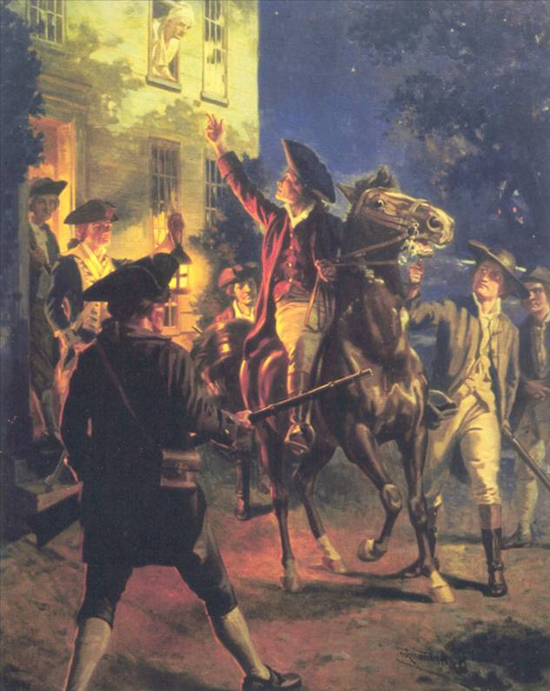


Paul Revere is more famous
Longfellow wrote
“The Midnight Ride
of Paul Revere.”

Slide 9
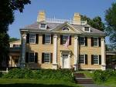
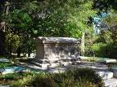
The midnight ride
Longfellow lived at 105 Brattle St. (“Tory Row”),
  Today it is the Longfellow Historical Site.
  He is buried in Mount Auburn Cemetery.

Slide 10
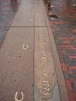

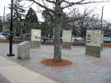
The midnight ride
“Dawes Island” at the southern tip of the Common has bronze horseshoes in the ground in commemoration,
and signs explaining Cambridge history.

Slide 11
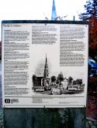
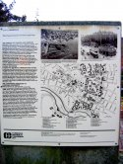
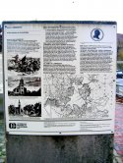
Signs at Dawes Island explain Cambridge history

Slide 12
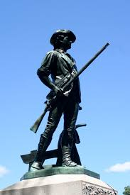
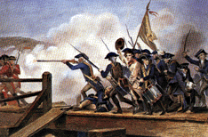
April 19, 1775:
The battles of Lexington & Concord.
In Massachusetts we celebrate
April 19 every year as Patriot’s Day.
Some Cambridge Minutemen went to the battles.

Slide 13
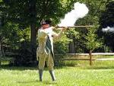

Cambridge Minutemen
Others waited in North Cambridge to ambush
the redcoats on their way back to Boston
(where Rindge Ave. comes into Mass.Ave., “Watson’s Corner.” Marker at 2158 Mass.Ave.)
Several were killed by British soldiers
  and are buried in The Old Burying Ground.

Slide 14

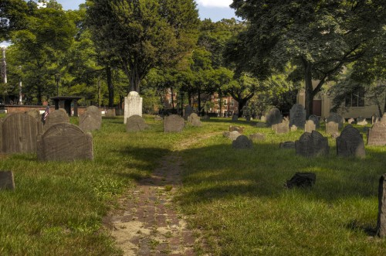
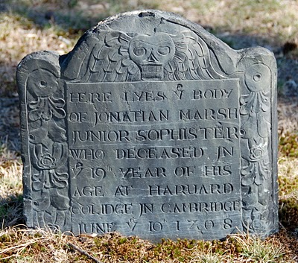
The Old Burying Ground is across the street from the Common

Slide 15
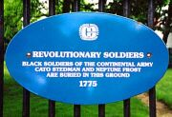
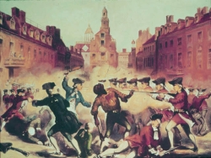
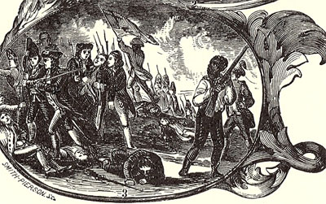
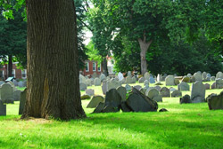
The cemetery contains the graves of 19 Revolutionary soldiers,
including two African-Americans
named Neptune Frost & Cato Stedman.
A granite shaft was placed on the spot.

Slide 16
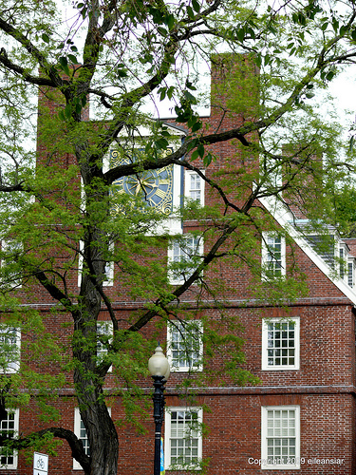
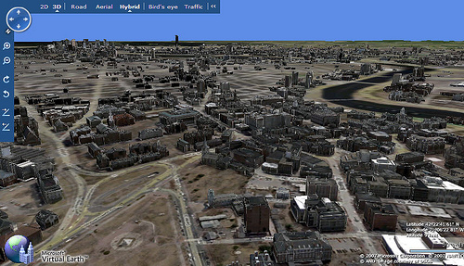
May 1, 1775: Harvard was evacuated.
The officers of the new army moved in.
Right across Mass. Ave. from the Common.
Massachusetts Hall is today
the Harvard President’s office.

Slide 17


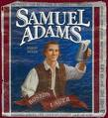

Most of the major leaders of the Revolution in Massachusetts had gone to school at Harvard University
John
Hancock
Sam
Adams
John
Adams
They took classes in Harvard Hall,
which is still there.
who was more important,
but worried that nobody would remember him for anything !

Slide 18
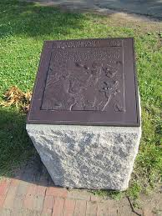
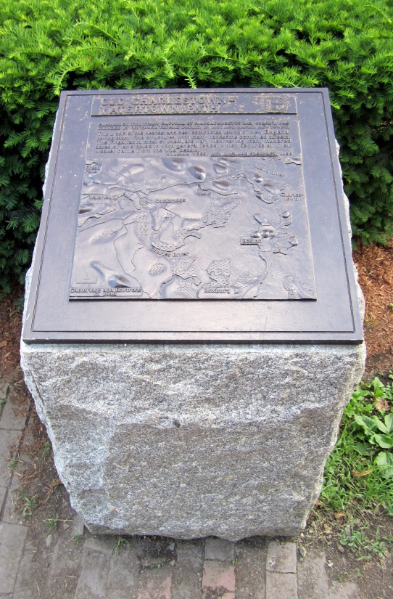
An army of 20,000 Americans gathered
at the Common and pitched their tents.
On June 13 they marched off to
the Battle of Bunker Hill in Charlestown.
They went along the
Charlestown-Watertown path (now Kirkland Street).
Marker maps show the way.

Slide 19
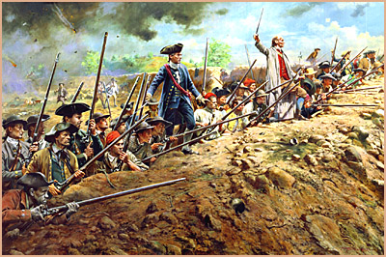
The Battle of Bunker Hill
  June 17, 1775.
  “Don’t fire until
  you see the whites of their eyes!”
  After the battle,
  the Ruggles-Fayerweather House at 175 Brattle Street was used as a hospital for the wounded.

Slide 20

George Washington
After Lexington & Concord, John Adams proposed to the Continental Congress making George Washington commander of the Continental Army.
He arrived
in Cambridge
July 2, 1775.

Slide 21
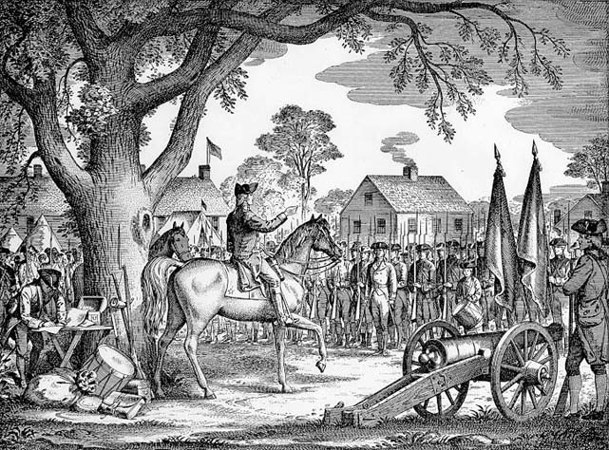
General Washington is shown July 3, 1775, taking command of the Continental Army.
From a drawing
by Paul Hawthorne, 1941.
http://www.harvardsquarelibrary.org/chistory/section5.htm

Slide 22
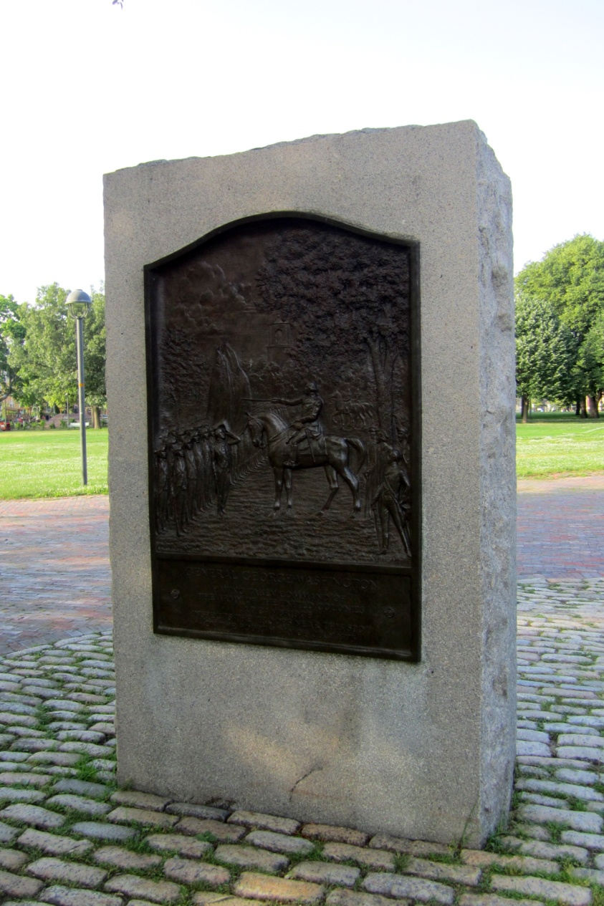

A monument
shows Washington taking command

Slide 23

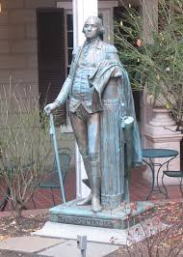

The Sheraton Commander Hotel
across Garden Street
is called that because Washington
was Commander in Chief.
It has a statue of him.

Slide 24

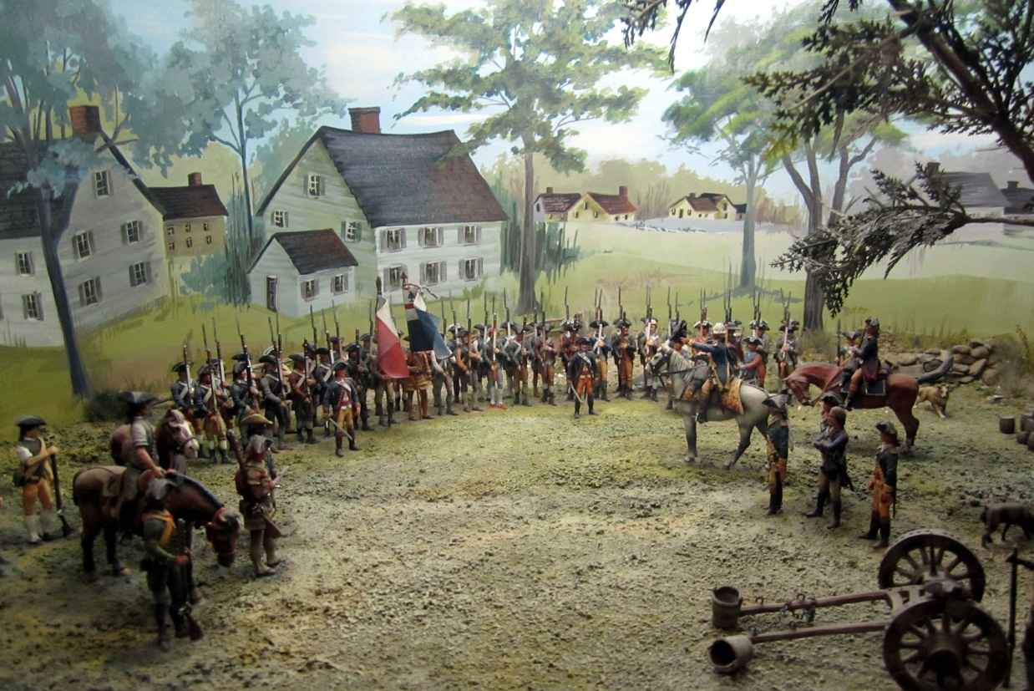
The Sheraton Commander Hotel also has
a “diorama” showing Washington taking
command of the troops near a famous elm tree.

Slide 25

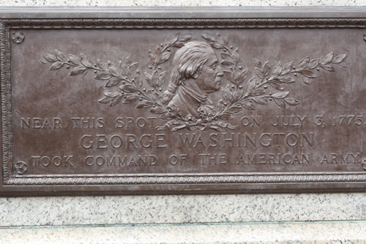
The Washington Gate
explains to visitors entering from Harvard Square.
“Near this spot
on July 3, 1775,
George Washington
took command of
the American Army.”

Slide 26
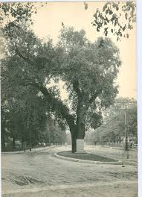

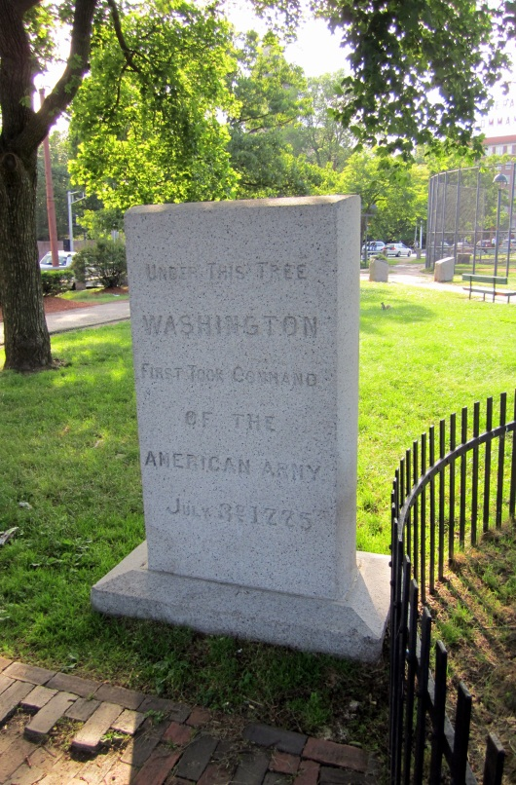
Where exactly was the Washington Elm?
It sat in the middle of what became Garden St.
The tree finally fell over in 1923.
They paved the street and just moved
the same monument to another tree !

Slide 27

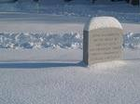
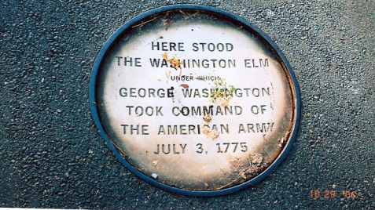
But the story of the tree is explained
in other places.
Across the park,
a “scion” of the Washington Elm
was grown
from a cutting.

Slide 28

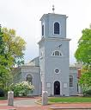
Martha Washington
came from Virginia
to join her husband
in Cambridge.
They stayed on Tory Row in the same house where Longfellow later lived.
They attended a service at
Christ Church across the
street from the Common,
Dec.31, 1775. It is still there.

Slide 29


Jan. 1, 1776:
The Continental Army got a new flag
The “Cambridge flag” (or “Union flag”)

Slide 30
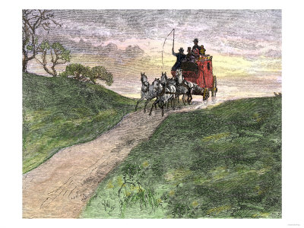
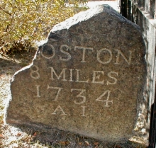
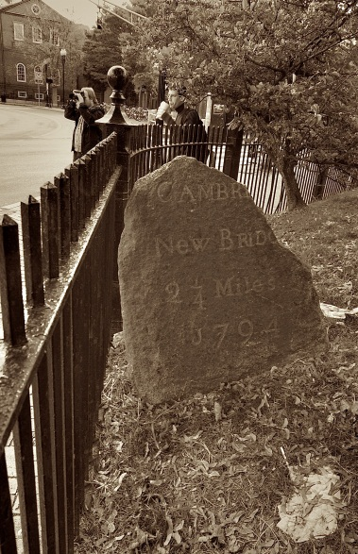
The road from Boston to Philadelphia
January 24, 1776: John Adams passed through the Common on horseback, on his way
to Philadelphia to help write
the Declaration of Independence.
  The road from Boston to New York &
  Philadelphia passed through Cambridge.
  The original stone marker
  lies across the street
  from Dawes Island.
  It points the way to the bridge
  across the Charles River.

Slide 31
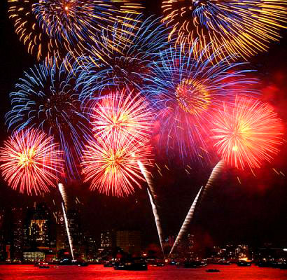
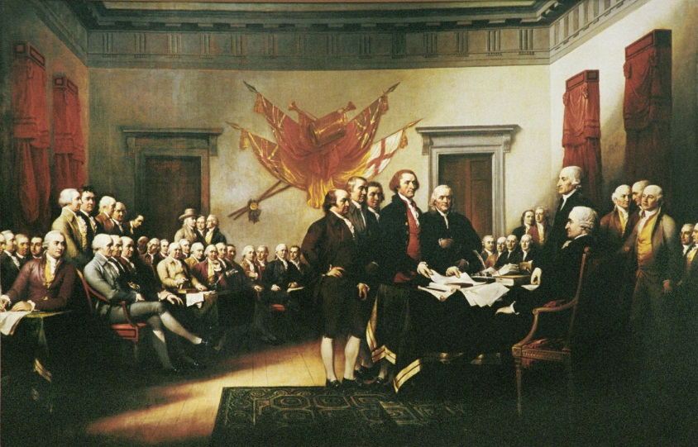
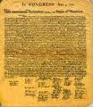
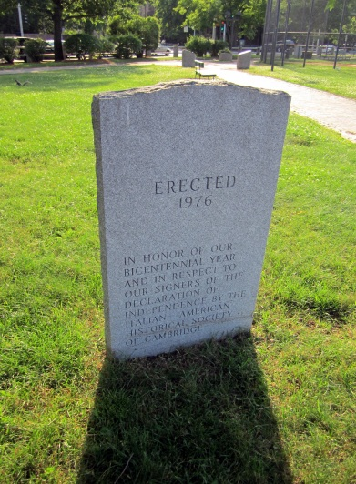
The Declaration of Independence
“We hold these truths to be self-evident, that all men are created equal…”
It was agreed on July 4, 1776.
  So we celebrate the Fourth of July
    as Independence Day

Slide 32
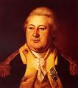

The British army holed up in Boston all winter.
Washington did not know how to get them out.
Henry Knox, the 25-year-old owner
of a Boston bookstore who had read
a lot of military books, joined the army.
He proposed a plan to Washington.
He went to Fort Ticonderoga,
300 miles away in New York.
  It had been captured
  from the British in May.

Slide 33
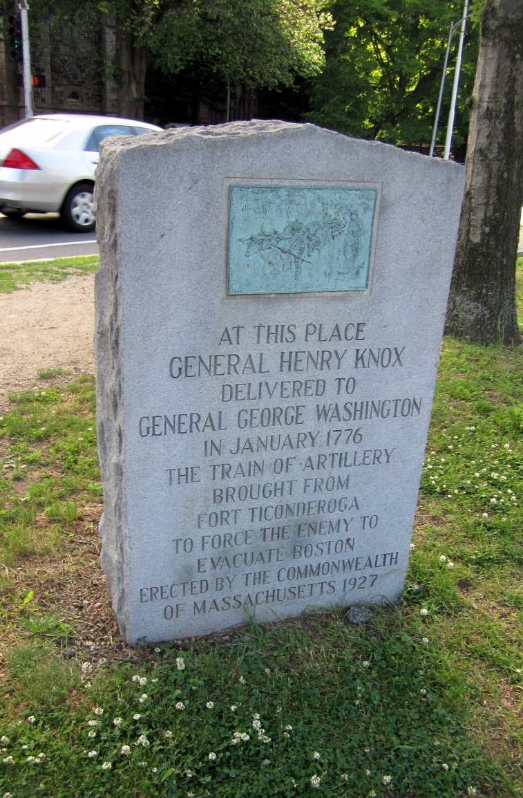

Knox took the cannon from the fort, and
dragged them across the snow in giant sleds,
  arriving back in Cambridge Common
  on Jan. 24,1776,
  where he presented
  them to Washington.

Slide 34



The British evacuation of Boston
The British general Gage woke up and,
looking at Dorchester Heights, saw Knox’s cannons facing down at him from the hilltop.
March 17, 1776: The British quickly left Boston.

Slide 35

Evacuation Day, March 17
Boston celebrates Evacuation Day each year.
The fighting moved on to New York and
then New Jersey,
never to return to
Massachusetts.
Some cannon left behind
by the British army were brought to Cambridge Common to mark the event.

Slide 36





The cannon on the Common were taken from Fort Independence which you can visit today in South Boston

Slide 37


Abraham Lincoln
1863: Lincoln gave the Gettysburg Address
It begins by referring to 1776:
“Four score & seven years ago
our forefathers brought forth
on this continent a new nation,
conceived in liberty, and
dedicated to the proposition
that all men are created equal.”
The Civil War Memorial,
with a statue of Lincoln,
dominates the center of
Cambridge Common.

Slide 38

























Things you can still see on the Common today:

Slide 39


Some famous fighters came from France & Poland to join the American Revolution.
  They wanted to try out similar revolutions
  in their own countries.
  Memorials to Tadeusz Kosciuszko & Casimir Pulaski

Slide 40


Immigrants from Ireland
Irish Famine
(1847)
monument

