Slide 1

“Should the Fed Be Subject to a Monetary Rule?”
[abbreviated]
Jeffrey Frankel
Harpel Professor of Capital Formation & Growth
Harvard University
Panel Discussion
Monetary Policy 10 Years After the Crisis
36th Annual Monetary Conference
Cato Institute
November 15, 2018

Slide 2
Summary bullet points
Two distinct questions:
  (1) To what extent should the central bank be constrained?
  (2) To whatever extent it is constrained by a rule, what should that rule be?
I have argued for Nominal GDP targeting
  because it is robust with respect to supply shocks
  while inflation targets are not.
But I am increasingly convinced that the constraint must be very loose.
  Central bankers, even if sincere, are chronically unable to fulfill commitments
  to nominal targets, rules, or even their own forward guidance.
Hence my mild proposal: Add a row for Nominal GDP
to the FOMC’s Summary of Economic Projections.
  Report NGDP in the 1st row of the SEP table
    before the rows for real growth, unemployment, inflation, & fed funds rate
A further thought regarding a different kind of constraint: if Fed independence is compromised, monetary policy may become pro-cyclical:
  tighter when unemployment is above 9% & looser when it is at 3.7%.

Slide 3
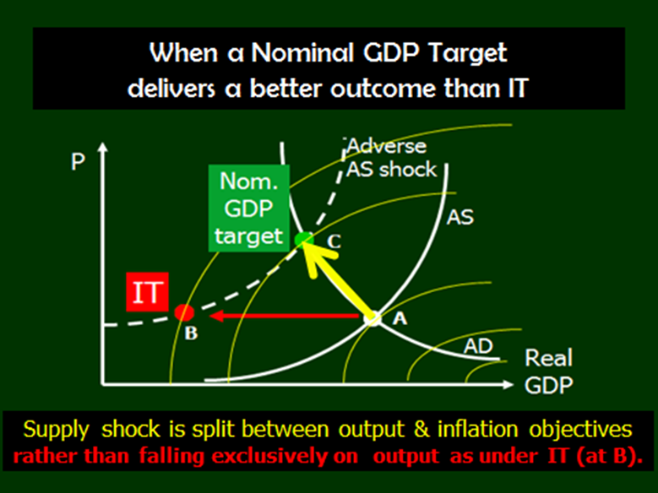
NGDPT is more robust with respect to supply shocks.

Slide 4
SEP table in June 2018
Change in nominal GDP

