Slide 1

“Should the Fed Be Subject to a Monetary Rule?”
Jeffrey Frankel
Harpel Professor of Capital Formation & Growth
Harvard University
Panel Discussion
Monetary Policy 10 Years After the Crisis
36th Annual Monetary Conference
Cato Institute
November 15, 2018

Slide 2
A perspective on monetary rules
Two distinct questions:
  (1) To what extent should the central bank be constrained?
    versus being allowed discretion.
  (2) To whatever extent it is constrained by a rule,
  what should that rule be?
I have argued for Nominal GDP targeting
  because it is robust with respect to supply shocks
  vs. CPI targets.
But I am increasingly convinced that the constraint – even if it is a NGDP target – must be very loose.
A further thought regarding a different kind of constraint:
if Fed independence is compromised, monetary policy may become pro-cyclical.

Slide 3
I am increasingly convinced that the constraint must be very loose.
Central bankers chronically end up unable to fulfill commitments to nominal targets, rules, or even their own forward guidance
  Not, in most cases, because they are insincere
  but because of unforeseen shocks.

Slide 4
Selected examples of inability to fulfill commitments
Nominal targets
  M1
    The Fed was forced in 1982 to abandon its experiment with monetarism , because of a big velocity shock.
    The Bundesbank continued to pay lip service to M1,
    but usually missed its targets.
    As do others today.

Slide 5
Selected examples of inability to fulfill commitments, continued
Nominal targets
  IT
    Inflation targeters chronically miss their targets
      traditionally on the upside.
    Since the 2008 crisis, advanced countries have missed
    their targets on the downside.
      Japan made an all-out commitment in 2013 to raising the inflation rate to 2% (Abenomics). 5 years later, it hasn’t even achieved 1% .
      The US mostly undershot its inflation target until 2018, despite quadrupling the monetary base and – eventually – re-attaining
      full employment anyway.
    A price level target would be even less credible.

Slide 6
Examples of inability to fulfill commitments, continued
Similar stories apply to other rules,
  like the Taylor rule
  which became inoperable when unexpectedly hitting ZLB in 2008.
And to forward guidance:
  Fed repeatedly postponed its guess-dates for interest rate hikes,
  e.g., when growth slowed in 2015-16.
Even thresholds haven’t worked:
  In Dec. 2012, the FOMC said it would keep interest rates at 0
  “at least as long as the unemployment rate remains above 6 ½ %.”
    That happened in April 2014 (LFPR decline). Guidance abandoned.
  In Aug. 2013 the Bank of England said it would not consider raising rates until UK unemployment fell to 7.0 %.
    That happened within 6 months (productivity shock), [long before the Bank was ready to consider tightening]. Guidance abandoned

Slide 7
The case for NGDP targeting, at 1-2 year horizon
It is more likely you can live with the commitment despite unknown shocks:
  More robust than M1 targeting
    which is vulnerable to velocity shocks:
    NGDP automatically offsets them.
  More robust than Inflation Targeting
    which is vulnerable to supply shocks:
    NGDPT divides them equally between GDP & inflation.

Slide 8
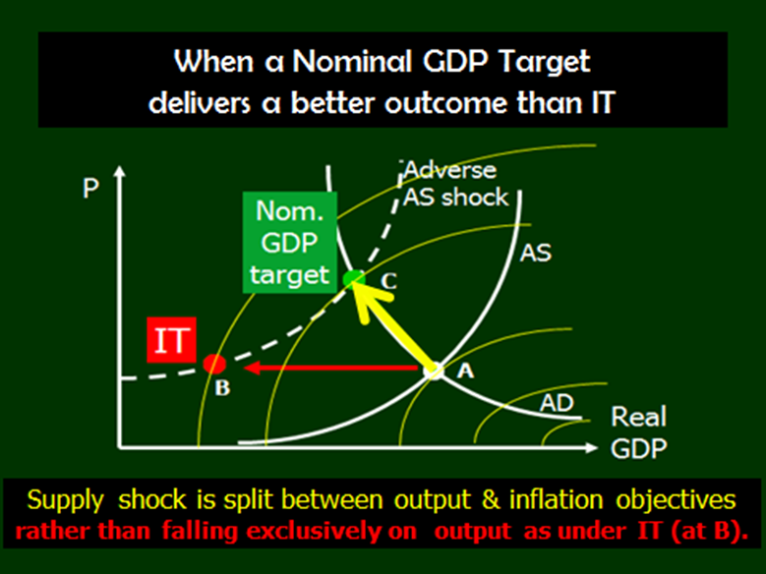
NGDPT is more robust with respect to supply shocks.

Slide 9
If the target is to be NGDP, how strong should the commitment be?
Not strong.
NGDP target may be as hard to attain as other targets.
My mild proposal: Add a row for Nominal GDP
to the FOMC’s Summary of Economic Projections,
  even if the Governors and district presidents who fill out the SEP table were simply to get their projected NGDP growth numbers by taking the sum of the real growth row and the (PCE) inflation rate row of table.
  But I would prefer that NGDP be reported
  in the 1st row of the SEP table
    before the rows for real growth, unemployment,
    inflation, & fed funds rate,
    and that the public be allowed to infer that the Fed
    was now paying some attention to NGDP.

Slide 10
SEP table in June 2018
Change in nominal GDP

Slide 11
Finally, a different kind of constraint:
If Fed independence is compromised…
i.e., if Congress or the White House succeeds in reining it in,
monetary policy could become pro-cyclical.
Consider some quotes
  Nov. 15, 2010 (unemployment = 9.8%), WSJ letter from 23 conservative economic and financial leaders protested the Fed’s monetary easing, foreseeing “currency debasement and inflation.”
  Sept. 29, 2011 (unemployment = 9.0%), Donald Trump: “The Fed's reckless policies of low interest and flooding the market with dollars needs to be stopped or we will face record inflation.”
  Oct. 11, 2018 (unemployment = 3.7%), Donald Trump: “the Fed is out of control” and July 19: “I am not happy about [interest-rate increases]”.
This and other historical evidence suggests that if the politicians who want to bring the Fed under control got their way,
they could tighten monetary policy when unemployment exceeded 9 % and loosen when lower than 4 %.
Let the Fed do its job!

