Slide 1


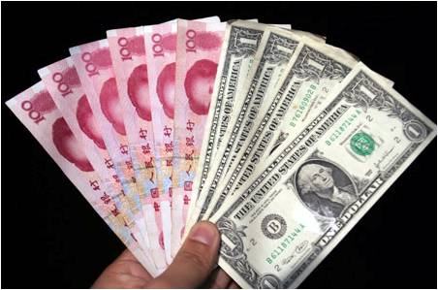
The Rise of China & the RMB
Jeffrey Frankel
Harpel Professor of Capital Formation & Growth
HKS China Society
February 8, 2015

Slide 2
Six questions
No
Has China passed US as #1 economy?
Do China’s accomplishments warrant
a big increase in its IMF quota share?
Has it reached incomes where
it can afford to cut pollution?
Has the RMB been “undervalued”?
Is it still?
Does the RMB warrant inclusion in the SDR?
Yes
Yes
Yes
Probably not
No; not yet.

Slide 3

Sensationalism about China
Headlines, December 2014:
China surpasses U.S. to become largest world economy FoxNews.com 12/6
…based on the latest 6-year update from the World Bank’s International Comparison Program.

Slide 4
The facts
On the one hand, China’s economic miracle is genuine:
  Growth at 10% p.a. for 3 decades is historic.
  It took the UK 58 years to double income, starting from 1780
    US: 47 years, from 1839
    Japan: 35 years, from 1885
    Korea: 11 years, from 1966
  But it took China just 8 years, from 1987 !
On the other hand, China is still poor:
  It ranks only midway among 199 countries (99th , with Albania).
The claim to rival US in size comes from multiplying
a middle income-per-capita times 1.3 billion people.

Slide 5

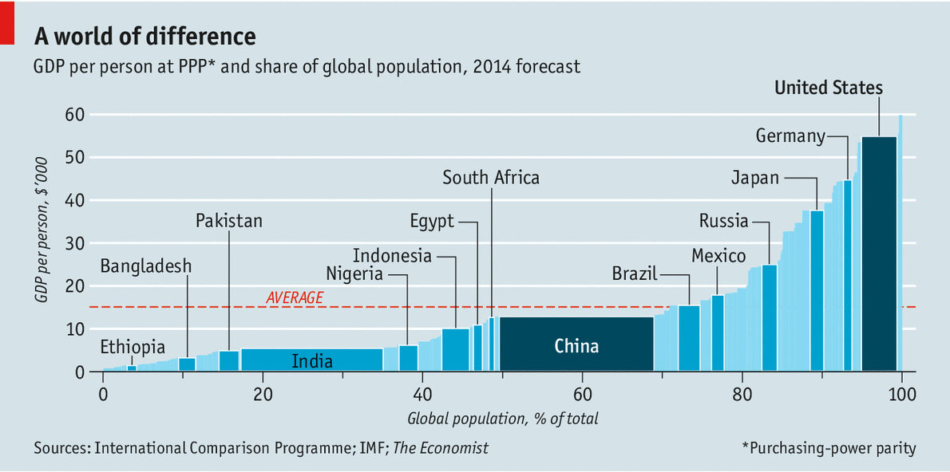


Measuring GDP The dragon takes wing
New data suggest the Chinese economy is bigger than previously thought May 3rd 2014 |
Korea
http://www.economist.com/news/finance-and-economics/21601568-new-data-suggest-chinese-economy-bigger-previously-thought-dragon

Slide 6
Six questions
No
Has China passed US as #1 economy?

Slide 7
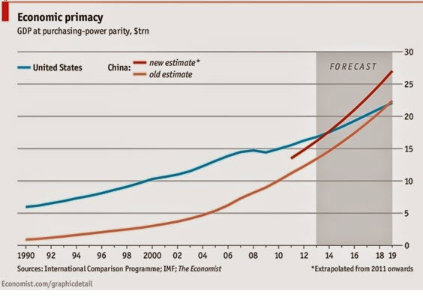
China’s GDP reportedly passed the US in 2014.
But that is a mis-application of the PPP numbers
from the World Bank’s ICP project

Slide 8
Use PPP rates to compare income per capita
Use actual exchange rates to compare GDP
e.g., to judge if:
  governments have successfully raised living standards;
  a country is rich enough to cut pollution;
  the currency is “undervalued,”
  given its income.
e.g., to judge:
  How big is the market,
  from the view of multinational companies?
  How big should a country’s quota be in the IMF?
  How many ships
  can its navy buy?
  How big is the global role
  for its currency?

Slide 9
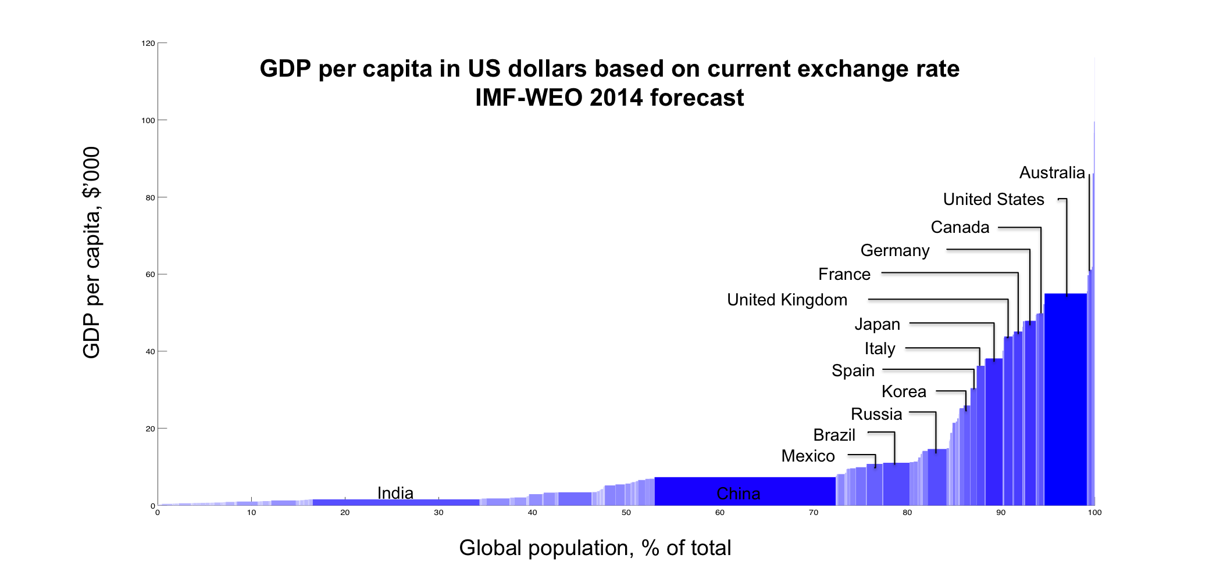
Measuring GDP
Using actual exchange rates gives a different answer:
The US is still 83% bigger than China.
2014 with IMF WEO forecast
Thanks to Qing Yu

Slide 10
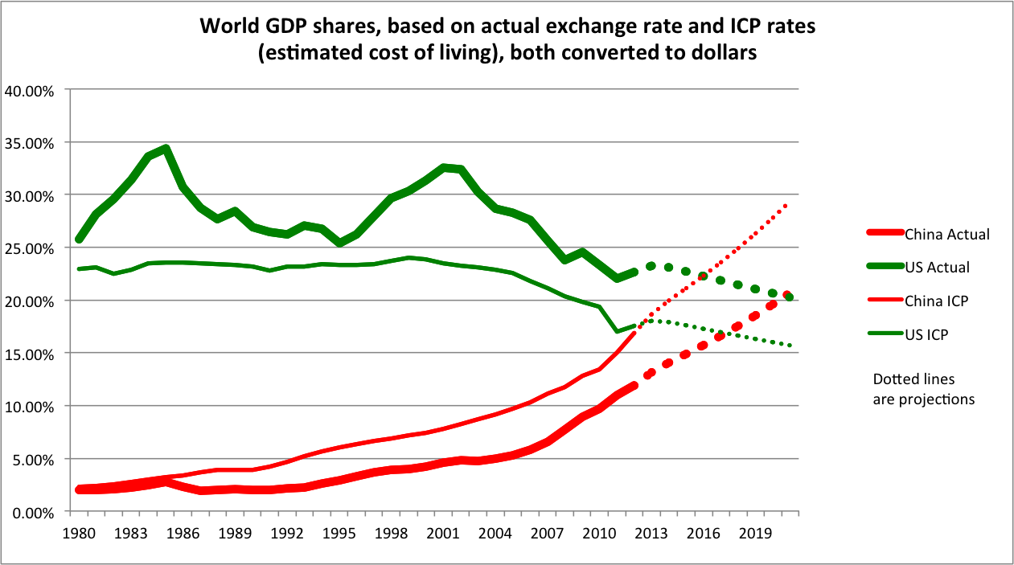
China has not yet overtaken the US.
Author’s
calculations.
(Thanks to Qing Yu.)
The cross-over will probably come after 2021,
under aggressive projections: real growth differential = 5%; real appreciation = 3%.

Slide 11
Six questions
2. Do China’s accomplishments warrant
a big increase in its IMF quota share?
Yes

Slide 12
Six questions
3. Has it reached incomes where
it can afford to cut pollution?
Yes

Slide 13
Environmental damage
Environmental
Kuznets Curve:
Economic growth is associated:
first, with environmental damage,
but then improvement, past a peak level of income.
  for some pollution measures, e.g., SO₂ and NO₂ .
  Peak is estimated about $6,000-$8,000 per capita (1990 $).
  China has reached that level.

Slide 14
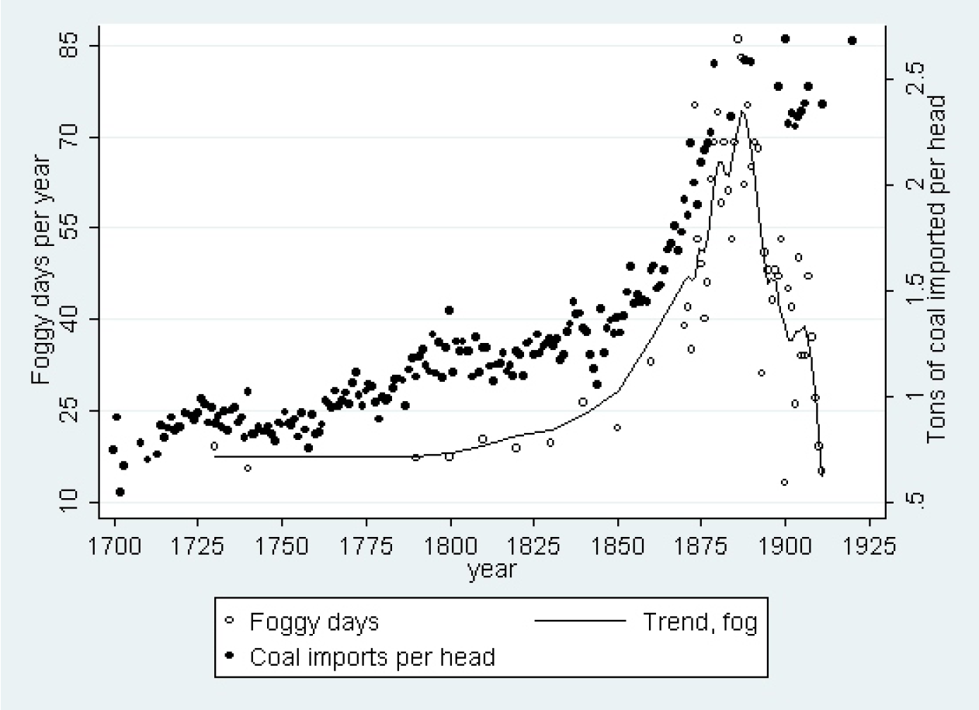

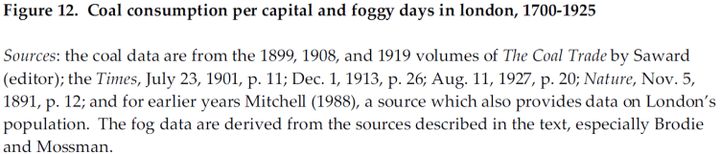
The first EKC: The London Fog (1730-1910),
i.e., coal smoke
Karen Clay & Werner Troesken, 2010.
"Did Frederick Brodie Discover the World's First
Environmental Kuznets Curve? Coal Smoke and
the Rise and Fall of the London Fog," NBER WP 15669.

Slide 15
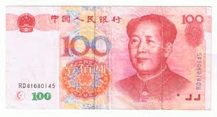
Six questions
4. Has the RMB been “undervalued”?
Yes

Slide 16

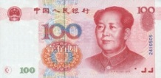
The Balassa-Samuelson Relationship
2005
Source: Arvind Subramanian, PB10-08, Peterson Institute for International Economics, April 2010.
Estimated 2005 undervaluation of RMB = 31%,
averaging across four regression estimates.
Compare to estimate for 2000 (Frankel 2005): 36%.
As recently as 2009 (Chang 2012) : 25% .

Slide 17
Six questions
Has the RMB been “undervalued”?
Is it still?
Yes
Probably not

Slide 18
A trend of real appreciation since 2005
Dooley, Folkerts-Landau, Garber (2014)

Slide 19

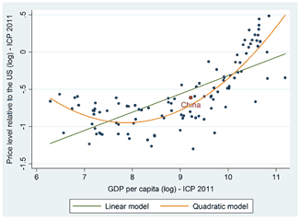
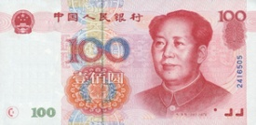
“Is the Renminbi Still Undervalued? Not According to New PPP Estimates”
M.Kessler & A.Subramanian, PIIE, May 2014
Balassa-Samuelson estimated for 2011
In 2014, the ICP released new absolute price data.
Benchmark years | GDP per capita (in PPP dollars) | RMB undervaluation (percent)
2005 | 4,802 | -34.5
2011 | 10,057 | -9.7

Slide 20
Six questions
6. Does the RMB warrant inclusion in the SDR?
No; not yet.

Slide 21
International Currency Rankings
The idea that the renminbi is joining
the ranks of international
currencies has generated
much excitement.
Indeed some claim that the RMB
could even overtake the $ by 2020:
    Subramanian (2011a, b).
& that the IMF will add the RMB to the SDR basket
  in the 5-year review this year, 2015.
  Criteria require the currency to be “freely usable.“
There are good reasons to doubt it.

Slide 22
China remains far less open financially
than the US or UK
De jure financial openness index (Chinn-Ito KAOPEN).
Higher values denote higher financial openness. Source: Chinn (2012).

Slide 24
Appendices on the RMB
1. No longer so clearly undervalued.
2. The RMB as an international currency.

Slide 25
1. China Adjusts, 2009-12
Various measures suggest that China achieved a share of the needed trade adjustment after 2009:
Its trade surplus peaked at $300 billion in 2008, and declined thereafter.
Substantial real appreciation of the RMB
brought it closer to equilibrium.
  Some nominal appreciation +
  Some price inflation and, especially, wage increases.

Slide 26
Adjustment of relative prices
The famous “China price”:
  Ever since China rejoined the world economy
  3 decades ago, its trading partners have been snapping up exports of manufacturing goods,
  because low Chinese wages made them
  super-competitive on world markets.
But relative prices adjusted
  following the laws of market economics.

Slide 27
Adjustment of relative prices, continued
The change in relative prices is reflected
as real exchange rate appreciation.
  This comprises, in part, nominal appreciation
  and, in part, Chinese inflation.
  Government officials would have been better advised
  to let more of the real appreciation take the form
  of nominal appreciation ($ per RMB).
  But since they didn’t, it showed up as inflation instead.
  See charts below:
    appreciation, against the $ and other currencies.

Slide 28
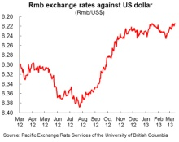
Appreciation versus the US $, 2005-12

Slide 29
Appreciation vs. index of currencies, 2005-12

Slide 30
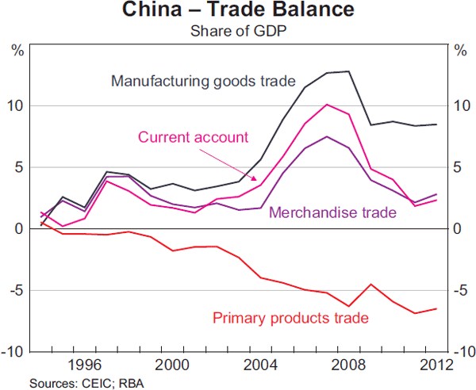
China’s trade balance
The surplus peaked in 2007, and then fell.
Source: Reserve Bank of Australia (June 2013)
China runs a deficit in primary products, offset by a surplus in manufactures.

Slide 31
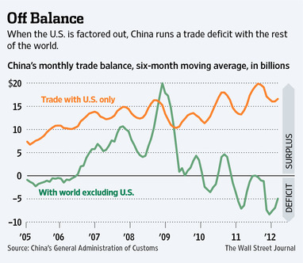
China’s trade balance
The bilateral surplus with the United States
is as big as ever – which has no economic importance,
but is politically sensitive.

Slide 32
The natural adjustment process was delayed.
1st, because the authorities intervened to keep the exchange virtually fixed against the dollar, in the years 1995-2005 and 2008-2010.
2nd, wages had not fully adjusted to (rising) marginal product of labor in coastal factories
  surplus labor in countryside (A.Lewis, 1954)
  impediments to migration (hukou system)
China continued to undersell the world.

Slide 33
But prices eventually adjusted.
Labor shortages began to appear =>
China’s urban workers won rapid wage hikes.
Meanwhile another cost of business,
land prices, have risen even more rapidly.
The yuan was finally allowed to appreciate
against the $ during 2005-08 & 2010-11,
by 25% cumulatively
    =17% + 8%,
    though less against other currencies.

Slide 34
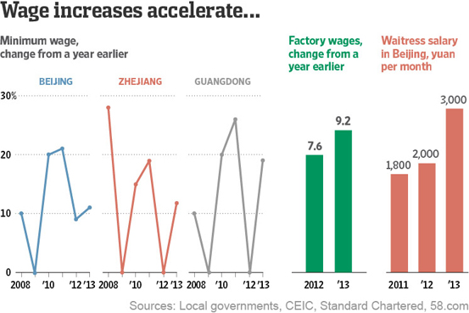
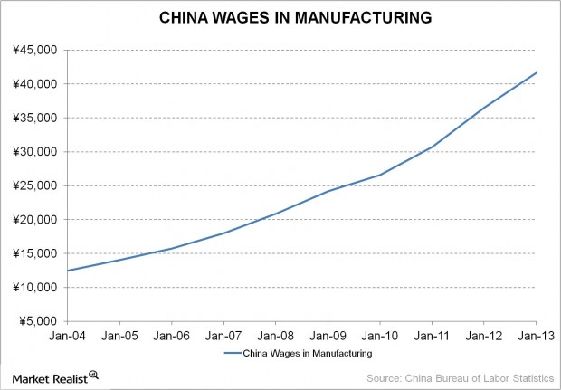
Chinese wages have been rising
Source: “China’s wage inflation,” Aug. 28, 2013

Slide 35
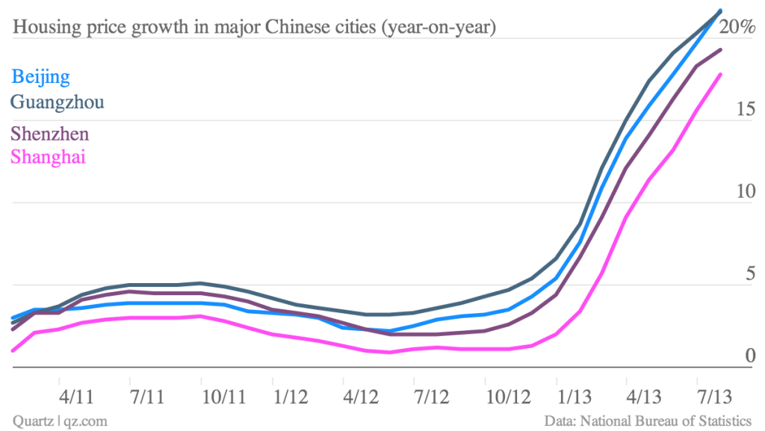

Overheating showed up in rise of land prices 2009-10
…and again in 2013
Rate of increase of housing prices
in 4 major Chinese cities (year-on-year)
Source: Gwynn Guilford — Sept. 6, 2013

Slide 36
Real appreciation
The RMB’s real appreciation against the $
from 2009 to 2012 amounted to 12%,
reducing the degree of undervaluation by roughly half,
    depending on whether one measures it against the $
    or against all currencies.
More is expected, as China’s relative wages continue to rise.
In any case, China’s real exchange rate is already closer to this measure of equilibrium than are most countries’ exchange rates (Cheung, Chinn & Fuji, 2010).

Slide 37
5 types of adjustment are gradually taking place in response to the new high level of costs in the factories of China’s coastal provinces:
1st, some manufacturing is migrating inland,
  where wages & land prices are still relatively low.
2nd, export operations are shifting to Vietnam or Bangla Desh
  where wages are lower still.
3rd, Chinese companies are beginning to automate,
  substituting capital for labor.
4th, they are moving into more sophisticated products,
  following the path blazed earlier by Japan, Korea, & other Asian tigers
    in the “flying geese” formation.
5th, multinational companies that had in the past moved some stages of their production process to China, out of the US
or other high-wage countries, are now moving back.

Slide 38
All five of these ways of reallocating resources represent the economic process operating as it should.
None of this comes as news
to most observers of China.

Slide 39
But many Western politicians are unable
to let go of the syllogism that seemed
so unassailable just a decade ago:
  (1) The Chinese have joined the world economy;
  (2) their wages are $0.50 an hour;
  (3) there are a billion of them, and so
  (4) their exports will rise without limit:
  “Chinese wages will never be bid up in line
  with the usual textbook laws of economics
  because the supply labor is infinitely elastic.”
But it turns out that the laws of economics do eventually apply after all -- even in China.

Slide 40
Expansion of the services sector.
This 6th dimension of adjustment still lags behind,
despite the consensus in favor of it.
China has had great success in manufacturing
  especially via exports.
Now it needs to help the other side of the economy catch up: services, via domestic demand
  Retail, education, environmental quality,
  health care, pensions, social safety net.
Some of this could be done via government spending
  especially with the economy in slowdown in 2012,
  as China did in 2009; but that was heavy investment.

Slide 41
2. What is an international currency?
Definition:
An international currency is used by non-residents.
The prospects for a country’s status as an international currency is not the same as its exchange rate prospects.
Example: 1993-95
  The dollar depreciated strongly, reaching an all-time low
  against the yen, among much hand-wringing.
  And yet its international currency use rose during that period.
41
Notes:
41

Slide 42
Roles of International Currency
Central bank reserve holdings are the most easily quantified,
and probably the most important, of the various measures.
42
Notes:
42

Slide 43
International reserve currency determinants
What suits a currency for international use?
Determinant
Size
Rate of return
3. Depth of financial markets
Empirical proxy:
GDP (or trade)
inflation,
(or trend depreciation
or exchange rate variance)
FX turnover
in main financial center
43
Notes:
43

Slide 44
Determination of international currency status, continued
People use a given currency
  when everyone else is using it,
  not just because of its intrinsic characteristics.
English became the international lingua franca
  not because of its beauty (French),
  nor its simplicity (Esperanto),
  nor even the number of native speakers (Chinese).
=> Network externalities.
44
Notes:
44

Slide 45
Determinants of reserve currency standing, continued
Network externalities
=> Tipping captured by:
Inertia lags
Nonlinearity logistic functional form
in determinants or
dummy for leader GDP
Source: Chinn & Frankel (2007)
45
Notes:
45

Slide 46
Historical illustration of the lag:
£ ‘s loss of premier international currency status in 20th century
By 1919, US had passed UK in
  output (1872)
  trade (1914)
  net international creditor position (1914-19)
But the $ passed £ as #1 reserve currency only with a lag.
46
Notes:
46

Slide 47
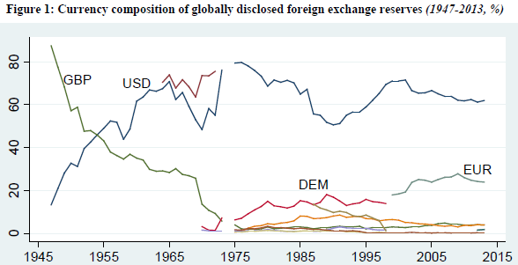
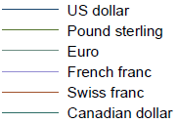
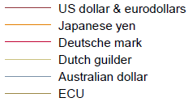
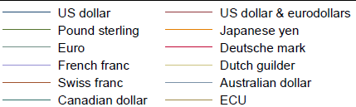
Central bank holdings of FX Reserves, 1947-2013
The US $ passed ₤ by 1955 and has been #1 ever since.
Eichengreen,
Chitu & Mehlo,
April 2014

Slide 48




Reserve Currency Shares are Affected by Size and Inflation
1947-2013
Statistically
significant:
Barry Eichengreen, Livia Chitu & Arnaud Mehlo,
“Stability or Upheaval?
The Currency Composition of International Reserves
in the Long Run.” April 201.
Lagged share
GDP
Inflation rate
Random effects estimates.
(S.e.s in parentheses are robust to heteroscedasticity and clustered heterogeneity.)
*** p=.01
** p=.05

Slide 49
Currency share vs. GDP (market rates).
The relationship is not linear, but steeper in the middle
Shares
of major currencies
In central bank reserve holdings
}
Tipping
point
Source: Chinn & Frankel (2007)
Size of currency’s home economy
49
Notes:
49

Slide 50
Explaining currency shares econometrically 1973-98
logit
 | [2] | [4] | [7]
GDP | 2.77 | 3.69 | 1.04
 | [0.64] | [0.92] | [0.29]
Inflation | -2.64 | -2.86
 | [1.16] | [1.16]
Depreciation |  |  | -1.10
trend |  |  | [0.59]
Ex rate variance | -0.98 | -1.40 | -1.25
 | [0.57] | [0.64] | [0.34]
FX turnover | 0.45 | 0.58 | 0.43
 | [0.29] | [0.30] | [0.15]
GDP leader dummy |  | -0.22
 |  | [0.16]
Lag logit: | 0.85 | 0.85 | 0.96
log(share _{t-1} / 1 - share _{t-1}) | [0.03] | [0.03] | [0.01]
50
Chinn & Frankel (2007)
Boldface = statistically significant: size, returns, turnover, and lag
Source: Chinn & Frankel
Notes:
50

Slide 51
How does China rank, by determinants of international currency status?
1. Size
Chinese economy passed Japan in 2010,
to attain 2nd ranking.
Some projections claim it will pass the US in 2014.
But
  What matters here is GDP (& trade) compared
  at market exchange rates, not PPP-adjusted.
Euroland’s GDP is still bigger than China too.
51
Notes:
51

Slide 52
China’s rank, by determinants of international currency status, cont.
2. Rate of return
A financial crisis probably still lurks
  somewhere down the road, from the shadow banking sector.
Nevertheless, it is likely that the rate of return
to holding RMB over the next ten years will be high.
Indeed that is the reason since 2004
for the strong portfolio capital inflows.
      Prasad & Wei.
As of 2014, the PBoC appears to have met successfully the inflation threat that had revived in 2010.
52
Notes:
52

Slide 53
China’s rank, by determinants of international currency status, concl.
3. Depth of financial markets
One the one hand…
China is starting to use RMB in international trade
      The IFC & ADB have issued “panda bonds” since 2005.
Foreign central banks can hold RMB since 2010
  Malaysia’s CB went first, buying RMB bonds for its FX reserves.
  Swap arrangements with 13 emerging-market CBs (Yu, July 2012).
RMB market developed in Hong Kong
  Foreigners have been able to issue “dim sum” bonds since 2007,
        Bank of China HK launched an index 2010.
  Yuan deposits reached RMB 920 b in April 2014.
53
Notes:
53

Slide 54
China’s rank, by determinants of international currency status, cont.
On the other hand…
Liquidity, breadth & openness still have a long way to go.
China’s financial markets still rank far behind others:
still highly regulated,
  domestic system still “financially repressed.”
  Cross-border capital flows still subject to heavy controls;
      foreign companies cannot borrow in China.
RMB bonds & deposits in HK are small as a fraction.
  Of course HK itself, tho part of PRC, is still firmly tied to US$.
The “offshore” strategy for internationalization
may not be enough.
54
Notes:
54

Slide 55
The Chinese government’s strategy of seeking RMB internationalization offshore
China first established special economic zones
  in a few provinces in the 1980s
  to experiment with opening to international trade.
  It worked spectacularly, and the SEZ experiment
  was expanded to more & more regions.
It is trying the same with RMB:
  to experiment with international use of the currency.
But segmentation of financial markets is harder,
  because arbitrage is easier, than with merchandise trade.

Slide 56
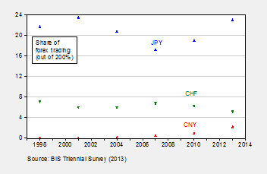


The RMB’s share of FX trading has risen but is still well behind SF, let alone ¥.
Courtesy of Menzie Chinn

Slide 57
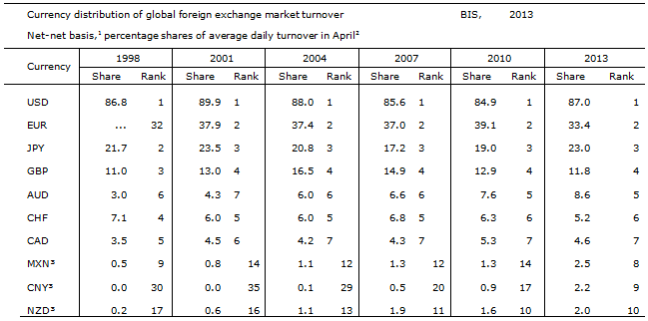
RMB has risen… to 9th place in FX trading

Slide 58
7th place in FX transaction costs, 2011-14
Foreign Exchange Spreads between Spot Bid & Ask Quotations Against the US $ in NY (% of ask price quotation)
1. Hong Kong $ | 0.007
2. Euro | 0.012
3. Danish krone | 0.014
4. Pound sterling | 0.016
5. Canadian $ | 0.020
6. Japanese yen | 0.022
7. Chinese yuan | 0.023
8. Australian $ | 0.035
9. Swiss franc | 0.045
10. Singapore dollar | 0.050
11. Indian rupee | 0.057
12. Malaysian ringgit | 0.073
13. Mexican peso | 0.075
14. New Zealand $ | 0.082
15. Brazilian real | 0.094
16. Swedish krona | 0.095
17. Thai baht | 0.124
18. Turkish new lira | 0.135
19. Norwegian krone | 0.144
20. Korean won | 0.164
Data for 2014 are through April 25. Average of daily closing prices. Source: Bloomberg & author's calculations. Thanks to A.Saiki

Slide 59
In foreign exchange reserves,
the RMB hasn’t yet broken into the top 7.
Meanwhile, the $’s share stopped falling;
  it levelled off in 2011-14.
In world payments,
The RMB passed the Swiss franc in Jan. 2014
to become the 7th most-used currency
  with a market share of 1.4 %,
  according to SWIFT.
  Still far behind $ & €.

Slide 60
Conclusion: China’s ascent in the currency rankings will be gradual
Why? Criteria #1 & #2 are in place.
But internationalization also requires:
  domestic financial liberalization,
  and then full currency convertibility.
which China is probably not yet ready to accept.
60
Notes:
60

Slide 61

My candidate to play the role of the Jekyll Island “duck hunters”: Zhou Xiao Chuan of the PBoC
The internationalization of the renminbi is the will
of the market rather than a government-backed move,
PBoC Governor Zhou Xiaochuan was quoted as saying….
"It is the result of the growing power of the nation and its financial market boom ... though there is still much to do considering the low level of development and openness,"
Zhou said in an interview with China Business News.
According to Zhou, China needs to …further open the nation's financial market. "In general, we should do our homework,
and let the market decide which currency
should be used," he said.
China Daily, June 5, 2012

Slide 62
One theory: officials like Zhou want to use international liberalization to force the pace of domestic liberalization.
      David Pilling, FT, Sept. 6, 2012.
  This is the sequence Japan & Indonesia tried.
  It did not work very well.
  The usual sequence is domestic
  liberalization before international,
    and for good reason.
A guess: the RMB will take a decade to rival the ¥.
and much longer to rival the €, let alone the $.

Slide 63
References by the speaker underlying this talk
“China is Not Yet Number 1,” VoxEU, May 9, 2014.
“Internationalization of the RMB and Historical Precedents,” 2012; Journal of Economic Integration.
“Historical precedents for the internationalization of the RMB,” 2011
workshop in Beijing of CFR & the China Development Research Foundation.
Summaries at RIETI & Vox, Oct. 2011.
International Currency Rankings
“The latest on the dollar’s international currency status,” VoxEU, Dec. 2013.
“Will the Euro Eventually Surpass the Dollar as Leading International Reserve Currency?” with Menzie Chinn, in G7 Current Account Imbalances: Sustainability and Adjustment, R.Clarida, ed. (U. Chicago Press), 2007. NBER WP No 11510.
The Dollar's Demise? Future of the Dollar as the World's Principal Reserve Asset," H.W.Brock, ed., SED, 1997.
"The SDR, Reserve Currencies, and the Future of the International Monetary System"
with Barry Eichengreen, in The Future of the SDR in Light of Changes in the International Financial System, M.Mussa, J.Boughton, & P.Isard, eds. (IMF), 1996.
"Still the Lingua Franca: The Exaggerated Death of the Dollar," Foreign Affairs 74, no.4, 1995
"On the Dollar," The New Palgrave Dictionary of Money and Finance (MacMillan), 1992.

Slide 65
References on yuan exchange rate by the speaker
"The Renminbi Since 2005," in The US-Sino Currency Dispute: New Insights from Economics, Politics and Law, edited by S.Evenett (CEPR: London) 2010.
“New Estimation of China’s Exchange Rate Regime,” in Pacific Economic
Review 14, no.3, August 2009. NBER WP no. 14700.
“Comment on ‘China’s Current Account and Exchange Rate,’ by Yin-Wong Cheung, Menzie Chinn & Eiji Fuji,” in China’s Growing Role in World Trade, NBER, edited by Feenstra & Wei (University of Chicago Press, 2010).
“Comments on Cline and Williamson’s ‘Estimates of the Equilibrium Exchange Rate of the Renminbi?’,” in Debating China's Exchange Rate Policy, M.Goldstein & N.Lardy, eds. (Peterson Institute for International Economics), 2008.
"Assessing China's Exchange Rate Regime," with Shang-Jin Wei, Economic Policy 51, July 2007. Video interview. Vox summary. NBER WP 13100.
"On the Yuan: The Choice Between Adjustment Under a Fixed Exchange Rate and Adjustment under a Flexible Rate," in Understanding the Chinese Economy, edited by G. Illing (Oxford U. Press), 2006. NBER WP 11274.
“On the Renminbi,” CESifo Forum, 6, no.3, Autumn 2005 (Ifo Institute for Economic Research, Munich).
http://ksghome.harvard.edu/~jfrankel/

