Slide 1
What is the US trying to accomplish in the trade war with China?
Jeffrey Frankel
Harpel Professor of Capital Formation & Growth
Harvard Kennedy School
Innovation Meeting with Executives from Sichuan State-owned Companies
Harvard University
December 11, 2019

Slide 2

What is the US trying to accomplish in its trade war with China?
The truth: President Trump has no coherent trade strategy.
I) Four Trump trade demands on China:
Stop “currency manipulation”
Managed trade: Ask China to agree to buy
US exports to reduce bilateral trade imbalance
Reduce the role of China’s government in the economy
Stop “Quid pro quos” (foreigners asked to share technology).
II) The future:
There will be no comprehensive settlement under Trump.
After Trump, what trade strategy should we pursue?
  Restore rule-based multilateral system, especially the WTO
  Return to negotiation of reciprocal tariff reduction.
III) A long-run perspective on China’s GDP.

Slide 3
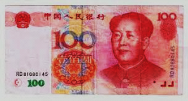

I) Four trade demands by Trump on China
(with recent writings by the author).
Stop “currency manipulation”
"Trump Wrong to Brand China a Currency Manipulator,"
Nikkei Asia Review, Sept. 20, 2018.
2. Managed trade: Ask China to agree to buy more soybeans
to reduce the bilateral trade imbalance
"Making America's Trade Deficits Great Again," Guardian, Jan.15, 2018.
3. Reduce the role of China’s government in the economy
"Xi and Trump Miss Their Chance to Expand Markets,"
Project Syndicate, March 21, 2019.
4. Stop “Quid pro quo”s (i.e., stop requiring foreign firms
to share technology in exchange for market access).
"The Case for Old-Fashioned Tariff Cuts," Korea Herald, Dec. 2, 2019.

Slide 4
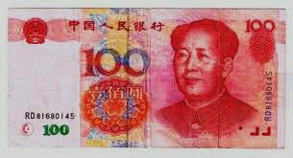
1. Stop “currency manipulation”
The RMB was undervalued in 2004-08
  by all three kinds of measures (very rare!):
  prices were internationally low, even adjusted for income/cap;
  the trade surplus reached high levels;
  foreign exchange reserves were rising, to world-record levels.
The US urged China to let the market set its exchange rate.
China had adjusted by 2014:
  RMB, wages, & prices rose => undervaluation ended.
  The trade surplus peaked in 2007 at 7% of GDP, then fell.
  Reserves peaked in 2014 at $4 trillion, then fell.
China has not manipulated its currency since 2014.

Slide 5

China’s RMB appreciated in real terms, 2005-2014
Dooley, Folkerts-Landau, Garber (2014)

Slide 6
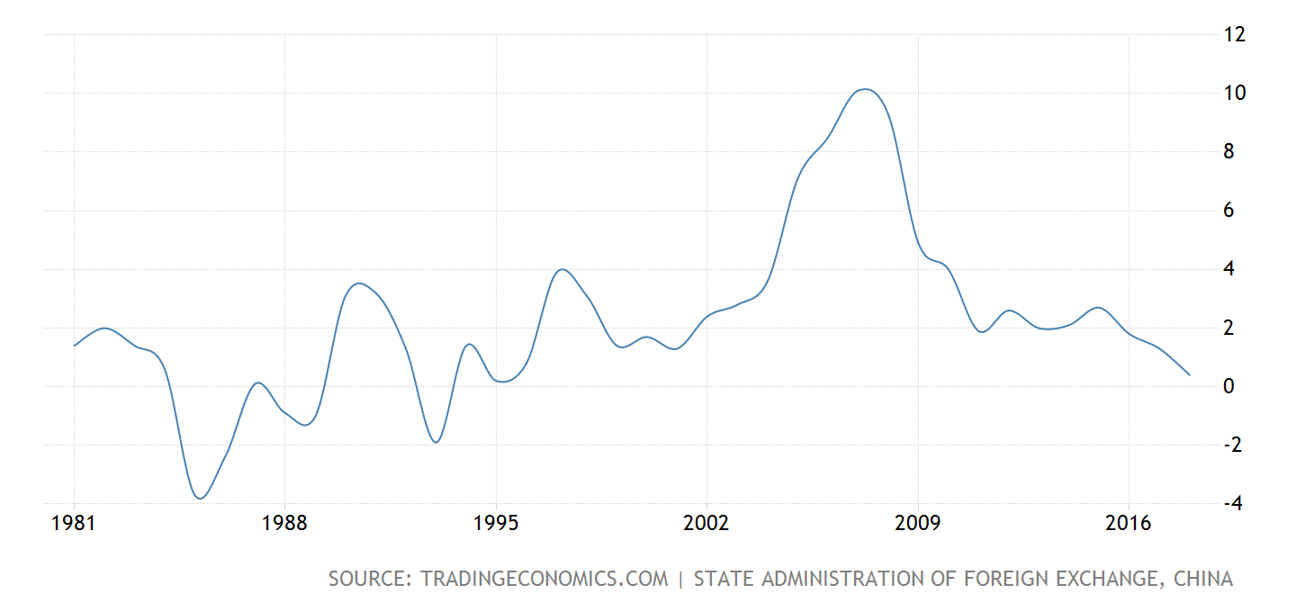
China’s Current Account peaked at 10% of GDP
in 2007; and then fell below 1% of GDP in 2018
China Ratio of Current Account to GDP 1981-2018

Slide 7
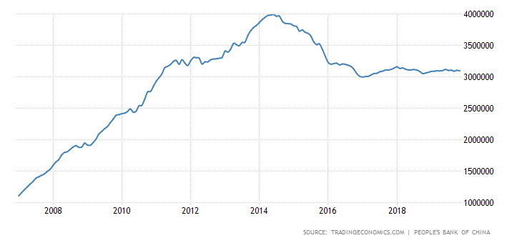
China’s forex reserves peaked in June 2014.
then fell by $ 1 trillion.
Foreign exchange reserves through Nov. 2019
The PBoC in 2014 stopped intervening to dampen its currency.
To the contrary, since then it has tried to slow the RMB’s depreciation.

Slide 8
2. Managing the bilateral trade balance
Trump wants China to agree to buy more natural gas, soybeans & other products to cut bilateral trade imbalance.
This would be government-managed trade.
It is the opposite of letting the free market work,
  which is what US politicians usually ask of China (demand # 3).
Even if this succeeded in reducing bilateral trade deficit,
it would not reduce overall US trade deficit.
  If the US sold more to China, it would sell less to other partners.
  It shows how bilateral trade balances are irrelevant.
  The overall Current Account balance is determined
  by National Saving & National Investment.

Slide 9
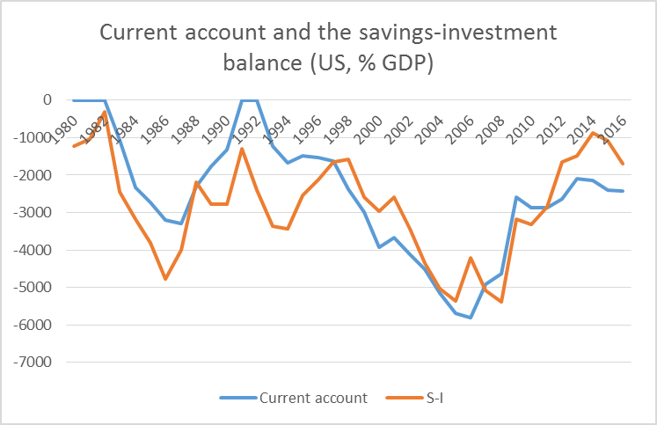
Current Account ≡ National Saving – Investment
(In practice there are measurement errors.)
Current account
NS - I
Daniel Gros,
Nov. 2017

Slide 10
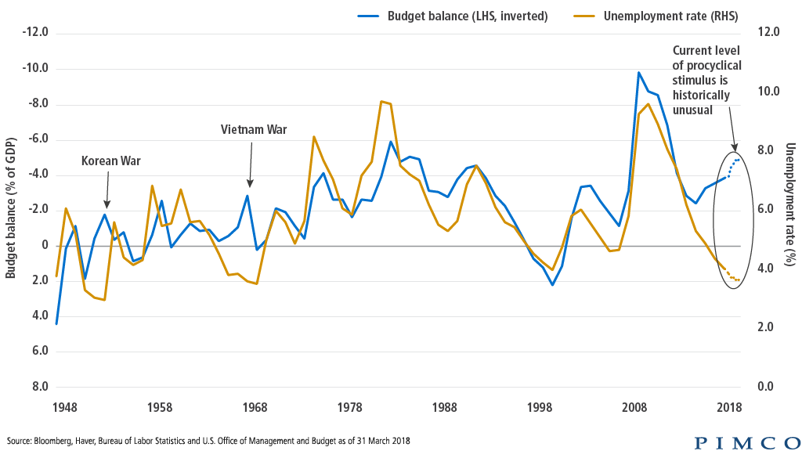
In 2018, unprecedentedly in peacetime, US fiscal policy
turned strongly expansionary at a time of full employment.
US Budget Deficit & Unemployment
  The US current account has predictably worsened under Trump because the $1.5 trillion corporate tax cut in December 2017 raised the US budget deficit & lowered national saving.

Slide 11
3. Reduce the role of China’s government in the economy
Government fiscal stimulus in 2008-09, though
a well-timed Keynesian response to the global recession,
  was not well-allocated across sectors.
  It left China with too much physical capacity in steel mills
  & coal-fired power plants.
China should reduce subsidies to State-Owned Enterprises,
  e.g., low-interest loans from state-directed banks to SOEs.
The SOE sector need not shrink in absolute terms.
  Just let the private firms grow.
Such market reforms would be in China’s interest,
  aside from any demands of the US or others.

Slide 12
A precedent from 30 years ago
If the leaders of the US & China were clever,
they could strike a deal analogous to the Structural Impediments Initiative between US & Japan,
  under President George H.W. Bush during 1989-1991.
  US agreed to cut its budget deficit and raise saving
    which in turn would reduce its current account deficit,
  while Japan agreed to market reforms
    such as enforcing competition.
That won’t happen now, with China.
  Even if US political leadership returned to sanity,
  President Xi Jinping seems uninterested in market reforms.

Slide 13
Chinese economists agree on appropriate reforms.
Many reforms were identified in 2013,
at the Third Plenum of the 18th Party Congress:
financial liberalization;
structural shifts
  away from manufacturing toward services,
  away from exports & heavy investment toward consumption;
environmental clean-up;
land reform;
hukou reform;
protection of private property rights;
and a reduction in the role of inefficient SOEs,
  thereby giving dynamic private firms more room to grow.

Slide 14
What has happened to these reforms since 2013?
Some have been enacted, but most have not.
If anything, the trend is an increasing role for the state.
It is not clear:
  Does President Xi see few economic advantages to free markets ?
  Or has he decided he is willing to sacrifice some economic performance for the imperative of maintaining political control over Chinese society?
Currently, in 2019, the Chinese government
is once again reining in non-bank lending,
  concerned over excessive credit, e.g., in housing sector.
  Lending to SOEs has been protected.
  The result: borrowing by private firms is squeezed,
    perhaps an unintended consequence.

Slide 15

4. Intellectual Property Rights (IPR) and “Quid pro quo”
China is said to require foreign firms to share technology to local Joint-Venture partners,
in exchange for market access.
  This is the area where American economists tend to agree with Trump, that China violates international obligations.
  But it is hard to regulate relations between firms.
  It would be better for China to abolish requirement that foreign firms must Joint Venture with a local company if they want to set up operations in China.
    as underway in finance & autos.
  Better yet:
  abolish tariffs, letting US & German auto companies export directly to Chinese consumers, without necessarily having to set up production facilities inside China.

Slide 16

(II) The future
1. Predictions?
Goldman Sachs forecast (December 9)
of next development in trade war:
  “China will purchase more US agricultural products in exchange for a rollback of the September 1 tariff step
  of 15% on about $100bn of US imports from China
  as well as cancellation of the December 15 tariff threat
  of 15% on the remaining $150bn.”
My view:
  The Dec.15 threat will probably be postponed
    the 5th tariff delay this year.
  There will be no comprehensive deal so long as Trump is president.
    Our trading partners have learned that he does not keep his word.

Slide 17

2. After Trump, what trade strategy should we pursue?
My choice would be:
  Let us restore the authority of the WTO
  & other multilateral institutions.
  Let us go back to reciprocal elimination of tariffs.
  US should re-join Trans-Pacific Partnership (TPP)
    which goes beyond “shallow integration,” to include IPR, Investor-State Dispute Settlement, labor rights, and environmental protections.
  Then China should eventually join TPP.
It is now seems that aspirations for “deep integration” were too ambitious. I would settle for (1) and (2).

Slide 18
III) A Long-Run Perspective on China’s GDP
Long-term perspective on the rise
& fall of great powers
The rise of China.
  Did its GDP pass the US in 2014?
China's recent slowdown
  Explanations.

Slide 19
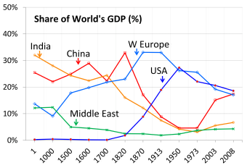

1. The long-term rise & fall of great powers
From 1500 to 1820, China was the world’s largest economy.
PPP basis
The global contribution by major economies from 1 AD to 2008 AD according to estimates
by Angus Maddison, 2007, Contours of the World Economy, I - 2030 AD (Oxford Univ. Press).
Note: Flag is Qing Dynasty’s

Slide 20





In the 19th century:
Within Western Europe,
  the UK economy dominated,
  but was surpassed by Germany’s GDP in 1900.
  According to Graham Allison’s Thucydides Trap,
  the challenge of Germany’s rise led to World War I,
    a worrisome precedent as China’s rise challenges the US.
US GDP passed the UK in 1872,
    an example when the Thucydides Trap was avoided,
  and US surpassed all of Western Europe by 1950.
The Soviet Union was at #2, 1940-1980,
  succeeded by Japan,
    viewed as a juggernaut in the 1980s.

Slide 21
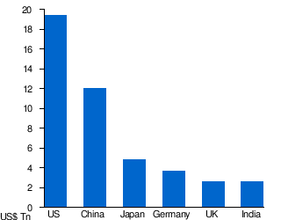
The rankings today
Largest economies by nominal GDP in 2017
Source: IMF estimates (WEO database, April 2018).
Note: At current exchange rates, France may be ahead of India.
Italy, Brazil, Canada, Russia & Korea follow.

Slide 22

Headlines about China’s economy 5ears ago:
2. The rise of China.
Did its GDP pass the US in 2014?
China poised to pass US as world’s leading economic power this year April 30, 2014, Financial Times.
China surpasses U.S. to become largest world economy Dec. 6, 2014, FoxNews.com.
… based on the latest 6-year update from
the World Bank’s International Comparison Program.
But was this right? Is China now bigger than US?

Slide 23
The facts
On the one hand, China’s economic miracle is genuine:
  Growth ≈ 10% p.a. for 3 decades is historic.
  It took the UK about 58 years to double income, starting from 1780
    US: 47 years, from 1839
    Japan: 35 years, from 1885
    Korea: 11 years, from 1966.
  But it took China only around 8 years, from 1987.
On the other hand, China is still a developing country.
  In 2017, its income per capita was only average, globally,
  ranking 79th among 189 countries, between Costa Rica & Brazil.

Slide 24
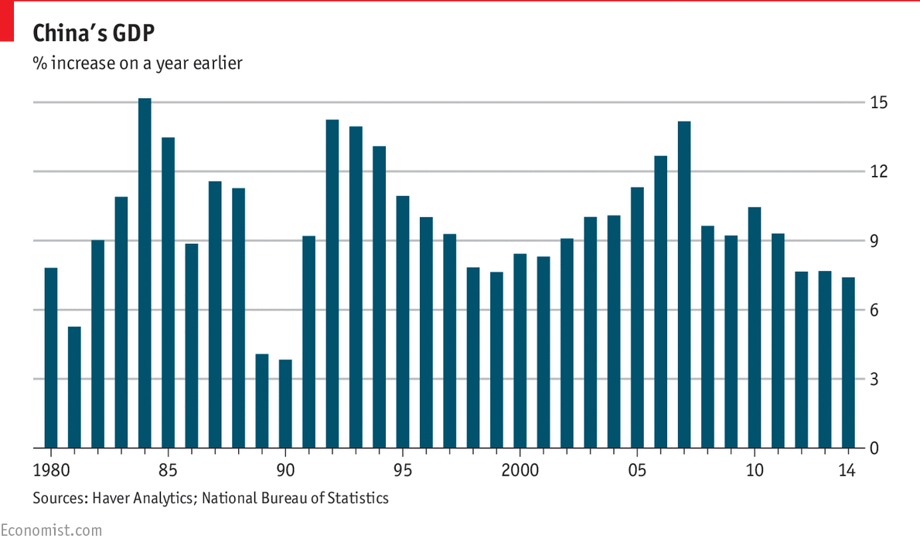
35 years of strong Chinese growth

Slide 25

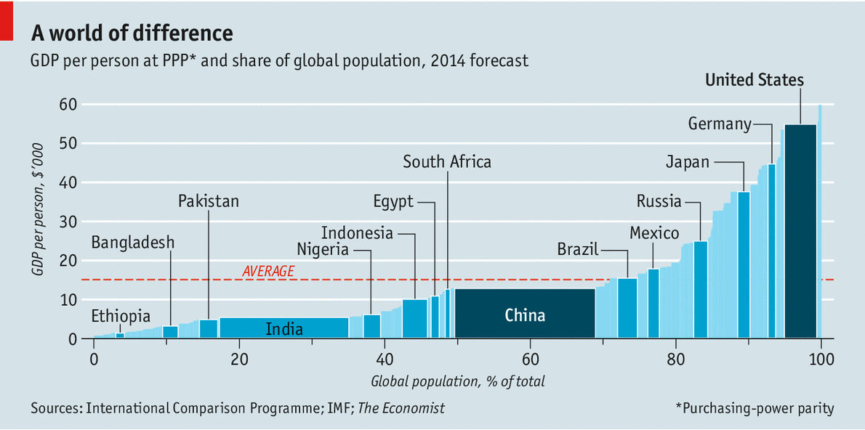


Measuring GDP The dragon takes wing May 3rd 2014 |
New data suggest the Chinese economy is bigger than previously thought.
The claim to rival US size comes, of course, from multiplying a middle income-per-capita times 1.3 billion people.
2014
France
www.economist.com/news/finance-and-economics/21601568-new-data-suggest-chinese-economy-bigger-previously-thought-dragon

Slide 26
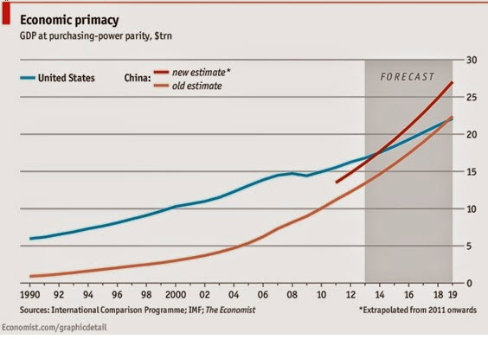
China’s GDP reportedly passed the US in 2014.
But I call that a mis-application of the PPP numbers
from the World Bank’s ICP project.

Slide 27
Use PPP rates to compare income per capita
Use actual exchange rates
to compare GDP
e.g., to judge if:
  governments have successfully raised living standards;
  a country is rich enough to cut pollution;
  the currency is “undervalued,”
  given its income.
e.g., to judge:
  How big is the market,
  from the view of multinational companies?
  How big should a country’s quota be in the IMF?
  How many ships
  can its navy buy?
  How big is the global role
  for its currency?

Slide 28
China GDP has reached US only if measured in PPP terms.

Slide 29
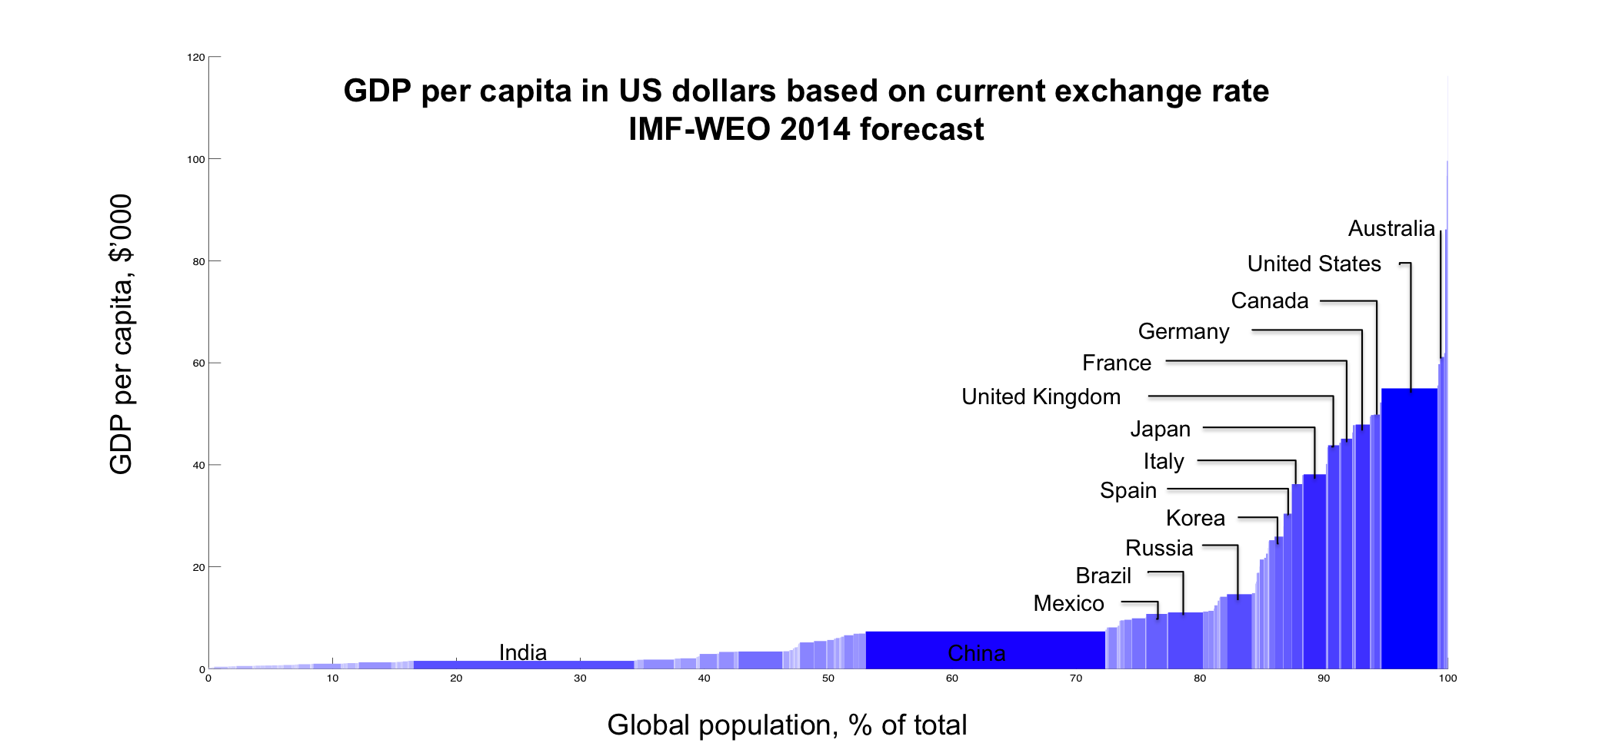
Measuring GDP
Using actual exchange rates gives a different answer:
The US is still 45% bigger than China, even in 2018, 23.3 %/ 16.1%
, 2014
China
Thanks to Qing Yu

Slide 30
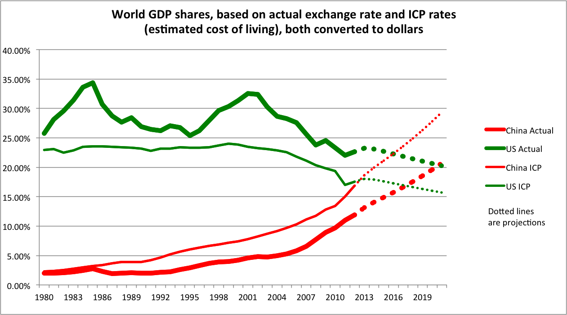
China has not yet overtaken the US.
Author’s
calculations.
(Thanks to Qing Yu.)
The cross-over won’t come before the 2020s.
In 2029, if the growth differential ≈ 4% and there is no real appreciation.

Slide 31
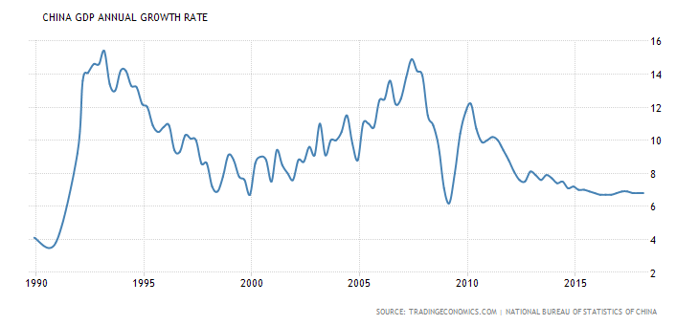
3. China’s recent slowdown
China’s growth has slowed relative to past 10% average.

Slide 32
Reasons for China’s long-term slowdown
Natural convergence
    Technological catch-up;
    Diminishing returns to capital
      Krugman (1994), Young (1994, 1995);
    Rural-urban migration
      Lewis turning point (1954);
    Rising costs of labor & land;
    Services have a lower rate of productivity growth.
Middle-income trap?
      Eichengreen, Park & Shin (2012) *
Regression to the mean
      Prasad (2009), Pritchett & Summers (2014). *
Aging. *
* See appendix.

Slide 33
Appendix: Reasons for long-term slowdown in China’s growth
Middle-income trap?
Regression to the mean.
Aging.
Is China undergoing a smooth transition
to a slower long-term growth path ?

Slide 34

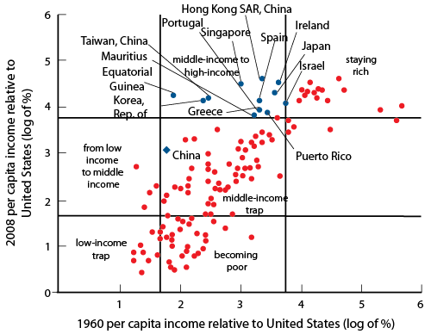
Is there a “middle-income growth trap”?
“Avoiding middle-income growth traps,” Pierre-Richard Agénor, Otaviano Canuto, Michael Jelenic, VoxEU, Dec. 2012
“Formal evidence on growth slowdowns and middle-income traps has suggested that at per capita incomes of about US$ 16,700 in 2005 constant international prices, the growth rate of per capita GDP typically slows from 5.6 to 2.1%.”
Citing Eichengreen, Park & Shin “When Fast Economies Slow Down: International Evidence and Implications for China”, Asian Ec. Papers, 2012.

Slide 35
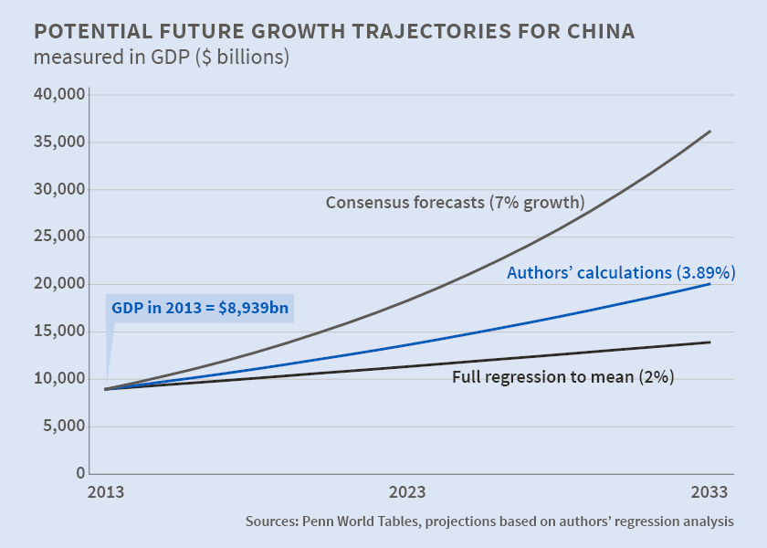
Pritchett & Summers (2014): “Regression to the mean” fits the data better than middle-income trap
“Asiaphoria Meets Regression to the Mean,” NBER WP No. 20573, Lant Pritchett and Lawrence Summers

Slide 36
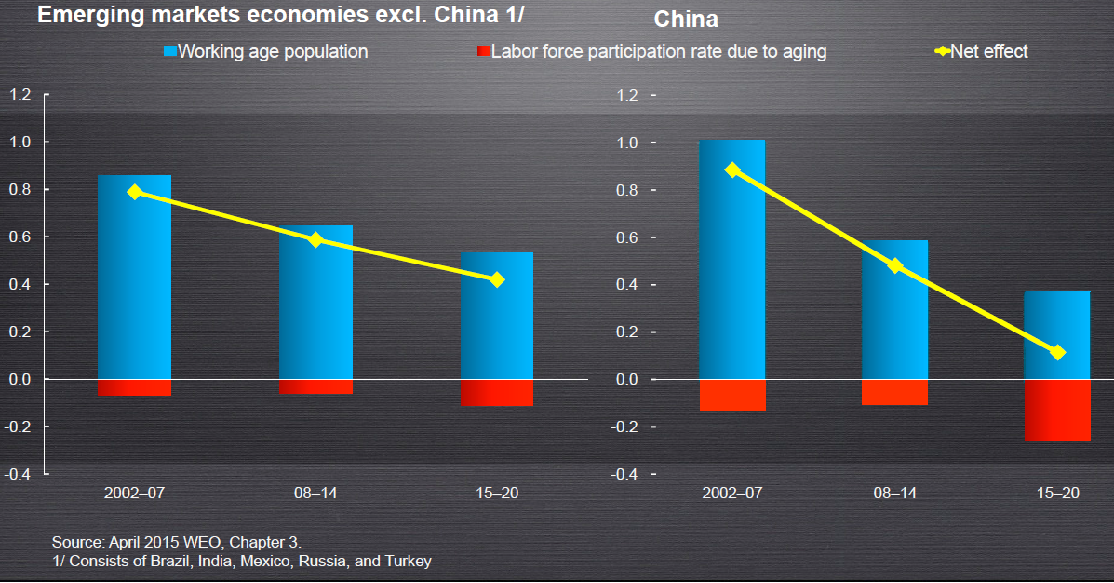



Demographic factors are reducing growth rate in China even more than in other countries

Slide 37
Chinese transition to slower growth path
Hard landing or soft landing?
  High investment in heavy industry is unsustainable.
  Debt
    Leverage becomes unsustainable when growth slows.
    Bad loans in the shadow banking system.
    $-denominated loans especially problematic in EMEs.
  Are financial bubbles-and-crashes a “rite of passage”
  that newly arrived economic powers undergo?
    Holland 1637, England 1720, France 1720,
    US 1929, Japan 1990, Korea 1997.
  So far, the hard landing has been avoided
    despite the financial-market fears of summer 2015.

