Slide 1
China in the World Economy
Jeffrey Frankel
Harpel Professor, Harvard University
MAS Term Professor, Public Lecture
National University of Singapore, May 25, 2017

Slide 2
A view of recent Chinese financial and macroeconomic developments
…just the viewpoint of an American economist,
  which is not the viewpoint
  of an American politician,
  as will become clear shortly.

Slide 3
2015: Chinese financial turmoil
In June 2015, Shanghai stock market
began a long plunge.
In August 2015, China surprised world markets by devaluing 3%.
The “China shock” to markets continued
through January 2016.

Slide 4
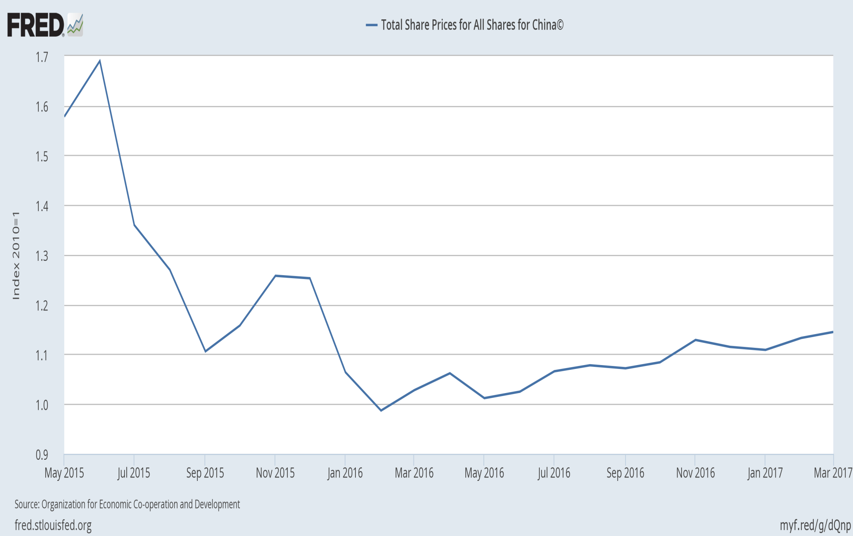
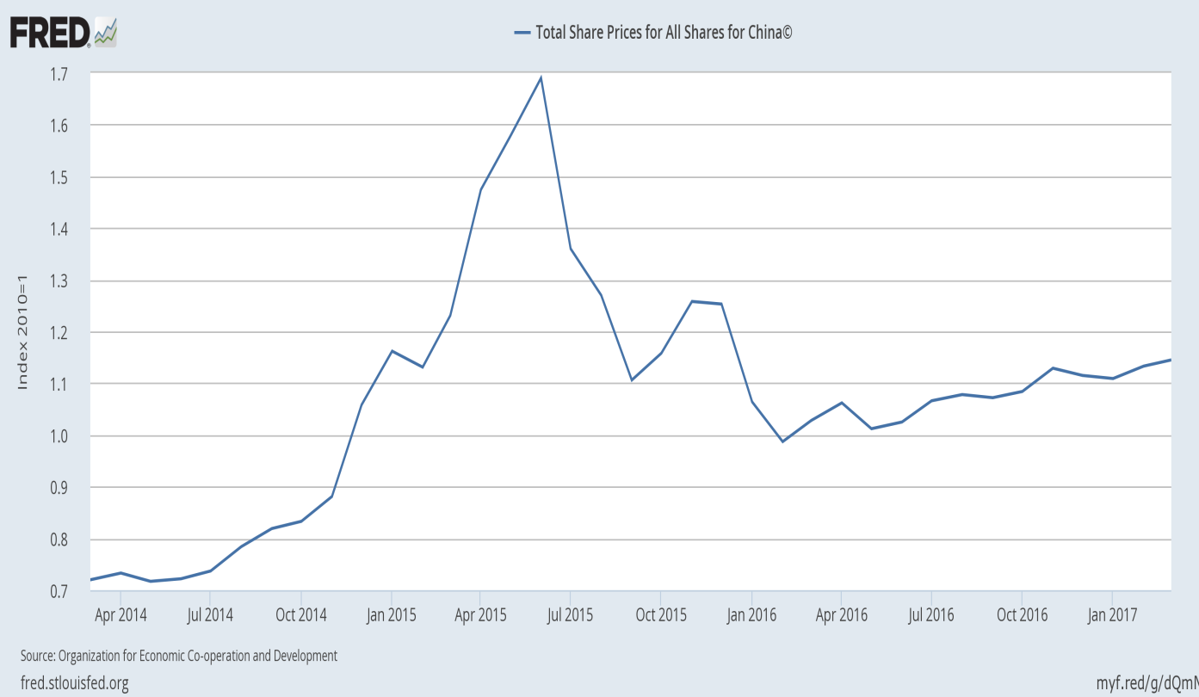
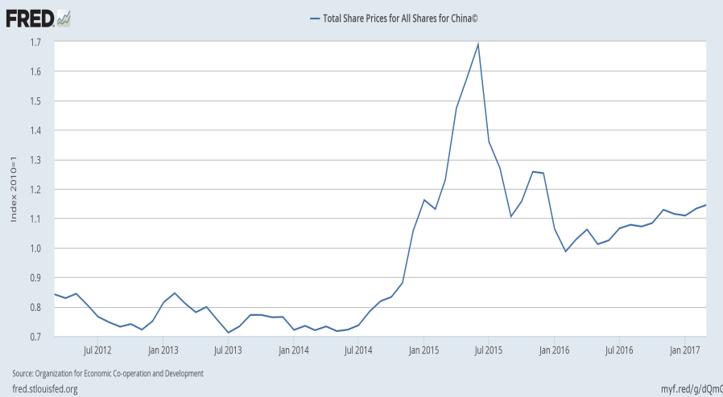
China’s stock prices fell sharply from June 2015
Total share price, all shares

Slide 5
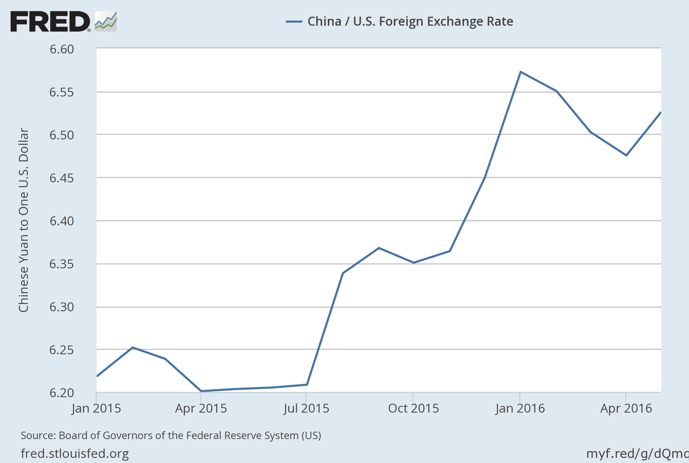
RMB/$ rate rose sharply, Aug. 2015 & Jan. 2016.
RMB/$ exchange rate

Slide 6
2015 Chinese financial turmoil
Two very different reactions.
  1) In US politics: It is more “currency manipulation.”
  2) In financial markets:
  It is evidence of trouble in China’s economy,
    mismanagement by the authorities
      of exchange rate & stock market.
    A hard landing, as the Chinese economy slows.
  Both reactions were wrong.

Slide 7
1) Clear evidence: it was not currency manipulation.
China’s FX reserves peaked in June 2014.
Since then, the PBoC has spent a record
$1 trillion to slow RMB depreciation vs. the $.
The most essential of the criteria used to define “currency manipulation” is reserve accumulation.
Yet American politicians were very slow to realize that China was no longer manipulating the RMB;
  If the PBoC were to stop FX intervention
  and move to a fully market-determined rate,
  under post-2014 conditions its currency would
  depreciate, not appreciate.

Slide 8
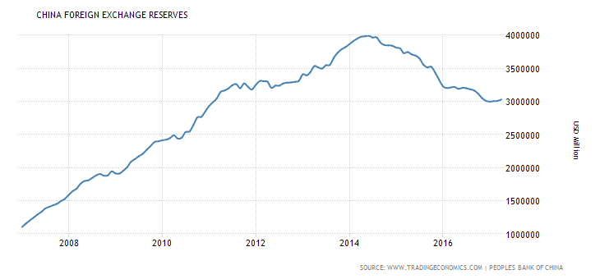
China’s foreign exchange reserves peaked at $4 tr. in June 2014
& fell by $ 1 trillion through April 2017.
PBoC is no longer intervening to push down the RMB. The opposite!

Slide 9
The end of RMB manipulation
The realization that China was no longer pushing the RMB down spread slowly.
The last politician to get the message:
President Trump.
  As recently as February 23, he called China
  the “champion of currency manipulators,”
    as he had throughout his election campaign.
  On April 12, he suddenly changed:
  “they’re not currency manipulators,”
    yet without admitting he had been wrong before.

Slide 10
True, ten years ago the RMB was undervalued by just about any criterion.
≈ an estimated 25%-35%, by the price criterion:
  income-adjusted PPP, estimated 2000, 2005, or 2009.
    i.e., the “Balassa-Samuelson” relationship.
    Frankel (2005, 06); Subramanian (2010); Chang (2012).
=> China ran big balance of payments surpluses
for a decade.
=> The PBoC clearly was intervening to hold down the value of the RMB.

Slide 11
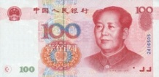
The Balassa-Samuelson Relationship
2005
The Balassa-Samuelson line in 2005
In 2005 the RMB was cheap, even
taking into account China’s income
}
•
Arvind Subramanian, PB10-08, PIIE, 2010
Undervaluation of RMB estimated in the regression = 26% in 2005.

Slide 12
But the RMB underwent real appreciation during 2005-11,
by 25% against the $.
Appreciation versus the $, nominal and real

Slide 13
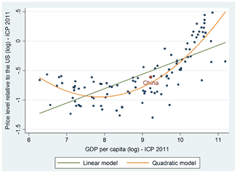
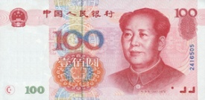
  By 2011, China’s relative prices were roughly in line with the normal relationship (Balassa-Samuelson).
The Balassa-Samuelson line in 2011
•
Kessler & Subramanian, PIIE, May 2014 “Is the Renminbi Still Undervalued? Not According to New PPP Estimates”
Benchmark years | GDP per capita (in PPP dollars) | RMB undervaluation (percent)
2005 | 4,802 | -34.5
2011 | 10,057 | -9.7

Slide 14
  With another 10% appreciation by January 2014,
  the RMB was, if anything, a little overvalued.
A trend of real appreciation 2005-2014
Dooley, Folkerts-Landau, Garber (2014)

Slide 15
Why has the RMB depreciated since 2014?
Could China have been using other means to push it down?
No.
Liberalization of controls on capital outflow was slowed, to try to reduce the downward pressure.
  Appropriate, even if it means delaying
  the project to internationalize the RMB.
The post-2014 depreciation was
due to economic fundamentals.

Slide 16
The FX fundamentals had turned negative,
China’s economy began to slow down in 2011-14
  after 3 decades averaging 10% growth.
  The PBoC began to cut interest rates November 2014.
High currency, slowed growth, interest rates cuts…
Thus it is no surprise that China started to experience capital outflows and payments deficits after June 2014,
  and that the currency started to depreciate.

Slide 17
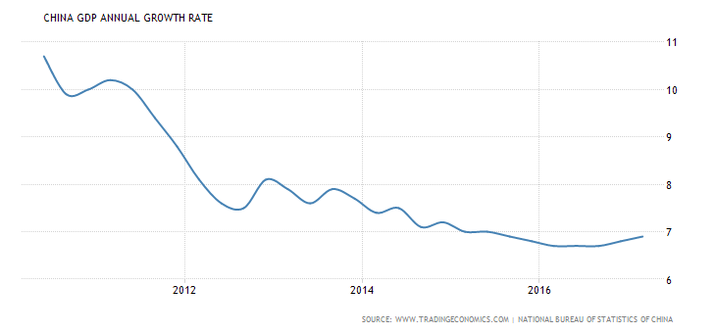
The economy slowed down, from ≈ 10% in the 30 years up to 2010, to ≈ 7% by 2015.

Slide 18
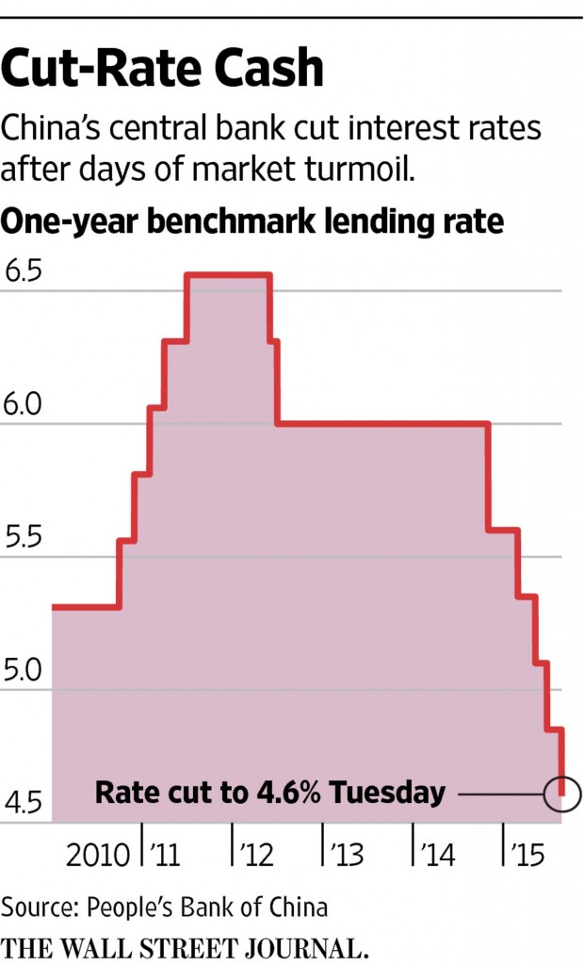
The PBoC responded to the slowdown
by cutting interest rates, Nov. 2014-Aug. 2015.
Aug. 25, 2015

Slide 19
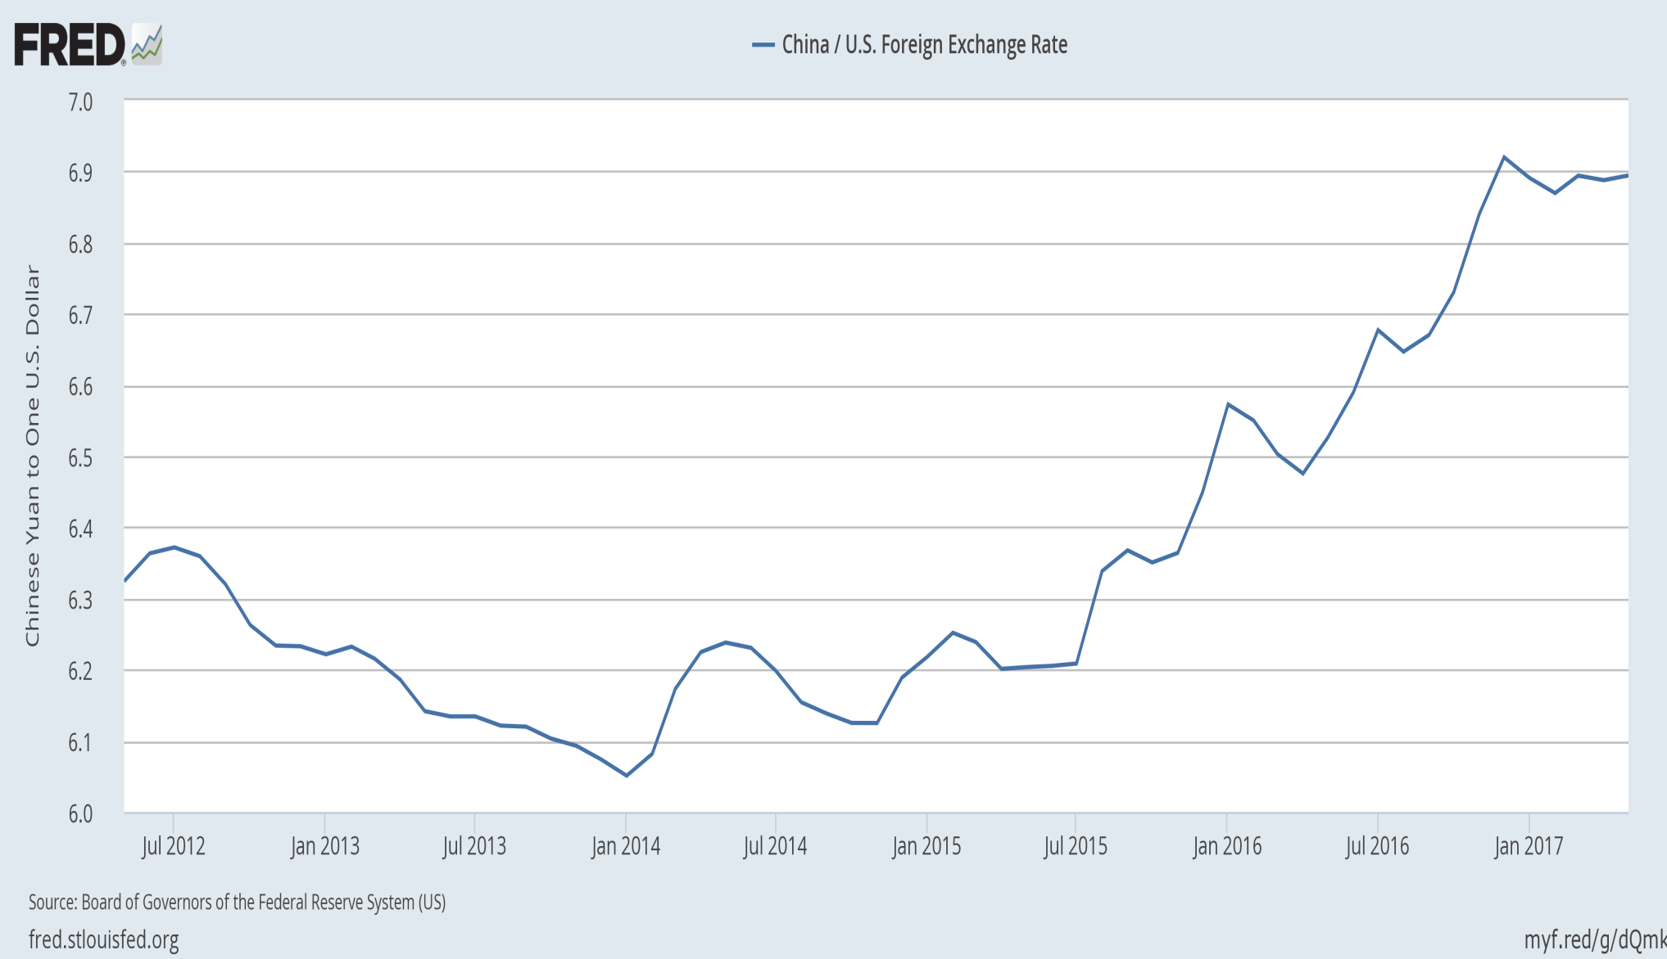
=> Depreciation of RMB, 2014-16
RMB/$ exchange rate

Slide 20
2) So, then, was the financial turmoil of 2015 evidence that China’s slowdown was likely to take the form of a hard landing?
I would say, again, “no.”
(i) The GDP slowdown had already
been well underway since 2012.
(iii) The stock market plunge of June 2015-Jan. 2016 merely reversed part of the preceding bubble.
  Stock prices did not fall as far as 2013 levels.

Slide 21
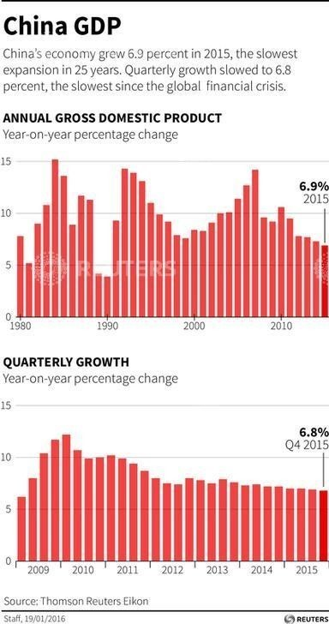
Slowdown
-- from 10% average of 1980-2010, to below 7% in 2015 –
began well before the fall in the stock market & RMB.
30 years of strong Chinese growth
Source: Reuters
https://www.weforum.org/agenda/2016/04/5-charts-explain-imf-global-growth-forecast/

Slide 22

The stock market plunge merely reversed (part of) the preceding bubble.
Total share prices for all shares in China

Slide 23
Macro management
True, government efforts to prop up the stock market in 2015 were clumsy.
But turning to the larger question of China’s macroeconomic management, it has arguably made fewer mistakes than other major countries.
  E.g., ECB’s delay in easing after the 2008 crisis,
  Premature end of US fiscal expansion in 2011,
  Japan’s consumption tax rise in April 2014.
China’s macro policy has been mostly counter-cyclical.

Slide 24
Slower long-term growth path
Growth in 2014-17 has slowed
down to about 6-7%. Why?
Convergence
    K/L ratio,
    technical catch-up,
    rural-urban migration
      Lewis (1954) turning point reached in 2010?
      Zhang, Yang & Wang (2011)..
Middle-income trap?
  e.g., Eichengreen, Park & Shin (2012)
Regression to the mean:
  Pritchett & Summers (2014)

Slide 25
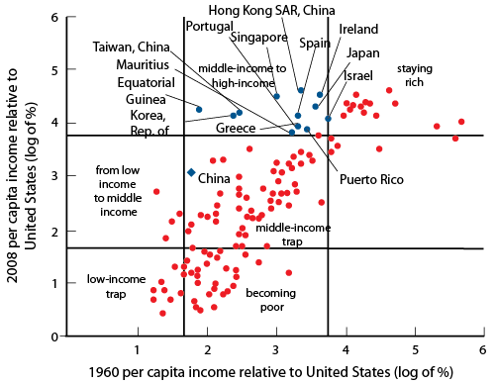
Is there a middle-income growth trap?
•
•
Eichengreen, Park & Shin 2011, “When Fast Economies Slow Down: International Evidence & Implications for China”
NBER WP 16919.
“Avoiding middle-income growth traps,” Agénor, Canuto, Jelenic ,VoxEU, Dec. 2012
“…at per capita incomes of about US$16,700 in 2005 constant international prices, the growth rate of per capita GDP typically slows from 5.6 to 2.1%.
Eichengreen, Park & Shin( 2011): growth slowdowns are essentially productivity growth slowdowns.”

Slide 26
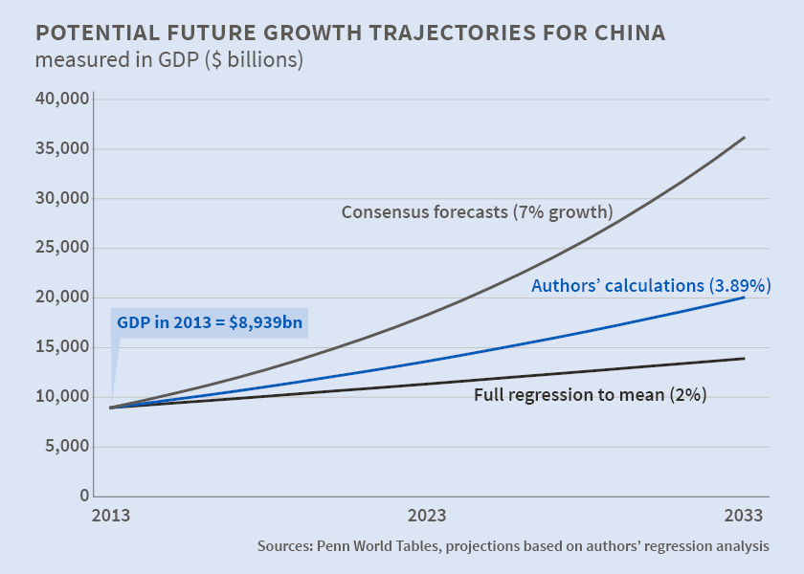
Pritchett & Summers (2014): “Regression to the mean” fits the data better than middle-income trap
“Asiaphoria Meets Regression to the Mean,” NBER WP No. 20573, Lant Pritchett & Lawrence Summers

Slide 27
Transition to slower growth path
The fear a year ago was that China’s transition would come with a hard-landing.
  GDP would fall more than potential GDP.
  Debt has been a particular source of concern.
    Leverage becomes unsustainable when growth slows.
    Bad loans in the shadow banking system.
    Moral hazard from the routine of bailing out failed debtors, especially SOEs.
But it looks like the hard landing
has been averted, at least for now.

Slide 28
Needed reforms
Recognized by Chinese government,
  e.g., at the Third Plenum of 2013
Some have been pursued:
  Anti-corruption drive.
  Shifting composition of GDP
    From Investment and Net Exports, to Consumption
    From Manufacturing to Services.
But some have seen insufficient progress:
    Reform of State Owned Enterprises
    Market orientation
    Hukou system
    Rural land rights
    Environment

Slide 29
Conclusions
It was probably inevitable, after 3 decades of 10% growth, that the rate of growth of China’s potential output would slow down to a more sustainable rate, say 6%.
The open question was whether the transition would take the form of a hard landing (crisis + growth less than potential) or soft landing.
The financial turmoil of summer 2015 was noise;
  it did not convey useful information.
So far, China seems to be escaping the hard landing.

Slide 30
China in the World Economy
Jeffrey Frankel
National University of Singapore, May 25, 2017

Slide 31
Appendices
(I) Exchange rate policy,
leaning against the wind:
  2005-11: resisting appreciation
  2014-17: resisting depreciation
(II) Macroeconomic policy,
mostly counter-cyclical
  (1) 2007-08 overheating
  (2) 2009 downturn
  (3) 2010: overheating resumed

Slide 32
(I) Exchange Rate Policy, 2005-11
As of 2005-2008, there were several good reasons to allow RMB appreciation, leaving aside US pressure.
External balance: Reserves were increasing rapidly
  to levels high enough for precautionary purposes.
  Sterilization was becoming more difficult.
Internal balance: The economy was overheating.
Currency regime: A country as large as China
should have a flexible exchange rate.
  Better to exit the peg in good times than in crisis.
PPP: The RMB was “undervalued” by the price criterion
  even taking into account China’s GDP/cap (see graph).
Frankel, 2006, "On the Yuan: The Choice Between Adjustment Under a Fixed Exchange Rate and Adjustment under a Flexible Rate," Understanding the Chinese Economy, G.Illing, ed. (Oxford U. Press).

Slide 33
The end of undervaluation: 2011-14
Various key measures suggest that China
achieved much of the needed trade adjustment between 2009 and 2013:
Substantial real appreciation of the RMB
brought it close to equilibrium.
  Some nominal appreciation and
  some price inflation &, especially, wage increases.
Its external surplus peaked in 2008 --
  current account > 10% of GDP --
  and then narrowed sharply by 2013.

Slide 34
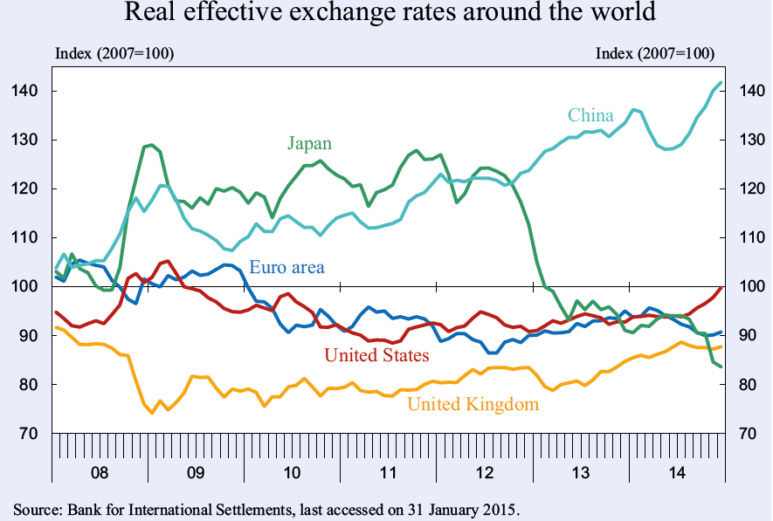
Against an average of currencies, rather than just the $, the RMB hit a record high in 2014.
http://www.cesifo-group.de/ifoHome/policy/EEAG-Report/Archive/EEAG_Report_2015/eeag_2015_report.html

Slide 35
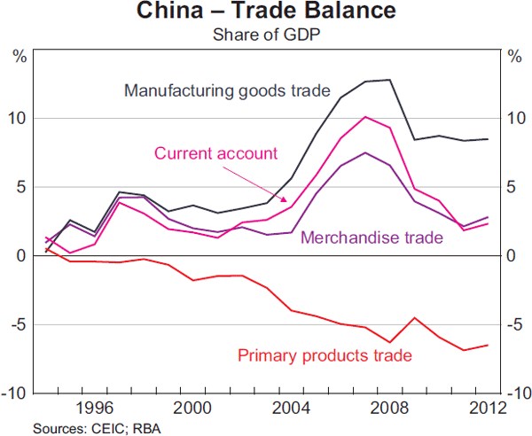
China’s trade surplus peaked in 2007, and then fell.
Source: Reserve Bank of Australia (June 2013)
China runs a deficit in primary products, offset by a surplus in manufactures.

Slide 36
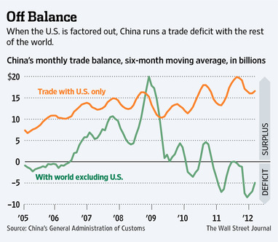
China’s trade balance
The bilateral surplus with the United States
is as big as ever – which has no economic importance,
but is politically sensitive.

Slide 37
The natural adjustment process was delayed.
1st, because the authorities intervened to keep
the exchange virtually fixed against the dollar,
in the years 1995-2005 and 2008-2010.
2nd, wages had not fully adjusted to (rising) marginal product of labor in coastal factories
  surplus labor in countryside (A.Lewis, 1954)
  impediments to migration (hukou system).
China continued to undersell the world.

Slide 38
But prices eventually adjusted.
Labor shortages began to appear =>
China’s urban workers won rapid wage hikes.
Meanwhile another cost of business,
land prices, rose even more rapidly.
The yuan was finally allowed to appreciate
against the $ during 2005-08 & 2010-11,
by 25% cumulatively
    =17% + 8%,
    though less against other currencies.

Slide 39
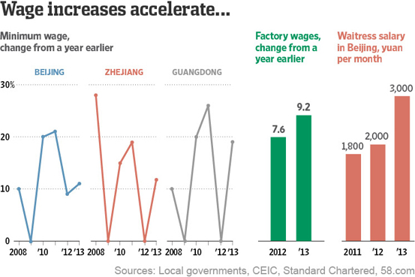
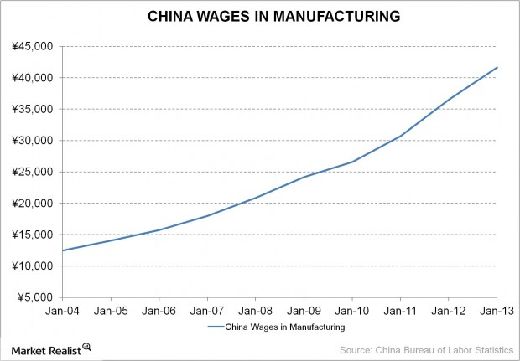
Chinese wages rose
Source: “China’s wage inflation,” marketrealist.com, Aug. 28, 2013

Slide 40
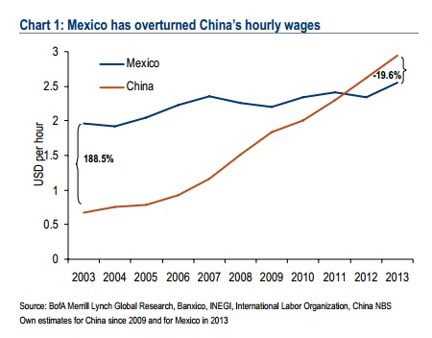
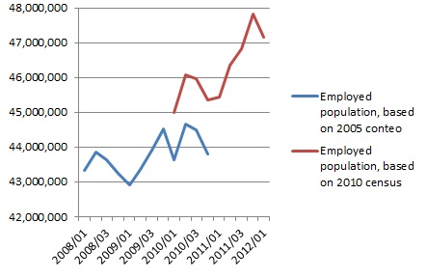
In response to rising wages, some labor-intensive manufacturing has moved out of China
Mexican employment is rising
Source: Noel Maurer, April 2013

Slide 41
5 types of adjustment are gradually reallocating resources in response to the new high level of costs in the factories of China’s coastal provinces:
1st, some manufacturing has been migrating inland,
  where wages & land prices are still relatively low.
2nd, export operations are shifting to Vietnam or Bangla Desh
  where wages are lower still.
3rd, Chinese companies are beginning to automate,
  substituting capital for labor.
4th, they are moving into more sophisticated products,
  following the path blazed earlier by Japan, Korea, & other Asian tigers
    in the “flying geese” formation.
5th, multinational companies that had in the past moved some stages of their production process to China, out of the US
or other high-wage countries, are now moving back.

Slide 42
American politicians find it hard to let go of the syllogism that seemed so unassailable just a decade ago:
  (1) The Chinese have joined the world economy;
  (2) their wages are $0.50 an hour;
  (3) there are a billion of them, and so
  (4) their exports will rise without limit:
  “Chinese wages will never be bid up in line
  with the usual textbook laws of economics
  because the supply labor is infinitely elastic.”
But it turns out that the laws of economics do eventually apply after all -- even in China.

Slide 43
Expansion of the services sector.
This 6th dimension of adjustment still lags behind,
despite the consensus in favor of it (3rd plenum, 2014).
China has had great success in manufacturing
  especially via exports.
Now it needs to help the other side of the economy
catch up: services, via domestic demand
  Retail, education, environmental quality,
  health care, pensions, social safety net.
  With the economy in slowdown in 2014-16,
  some of this could be done via government spending
  as China did in 2009. But that was heavy investment.
  Better to allow households to consume more.

Slide 44
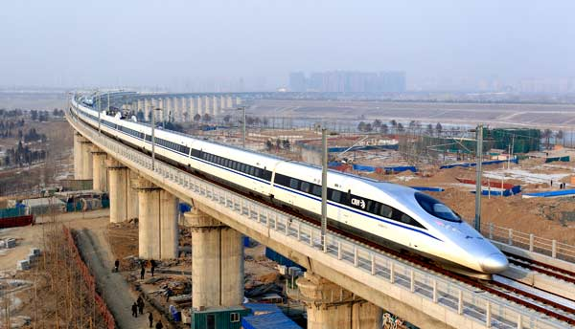

(II) Countercycal macro policy
(1) 2007-08 overheating
  => monetary tightening.
(2) 2009 downturn
  => fiscal expansion.
(3) 2010: overheating resumed
  => monetary tightening

Slide 45
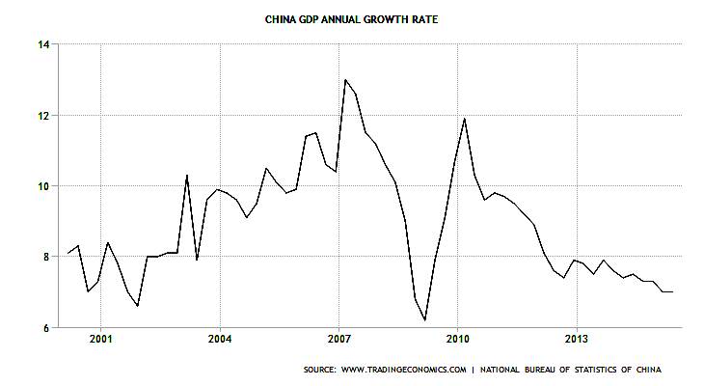
(1) 2007-08 overheating
(a) Real growth > 10% in 2007-08.
Growth > 10%

Slide 46
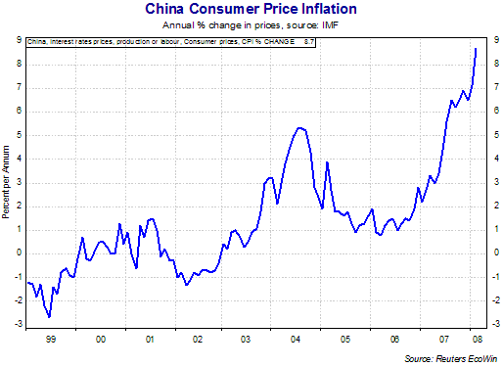
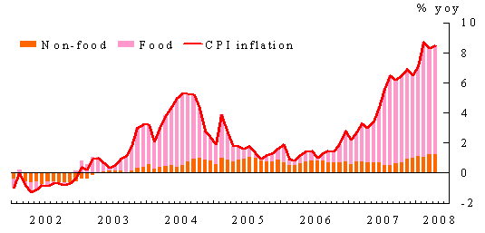
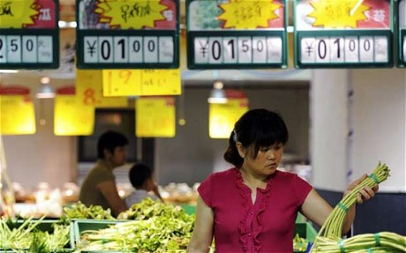
(b) China’s CPI accelerated in 2007-08.
L6 appendix
Inflation 1999 to 2008
Source: HKMA, Half-Yearly Monetary and Financial Stability Report, June 2008

Slide 47
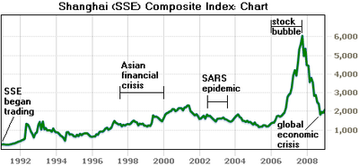
(c) Apparent 2007-08 bubble in stock market
Data from EconStatsTM, Reuters, and major online news outlets such as the BBC & NYT.

Slide 48
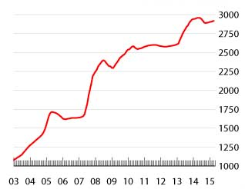
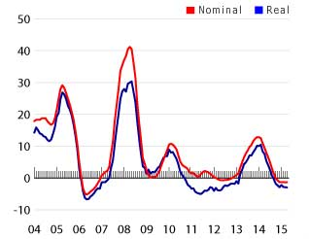
(d) Apparent 2008 bubble in housing market.
Second-hand House Price Index, Shanghai (2003=1000)
House price
change, Shanghai
(% change over
a year earlier)
Data source: eHomeday
www.globalpropertyguide.com/real-estate-house-prices/C#china

Slide 49
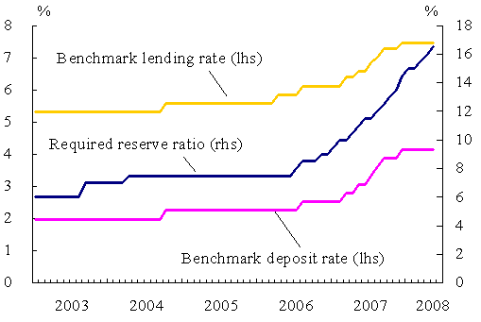
The PBoC tightened money by raising reserve ratios
and also raising lending interest rates
Source: HKMA, Half-Yearly Monetary & Financial Stability Report, June 2008

Slide 50
(2) Global recession & response: 2009
The global recession hit in 2008, 4th quarter,
  It cut China’s exports by 1/4.
Growth and inflation fell sharply.
The government responded with a big
counter-cyclical fiscal stimulus in 2009.
The economy returned to rapid growth in 2010,
  even excess demand in 2011.

Slide 51
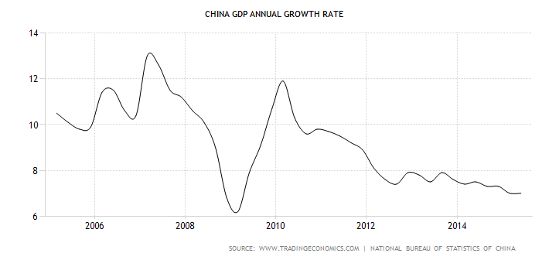
China was hit by the 2009 global recession.
2005-July 2015

Slide 52
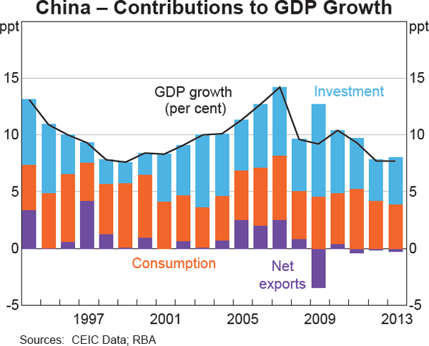
Chinese government investment spending in 2009 counteracted the recession.
}
A rise in public investment offset the loss of export demand in 2009.
Reserve Bank of Australia

Slide 53
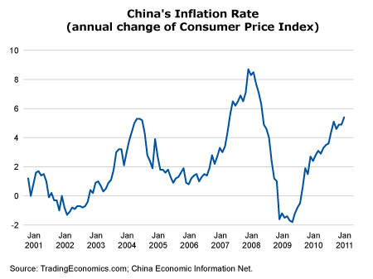
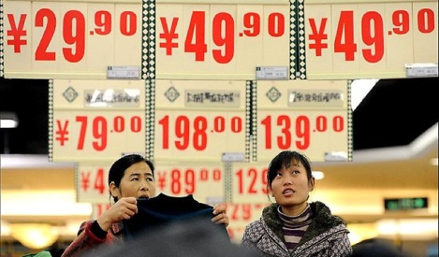
China’s inflation broke sharply in 2009,
But took off again in 2010-11.
Inflation 2001 to 2011

Slide 54
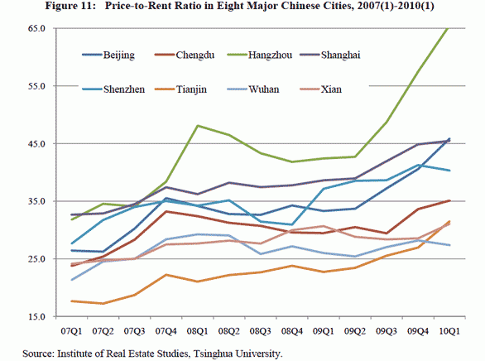

House prices rose relative even to rents in 2010, as in 2007
(3) Overheating resumed in 2010-11.
Besides general inflation, it showed up in rapidly rising land prices.
Scott Reeve blog

Slide 55
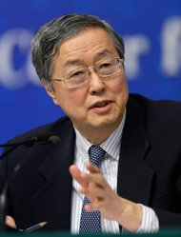
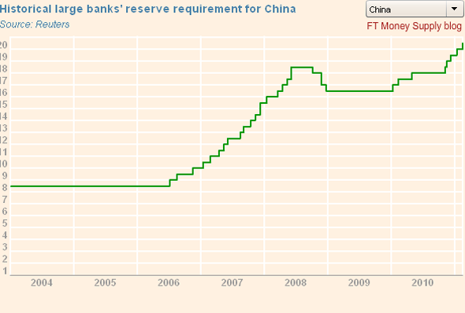
China in 2010 resumed raising reserve requirements in a renewed attempt to rein in M1 growth.

Slide 56
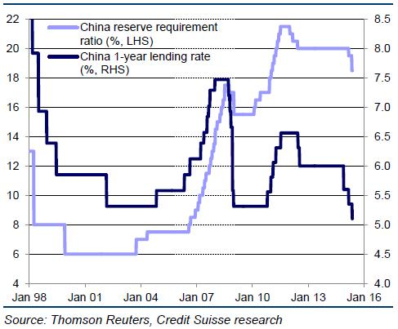
China tightened monetary policy in 2011, as it had in 2007: raising interest rates & reserve requirements.
June 1, 2015, Fiscal Times,
http://www.thefiscaltimes.com/Columns/2015/06/01/Why-China-s-Stock-Bubble-Isn-t-Ready-Burst

Slide 57

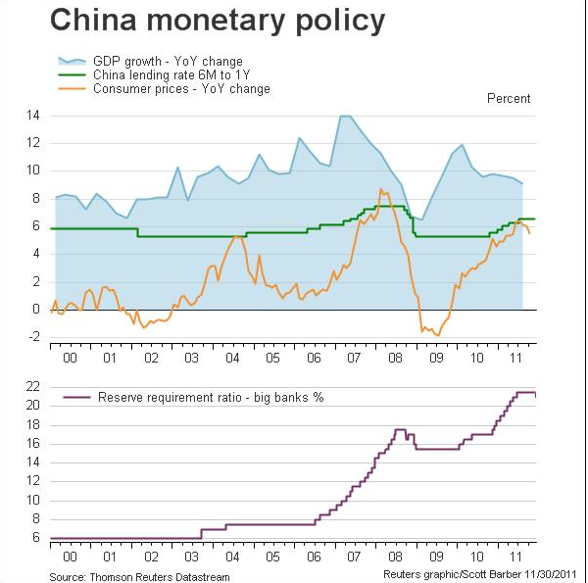

China’s tightened money in 2010-11 to help head off
rising inflation,
$\frac{d\overline{y} }{dt}$?
as it had in 2004
& 2008.
Fxtimes.com

Slide 58
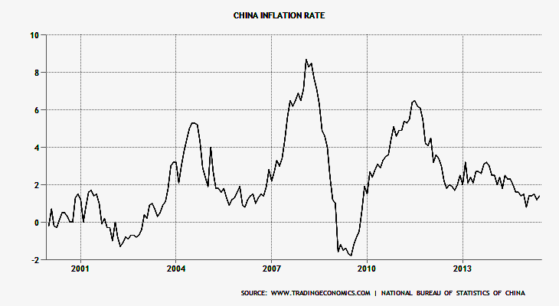

Chinese inflation fell in 2012,
as it had in 2008-09.
Annual change in CPI, through August 2015

Slide 59
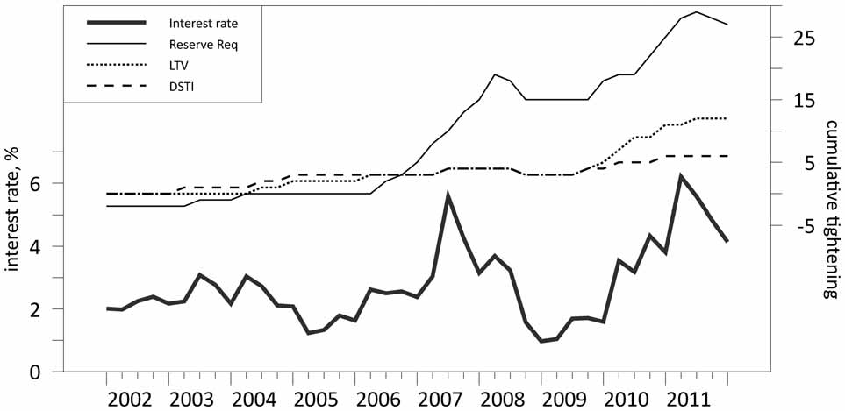
Besides tightening monetary policy in 2011, China also tightened macroprudential policies, particularly in housing finance:
Loan-to-Value and Debt-Service-to-Income limits
Interest rate and credit policies in China
Fig.3, Kenneth Kuttner & Ilhyock Shim, “Can non-interest rate policies stabilize housing markets? Evidence from a panel of 57 economies,” NBER WP 19723, 2013.

Slide 60
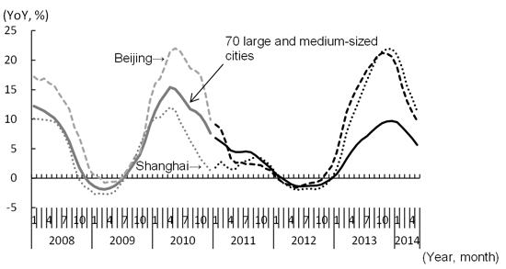
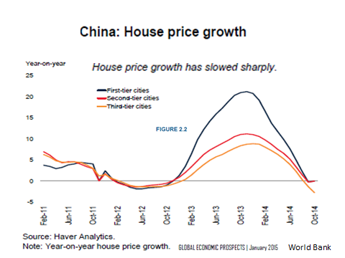
Housing prices came down in 2012,
“China's Real Estate Market Entering a Correction Phase: Housing bubble close to bursting” 6/4/14.
Note: Price Indices of Newly Constructed Residential Buildings until December 2010. Price Indices of Newly Constructed Commercial Residential Buildings from January 2011. 70 large and medium-sized cities is the simple average. Data Source: Compiled by the author based on the CEIC Database (Original data from the National Bureau of Statistics of China)

Slide 61
Relevant publications by the speaker
On the Yuan: The Choice Between Adjustment Under a Fixed Exchange Rate and Adjustment under a Flexible Rate,” in Understanding the Chinese Economy, edited by Gerhard Illing, (Oxford University Press), 2006, 246-275.
"The Renminbi Since 2005," in The US-Sino Currency Dispute: New Insights from Economics, Politics and Law, edited by S.Evenett (CEPR) 2010, 51-60.
"Misinterpreting Chinese Intervention in Financial Markets," China-US Focus, September, 2015
"Congress, China, and Currency Manipulation," China-US Focus, vol. 6, April-May 2015, 36-38.
“Globalization and Chinese Growth: Ends of Trends?” 2017, Il Grande Sconvolgimento, edited by Paolo Onofri (Il Mulino). HKS RWP 16-029.

