Slide 1
The Dollar versus the Euro as International Reserve Currencies
Menzie D. Chinn (University of Wisconsin, Madison)
Jeffrey A. Frankel (Harvard University)
Hiro Ito (Portland State University)
The ECB@25 Symposium
Erasmus University
January 16, 2024

Slide 2
Menzie Chinn & Jeffrey Frankel (2005, 2007), “Will the Euro Eventually Surpass the Dollar as Leading International Reserve Currency?”
At that time, we estimated an equation to determine aggregate central banks’ holdings of $ reserves, vs. DM, vs. ¥, vs. £, over 1973-1998.
Four key determinants
  Size of economy where currency is issued: GDP
  Size of financial markets located in host country: forex turnover
  Issuer’s ability to discipline its exorbitant privilege & so maintain the value of its currency: average rate of depreciation.
  Network externalities: long lag in effects + tipping-point functional form.
Then we used the estimates to simulate future $ vs. € shares.
We found: € would catch up with $ by 2020, provided
  UK & Sweden joined € so that its GDP & financial markets surpassed US.
  The $ continued its trend depreciation.
Neither of those two things happened. Euro’s share stayed below 20%.
  Nevertheless, the $ share has continued its slow decline.

Slide 3
A lot has changed since 2005…
The “new view” of Eichengreen (2010) de-emphasized network externalities & consequent lags.
The RMB replaced the € as the most-discussed eventual $ rival.
  -- Euro (& SGP) fared poorly, 2008-2010.
  -- Subramanian (2011), e.g., forecast RMB would eclipse $ by 2020.
Abuse of exorbitant privilege not limited to deficits (=> depreciation),
but can also consist of frequent use of sanctions.
  -- E.g., US & EU against Russia in 2014 & 2022.
Gold re-joined the roster of active international reserve assets.
China’s era of 10% growth & capital account liberalization ended in 2014.

Slide 4
New sorts of data have become available…
China, previously a non-reporting reserve holder, began to allow the IMF to include the composition of its holdings in COFER.
Whereas most earlier studies only had aggregate central bank holdings of the reserve currencies, it became possible to construct the data holder-by-holder.
  -- thereby greatly increasing the data set
  -- plus allowing additional determinants such as bilateral trade and bilateral vulnerability to geopolitical sanctions
  -- E.g., Ito & McCauley (2020) and Chinn, Ito, & McCauley (2022).
  So it is a good time to update our paper of 19 years ago.

Slide 5
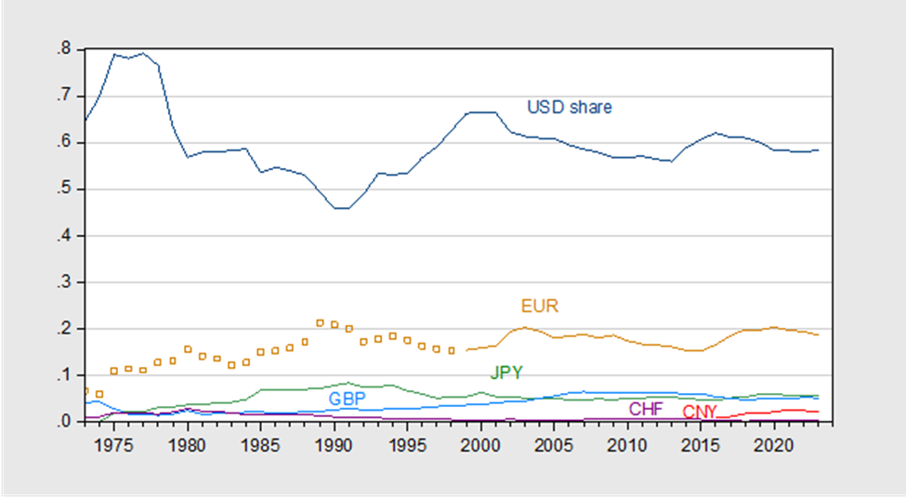
Aggregate Holdings: IMF Annual Reports & COFER

Slide 6
Explaining Aggregates pre-1999
1973-1998, USD, DEM, FFR, GBP, JPY, SFR,

Slide 7
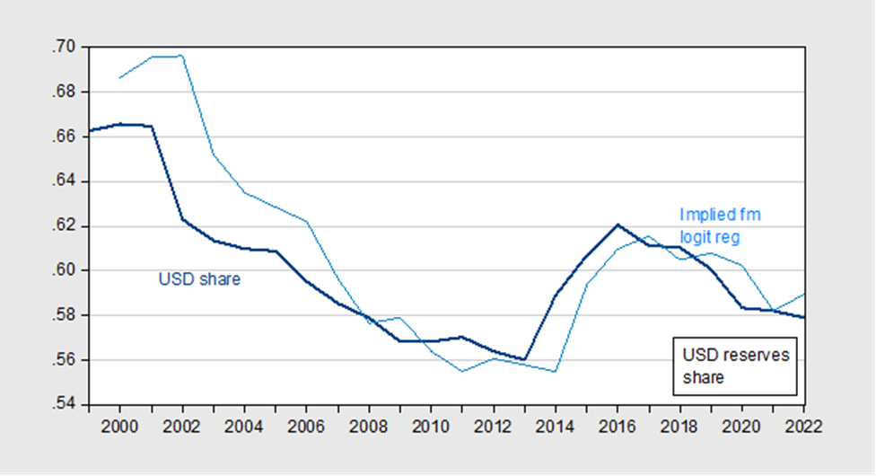
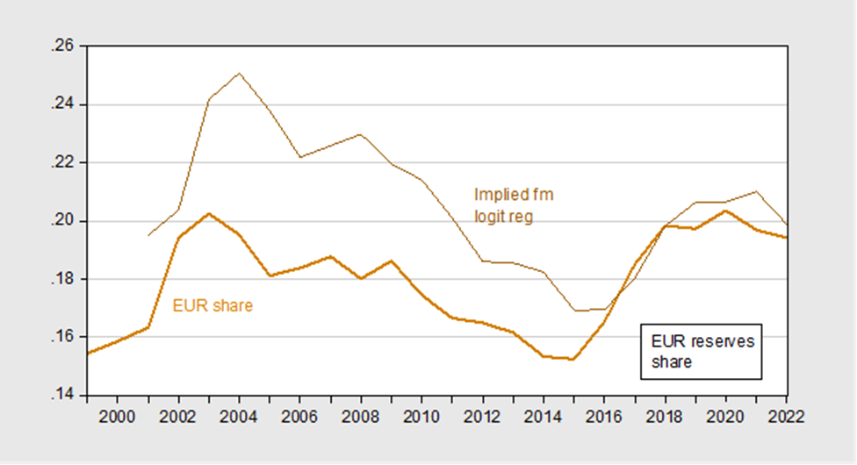
Using pre-Euro Equations

Slide 8
Post-EMU Sample
Estimated over USD, EUR, GBP, JPY, RMB
Note every coefficient is different except autoregressive coefficient
Wrong signs on all but AR coefficient
The limit of aggregate regressions

Slide 9
Central Bank Holdings, Currency-by-Currency
Ito-McCauley (JIMF, 2020) database on individual CB holdings
55 countries, ex-reserve currency issuers US, Euro, UK, Japan, China
Focus for USD holdings, then EUR holdings, then JPY holdings…
Use reserve share (few observations at bounds for USD, EUR)
Country j specific variables
Country j alliance w/ctry i
Sanctions by US, EU, UN on country j

Slide 11
Largest std’d beta

Slide 13
i
Largest std’d beta

Slide 14
Central Bank Holding Shares, 5 Reserve Currencies

Slide 15
Central Bank Holding Shares, 5 Reserve Currencies
Size matters

Slide 16
Central Bank Holding Logit, 5 Reserve Currencies

Slide 17
Central Bank Holding Logit, 5 Reserve Currencies
Trade matters

Slide 18
CB Recursive Holdings Shares, 5 Reserve Currencies

Slide 19
Robustness Checks
Coefficients, statistical significance do not change significantly if using tobit instead of OLS.
Relative size, turnover in reserve currency issuer countries not significant
Geopolitical distance using UN voting (e.g., Goldberg & Hannaoui) similar to alliance variable
Specific sanctions variables, country i against j do not change the results.
(Invoicing share, fx turnover would enter in significantly but are highly endogenous)

Slide 20
Conclusions
The dollar retains dominance as reserve currency – due to use as anchor currency, size.
The euro is held in large part due to trade (which follows from distance)
Relative GDP matters, but only shows up when exploiting cross currency variation (as in the central bank data – five currency regressions)
Sanctions (as dummy variable) do not show up as significantly important…yet.

