Slide 1

Macroeconomic determinants
of international commodity prices
Jeffrey Frankel
Harpel Professor Capital Formation & Growth
Harvard University
National Minerals Information Center Seminar Series
U.S. Geological Survey, 991 National Center, Reston, VA
August 23, 2018

Slide 2
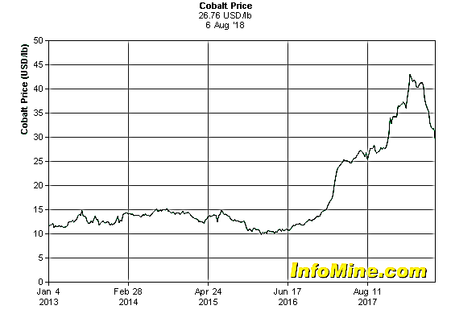
What drives commodity prices?
Individual commodities are of course influenced by individual micro causes.
  E.g., why did cobalt prices quadruple in 2017-18?
    Rising EV battery demand;
    Congo-concentrated supply hit by instability & sanctions.
Cobalt prices
Aug. 6
2018

Slide 3
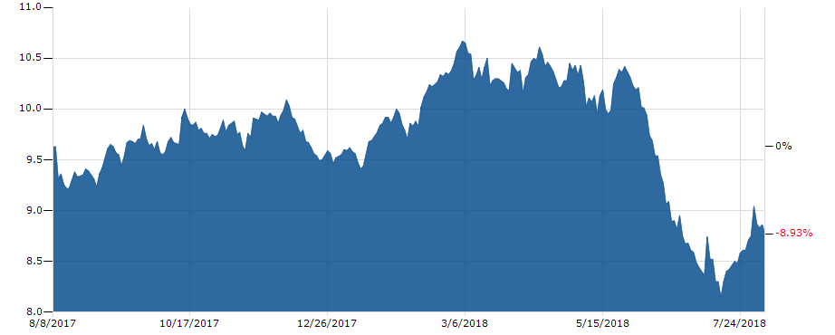
What drives commodity prices?
Individual micro causes.
  Why did soybean prices fall by 20% in June-July, 2018?
  Chinese retaliation against Trump tariffs.
Soybean option prices
Source: Business Insider, 8/7/2018

Slide 4
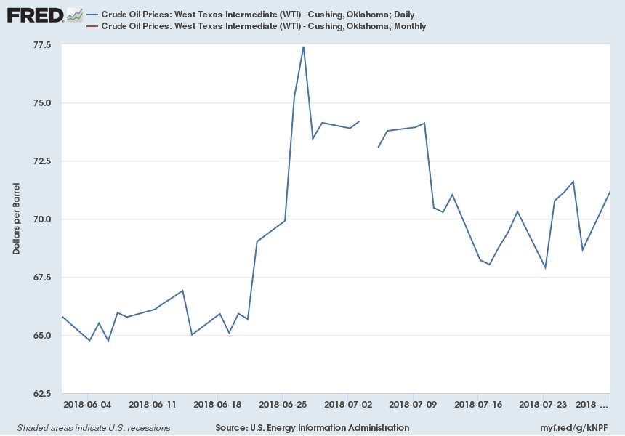
What drives commodity prices?
Individual micro causes.
  Why did oil prices rise in June?
  In part, US sanctions on Iran after withdrawing from JCPA.
Crude Oil Price: WTI – Cushing, OK, Daily
FRED, Aug. 8, 2018
Notes:
Source:
U.S. Energy Information Administration
Release:
Spot Prices
Units:
Dollars per Barrel, Not Seasonally Adjusted
Frequency:
Daily
Definitions, Sources and Explanatory Notes:http://www.eia.doe.gov/dnav/pet/TblDefs/pet_pri_spt_tbldef2.asp
U.S. Energy Information Administration,
Crude Oil Prices: West Texas Intermediate (WTI) - Cushing, Oklahoma [DCOILWTICO],
retrieved from FRED,
Federal Reserve Bank of St. Louis;
https://fred.stlouisfed.org/series/DCOILWTICO,
August 8, 2018.
Source:
U.S. Energy Information Administration
Release:
Spot Prices
Units:
Dollars per Barrel, Not Seasonally Adjusted
Frequency:
Monthly
Definitions, Sources and Explanatory Notes:http://www.eia.doe.gov/dnav/pet/TblDefs/pet_pri_spt_tbldef2.asp
U.S. Energy Information Administration,
Crude Oil Prices: West Texas Intermediate (WTI) - Cushing, Oklahoma [MCOILWTICO],
retrieved from FRED,
Federal Reserve Bank of St. Louis;
https://fred.stlouisfed.org/series/MCOILWTICO,
August 8, 2018.

Slide 5
What drives commodity prices?
But the extent to which prices of different commodities move together is striking.
    E.g., Robert Pindyck & Julio Rotemberg, 1990,
    “The Excess Co-Movement of Commodity Prices,”
    The Economic Journal.
There are direct microeconomic linkages
among some of them, to be sure.
But the correlation is broader than that.

Slide 6
Fig. 1: Commodity prices are (i) volatile & (ii) correlated.
Commodity price indexes, annual
US$ constant
2010=100
Source: Commodity Markets Outlook, World Bank Group, Oct. 2017

Slide 7


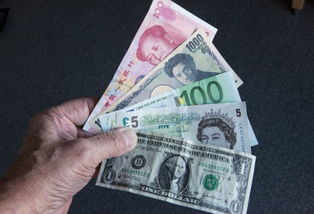
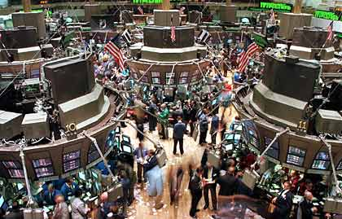
Some macroeconomic factors influence commodity prices jointly.
Economic Activity: GDP
Monetary policy: real interest rate.
The overshooting model
theory & evidence.
What about exchange rates?
Other determinants of
net convenience yield
    Inventories
    Risk premium
  The “carry trade” model.

Slide 8
1. First macro factor: overall economic activity
as measured by US GDP or a global counterpart.
  Probably China’s growth rate has mattered
  more for global commodity demand
  than that of other countries,
    e.g., Kilian & Hicks (2013).
Some of the big price swings since 2000
can be explained by GDP.
But there is more going on.

Slide 9
2. Second macro factor: monetary policy
The claim: An increase in the real interest rate r,
has a negative effect on real commodity prices,
  even controlling for GDP.
E.g., why did commodity prices:
  (i) continue to rise sharply mid-2007 – mid-2008?
    Aggressive Fed easing in 2008.
  (ii) fall sharply in mid-2014?
    The end of QE in 2014.
I have been making this case for over 30 years.
  “Overshooting model” (1984, 1986, 2006, 2008):
    effect of r on real commodity prices.
  “The carry-trade model” (2010, 2014):
    add in also convenience yield & its determinants.

Slide 10
High real interest rates reduce the price of storable commodities through 4 channels:
¤ by increasing the incentive for extraction today
  rather than tomorrow.
  Think of rates at which oil is pumped, copper mined, or forests logged.
¤ by decreasing firms' desire to carry inventories.
  Think of oil inventories held in tanks or cattle in feed lots.
¤ by encouraging speculators to shift out of spot commodity contracts, and into treasury bills.
  Think of the “financialization" of commodities..
¤ by appreciating the domestic currency
  and so reducing the price of internationally traded commodities
  in domestic terms,
  even if the price hasn't fallen in terms of foreign currency.

Slide 11
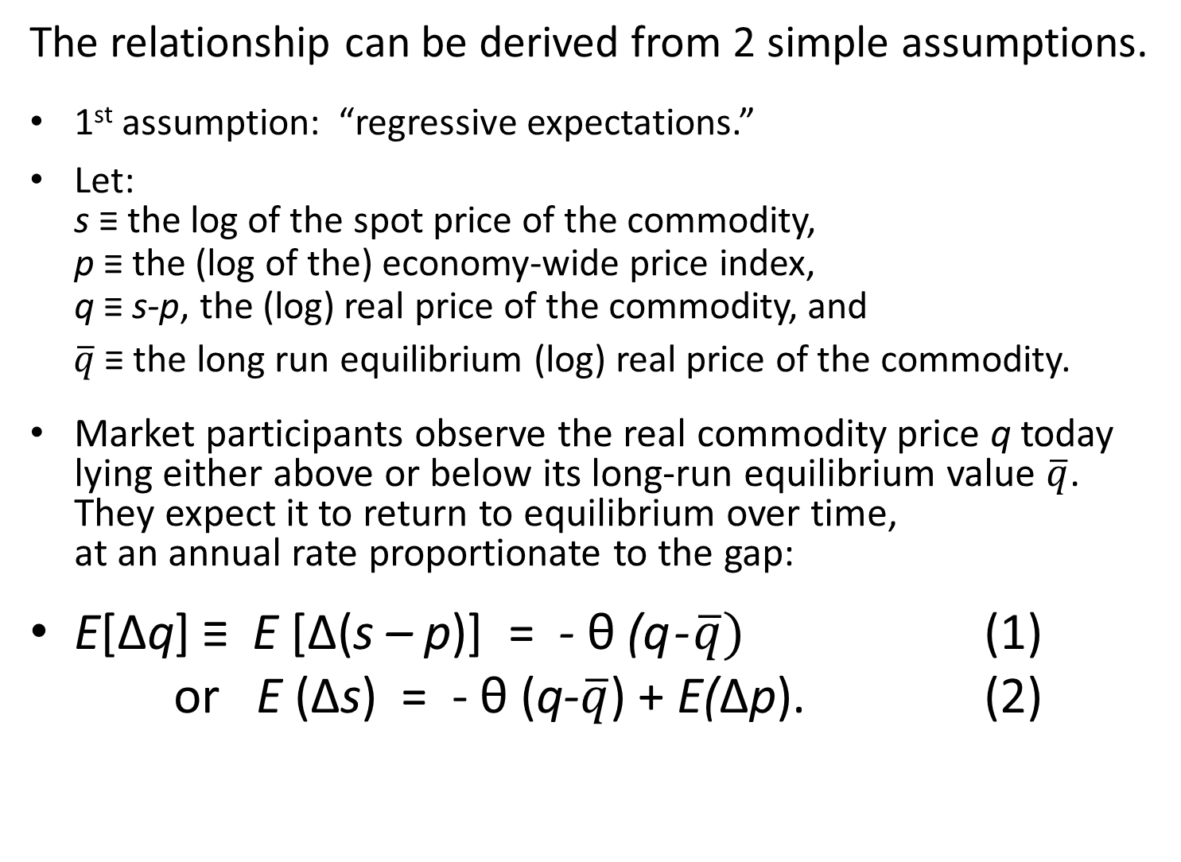
Derivation of the overshooting model
The relationship can be derived from 2 simple assumptions.
1st assumption: “regressive expectations.”
Let:
s ≡ the log of the spot price of the commodity,
p ≡ the (log of the) economy-wide price index,
q ≡ s-p, the (log) real price of the commodity, and
$\overline{q}$ ≡ the long run equilibrium (log) real price of the commodity.
Market participants observe the real commodity price q today lying either above or below its long-run equilibrium value $\overline{q}$. They expect it to return to equilibrium over time,
at an annual rate proportionate to the gap:
E[Δq] ≡ E [Δ(s – p)] = - θ (q - $\overline{q})$ (1)
or E (Δs) = - θ (q-$\overline{q}$) + E(Δp). (2)

Slide 12
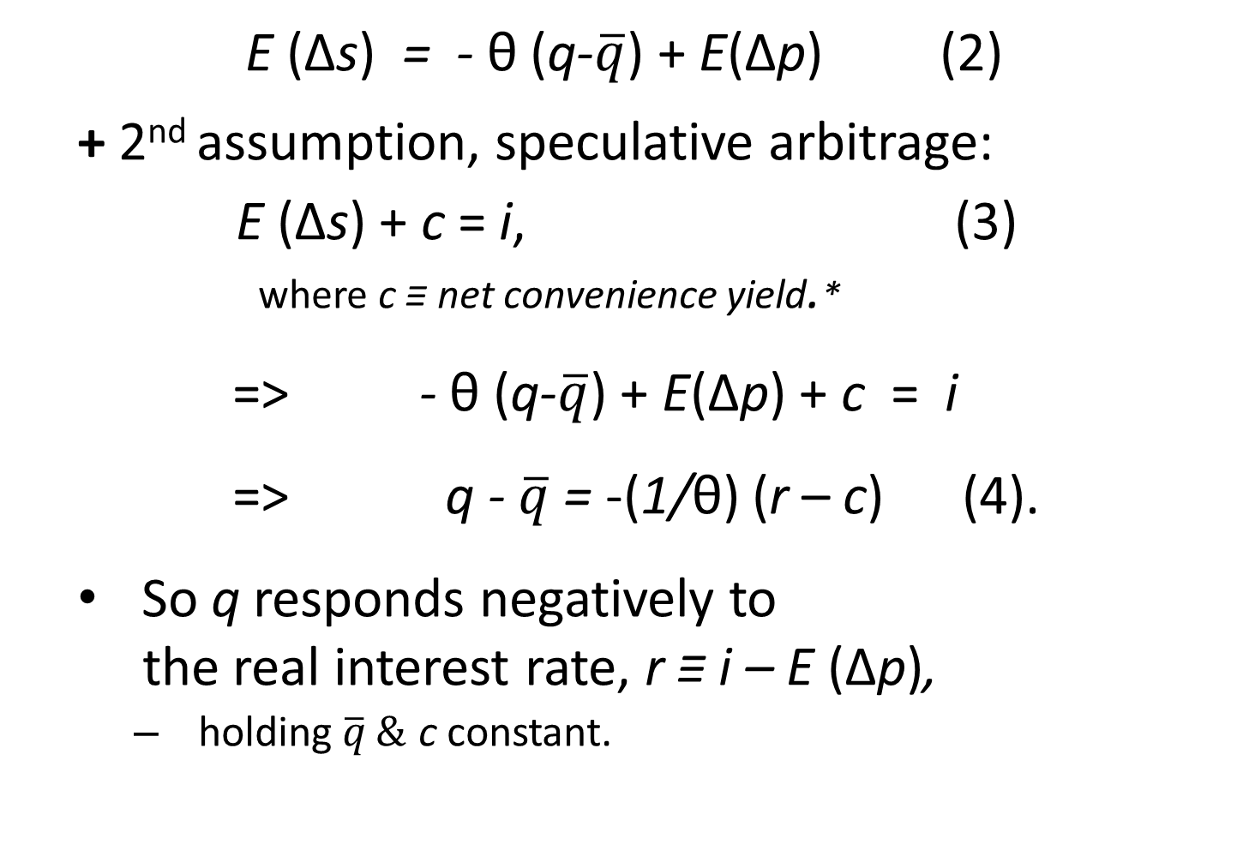
Derivation of the overshooting model, continued
E (Δs) = - θ (q-$\overline{q}$) + E(Δp) (2)
+ 2nd assumption, speculative arbitrage:
E (Δs) + c = i, (3)
where c ≡ net convenience yield.*
=> - θ (q-$\overline{q}$) + E(Δp) + c = i
=> q - $\overline{q}$ = -(1/θ) (r – c) (4).
So q responds negatively to
the real interest rate, r ≡ i – E (Δp),
  holding$\overline{q} \&$ c constant.
* c ≡ cy – sc – rp ≡ convenience yield – storage cost – risk premium.

Slide 13
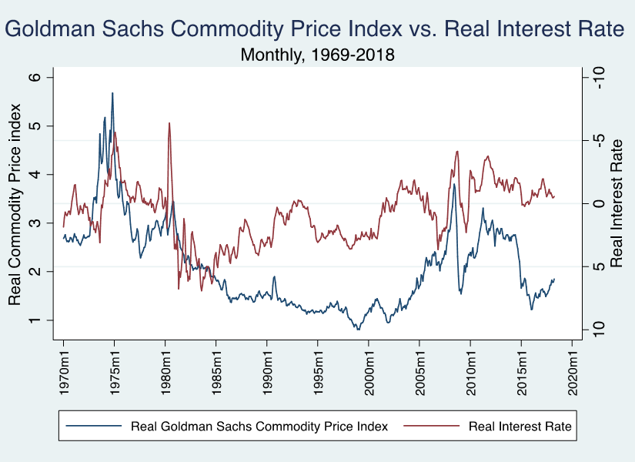
The overshooting equation: q = $\overline{q}$ - (1/ϑ)(r-c)
q is negatively related to the real interest rat r.
q
Easy
money↑
Tight
money ↓
(inverted scale)
Thanks to Marco Martinez del Angel.

Slide 14
The real commodity price index is negatively related to the real interest rate.
q
r
Thanks to Shruti Lakhtakia

Slide 15
Regression of real commodity price indices against real interest rate
(1950-2012)
OLS estimates of the overshooting equation
Table 1 | Dependent variable: log of commodity price index, deflated by US CPI
VARIABLES | CRB index | Dow Jones Index | Moody’s index | Goldman Sachs Index
Real interest rate | -0.041*** | -0.034*** | -0.071*** | -0.075***
 | (0.007) | (0.006) | (0.005) | (0.007)
Constant | 0.900*** | 0.066*** | 2.533*** | 0.732***
 | (0.017) | (0.016) | (0.011) | (0.018)
Observations | 739 | 739 | 739 | 513
R² | 0.04 | 0.04 | 0.25 | 0.18
*** p<0.01 (Standard errors in parentheses.)
Frankel (2014)

Slide 16
Feb 1951-Apr.2018 Feb 1951-Feb 2014 Feb 1951-Apr.2018 Dec1969-Apr.2018
Updated estimates of overshooting model
Commodity price indices are significantly negatively correlated with real interest rates.
 | (1) | (2) | (3) | (4)
 | Dependent variable: Log of Real Commodity Price Index
VARIABLES | CRB (BLS) Foods Price Index | Dow Jones-AIG Commodity Price Index | Moody's Commodity Price Index | Goldman Sachs Commodity Price Index
Real Interest Rate | -0.026*** | -0.026*** | -0.088*** | -0.071***
 | (0.007) | (0.007) | (0.005) | (0.006)
Constant | 0.847*** | 0.043** | 2.594*** | 0.713***
 | (0.017) | (0.017) | (0.013) | (0.016)
Observations | 807 | 757 | 807 | 581
R² | 0.018 | 0.022 | 0.295 | 0.172
*** p<0.01, ** p<0.05. (Heteroskedastic robust standard errors in parentheses.)
REAL INTEREST RATE (Month X, YEAR T) = [ 3-TBILL(Month X, YEAR T)/100 - INFLATION (Month X-1, YEAR T) ]*100 for months (Feb-Dec) ;
for Jan we take INFLATION (Month X-1, YEAR T-1). ● INFLATION (Month X, Year T) =Log CPI (Month X, Year T) – Log CPI (Month X, Year T-1).
Source for 3-month treasury bill rates: FRB of St. Louis. Source for Commodity Price Indexes: Global Financial Data
Thanks to S.Lakhtakia

Slide 17

3. What about exchange rates and commodity prices in other currencies?
The limiting case of a small country in
an integrated global commodity market:
  a 1% exchange rate change translates into an immediate 1 % commodity price change expressed in terms of local currency.
Even for the US, $ depreciation => commodity price↑
  though smaller & slower than for other countries.
Regardless the country, the exchange rate is endogenous.
Real interest differentials move real exchange rates,
  & so move local-currency real commodity prices,
  relative to the real $ commodity price.

Slide 18
Determining commodity prices in non-$ currencies.
Dependent variable: Log real CRB commodity price index in local currency
Short Rates: US r r diff. Long Rates: US r r diff.
Australia -0.023* -0.076* -0.057* -0.067*
1/1950-8/2005. (0.006) (0.003) (0.005) (0.004)
Brazil -0.024* -0.006* -0.161* 0.001
7/65-12/89, 1/95-8/05 (0.007) (0.002) (0.019) (0.001)
Canada -0.047* -0.065* -0.073* -0.076*
1/1950-9/2005 (0.005) (0.005) (0.004) (0.006)
Chile -0.063* -0.021* -0.092* -0.018*
7/1997-9/2005 (0.006) (0.004) (0.014) (0.003)
Mexico 0.055* -0.017* 0.047* 0.000
1/1978-9/2005 (0.013) (0.002) (0.011) (0.003)
NZ 0.001 -0.067* -0.081* -0.075*
3/1978-8/2005 (0.009) (0.004) (0.006) (0.004)
Switzerland 0.034* -0.054* -0.171* -0.095*
1/1980-9/2005 (0.016) (0.009) (0.013) (0.012)
UK -0.053* -0.086* -0.106* -0.023*
1/1950-9/2005 (0.010) (0.007) (0.007) (0.006)
* indicates coefficient significant at the 5% level of significance. (Robust standard errors.)
Frankel (2008)

Slide 19
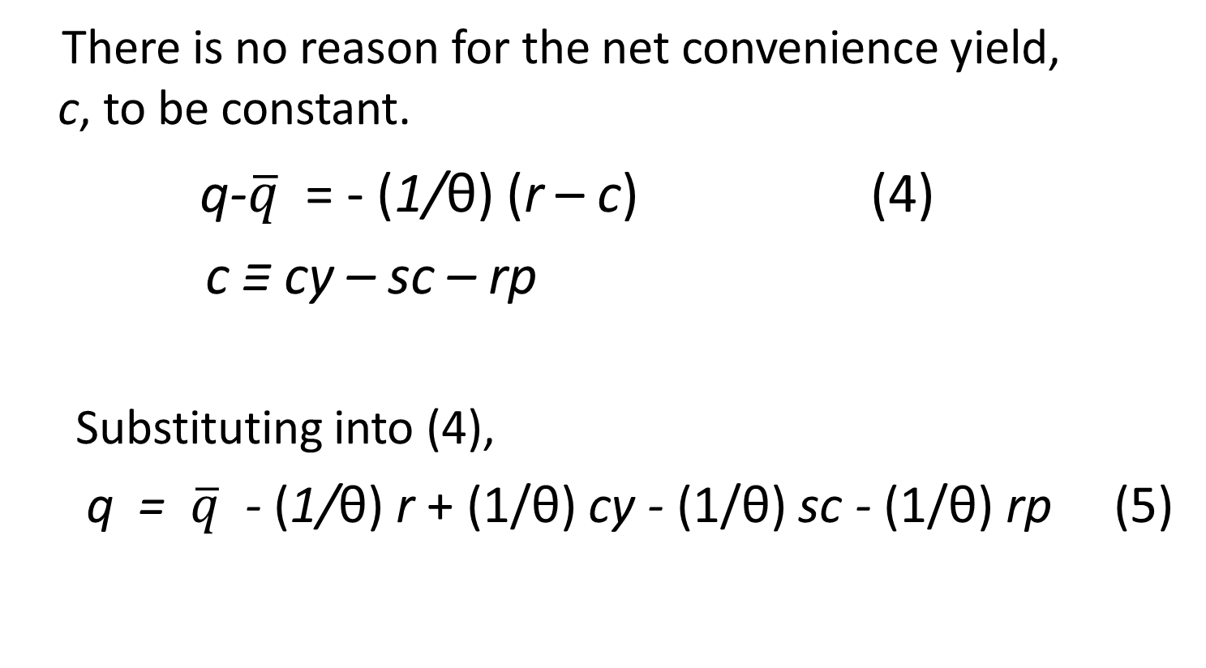
Now, complete the “carry trade” equation
4. Other determinants of net convenience yield
There is no reason for the net convenience yield,
c, to be constant.
q-$\overline{q}$ = - (1/θ) (r – c) (4)
c ≡ cy – sc – rp
Substituting into (4),
q = $\overline{q}$ - (1/θ) r + (1/θ) cy - (1/θ) sc - (1/θ) rp (5)

Slide 20
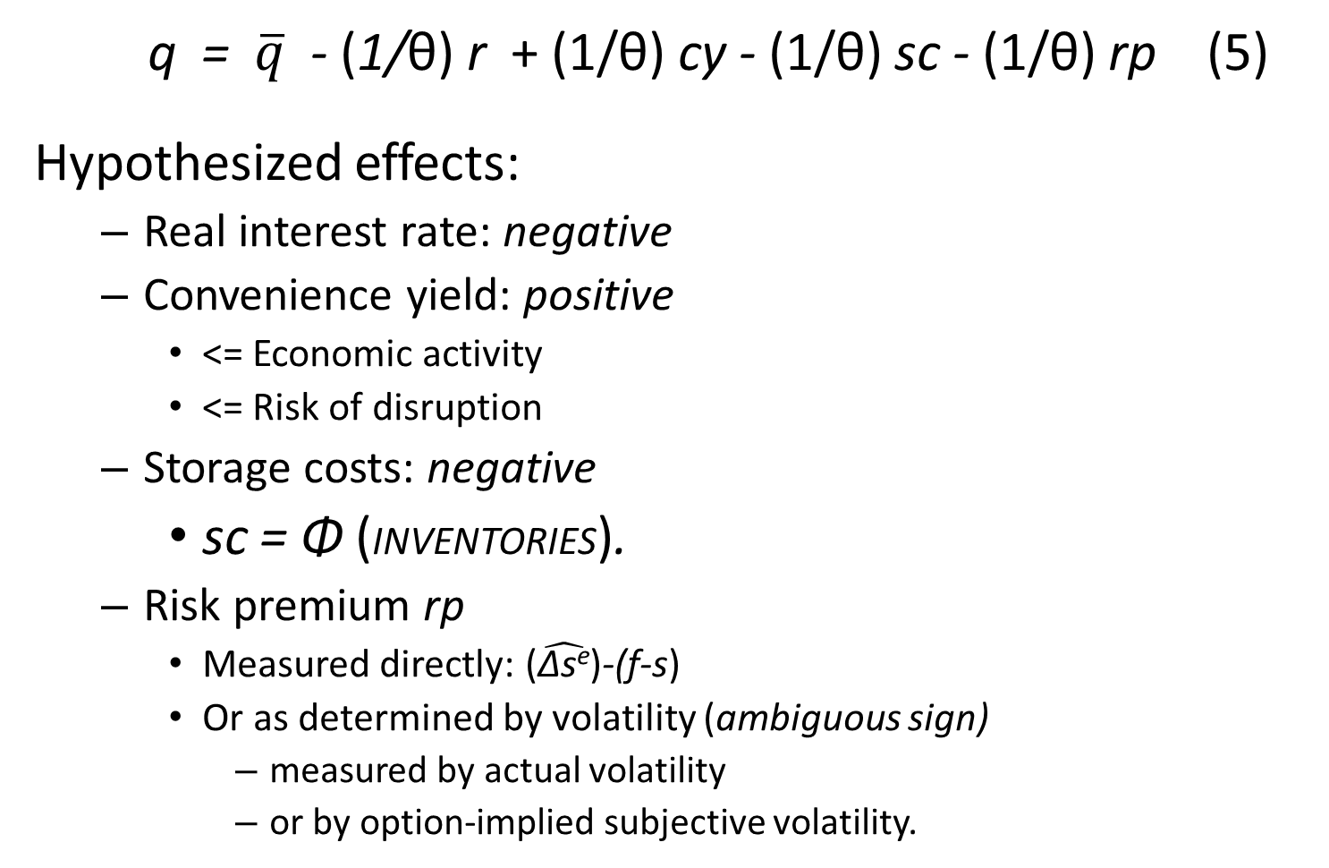
Complete “carry trade” equation for price determination, continued
q = $\overline{q}$ - (1/θ) r + (1/θ) cy - (1/θ) sc - (1/θ) rp (5)
Hypothesized effects:
  Real interest rate: negative
  Convenience yield: positive
    <= Economic activity
    <= Risk of disruption
  Storage costs: negative
    sc = Φ (INVENTORIES).
  Risk premium rp
    Measured directly: ($\hat{\text{Δs}\text{e}}$)-(f-s)
    Or as determined by volatility (ambiguous sign)
      measured by actual volatility
      or by option-implied subjective volatility.

Slide 21
Estimation of the carry-trade equation.
My 2014 paper estimated for the period 1950-2012
the complete equation that included the micro variables:
  commodity-specific data on inventories, volatility,
  and survey expectations of future price changes.
I found the real interest rate had particularly strong negative effects on the prices of copper, cattle, hogs, oats & soybeans.
Inventories had a particularly strong negative effect
on the prices of copper, oats, & platinum.
For a complete panel across the 11 commodities where all data were available, all four variables of interest appeared significant: real interest rate, global business cycle, inventories, and volatility.
  When the equation was estimated on first differences,
  significance was lost, in particular, for inventories & volatility.

Slide 22

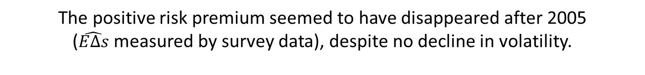
option-implied & actual volatilities
Risk premium
2 measures of volatility
(f-s) - $\hat{E∆s}$
The positive risk premium seemed to have disappeared after 2005
($\hat{E∆s}$ measured by survey data), despite no decline in volatility.
Consistent with Hamilton &Wu’s (2013) interpretation of the financialization hypothesis:
Investors in commodity indices took the long side of the futures market after 2005.
From Frankel (2014)

Slide 23
5. Updated tests
There is some negative correlation between perceived volatility as measured by the VIX
and the commodity price index.
  E.g., prices high in 2006, when VIX low (“risk on”),
  & prices low in 2009, when high VIX high (“risk off”).
But the VIX is not a significant determinant
  when controlling for r and GDP.

Slide 24
VIX-implied volatility appears negatively correlated with real commodity price index.
Less
volatile↑
More
volatile ↓
(inverted scale)
Thanks to S.Lakhtakia

Slide 25
Updated tests for real commodity price index show significant negative effect of r
and positive effect of GDP.
 | Dependent variable: Real Commodity Price Index
 | 1 | 2 | 3 | 4 | 5
Real Interest | -0.035*** | -0.015* | -0.023** | -0.029*** | -0.013
Rate | (0.010) | (0.009) | (0.009) | (0.010) | (0.008)
Real Commd | -1.627 |  |  | -1.817
PI trend | (2.203) |  |  | (1.877)
Lagged |  | 0.689*** |  |  | 0.596***
Real ComPI |  | (0.153) |  |  | (0.147)
Real |  |  | 4.676*** | 4.738*** | 3.501***
US GDP |  |  | (1.226) | (1.206) | (0.962)
Constant | 8.198 | 0.958* | 3.093*** | 8.789 | 1.244***
 | (6.928) | (0.476) | (0.040) | (5.897) | (0.455)
Observations | 47 | 46 | 47 | 47 | 46
R² | 0.150 | 0.497 | 0.300 | 0.322 | 0.587
*** p<0.01, ** p<0.05, * p<0.1 |  |  | (Robust standard errors in parentheses.)
Thanks to S.Lakhtakia

Slide 26
Consider four components of price index
In regressions for the four price indices,
r has a negative sign for all variations. It is most consistently significant in the case of industrial metals prices.
Thanks to S.Lakhtakia

Slide 27
Stylized macro effects on commodity prices
Period | GDP growth | Monetary ease | r | Value of $ | $ commodity prices
2004-07 | ↑ | ↓ | ↑ | ↓ | ↑
2007-08 | ↓ | ↑ | ↓ | ↓ | ↑
2008-09 | ↓ | ↑ | ↓ | ↑ | ↓
2010-11 | ↑ | ↑ | ↓ | ↓ | ↑
2014-16 | ↑ | ↓ | ↑ | ↑ | ↓
Forecast (My guess, as of 2018) |  |  | ↑ | ↑ | ↓

Slide 28
Some references by the author on macroeconomic determination of commodity prices.
The overshooting model: Real interest rates influence real commodity prices.
"Expectations and Commodity Price Dynamics: The Overshooting Model,“ 1986, American Journal of Agricultural Economics 68, no. 2, May, pp.344-48.
"Commodity Prices, Money Surprises, and Fed Credibility," with Gikas Hardouvelis, 1985, Journal of Money, Credit & Banking 17, no.4, Nov., 427-38.
Determinants of commodity prices in non-$ currencies
"The Effect of Monetary Policy on Real Commodity Prices," 2008, Asset Prices and Monetary Policy, John Campbell, ed. (U.Ch.Press), 291-327. NBER WP 12713.
The “carry trade” model: Determinants of convenience yield matter too.
"Determination of Agricultural and Mineral Commodity Prices," with Andrew Rose, 2010, in Inflation in an Era of Relative Price Shocks (Reserve Bank of Australia), pp. 9-51. HKS RWP 10-038.
"Effects of Speculation and Interest Rates in a ‘Carry Trade’ Model of Commodity Prices," 2014, Journal of International Money and Finance, vol.42, pp. 88-112. NBER WP 19463.

Slide 29

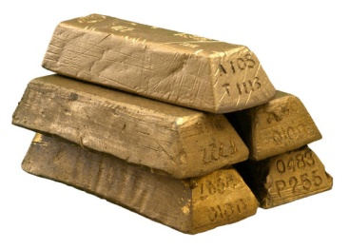
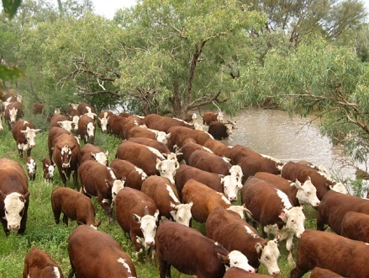
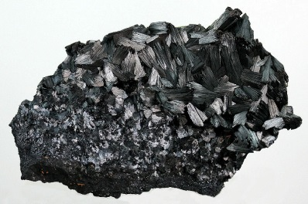




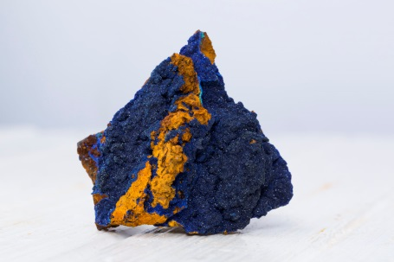
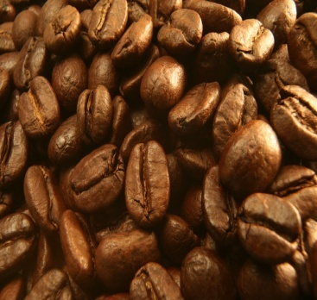




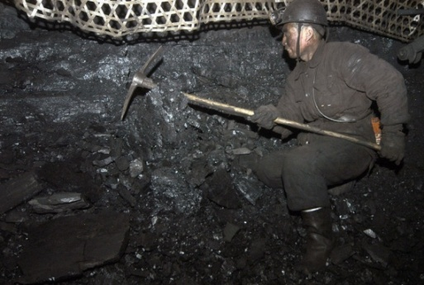

29
Notes:
29
29

Slide 30
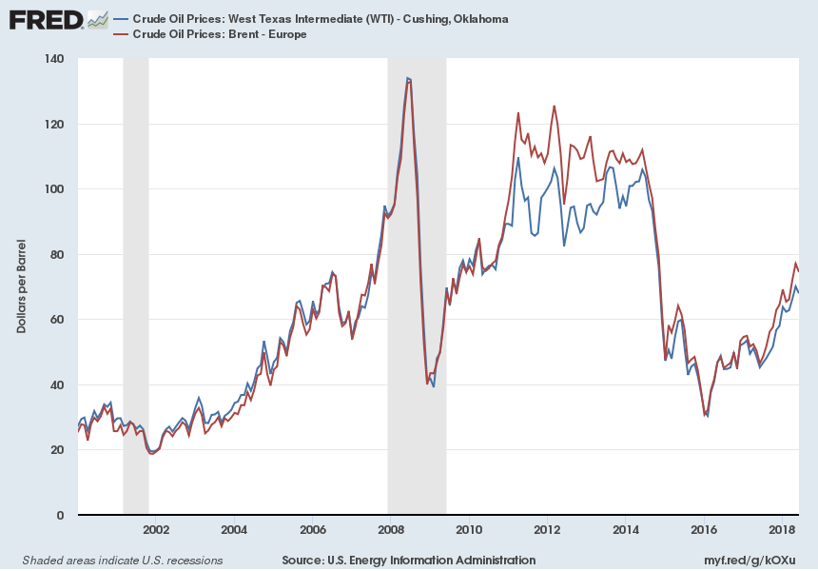
Appendix: Oil prices (Jan. 2000 – June 2018)
Notes:
Source:
U.S. Energy Information Administration
Release:
Spot Prices
Units:
Dollars per Barrel, Not Seasonally Adjusted
Frequency:
Monthly
Definitions, Sources and Explanatory Notes:http://www.eia.doe.gov/dnav/pet/TblDefs/pet_pri_spt_tbldef2.asp
U.S. Energy Information Administration,
Crude Oil Prices: West Texas Intermediate (WTI) - Cushing, Oklahoma [MCOILWTICO],
retrieved from FRED,
Federal Reserve Bank of St. Louis;
https://fred.stlouisfed.org/series/MCOILWTICO,
August 10, 2018.
Source:
U.S. Energy Information Administration
Release:
Spot Prices
Units:
Dollars per Barrel, Not Seasonally Adjusted
Frequency:
Monthly
Definitions, Sources and Explanatory Notes:http://www.eia.doe.gov/dnav/pet/TblDefs/pet_pri_spt_tbldef2.asp
U.S. Energy Information Administration,
Crude Oil Prices: Brent - Europe [MCOILBRENTEU],
retrieved from FRED,
Federal Reserve Bank of St. Louis;
https://fred.stlouisfed.org/series/MCOILBRENTEU,
August 10, 2018.

Slide 31
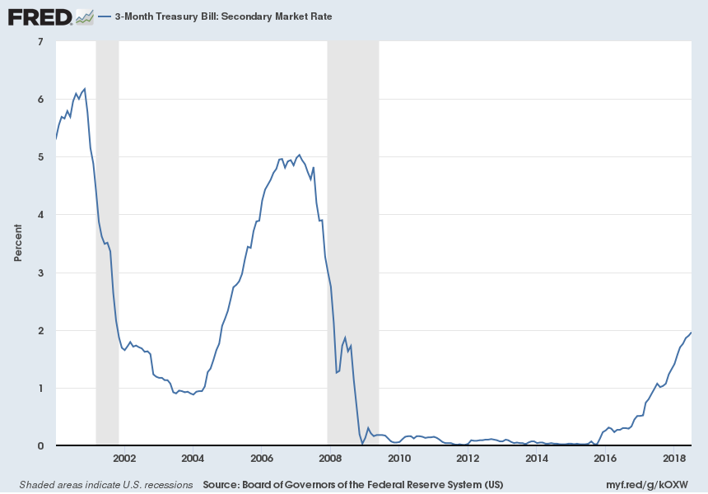
Short-term interest rates: Jan. 2000 – July 2018
Notes:
Source:
Board of Governors of the Federal Reserve System (US)
Release:
H.15 Selected Interest Rates
Units:
Percent, Not Seasonally Adjusted
Frequency:
Monthly
Averages of Business Days, Discount Basis
Board of Governors of the Federal Reserve System (US),
3-Month Treasury Bill: Secondary Market Rate [TB3MS],
retrieved from FRED,
Federal Reserve Bank of St. Louis;
https://fred.stlouisfed.org/series/TB3MS,
August 10, 2018.

Slide 32
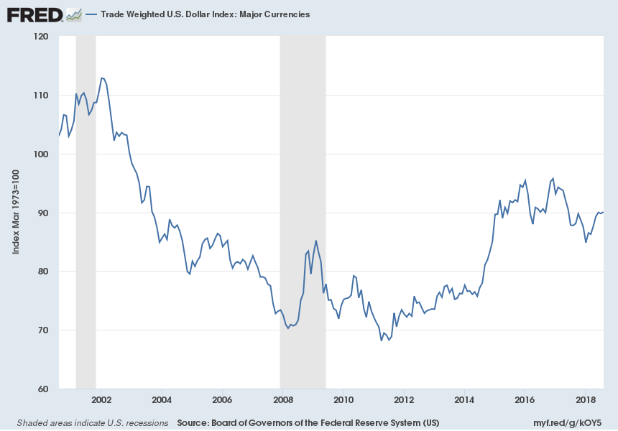
Value of dollar (Jan. 2000-Aug. 2018)
Notes:
Source:
Board of Governors of the Federal Reserve System (US)
Release:
H.10 Foreign Exchange Rates
Units:
Index Mar 1973=100, Not Seasonally Adjusted
Frequency:
Daily
A weighted average of the foreign exchange value of the U.S. dollar against a subset of the broad index currencies that circulate widely outside the country of issue.Major currencies index includes the Euro Area, Canada, Japan, United Kingdom, Switzerland, Australia, and Sweden. For more information about trade-weighted indexes see http://www.federalreserve.gov/pubs/bulletin/2005/winter05_index.pdf.
Board of Governors of the Federal Reserve System (US),
Trade Weighted U.S. Dollar Index: Major Currencies [DTWEXM],
retrieved from FRED,
Federal Reserve Bank of St. Louis;
https://fred.stlouisfed.org/series/DTWEXM,
August 10, 2018.

Slide 33

Macroeconomic determinants
of commodity prices
Jeffrey Frankel

