Slide 1


Global Monetary Coordination
Jeffrey Frankel
Professor, Harvard University
Panel Discussion, Friday, April 7, 2023
EGROW Foundation Webinar Series

Slide 2
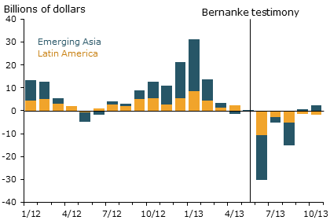
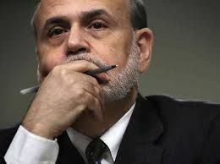
1. Spillover effects of the “taper tantrum” of May 2013
After Fed taper talk, US interest rates rose & EM capital flows reversed.
Net capital flows
to Emerging Market economies
Jay Powell, 2013, “Advanced Economy Monetary Policy and Emerging Market Economies.”
Speech at the Federal Reserve Bank of San Francisco Asia Economic Policy Conference, Nov.
http://www.frbsf.org/economic-research/publications/economic-letter/2014/march/federal-reserve-tapering-emerging-markets/

Slide 3
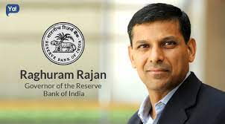
Calls for international monetary coordination followed the taper tantrum.
Raghuram Rajan, Governor,
Reserve Bank of India, Jan. 2014:
“International monetary cooperation has broken down… The U.S. should worry about the effects of its policies on the rest of the world.”
Brisbane Action Plan, G20, Nov. 2014:
“We are determined to step up our cooperation to provide significant new momentum to the global economy; boost demand and jobs…”

Slide 4
2. Coordination as game theory
Economic theory has a specific definition of coordination:
an agreement to set policies jointly, in such a way that the package leaves all participants better off than they would be in the Nash non-cooperative equilibrium where each ”player” takes the policies of the others as given.
Let’s apply game theory to recent macroeconomic history. Three “games”:
  “Exporting unemployment” game
  “Currency wars” game
  Competitive appreciation game.

Slide 5
3. The “exporting unemployment” game
Joint fiscal expansion is a classic case of coordination.
In the non-cooperative equilibrium, each country holds back
from increasing spending, for fear of worsening its trade deficit.
  Each seeks to export unemployment to its neighbors.
  => global demand deficiency => low growth & employment. As in the 1930s.
Coordination offers a solution, the “locomotive theory”:
  Countries agree to joint fiscal stimulus
  => the world is pulled out of recession.
  Examples:
    The Bonn G7 summit in 1978.
    The first G20 Leaders’ summits, in 2008-09 (GFC).

Slide 6
The exporting unemployment game (“locomotive theory”)
 | US tightens fiscally | US expands fiscally
Europe tightens fiscally | Non-cooperative “beggar- thy-neighbor” equilibrium: global recession. | US runs trade deficit; complains on behalf of its exporters & import-competing firms.
Europe expands fiscally | Europe complains, on behalf of its exporters and import-competing firms. | Cooperative “locomotive” outcome: nobody achieves a trade surplus, but higher spending lifts all boats.

Slide 7
4. A similar case for cooperative joint monetary expansion?
Rajan’s specific complaint in 2014: the Fed was switching from QE
to a tighter monetary policy, hurting other countries.
In this view, coordination => agreeing to keep money easy.
But monetary policy differs from fiscal policy,
in that its effects on trade are ambiguous:
  On the one hand, yes, when the Fed cuts interest rates (as in response
  to the 2020 pandemic), faster US growth pulls in more imports.
  On the other hand, the dollar depreciates, making it harder
  for producers in other countries to compete with US producers.

Slide 8

5. The competitive depreciation game
From 2003 onward, the US complained
that China kept its RMB unfairly undervalued.
In 2010-11, Brazilian leaders coined the phrase “currency wars.”
  They complained that the Fed (+ subsequently BoJ & ECB) had eased excessively (QE),
  each seeking to depreciate its own currency & so improve its trade balance.
  Brazil said upward pressure on other currencies, like its real, hurt its exporters.
The competition was deemed particularly acute then, because the ZLB limited the Fed, ECB & BoJ from the usual stimulus by low interest rates.
.
Under this game, one cooperative solution is to adopt fixed exchange rates.
  This was one motivation behind Bretton Woods in 1944,
  said to be a reaction to the competitive devaluations of the 1930s.

Slide 9
The competitive depreciation game (“currency wars”)
 | US pursues monetary discipline | US pursues expansionary monetary policy (QE2)
Japan pursues monetary discipline | Superior cooperative equilibrium: everyone agrees to refrain from currency warfare. | Dollar depreciates. Trading partners complain, on behalf of their exporters & import-competing firms.
Japan pursues expansionary monetary policy, to depreciate the yen (Abenomics). | Dollar appreciates. US complains, on behalf of its exporters & import-competing firms. | “Currency war” non-cooperative outcome; nobody achieves depreciation & trade stimulus.

Slide 10
6. The competitive appreciation game
In 2022, priority shifted to fighting inflation, which exceeds IT targets.
  Concerns about trade deficits faded.
The Fed raised US interest rates (as did others).
  => The $ appreciated, exporting inflation to other countries. Esp. commodities.
Say hello to “reverse currency wars.”
  Countries raise interest rates, hoping to appreciate their currencies
    and to reduce inflation toward targets.
    In the non-cooperative equilibrium, global interest rates are too high,
      hurting EM economies with $-denominated debts.
This view would imply gains from cooperating
to moderate interest rates.

Slide 11
Inflation rose globally in 2021-22
target
IMF World Economic Outlook, Jan. 2023. Data sources: Haver Analytics; & IMF staff calculations.
Inflation across 18 advanced economies and 17 emerging market & developing economies.
The gray bands depict the 10th to 90th percentiles of inflation across economies.
https://www.imf.org/en/Publications/WEO/Issues/2023/01/31/world-economic-outlook-update-january-2023#:~:text=Global%20inflation%20is%20expected%20to,levels%20of%20about%203.5%20percent.

Slide 12
Global Monetary Coordination
Jeffrey Frankel
“International Coordination,“ 2016, in Policy Challenges in a Diverging Global Economy, R.Glick & M.Spiegel, eds. (FRBSF).
"Get Ready for Reverse Currency Wars," 2022, Project Syndicate, May 25.
The Globe and Mail or Korea Herald, May 30.
“Nominal GDP Targeting for Developing Countries,” with Pranjul Bhandari, 2017, Research in Economics (Elsevier), vol.71, 3, Sept., pp. 491-506.
NBER WP 20898.

Slide 13
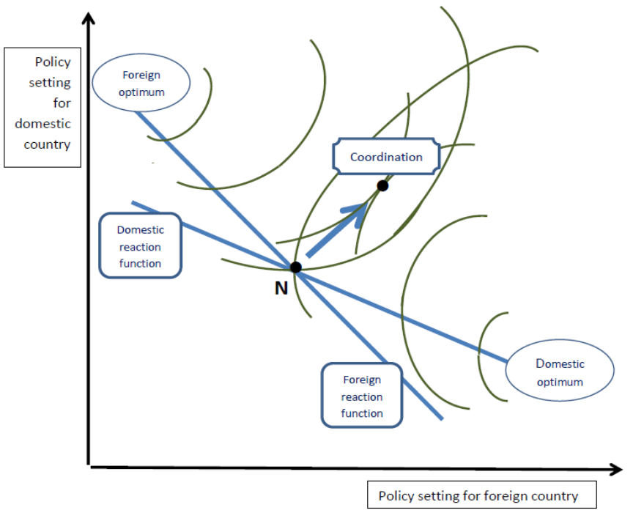
Appendix 1: In the exporting unemployment game, coordination entails joint expansion.

