Slide 1

Macroeconomics and the Pandemic Recession:
A Global Outlook
Jeffrey Frankel
James W. Harpel Professor of Capital Formation and Growth
Dean’s Council, October 9, 2020

Slide 2
Part I: Differences Across Countries
Health & economic impacts of the pandemic have spread
to virtually every part of the globe:
  188 countries & territories,
  though not Samoa.
Severity has varied widely,
  across continents and across countries,
  and not always in ways that one might have predicted.
  It’s not too early to draw some lessons.
Surprisingly, death rates have apparently been worse in the US & Europe than among many Emerging Market / Developing Economies (EMDEs).
  But economic impacts will be more extensive among EMDEs.
The policy trade-off between health & the economy is illusory.

Slide 3
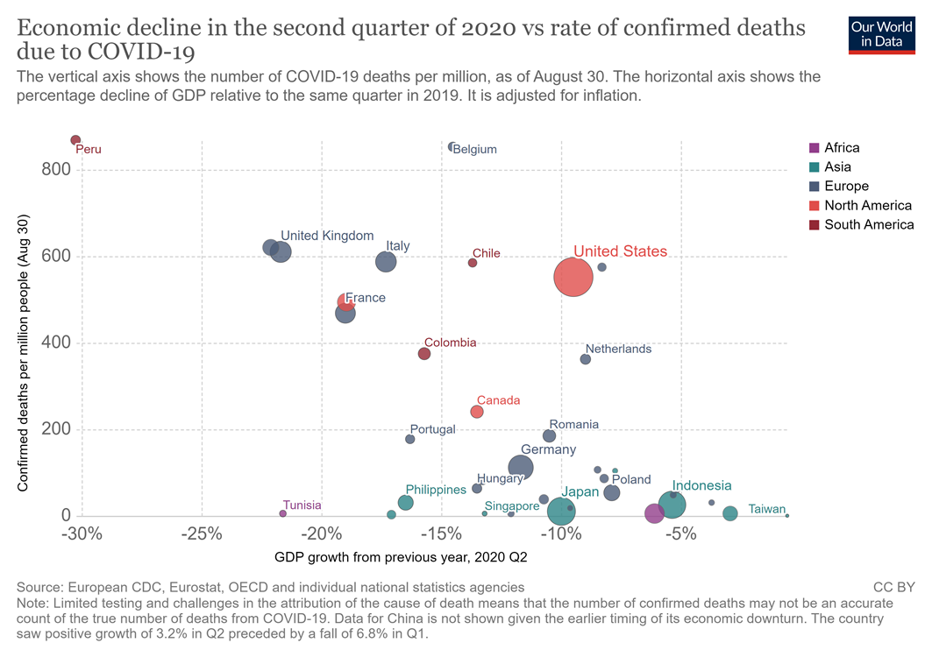
No sign of a trade-off between economic growth & health.
To the contrary.
Confirmed deaths per million
people.
(Aug. 30)
“Which countries have protected both health and the economy
in the pandemic?” Joe Hasell,
Sept. 2020, Our World in Data.
https://ourworldindata.org/covid-health-economy
GDP growth, 2020 Q2 (from previous year)

Slide 4
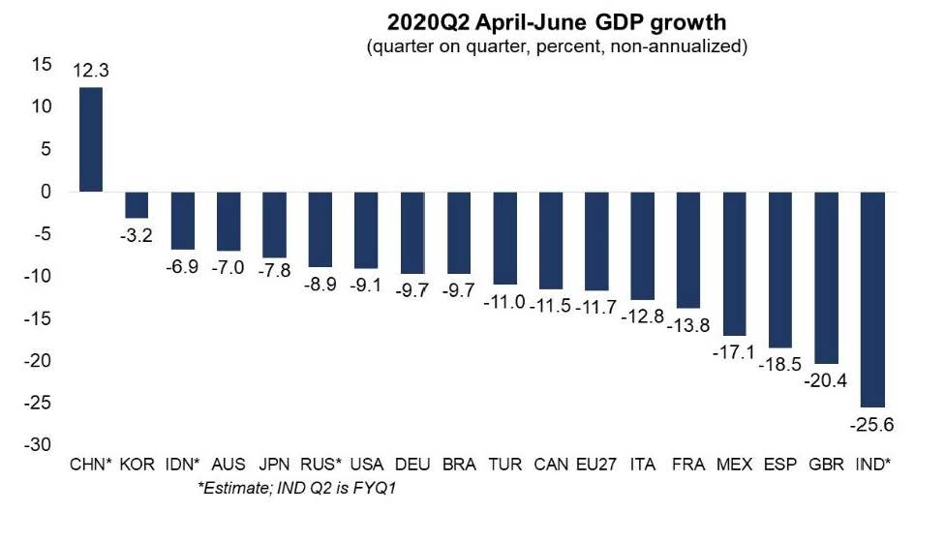
Of the G-20, India’s economy was the worst-hit in Q2, followed by UK, Spain & Mexico. China & Korea did the best.
Source: IMF, Sept. 2, 2020

Slide 5
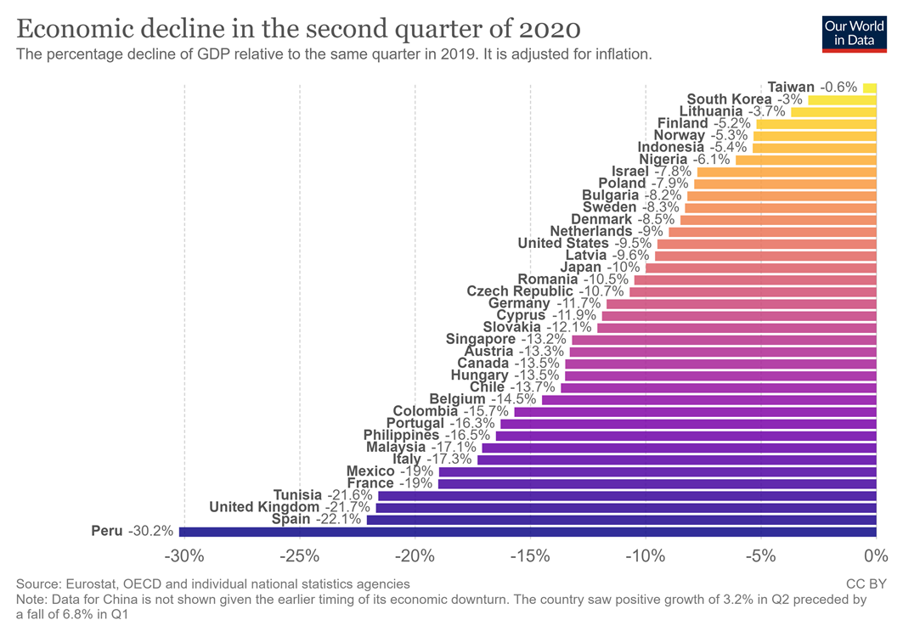
Peru’s recession has been even worse than Spain & UK; while Taiwan has suffered the least, followed by South Korea.
of 38 countries
“Which countries have protected both health and the economy in the pandemic?” Joe Hasell, Sept. 2020.

Slide 6
Why the differences across continents?
Why has Latin America been hit so badly (≈ ½ global deaths)?
  Big densely populated cities, informal workers, internal migrants;
  Inequality, inadequate public health systems.
Why have East & SE Asia & the Pacific done the best?
  In part: cultural willingness to wear masks or quarantine;
  Recent experience with epidemics => good habits of response; took it seriously.
    E.g., Samoa, which experienced a measles epidemic in 2019.
  Vs. Western Hemisphere & Europe.
Why has Africa apparently done relatively well?
  Low population density;
  Young population;
  Again, experience with epidemics => habits of response.

Slide 7
Why the differences within continents?
Air hubs are hit 1st (Milan, London, NYC, Johannesburg).
Within Latin America, 3 doing esp. badly: Brazil, Mexico, & Nicaragua.
  Why? Poor political leadership.
    The 3 presidents deny seriousness of the coronavirus,
    discourage testing & mask-wearing.
  Vs., e.g., Uruguay has done it right
    => many tests, few cases.
  But then, Peru suffering badly
    and yet it is hard to say what it has done wrong.
Within Europe:
  UK leadership did not take the situation seriously enough. UK has done poorly.
  Vs. Germany’s leaders did take it seriously. Has done well.

Slide 8
Possible lessons for policy, so far in the pandemic
Countries suffer worse, overall, where governments downplay Covid-19,
  e.g., suppressing statistics, failing to promote masks & testing,
  or shutting down late & re-opening early,
  whether for economic or political motivations.
The presumed trade-off between protecting health
and protecting the economy is illusory,
  despite the beliefs of many political leaders.

Slide 9
Part II:
Economic impact on EM & Developing Economies
The economic outlook is overall worse in EMDEs,
  Besides direct health impact, they have lost exports (esp. oil & tourism)
    & remittances.
  They lack the fiscal space to respond,
    relative to the US & Europe which have been able to respond
    with unprecedented fiscal spending & monetary expansion.
Initially (Feb. 20-March 16) global investors switched to “risk off”
  and pulled out of EMDEs.
EM asset prices recovered in spring/summer,
  spurred by aggressive Fed easing.
But how long before the financial environment turns against EMDEs?

Slide 10
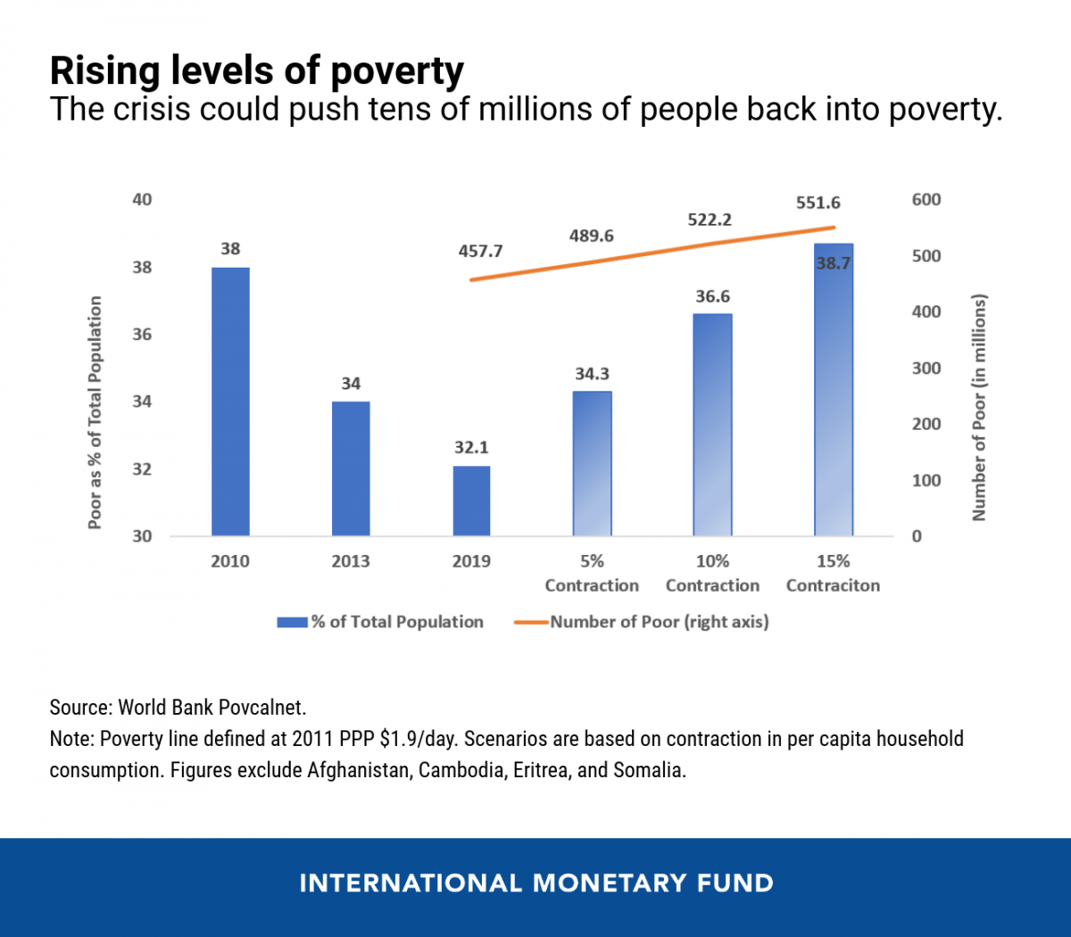
The historic 1970-2019 downward trend in global poverty levels is now reversing.
The number living in poverty worldwide has risen by
37 million since Covid-19 hit.
( Institute of Health Metrics & Evaluationvia NYT, 9/17/2020)
“COVID-19: Without Help, Low-Income Developing Countries
Risk a Lost Decade,“ IMF, Aug. 2020
https://blogs.imf.org/2020/08/27/covid-19-without-help-low-income-developing-countries-risk-a-lost-decade/

Slide 11
Difficulties financing deficits among EMDEs
Fiscal response less in Low-Income vs. Advanced Economies.
High debt & high spreads limit fiscal space.
Capital outflows followed February 2020 shock. “Risk off.”
Downgrades of sovereign debt.
Official flows have helped.
Many EMDEs need more debt restructuring.

Slide 12
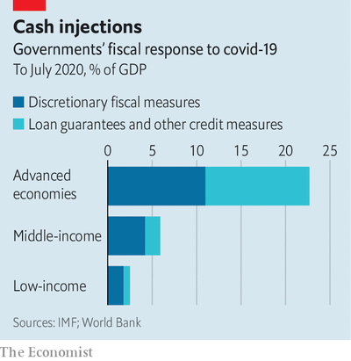
1. While the spending response in Advanced Economies has been massive, Low-Income Countries lack the fiscal space.
“A sigh of relief, a gasp for breath,” The Economist, August 1, 2020.

Slide 13
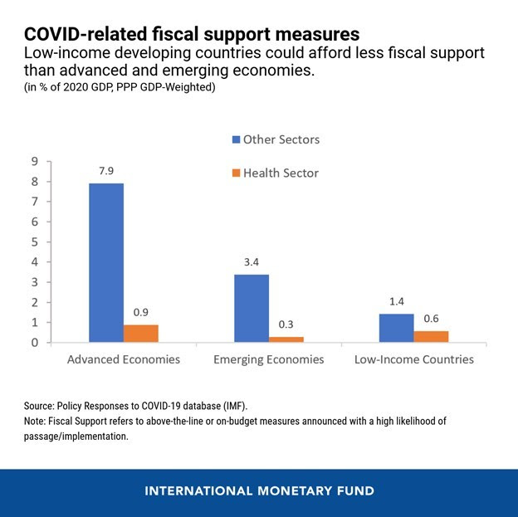
The spending that Low-Income countries have managed in response, has been focused on the health sector. Less fiscal support.
“Many LIDCs …expended less fiscal support to their economies than AEs or EMs, [but] the share of additional spending dedicated to health has been higher.”
“COVID-19: Without Help, Low-Income Developing Countries Risk a Lost Decade,“ IMF, August 2020
https://blogs.imf.org/2020/08/27/covid-19-without-help-low-income-developing-countries-risk-a-lost-decade/

Slide 14
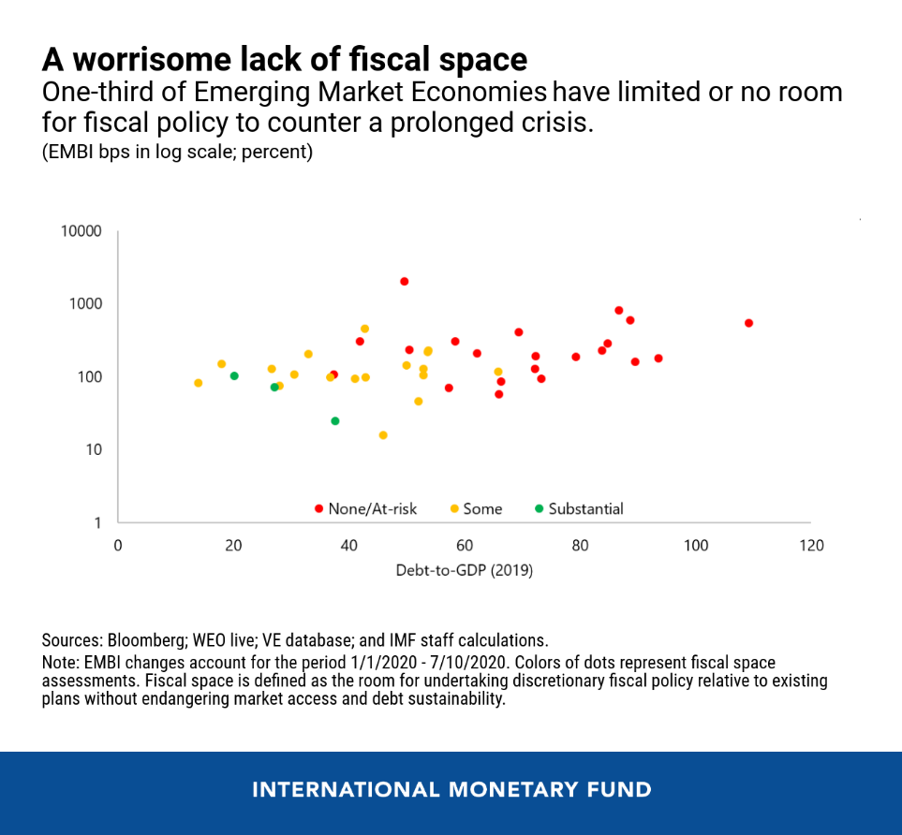
2. Little space to run deficits, among those EMDEs that entered 2020 with high Debt/GDPs &
that saw higher sovereign spreads
when the Covid-19 recession hit.
“COVID-19 Response in Emerging Market Economies: Conventional Policies and Beyond,” IMF blog, Aug. 6, 2020

Slide 15
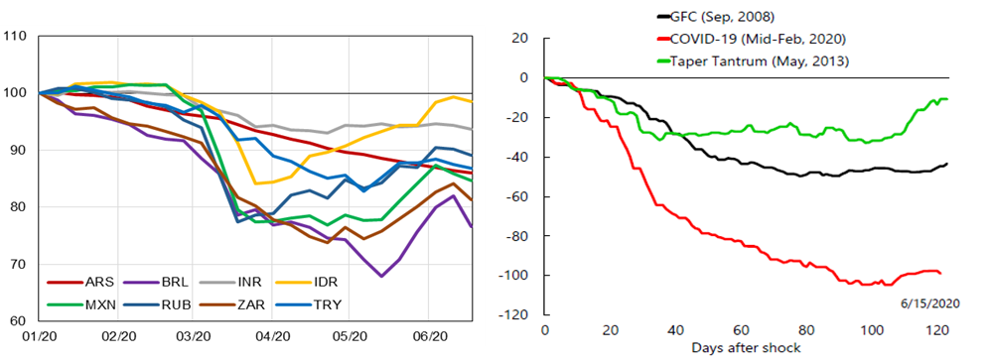
3. Portfolio outflows from EMs when the Covid-19 crisis hit exceeded outflows in the 2008 GFC or 2013 Taper Tantrum
Portfolio flows, USD bn
G20 High-Level Ministerial Conference: Tackling the COVID-19 Crisis – Restoring Sustainable flows of Capital and Robust Financing for Development, 8 July 2020, Session II Issues Note, Figure 1B. Data Sourc3: IIF

Slide 16
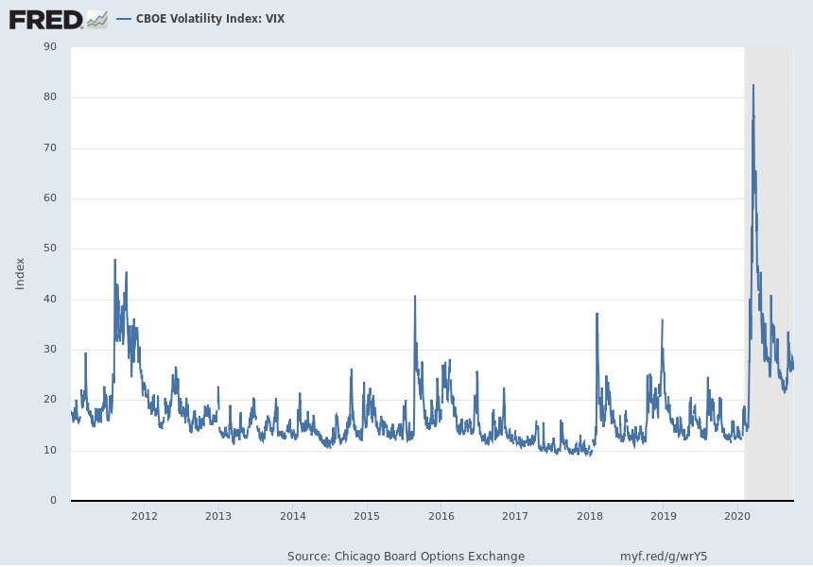
“Risk off” – Perceived volatility rose sharply from Feb. 20 to March 16, 2020.
2010 – Oct. 2, 2020
The VIX (Volatility Index)
was below 14.0 as late as Feb. 14,
but then rose, to 70 in mid-March.

Slide 17
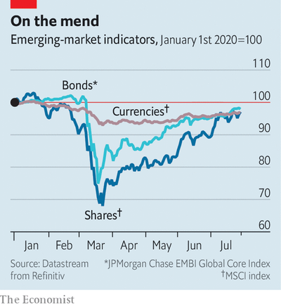
Since March, EM asset prices have recovered too.
But can it last?
“A sigh of relief, a gasp for breath,”
The Economist, August 1, 2020.

Slide 18
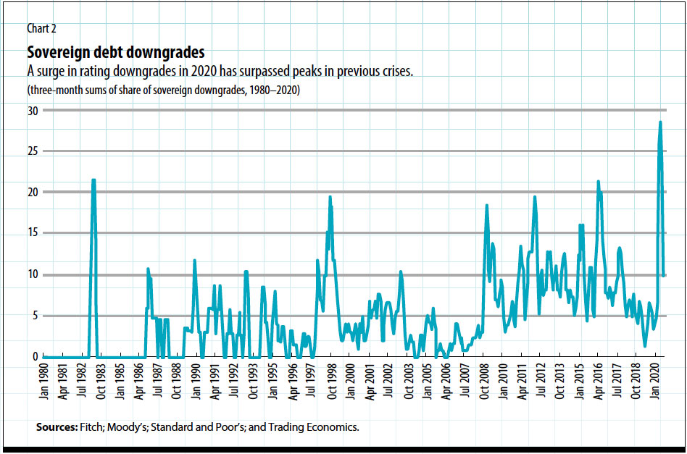
4. Downgrades of sovereign debts in 2020 exceed
1982 intl.debt crisis, 1997-98 Asia crisis, 2008-09 GFC, etc.
J.Bulow, C.Reinhart, K.Rogoff & C.Trebesch, “The Debt Pandemic,” Finance & Development, Fall 2020.

Slide 19
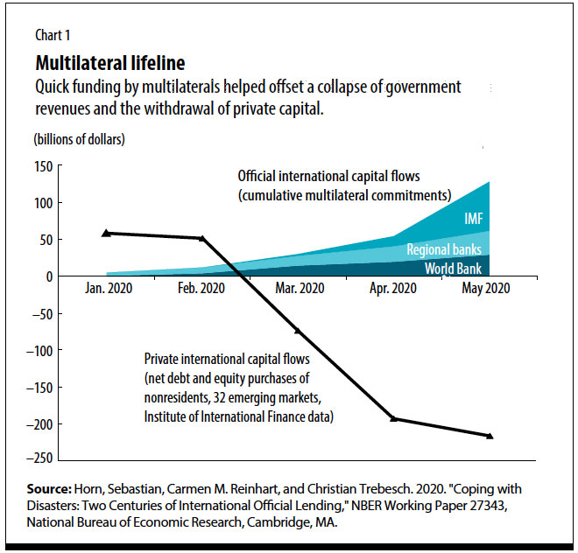
5. When the EMDEs lost private capital inflows, official flows helped.
J.Bulow, C.Reinhart, K.Rogoff & C.Trebesch, “The Debt Pandemic,” Finance & Development, Fall 2020.

Slide 20
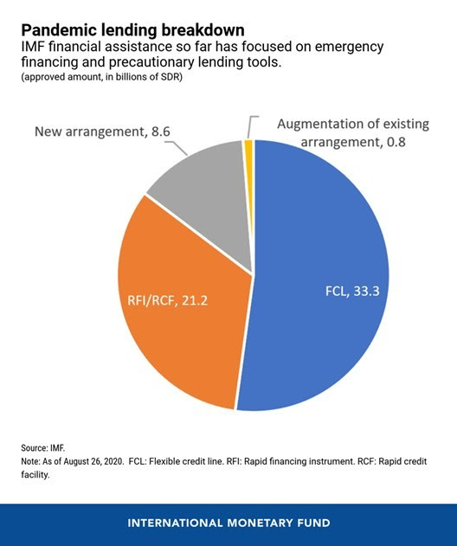
The IMF has provided financial assistance to about 80 countries as of September,
mainly through emergency lending
and precautionary lending tools.
IMF Lending During the Pandemic and Beyond, IMF, Sept. 17, 2020

Slide 21
6. G-20 in April offered to suspend bilateral official debt payments, for world’s 73 poorest countries: DSSI. But much more is needed.
Suspension is not the same as debt forgiveness.
To what extent does that include China’s loans?
  “Transparency.” Carmen Reinhart found China is largest official creditor; surpassing
  “the loan books of the IMF, World Bk & of all other 22 Paris Club govts” combined.
  As of Sept., China says it has struck agreements with half of 20 eligible low-income countries.
The G20 moratorium doesn’t include private creditors. https://voxeu.org/article/debt-standstill-covid-19-low-and-middle-income-countries
  Indeed many debtors reluctant to take up G-20 offer, for fear they would lose mkt access.
  For that reason, only 42 countries have taken them up on the offer (as of Sept. 18),
    requesting deferrals ≈ half what is eligible.
    And none have requested Private Sector Involvement, as of September.
  In late-1990s currency crises, PSI was made part of the rescue package in IMF programs;
  Similarly in 1982 intl. debt crisis, banks were “bailed in” rather than “bailed out.”
  Need restructuring of debt, public & private.
Extend to middle-income countries.

Slide 22
Summary
If you had guessed
  that poor countries would suffer more Covid-19 casualties than rich countries, you would be mostly wrong.
  that there would be a trade-off between protecting health and protecting the economy, you would be mostly wrong.
But if you guessed that the poor would suffer the greatest economic impact, you would be mostly right.
  EMDEs have limited space for budget deficits & current account deficits.
  In contrast, the US & Europe have been able to respond with unprecedented fiscal spending and monetary expansion.

Slide 23
What else is to be done?
  EM/DCs need to be able export, to earn forex to service debts.
  But global trade has collapsed,
    due to worst tariff war
    & worst global recession
    since 1930s.
  The whole world is paying a cost for an absence of political leadership and a breakdown in the multi-lateral order.

Slide 24
A full global economic recovery from the coronavirus pandemic may take as much as five years, according to World Bank's chief economist, Carmen Reinhart. (9/18)

Slide 25
Jeffrey Frankel
James W. Harpel Professor of Capital Formation and Growth
http://scholar.harvard.edu/frankel/
https://twitter.com/JFrankelEcon
www.project-syndicate.org/columnist/jeffrey-frankel

Slide 26
Appendix 1: Attributable deaths
1.1 Recorded deaths attributed to Covid-19 are an underestimate,
  judging by statistics on excess mortality.
1.2 U.S. mortality has been worse than Europe’s.
1.3 Countries that locked down early, did better.

Slide 27
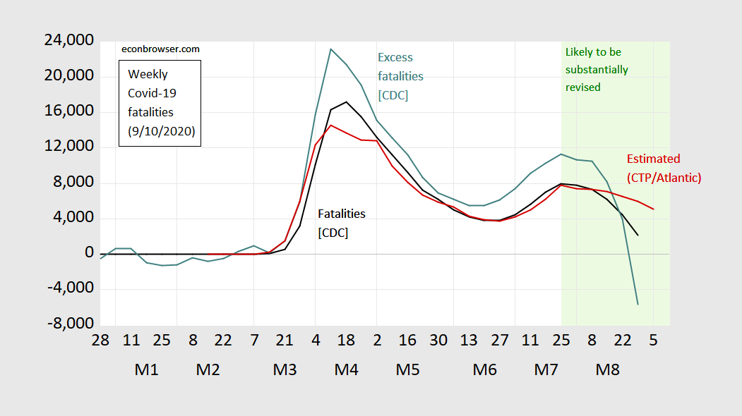
1.1 Officially reported Covid fatalities are an under-estimate of excess fatalities, even in the US
Figure 1: Weekly fatalities due to Covid-19 as reported to CDC for weeks ending on indicated dates (black), excess fatalities calculated as actual minus expected (teal), fatalities as tabulated by The Covid Tracking Project/Atlantic (dark red). Light green shading denotes CDC data that are likely to be revised. Source: CDC 9/5/2020 vintage, Covid Tracking Project/Atlantic accessed 9/10/2020 and author’s calculations.
Source: Menzie Chinn, http://econbrowser.com/archives/2020/09/are-us-covid-19-fatalities-declining-probably. Sept. 11, 2020

Slide 28
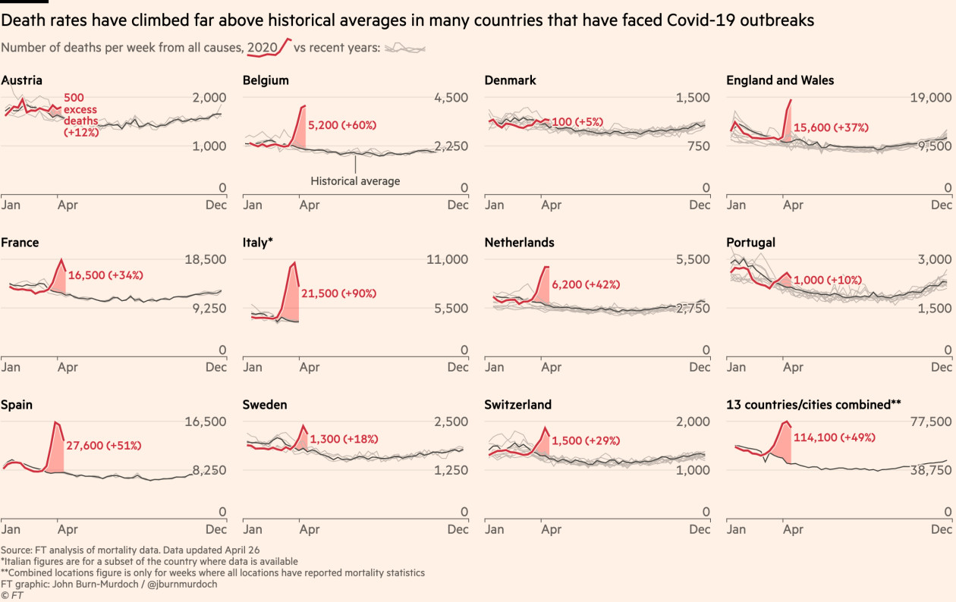
Excess mortality in 14 countries has run about 60% above reported Covid-19 death tolls.
Financial Times, May 2020 www.ft.com/content/6bd88b7d-3386-4543-b2e9-0d5c6fac846c

Slide 29
1.2 “The US excess mortality rate from COVID-19 is substantially
worse than Europe’s,” Janine Aron & John Muellbauer, VoxEU, 9/29/20:
https://voxeu.org/article/us-excess-mortality-rate-covid-19-substantially-worse-europe
“The US has 4% of the world’s population but 21% of the global COVID-19-attributed infections and deaths. …[W]hen comparing excess mortality rates, a more robust way of reporting on pandemic deaths, Europe’s cumulative excess mortality rate from March to July is 28% lower than the US rate…”
E.Luce, FT, 2 Oct.:
  “America’s mortality rate is five times its share of the global population —
  & more than 200 x the per-capita death ratio in China where the pathogen originated.
  A recent study of excess mortality found the US had a 28 % higher death rate than Europe, in spite of having
      a far lower population density,
      a younger median age
      and three extra weeks to anticipate the pandemic.”

Slide 30
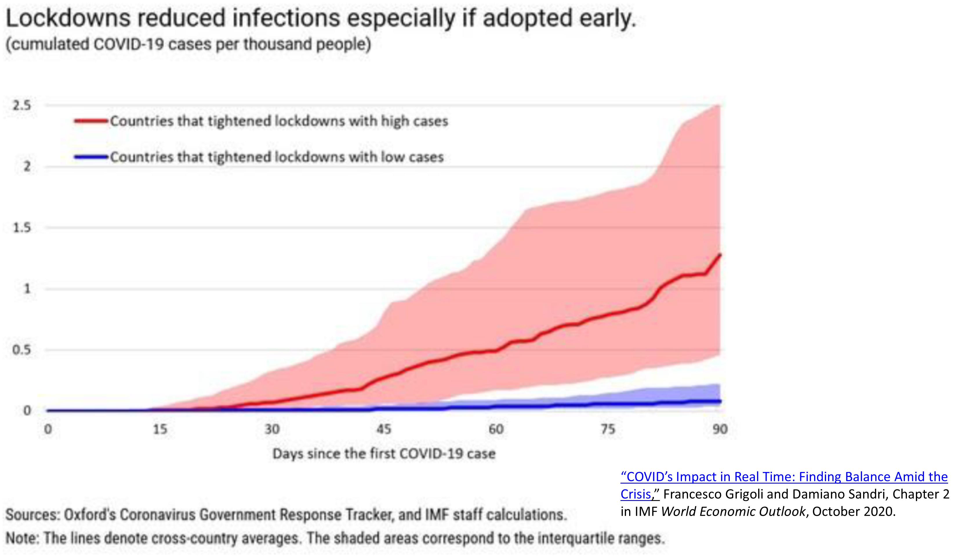
1.3 Countries that locked down early suffered fewer Covid-19 cases subsequently.

Slide 31
But lockdowns did bring a contemporary economic loss.
More stringent lockdowns are correlated with sharper economic contractions.
IMF World Economic Outlook, Oct. 2020, Ch.2, “THE GREAT LOCKDOWN: DISSECTING THE ECONOMIC EFFECTS,” Fig.2.1.

Slide 32
Appendix 2: US economic situation
2.1 Measuring unemployment
2.2 Financial markets
2.3 Debt/GDP

Slide 33
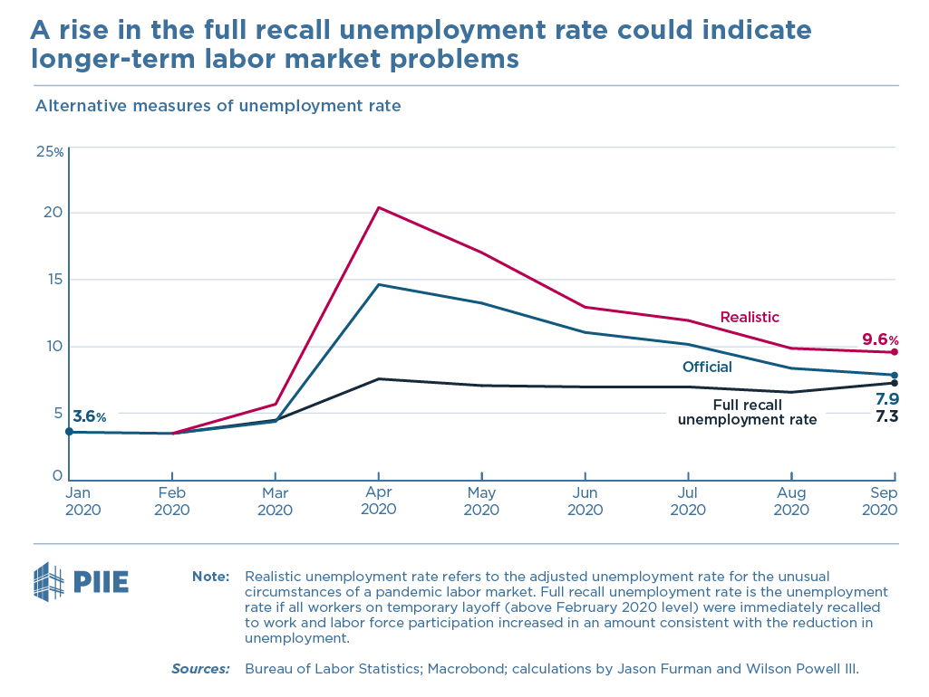
Official US unemployment at 7.9% in September. The “realistic” rate takes into account that many furloughed workers have neglected to report as unemployed.
Source: Jason Furman
Oct. 2, 2020
www.piie.com/blogs/realtime-economic-issues-watch/challenge-facing-us-labor-market-worsened-september-even

Slide 34
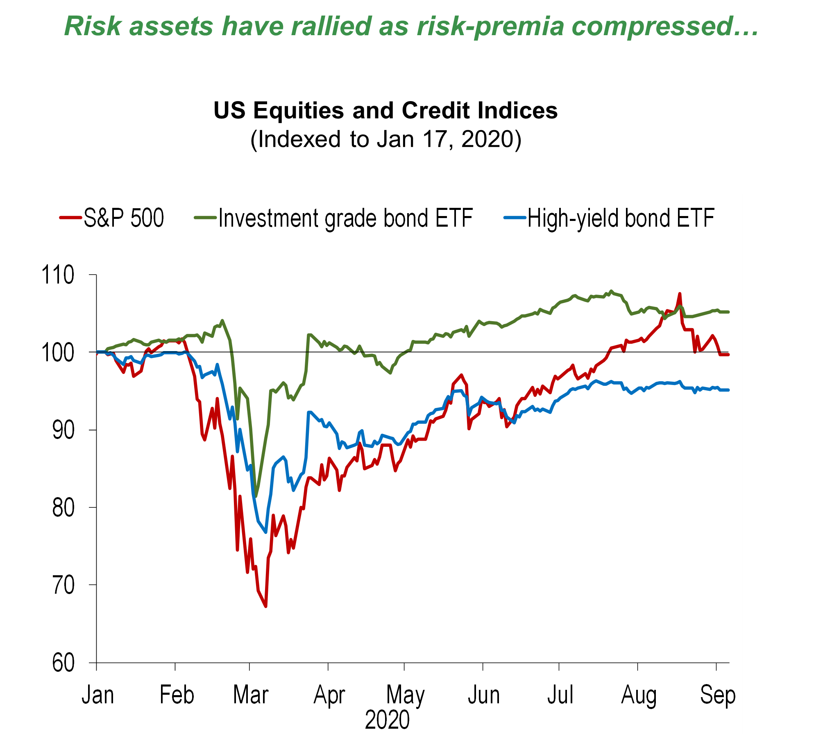
US asset prices have recovered from their Feb.-March plunge.
Tobias Adrian (IMF), “A global asset bubble in a weak world economy” at AEI, Sept.21, 2020

Slide 35
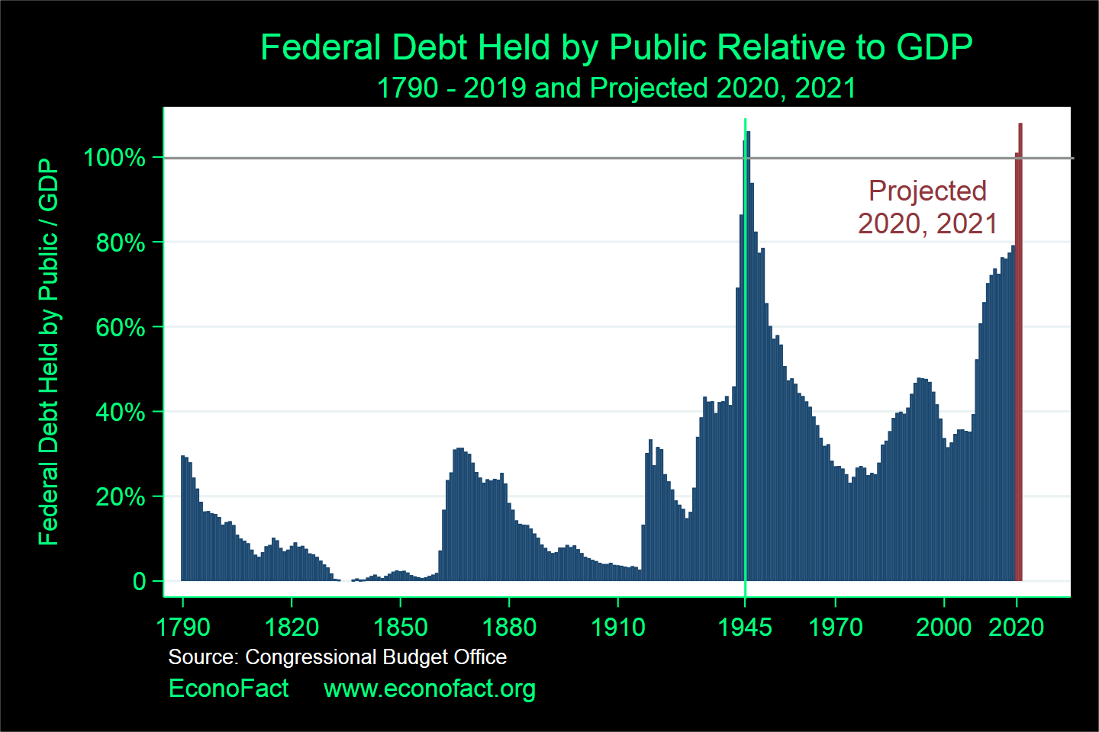
The fiscal response implies an unprecedented run-up in debt/GDP ratios.
The US can get away with it, because the $ & US Treasury bills remain the world's #1 safe-haven assets.
WWII
Coronavirus
recession
Great recession
Depression
Reagan
tax cuts
American
Revolution
WWI
Civil War

