Slide 1

Global Economic Outlook
Dean’s Council meeting,
September 29, 2021
Jeffrey Frankel
James W. Harpel Professor of Capital Formation and Growth

Slide 2
The current economic outlook -- Summary
Global GDP is projected to grow by 5.7% in 2021 & 4.5% in 2022
  OECD Economic Outlook, September 22, 2021.
Advanced countries are recovering well from sharp 2020 recession.
But large output & employment gaps remain in many countries.
Particularly in Emerging-Market & Developing Economies (EMDEs)
  vaccination rates are low,
  and debt levels are worrisome.
A variety of risks threaten the outlook.

Slide 3
The US & Europe are recovering well from the 2020 recession.
As has China, so far.
GDP growth Y-o-y % changes | 2020 | 2021 projections | 2022 projections
World | -3.4 | 5.7 | 4.5
US | -3.4 | 6.0 | 3.9
Euro area | -6.5 | 5.3 | 4.6
UK | -9.8 | 6.7 | 5.2
Japan | -4.6 | 2.5 | 2.1
China | 2.3 | 8.5 | 5.8
OECD Economic Outlook, Sept.2021

Slide 4
UNCTAD Trade & Development Report, September 2021
Global GDP has now surpassed its pre-pandemic level.
But is still 3½ % lower than projected before the pandemic.*
}
* OECD estimate

Slide 5
Economic impact of Covid crisis, 2020-21, vs. Global Financial Crisis, 2009-10.
% of GDP
Covid-19
GFC
Covid-19 has
hit developing
countries harder.
Estimated by UNCTAD, Sept. 2021

Slide 6
For low-income countries, convergence went into reverse in 2020: income per capita fell more sharply there than elsewhere.
Level of GDP/capita in lower-income countries relative to upper-income
Growth in GDP/ capita
97 m. into extreme poverty –
World Bank, 6/24/2021
https://blogs.worldbank.org/opendata/updated-estimates-impact-covid-19-global-poverty-turning-corner-pandemic-2021
Data source: World Bank

Slide 7
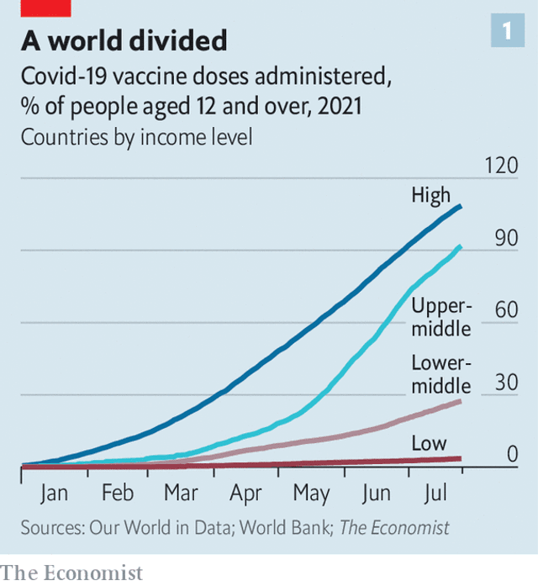
Vaccination in low-income & lower-middle countries lags far behind the rich.
The US & other rich countries should make vaccines more extensively available to
lower-income countries.
So long as this coronavirus runs wild anywhere, it is a danger
to everyone everywhere.
The Economist, July 31, 2021.
“The pandemic has exacerbated existing political discontent”
www.economist.com/international/2021/07/31/the-pandemic-has-exacerbated-existing-political-discontent

Slide 8
EM debt is vulnerable
Governments were able to finance spending in response to pandemic.
  Good.
But I worry high Debt/GDP now leaves EMDEs vulnerable.
  Why, if interest is low?
  Because debt sustainability is vulnerable to a rise in interest rates,
    whether from US interest rates,
    local risk premia,
    or both.

Slide 9
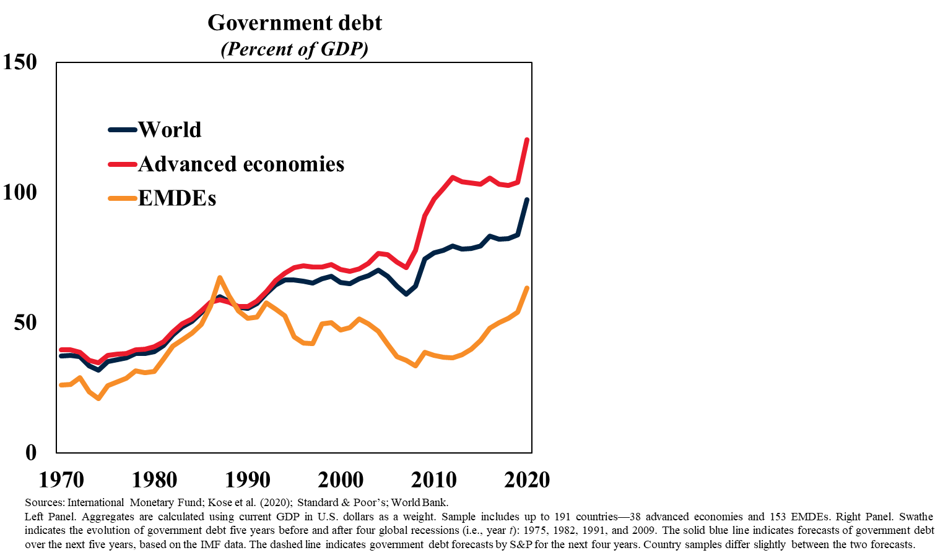
Government debt/GDP has risen sharply in the pandemic, in both AEs & EMDEs.
M. Ayhan Kose,
World Bank, Sept.2021

Slide 10
Downside risks to the outlook
The world could lose the race between vaccination
and more dangerous coronavirus variants.
A Fed tightening could cause investors to pull back
from high-return assets in general,
  and from the debts of EMDEs in particular,
  leading to EM crises as in 1982, 1994, 1997, 2013, 2015, 2018.
China could experience a financial crisis
  due to the longstanding problem of bad loans.
  In particular, now: Evergrande.
Some other event, like the US going over the debt ceiling cliff,
could burst the “everything bubble.”
  Stocks
  Bonds
  The bubbliest assets: Meme stocks, SPACs, Cryptocurrencies, NFTs…

Slide 11
Global Economic Outlook
Jeffrey Frankel

Slide 12
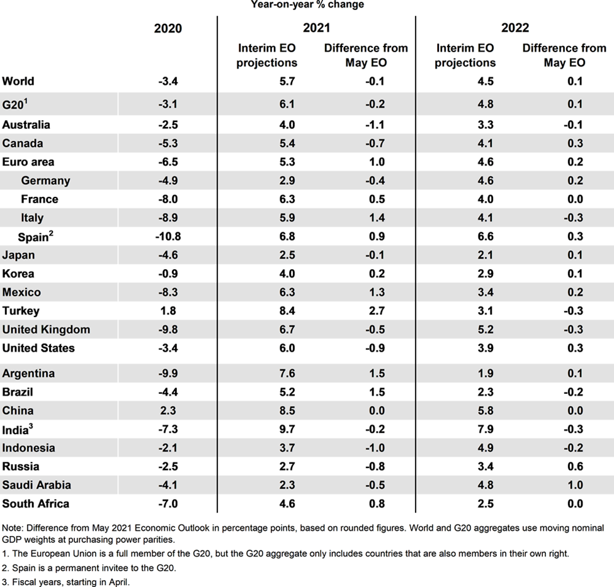
Appendix
1) Growth projections including G20 countries.
OECD Economic Outlook, Sept.2021

Slide 13
Growth projections for G20 countries.
OECD Economic Outlook, Sept.2021
Real income, 2021 over 2019

Slide 14
2) Catch Up with Advanced Economies
Falling Behind in LICs, FCS, Small States, LAC, MNA, & SSA
Ayhan Kose,
World Bank
Sept. 2021
Relative per capita income growth
(Percentage points; relative to advanced economies)
Relative per capita income growth, by region
(Percentage points; relative to advanced economies)
Source: World Bank.
Note: LICs, FCS, IDA, EAP, ECA, LAC, MNA, SAR, and SSA refer to, respectively, low-income countries, fragile and conflict-affected situations, International Development Association, East Asia and Pacific, Europe and Central Asia, Latin America and the Caribbean, Middle East and North Africa, South Asia, and Sub-Saharan Africa. IDA includes countries eligible to IDA support, including Blend economies. Relative per capita income growth is computed as a difference in per capita GDP growth between respective EMDE groups and advanced economies, expressed in percentage points. Right Panel. SSA excluding big 3 refers to Sub-Saharan Africa excluding Angola, Nigeria, and South Africa.

Slide 15
3) Income and Poverty
Substantial Income Losses; Significant Increase in Poverty
Ayhan Kose,
World Bank
Sept. 2021
EMDEs with per capita income gains reversed in 2020
(Percent of countries; by years of gains)
Increase in poverty headcounts
(Millions of people; by end-2021)
Sources: Mahler et al. (2021); World Bank.
Left Panel. LICs refers to low-income countries. Figure shows percent of EMDEs by the number of years of lost per capita income gains in 2020. Right Panel. SAR and SSA refer to South Asia and Sub-Saharan Africa, respectively. Figure shows the estimated number of people pushed into poverty as a result of the pandemic. This is calculated by comparing poverty using pre- and post-pandemic growth forecasts (Lakner et al. 2020). Extreme poverty reflects the international poverty line of $1.90/day. Multidimensional poverty also includes deprivations in health, education, and living standards (UNDP and OPHI 2020; World Bank 2020). Percent increase in multidimensional poverty as a result of the pandemic is estimated to be the same as for extreme poverty.

Slide 16
4) Recovery after the Pandemic
Faster Growth in Aes with Rapid Vaccination
Ayhan Kose,
World Bank
Sept. 2021
Countries exceeding pre-recession peak after two years
(Percent of countries)
Forecast revisions in 2021,
by vaccination progress
(Percentage points)
COVID-19 cases and vaccine doses, July to August
(Percent of population)
Sources: Bolt et al. (2018); Kose, Sugawara, and Terrones (2020); Our World in Data; World Bank.
Left Panel. The share of economies in which per capita income levels after two years of global recessions are above the pre-recession peaks. Bar for past global recessions shows an average share during the five previous global recessions: 1945-46, 1975, 1982, 1991, and 2009 global recessions. Center Panel. Figure shows 2020 GDP-weighted forecast revisions for countries above or below median vaccination progress in each aggregate, based on the total number of people that received at least one dose of COVID-19 vaccine per 100 people. The vaccination measure is used as a daily average over June to August (up to August 22). Sample includes 36 advanced economies and 147 EMDEs. Right Panel. Figure shows the one-month accumulation of COVID-19 cases in advanced economies and EMDEs over July 5 – August 1, as estimated by the Institute for Health Metrics and Evaluation (IHME), and vaccinations as a share of the population.

Slide 17
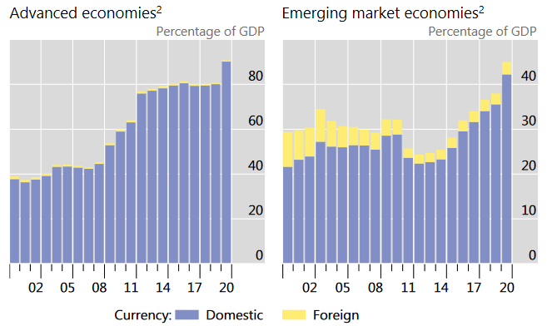
5) Government debt/GDP rose sharply in 2020, in both AEs & EMs.
Bank for International Settlements Quarterly Review, June 2021, p.21
Data sources: ECB Securities Issues Statistics (SEC); Dealogic; Euroclear; Thomson Reuters; Xtrakter ltd; natl data; IMF WEO; BIS calculations.
² General government bonds outstanding aggregated across countries, as a ratio to their combined GDP.

