Slide 1
Coronavirus Pandemic and the Global Economy
Policy Panel
April 29, 2020
Professor Jeffrey Frankel
Harvard Kennedy School
Harvard University

Slide 2
Outline
I. Historical severity of the crisis
II. The rapid sequence of events so far
III. Policy response by governments
IV. Baseline forecast of economic growth
V. Shape of the recovery: “V”, “U”, or “W”?

Slide 3
I. Historical severity of the crisis
The developments of 2020 are much worse, even, than
pandemics like the H1N1 virus of 2009 (“Swine flu”)
or recessions like the 2007-09 Global Financial Crisis.
For adequate precedents we have to go back
to the first half of the 20th century:
the global influenza pandemic of 1918-19
and the Great Depression of the 1930s.

Slide 4
II. The rapid sequence of events so far
Jan. 30: WHO declares Public Health Emergency.
Virus spreads to successive countries.
Feb. 24: “Risk off” in global financial markets.
Feb. 26: Collapse in oil price.
March: Recession starts.

Slide 5
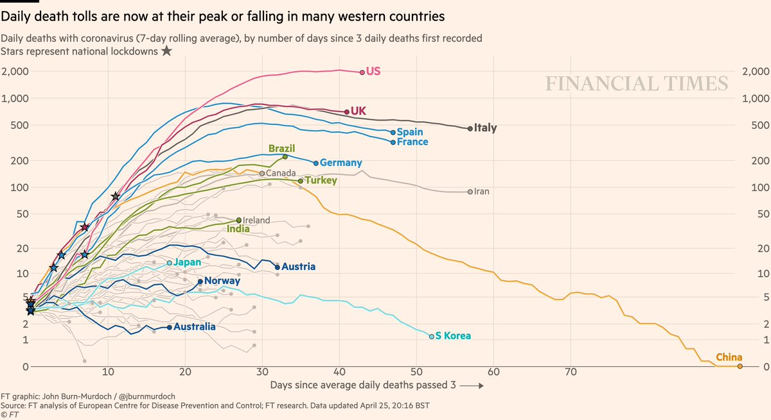
1. Reported deaths peaked in China. Then Italy. UK & US may be next.
https://www.ft.com/coronavirus-latest
Note: Excess mortality in 14 countries runs about 60% above reported Covid19 death tolls. www.ft.com/content/6bd88b7d-3386-4543-b2e9-0d5c6fac846c

Slide 6
2. “Risk off” in global financial markets
  Perceived risk, as measured by the VIX (CBOE Volatility Index)
  was below 14.0 as late as Feb. 14,
  but then rose, to 70 in mid-March.
  => Investors turned risk-averse:
    pulled out of equites (Feb. 24),
    then corporate bonds (esp. junk bonds & EM securities, March 10).
  They moved into safe-haven currencies,
    particularly the US $,
      which on March 23 reached its highest value since 2002.

Slide 7
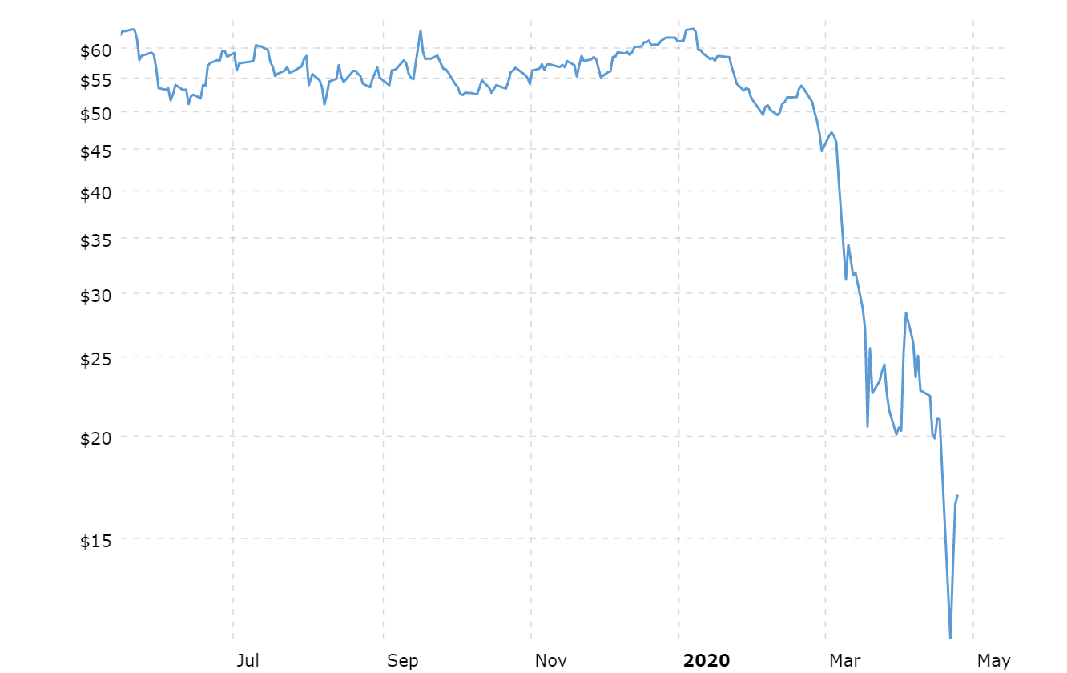
3. Collapse of oil prices
started February 26.
On April 20, price of WTI < 0.
The losers: Middle East & Russia
and some in Latin America & Africa.
For many developing countries, a fall in commodity export prices
comes on top of:
  a sudden stop to capital inflows,
  declining remittances,
  and the terrible challenges of Covid-19 itself spreading to countries with health care systems that are inadequate even at the best of times.
WTI Crude Oil Price,
Macrotrends, April 24, 2020

Slide 8
4. It is rare that one can predict recession before the numbers are in. But not this time. Most countries are in recession.
(IMF baseline forecast)
IMF WEO, April 2020, Figure 1.5. World Growth in GDP per Capita and Recession

Slide 9
III. Policy response by governments
1. In most countries, officials did not take Covid-19 seriously enough,
  especially those with insufficient awareness of past history of pandemics.
  China released the genetic code for the new coronavirus in early January.
  But countries like the US & UK did not use the time to prepare.
  They should have launched testing campaigns & ordered equipment.
  E.g.., U.S. President, Feb. 26: “…when you have 15 people,
  and the 15 within a couple of days is going to be down to close to zero,
  that’s a pretty good job we’ve done.”

Slide 10
2. By now, however, most countries have responded with:
  public health measures
  and appropriate macroeconomic stimulus:
    fiscal relief & stimulus measures (in US, March 27)
    and monetary expansion
      going even beyond the Unconventional Monetary Policies of 2008-09.

Slide 11
IV. Forecast of GDP growth:
IMF’s World Economic Outlook, April 14
lowered its forecast for global growth in 2020 sharply,
  by 6.3% pts. from the January forecast,
  to an unprecedented –3.0% worldwide.
That averages -1.0 % in EM & developing countries
and -6.1% in advanced economies (expected mostly in Q2)
  including -5.9% in US 2020 GDP.
    US Q1 BEA reported this a.m.: a fall of 4.8% q/q, per annum.
    US Q2 ≈ almost -40%, q/q compounded per annum.
IMF’s base case is probably still too optimistic, due to downside risks.

Slide 12
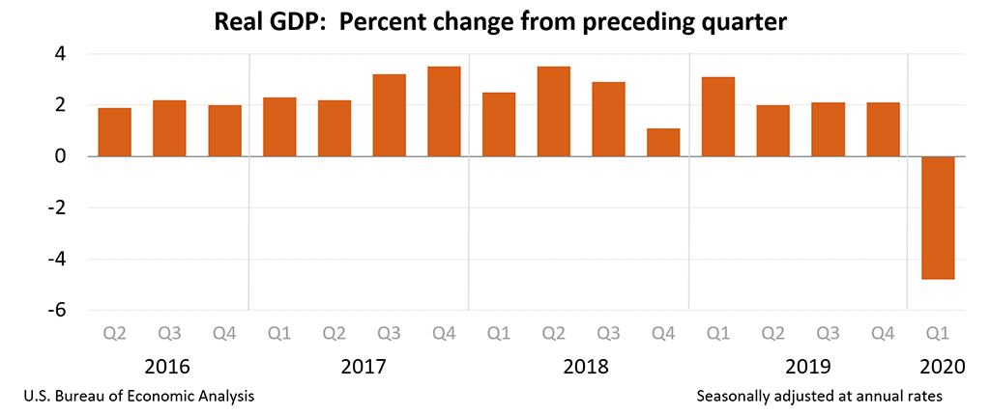
April 29, US BEA announced GDP fell 4.8% in Q1
(q-o-q, p.a.)

Slide 13
The IMF base case is a 2020 recession much worse than 2008.
IMF World Economic Outlook, April 2020

Slide 14
Even EM & Developing Economies show negative growth.
IMF World Economic Outlook, April 2020

Slide 15
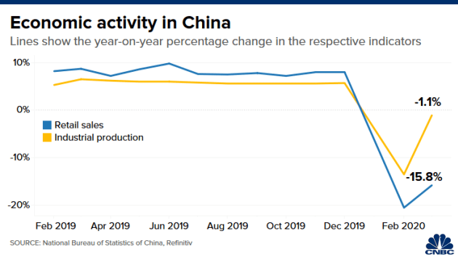
V. What shape of recovery: “V”, “U”, or “W”?
1. V-shaped recovery in the global economy is not likely.
  At first, V bounce-backs seemed plausible.
  Natural disasters usually follow that pattern.
  E.g., China’s 2003 SARS is estimated to have cost 2% growth in Q2,
  but didn’t show up in the year’s overall GDP.
  Indeed, China itself reports that
  Industrial Production bounced back
  in March 2020 from its February plunge.
  But a V is too optimistic, for the aggregate world economy.

Slide 16
2. More likely, at best, is a U-shaped recovery:
60% of business leaders expect “U” shape
  -- World Ec. Forum, April 24.
Certain segments of the economy go back to work,
while others remain shut down longer…
at least until we achieve massive, frequent, convenient, free testing
  + contact-tracing
  + reliable tests for anti-bodies;
and perhaps even until a vaccine is available,
which we are told will take 1 ½ years at best,
  or an effective treatment.

Slide 17
3. I worry about a W-shaped recovery, arising from policy mistakes.
Two possible mistakes are illustrated by events of the inter-war period.
Mistake #1: Leaders sound the “all-clear” signal on contagion too soon.
  Some politicians have shown an excessive bias towards optimism.
    This over-optimism has already done harm by delaying action.
    It can do more harm if they try to re-open the economy prematurely.
  The 1918-19 global influenza pandemic is an informative precedent.
    American cities instituted public health interventions in 1918.
    Those cities that let up early suffered a 2nd or 3rd wave of flu, with more deaths.

Slide 18
Mistake #2: Abandoning economic stimulus too soon,
  resulting in a renewed downturn.
  The best precedent in the US is 1936-37.
    Roosevelt prematurely tightened fiscal policy.
    The Fed too tightened in 1936.
    As a result, the US went back into severe recession in 1937-38.
  This could easily happen again in 2021.
Conclusion:
A W-shaped pattern, i.e., relapses in health & the economy,
  could result from early withdrawal
    either of public health measures
    or of economic stimulus.

Slide 19
Coronavirus Pandemic
and the Global Economy
Policy Panel
Professor Jeffrey Frankel
Harvard University

Slide 20
Appendix graphs
Effects on:
Financial markets
Commodity prices
International trade

Slide 21
Investors shifted out of corporate bonds & equities.
IMF WEO, April 2020. Figure 1.2. Advanced Economies: Monetary and Financial Market Conditions

Slide 22
Investors pulled out of Emerging Market bonds.
(EMBI Sovereign Spreads, basis points)
IMF WEO, April 2020.

Slide 23
Investors pulled out of Emerging Market equities.
(Jan.1, 2019 = 100)
IMF WEO, April 2020. Figure 1.3.

Slide 24
Impact of the Covid-19 outbreak on oil & commodity prices
%
%
IMF WEO, April 2020. Figure 1.SF.1

Slide 25
Trade is falling even more sharply than GDP.
IMF World Economic Outlook, April 2020

