Slide 1
The Coronavirus Recession of 2020
May 13, 2020
Professor Jeffrey Frankel
Harvard Kennedy School

Slide 2
Outline
I. Historical severity of the crisis
II. The rapid sequence of events so far
III. Policy response by governments
IV. Forecast of GDP growth
V. Shape of the recovery: “V”, “U”, or “W”?
VI. Debt sustainability

Slide 3
I. Historical severity of the crisis
The developments of 2020 are worse than
pandemics like the “Hong Kong flu” of 1968,
or recessions like the 2007-09 Global Financial Crisis.
For adequate precedents we have to go back
to the first half of the 20th century:
the global influenza pandemic of 1918-19 (“Spanish flu”)
and the Great Depression of the 1930s.

Slide 4
II. The rapid sequence of events so far
Spread of virus (Jan.-Feb., 2020).
“Risk off” in global financial markets (Feb. 24)
Collapse of oil prices (Feb. 26)
Onset of global recession (March-April)
The rush to re-open (May)

Slide 5
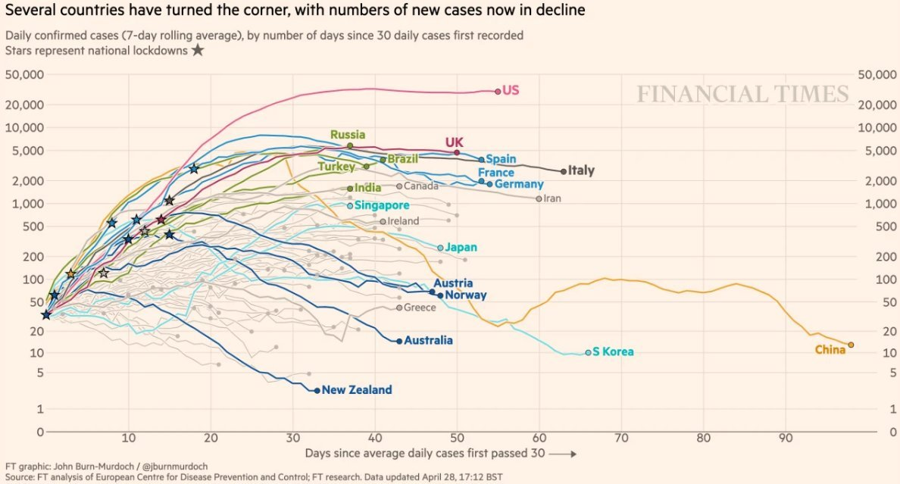
1. Spread of the virus

Slide 6
2. “Risk off” in global financial markets
  Perceived risk, as measured by the VIX (Volatility Index)
  was below 14.0 as late as Feb. 14,
  but then rose, to 70 in mid-March.
  => Investors turned risk-averse:
    pulled out of equities (Feb. 24-March 23),
    then corporate bonds, esp. junk bonds (March 10-23)
    & EM securities.
    (See Appendix 1 for “Risk off” charts.)
  Investors moved from EM currencies to safe-havens,
    particularly the US $.

Slide 7
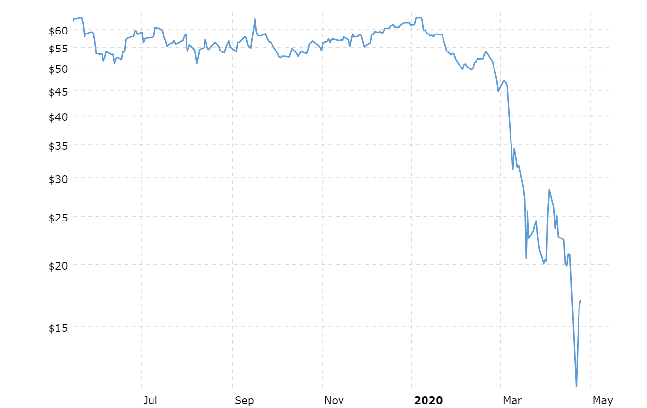
3. Collapse of oil prices
WTI Crude Oil Price,
Macrotrends, April 24, 2020
started February 26.
On April 20, price of WTI < 0.
The losers: Middle East & Russia
and some in Latin America & Africa.

Slide 8
Impact of the Covid-19 outbreak on oil & commodity prices
%
%
IMF WEO, April 2020. Figure 1.SF.1

Slide 9
For many developing countries,
a fall in commodity export prices comes on top of:
  the sudden stop to capital inflows,
  declining remittances,
  and the terrible challenges of Covid-19 itself spreading
  where health care systems are inadequate
  even at the best of times.
The recession will hit almost everyone.
  Not concentrated among Advanced Countries, as in 2008-2010,
  nor just among EM countries, as in 1997-98.

Slide 10
4. It is rare that one can predict recession before the numbers are in. But this time one could. A recession worse than 2008-09.
(IMF baseline forecast)
IMF WEO, April 2020, Figure 1.5. World Growth in GDP per Capita and Recession

Slide 11
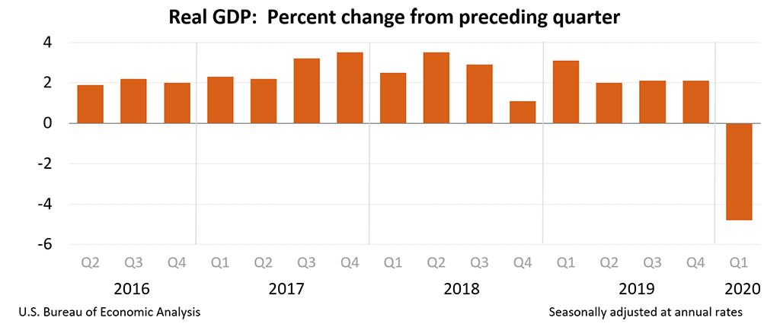
GDP already down in Q1 of 2020 (annualized & s.a.)…
US
China’s growth = -36.6 %.
Korea’s = -5.5 %.
In Europe,
  -21.3 % in France,
  -19.2 % in Spain,
  & -17.5 % in Italy.
US growth =-4.8%.
All will be much worse in the 2nd quarter.
  US unemployment already at 14.7% in April, as measured.

Slide 12
III. Policy response by governments
1. In most countries, officials did not take Covid-19 seriously enough,
  especially those with insufficient awareness of past history of pandemics.
  China released the genetic code for the new coronavirus in early January.
  WHO declared Public Health Emergency of International Concern Jan. 30.
  But countries like the US & UK did not use the time to prepare.
  They should have launched testing campaigns & ordered equipment.
  President Trump was in denial. E.g., Feb. 26: “…when you have 15 people,
  and the 15 within a couple of days is going to be down to close to zero,
  that’s a pretty good job we’ve done.”

Slide 13
2. By now, however, most countries have responded with:
  shutdowns & other public health measures
  and appropriate macroeconomic stimulus:
    fiscal relief & stimulus measures (in US, March 27)
    and monetary expansion
      going even beyond the Unconventional Monetary Policies of 2008-09:
      Central banks buying corporate securities.

Slide 14
2020 fiscal response exceeds 2009, esp. in G7 countries.
2020
2009
Advanced
countries
EM countries
FISCAL MONITOR: POLICIES TO SUPPORT PEOPLE DURING THE COVID-19 PANDEMIC, IMF, May 2020
Data sources: IMF 2009a; IMF 2009b; national authorities; and IMF staff estimates as of April 8, 2020. Panel 1 includes above-the-line spending and revenue measures only, weighted by GDP in PPP-adjusted current US dollars. Panel 2 adds below-the-line measures (loans, equity injections) and government guarantees to revenue and expenditure measures adopted in 2020. These are presented in the same panel for ease of reference but are not additive. The decomposition between loans and guarantees is based on available information as of April 8, 2020..

Slide 15
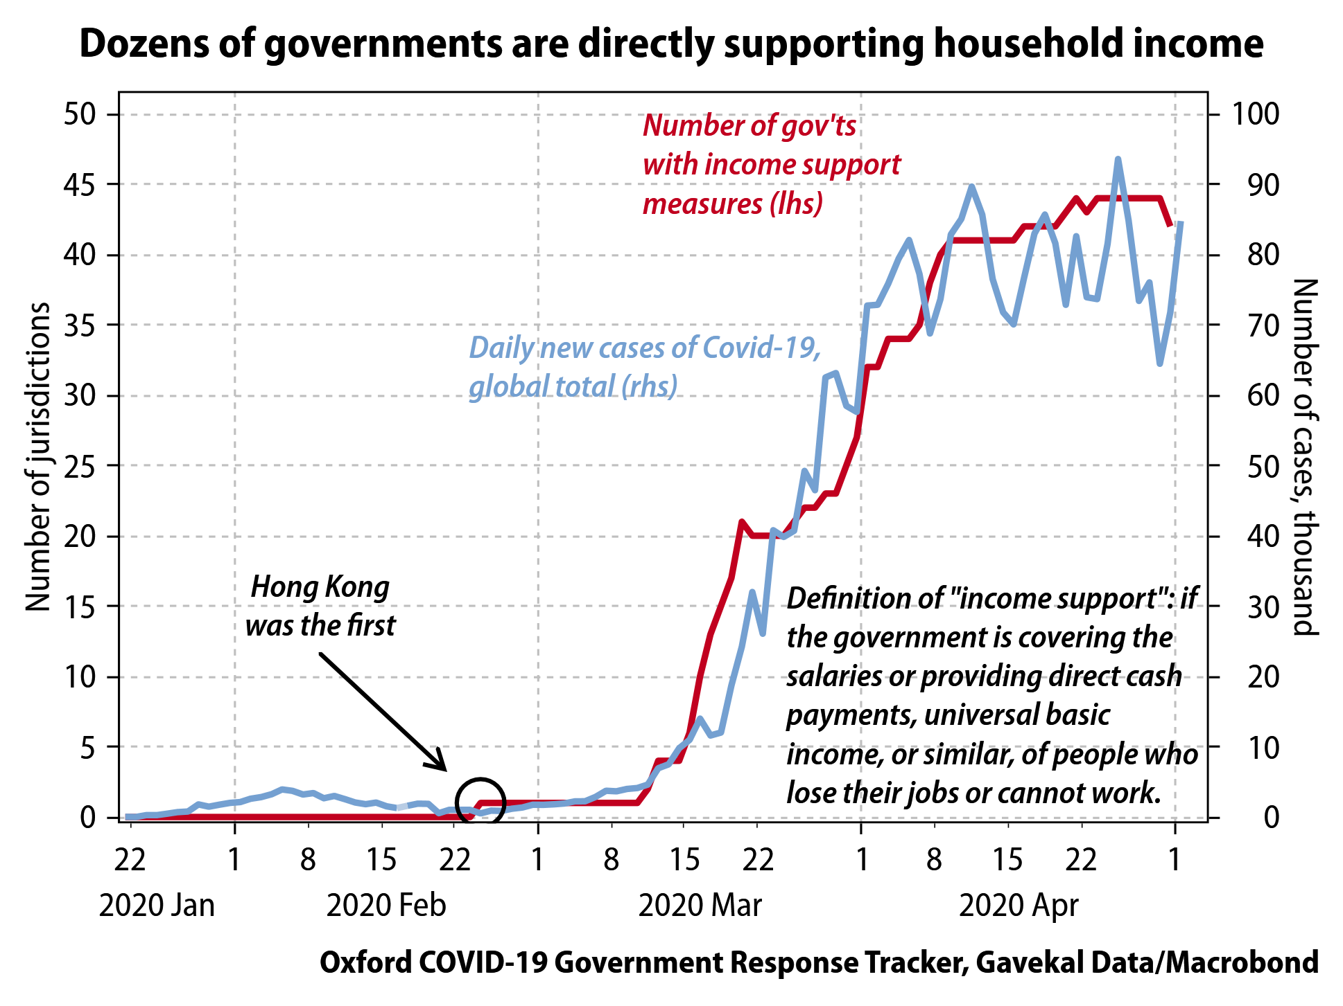
https://andrewbatson.com/2020/05/03/why-china-isnt-sending-money-to-everyone/

Slide 16
IV. Forecast of GDP growth:
IMF’s World Economic Outlook, April 14
lowered its forecast for global growth in 2020 sharply,
  by 6.3% pts. from the January forecast,
  to an unprecedented –3.0% worldwide.
That averages -1.0 % in EM & developing countries
and -6.1% in advanced economies.
(See Appendix 2 for WEO tables.)
It is already clear that the IMF forecasts were too optimistic,
  especially for developing countries,
  as it has now said.

Slide 17
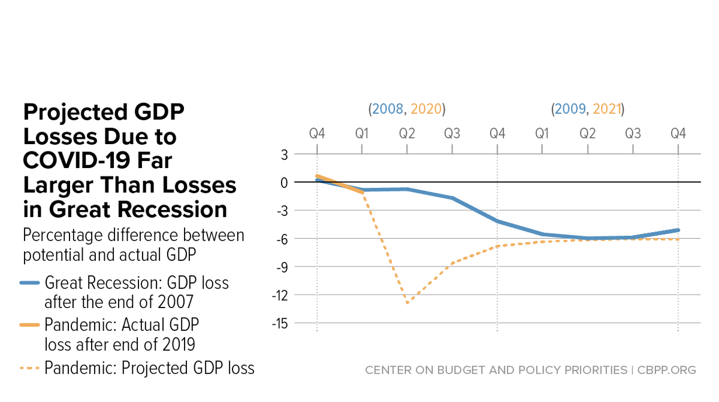
Lost US Output
US Q2 forecast ≈ -40%, q/q compounded per annum.
“Putting the Size of the Needed COVID-19 Fiscal Response in Perspective,” CBPP, May 4, 2020
www.cbpp.org/research/federal-budget/putting-the-size-of-the-needed-covid-19-fiscal-response-in-perspective”,”

Slide 18
V. What shape of recovery: “V”, “U”, or “W”?
1. V-shaped recovery in the global economy is not likely.
  At first, V bounce-backs seemed plausible.
  Natural disasters usually follow that pattern.
  E.g., China’s 2003 SARS is estimated to have cost 2% growth in Q2,
  but didn’t show up in the year’s overall GDP.
  But a V is too optimistic, for the aggregate world economy.

Slide 19
2. More likely, at best, is a U-shaped recovery:
60% of business leaders expect “U” shape
  -- World Ec. Forum, April 24.
Certain segments of the economy go back to work,
  perhaps in shifts,
while others should remain shut down longer…
  including, I would think, tatoo parlors & night clubs!
at least until we achieve massive, frequent, convenient, free testing
  + contact-tracing
  + reliable tests for anti-bodies.
A full recovery will wait until a vaccine is available,
which we are told will take at least 1 year,
  or an effective treatment.

Slide 20
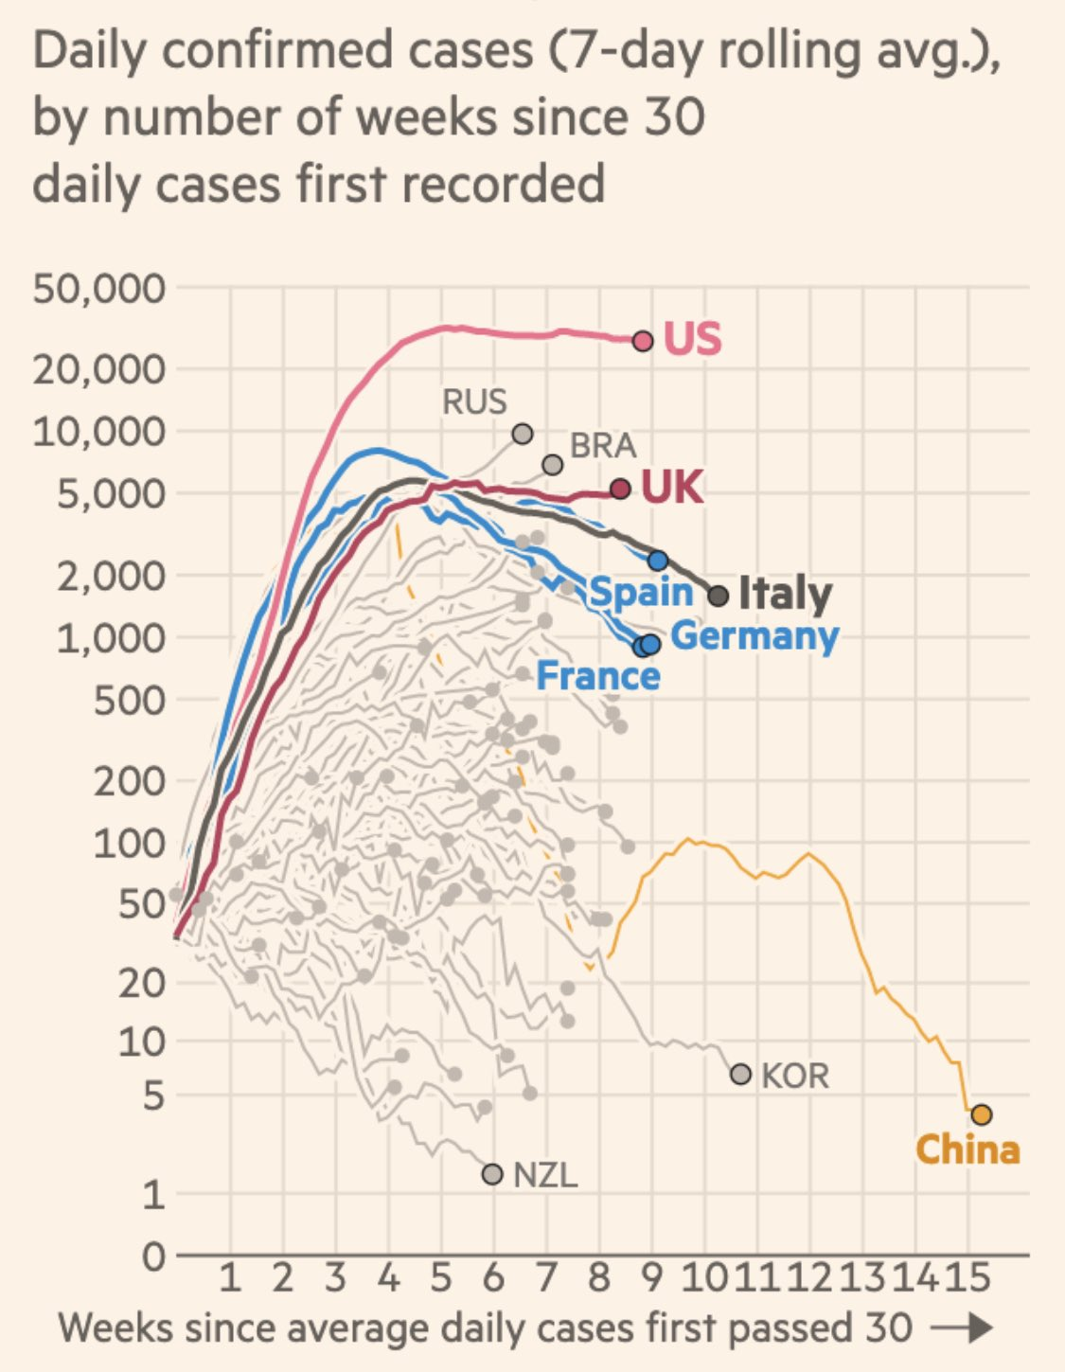
Reported cases have peaked in China, France, Italy & Spain.
Not yet in US, Russia, Brazil or UK.
R. Baldwin
May 9, 2020

Slide 21
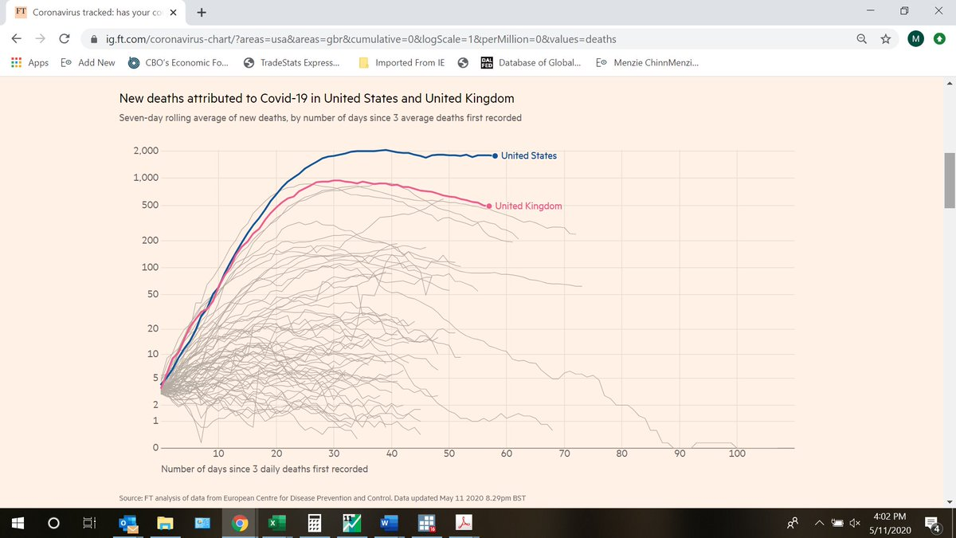
The death rate has not yet peaked in the US.
Financial Times, May 10, 2020
Note: Excess mortality in 14 countries runs about 60% above reported Covid19 death tolls..
www.ft.com/content/6bd88b7d-3386-4543-b2e9-0d5c6fac846c

Slide 22
3. I worry about a W-shaped recovery, arising from policy mistakes.
Two possible mistakes are illustrated by events of the inter-war period.
Mistake #1: Leaders sound the “all-clear” signal on contagion too soon.
  Some politicians have shown an excessive bias towards optimism,
    Which has already done harm by delaying action.
    It can do more harm if they try to re-open the economy prematurely.
    It is not enough for the numbers to have peaked. They need to show a sustained decline.
  The 1918-19 global influenza pandemic is an informative precedent.
    American cities instituted public health interventions in 1918.
    Those cities that let up early suffered a 2nd or 3rd wave of flu, with more deaths.

Slide 23
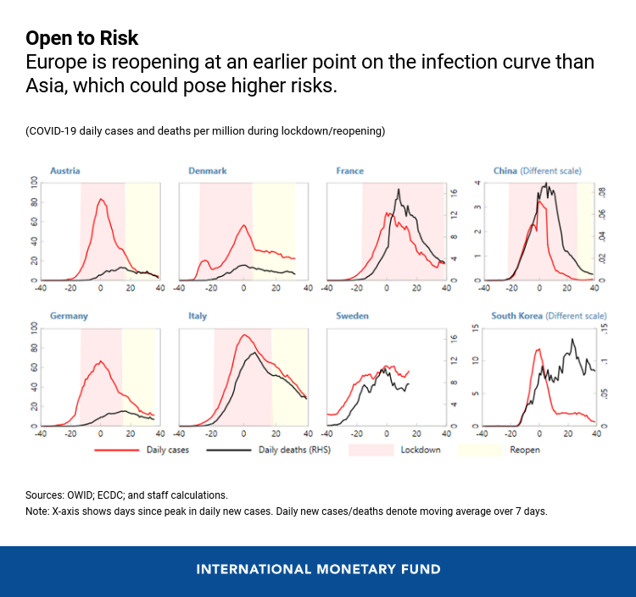
China
re-opened after cases were way down.
not so much
Changyong Rhee and Poul M. Thomsen, May 12, 2020, IMF
https://blogs.imf.org/2020/05/12/emerging-from-the-great-lockdown-in-asia-and-europe/

Slide 24
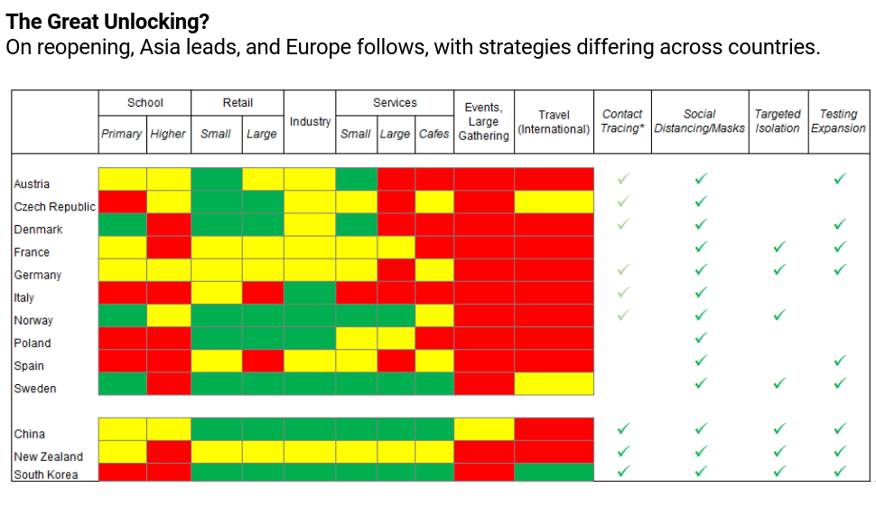
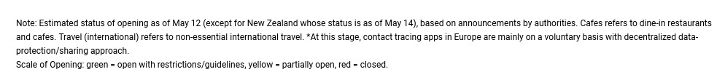
Strategies vary widely from country to country
May 12, 2020, IMF.
C.Rhee & P.Thomsen

Slide 25
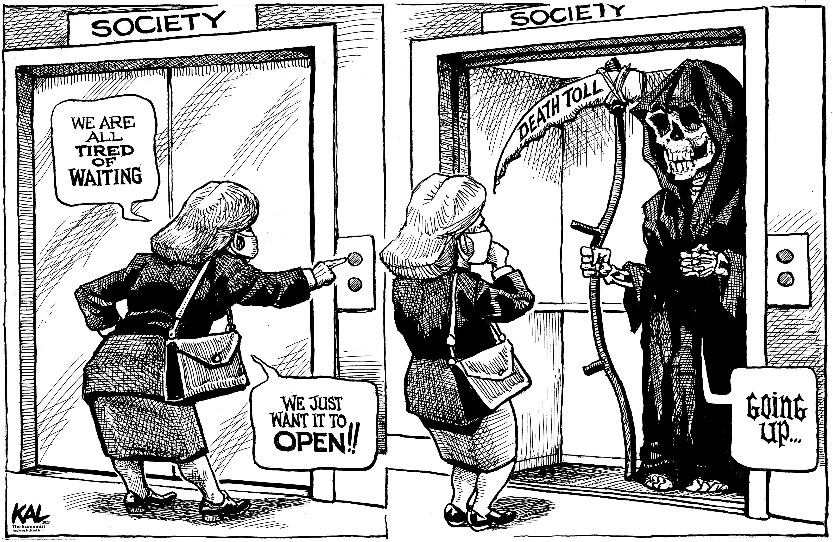
Most economists: A health/economy tradeoff is illusory.
From The Economist,
May 7, 2020
www.economist.com/the-world-this-week/2020/05/07/kals-cartoon
Lasting growth cannot be restored, without first defeating the virus.

Slide 26
Mistake #2: Abandoning economic stimulus too soon,
  resulting in a renewed downturn.
  The best precedent in the US is 1936.
    The Roosevelt Treasury prematurely curbed federal spending
      & raised taxes to restore a balanced budget.
    The Fed too tightened in 1936,
      Doubling bank reserve requirements
      And starting to sterilize gold inflows.
    As a result, the US went back into severe recession in 1937-38.
  This could easily happen again,
    perhaps as the result of partisan politics.
Conclusion:
A W-shaped pattern, i.e., relapses in health & the economy,
  could result from premature withdrawal
    either of public health measures or of economic stimulus.

Slide 27
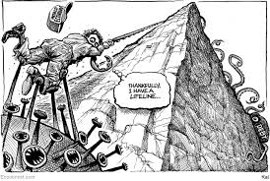
VI. Is all this additional debt sustainable?
From The Economist,
April 30, 2020
www.economist.com/the-world-this-week/2020/04/30/kals-cartoon

Slide 28
Those of us recommending sustained fiscal stimulus must address whether the implied debt path is sustainable.
Divide countries in 3 categories:
1) US seems still able to borrow as much as it wants,
  at low i & high $,
  <= exorbitant privilege, despite past abuse of it,
    e.g., 2017-19, when we incurred a $ 1 trillion budget deficit at the cyclical peak.
    CBO, April 24: US budget deficit ≈ $3.7 trillion & Debt/GDP ≈ 101% by end-2020.
2) Many EM & developing countries are on unsustainable debt paths,
  defined as ever-rising Debt/GDP ratios.
  They may require standstills & some restructuring.
3) In between are countries like UK & France.

Slide 29
The debt sustainability question is open.
But perhaps Larry Summers is right about secular stagnation
& the near-permanence of low r.
  If so, that applies not just to US but also to Europe
  => countries can afford to borrow.
Just as growth cannot be lastingly restored without defeat of the virus, so debt sustainability cannot come without lastingly restored growth.

Slide 30
The Coronavirus Recession of 2020
Prof. Jeffrey Frankel
Harvard Kennedy School
May 13, 2020

Slide 31
Appendix
1 “Risk off” in financial markets, Feb.-March.
2. IMF forecasts of April 14 (already too rosy)
3. Which EMs are in the most danger of debt crises?

Slide 32
CBOE VIX, 1990:1-2020:3 & RRT VIX Proxy, 1990:1-2020:3
1. Risk off
(1.1)
For the VIX proxy,
March 2020 surpasses
2008-2009 crisis. Volatility
akin to the 1930s
Carmen Reinhart, Covid-19 and Global Financial Markets, April 29, 2020. Source: Reinhart, Reinhart, & Trebesch (2020).

Slide 33
(1.2) Corporate interest rate spreads rose & equity prices fell.
IMF WEO, April 2020. Figure 1.2. Advanced Economies: Monetary and Financial Market Conditions

Slide 34
(1.3) Emerging Market spreads rose.
(EMBI Sovereign Spreads, basis points)
IMF WEO, April 2020.

Slide 35
Emerging Market equities fell.
(Jan.1, 2019 = 100)
IMF WEO, April 2020. Figure 1.3.

Slide 36
(1.4) Exchange Rate Changes versus the US Dollar
December 31, 2019-March 31, 2020, (in percent)
Percent
Snapshot of changes for 184 countries reporting to IMF
Countries with
depreciations
> 10%
Parallel market rate
In red

Slide 37
Appendix 2: World Economic Outlook, April
Even the IMF base case was a severe global 2020 recession.
IMF World Economic Outlook, April 2020

Slide 38
EM & Developing Economies also show negative growth.
IMF World Economic Outlook, April 2020

Slide 39
Trade is falling even more sharply than GDP, an intensification of post-2008 de-globalization.
IMF World Economic Outlook, April 2020

Slide 40
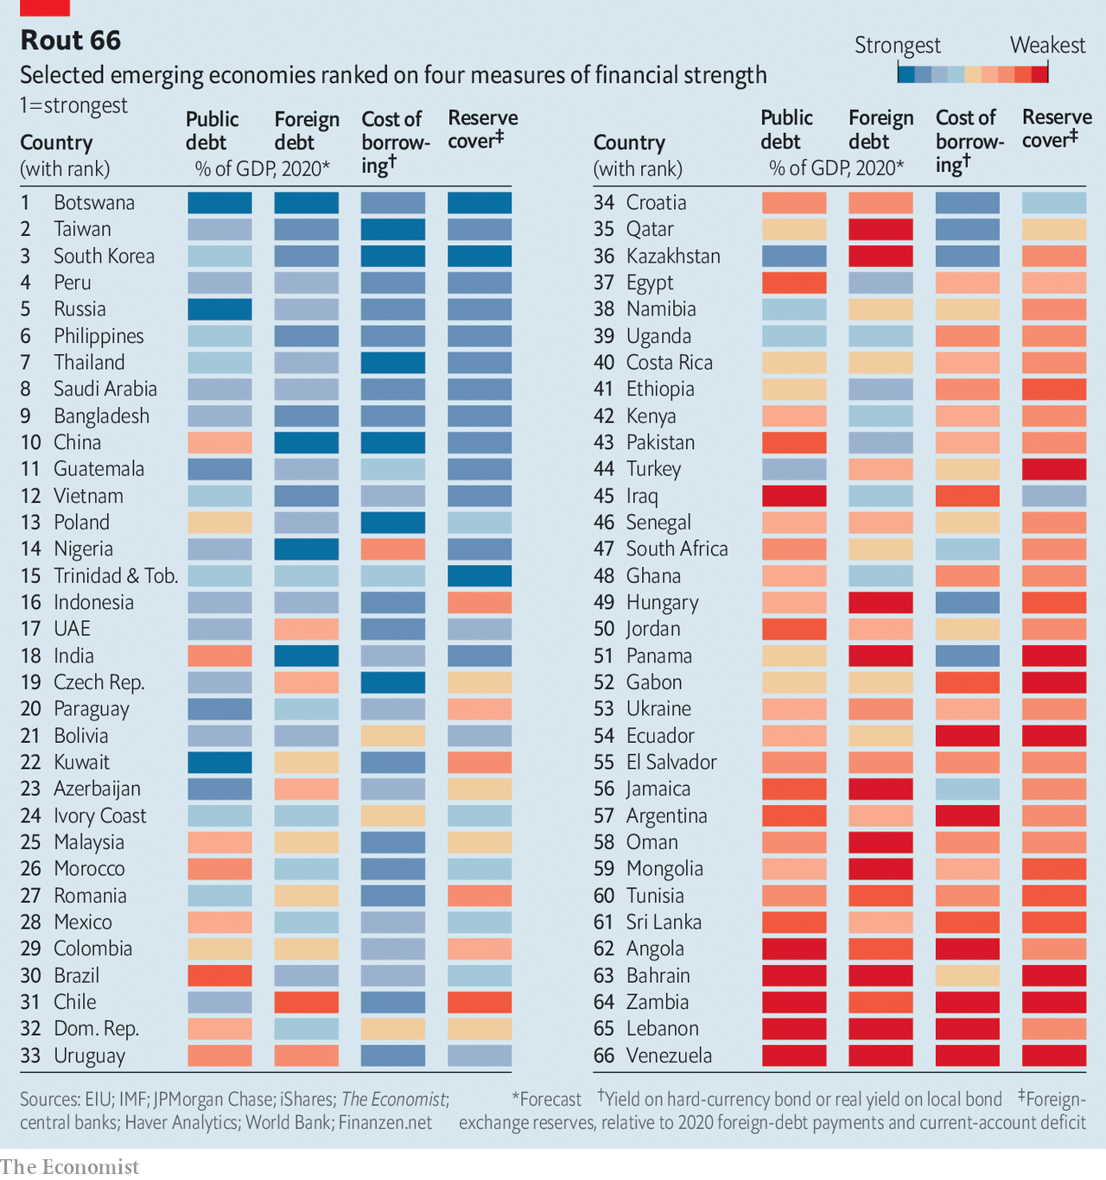
“Which EMs are in most financial peril? – The Economist,
May 2, 2020. www.economist.com/briefing/2020/05/02/which-emerging-markets-are-in-most-financial-peri l
Appendix 3
Criteria include
Public debt
Foreign debt
Cost of borrowing
ForEx reserves

