Slide 1
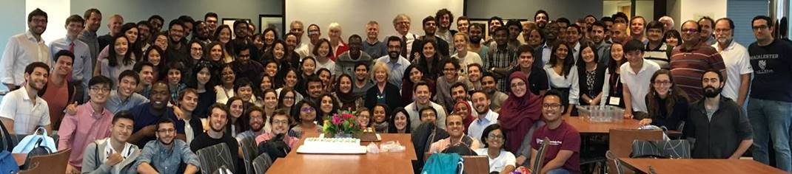
Panel: Addressing the COVID-19 Crisis
Virtual 2020 MPA/ID Celebration
Friday, May 8, 2020, 2-3:30pm
The Advanced Economies
Prof. Jeffrey Frankel, Harvard Kennedy School

Slide 2
Addressing the COVID-19 Crisis in the Advanced Economies
The economic situation gets worse & worse.
Governments’ reactions.
The current debate: re-opening the economy.
Those of us recommending sustained fiscal stimulus must address whether the implied debt paths are sustainable.

Slide 3
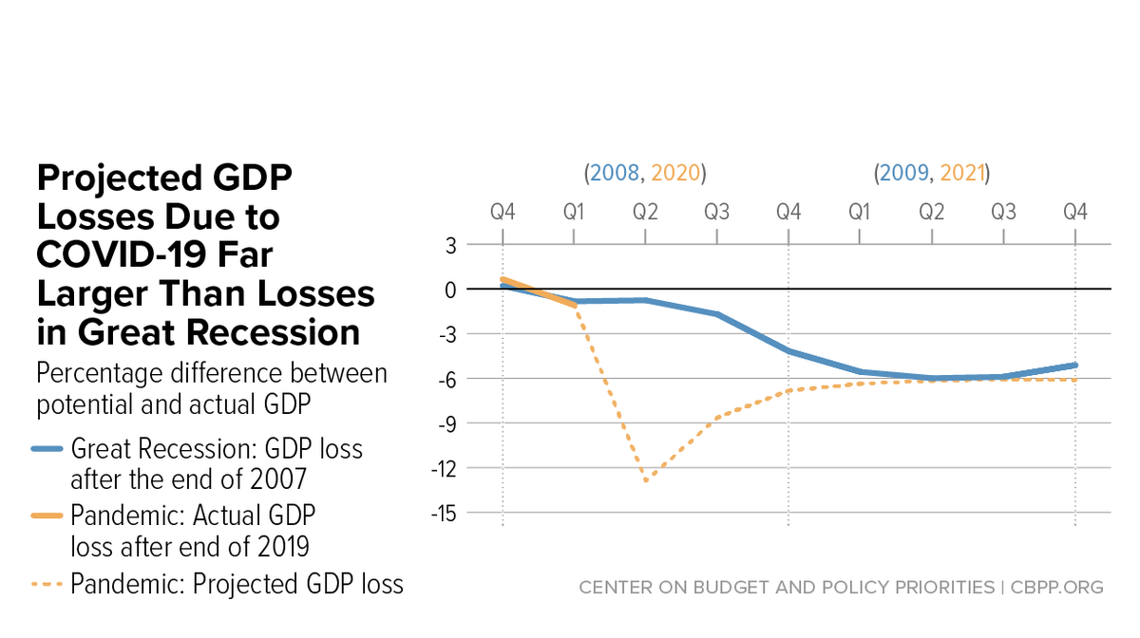
1. The economic situation gets worse & worse.
Lost US Output
“Putting the Size of the Needed COVID-19 Fiscal Response in Perspective,” CBPP, May 4, 2020
www.cbpp.org/research/federal-budget/putting-the-size-of-the-needed-covid-19-fiscal-response-in-perspective”,”

Slide 4
2. Govt. reactions: 2020 Fiscal response > 2009, esp. G7.
FISCAL MONITOR: POLICIES TO SUPPORT PEOPLE DURING THE COVID-19 PANDEMIC, IMF, May 2020
Data sources: IMF 2009a; IMF 2009b; national authorities; and IMF staff estimates as of April 8, 2020. Panel 1 includes above-the-line spending and revenue measures only, weighted by GDP in PPP-adjusted current US dollars. Panel 2 adds below-the-line measures (loans, equity injections) and government guarantees to revenue and expenditure measures adopted in 2020. These are presented in the same panel for ease of reference but are not additive. The decomposition between loans and guarantees is based on available information as of April 8, 2020..

Slide 5
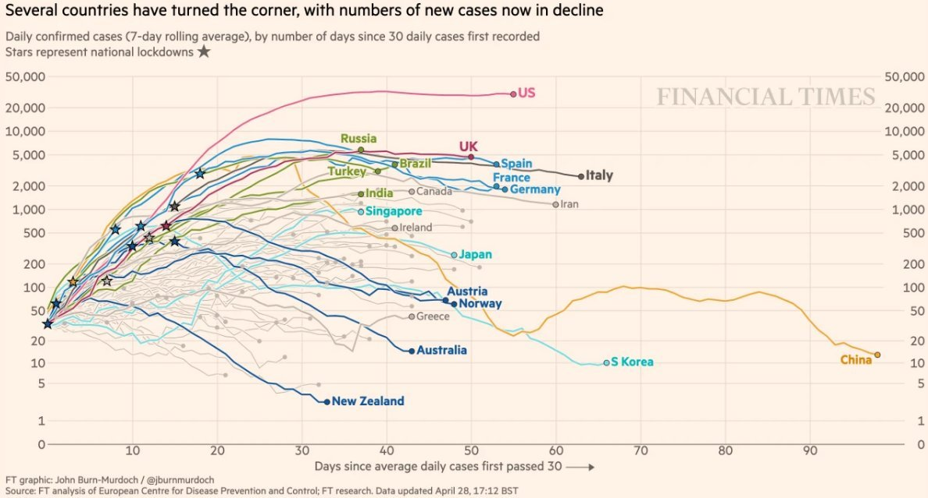
3. Time to re-open the economy? Deaths have barely peaked.
Note: Excess mortality in 14 countries runs about 60% above reported Covid19 death tolls. www.ft.com/content/6bd88b7d-3386-4543-b2e9-0d5c6fac846c

Slide 6
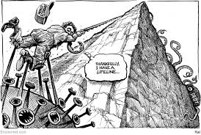
4. Debt sustainability:
A tradeoff between health & re-opening the economy is illusory
– but the tradeoff with debt sustainability is real.
From The Economist
April 30, 2020
www.economist.com/the-world-this-week/2020/04/30/kals-cartoon

Slide 7
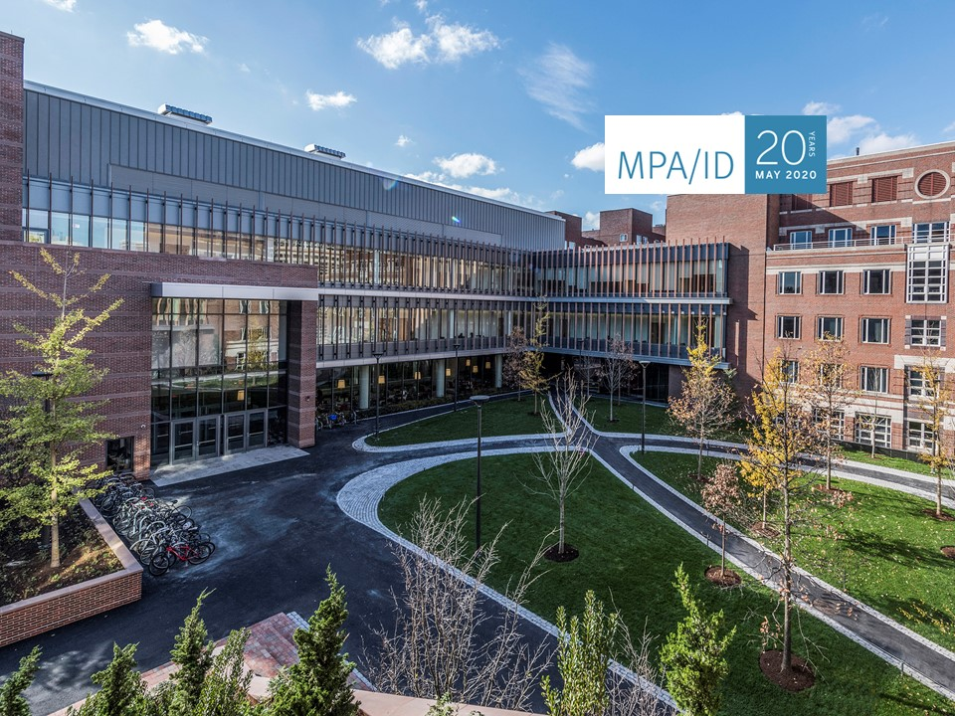
Addressing the COVID-19 Crisis

