Slide 1


Slide 2

An Economic Perspective on the Natural Resource Curse and Its Implications for a Developing Country
Jeffrey Frankel
Harpel Professor of Capital Formation and Growth
Harvard University
Day of Ecuador at Harvard:
Breaking the Natural Resources Dependence:
Is It Possible? A Vision from the Middle of the World
Monday, April 21, 2014, 9:00am to 4:30pm

Slide 3
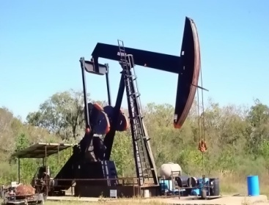
The Natural Resource Curse
Many countries that are
richly endowed with oil,
minerals, or fertile land
have failed to grow more
rapidly than those without.
Example:
Some studies find a negative effect of oil
in particular, on economic performance.

Slide 4

Meanwhile, East Asian economies achieved western-level standards of living despite having virtually no exportable natural resources:
  Japan, Singapore, Hong Kong, Korea & Taiwan,
    rocky islands or peninsulas;
  followed by China.

Slide 5
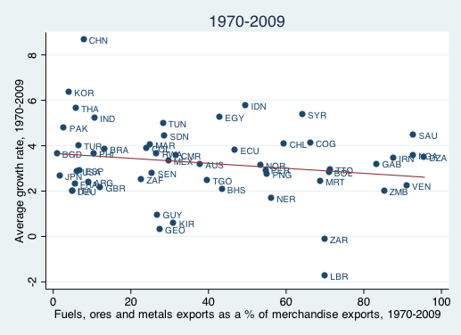

Growth declines with fuel & mineral exports.

Slide 6
Are natural resources necessarily bad?
No, of course not.
Commodity wealth need not necessarily lead to inferior economic or political development.
Rather, it is a double-edged sword,
with both benefits and dangers.
  It can be used for ill as easily as for good.
The priority should be on identifying ways
to sidestep the pitfalls that have afflicted
commodity producers in the past,
to find the path of success.

Slide 7

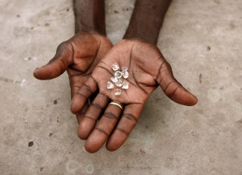
Some developing countries have avoided
the pitfalls of commodity wealth.
  E.g., Chile (copper)
  Botswana (diamonds)
Some of their innovations are worth emulating.
I will suggest some policies & institutional
innovations to avoid the curse,
especially ways of dealing with price swings.

Slide 8
Policies & institutions to avoid pitfalls of the Natural Resource Curse
II. Recommended:
  Devices to hedge risk.
  Ideas to reduce macroeconomic pro-cyclicality.
  Institutions for better governance.
III. Some that are not recommended:
  Institutions that try to suppress price volatility.

Slide 9

Devices to share risks
II. Six recommendations
for commodity-exporting countries
  1. Index contracts with foreign companies
  (royalties…) to the world commodity price.
  2. Hedge commodity revenues
  in options markets
  3. Link debt to the commodity price
Notes:
9

Slide 10


Countercyclical macroeconomic policy
6 recommendations for commodity producers continued
In the past, policy has often been procyclical.
4. Monetary policy:
Try Nominal GDP Targeting,
as an alternative to the popular CPI-targeting.
5. Fiscal policy:
Emulate Chile: to avoid over-spending in boom times,
allow deviations from a target surplus only
in response to permanent commodity price rises.
With non-political determination of “permanent” vs. “temporary.”
Notes:
10

Slide 11


Good governance institutions
6 recommendations for commodity producers, concluded
6) Professional management of wealth funds
Norway’s Pension Fund
  All govt. oil revenues go into it.
  Govt. (on average over the cycle)
  can spend expected real return, 4%.
  All invested abroad. Reasons:
    (1) for diversification,
    (2) to avoid cronyism in investments.
But also insulate it from politics,
  like Botswana’s Pula Fund,
    for financial optimization, not social objectives.
Notes:
11

Slide 12
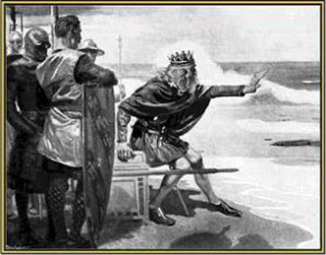
Other policies have not worked so well.
Producer subsidies
Stockpiles
Marketing boards
Price controls
Export controls
Blaming derivatives
Resource nationalism
Banning foreign participation

Slide 13
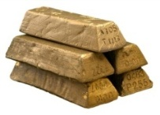
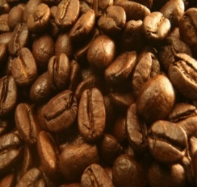
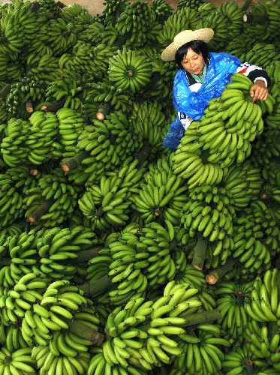



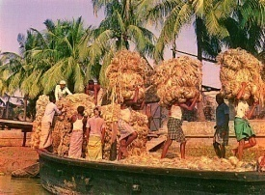
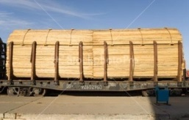
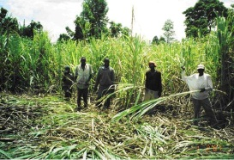






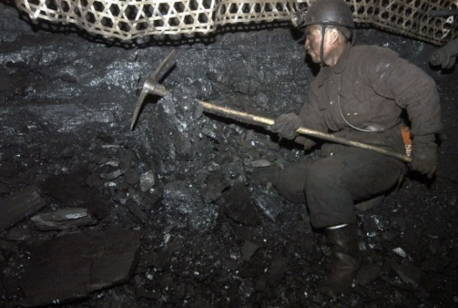

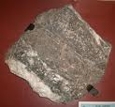
13
Notes:
13

Slide 14
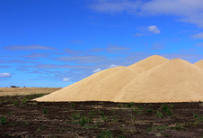
I) Policies that have not worked so well
1) Producer subsidies to “stabilize” prices at high levels,
  often via wasteful stockpiles & protectionist import barriers.
Examples:
  The EU’s Common Agricultural Policy
    Bad for EU budgets, economic efficiency,
    international trade, & consumer pocketbooks.
  Or fossil fuel subsidies
    which are equally distortionary & budget-busting,
    and bad for the environment as well.
    Iran, Saudi Arabia, Venezuela, Indonesia, UAE, Iraq, Algeria, Mexico…
  Or US corn-based ethanol subsidies,
    with tariffs on Brazilian sugar-based ethanol.
Notes:
14

Slide 15
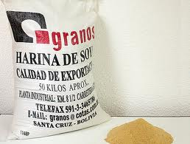
Unsuccessful policies, continued
2) Price controls to “stabilize” prices at low levels
Often the goal of controls is to shield consumers
of staple foods & fuel from price increases.
But the artificially suppressed price
    discourages domestic investment & production,
    and requires rationing to domestic households.
      Shortages & long lines can fuel political
      rage as well as higher prices can,
      not to mention when the government
      is forced by huge gaps to raise prices discontinuously.
    Price controls can also require imports, to satisfy excess demand.
        exacerbating a world price spike even more.
Notes:
15

Slide 16
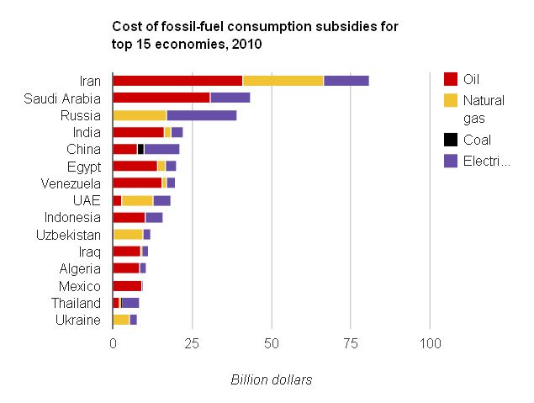
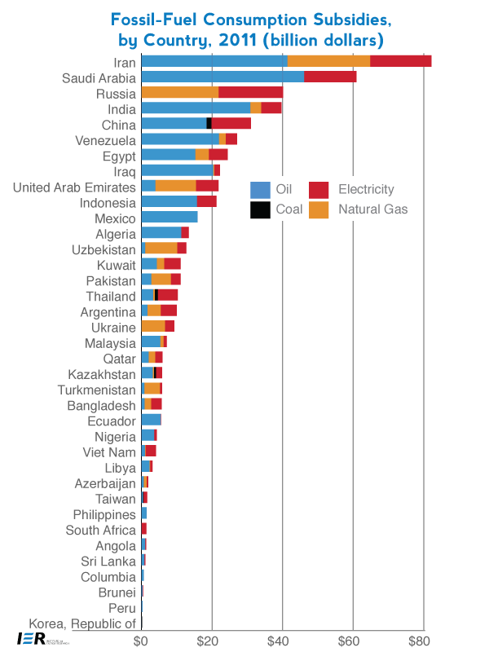
Subsidies to consumption of fossil fuels are expensive
especially among exporting countries.
city
$ billions
Source: IEA

Slide 17
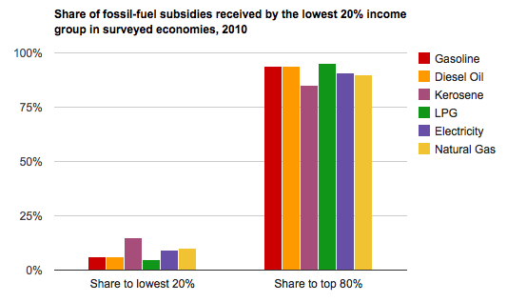
Few fossil fuel subsidies actually go to the poor,
typical of subsidies adopted in the name of equality.
Source: IEA

Slide 18

Unsuccessful policies, continued
  3) Some African countries adopted
  commodity marketing boards
  for coffee & cocoa around
  the time of independence.
    The original rationale:
    to buy the crop in years of excess supply,
    sell in years of excess demand.
    In practice the price paid to cocoa & coffee farmers
    was always below the world price.
      As a result, production fell.
Notes:
18

Slide 19

Microeconomic policies, continued
4) In producing countries, prices are artificially suppressed by means of export controls
to insulate domestic consumers from a price rise.
    In 2008, India capped rice exports.
    Argentina capped wheat exports,
    as did Russia in 2010.
Results:
  Domestic supply is discouraged.
        World prices go even higher.
Notes:
19

Slide 20
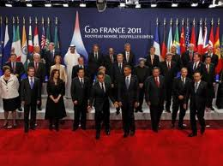
A G20 initiative deserved to succeed:
Producers & consuming countries in grain markets
should cooperatively agree to refrain
from export controls and price controls.
  The result would be lower world price volatility.
Notes:
20

Slide 21
An initiative that has less merit:
5) Attempts to blame speculation for volatility
  and so to ban derivatives markets.
Yes, prices are sometimes hit by speculative bubbles.
But in commodity markets
  prices are more often the signal for fundamentals.
    Don’t shoot the messenger.
  Also, derivatives are useful for hedgers.

Slide 22


The overall lesson for microeconomic policy
Attempts to prevent
commodity prices from
fluctuating generally fail.
Even though enacted
in the name of reducing
volatility & income inequality,
their effect is often different.
Better to accept volatility and cope with it.
When the aim is poverty alleviation, use well-targeted programs instead,
  Conditional Cash Transfers
    along the lines of Oportunidades (Mexico)
    or Bolsa Familia (Brazil).
Notes:
22

Slide 23

“Resource nationalism”
Another motive for commodity export controls:
  6) to subsidize downstream industries.
  E.g., “beneficiation” in South African diamonds
    But it didn’t make diamond-cutting competitive,
    and it hurt mining exports.
7) Nationalization of foreign companies
  Like price controls, it discourages investment.

Slide 24
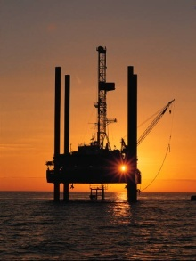
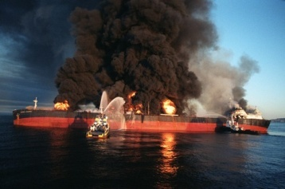
“Resource nationalism” continued
8) Keeping out foreign companies altogether.
  But often they have the needed technical expertise.
  Examples: declining oil production in Mexico & Venezuela.
9) Going around “locking up” resource supplies.
  China must think that this strategy will
  protect it in case of a commodity price shock.
  But global commodity markets are increasingly integrated.
    If conflict in the Persian Gulf doubles
    world oil prices, the effect will be
    pretty much the same for those
    who buy on the spot market and
    those who have bilateral arrangements.

Slide 25

More Appendices
Elaboration on proposals to reduce the pro-cyclicality of macroeconomic policy
II) To make monetary policy less procyclical:
• Nominal GDP targeting
• or Product Price Targeting
III) To make fiscal policy less procyclical:
• emulate Chile.
PPT

Slide 26
II) The challenge of designing a monetary regime for countries where commodity shocks dominate the cycle
Fixing the exchange rate
leads to pro-cyclical monetary policy:
  Money flows in during commodity booms.
    Excessive credit creation can lead to inflation.
    Example: Saudi Arabia & other Gulf countries
      during the 2003-08 oil boom.
  Money flows out during commodity busts.
    Credit squeeze can lead to excess supply,
    recession & balance of payments crisis.
    Example: Exporters of oil & other commodities
      in 1982, 1997.

Slide 27

Currency regime, continued
Floating accommodates terms of trade shocks:
  If terms of trade improve,
  currency automatically appreciates,
    preventing excessive money inflows, overheating & inflation.
  If terms of trade worsen,
  currency automatically depreciates,
    preventing recession & balance of payments crisis.
Disadvantages of floating:
  Dutch Disease can be worse;
  Volatility can be excessive,
  & currency costs, esp. for small open economies.
  One needs a nominal anchor.

Slide 28
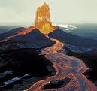
Demand vs. supply shocks
Currency regime, continued
An old wisdom regarding the source of shocks:
  Fixed rates work best if shocks are mostly internal demand shocks (especially monetary);
  floating rates work best if shocks tend to be
  supply shocks (especially external terms of trade).
One set of supply shocks:
natural disasters
  R.Ramcharan (2007) finds floating works better.
The most important category:
trade shocks
Notes:
28

Slide 29

Textbook theory: a country where trade shocks dominate should accommodate them by a floating exchange rate.
Confirmed empirically:
  Developing countries facing terms of trade shocks do better
  with flexible exchange rates than fixed exchange rates.
  Broda (2004), Edwards & L.Yeyati (2005), Rafiq (2011), and Céspedes & Velasco (2012)…
So allow currency appreciation in response to a commodity boom.
  But do not free-float necessarily.
    Accumulate some forex reserves first.
    If inflation is an issue,
      try to sterilize.
      Raise banks’ reserve requirements, esp. on $ liabilities
      Put some foreign assets into a commodity fund.
Notes:
29

Slide 30
If the exchange rate is not to be the monetary anchor, what is?
The popular choice of last decade:
Inflation Targeting.
  But CPI target can react perversely
    to supply shocks
    & terms of trade shocks.

Slide 31
Needed:
Nominal anchor that accommodates the shocks that are common in developing countries
Supply shocks,
  e.g., droughts, floods, hurricanes:
  Nominal GDP targeting.
Terms of trade shocks
  e.g., fall in price of commodity export.
  Product Price Targeting
PPT

Slide 32
Nominal GDP target moderates effects of supply shocks
Adverse
AS shock
P
Nom.
GDP
target
AS
•
IT
•
•
AD
Real
GDP

Slide 33
Product Price Targeting:
PPT
Target an index of domestic production prices [1]
such as the GDP deflator
Include export commodities in the index
and exclude import commodities,
    so money tightens & the currency appreciates
    when world prices of export commodities rise
      accommodating the terms of trade --
      not when world prices of import commodities rise.
The CPI does it backwards:
  It calls for appreciation when import prices rise,
  not when export prices rise !
[1] Frankel (2011, 2012).
Notes:
33
33

Slide 34
Why is PPT better than a fixed exchange rate for countries with volatile export prices?
PPT
If the $ price of the export commodity goes up,
the currency automatically appreciates,
  moderating the boom.
If the $ price of export commodity goes down,
the currency automatically depreciates,
  moderating the downturn
  & improving the balance of payments.
Notes:
34

Slide 35
Why is PPT better than CPI-targeting for countries with volatile terms of trade?
PPT
If the $ price of imported commodity goes up,
CPI target says to tighten monetary policy
enough to appreciate the currency.
  Wrong response. (E.g., oil-importers in 2007-08.)
  PPT does not have this flaw .
If the $ price of the export commodity goes up,
PPT says to tighten money enough to appreciate.
  Right response. (E.g., Gulf currencies in 2007-08.)
  CPI targeting does not have this advantage.
Notes:
35

Slide 36



III) Achieving counter-cyclical fiscal policy
Chile’s budget institutions (adopted, 2000; formalized in law, 2006)
1st rule – Governments must set a fiscal target,
    set = 0 in 2008 under President Bachelet.
2nd rule – The fiscal target is structural:
Deficits allowed only to the extent that
  (1) output falls short of trend, in a recession,
  (2) or the price of copper is below its trend.
3rd rule – The trends are projected by 2 panels
of independent experts, outside the political process.
  Result: Chile avoids the pattern of 32 other governments,
    where forecasts in booms are biased toward over-optimism.
  Chile ran surpluses in the 2003-07 boom,
    while the U.S. & Europe failed to do so.
Notes:
36

Slide 37
The Pay-off
Chile’s fiscal position strengthened immediately:
  Public saving rose from 2.5 % of GDP in 2000 to 7.9 % in 2005
  allowing national saving to rise from 21 % to 24 %.
Government debt fell sharply as a share of GDP
and the sovereign spread gradually declined.
By 2006, Chile achieved a sovereign debt rating of A,
    several notches ahead of Latin American peers.
By 2007 it had become a net creditor.
By 2010, Chile’s sovereign rating had climbed to A+,
    ahead of some advanced countries.
=> It was able to respond to the 2008-09 recession
  via fiscal expansion.

Slide 38

IV: An example of commodity speculation
In the 1955 movie version
of East of Eden, the legendary James Dean plays Cal.
Like Cain in Genesis, he competes with his brother for the love of his father.
Cal “goes long” in the market
for beans, in anticipation of
a rise in demand if the US enters WWI.

Slide 39

An example of commodity speculation, cont.
Sure enough, the price of beans goes sky high,
Cal makes a bundle, and offers it to his father,
a moralizing patriarch.
But the father is morally offended by Cal’s speculation,
not wanting to profit
from others’ misfortunes,
and tells him he will have
to “give the money back.”

Slide 40

An example of commodity speculation, cont.
Cal has been the agent of
Adam Smith’s famous invisible hand:
  By betting on his hunch about
  the future, he has contributed
  to upward pressure on the price
  of beans in the present,
  thereby increasing the supply so that more
  is available precisely when needed (by the Army).
The movie even treats us to a scene where Cal watches the beans grow in a farmer’s field, something real-life speculators seldom get to see.

Slide 41


Slide 42
Appendix V: Channels of
the Natural Resource Curse
How could abundance
of commodity wealth be a curse?
What is the mechanism
for this counter-intuitive relationship?
At least 5 categories of explanations.
42

Slide 43
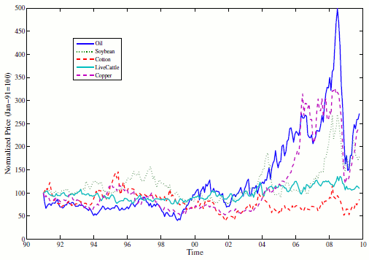




5 Possible Natural Resource Curse Channels
Volatility
Crowding-out of manufacturing
Autocratic Institutions
Anarchic Institutions
Procyclicality including
  Procyclical capital flows
  Procyclical monetary policy
  Procyclical fiscal policy.
43

Slide 44
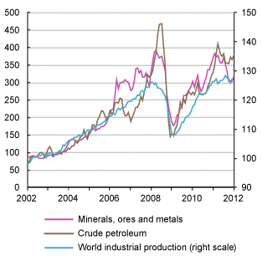
Commodity prices have been especially volatile over the last decade.
1. Volatility in global commodity prices.
Source: UNCTAD

Slide 45
2. Natural resources may crowd out manufacturing,
and manufacturing could be the sector
that experiences learning-by-doing
  or dynamic productivity gains from spillover.
So commodities could in theory be a dead-end sector.
My own view: a country need not repress the commodity sector to develop the manufacturing sector.
  It can foster growth in both sectors.

Slide 46

3. Autocratic/Oligarchic Institutions
A typical list:
  corruption,
  rent-seeking,
  class-based inequality,
  intermittent dictatorship,
  ineffective judiciary branch, and
  lack of constraints to prevent elites & politicians from plundering the country.

Slide 47

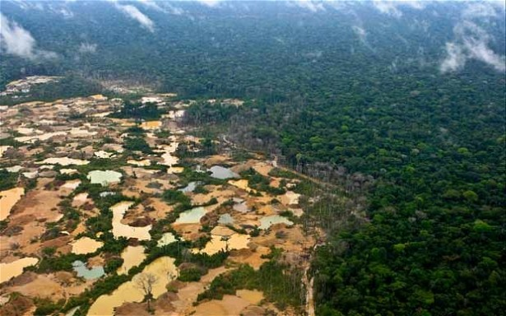

4. Anarchic institutions
  Unsustainably rapid
  depletion of resources
  Unenforceable
  property rights
  Civil war
47
Notes:
47

Slide 48

5. Procyclicality
The Dutch Disease describes unwanted
side-effects of a commodity boom.
Commodity exporting countries are
historically prone to procyclicality,
Procyclicality in:
  Capital inflows; Monetary policy;
  Real exchange rate; Nontraded Goods
  Fiscal Policy
48
Notes:
48
keep

Slide 49
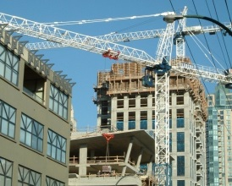
The Dutch Disease:
5 side-effects of a commodity boom
1) A real appreciation in the currency
2) A rise in government spending
3) A rise in non-traded goods prices
4) A resultant shift of production
out of manufactured goods
5) Sometimes debt.
49
Notes:
49

Slide 50
The Natural Resource Curse should not be interpreted as a rule that commodity-rich countries are doomed to fail.
The question is what policies to adopt
  to avoid the pitfalls and improve the chances of prosperity.
A wide variety of measures have been tried.
Some work better than others.

Slide 51
References by the author
http://www.hks.harvard.edu/fs/jfrankel/
Project Syndicate,
  “Escaping the Oil Curse,” Dec.9, 2011.
  "Barrels, Bushels & Bonds: How Commodity Exporters Can Hedge Volatility," Oct.17, 2011.
“The Natural Resource Curse: A Survey of Diagnoses and Some Prescriptions,” 2012, Commodity Price Volatility and Inclusive Growth in Low-Income Countries , R.Arezki et al., eds. (IMF). HKS RWP12-014.
“The Curse: Why Natural Resources Are Not Always a Good Thing,” Milken Institute Review, vol.13, no.4, 4th quarter 2011: 28-39.
“How Can Commodity Exporters Make Fiscal and Monetary Policy Less Procyclical?” 2011, Natural Resources, Finance & Development. R.Arezki, T.Gylfason & A.Sy, eds. (IMF). HKS RWP 11-015.
“On Graduation from Fiscal Procyclicality,” with C.Végh & G.Vuletin, 2013 in Journal of Development Economics, 100, no.1, Jan., pp. 32-47. NBER WP 17619. Summary, VoxEU, 2011.
“Chile's Countercyclical Triumph," in Transitions, Foreign Policy, June 2012.
“A Solution to Fiscal Procyclicality: The Structural Budget Institutions Pioneered by Chile,” Central Bank of Chile WP604, 2011. Spanish:Journal Economía Chilena , Aug.2011, CBC, 39-78.
"Product Price Targeting -- A New Improved Way of Inflation Targeting,“ 2012,
in MAS Monetary Review XI, 1, (Monetary Authority of Singapore).
“A Comparison of Product Price Targeting and Other Monetary Anchor Options, for Commodity-Exporters in Latin America," Economia, 2011 (Brookings), NBER WP 16362.

Slide 52
References by others
Rabah Arezki & Kareem Ismail, 2010, “Boom-Bust Cycle, Asymmetrical Fiscal Response and the Dutch Disease,” IMF WP/10/94, April.
Luis Céspedes & Andrés Velasco, 2012, “Macroeconomic Performance During Commodity Price Booms & Busts” NBER WP 18569, Nov.
W.McKibbin & K.Singh, 2003, “Issues in the Choice of a Monetary Regime for India,” in K.Kalirajan & U.Sankar, eds., Economic Reform and the Liberalisation of the Indian Economy, pp. 221-74.
James Meade, 1978, “The Meaning of Internal Balance,” Economic Journal, 91, 423-35.
Richard Auty, 1993, Sustaining Development in Mineral Economies: The Resource Curse Thesis (Oxford University Press, NY).
Stanley Engerman & Kenneth Sokoloff, 2000, “Institutions, Factor Endowments, and Paths of Development in the New World,” Journal of Economic Perspectives XIV: 217-32.
J.Isham, M.Woolcock, L.Pritchett & G.Busby, 2005, “The Varieties of Resource Experience: Natural Resource Export Structures and the Political Economy of Economic Growth,” World Bank Economic Review.
Jeffrey Sachs, “How to Handle the Macroeconomics of Oil Wealth,” 2007, in Escaping the Resource Curse, M.Humphreys, J.Sachs & J.Stiglitz, eds. (Columbia Univ.Press: NY), pp. 173-93.
__, and Andrew Warner, 1995, “Natural Resource Abundance and Economic Growth,” in G. Meier and J. Rauch, eds., Leading Issues in Economic Development (Oxford University Press.)

