Slide 1
Systematic Managed Floating
Jeffrey Frankel
Harpel Professor of Capital Formation and Growth
Harvard University
Robert Mundell Distinguished Lecture
Conference on The Center at 50
International Center for Monetary and Banking Studies
Geneva, 27 October, 2023

Slide 2
Introduction
Congratulations to ICMB on its 50th birthday.
50 years ago, the system of pegged exchange rates ended; the world moved to floating.
Mundell’s “Optimum Currency Areas” conception of fixed vs. floating did not consider a continuum.

Slide 3
Countries’ choice of exchange rate regimes
A majority neither free float nor firmly peg.
Intermediate exchange rate regimes, then.
  But, in practice, they also seldom obey well-defined
  target zones or basket pegs.
  Proposed: a regime of “systematic managed floating,”
  where the central bank regularly responds to changes
  in total exchange market pressure by
    allowing some fraction to be reflected as Δ exchange rate,
    the remaining fraction to be absorbed as Δ FX reserves.

Slide 4
Outline
I) Five recent historical episodes
II) Four challenges to the relevance of
intermediate exchange rate regimes
III) Classification schemes
IV) Criteria to identify systematic managed floats
V) Does the regime choice matter?

Slide 5
I) Five recent historical episodes showing direction of Exchange Market Pressure (EMP) on smaller countries
FRB QE2: Jan 2010 – July 2011 EMP↑
Taper tantrum: May 2013 - Dec. 2013 EMP↓
Commodity price fall: Jul 2014-Jan 2016 EMP↓
Covid loosening: April 2020 – June 2020 EMP↑
Rapid tightening: Mar 2022– Nov 2022 EMP↓

Slide 6
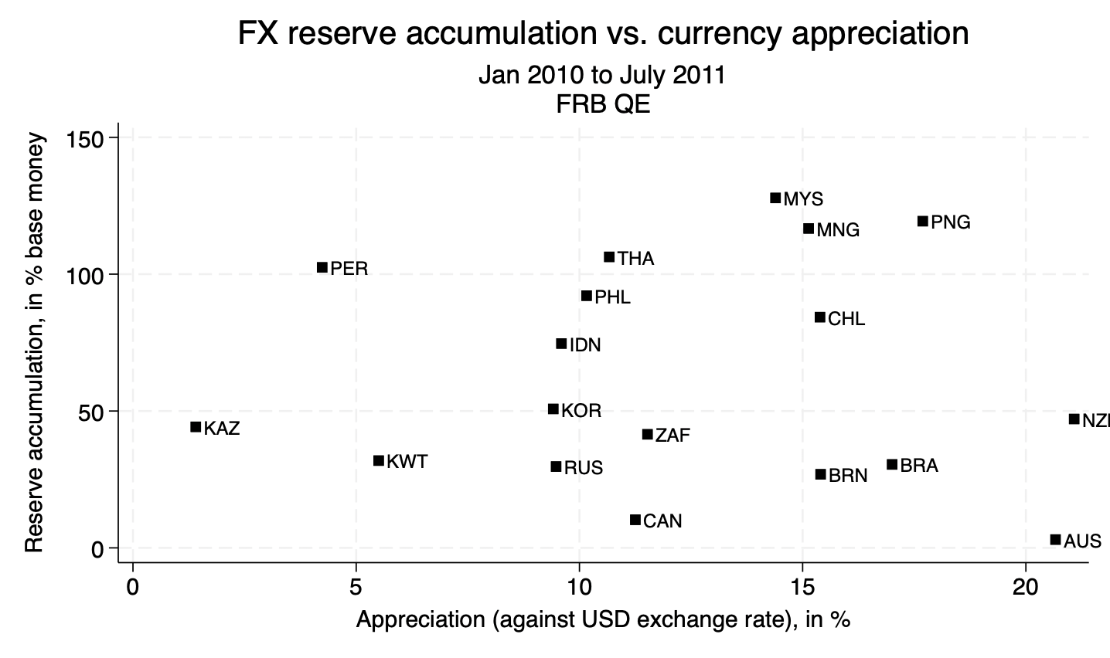







FRB QE2: Jan 2010 – July 2011, EMP↑ ^{Ϯ}
Australia & Brazil allowed their currencies to appreciate;
Kazakhstan & Peru bought $
FIGURE 1
more-managed floating
less-managed floating
^{Ϯ} “Currency war” – Brazilian officials

Slide 7
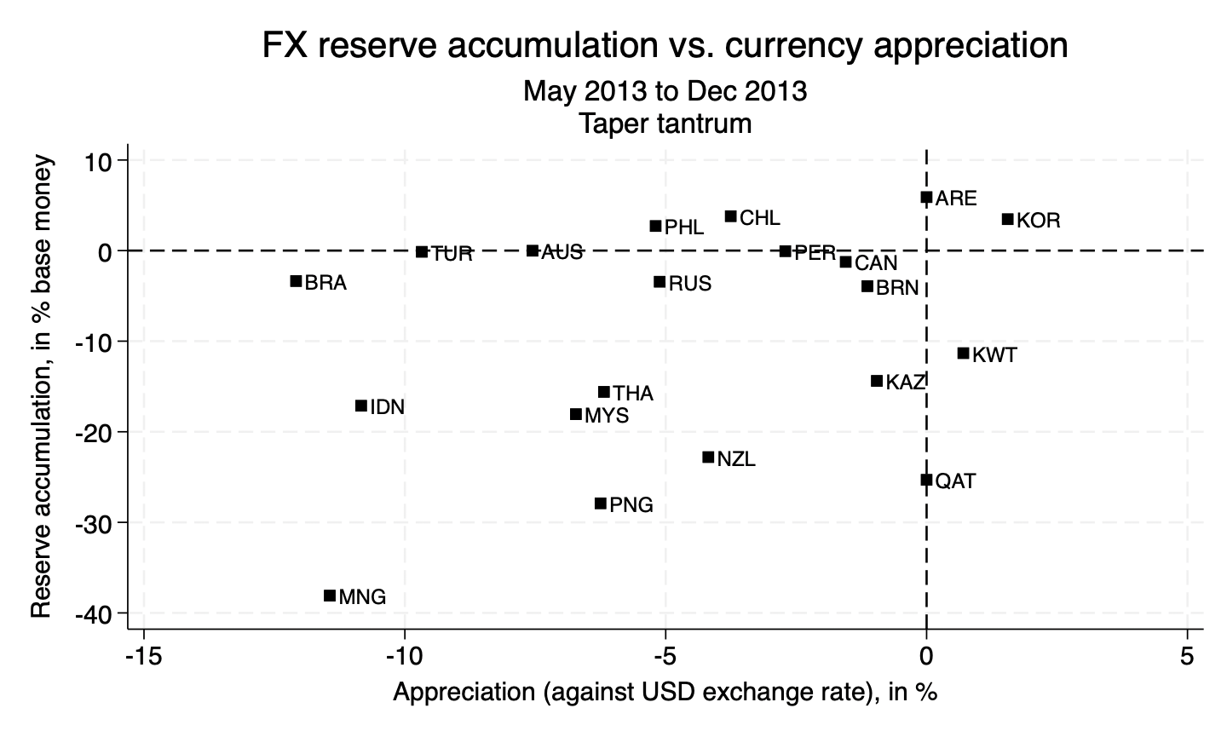





Taper tantrum: May 2013 - Dec. 2013, EMP↓ ^{Ϯ}
Australia & Brazil allowed their currencies to depreciate;
Kazakhstan, Qatar & Kuwait sold $
FIGURE 2
less-managed
floating
more-managed floating
^{Ϯ} “Central banks should assess spillover effects from their own actions…
in emerging markets…” -- Raghu Rajan, RBI, 1/20 & 4/10/2014

Slide 8
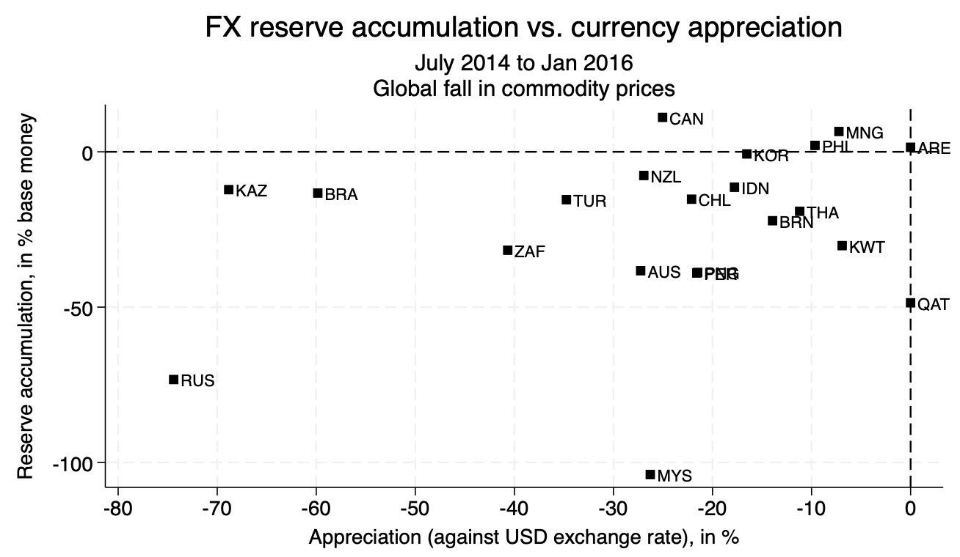


Global fall in commodity prices: July 2014-Jan 2016, EMP↓ ^{Ϯ}
Brazil & Kazakhstan allowed their currencies to depreciate;
Kuwait & Qatar sold $
FIGURE 3
less-managed floating
more-managed floating
^{Ϯ} E.g, Price of oil fell 75%

Slide 9
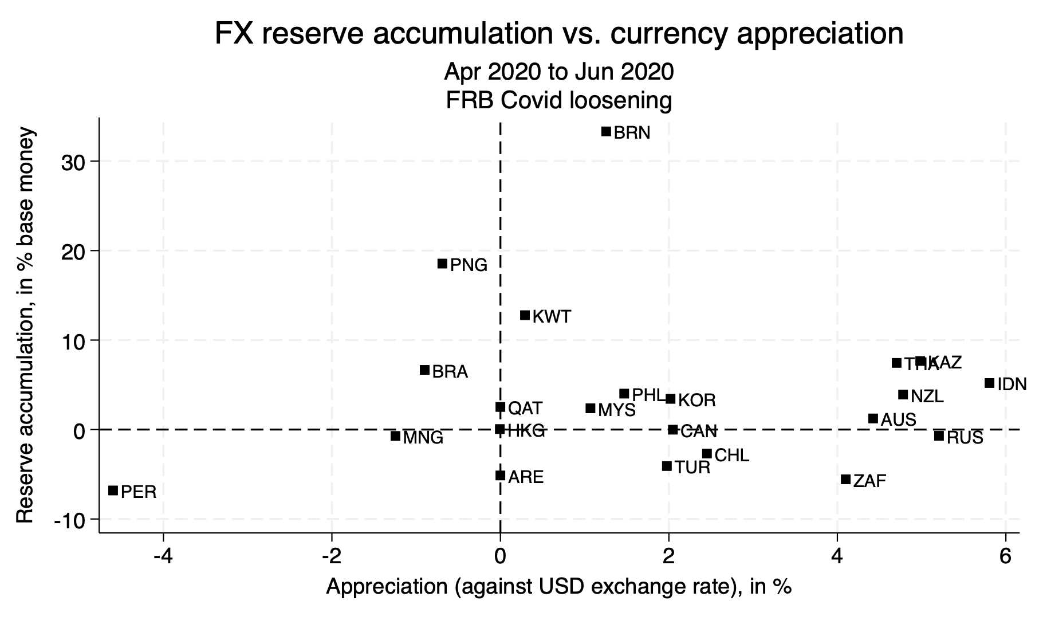

FIGURE 1
FRB Covid loosening: April 2020 – June 2020, EMP↑
Russia & Indonesia allowed their currencies to appreciate;
Qatar & Kuwait bought $
FIGURE 4
FIGURE 4
more-managed floating
less-managed floating

Slide 10
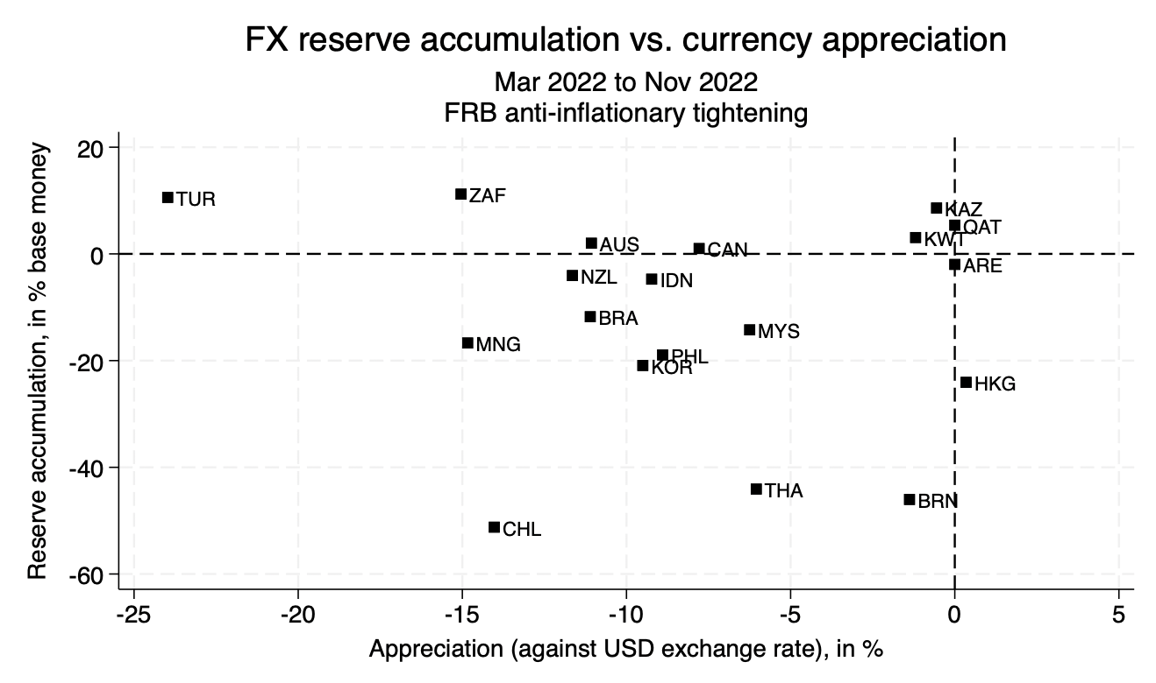


FRB anti-inflation tightening: Mar 2022– Nov 2022, EMP↓
Brazil & Indonesia allowed their currencies to depreciate;
Hong Kong & Thailand sold $
FIGURE 5
Call the slope 1/φ ≡ aggressiveness of fx management
less-managed floating
more-managed floating

Slide 11
Why choose a systematically managed float?
Intermediate regimes allow an intermediate degree
of monetary independence, including freedom from external shocks, in return for an intermediate degree
of exchange rate flexibility.
But
II) Four challenges:
  (a) “the corners hypothesis,”
  (b) “dilemma vs. trilemma,”
  (c) “intervention ineffectiveness” and
  (d) “exchange rate disconnect.”

Slide 12
Challenge (a): Corners Hypothesis
“Intermediate regimes are increasingly unviable.”
  “Countries are forced to move to corners: free float or firm fix.”
An impressive pedigree,
  including: Eichengreen (1994), CFR (1999), Summers (1999), Meltzer (2000), and Fischer (2001).
But,
  theoretically, there are perfectly well-developed theories
  of intermediate regimes,
    e.g., target zones: Krugman (1991); and
  empirically, intermediate regimes are now the biggest category
    Ghosh, Ostry, & Qureshi (2015)
    Ilzetzki, Reinhart and Rogoff (2019),
    though many of them remain murky.

Slide 13
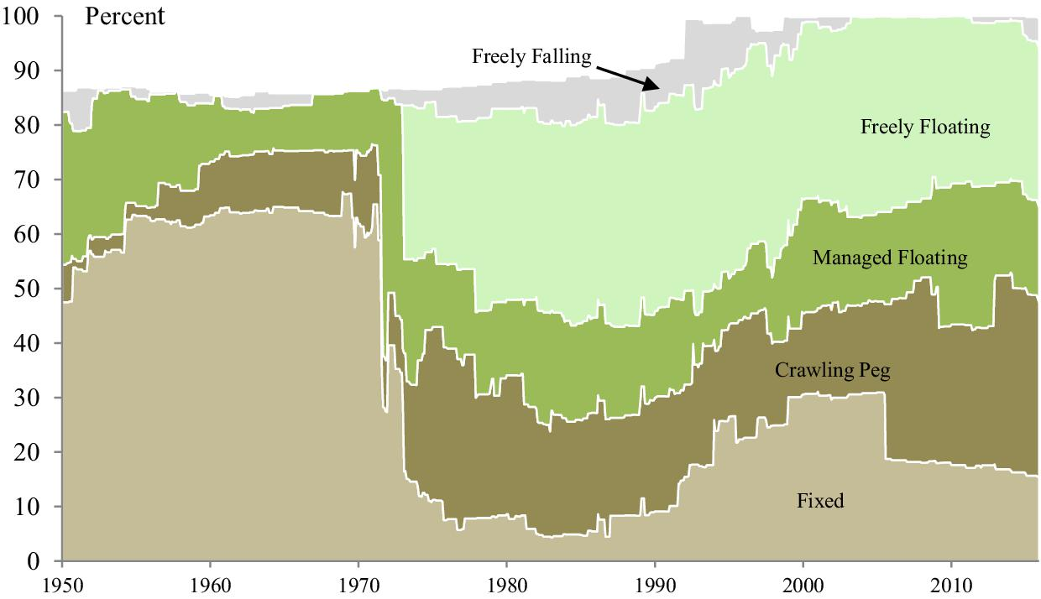

De Facto Exchange Rate Arrangements, 1946–2016
Coarse Classification: Share of World GDP in Each Group
Challenge (a): Corners Hypothesis
The share of intermediate regimes rose after 2000.
Ilzetzki, Reinhart & Rogoff, 2019, QJE.

Slide 14
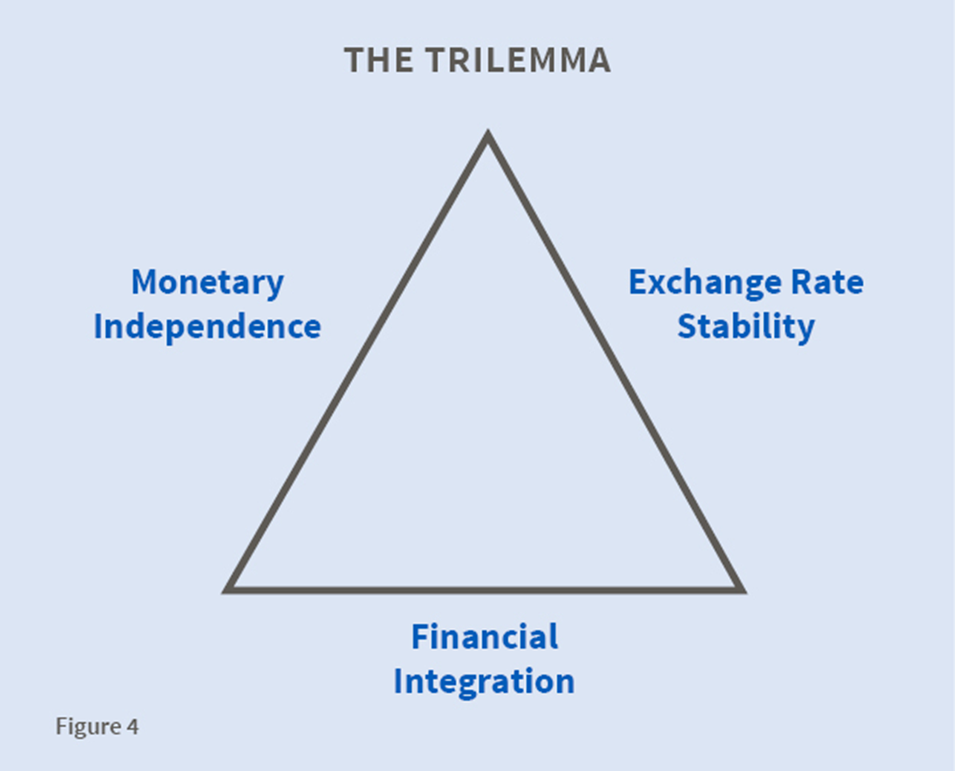
Challenge (a): Corners Hypothesis
The Trilemma, or Impossible Trinity
At each corner of the triangle, it is possible to obtain 2 attributes.
But not all 3..
•
Full capital controls
•
•
•
Pure Float
Firm fix
Intermediate regime
=> Forced to choose between corners?
No. Triangles have sides!

Slide 15
Challenge (b): “Dilemma not trilemma”
Challenge to trilemma from Rey (2014)
  and Agrippino & Rey (2014), Farhi & Werning (2014), Edwards (2015).
Claim: Floating rates don’t offer insulation
from external shocks
  such as i_{US} ⬆ or VIX ⬆.
The triangle collapses into
a single line segment, with
the choice of exchange
rate regime not relevant.
•
Full capital controls
Monetary independence
•
Monetary
dependence
Open capital markets
But some say floating does
allow monetary independence:
  Aizenman, Chinn, & Ito (2010, 2011), Eichengreen et al (2020), Di Giovanni & Shambaugh (2008), Klein & Shambaugh (2012, 2015), Obstfeld (2015), Obstfeld, et al (2017), Obstfeld, Shambaugh & Taylor (2005), Shambaugh (2004), and Frankel, Schmukler & Servén (2004).

Slide 16
Challenge (c): “FX intervention is powerless to affect nominal exchange rates”
“unless it is non-sterilized,
    in which case it is just another kind of monetary policy.”
But many EME studies show intervention has effects:
    Fratzscher et al (2016), Adler, Lisack & Mano (2015),
    Adler & Tovar (2011), Blanchard, Adler, & de Carvalho
    Filho (2015), Daude, Levy-Yeyati & Nagengast (2014),
    and Disyatat & Galati (2007). Survey by Menkhoff (2013).

Slide 17
Challenge (d): “Exchange rate disconnect”
Claim: The nominal exchange rate has no implications for real economic factors such as the real exchange rate, trade, or output.
Empirical studies often fail to find correlations between
nominal exchange rates and real fundamentals.
  E.g., Flood & Rose (1999), Devereux & Engel (2002) and Rose (2011).
Some say shocks have the same effect on the real exchange rate regardless whether floating or fixed.
We can test the null hypothesis that the exchange rate regime doesn’t matter for the real exchange rate.

Slide 18
(III) Classification schemes
It is well-established that de facto regimes need not correspond to de jure.
  What a country does in practice often differs from what it says it does officially.
  Consider countries that say they fix their exchange rate.
    Often in practice they adjust it when under pressure.
    “The mirage of fixed exchange rates,” Obstfeld & Rogoff (1995).
  Consider countries that say they float.
    Often can’t refrain from intervening in the market.
    “Fear of floating,” Calvo & Reinhart (2002).

Slide 19
The discrepancies have led to studies that attempt to estimate and report the true de facto regimes.
Some prominent de facto classification schemes:
  Ghosh, Gulde, & Wolf (2000), Reinhart & Rogoff (2004), Bénassy-Quéré, Coeuré, & Mignon (2004), Levy-Yeyati & Sturzenegger (2001, 2003, 2005), and Ilzetzki, Reinhart & Rogoff (2017).
Surveys of the literature on classification include:
  Klein & Shambaugh (2012),
  Rose (2011),
  and Tavlas, Dellas & Stockman (2008).

Slide 20
But the de facto classification schemes, though designed to get at the “true answer,” disagree among themselves.
Frankel (2004):
  3 prominent schemes coincided with the IMF de jure classification only 50.4% of the time.
  But they coincided with each other even less, only 38.6% of the time!
Bénassy-Quéré, et al (2004):
  3 de facto schemes correlated .69 with the IMF de jure scheme,
  but only .63 with each other.
Shambaugh (2007):
  3 de facto schemes agreed 80 percent with the de jure listings,
  but only 78 per cent among themselves.
Klein & Shambaugh (2011):
  3 de facto schemes coincided with the IMF classification 62 %
  and coincided with each other also 62 % of the time.

Slide 21
Why do classification schemes give such different answers?
1. Differences in de facto regime estimation methodology.
  E.g., some look simply at exchange rate variability,
  while others compare it to the variability of reserves.
2. Frequent changes in parameters or even in regime,
  e.g., once a year, even among the transparent cases.
  A country that follows no systematic regime for longer
  than a year at a time should perhaps be treated as
  having no systematic regime at all.
3. Murkiness of true regimes.

Slide 22
(IV) Three approaches to identifying which countries are systematic managed floaters
1) Regressions to estimate CB reaction function for fx intervention.
  A big disadvantage: Causality.
2) Regressions of Δs against ΔEMP. Call the coefficient β.
where ΔEMP ≡ Exchange Market Pressure ≡ (Δs + γ ΔRes /MB).
s ≡ log (value of currency);
Res ≡ FX reserves;
MB ≡ monetary base
  Include among regressors: Δ values of major currencies in potential basket.
  Frankel-Wei-Xie (1993-2022). (Constrained γ = 1.)
3) Simple-minded correlation (Δs , ΔRes /MB).
  Advantages:
    Easy
    No need to presume direction of causality.

Slide 23
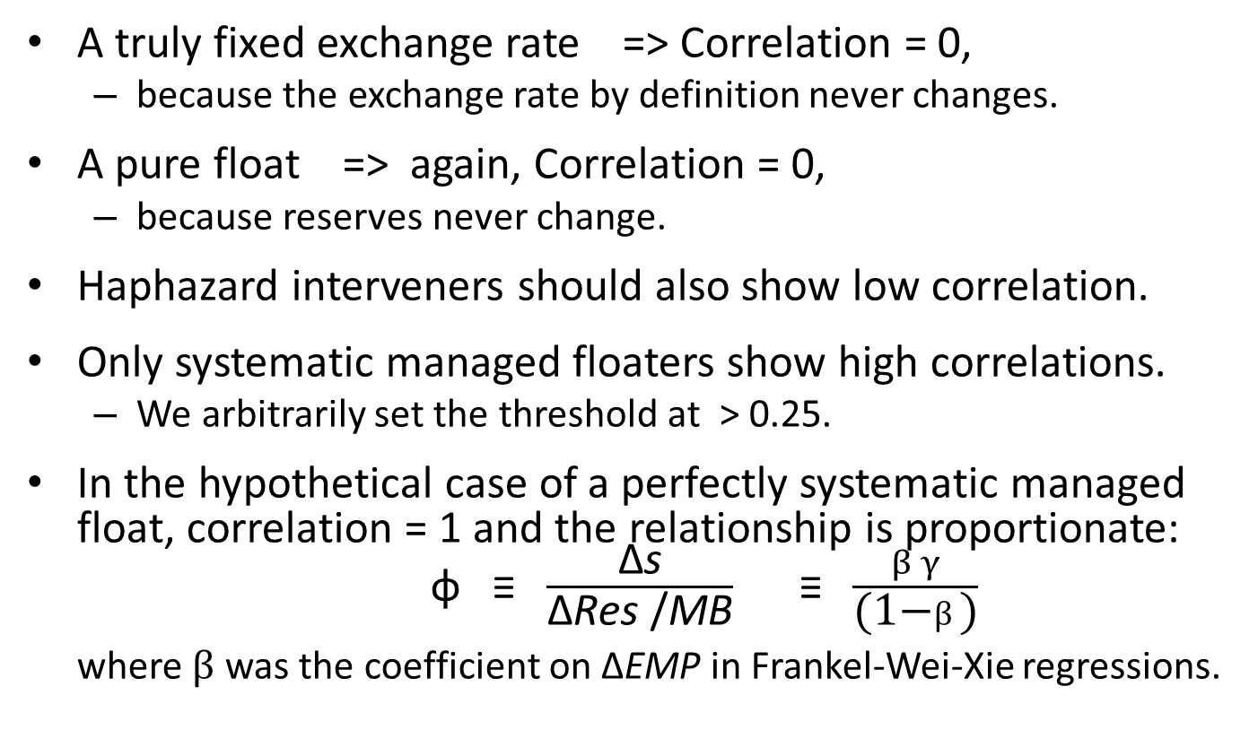
Simple-minded Correlation (Δs , ΔRes /MB)
(IV) Identifying which countries are systematic managed floaters
A truly fixed exchange rate => Correlation = 0,
  because the exchange rate by definition never changes.
A pure float => again, Correlation = 0,
  because reserves never change.
Haphazard interveners should also show low correlation.
Only systematic managed floaters show high correlations.
  We arbitrarily set the threshold at > 0.25.
In the hypothetical case of a perfectly systematic managed float, correlation = 1 and the relationship is proportionate:
φ ≡ $\frac{\text{Δ}\text{s}}{\text{Δ}\text{Res}\text{ /}\text{MB}}$ ≡$\frac{β γ}{\text{(1−}β\text{)}}$
where $β$ was the coefficient on $\text{Δ}$EMP in Frankel-Wei-Xie regressions.

Slide 24
Table 1: Simple-minded correlation between Δ s and (Δ Res)/MB. (Monthly, 2001-2023)
Corr. > 0.25: Systematic managed floaters
Corr. < 0.15:
free floaters,
fixers,
& miscellaneous.

Slide 25
V) The final exercise:
Does the regime choice matter?
Does it make a difference for the real exchange rate?
Null hypothesis:
Shocks produce the same real exchange rate regardless:
  They show up in nominal exchange rate under floating,
  in price level if exchange rate is fixed.
Alternative hypothesis: A positive external shock
  will lead to real appreciation, under floating;
  the same under systematic managed floating, but less;
  no real appreciation in SR, if nominal exchange rate is fixed.
Econometric tests use two external shock measures
  For emerging markets: the VIX;
  For commodity exporters: a country-specific index of $ global prices for the oil, minerals, & agricultural products it exports.

Slide 26
Summary of conclusions
I offer the idea of a “systematic managed float,”
  defined as fx intervention that is systematic as
  a proportion of total Exchange Market Pressure,
  identified as countries with
  Correlation between Δ s and (Δ Res)/MB > 0.25;
7 examples of systematic managed floaters:
S. Korea, Malaysia, Peru, Philippines, Russia, S. Africa & Thailand.
The choice of regime matters: External shocks are reflected in the RER for systematic managed floaters, more often than for firm-fixers,
  and less often than for free-floaters.

Slide 27
Systematic Managed Floating
Jeffrey Frankel

Slide 28
Appendix 1: Estimates for two Asian currencies, using the Frankel-Wei-Xie technique to explain Δ value of currency with γ constrained to 1.0, in calculation of EMP. From Frankel (2019).
INDIA | (1) | (2) | (3) | (4) | (5)
VARIABLES | 11/3/2008-9/9/2009 | 9/10/2009-11/22/2012 | 11/23/2012-10/1/2013 | 10/2/2013-4/7/2015 | 4/8/2015-2/28/2017
USA $ | 0.472*** | 0.416*** | 0.440*** | 0.461*** | 0.480***
 | (0.016) | (0.005) | (0.007) | (0.012) | (0.004)
eur | 0.349*** | 0.360*** | 0.379*** | 0.356*** | 0.330***
 | (0.021) | (0.004) | (0.006) | (0.010) | (0.004)
jpn | 0.099*** | 0.128*** | 0.086*** | 0.065*** | 0.080***
 | (0.012) | (0.004) | (0.003) | (0.009) | (0.003)
Δ EMP | 0.901*** | 0.988*** | 0.994*** | 0.964*** | 0.983***
 | (0.024) | (0.005) | (0.003) | (0.010) | (0.006)
t | -0.000*** | 0.000*** | 0.000*** | -0.000*** | -0.000
 | (0.000) | (0.000) | (0.000) | (0.000) | (0.000)
Constant | 0.017*** | -0.001*** | -0.019*** | 0.007*** | 0.000
 | (0.005) | (0.000) | (0.001) | (0.001) | (0.000)
Observations | 214 | 804 | 214 | 377 | 474
R2 | 0.973 | 0.993 | 0.998 | 0.982 | 0.997
gbp | 0.080 | 0.096 | 0.095 | 0.117 | 0.109
(Robust standard errors in parentheses.) *** p<0.01, ** p<0.05, * p<0.1

Slide 29
CHINA | (1) | (2) | (3) | (4) | (5)
VARIABLES | 6/8/2011-1/2/2013 | 1/3/2013-9/3/2013 | 9/4/2013-2/3/2015 | 2/4/2015-4/1/2016 | 4/4/2016-4/28/2017
USA $ | 0.448*** | 0.501*** | 0.457*** | 0.509*** | 0.484***
 | (0.007) | (0.014) | (0.010) | (0.008) | (0.005)
Eur € | 0.345*** | 0.328*** | 0.358*** | 0.316*** | 0.331***
 | (0.006) | (0.010) | (0.007) | (0.006) | (0.005)
Jpn ¥ | 0.099*** | 0.078*** | 0.066*** | 0.069*** | 0.078***
 | (0.003) | (0.003) | (0.004) | (0.004) | (0.003)
Δ EMP | 0.951*** | 0.895*** | 0.961*** | 0.926*** | 0.972***
 | (0.012) | (0.025) | (0.014) | (0.013) | (0.012)
t | 0.000*** | 0.000*** | 0.000*** | 0.000*** | 0.000***
 | (0.000) | (0.000) | (0.000) | (0.000) | (0.000)
Constant | -0.002*** | -0.013*** | -0.003*** | -0.005*** | -0.002***
 | (0.000) | (0.001) | (0.000) | (0.001) | (0.001)
Observations | 393 | 168 | 354 | 290 | 269
R² | 0.997 | 0.998 | 0.995 | 0.996 | 0.999
Gbp £ | 0.108 | 0.093 | 0.118 | 0.106 | 0.108
(Robust standard errors in parentheses.) *** p<0.01, ** p<0.05, * p<0.1
γ constrained to 1.0, in calculation of EMP. From Frankel (2019).

Slide 30
Appendix 2: Effects of Shocks on Real Exchange Rates
Adverse shock => real depreciation, for all 7 systematic managed floaters;
but not for the firm fixer, Hong Kong.
A: Effect of VIX Shocks on Real Exchange Rates among Asia Non-Commodity-Exporters
 | (1) | (2) | (3) | (4) | (5) | (6) | (7) | (8)
VARIABLES | H Kong | India | Korea, R | Malaysia | Philippines | Singapore | Thailand | Turkey
Log of VIX | 0.002 | -0.006* | -0.047*** | -0.009* | -0.011*** | -0.005*** | -0.011*** | -0.019***
 | (0.004) | (0.003) | (0.009) | (0.005) | (0.003) | (0.002) | (0.003) | (0.006)
REER Lag | 0.993*** | 0.987*** | 0.874*** | 0.935*** | 0.996*** | 0.997*** | 0.970*** | 0.955***
 | (0.008) | (0.012) | (0.027) | (0.028) | (0.007) | (0.005) | (0.024) | (0.016)
Constant | 0.027 | 0.080 | 0.703*** | 0.326** | 0.053 | 0.028 | 0.171 | 0.254***
 | (0.035) | (0.056) | (0.141) | (0.126) | (0.033) | (0.026) | (0.112) | (0.077)
Observatns | 227 | 227 | 227 | 227 | 227 | 227 | 227 | 227
R2 | 0.990 | 0.968 | 0.928 | 0.904 | 0.986 | 0.992 | 0.954 | 0.956
Robust standard errors in parentheses; *** p<0.01, ** p<0.05, * p<0.1
From Frankel (2019).

Slide 31
Many firm-fixers show no effect of commodity price shocks on the RER, including oil-exporters:
B: Effect of Commodity Shocks on RERs among Firm-fixing Oil-Exporters
 | (13) | (14) | (17) | (18) | (20) | (9)
VARIABLES | Bahrain | Brunei | Kuwait | Qatar | Saudi A. | UAE
Commodity Price Indices | -0.002 | 0.004*** | 0.003* | 0.002 | 0.004** | -0.030
 | (0.004) | (0.001) | (0.002) | (0.003) | (0.002) | (0.020)
REER Lag | 0.979*** | 0.980*** | 0.996*** | 1.001*** | 1.015*** | 0.942***
 | (0.021) | (0.008) | (0.010) | (0.013) | (0.010) | (0.049)
Constant | 0.100 | 0.094** | 0.022 | -0.003 | -0.069 | 0.273
 | (0.095) | (0.039) | (0.049) | (0.059) | (0.048) | (0.233)
Observatns | 227 | 227 | 227 | 156 | 227 | 107
R2 |  | 0.982 | 0.976 | 0.978 | 0.980 | 0.936
†
Robust standard errors in parentheses; *** p<0.01, ** p<0.05, * p<0.1
† Brunei is an exception: a highly significant effect, perhaps because its hard peg is to Singapore.

Slide 32
All four floaters show significant RER effects of commodity prices.
C: Effect of Commodity Shocks on RERs among Asia/Pacific Commodity-Exporters
 | (1) | (2) | (10) | (11) | (16) | (21)
VARIABLES | Australia | New Zeald | Indonesia | Papua NG | Kazakhstan | Mongolia
Commodity Price Indices | 0.038*** | 0.086** | 0.091*** | 0.025*** | 0.014*** | 0.044***
 | (0.015) | (0.042) | (0.033) | (0.006) | (0.005) | (0.015)
REER Lag | 0.944*** | 0.955*** | 0.890*** | 0.963*** | 0.958*** | 0.946***
 | (0.019) | (0.022) | (0.041) | (0.013) | (0.018) | (0.025)
Constant | 0.269*** | 0.244** | 0.535*** | 0.187*** | 0.198** | 0.264**
 | (0.092) | (0.114) | (0.197) | (0.062) | (0.084) | (0.118)
Observations | 226 | 226 | 227 | 227 | 227 | 227
R2 | 0.983 | 0.975 | 0.908 | 0.973 | 0. 965 | 0.968
Robust standard errors in parentheses; *** p<0.01, ** p<0.05, * p<0.1

Slide 33
Among other commodity exporters,
Commodity shocks have no significant RER effect in the firm-fixer (Ecuador)
but do in most of the managed floaters.†
B: Effect of Commodity Shocks on RERs among Non-Asia Commodity-Exporters
 | (4) | (3) | (6) | (7) | (8) | (5) | (15) | (19)
VARIABLES | Brazil | S. Africa | Colombia | Ecuador | Peru | Chile | Canada | Russia
Commodity Price Indices | 0.144*** | 0.000 | 0.011 | 0.010 | 0.008** | 0.012* | 0.013*** | 0.033**
 | (0.052) | (0.010) | (0.008) | (0.010) | (0.004) | (0.006) | (0.004) | (0.016)
REER Lag | 0.952*** | 0.970*** | 0.981*** | 0.965*** | 0.970*** | 0.960*** | 0.939*** | 0.926***
 | (0.017) | (0.021) | (0.016) | (0.036) | (0.013) | (0.014) | (0.019) | (0.028)
Constant | 0.229*** | 0.138 | 0.091 | 0.170 | 0.138** | 0.170*** | 0.279*** | 0.349***
 | (0.079) | (0.095) | (0.077) | (0.170) | (0.059) | (0.064) | (0.086) | (0.130)
Observatns | 227 | 227 | 227 | 227 | 227 | 227 | 227 | 227
R2 | 0.973 | 0.928 | 0.963 | 0.935 | 0.965 | 0.949 | 0.984 | 0.974
Robust standard errors in parentheses; *** p<0.01, ** p<0.05, * p<0.1
† South Africa is an exception. But it shows a positive effect in IV regressions on the BoP.

