Slide 1

Evaluating Which Countries
Do their Fair Share in Pledged Carbon Cuts
Prof. Jeffrey Frankel
Harvard University
T20 for the Indonesia Presidency of G20 in 2022,
Webinar on Managing Elevated Risks of Climate Transition,
June 2, 2022

Slide 2
Targets for Greenhouse Gas emissions
Paris Agreement in 2015:
countries set Nationally Defined Contributions.
The Glasgow Climate Pact in Nov. 2021:
all countries should strengthen targets in their NDCs in 2022.
President Biden in 2021 announced a US GHG target for 2030,
  slightly more ambitious than in Paris:
  50 - 52 % below 2005 levels.
So did Canada:
  40 - 45 % below 2005 levels.
But, then, the US & Canada started from high emissions.

Slide 3
Fair share of the reductions in GHG emissions?
How can we tell what is a fair share of the burden
for each country, given its circumstances?
Climate Action Tracker (June 2022)
  collects various attempts at scorecards.
  It rates most countries as “Insufficient” or “highly insufficient.”
Perceptions of “fairness” vary wildly.

Slide 4
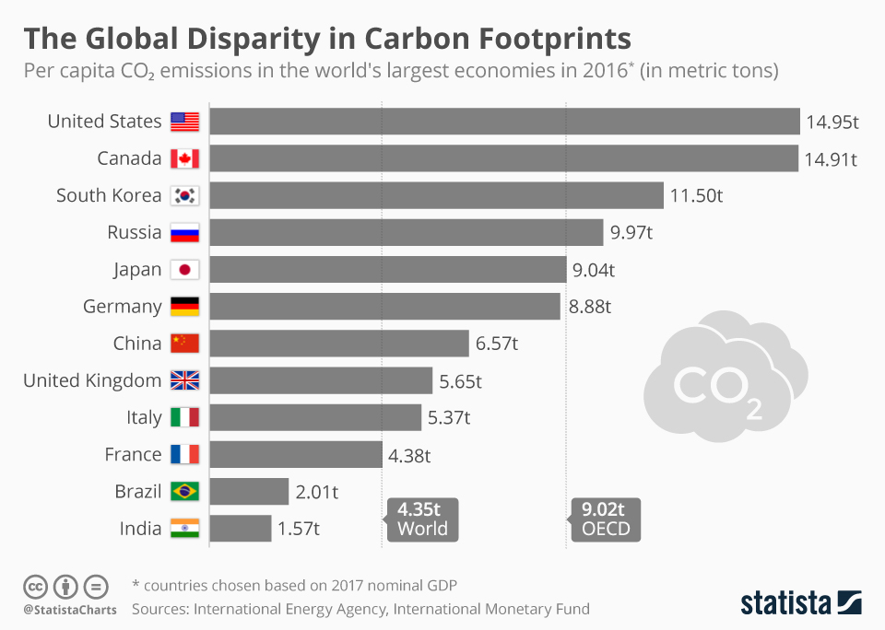
CO₂ emissions/capita vary widely across countries.
In 2020 –
The average American emitted 8 times as much GHGs as an average Indian:
13.7 vs. 1.7 mt/cap .
The average Saudi emitted
8 times as much as
an average Indonesian:
17.0 vs. 2.1 mt/cap.

Slide 5
Different vantage points
From the vantage of India or Indonesia,
a fair allocation might be equal emissions/capita all around.
Americans, for their part, think it would be unfair to make US firms pay a very high economic cost to reduce emissions,
  especially if energy-intensive industries simply relocated to developing countries that had not constrained their own emissions.

Slide 6
Each side has a point.
Unreasonable to ask poor countries to cut the same %-age as the rich.
  This would deny them the opportunity for economic growth
  that rich countries have already enjoyed,
  while the rich created the problem.
Unrealistic to expect rich countries to agree to equal emissions/cap,
  at least, anytime soon.
  That would be equivalent to transferring truly massive slices of GDP.

Slide 7
One can quantify fair & reasonable targets for each.
Three principles:
Cost:
It is not realistic to expect any one country to agree to cuts that would result in disproportionately large economic costs for it,
  measured relative to what their emissions would otherwise have been,
  the “Business as Usual” path (BAU).
Progressivity:
Rich countries should accept bigger cuts than poor.
  Short-term targets for poor countries could be generous enough, & close enough to their BAUs, that they would financially come out ahead at first:
  they could sell emission permits to high-income countries. “Climate Finance.”
Latecomer Catchup:
It is fair to expect countries that have increased their emissions
to bring them back down gradually toward past levels,
  but not practical for them to reverse fully & instantly in the first budget periods.

Slide 8
Targets agreed in past UNFCC COPs tend statistically to obey a formula that quantifies the 3 principles.
Progressivity --
Richer countries agreed to steeper cuts than others:
At Kyoto in 1997, every 10 % rise in income/cap corresponded
to an agreed GHG reduction of another 1.4 % relative to BAU.
At Lima in 2014 (pre-Paris), every 10% rise in income corresponded
to another GHG cut of 1.7 % relative to BAU.

Slide 9
COP targets also showed latecomer catch-up factor
pulling each country back toward what its emissions were in 2005.
Extend the formula through the remainder of the century,
  with gradually decreasing weight on the past
  and gradually increasing weight on equal per capita targets.
Model estimates show country losses < 1 % of GDP in PDV.
References:
Valentina Bosetti & J. Frankel, 2021,“How to Set Greenhouse Gas Emission Targets for All Countries,” Chapter 6 in Combatting Climate Change, B. Weder di Mauro, ed. (CEPR Press), pp. 43-48.
-------,- 2014, “Sustainable Cooperation in Global Climate Policy: Specific Formulas and Emission Targets,” Climate Change Economics, vol.5, no.3, Aug.
--------- , 2012, “Politically Feasible Emission Target Formulas to Attain 460 ppm CO2 Concentrations," Rev. of Environmental Econ. & Policy (Oxford Univ. Press) 6, no.1, pp. 86-109.
J. Frankel, 2009, "An Elaborated Proposal for Global Climate Policy Architecture: Specific Formulas and Emission Targets for All Countries in All Decades,” Chapter 2 in Post-Kyoto International Climate Policy, J. Aldy & R. Stavins, eds., pp. 31-87 (Cambridge Univ. Press).

Slide 10
Progressivity & LCF are both statistically significant in explaining 2020 cuts targeted in 2014.

Slide 11
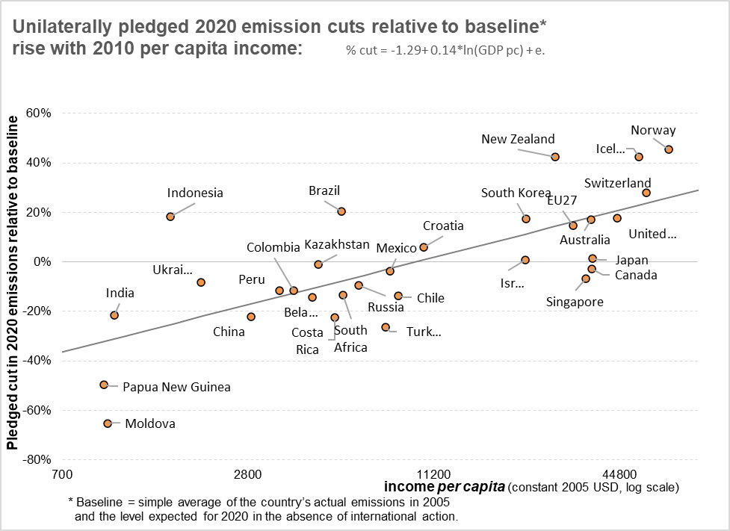
Countries’ targets set in 2014 for 2020 GHG cuts
(relative to a baseline = average of its actual 2005 emissions & 2020 BAU) rise with income/cap.

Slide 12
Models
We use an economic/climate model to estimate BAU and to translate pledges into common terms of emission tons:
A.Hof, M. den Elzen, & M. Roelfsema, 2013. “The Effect of Updated Pledges and Business-as-Usual Projections, and New Agreed Rules on Expected Global Greenhouse Gas Emissions in 2020.” Environmental Science & Policy 33, Nov., pp. 308–19.
And we use the WITCH model to project effects of targets:
V. Bosetti, E. De Cian, A. Sgobbi, & M. Tavoni, 2009. “The 2008 WITCH Model: New Model Features and Baseline”. FEEM Working Paper N. 85.

Slide 13
The bad news: most failed by 2020 to achieve these promised targets.
Stronger country commitments to specific targets are needed.
A good place to start:
  (i) report publicly which countries have met the emission targets that they set for 2020; and
  (ii) evaluate whether current pledges for 2030 show individual countries as doing their fair share when judged by criteria like mine.
Needed as well:
  is an international agreement that allows countries that have made pledges, and are abiding by them, to impose a Carbon Border Adjustment Tariff against relevant imports from countries that have not.

Slide 14

The bad news: most failed to reach their promised targets by 2020.
We need stronger country commitments to numerical targets.
A good place to start:
  (i) report publicly which countries have met the targets that they set for 2020;
  (ii) evaluate whether current pledges for 2030 show individual countries
  as doing their fair share when judged by criteria like mine.
Also needed:
  an international agreement allowing countries that abide by pledges
  to impose Carbon Border Adjustment Tariffs against relevant imports
  from countries that have not made pledges or are not abiding by them.

Slide 15
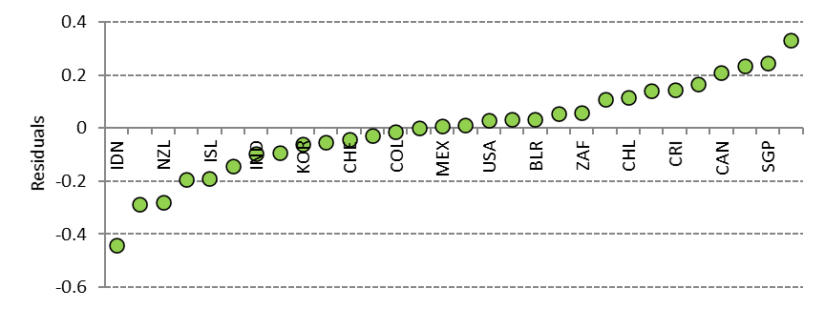
Appendix
Countries’ GHG emissions targets set in 2014 for 2020
minus the formula’s evaluation of their fair shares.
But remember: most countries failed to achieve these targets for 2020.

