Slide 1

The Currency-plus-Commodity Basket Peg:
A Proposed Monetary Regime for Commodity-Exporting Countries
Jeffrey Frankel
Harpel Professor of Capital Formation and Growth
Harvard University
For Session on Monetary Policy in a Globalized World
LACEA/LAMES Annual Meeting, Guayaquil, Ecuador
November 9, 2018

Slide 2
Commodity prices since 2000 have been even more volatile than usual.
Commodity price indexes, annual
US$ constant
2010=100
Source: Commodity Markets Outlook, World Bank Group, Oct. 2017

Slide 3
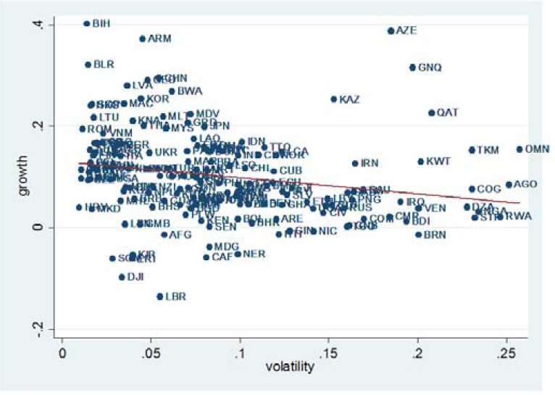
Terms of Trade Volatility Associated with Slow Growth
The relationship is statistically significant at the 1% level.
Economic growth and terms of trade volatility (cross-country relationship)
Sample: 175 countries, 1980-2010,
5-year non-overlapping panel data.
Source: M.Brueckner & F.Carneiro, CAMA, 2016, Fig. 3, p. 18.

Slide 4
Can’t commodity-exporters use financial markets to smooth trade fluctuations?
If international financial markets worked well,
countries facing temporary adverse trade shocks could borrow to finance current account deficits, and vice versa.
But they don’t work that well. Capital flows to developing countries tend, if anything, to be pro-cyclical.
  “When It Rains, It Pours” (Kaminsky, Reinhart & Végh, 2004).
The appropriate theory? Borrowing requires collateral,
  in the form of commodity export proceeds.
So some thought is required
  to design institutions that can protect against the volatility.
  I have proposed some, particularly in the area of money.

Slide 5
Adopt a monetary policy regime that can accommodate terms of trade shocks
Longstanding textbook wisdom:
For a country subject to big terms of trade shocks,
the exchange rate should be able to accommodate them.
 |  | so as to avoid
 |  | excessive money inflows, credit, debt, inflation & asset bubbles.
When the $ price of commodities is: | we want the currency to | so as to avoid
high, | appreciate | excessive money inflows, credit, debt, inflation & asset bubbles.
low, | depreciate | trade deficit, fx reserve crisis, excessively tight money & recession.
When the $ price of commodities is: | we want the currency to
high, | appreciate
Floating delivers that…

Slide 6
  The exchange rate regime does make a difference!
  Four cases (1995-2015) illustrate that floating delivers
  a high correlation between the Real Effective Exchange Rate &
  the exogenous price of the export commodity, and fixing does not.
Floaters:
Fixers:
Canada
Ecuador
Correlation
(REER, CP)
= .92
Correlation
(REER, CP)
= .16
& Chile
& Saudi
Arabia
Correlation
(REER, CP)
= .80†
Correlation
(REER, CP)
= -.56
† for 2000-15, floating period
Correlations on changes: .38, .35; -.16, -.34

Slide 7
Should commodity exporters float, then?
Long-time conventional wisdom:
floating works better for countries exposed to volatility in the prices of their export commodities.
Has been confirmed in empirical studies, including:
  Broda (2004),
  Edwards & Levy-Yeyati (2005),
  Rafiq (2011),
  Céspedes & Velasco (2012) and
  Berg, Goncalves & Portillo (2016).

Slide 8
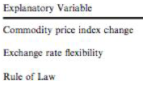
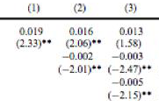


Across 107 major commodity boom-bust cycles, output loss is bigger the bigger is the commodity price change & the smaller is exchange rate flexibility.
Céspedes & Velasco, 2012, IMF Economic Review,
“Macroeconomic Performance During Commodity Price Booms & Busts”

Slide 9
But what choice of monetary anchor or target?
Of the variables that are candidates for nominal target,
the traditional ones prevent accommodation of terms of trade shocks:
  Not just exchange rate target,
  but also M1 (traditional monetarism)
  and the CPI (Inflation Targeting, if interpreted literally).
But some novel candidates would facilitate accommodation of trade shocks:
  Target an index of product prices (PPT)
  Target Nominal GDP (NGDPT)
  Add the export commodity to a currency basket peg (CCB).

Slide 10

Proposal:
Target a Currency + Commodity Basket (CCB)
Consider three commodity-exporters that, at times,
have pegged to a basket of major foreign currencies:
  Kuwaiti dinar (1975-2003, 2007-present), pegged to basket of $ + €,
  Chilean peso (1992-1999) pegged to $ + DM + ¥,
  Kazakh tenge (2013-2014) to $ + € + ₱.
The proposal is to add the commodity to the basket.
  E.g., oil for Kuwait & Kazakhstan,
  copper for Chile.

Slide 11

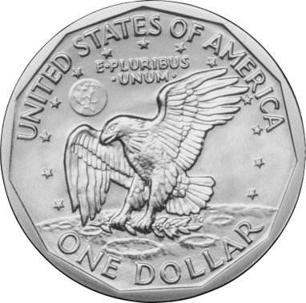

CCB: Add the export commodity, e.g., oil, to the currency basket
  “The Currency-Plus-Commodity Basket: A Proposal for Exchange Rates in Oil-Exporting Countries to Accommodate Trade Shocks Automatically,​” 2018; forthcoming, K.Mohaddes, J.Nugent & H.Selim, Institutions and Macroeconomic Policies in Resource-Rich Arab Economies (Oxford University Press).

Slide 12



Currency + Commodity Basket
This target may give the best of both worlds:
  It is precise and transparent on a daily basis.
  Yet it is sustainable in the face of shocks:
    The currency would automatically strengthen
    (vs. the $) when the $ price of the commodity rises,
    and automatically fall when the $ price falls.

Slide 13




How would the weights be chosen?
3 possible approaches:
For simplicity: 1/3 $ + 1/3 € + 1/3 oil.
Or scientifically:
  have a Ph.D. student estimate optimal weights.
Or to rationalize past policies & preserve continuity:
  Estimate the weights that fit past history the best.

Slide 14
Application to Gulf countries
Their currencies are currently pegged:
  Kuwait pegged to the euro+dollar basket,
  Saudi Arabia & the others pegged to the dollar.
Claim: During periods when their actual currency value
  was less than the level that the CCB formula would have given,
  it was “undervalued”, and
  when greater than the CCB level, it was “overvalued.”
Testable symptoms of undervaluation/overvaluation:
  Statistics on inflation, the balance of payments, etc.
  Language in IMF Article IV reports regarding internal balance
  & external balance.

Slide 15
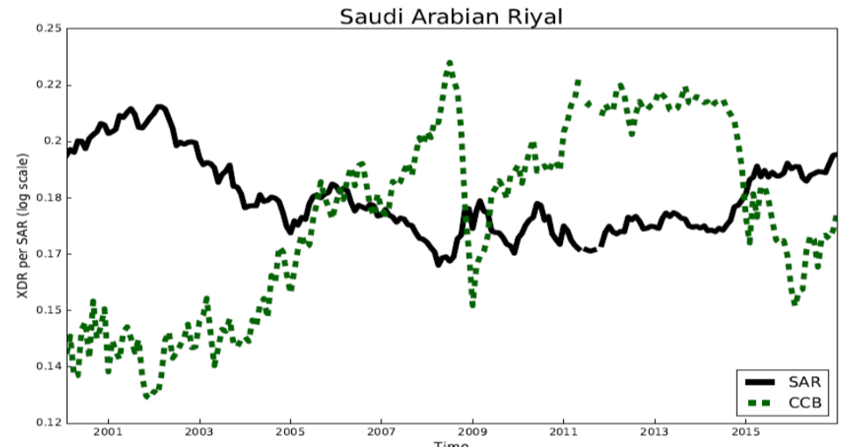
The value of the Saudi riyal would have behaved very differently under CCB.

Slide 16
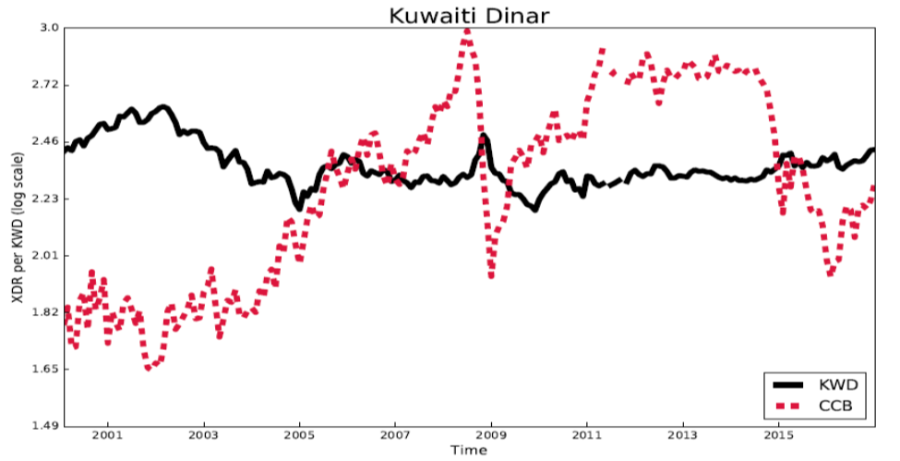
The value of the Kuwaiti dinar, too, would have behaved very differently under CCB.

Slide 17
Was the Saudi riyal “undervalued” when less than the CCB level & “overvalued” when greater?
Undervaluation periods | Overvaluation periods | Inflation (annual %) | Δ FX reserves (US$ mn, avg monthly) | Δreserves /GDP (avg monthly)
 | JAN 2001 - JAN 2005 | 0.03 | 1606.1 | 0.51
MAR 2007 - SEP 2008 |  | 6.66 | 10933.2 | 2.29
 | NOV 2008 - MAR 2009 | 7.55 | -5884.2 | -1.35
MAY 2009 - NOV 2014 |  | 4.20 | 5014.3 | 0.74
 | JUN 2015 - OCT 2016† | 3.50 | -8229.2 | -1.52
 | Average for over-valuation periods | 1.36 | -1177.0 | 0.15
Average for under-valuation periods |  | 4.69 | 6322.0 | 1.08
Data Source: Global Financial Data, WDI |  |  | † FX Reserves data end Dec.2015
Note: "Undervaluation (overvaluation)" ≡ actual currency value (in terms of SDRs) was at least 5% below (above) what the CCB formula with weights 1/3, 1/3/1/3 would have given.
  Frankel, 2017, “The Currency-Plus-Commodity Basket: A Proposal for Exchange Rates in Oil-Exporting Countries to Accommodate Trade Shocks Automatically,” Harvard CID WP no.333. Table 1

Slide 18
Application to Gulf countries, 2001-2016:
Relationship between balance of payments and “over-/under-valuation” of currency relative to CCB
Figure 3:
"Overvaluation" measures the actual value of the currency (in terms of SDRs)
relative to what the CCB formula with weights 1/3, 1/3/,1/3 would have given.
  Frankel (2018)

Slide 19
Mechanics of the CCB target
Compatible with IT: The country can pick a long-term inflation target.
Once a year, the monetary authorities announce the parameters:
  the weights in the basket on each foreign currency & commodity,
    translated into coefficients on units of $, barrels of oil, etc.; and
  the rate of crawl (if ≠0) to achieve the year’s inflation target in expected value.
Once a day:
  The central bank posts the $ exchange rate for the riyal or peso implied
  arithmetically by the previously announced parameters and
  that day’s $ price of oil and $ exchange rate for the €, etc.,
    using, e.g., the Brent Crude Oil settlement price set on the ICE † at 19:30 London time.
Within the day:
  The central bank stands ready to intervene in the foreign exchange market
  to maintain the $ dollar exchange rate that has been posted for the day.
  But if all goes well, it would not have to intervene much,
    because the regime’s credibility would motivate banks to trade at the day’s rate.
† InterContinental Exchange.

Slide 20
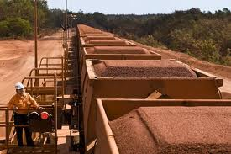
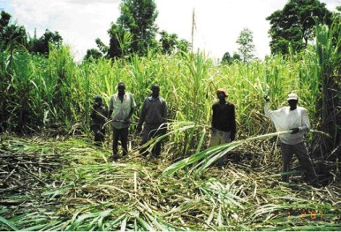
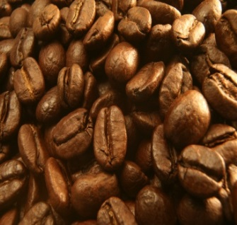

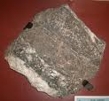





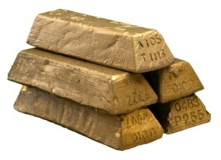








20
Notes:
20

Slide 21
References by the author
On CCB proposal for monetary policy (Currency + Commodity Basket):
  “The Currency-Plus-Commodity Basket: A Proposal for Exchange Rates in Oil-Exporting Countries to Accommodate Trade Shocks Automatically,​” forthcoming, 2018, K.Mohaddes, J.Nugent & H.Selim, Institutions and Macroeconomic Policies
  in Resource-Rich Arab Economies (Oxford University Press).
  "UAE & Other Gulf Countries Urged to Switch Currency Peg from the Dollar to a Basket That Includes Oil," VoxEU, 2008.
  "Iraq’s Currency Solution? Tie the Dinar to Oil," The International Economy, Fall 2003.
Other proposals for nominal anchors that accommodate commodity shocks
  “Nominal GDP Targeting for Developing Countries. Research in Economics,” with P.Bhandari, 2017, Research in Economics; 71(3).
  “A Comparison of Product Price Targeting and Other Monetary Anchor Options, for Commodity-Exporters in Latin America," Economia, LACEA, vol.12, no.1, 2011, 1-57.
  “Peg the Export Price Index: A Proposed Monetary Regime for Small Countries,” Journal of Policy Modeling, June 2005.
On the “commodity curse” and solutions generally:
  “The Natural Resource Curse: A Survey of Diagnoses and Some Prescriptions,”
  in Commodity Price Volatility and Inclusive Growth in Low-Income Countries, 2012, edited by Rabah Arezki, et.al. (International Monetary Fund: Washington DC).

Slide 22
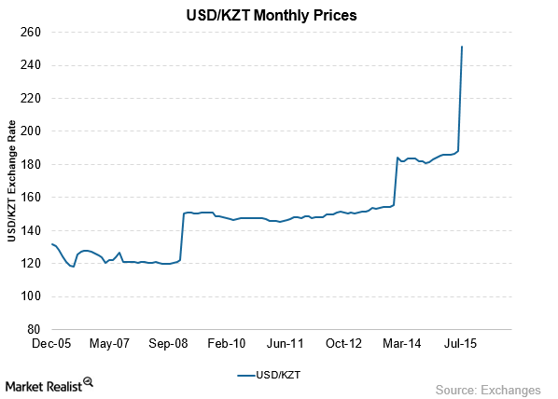

Applications of CCB
(1) Implementation together with a devaluation:
In the summer of 2015, Kazakhstan could have announced a CCB target with weights that fit past history.
(313 KZT/$,
April 2017)
KZT/US$ exchange rate
KZT/$

Slide 23
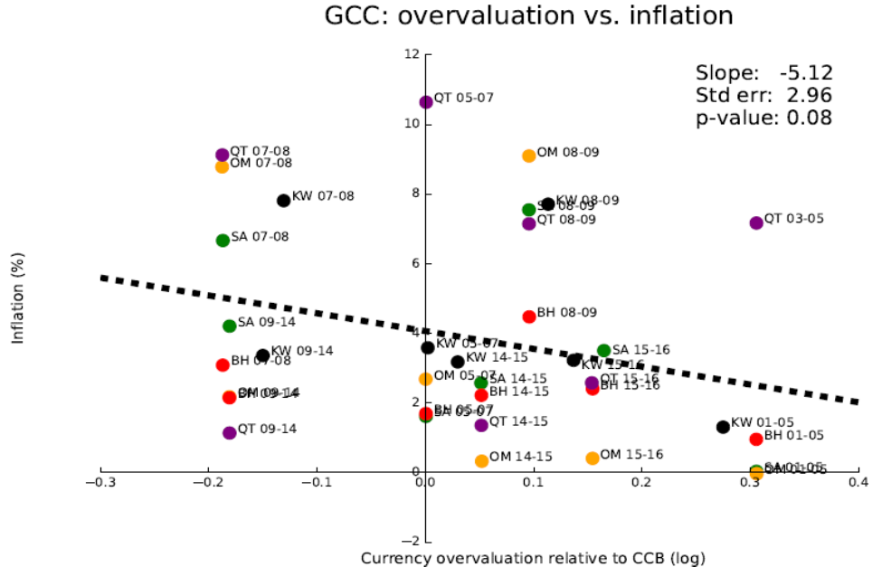
(2) Vs. rigid pegs: Application to Gulf countries:
Relationship between inflation & “over-/under-valuation” of currency relative to CCB
"Overvaluation" measures the actual value of the currency (in terms of SDRs)
relative to what the CCB formula with weights 1/3, 1/3, 1/3 would have given.
  Frankel, 2018, “The Currency-Plus-Commodity Basket: A Proposal for Exchange Rates in Oil-Exporting Countries to Accommodate Trade Shocks Automatically.”

Slide 24
IMF Article IV consultations for Kuwait, Saudi Arabia & UAE
Appendix: Were Gulf currencies “undervalued” when
less than the CCB level & “overvalued” when greater?
Under-valuation periods | Over-valuation periods | Internal balance | External balance
 | JAN 2001 - JAN 2005 | Repeated comments on the low level of inflation in all 3 countries.
MAR 2007 - SEP 2008 |  | Concern about accelerating inflation, particularly in the housing market. Strong demand for goods & labor and high asset prices (equities & real estate). Saudi inflation “poses the main challenge for the authorities.” The UAE is “vulnerable in the wake of an unprecedented credit and asset price boom.” | The Saudi balance of payments surplus piled up reserves, to a level equal to 19 months’ worth of imports. Efforts to sterilize the inflow were not sufficient to “contain the expansion in monetary aggregates.”
Note: "Undervaluation (overvaluation)" ≡ actual currency value (in terms of SDRs) was at least 5% below (above) what the CCB formula with weights 1/3, 1/3/,1/3 would have given.
  Frankel (2018)

Slide 25
IMF Article IV consultations for Kuwait, Saudi Arabia & UAE, continued
Under-valuation periods | Over-valuation periods | Internal balance | External balance
 | NOV 2008 - MAR 2009 | Abrupt downturns. Inflation fell substantially in all three countries. In the UAE, “After peaking at about 12 % in 2008, inflation declined to 1 % in 2009." In Kuwait, “Equity prices continued to decline, money growth slowed, and credit growth plunged.” UAE hit by a stalling of “all three growth engines in 2009. Oil receipts plummeted, global trade & logistics contracted, and property development all but ground to a halt as incomes fell and property prices plunged. | The UAE began to run a rare current account deficit, equaling almost 3% of GDP.
Note: "Undervaluation (overvaluation)" ≡ actual currency value (in terms of SDRs) was at least 5% below (above) what the CCB formula with weights 1/3, 1/3/1/3 would have given.
  Frankel (2018)

Slide 26
IMF Article IV consultations for Kuwait, Saudi Arabia & UAE concluded
Under-valuation periods | Over-valuation periods | Internal balance | External balance
MAY 2009 - NOV 2014 |  | Concerns about rising inflation and high Saudi equity market. A UAE economic recovery was welcome, but by 2014 the “risk of potentially large private credit growth” called for macro-prudential response. Dubai real estate prices up 27 % 2013-14 & the stock index by 100 %. | The reports also note large external surpluses in Saudi Arabia and the UAE, reaching the vicinity of 10% of GDP.
 | JUN 2015 - OCT 2016 | Saudi inflation & real GDP growth and inflation down. Tightening of UAE monetary conditions and a return of decline in the real estate market. “Price-to-rent ratios have declined since mid-2014…” | Deteriorating external balances. SAMA reserves fell substantially. UAE external position weaker than consistent with fundamentals.
Note: "Undervaluation " ≡ actual currency value at least 5% below what the CCB would have given.
  Frankel (2018)

