Slide 1

Policies for Managing External Shocks in Commodity-Exporting Countries
Jeffrey Frankel
Harpel Professor of Capital Formation and Growth
Harvard University
Conference on Current Account Sustainability:
Recent Methods and Policy Issues
Inter-American Development Bank
April 18, 2017

Slide 2
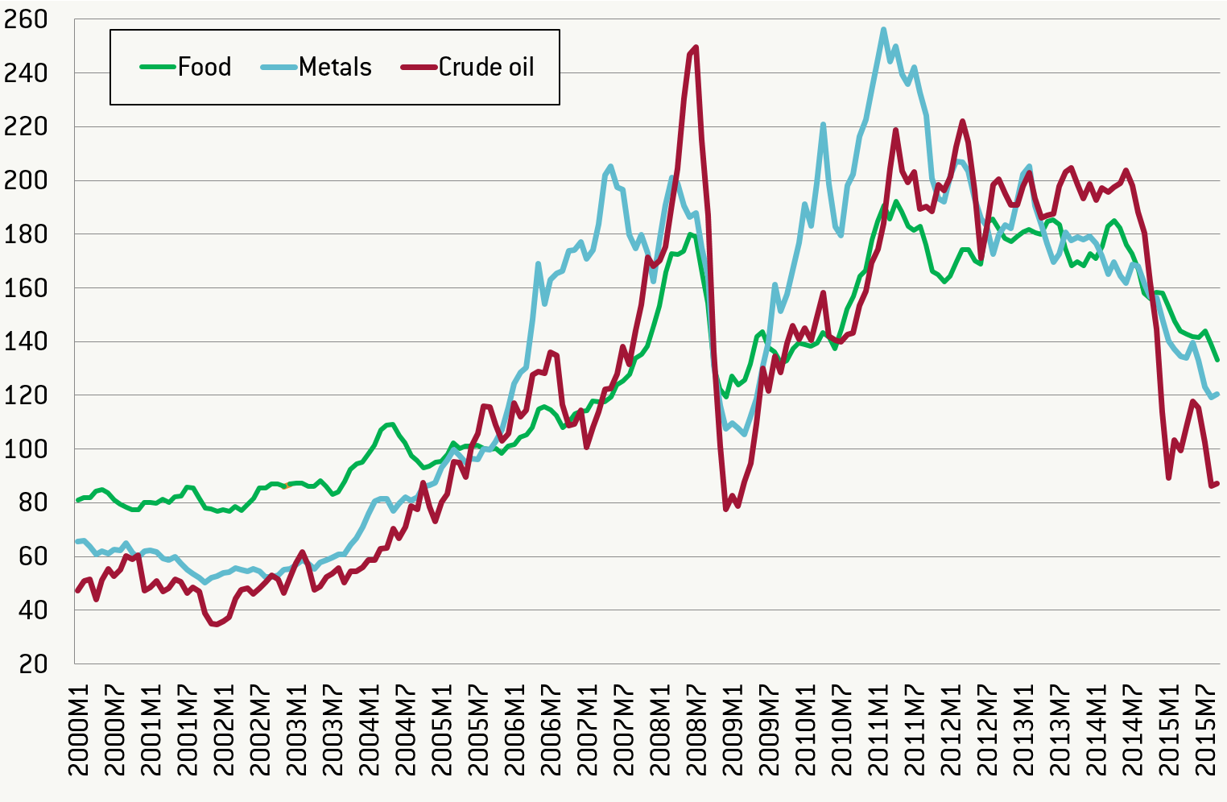
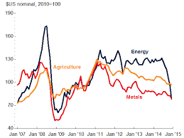
Commodity prices over the last decade have been even more volatile than usual.
IMF
Bruegel

Slide 3
Can’t commodity-exporters use financial markets to smooth trade fluctuations?
If international financial markets worked well,
countries facing temporary adverse trade shocks could borrow to finance current account deficits, and vice versa.
But they don’t work that well. Capital flows to developing countries tend, if anything, to be pro-cyclical.
  “When It Rains, It Pours” (Kaminsky, Reinhart & Végh, 2004).
The appropriate theory? Borrowing requires collateral,
  in the form of commodity export proceeds.
So some thought is required
  to design institutions that can protect against the volatility.
  I have four to propose. Two are tried & tested, two not.

Slide 4
How can countries that export commodities cope with the high volatility in their terms of trade?
Four areas where institutions can help
 | Micro | Macro
Tried & tested: | 1. Hedging | 3. Fiscal policy
 | 2. Debt denomination | 4. Monetary policy
Largely
untried:

Slide 5


  Idea 1: Commodity options
The general theoretical case for hedging is clear.
  E.g., Eduardo Borensztein, Olivier Jeanne & Damiano Sandri,
  "Macro-hedging for commodity exporters," JDE, 2013.
I suggest using options to hedge against downside fluctuations of the $ price of the export commodity
  as Mexico does annually for oil.
    thereby mitigating, e.g., the 2009 & 2015 downturns.
Why not use the futures or forward market?
  E.g., Ghana has tried it, for cocoa.
  But: The minister who sells forward may get
    meager credit if the $ price of the commodity goes down,
    and lots of blame if the price goes up.
      E.g., Ecuador, 1992.
    Options avoid this problem.

Slide 6
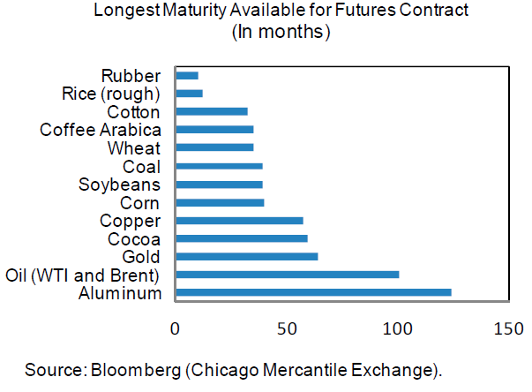
For some commodities, derivatives contracts
are unavailable at long horizons.
Chicago Mercantile Exchange Data source: Bloomberg
“Managing Volatility in Low-Income Countries:The Role and Potential for Contingent Financial Instruments,”
IMF SPRD & World Bank PREM, approved by R. Moghadam & O. Canuto, 2011. Fig.7 p.21.

Slide 7

  Idea 2: Commodity bonds
To hedge against long-term fluctuations in $ commodity price.
For those who borrow,
  e.g., if Niger has to finance development of oil discoveries
  or if Ecuador or Venezuela has to restructure its debt.
link the terms of the loan, not to $ or €, nor to the local currency, but to the price of the export commodity.
  Then debt service obligations will match revenues.
  Indexation of debts to oil prices might have prevented some crises
    in 1998: Indonesia, Russia & Ecuador, and
    in 2015: Ghana, Ecuador, Nigeria & Venezuela,
    <= the $ prices of their oil exports fell,
      and so their debt service ratios worsened.
An old idea. Why has it hardly been tried?

Slide 8
    “Who would buy bonds linked to commodity prices?”
Answer -- There are natural customers:
  Power utilities & airlines, for oil;
  Steelmakers, for iron ore;
  Millers & bakers, for wheat;
  Etc.
These firms want the commodity exposure,
but not the credit risk.
=> The World Bank or other MDB could intermediate:
  Link client-country loans to the oil price;
  then lay off the oil risk by selling precisely that amount
  of oil-linked World Bank bonds to the private sector.

Slide 9
Everyone gets what they want.
Niger:
wants to borrow,
but to be protected against a fall in the $ price of oil.
Bank issues oil-linked loan to Niger.
Airline or utility:
wants to be protected against a rise in the $ price of oil;
but doesn’t want to take on African country credit risk.
World Bank:
wants to lend to Niger;
but doesn’t want to take on oil price risk.
Bank sells oil-linked bond to corporate investors.

Slide 10

Idea 3: Adopt institutions to achieve counter-cyclical fiscal policy
Developing countries, historically,
have had notoriously pro-cyclical spending,
  especially commodity-exporters
  Cuddington (1989), Gavin & Perotti (1997), Tornell & Lane (1999), Kaminsky, Reinhart & Végh (2004), Talvi & Végh (2005), Mendoza & Oviedo (2006), Alesina, Campante & Tabellini (2008), Ilzetski & Végh (2008), Medas & Zakharova (2009), Medina (2010), Arezki, Hamilton & Kazimov (2011), Erbil (2011) and Avellan & Vuletin (2015).
  Tax policy tends to be procyclical as well: Végh & Vuletin (2015).
But after 2000 some achieved counter-cyclicality,
  running surpluses 2002-08, then easing in 2009.
  Frankel, Carlos Végh & Guillermo Vuletin, 2013,
  “On Graduation from Fiscal Procyclicality,” J.Dev.Ec.
  Luis Felipe Céspedes & Andrés Velasco, 2014,
  “Was this Time Different? Fiscal Policy in Commodity Republics,” J.Dev.Ec.

Slide 11
Who achieves counter-cyclical fiscal policy?
Countries with “good institutions”
”On Graduation from Fiscal Procyclicality,”
J.Frankel, C. Végh & G. Vuletin; J.Dev.Ec., 2013.

Slide 12
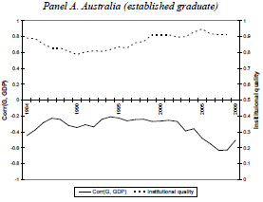
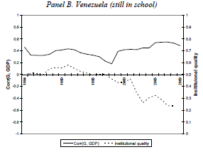
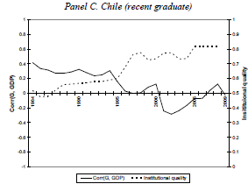



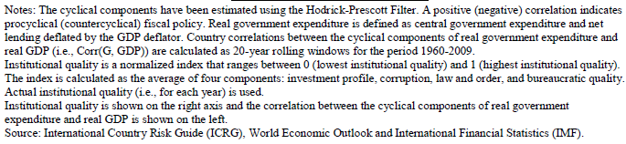
The quality of institutions varies, not just across countries, but also across time.
1984-2009
Worsened institutions;
More-cyclical spending.
Improved institutions;
Less-cyclical spending.
Good institutions;
Countercyclical spending
Frankel, Végh &
Vuletin, 2013, Fig.6.

Slide 13
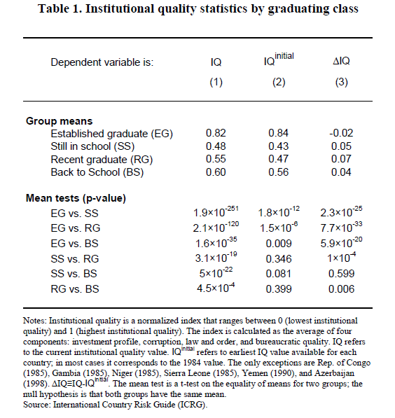
The comparison
is statistically
significant not only
in cross-section,
but also across time.
Frankel, Végh & Vuletin, JDE, 2013.

Slide 14

  What specific institutions can help?
Budget rules?
  Budget deficit ceilings or debt brakes?
    Have been tried by many countries:
      97 IMF members, by 2013.
      Usually fail.
  Rigid Budget Deficit ceilings operate pro-cyclically.
  Phrasing the target in cyclically adjusted terms helps
  solve that problem in theory. But…
Rules don’t address a major problem:
  Bias in official forecasts
    of GDP growth rates, tax receipts & budgets.
  In practice, overly optimistic forecasts
  by official agencies render rules ineffective.
    Frankel & Schreger (2013).

Slide 15
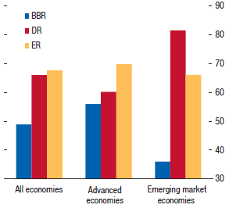



Countries with Balanced Budget Rules frequently violate them.
BBR: Balanced
Budget Rules
DR:
Debt Rules
ER: Expenditure Rules
Compliance
< 50%
International Monetary Fund, 2014

Slide 16
Over-optimism in official forecasts
Statistically significant bias among 33 countries
  Worse in booms.
  Worse at 3-year horizons than 1-year.
  Frankel (2011, 2013); Frankel & Schreger (2016).
Leads to pro-cyclical fiscal policy:
  If the boom is forecast to last indefinitely,
  there is no apparent need to retrench.
BD rules don’t help.
  The SGP worsens forecast bias for euro countries.
  Cyclically adjusted rules won’t help the bias either.
Solution?

Slide 17

An institution that others might emulate:
The Chile model
My take: Frankel, 2013, “A Solution to Fiscal Procyclicality:
The Structural Budget Institutions Pioneered by Chile,”
in Fiscal Policy and Macroeconomic Performance, L.Céspedes & J.Galí, eds.
I concluded that the key feature was the delegation
to independent committees of the responsibility
to estimate long-run trends in the copper price & GDP,
    thus avoiding the systematic over-optimism that
    plagues official forecasts in 32 other countries.

Slide 18
Idea 4: Adopt a monetary policy regime that can accommodate terms of trade shocks
Longstanding textbook wisdom:
For a country subject to big terms of trade shocks,
the exchange rate should be able to accommodate them.
When the $ price of commodities is: | we want the currency to
high, | appreciate
 |  | so as to avoid
 |  | excessive money inflows, credit, debt, inflation & asset bubbles.
When the $ price of commodities is: | we want the currency to | so as to avoid
high, | appreciate | excessive money inflows, credit, debt, inflation & asset bubbles.
low, | depreciate | trade deficit, fx reserve crisis, excessively tight money & recession.

Slide 19
Should commodity exporters float?
The long-time conventional wisdom that floating works better for countries exposed to volatility in the prices of their export commodities has been confirmed in empirical studies, including:
  Broda (2004),
  Edwards & Levy-Yeyati (2005),
  Rafiq (2011),
  and Céspedes & Velasco (2012).

Slide 20
Céspedes & Velasco, 2012, IMF Economic Review
“Macroeconomic Performance During Commodity Price Booms & Busts”
Constant term
not reported.
(t-statistics in
parentheses.)
** Statistically
significant
at 5% level.
Across 107 major commodity boom-bust cycles,
output loss is bigger the bigger is the commodity price change & the smaller is exchange rate flexibility.

Slide 21
  The exchange rate regime does make a difference!
  Four cases illustrate that floating delivers a high correlation
  between the Real Effective Exchange Rate
  & the exogenous price of the export commodity and fixing does not.
Floaters:
Fixers:
Canada
Ecuador
Correlation
(REER, CP)
= .92
Correlation
(REER, CP)
= .16
& Chile
& Saudi
Arabia
Correlation
(REER, CP)
= .80†
Correlation
(REER, CP)
= -.56
† for 2000-15, floating period
Correlations on changes: .38, .35; -.16, -.34

Slide 22
  Most central banks still need a nominal anchor or target for credibility & transparency.
  In developing countries in particular, monetary
  policy-makers may have more need for credibility.
  a) due to high-inflation histories,
  b) less-credible institutions, or
  c) political pressure to monetize big budget deficits.
  Fraga, Goldfajn & Minella (2003), “Inflation Targeting in Emerging Market Economies.”
  But does it add to credibility to announce a target which the central bank is likely to miss subsequently?

Slide 23
What choice of monetary anchor or target?
Of the variables that are candidates for nominal target,
the traditional ones prevent accommodation of terms of trade shocks:
  Not just exchange rate target,
  but also M1 (traditional monetarism)
  and the CPI (Inflation Targeting, if interpreted literally).
    Yes, I know. Flexible Inflation Targeting is flexible.
But some novel candidates would facilitate accommodation of trade shocks:
  Target an index of product prices (PPT)
  Target Nominal GDP (NGDPT)
  Add the export commodity to a currency basket peg (CCB).

Slide 24

New proposal:
Target a Currency + Commodity Basket (CCB)
Consider three commodity-exporters that, at times,
have pegged to a basket of major foreign currencies:
  Kuwaiti dinar (1975-2003, 2007-present), pegged to basket of $ + €,
  Chilean peso (1992-1999) pegged to $ + DM + ¥,
  Kazakh tenge (2013-2014) to $ + € + ₱.
The proposal is to add the commodity to the basket.
  E.g., oil for Kuwait & Kazakhstan,
  copper for Chile.

Slide 25
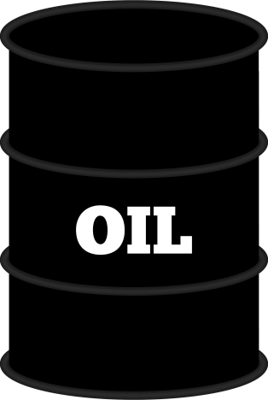
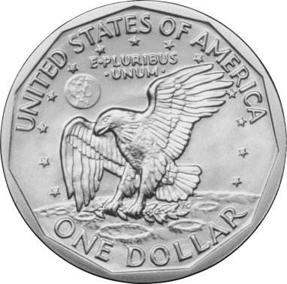

CCB: Add the export commodity, e.g., oil, to the currency basket

Slide 26



Target a Currency + Commodity Basket (CCB)
This target might give the best of both worlds:
  It is precise and transparent on a daily basis.
  Yet it is sustainable in the face of shocks:
    The currency would automatically strengthen
    (vs. the $) when the $ price of the commodity rises,
    and automatically fall when the $ price falls.

Slide 27




How would the weights be chosen?
3 possible approaches:
For simplicity: 1/3 $ + 1/3 € + 1/3 barrel of oil.
Or scientifically:
  turn Ph.D. students loose on estimating optimal weights.
Or to rationalize past policies:
  Estimate the weights that fit past history the best,
  either
    on the theory that true economic fundamentals reveal themselves,
    or to salvage a bit of credibility for officials.

Slide 28
Application to Gulf countries
Their currencies are currently pegged:
  Kuwait pegged to the euro+dollar basket,
  Saudi Arabia & the others pegged to the dollar.
Claim: During periods when their actual currency value
  was less than the level that the CCB formula would have given,
  it was “undervalued”, and
  when greater than the CCB level, it was “overvalued.”
Testable symptoms of undervaluation/overvaluation:
  Statistics on inflation, the balance of payments, etc.
  Language in IMF Article IV reports regarding internal balance
  & external balance.

Slide 29
Was the Saudi riyal “undervalued” when less than the CCB level & “overvalued” when greater?
Undervaluation periods | Overvaluation periods | Inflation (annual %) | Δ FX reserves (US$ mn, avg monthly) | Δreserves /GDP (avg monthly)
 | JAN 2001 - JAN 2005 | 0.03 | 1606.1 | 0.51
MAR 2007 - SEP 2008 |  | 6.66 | 10933.2 | 2.29
 | NOV 2008 - MAR 2009 | 7.55 | -5884.2 | -1.35
MAY 2009 - NOV 2014 |  | 4.20 | 5014.3 | 0.74
 | JUN 2015 - OCT 2016† | 3.50 | -8229.2 | -1.52
 | Average for over-valuation periods | 1.36 | -1177.0 | 0.15
Average for under-valuation periods |  | 4.69 | 6322.0 | 1.08
Data Source: Global Financial Data, WDI |  |  | † FX Reserves data end Dec.2015
Note: "Undervaluation (overvaluation)" ≡ actual currency value (in terms of SDRs) was at least 5% below (above) what the CCB formula with weights 1/3, 1/3/1/3 would have given.
  Frankel, 2017, “The Currency-Plus-Commodity Basket: A Proposal for Exchange Rates in Oil-Exporting Countries to Accommodate Trade Shocks Automatically,​” Harvard CID WP no.333, March. Table 1

Slide 30
Application to Gulf countries, 2001-2016:
Relationship between balance of payments and “over-/under-valuation” of currency relative to CCB
Figure 3:
"Overvaluation" measures the actual value of the currency (in terms of SDRs)
relative to what the CCB formula with weights 1/3, 1/3/1/3 would have given.
  Frankel (2017)

Slide 31
Mechanics of the CCB target
Compatible with IT: The country can pick a long-term inflation target.
Once a year, the monetary authorities announce the parameters:
  the weights in the basket on each foreign currency & commodity,
    translated into coefficients on units of $, barrels of oil, etc.; and
  the rate of crawl (if ≠0) to achieve the year’s inflation target in expected value.
Once a day:
  The central bank posts the $ exchange rate for the peso implied
  arithmetically by the previously announced parameters and
  that day’s $ price of oil and $ exchange rate for the euro, etc.,
    using, e.g., the Brent Crude Oil settlement price set on the ICE † at 19:30 London time.
Within the day:
  The central bank stands ready to intervene in the foreign exchange market
  to maintain the $ dollar exchange rate that has been posted for the day.
  But often it would not have to intervene much,
    because the regime’s credibility would motivate banks to trade at the day’s rate.
† InterContinental Exchange.

Slide 32







Summary: How can countries that export commodities cope with the high volatility in their terms of trade?
Four ideas may help
 | Micro: Hedge | Macro: Counter-cyclical policy
Tried & tested: | 1. Use options. | 3. Fiscal: protect independence of forecasts.
Untried: | 2. Commodity bonds. | 4. Monetary: target a Currency + Commodity Basket.

Slide 33
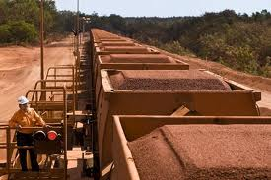
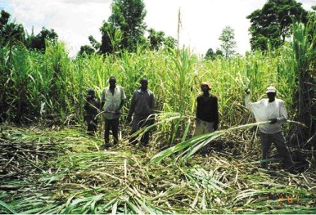
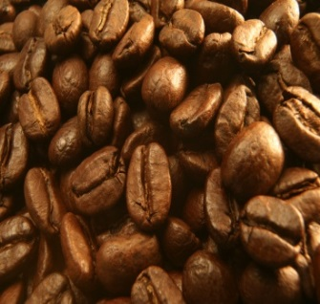
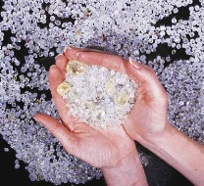
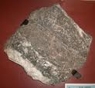

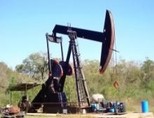

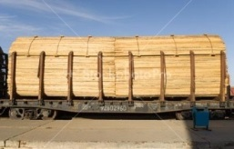

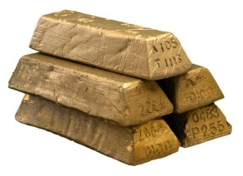




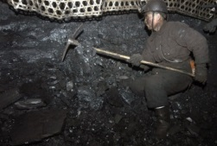



33
Notes:
33

Slide 34
References by the author
On commodity bonds:
  “Barrels, Bushels and Bonds: How Commodity Exporters Can Hedge Volatility," Project Syndicate, Oct. 17, 2011.
On counter-cyclical fiscal policy:
  ”On Graduation from Fiscal Procyclicality,” 2013, with Carlos Végh & Guillermo Vuletin; Journal of Development Economics.
  “A Solution to Fiscal Procyclicality: The Structural Budget Institutions Pioneered by Chile,” 2013, in Fiscal Policy and Macroeconomic Performance, L.Céspedes & J.Galí, eds.
On CCB proposal for monetary policy (Currency + Commodity Basket):
  “The Currency-Plus-Commodity Basket: A Proposal for Exchange Rates in Oil-Exporting Countries to Accommodate Trade Shocks Automatically,​” forthcoming, Macroeconomic Institutions & Management in Resource-Rich Arab Economies (Oxford Univ. Press). CID WP no.333, 2017.
  A Comparison of Product Price Targeting and Other Monetary Anchor Options, for Commodity-Exporters in Latin America," Economia, LACEA, vol.12, no.1, 2011, 1-57. NBER WP 16362.
  "UAE & Other Gulf Countries Urged to Switch Currency Peg from the Dollar to a Basket That Includes Oil," VoxEU, July 2008.
  "Iraq’s Currency Solution? Tie the Dinar to Oil," The International Economy, Fall 2003.
On the “commodity curse” and solutions generally:
  “How to Cope with Volatile Commodity Export Prices: Four Proposals,” forthcoming in an e-book, edited by R.Arezki & R.Boucekkine. Keynote, Bank of Algeria, Algiers, May 28-29, 2016.
  “The Natural Resource Curse: A Survey of Diagnoses and Some Prescriptions,” in Commodity Price Volatility and Inclusive Growth in Low-Income Countries, 2012, edited by Rabah Arezki, et.al. (International Monetary Fund: Washington DC). HKS RWP12-014.

Slide 35
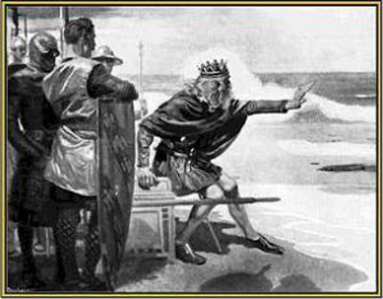
Appendices
Appendix 1: Some policies
that don’t usually work.
Appendix 2: Commodity bonds
Appendix 3: Fiscal policy
  3.1 Which countries achieved
  counter-cyclical policy?
  3.2 Chile’s fiscal institutions
Appendix 4: Applications of CCB
  4.1 Vs. occasional devaluations: Kazakhstan
  4.2 Vs. a rigid peg: GCC countries
35
Notes:
35
keep

Slide 36
Appendix 1: How can commodity-exporters cope with the high volatility in their terms of trade?
Not by policies that try
to suppress price volatility:
Producer subsidies
Blaming derivatives
Nationalization
Banning foreign participation
Price controls
Export controls
Stockpiles
Marketing boards

Slide 37
The problem:
Appendix 2: Commodity bonds
If an African oil-exporting country borrows in $,
it is very vulnerable to future fluctuations in the $ price of oil on world markets:
  If the $ price of oil falls in the future, the country may not have the foreign exchange it needs to service its debt.
  It is then forced to cut spending, devalue, default, or go to the IMF for an emergency program.
Borrowing in € or CFA francs doesn’t help much.

Slide 38
Insulation against the risk of future ups & downs in the $ price of oil
In theory, the oil-exporting country could hedge against falls in the price of oil by selling on the forward market.
  Problem #1: Transaction costs may be too high.
  Problem #2: The maturities or horizons of forward/futures markets generally do not go out past 1 year.
    This does not help much for the long-term horizon of oil exploration, drilling, pipeline investment, etc..

Slide 39
Insulation against the risk of future ups & downs in the $ price of oil
If the country is borrowing anyway,
e.g., a long-term loan from the World Bank, then express the loan in terms of oil rather than $.
  This solves the problem.
  The stream of foreign exchange proceeds from future oil exports corresponds to cost of debt service.
  The country is protected/hedged/insulated/covered:
    It need not worry about future fluctuations in oil prices.

Slide 40
Question: Who would take the other side of the transaction, buying the oil bonds?
Answer: Airlines, electric power utilities, and other corporations in rich countries for whom oil is a cost rather than an income.
  They want to hedge against oil price increases.
  Thus they are natural customers for oil bonds.
But they may not want to be in the business of evaluating creditworthiness of African borrowers.

Slide 41
Who would take the other side of the transaction, buying the oil bonds?
Solution: The World Bank links the terms of a Niger loan to the price of oil.
  E.g., the $ value of the principle might be $500 million if the price of oil stays at $50 per barrel,
  but would go up or down 1% every time the $ price
  of oil goes up or down 1% relative to $50/barrel.
The World Bank then lays off the oil risk (not the country risk) by selling the same amount of oil bonds to investors
  where airlines and utilities would happily take the opportunity to “go long” in terms of oil.

Slide 42
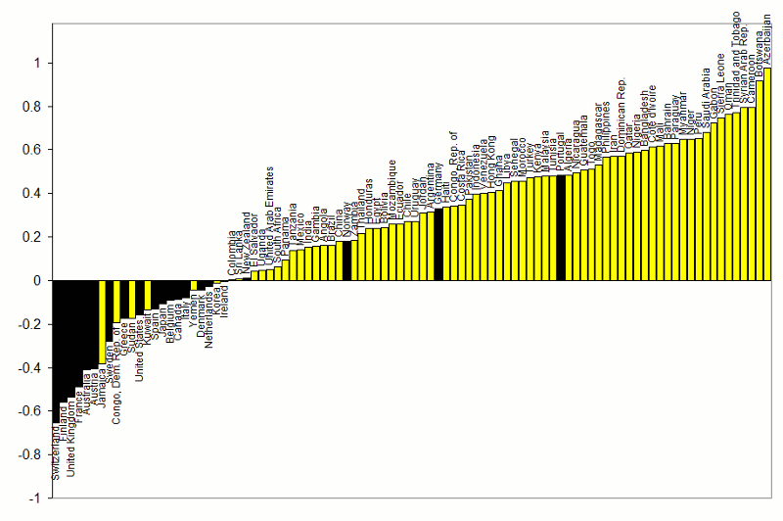




Appendix 3.1: Procyclical vs. countercyclical fiscal policy
}
Correlations between Gov.t Spending & GDP: 1960-99
procyclical
Adapted from Kaminsky, Reinhart & Vegh (2004)
countercyclical
G always used to be pro-cyclical
for most developing countries.

Slide 43
Some developing countries were able
to break the historic pattern after 2000
  taking advantage of the boom of 2002-2008
    to run budget surpluses & build reserves,
  thereby earning the ability to expand
  fiscally in the 2008-09 crisis.
  Chile, Botswana, Malaysia, Indonesia, Korea…
43
Notes:
43
keep

Slide 44
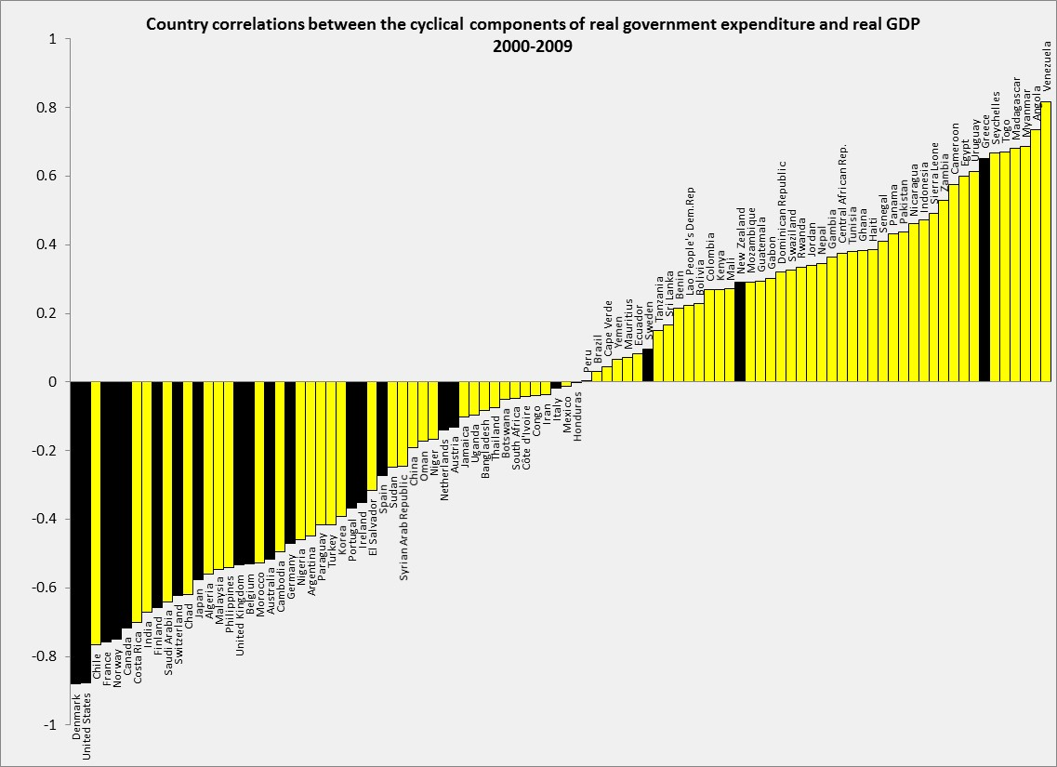
Correlations of Government spending & GDP: 2000-09
Adapted from Frankel, Vegh & Vuletin (JDE, 2013)
In the decade 2000-2009,
about 1/3 developing countries
switched to countercyclical fiscal policy:
Negative correlation of G & GDP.
DEVELOPING:
43% (or 32 out of 75) countercyclical. The figure was 17% (or 13 out of 75) in 1960-1999.
INDUSTRIAL:
86% (or 18 out of 21) countercyclical. The figure was 80% (or 16 out of 20) in 1960-1999.

Slide 45



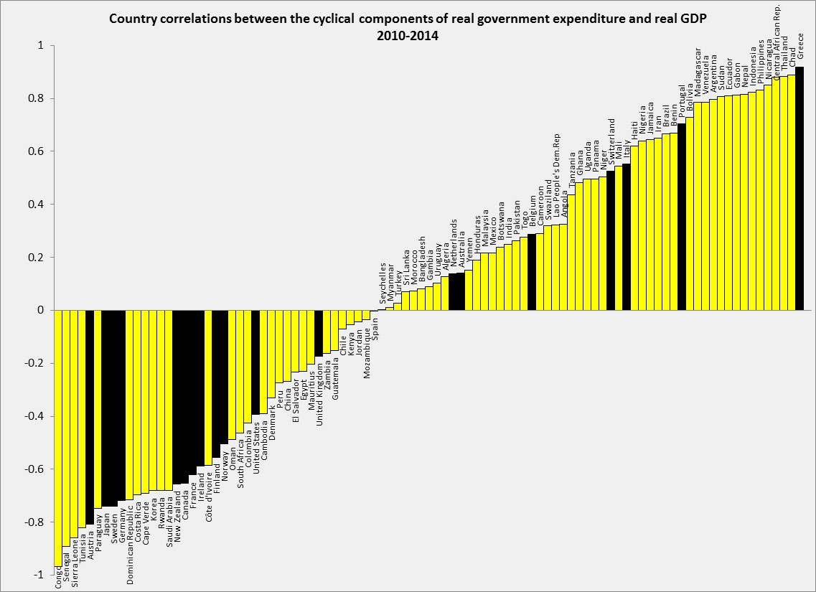


Update of Correlation (G, GDP): 2010-14
Back-sliding among some countries.
Thanks to Guillermo Vuletin
DEVELOPING: 37% (or 29 out of 76) pursue counter-cyclical fiscal policy.
INDUSTRIAL: 63% (or 12 out of 19) pursue counter-cyclical fiscal policy.

Slide 46


Appendix 3.2
The example of Chile’s fiscal institutions
1st rule – Governments
must set a budget target,
2nd rule – The target is structural:
Deficits allowed only to the extent that
  (1) output falls short of trend, in a recession, or
  (2) the price of copper is below its trend.
3rd rule – The trends are projected by 2 panels
of independent experts, outside the political process.
  Result: Chile avoided the pattern of 32 other governments,
    where forecasts in booms were biased toward optimism.
Notes:
46

Slide 47
Chilean fiscal institutions
In 2000 Chile instituted its structural budget rule.
The institution was formalized into law in 2006.
The structural budget surplus must be…
  0 as of 2008 (was higher before, lower after),
  where “structural” is defined by output & copper price
  equal to their long-run trend values.
I.e., in a boom the government can only spend increased revenues that are deemed permanent;
any temporary copper bonanzas must be saved.

Slide 48
The Pay-off
Chile’s fiscal position strengthened immediately:
  Public saving rose from 3 % of GDP in 2000 to 8 % in 2005
  allowing national saving to rise from 21 % to 24 %.
Government debt fell sharply as a share of GDP
and the sovereign spread gradually declined.
By 2006, Chile achieved a sovereign debt rating of A,
    several notches ahead of Latin American peers.
By 2007 it had become a net creditor.
By 2010, Chile’s sovereign rating had climbed to A+,
    ahead of some advanced countries.
=> It was able to respond to the 2008-09 recession.

Slide 49
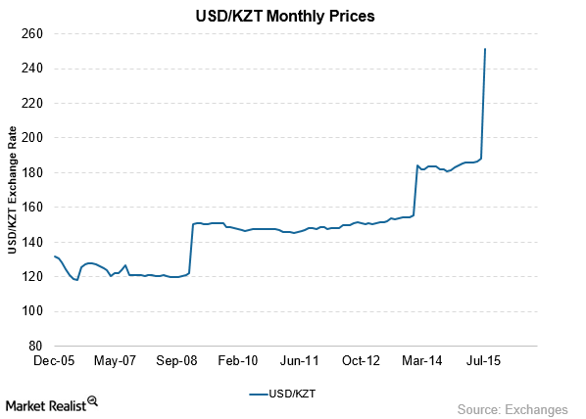

Appendix 4. Applications of CCB
4.1 Implementation together with a devaluation:
In the summer of 2015, Kazakhstan could have announced a CCB target with weights that fit past history.
(313 KZT/$,
April 2017)
KZT/US$ exchange rate
KZT/$

Slide 50
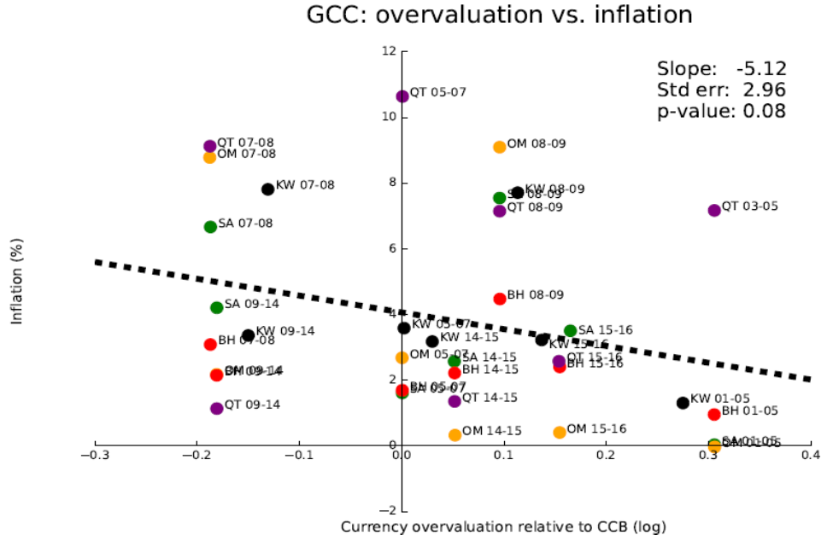
4.2 Vs. rigid pegs: Application to Gulf countries:
Relationship between inflation & “over-/under-valuation” of currency relative to CCB
"Overvaluation" measures the actual value of the currency (in terms of SDRs)
relative to what the CCB formula with weights 1/3, 1/3/1/3 would have given.
  Frankel, 2017, “The Currency-Plus-Commodity Basket: A Proposal for Exchange Rates in Oil-Exporting Countries to Accommodate Trade Shocks Automatically,​” Harvard CID WP no.333, March.

Slide 51
IMF Article IV consultations for Kuwait, Saudi Arabia & UAE
Were Gulf currencies “undervalued” when less
than the CCB level & “overvalued” when greater?
Under-valuation periods | Over-valuation periods | Internal balance | External balance
 | JAN 2001 - JAN 2005 | Repeated comments on the low level of inflation in all 3 countries.
MAR 2007 - SEP 2008 |  | Concern about accelerating inflation, particularly in the housing market. Strong demand for goods & labor and high asset prices (equities & real estate). Saudi inflation “poses the main challenge for the authorities.” The UAE is “vulnerable in the wake of an unprecedented credit and asset price boom.” | The Saudi balance of payments surplus piled up reserves, to a level equal to 19 months’ worth of imports. Efforts to sterilize the inflow were not sufficient to “contain the expansion in monetary aggregates.”
Note: "Undervaluation (overvaluation)" ≡ actual currency value (in terms of SDRs) was at least 5% below (above) what the CCB formula with weights 1/3, 1/3/1/3 would have given.
  Frankel (2017)

Slide 52
IMF Article IV consultations for Kuwait, Saudi Arabia & UAE, continued
Under-valuation periods | Over-valuation periods | Internal balance | External balance
 | NOV 2008 - MAR 2009 | Abrupt downturns. Inflation fell substantially in all three countries. In the UAE, “After peaking at about 12 % in 2008, inflation declined to 1 % in 2009." In Kuwait, “Equity prices continued to decline, money growth slowed, and credit growth plunged.” UAE hit by a stalling of “all three growth engines in 2009. Oil receipts plummeted, global trade & logistics contracted, and property development all but ground to a halt as incomes fell and property prices plunged. | The UAE began to run a rare current account deficit, equaling almost 3% of GDP.
Note: "Undervaluation (overvaluation)" ≡ actual currency value (in terms of SDRs) was at least 5% below (above) what the CCB formula with weights 1/3, 1/3/1/3 would have given.
  Frankel (2017)

Slide 53
IMF Article IV consultations for Kuwait, Saudi Arabia & UAE concluded
Under-valuation periods | Over-valuation periods | Internal balance | External balance
MAY 2009 - NOV 2014 |  | Concerns about rising inflation and high Saudi equity market. A UAE economic recovery was welcome, but by 2014 the “risk of potentially large private credit growth” called for macro-prudential response. Dubai real estate prices up 27 % 2013-14 & the stock index by 100 %. | The reports also note large external surpluses in Saudi Arabia and the UAE, reaching the vicinity of 10% of GDP.
 | JUN 2015 - OCT 2016 | Saudi inflation & real GDP growth and inflation down. Tightening of UAE monetary conditions and a return of decline in the real estate market. “Price-to-rent ratios have declined since mid-2014…” | Deteriorating external balances. SAMA reserves fell substantially. UAE external position weaker than consistent with fundamentals.
Note: "Undervaluation " ≡ actual currency value at least 5% below what the CCB would have given.
  Frankel (2017)

