Slide 1

Inequality in America:
Achieving An Economy
That Works for All
Jeffrey Frankel
Harpel Professor of Capital Formation & Growth
Equity Group Discussion, with 2020 ALI Fellows
Advanced Leadership Initiative
May 26, 2020
Based on Economic Policy Forum, Northeastern University, Sept. 2017

Slide 2
Inequality in America:
Achieving An Economy That Works for All
Ordinary Americans have been left
behind in the modern economy.
Why?
What is to be done about it?

Slide 3
(I) If the economy was in such good shape, (pre coronavirus), why was there such discontent?
An obvious answer:
The longer-term trend for typical Americans has not been good.
Since 2000, the gains have gone to those at the top.
The longer-term trend for the typical American has not been good:

Slide 4
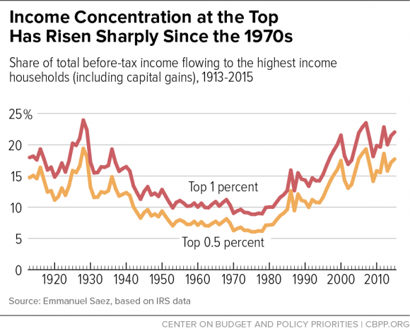
The share of US income going to the top has been rising since 1980, and is now back to the 1920s level.
Chad Stone et al, CBPP, Sept 30, 2016 www.cbpp.org/research/poverty-and-inequality/a-guide-to-statistics-on-historical-trends-in-income-inequality

Slide 5
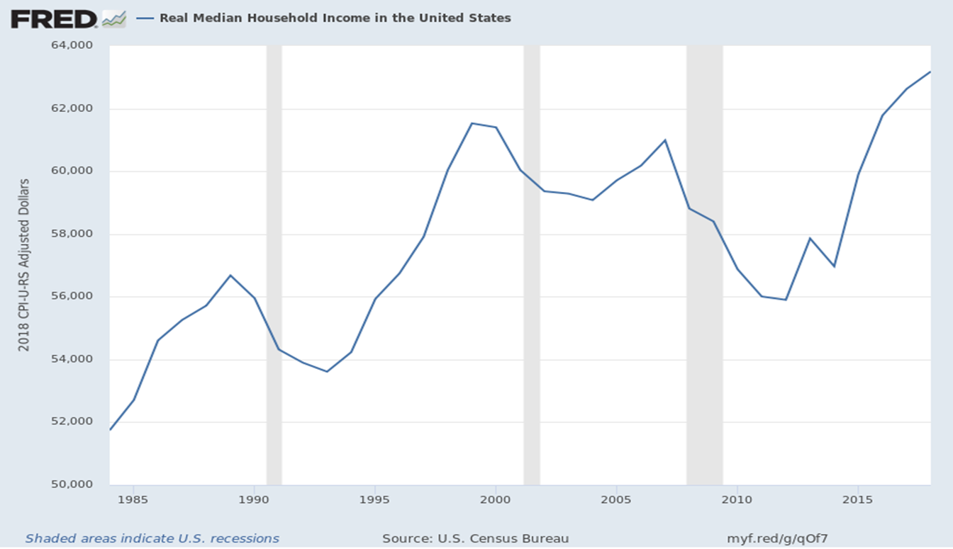
US Real Median Family Income has stagnated,
especially since 2000.
2018

Slide 6
Overview
So, yes, ordinary Americans have been
left behind in the modern economy.
Ten reasons why US inequality has risen.
Nine policy proposals to help share a growing economic pie more equally.

Slide 7
(II) Why has inequality risen in the US? Ten reasons.
  Trade probably plays a role. But also:
  Technological change raises demand for skilled workers;
  education lags in raising the supply of skilled workers.
  “Winner-take-all” labor markets;
  “Assortative mating;”
  More corporate monopoly power (higher “rents”);
  and “excessive” executive compensation.
  Piketty: wealth accumulates faster than income.
  The decline in union power.
  Tax cuts for the rich in early 1980s & 2000s (&2017).

Slide 8

1. Trade may play a role
Import competition certainly has hurt some sectors,
  such as clothing & steel.
But trade also has benefits:
  Imports lower costs to consumers,
  especially low-income consumers.
  Imported components keep costs low for US firms,
    e.g., allowing US autos to remain globally competitive.
  Exports create new jobs
    which tend to pay 12% more than average jobs.

Slide 9
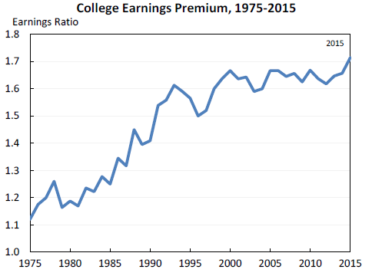
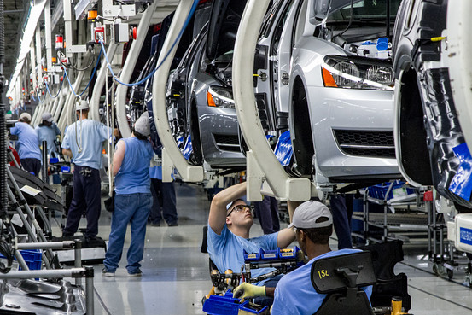
2. Technology raises demand for “skilled” vs. “unskilled” workers, as shown by widening wage gap.
Jason Furman, CEA, Oct. 17, 2016, Fig.10.

Slide 10
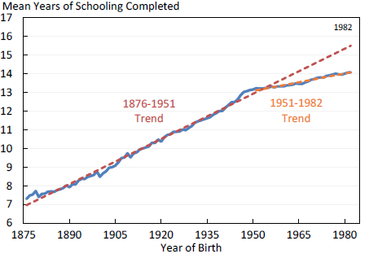

3. The trend in years of education slowed during 1981-2012.
So the supply of skilled workers has not kept up with the demand.
Average Years of Schooling at Age 30, U.S. Native-Born, by Year of Birth, 1876-1982
Trend
1906 – 1981
= 1876+30 to 1951+30.
Trend
1981 – 2012
= 1951+30 to 1982+30.
Jason Furman, CEA, Oct. 17, 2016, Fig.11.

Slide 11

4. “Winner take all” labor markets
    Taylor Swift earned $185 million in 2019, making her
    the world’s highest paid celebrity (according to Forbes).

Slide 12

5. “Assortative mating”
    Crudely put: educated
    & highly paid male professionals
    used to marry their secretaries,
    but now are more likely
    to marry educated & (relatively) highly paid women.
    The couple passes the advantages on to their children.

Slide 13
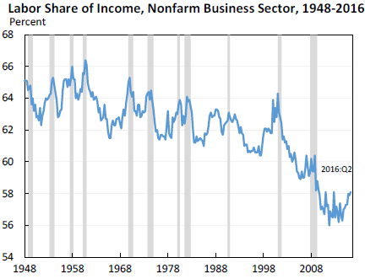
6. The share of US national income going to labor has declined since 2000 in part due to increased market power of firms.
Jason Furman, CEA, Oct. 17, 2016, Fig.13.

Slide 14
7. Excessive compensation?
Many top-1%-ers are executives and/or in finance.
Composition of Top 1 Percent Income Share by Primary Occupation
Jason Furman, CEA, Oct. 17, 2016, Fig.4a.

Slide 15
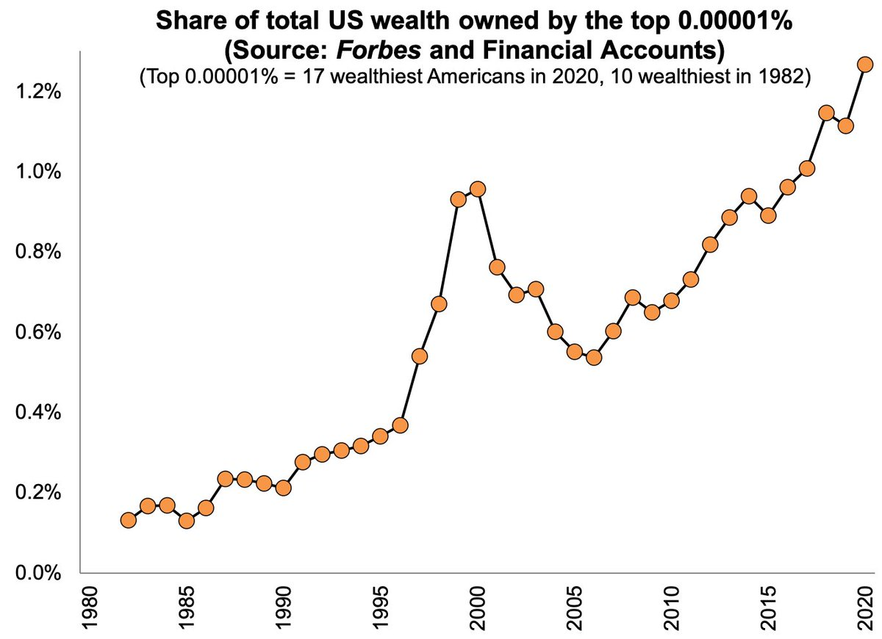

8. Supporting Piketty:
The share of wealth at the top has also been rising back to pre-WWII levels.

Slide 16
On the other hand, the biggest increase in inequality has been within labor.
Jason Furman, CEA, Oct. 17, 2016, Fig.15.

Slide 17




What weights should we place on each of these factors in explaining increased inequality?
I don’t know.
Probably all merit some weight:
  Trade,
  technology, education,
  winner-take-all,
  assortative mating,
  rents, executive compensation,
  and wealth accumulation.
Surely one must diagnose the cause before
deciding on the corresponding remedy?
No, I don’t think one has to.

Slide 18
  (III) Nine policy proposals to promote shared prosperity
Expand, don’t reduce, the health-insured population.
- E.g., the Affordable Care Act + public option.
Strengthen, don’t weaken, US financial regulation.
Reform the tax system (staying revenue-neutral)
  Expand the EITC, not the estate tax exemption.
  Make the income tax more progressive, not less.
  2017 corporate tax rate cut should have been offset by eliminating deductions
    to be revenue-neutral, rather than producing $ 1 trillion deficits at cyclical peak.
Put social security on a sound footing.
Improve education, esp. universal pre-school education.
Increase infrastructure spending.
Address the long-term rise in household debt.
Energy: Start a carbon tax; don’t subsidize fossil fuels.
Pursue competition policy.

Slide 19
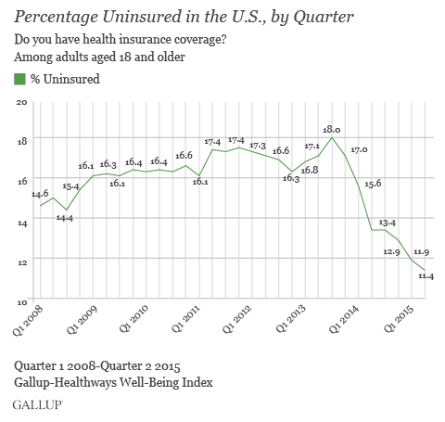
1. Keep the Affordable Care Act which has sharply reduced the percentage of Americans lacking health insurance. Add public option.

Slide 20
2. Retain intelligent financial regulation
Reinstate the “fiduciary rule” for financial advisers.
Don’t gut Dodd-Frank financial reform, esp. its:
  higher capital requirements for banks,
  tough stress tests on banks,
  designation of Systemically Important Fin. Institutions,
  enhanced transparency for derivatives, and
  Consumer Financial Protection Bureau.

Slide 21
3. Reform the tax system
(staying revenue-neutral)
Reform personal income tax to make it
more progressive, not regressive.
  E.g., expand EITC ,
  and abolish the carried interest deduction.
Don’t eliminate the estate tax.
Reform corporate income tax but stay revenue-neutral:
  Lowering the rate in December 2017 made sense,
  but cut distorting deductions,
    e.g., oil subsidies & interest deductions.

Slide 22
4. Put social security on a sound footing
Gradually raise the retirement age. Meanwhile,
Make payroll taxes more progressive:
  Exempt low-income workers and
  raise the cap on payroll taxes (now at $127,000).
5. Improve education,
-- esp. universal pre-school education.
6. Increase infrastructure spending.
It’s good for growth
and makes jobs for construction workers.
I would include green goals.

Slide 23
7: Address the long-term rise in household debt: housing, auto, & student loans
Reduce the policy tilt toward getting American families
up to their eyeballs in mortgage debt they can’t afford.
  It led to 2007-09 financial crisis.
    without even raising home ownership rates.
  Specific policies:
    Require a serious minimum down payment, as other countries do.
    Require “skin in the game,” on the part of mortgage-originators.
    Curtail tax deductibility of mortgage interest,
    Don’t repeat the mistake of privatizing Fannie Mae & Freddie Mac.
  And it drives up housing prices

Slide 24
Address household debt: housing, auto & student loans, continued
Auto dealers should not have been exempted
from the Consumer Finance Protection Bureau.
  A rising share of sub-prime auto loans are delinquent.
Although most college educations are still a good deal, and worth going into debt for if that is the only way, some enterprises are bad deals.
    Especially for-profit universities.
    Government should expand student grants & loans,
    but tighten requirements that the college or university have a decent record regarding rates of graduation & gainful employment, not loosen them.

Slide 25
The last 2 of the 9 policy proposals
Energy:
  Start a carbon tax; don’t subsidize fossil fuels.
    Energy taxes are the most efficient
      as proposed by Baker, Feldstein, Mankiw, Paulson & Schultz, 2017.
9. Increase competition, including
  - anti-trust policy, and
  - keeping US global leadership on trade.

Slide 26
Inequality in America:
How Do We Achieve An Economy
That Works for All?
Jeffrey Frankel
Harpel Professor of Capital Formation and Growth
Harvard University

Slide 27
Appendices
The stagnation in earnings for non-college-educated men and the role of manufacturing
Job losses in some sectors: manuf., ag., & coal.
Five trade fallacies.
Policies targeted toward individual causes of inequality.

Slide 28
Appendix 1
The stagnation in earnings for non-college-educated men and the role of manufacturing jobs.

Slide 29
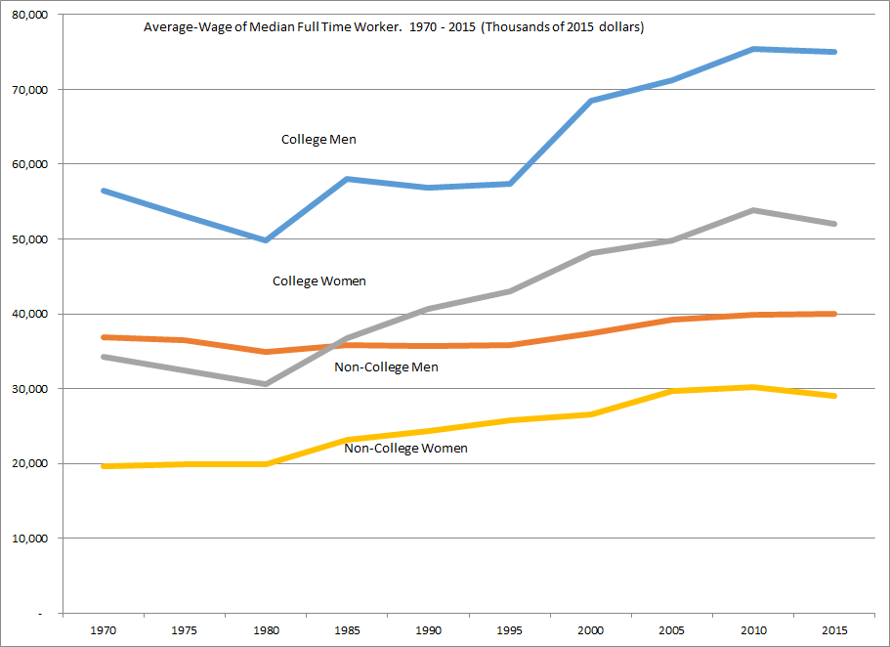
Real Wage Earnings of Median Worker (1970-2015):
Almost No Growth for Non-College Men over 45 years!
Average Annual
Real Wages of
Median Worker
College Women
+51.7%
Non-College
Women +47.6%
College Men +23.8%
Non-College Men
+8.6%
Data Source: BLS Current Employment Survey

Slide 30
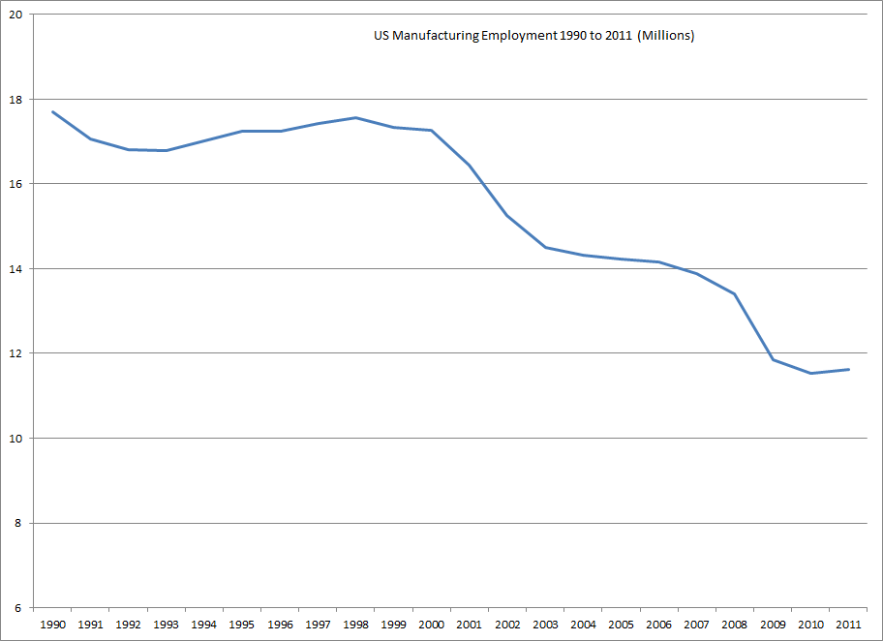
US Manufacturing employment 1990-2011: down almost 6 million since 2000

Slide 31
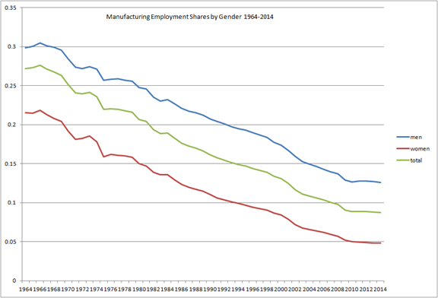
US manufacturing jobs were especially important for men….
Robert Lawrence, HKS

Slide 32
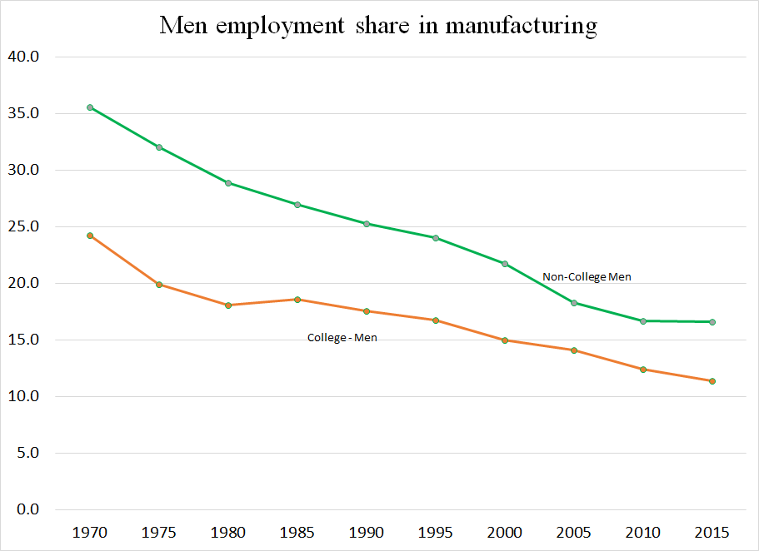
…and especially for men without college
Robert Lawrence, HKS

Slide 33
The negative trend in US manufacturing share of employment goes back to 1961, well before China, NAFTA, etc..
Manufacturing share in establishment employment, 1961–2010
Share
Fitted trendline
Forecast

Slide 34
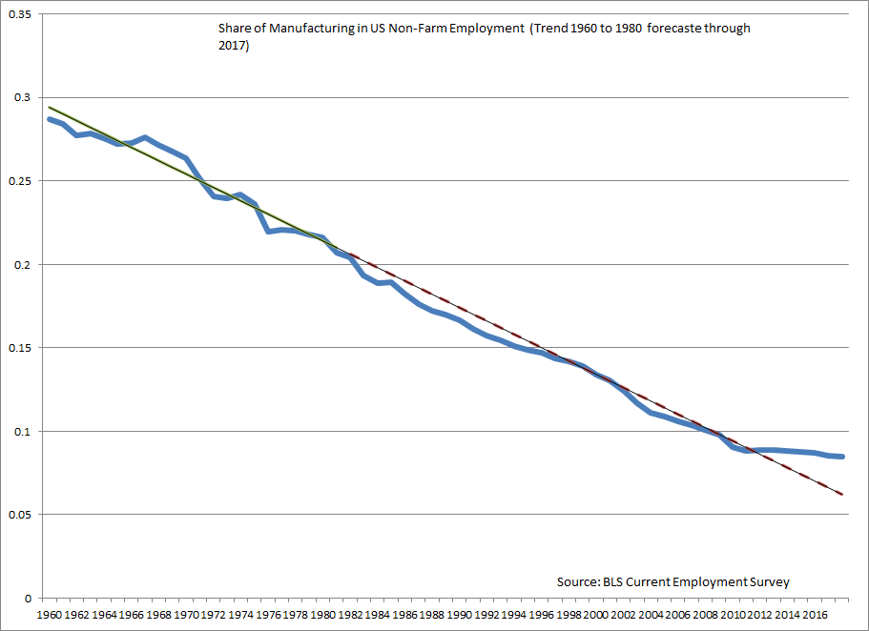
In fact the manufacturing share of employment levelled off after 2010.

Slide 35
US is not unusual. Decline in manufacturing share of employment is similar across advanced economies
including in countries with habitual trade surpluses.
Sh
a
r
e
o
f
e
m
p
l
o
y
m
e
n
t
i
n
m
a
n
u
fa
c
tu
r
i
n
g
,
1
9
7
3
–
2
0
1
0
(p
e
rce
n
t
)
C
o
u
n
tr
y
1973
1990
2000
2010
Change
(1
)
(2
)
(3
)
(4
)
(4
)
-
(1
)
U
n
i
t
e
d
St
a
t
e
s
24.8
18.0
14.4
10.1
-1
4
.
7
Canada
22.0
15.8
15.3
10.3
-1
1
.
7
Au
st
ra
l
i
a
23.3
14.4
12.0
8.9
-1
4
.
4
Ja
p
a
n
27.8
24.3
20.7
16.9
-1
0
.
9
F
ra
n
ce
28.8
21.0
17.6
13.1
-1
5
.
7
G
e
rma
n
y
36.7
31.6
23.9
21.2
-1
5
.
5
Italy
27.9
22.6
23.6
18.8
-9
.
1
N
e
t
h
e
rl
a
n
d
s
25.3
19.1
14.8
10.6
-1
4
.
7
Sw
e
d
e
n
27.6
21.0
18.0
12.7
-1
4
.
9
So
u
rce
:
Bu
re
a
u
o
f
L
a
b
o
r
St
a
t
i
st
i
cs.

Slide 36
Appendix 2: Long-term job loss in some sectors
Manufacturing employment has been falling as a share since 1950,
  conspicuously in such sectors as autos, steel, and apparel,
    while leaving efficient viable cores today.
Due to international trade?
  Yes, in part, in some sectors.
Also, manufacturing output continues to rise, even as employment falls.
  That means productivity has gone up a lot:
    It takes fewer workers to produce one auto today than 65 years ago,
      not to mention that the cars are much higher-quality.
By analogy, farmers were 90% of national employment in 1790
  vs. 2% today.
Or consider coal miners.

Slide 37
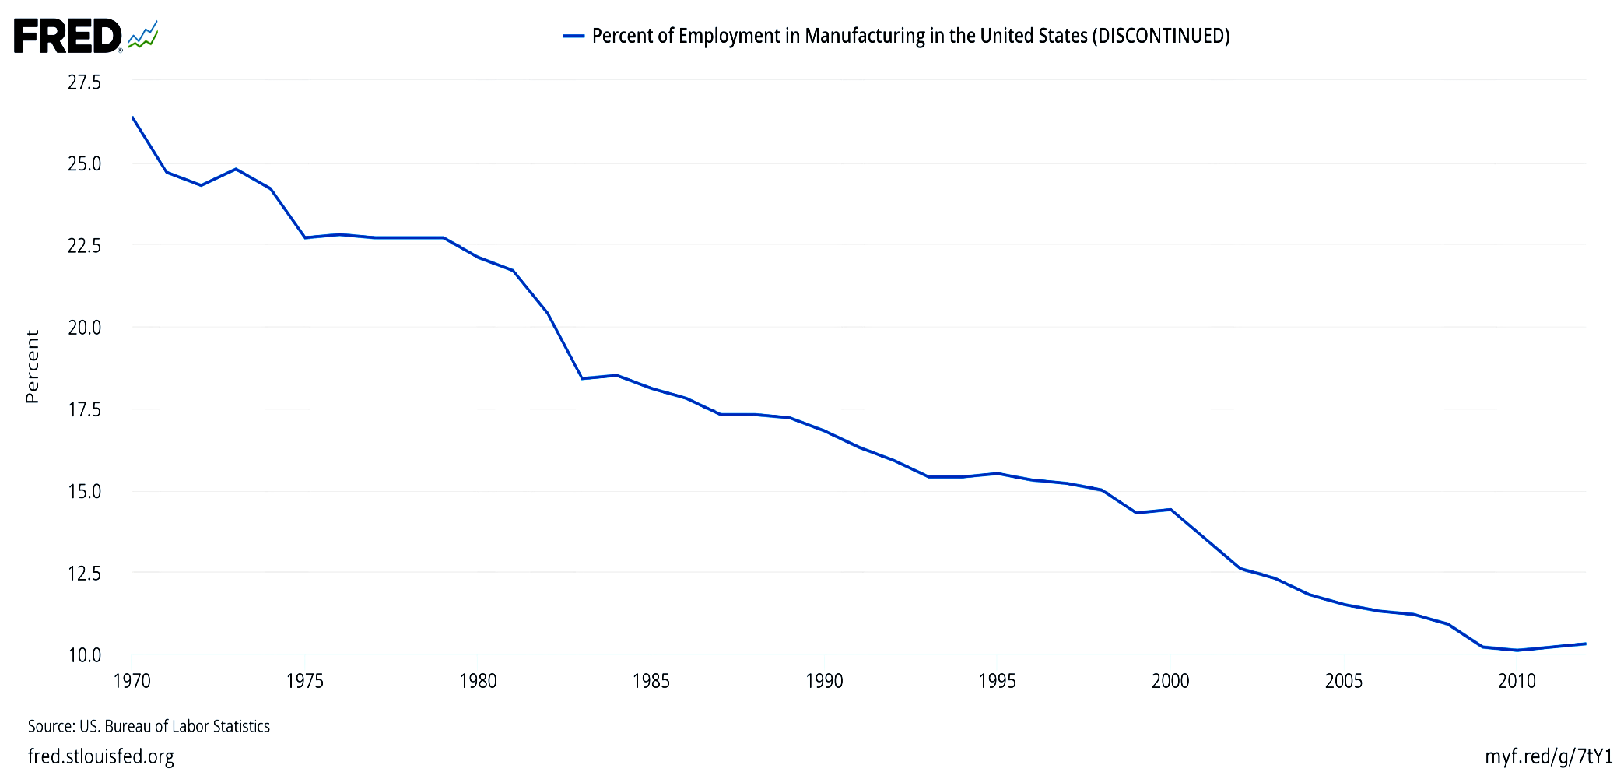
Manufacturing jobs were 32% of the national total in 1950, and had declined to 10% by 2010.
Percent of employment in US manufacturing (1970-2012)
Those jobs are not coming back.

Slide 38
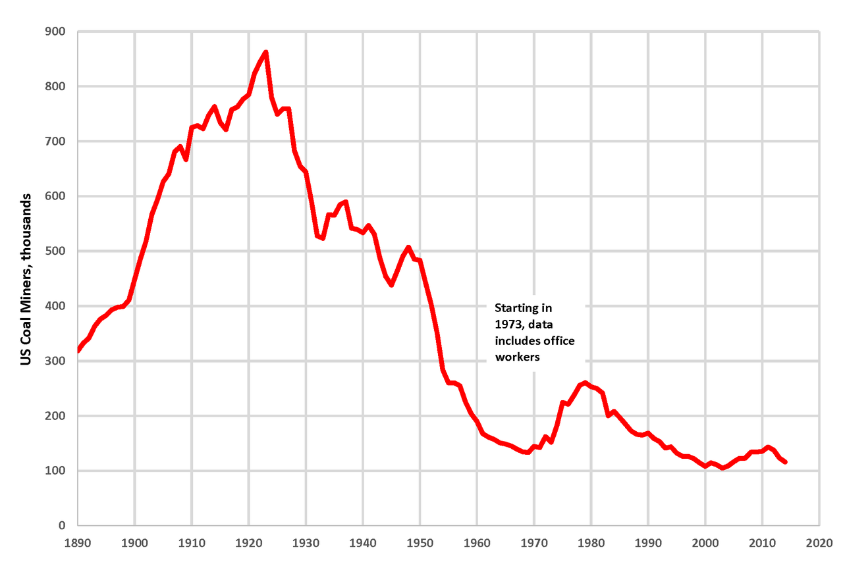
Similarly, we are not going back to the number of coal miners that were employed in 1923.
By Plazak - Own work, CC BY-SA 4.0, https://commons.wikimedia.org/w/index.php?curid=48261916

Slide 39
Some reasons for employment shifts
Trade? It works in favor of the US agricultural and coal sectors.
Even regulation has not been the big source of job loss in coal.
  Rather, in recent years, it has been cheap natural gas from fracking;
  and, before that, the shift from Appalachian underground mining
  to Wyoming open-pit mining.
In the case of all 3 sectors, the biggest reason for the decline
in jobs has not been trade, but rather productivity growth,
  particularly arising from technological progress, including automation.
  The demand for labor has shifted toward high-skill jobs.
  Meanwhile the supply of high-skilled workers has not kept up.
But regardless the causes of rising inequality,
good policies can share income gains more widely.

Slide 40
Appendix 3: Five Trade Fallacies
Regarding:
Negotiators;
Bilateral trade deficits;
Causes of the overall trade deficit;
Effects of the trade deficit on GDP;
Trade & Inequality

Slide 41
Fallacy #1: “US trade negotiators have been out-negotiated by those from other countries.”
Wrong.
In most trade negotiations, such as TPP, NAFTA, and the Uruguay Round, the US has been able to get most of what it asked for – as leader of the international order.
Trade agreements have required high-tariff trading partners to reduce barriers against US goods.
US demands have also driven deeper integration
  in such areas as labor rights, the environment, investor-state dispute settlement and intellectual property rights.
How could NAFTA usefully be modernized & expanded? TPP.
One of the funniest things that Trump has said:
"The negotiators for Germany have done a far better job than the negotiators for the US."

Slide 42
Fallacy #2: “Bilateral trade imbalances reflect bad trade agreements.”
Wrong.
If country A runs a bilateral trade deficit with country C,
it generally signifies some combination of 3 causes:
  (i) A currently has a trade deficit overall,
  (ii) C has a trade surplus overall,
  (iii) C needs to earn a structural surplus with countries like A,
  to pay for a structural deficit with, e.g., oil exporters.
If we stop importing consumer electronics from China,
we will import them from other Asian countries.
The guy who cuts my hair insists I pay him with money.
He refuses to accept as payment a lecture in economics.

Slide 43
Fallacy #3: “A trade deficit indicates the absence of a level playing field.”
Wrong.
There is no (positive) correlation between countries’
tariff rates and their trade balances. [See Figure 1.]
Trade deficits are macroeconomic phenomena,
  influenced by national incomes and exchange rates,
  and determined in a deeper sense by national saving & investment.
The US has run current account deficits since 1982
because national saving has been low [see Figure 2],
  both low private saving and low public saving.
  The famous twin deficits: increase in the budget deficit leads to an increase in the trade deficit (e.g., 2001-07).
China, Germany, Japan, & South Korea run current account surpluses because they have high national saving rates.

Slide 44
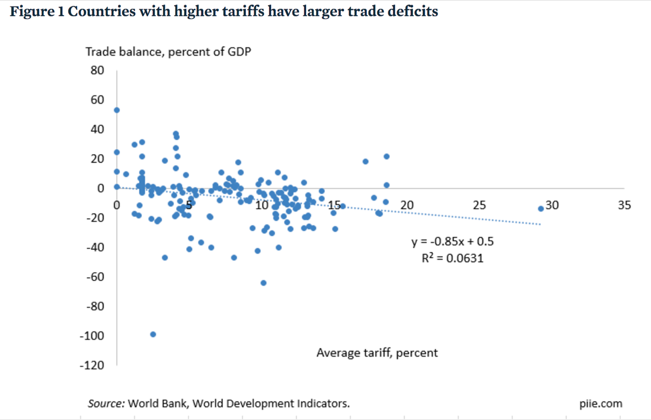
Fig. 1: High tariffs do not improve a country’s trade balance.
Average applied tariffs and average trade balances from 2012 to 2015 for 183 countries
Caroline Freund, PIIE, May 8, 2017 “Public Comment on Trump Administration Report on Significant Trade Deficits.”

Slide 45
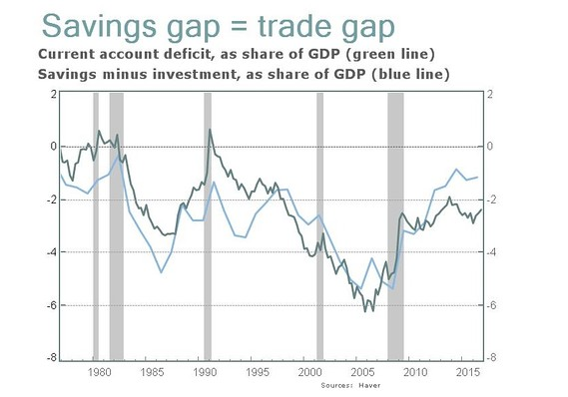
Fig. 2: Current account ≡ national saving - investment
Jeff Sachs, “Opinion: What Trump doesn’t get about the link between U.S. savings and trade deficits,“ Marketwatch, April 21, 2017.

Slide 46
Fallacy #4:
“Trade deficits are bad, subtracting from growth. Cut the trade deficit to add to GDP & create jobs.”
Well, not always wrong.
  An export boost when there is excess capacity in the economy
  can add nicely to output & employment.
  Also chronic current account deficits imply rising international debt
    which, for normal countries, eventually impairs creditworthiness.
But trade deficits are not always bad news
and trade surpluses are not always good news:
  E.g., the rise in the trade deficit in the late 1990s (post-NAFTA)
  accompanied the longest US economic expansion on record.
    Originating in an investment boom,
    it brought unemployment as low as 3.8% by 2000,
    with rising real wages & incomes for the median family.
  Conversely, a sudden trade balance rise is usually due to recession.
    E.g., the US deficit fell by half in 2009. [See Figure 3.]

Slide 47
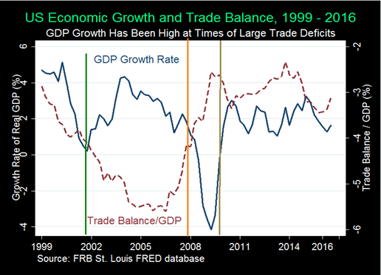
Figure 3: The trade balance need not add to growth.
Indeed the balance “improves” in recessions like 2007-09.
From: Menzie Chinn & Michael Klein, “Is the Trade Deficit a Drag on Growth?” Econofact, Jan.20, 2017

Slide 48
Fallacy #5: “Trade explains the stagnation in US median family income since 2001.
An aggressive trade policy would reduce inequality.”
Probably wrong.
Yes, imports create both winners and losers.
  So do all changes. Keeping out imports does too.
  Take the example of Trump moves against imports of steel & aluminum.
    Even ignoring the flimsy national security claim (under Section 232),
    loss of these imports raises costs to US manufacturers that use the products as inputs (such as autos). This both raises the cost of living at home and makes US exports less competitive abroad.
  Further costs of import protection: We would lose exports through
    (1) foreign loss of dollar earnings with which to buy goods from us,
    (2) dollar appreciation, and
    (3) foreign retaliation against US products.

Slide 49
Appendix 4: For each of the 8 inequality diagnoses, one might think of a targeted policy response:
1. Trade
  Trade Adjustment Assistance or, better yet, wage insurance.
2. Technology and 3. education
  Make college more accessible to lower-income students.
4. “Winner-take-all” labor markets.
  Raise income taxes & payroll taxes for the upper 0.1%.
5. “Assortative mating”
  Education again, especially universal pre-school.
  …

Slide 50
For each of the 8 inequality diagnoses, a targeted policy response continued:
…
6. Corporate monopoly power
  More aggressive anti-trust action.
7. Executive compensation, especially in finance
  Reforms such as “say on pay,” separating the function of CEO
  & Chairman of the Board, “claw-back provisions,” and so on;
  Continued financial reform, begun under Dodd-Frank.
  Higher tax rates on the upper 0.1% and, very specifically, eliminating the carried-interest deduction.
8. Piketty’s wealth accumulation:
-- Inheritance tax, at least on estates above $5 million.

