Slide 1

Inequality in America:
Achieving An Economy
That Works for All
Jeffrey Frankel
Harpel Professor of Capital Formation & Growth
Economic Policy Forum,
Northeastern University
September 28, 2017

Slide 2
Inequality in America:
Achieving An Economy That Works for All
Are ordinary Americans being left
behind in the modern economy?
If so, why?
And what is to be done about it?

Slide 3
Current state of the economy
The economic statistics are positive:
  Real GDP has grown ≈ 2%/year, steadily since mid-2009.
  Employment too:
    August continued the longest streak of job growth on record.
    17 million jobs added since early 2010.
    Unemployment rate down to 4.4%, ≈ full employment.

Slide 4
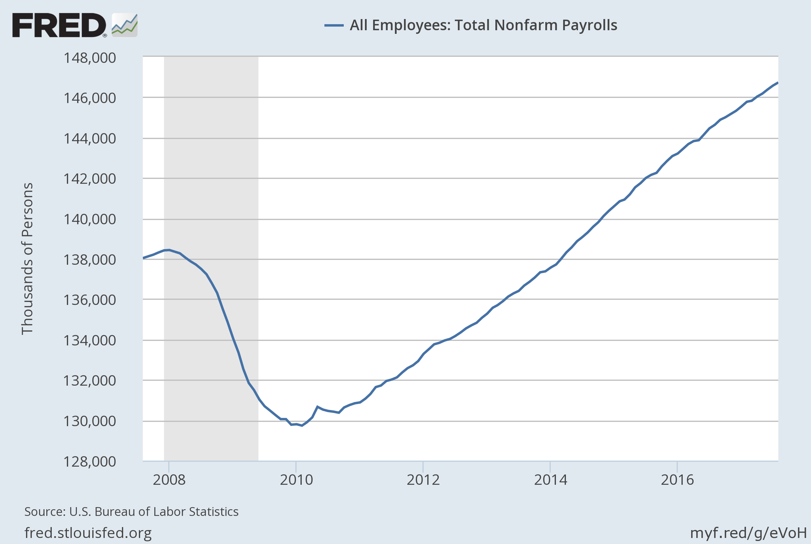
Altogether, the economy has added
17 million jobs since early 2010.

Slide 5
(I) If the economy is in such good shape, why has there been such discontent?
An obvious answer:
The longer-term trend for typical Americans has not been good.
Since 2000, the gains have gone to those at the top.
The longer-term trend for the typical American has not been good:

Slide 6
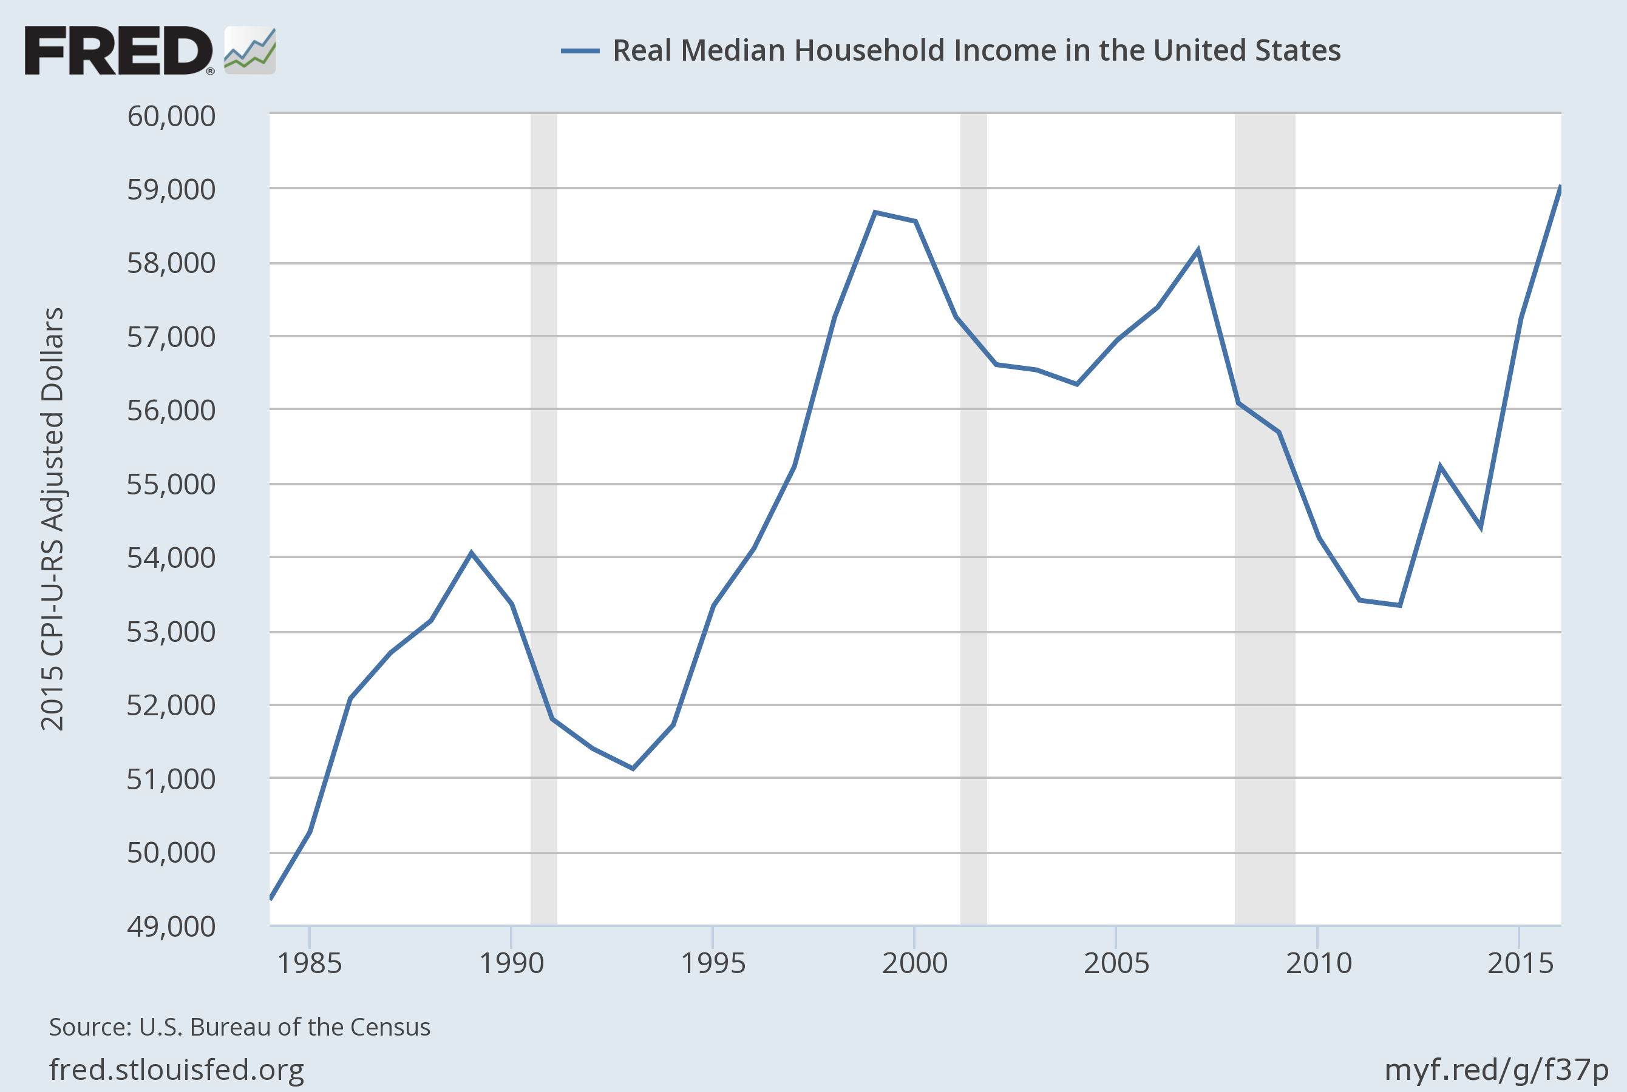
US Real Median Family Income has been flat since 2000,
even with strong gains in 2015-16.
Notes:
Source:
U.S. Bureau of the Census
Release:
Income and Poverty in the United States
Units:
2015 CPI-U-RS Adjusted Dollars, Not Seasonally Adjusted
Frequency:
Annual
Household data are collected as of March.
As stated in the Census's "Source and Accuracy of Estimates for Income, Poverty, and Health Insurance Coverage in the United States: 2011" (http://www.census.gov/hhes/www/p60_243sa.pdf)
Estimation of Median Incomes. The Census Bureau has changed the methodology for computing median income over time. The Census Bureau has computed medians using either Pareto interpolation or linear interpolation. Currently, we are using linear interpolation to estimate all medians. Pareto interpolation assumes a decreasing density of population within an income interval, whereas linear interpolation assumes a constant density of population within an income interval. The Census Bureau calculated estimates of median income and associated standard errors for 1979 through 1987 using Pareto interpolation if the estimate was larger than $20,000 for people or $40,000 for families and households. This is because the width of the income interval containing the estimate is greater than $2,500.
We calculated estimates of median income and associated standard errors for 1976, 1977, and 1978 using Pareto interpolation if the estimate was larger than $12,000 for people or $18,000 for families and households. This is because the width of the income interval containing the estimate is greater than $1,000. All other estimates of median income and associated standard errors for 1976 through 2011 (2012 ASEC) and almost all of the estimates of median income and associated standard errors for 1975 and earlier were calculated using linear interpolation.
Thus, use caution when comparing median incomes above $12,000 for people or $18,000 for families and households for different years. Median incomes below those levels are more comparable from year to year since they have always been calculated using linear interpolation. For an indication of the comparability of medians calculated using Pareto interpolation with medians calculated using linear interpolation, see Series P-60, Number 114, Money Income in 1976 of Families and Persons in the United States (www2.census.gov/prod2/popscan/p60-114.pdf).
U.S. Bureau of the Census,
Real Median Household Income in the United States [MEHOINUSA672N],
retrieved from FRED,
Federal Reserve Bank of St. Louis;
https://fred.stlouisfed.org/series/MEHOINUSA672N,
September 13, 2017.

Slide 7
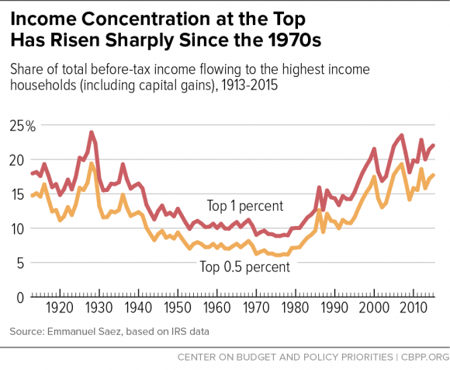
The share of US income going to the top has been rising since 1980, and is now back to the 1920s level.
Chad Stone et al, CBPP, Sept 30, 2016 www.cbpp.org/research/poverty-and-inequality/a-guide-to-statistics-on-historical-trends-in-income-inequality

Slide 8
Overview
So, yes, ordinary Americans have been
left behind in the modern economy.
Ten reasons why US inequality has risen.
Ten policy proposals to help share a growing economic pie more equally.

Slide 9
(II) Why has inequality risen in the US? Ten reasons.
  Trade probably plays a role. But also:
  Technological change raises demand for skilled workers;
  education lags in raising the supply of skilled workers.
  “Winner-take-all” labor markets,
  “Assortative mating,”
  More corporate monopoly power (higher “rents”),
  and “excessive” executive compensation.
  Piketty: wealth accumulates faster than income.
  Possibly the decline in union power & minimum wages.
  The tax cuts for the rich in early 1980s & 2000s.

Slide 10

1. Trade may play a role
Import competition certainly has hurt some sectors,
  such as clothing & steel.
But trade also has benefits:
  Imports lower costs to consumers,
  especially low-income consumers.
  Imported components keep costs low for US firms,
    e.g., allowing US autos to remain globally competitive.
  Exports create new jobs
    which tend to pay 12% more than average jobs.

Slide 11
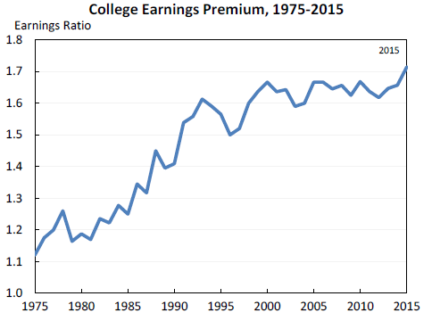

2. Technology raises demand for “skilled” vs. “unskilled” workers, as shown by widening wage gap.
Jason Furman, CEA, Oct. 17, 2016, Fig.10.

Slide 12
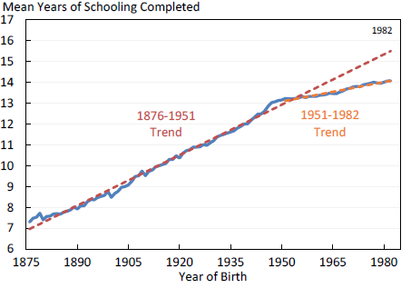

3. The trend in years of education slowed during 1981-2012.
So the supply of skilled workers has not kept up with the demand.
Average Years of Schooling at Age 30, U.S. Native-Born, by Year of Birth, 1876-1982
Trend
1906 – 1981
= 1876+30 to 1951+30.
Trend
1981 – 2012
= 1951+30 to 1982+30.
Jason Furman, CEA, Oct. 17, 2016, Fig.11.

Slide 13

4. “Winner take all” labor markets
    Taylor Swift earned $170 million in 2016, making her
    the world’s highest paid celebrity (according to Forbes).

Slide 14

5. “Assortative mating”
    Crudely put: educated
    & highly paid male professionals
    used to marry their secretaries,
    but now are more likely
    to marry educated & (relatively) highly paid women.
    The couple passes the advantages on to their children.

Slide 15
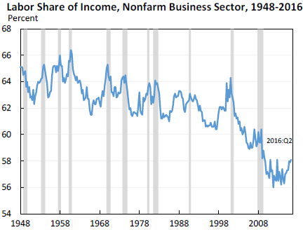
6. The share of US national income going to labor has declined since 2000 in part due to increased market power of firms.
Jason Furman, CEA, Oct. 17, 2016, Fig.13.

Slide 16
7. Excessive compensation?
Many top-1%-ers are executives and/or in finance.
Composition of Top 1 Percent Income Share by Primary Occupation
Jason Furman, CEA, Oct. 17, 2016, Fig.4a.

Slide 17
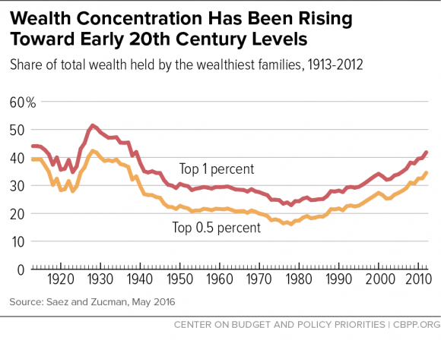

8. Supporting Piketty:
The share of wealth at the top has also been rising.
Chad Stone et al, CBPP, Sept 30, 2016 www.cbpp.org/research/poverty-and-inequality/a-guide-to-statistics-on-historical-trends-in-income-inequality

Slide 18
On the other hand, the big increase in inequality has been within labor (and within capital).
Jason Furman, CEA, Oct. 17, 2016, Fig.15.

Slide 19

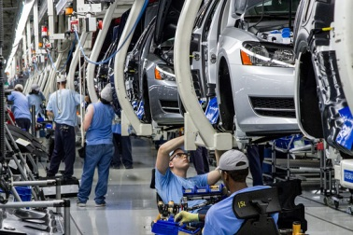


What weights should we place on each of these factors in explaining increased inequality?
I don’t know.
Probably all merit some weight:
  Trade,
  technology, education,
  winner-take-all,
  assortative mating,
  rents, executive compensation,
  and wealth accumulation.
Surely one must diagnose the cause before
deciding on the corresponding remedy?
No, I don’t think one has to.

Slide 20
  (III) Ten policy proposals to promote shared prosperity
Expand, don’t reduce, the health-insured population.
Strengthen, don’t weaken, US financial regulation.
Reform the tax system (staying revenue-neutral)
  Expand the EITC, not the estate tax exemption.
  Make the payroll tax more progressive, not less.
  Corporate: lower the tax rate, but offset by eliminating deductions.
Put social security on a sound footing.
Improve education, esp. universal pre-school education.
Increase infrastructure spending.
Address the long-term rise in household debt.
Energy:
  Start a carbon tax; don’t subsidize fossil fuels.
  But allow fracking (regulated).
Consider wage insurance.
Keep US global economic leadership, including trade agreements.

Slide 21
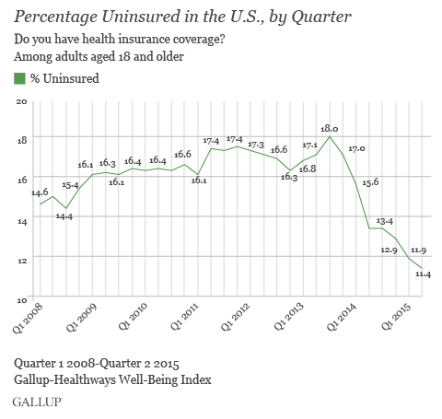
1. Keep the Affordable Care Act which has sharply reduced the percentage of Americans lacking health insurance, and is fully funded.

Slide 22
2. Retain intelligent financial regulation
Keep the “fiduciary rule” for financial advisers.
Don’t gut Dodd-Frank financial reform, esp. its:
  higher capital requirements for banks,
  tough stress tests on banks,
  designation of Systemically Important Fin. Institutions,
  enhanced transparency for derivatives, and
  Consumer Financial Protection Bureau.

Slide 23
3. Reform the tax system
(staying revenue-neutral)
Reform personal income tax to make it
more progressive, not regressive.
  E.g., expand EITC ,
  and abolish the carried interest deduction.
Don’t eliminate the estate tax.
Reform corporate income tax but stay revenue-neutral:
  lower rate,
  but cut distorting deductions,
    e.g., oil subsidies & interest deductions.

Slide 24
4. Put social security on a sound footing
Gradually raise the retirement age. Meanwhile,
Make payroll taxes more progressive:
  Exempt low-income workers and
  raise the cap on payroll taxes (now at $127,000).
5. Improve education,
-- esp. universal pre-school education.
6. Increase infrastructure spending.
It’s good for growth
and makes jobs for construction workers
(though we could have really used it 5-7 years ago,
when unemployment was twice as high.)

Slide 25
7: Address the long-term rise in household debt: housing, auto, & student loans
Reduce the policy tilt toward getting American families
up to their eyeballs in mortgage debt they can’t afford.
  It led to 2007-09 financial crisis.
    without even raising home ownership rates.
  Specific policies:
    Require a serious minimum down payment, as other countries do.
    Require “skin in the game,” on the part of mortgage-originators.
    Curtail tax deductibility of mortgage interest,
      which mainly benefits the well-off.
        It generally saves less than $200 for households earning $65,000.
      Reduce deductions at the upper end,
      especially if loan is used other than for purchase of residence
        i.e., 2nd home or “cash out” for spending.
    Don’t repeat the mistake of privatizing Fannie Mae & Freddie Mac.
  And it drives up housing prices

Slide 26
Address household debt: housing, auto & student loans, continued
Auto dealers should not have been exempted
from the Consumer Finance Protection Bureau.
  A rising share of sub-prime auto loans are now delinquent.
Although most college educations are still a good deal, and worth going into debt for if that is the only way, some enterprises are bad deals.
    Especially many of for-profit universities.
    Government should expand student grants & loans,
    but tighten requirements that the college or university have a decent record regarding rates of graduation & gainful employment, not loosen them.

Slide 27
The last 3 of the 10 policy proposals
Energy:
  Start a carbon tax; don’t subsidize fossil fuels.
    Energy taxes are the most efficient
      as proposed by Baker, Feldstein, Mankiw, Paulson & Schultz, Feb.2017.
  But allow states to frack (regulated).
Consider wage insurance,
  which compensates those who lose jobs (not just due to trade)
  and does not penalize taking a new job at lower wage.
  Pay for costs by proposal #8.
10. Keep US global economic leadership,
including abiding by trade agreements.

Slide 28
Inequality in America:
How Do We Achieve An Economy
That Works for All?
Jeffrey Frankel
Harpel Professor of Capital Formation and Growth
Harvard University

Slide 29
Appendices
Turnaround from recession in 2009.
Long-term job losses in some sectors:
manufacturing., ag., & coal.
Policies targeted toward individual causes of inequality.
The stagnation in earnings for non-college-educated men and the role of manufacturing
Five trade fallacies.

Slide 30
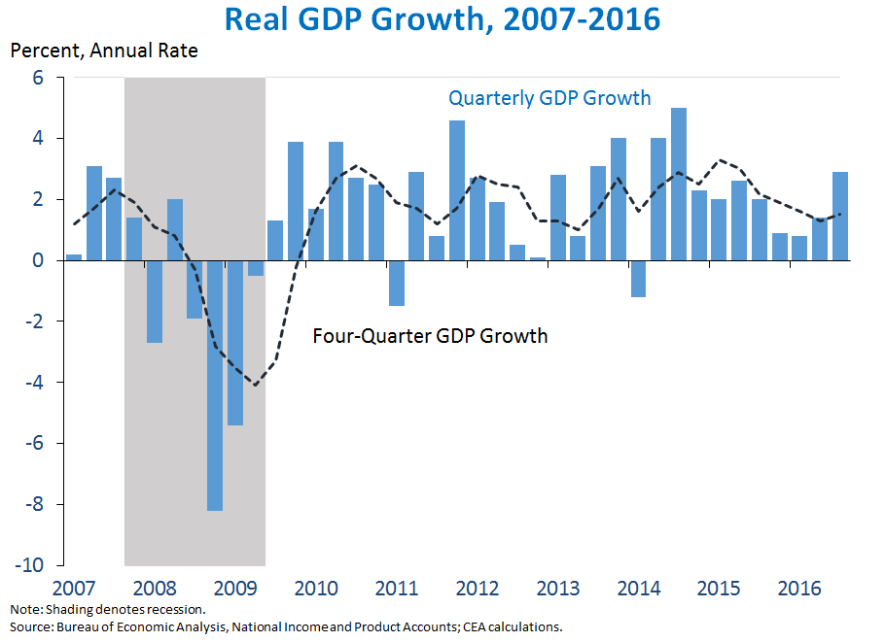
Appendix 1: More on macroeconomic developments
The economy turned around in June 2009,
but the recovery was slow and long.
https://www.whitehouse.gov/blog/2016/10/28/advance-estimate-gross-domestic-product-third-quarter-2016

Slide 31
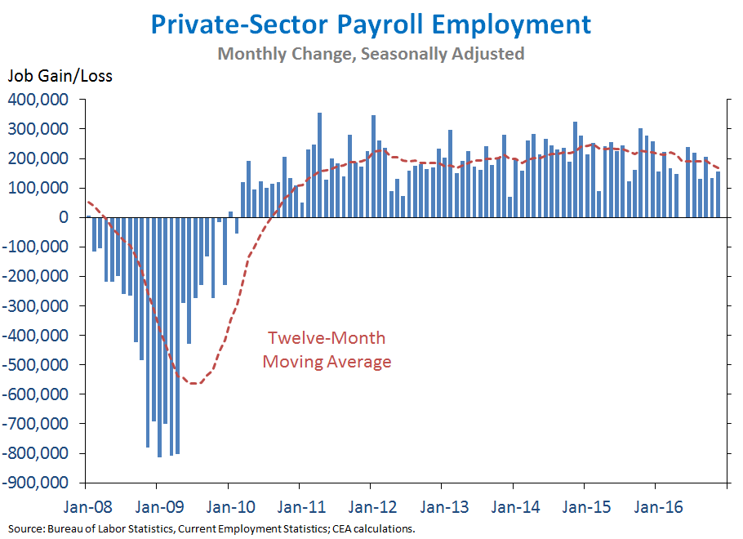
Employment growth has been steady since early 2010.
The private sector has added 17 million jobs.

Slide 32
Appendix 2: Long-term job loss in some sectors
Manufacturing employment has been falling as a share since 1950,
  conspicuously in such sectors as autos, steel, and apparel,
    while leaving efficient viable cores today.
Due to international trade?
  Yes, in part, in some sectors.
Also, manufacturing output continues to rise, even as employment falls.
  That means productivity has gone up a lot:
    It takes fewer workers to produce one auto today than 65 years ago,
      not to mention that the cars are much higher-quality.
By analogy, farmers were 90% of national employment in 1790
  vs. 2% today.
Or consider coal miners.

Slide 33
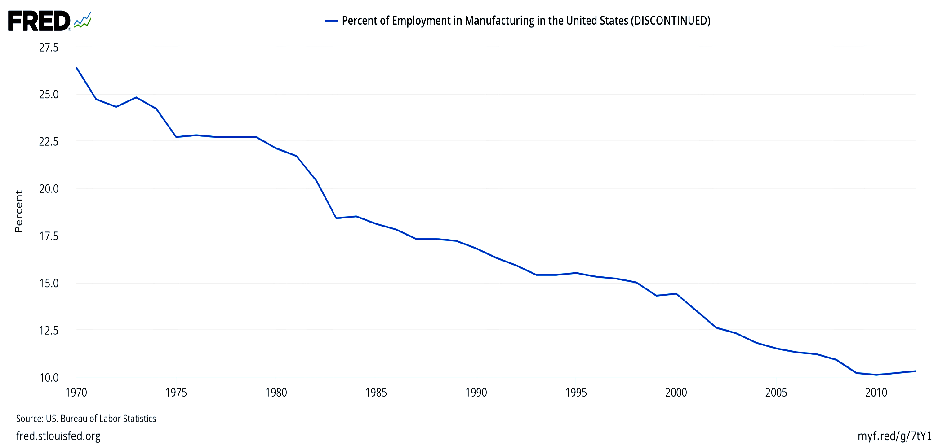
Manufacturing jobs were 32% of the national total in 1950, and had declined to 10% by 2010.
Percent of employment in US manufacturing (1970-2012)
Those jobs are not coming back.

Slide 34
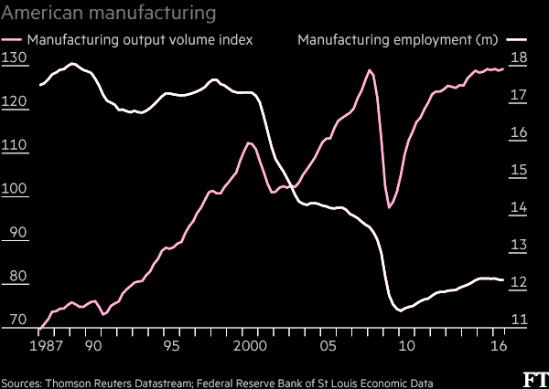
Manufacturing output rises
as employment falls, reflecting productivity growth.
“What role for the workers in Trump’s American factory revival?” Financial Times, Nov. 23, 2016.

Slide 35
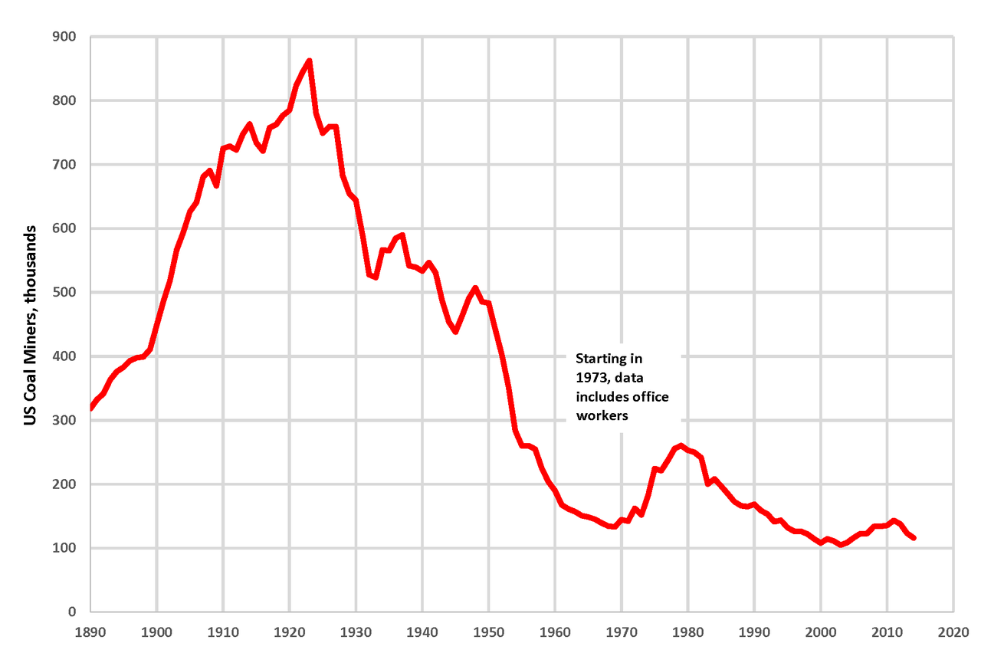
Similarly, we are not going back to the number of coal miners that were employed in 1923.
By Plazak - Own work, CC BY-SA 4.0, https://commons.wikimedia.org/w/index.php?curid=48261916

Slide 36
Some reasons for employment shifts
Trade? It works in favor of the US agricultural and coal sectors.
Even regulation has not been the big source of job loss in coal.
  Rather, in recent years, it has been cheap natural gas from fracking;
  and, before that, the shift from Appalachian underground mining
  to Wyoming open-pit mining.
In the case of all 3 sectors, the biggest reason for the decline
in jobs has not been trade, but rather productivity growth,
  particularly arising from technological progress, including automation.
  The demand for labor has shifted toward high-skill jobs.
  Meanwhile the supply of high-skilled workers has not kept up.
But regardless the causes of rising inequality,
good policies can share income gains more widely.

Slide 37
Appendix 3: For each of the 8 inequality diagnoses, one might think of a targeted policy response:
1. Trade
  Trade Adjustment Assistance or, better yet, wage insurance.
2. Technology and 3. education
  Make college more accessible to lower-income students.
4. “Winner-take-all” labor markets.
  Raise income taxes & payroll taxes for the upper 0.1%.
5. “Assortative mating”
  Education again, especially universal pre-school.
  …

Slide 38
For each of the 8 inequality diagnoses, a targeted policy response continued:
…
6. Corporate monopoly power
  More aggressive anti-trust action.
7. Executive compensation, especially in finance
  Reforms such as “say on pay,” separating the function of CEO
  & Chairman of the Board, “claw-back provisions,” and so on;
  Continued financial reform, begun under Dodd-Frank.
  Higher tax rates on the upper 0.1% and, very specifically, eliminating the carried-interest deduction.
8. Piketty’s wealth accumulation:
-- Inheritance tax, at least on estates above $5 million.

Slide 39
Appendix 4
The stagnation in earnings for non-college-educated men and the role of manufacturing jobs.

Slide 40
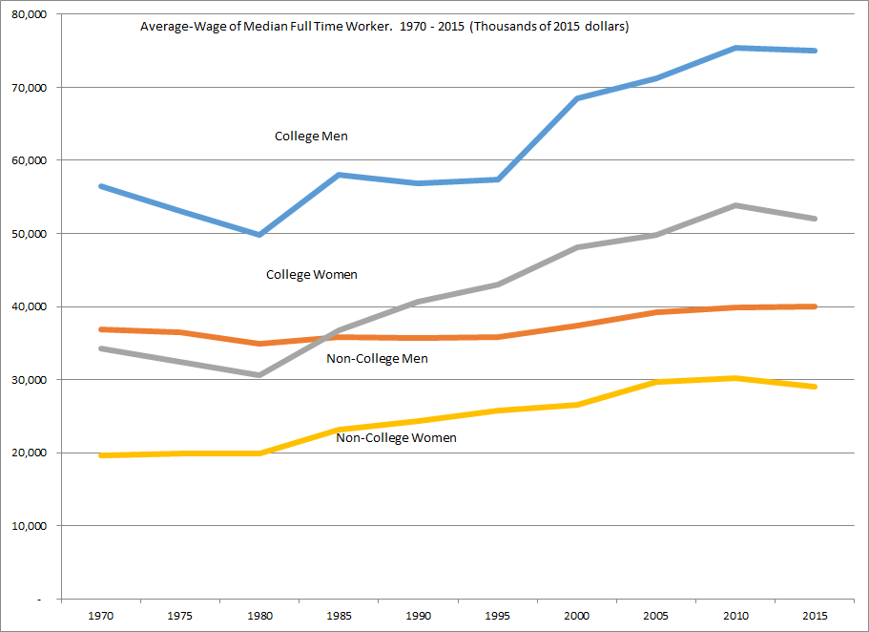
Real Wage Earnings of Median Worker (1970-2015):
Almost No Growth for Non-College Men over 45 years!
Average Annual
Real Wages of
Median Worker
College Women
+51.7%
Non-College
Women +47.6%
College Men +23.8%
Non-College Men
+8.6%
Data Source: BLS Current Employment Survey

Slide 41
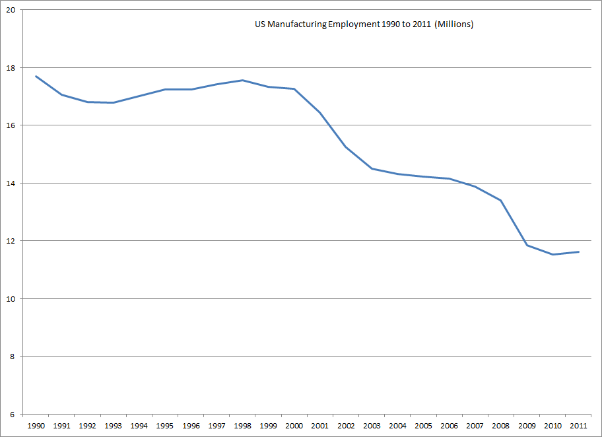
US Manufacturing employment 1990-2011: down almost 6 million since 2000

Slide 42
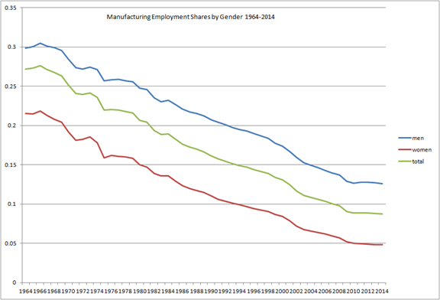
US manufacturing jobs were especially important for men….
Robert Lawrence, HKS

Slide 43
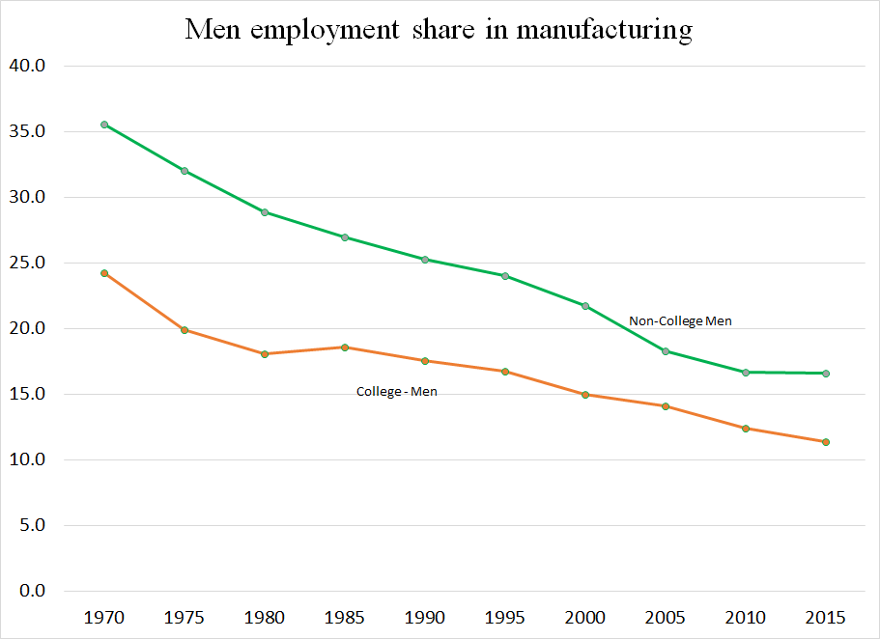
…and especially for men without college
Robert Lawrence, HKS

Slide 44
The negative trend in US manufacturing share of employment goes back to 1961, well before China, NAFTA, etc..
Manufacturing share in establishment employment, 1961–2010
Share
Fitted trendline
Forecast

Slide 45
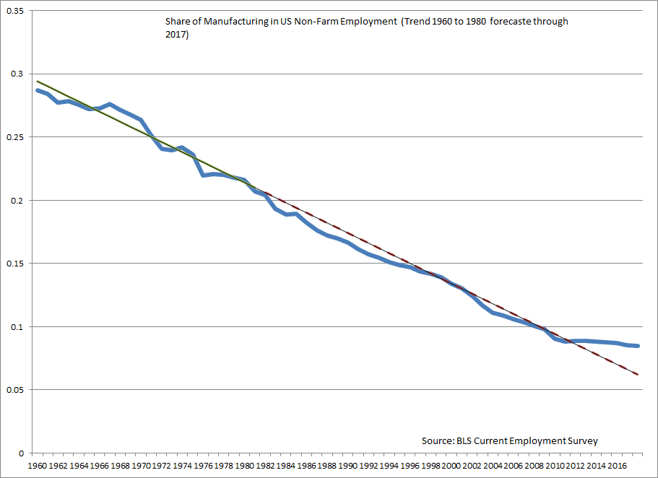
In fact the manufacturing share of employment levelled off after 2010.

Slide 46
US is not unusual. Decline in manufacturing share of employment is similar across advanced economies
including in countries with habitual trade surpluses.
Sh
a
r
e
o
f
e
m
p
l
o
y
m
e
n
t
i
n
m
a
n
u
fa
c
tu
r
i
n
g
,
1
9
7
3
–
2
0
1
0
(p
e
rce
n
t
)
C
o
u
n
tr
y
1973
1990
2000
2010
Change
(1
)
(2
)
(3
)
(4
)
(4
)
-
(1
)
U
n
i
t
e
d
St
a
t
e
s
24.8
18.0
14.4
10.1
-1
4
.
7
Canada
22.0
15.8
15.3
10.3
-1
1
.
7
Au
st
ra
l
i
a
23.3
14.4
12.0
8.9
-1
4
.
4
Ja
p
a
n
27.8
24.3
20.7
16.9
-1
0
.
9
F
ra
n
ce
28.8
21.0
17.6
13.1
-1
5
.
7
G
e
rma
n
y
36.7
31.6
23.9
21.2
-1
5
.
5
Italy
27.9
22.6
23.6
18.8
-9
.
1
N
e
t
h
e
rl
a
n
d
s
25.3
19.1
14.8
10.6
-1
4
.
7
Sw
e
d
e
n
27.6
21.0
18.0
12.7
-1
4
.
9
So
u
rce
:
Bu
re
a
u
o
f
L
a
b
o
r
St
a
t
i
st
i
cs.

Slide 47
Appendix 5: Five Trade Fallacies
Regarding:
Negotiators;
Bilateral trade deficits;
Causes of the overall trade deficit;
Effects of the trade deficit on GDP;
Trade & Inequality

Slide 48
Fallacy #1: “US trade negotiators have been out-negotiated by those from other countries.”
Wrong.
In most trade negotiations, such as TPP, NAFTA, and the Uruguay Round, the US has been able to get most of what it asked for – as leader of the international order.
Trade agreements have required high-tariff trading partners to reduce barriers against US goods.
US demands have also driven deeper integration
  in such areas as labor rights, the environment, investor-state dispute settlement and intellectual property rights.
How could NAFTA usefully be modernized & expanded? TPP.
One of the funniest things that Trump has said:
"The negotiators for Germany have done a far better job than the negotiators for the US."

Slide 49
Fallacy #2: “Bilateral trade imbalances reflect bad trade agreements.”
Wrong.
If country A runs a bilateral trade deficit with country C,
it generally signifies some combination of 3 causes:
  (i) A currently has a trade deficit overall,
  (ii) C has a trade surplus overall,
  (iii) C needs to earn a structural surplus with countries like A,
  to pay for a structural deficit with, e.g., oil exporters.
If we stop importing consumer electronics from China,
we will import them from other Asian countries.
The guy who cuts my hair insists I pay him with money.
He refuses to accept as payment a lecture in economics.

Slide 50
Fallacy #3: “A trade deficit indicates the absence of a level playing field.”
Wrong.
There is no (positive) correlation between countries’
tariff rates and their trade balances. [See Figure 1.]
Trade deficits are macroeconomic phenomena,
  influenced by national incomes and exchange rates,
  and determined in a deeper sense by national saving & investment.
The US has run current account deficits since 1982
because national saving has been low [see Figure 2],
  both low private saving and low public saving.
  The famous twin deficits: increase in the budget deficit leads to an increase in the trade deficit (e.g., 2001-07).
China, Germany, Japan, & South Korea run current account surpluses because they have high national saving rates.

Slide 51
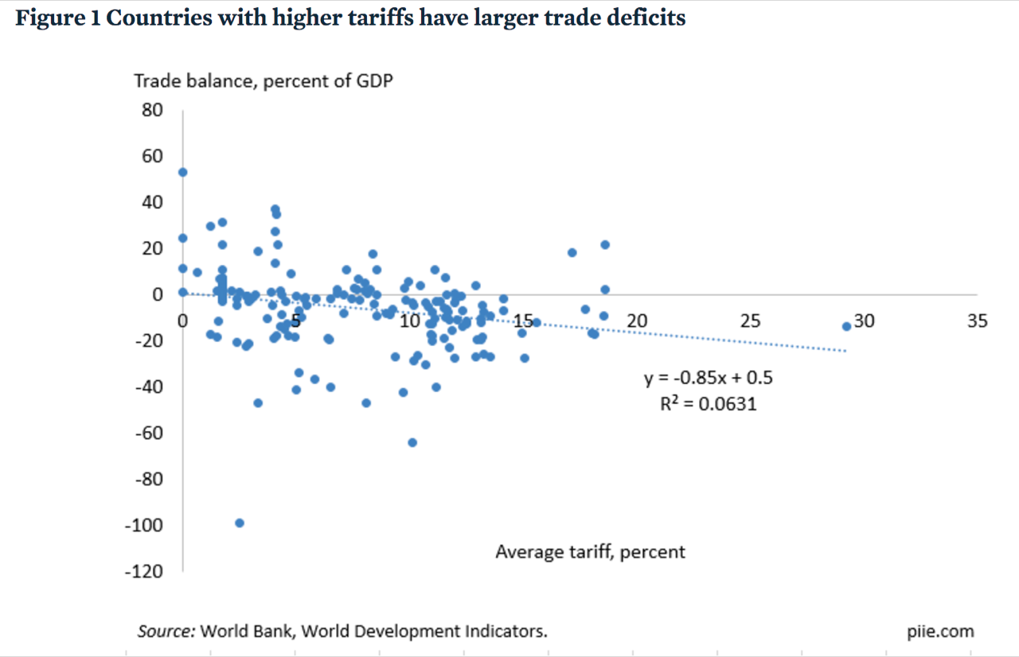
Fig. 1: High tariffs do not improve a country’s trade balance.
Average applied tariffs and average trade balances from 2012 to 2015 for 183 countries
Caroline Freund, PIIE, May 8, 2017 “Public Comment on Trump Administration Report on Significant Trade Deficits.”

Slide 52
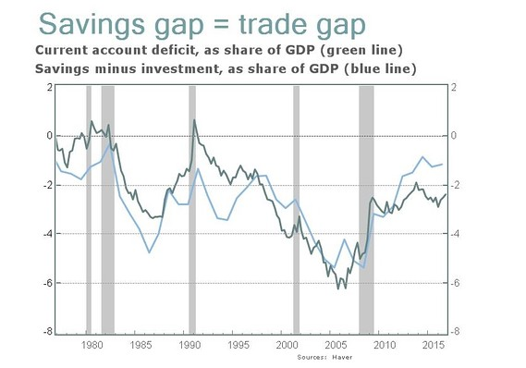
Fig. 2: Current account ≡ national saving - investment
Jeff Sachs, “Opinion: What Trump doesn’t get about the link between U.S. savings and trade deficits,“ Marketwatch, April 21, 2017.

Slide 53
Fallacy #4:
“Trade deficits are bad, subtracting from growth. Cut the trade deficit to add to GDP & create jobs.”
Well, not always wrong.
  An export boost when there is excess capacity in the economy
  can add nicely to output & employment. (We are no longer there.)
  Also chronic current account deficits imply rising international debt
    which, for normal countries, eventually impairs creditworthiness.
But trade deficits are not always bad news
and trade surpluses are not always good news:
  E.g., the rise in the trade deficit in the late 1990s (post-NAFTA)
  accompanied the longest US economic expansion on record.
    Originating in an investment boom,
    it brought unemployment as low as 3.8% by 2000,
    with rising real wages & incomes for the median family.
  Conversely, a sudden trade balance rise is usually due to recession.
    E.g., the US deficit fell by half in 2009. [See Figure 3.]

Slide 54
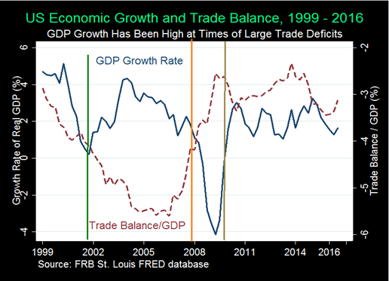
Figure 3: The trade balance need not add to growth.
Indeed the balance “improves” in recessions like 2007-09.
From: Menzie Chinn & Michael Klein, “Is the Trade Deficit a Drag on Growth?” Econofact, Jan.20, 2017

Slide 55
Fallacy #5: “Trade explains the stagnation in US median family income since 2001.
An aggressive trade policy would reduce inequality.”
Probably wrong.
Yes, imports create both winners and losers.
  So do all changes. Keeping out imports does too.
  Take the example of Trump moves against imports of steel & aluminum.
    Even ignoring the flimsy national security claim (under Section 232),
    loss of these imports would raise costs to US manufacturers that use the products as inputs (such as autos). This would both raise the cost of living at home and make US exports less competitive abroad.
  Further costs of import protection: We would lose exports through
    (1) foreign loss of dollar earnings with which to buy goods from us,
    (2) dollar appreciation, and
    (3) foreign retaliation against US products.

