Slide 1

Might the pandemic signal the end
of global economic convergence?
Jeffrey Frankel
Harpel Professor of Capital Formation and Growth
G20 Global Financial Stability Conference 2021
Keynote address, Sept. 7, 10:10 (KST) = Sept. 6, 21:10 (EDT)
Seoul, Republic of Korea

Slide 2
Summary of global outlook
The world economy did better than expected, in the 1st half of 2021, | But downside risks are evident:
due to monetary & fiscal stimulus | The “everything bubble” might burst;
and the miraculous scientific accomplishment of the vaccines. | and vaccination is slower than it should be.
Divergence: The downside is worse
for Emerging Market and Developing Economies (EMDEs).

Slide 3
Convergence: EMDEs grew faster than AEs, 2000-2013.
They survived the 2008-09 GFC relatively well.
Level of GDP/ capita in EMDEs relative to Advanced Economies
EMDEs
Growth in GDP/ capita
AEs
Data source: IMF
But convergence slowed, 2013-2020;
reversed for poor countries in 2020.

Slide 4
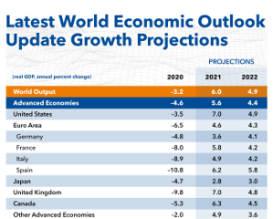
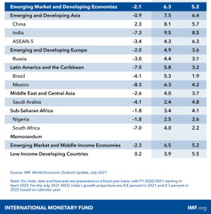
marked up AEs, esp. US (7.0%), while marking down EMs & esp. low-income countries (3.9%).
Growth projections: The latest IMF WEO update for 2021
2020 2021 2022
World Economic Outlook Update: Fault Lines Widen in the Global Recovery, July 27, 2021

Slide 5
Why did EMDE growth slow, after 2013?
Even before the pandemic.
Some possible explanations:
Global trade had slowed.
Commodity prices fell on world markets in 2014, in dollars.
China slowed after 2010,
  perhaps due to diminishing returns to capital
  or the Lewis turning point in rural-urban migration.
EMs more vulnerable to sudden stops in portfolio inflows?

Slide 6
Vulnerability to sudden stops of portfolio inflows
Reforms made some EMs less vulnerable in 2000-2010.
  Fiscal policy became less pro-cyclical.
  Capital inflows were used to build reserves,
    rather than to run current account deficits.
  The $-denominated share of inflows was reduced
    especially in the case of public debt.
But some backsliding followed.

Slide 7
Dangers, looking forward,
even leaving aside the effects of climate change,
  which are arriving faster than was expected
  and which will hit middle-latitude countries especially hard.
(1) The pandemic could halt catch-up in developing countries’ incomes.
(2) EM debt crises could return
  especially when the Fed signals an increase in interest rates.
  As in 1982, 1994, 1997, 2013, 2015, 2018….
(3) The world could lose the race between vaccination & new variants,
  due to vaccine skepticism
  & lack of availability in lower income countries.

Slide 8
International cooperation in such bodies as the G20 is more important than ever.
By “cooperation,” I am not referring here to coordinated setting
of national monetary or fiscal policies.
  Countries can mostly move in the right directions on their own.
But, rather,
  (1) initiatives to enhance financial stability, to reduce likelihood and severity of new EMDE financial crises.
    Like the Debt Service Suspension Initiative,
    And new SDR allocation by the IMF in August;
    But much more is needed.
  (2) Good old-fashioned trade liberalization.
  (3) Vaccination worldwide.

Slide 9
(1) Financial stability: Despite the Covid-19 shock in March 2020, market sentiment recovered after aggressive easing by the FRB.
EM interest rate spreads
Emerging Market
Hard Currency
Credit Spreads
(Basis points)
IMF Financial
Stability Report,
April 2021, Fig.2

Slide 10
Emerging Market portfolio flows rebounded too.
(Billions of $US)
IMF Financial Stability Report, April 2021

Slide 11
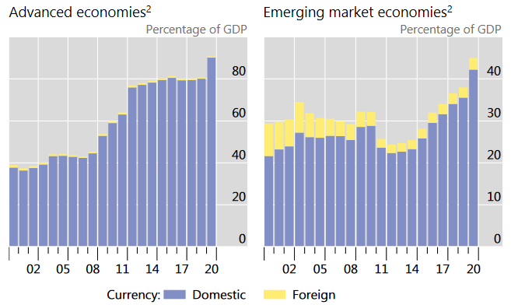
But government debt/GDP rose sharply in 2020, in both AEs & EMs.
Bank for International Settlements Quarterly Review, June 2021, p.21
Data sources: ECB Securities Issues Statistics (SEC); Dealogic; Euroclear; Thomson Reuters; Xtrakter ltd; natl data; IMF WEO; BIS calculations.
² General government bonds outstanding aggregated across countries, as a ratio to their combined GDP.

Slide 12
EM debt sustainability is vulnerable to a future rise interest rates.
Governments were able to finance spending in response to pandemic.
  Good.
But I worry that high Debt/GDP now leaves EMDEs vulnerable.
  Why, if interest is low?
  Because debt sustainability is vulnerable to a rise in interest rates,
    whether from US interest rates, local risk premia, or both.
    Why, then, do I downplay monetary cooperation, as Rajan urged in 2014?
The financial situation must be judged particularly fragile if one sees
a bubble component to today’s high prices for risky assets.
  The Fed has the difficult job of letting some air out of the bubble,
    without precipitating a financial crash.

Slide 13
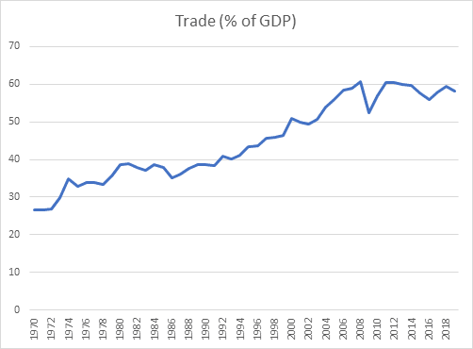
(2) Trade: The upward global trend in trade/GDP stalled from 2008, even before Trump’s tariffs or the pandemic.
Data source:
World Bank, 2021

Slide 14
Four trade liberalization ideas
E.g., US & China should roll back trade barriers,
  which they raised over the last four years.
Liberalize, in particular, trade in environmental goods
  such as equipment for wind & solar power.
Agree international rules guiding Carbon Border-Adjustment Taxes,
  so that they can be used, but not mis-used,
  working with the WTO.
Complete progress toward a global regime for corporate taxation
  working with the OECD.

Slide 15
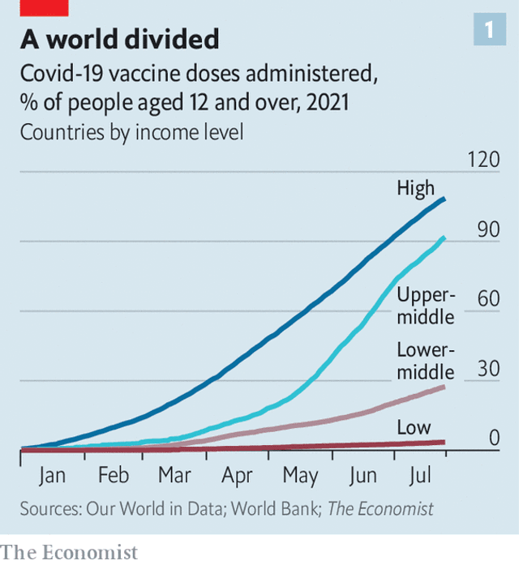
(3) Vaccination in low-income & lower-middle countries lags far behind the rich.
The US & other rich countries should make vaccines more extensively available to lower-income countries.
It is ridiculous to chase after vaccine skeptics at home, trying to coax them into accepting the benefits
of this scientific miracle,
without also doing more to bring vaccines where most needed.
Agarwal & Gopinath of the IMF
have proposed a plan of action:
  Estimated cost/benefit ≈$50b/$9,000b.
The Economist, July 31, 2021.
“The pandemic has exacerbated existing political discontent”
www.economist.com/international/2021/07/31/the-pandemic-has-exacerbated-existing-political-discontent

Slide 16
So long as this coronavirus runs wild anywhere,
it is a danger to everyone everywhere.
That is international interdependence.
Jeffrey Frankel

Slide 17
Appendix graph
For low-income countries, convergence went into reverse in 2020.
Level of GDP/ capita in lower-income countries relative to AEs
Growth in GDP/ capita
Data source: World Bank

