Slide 1
Chinese surpluses & currency valuation, 2004-2017
Jeffrey Frankel,
Harpel Professor of Capital Formation & Growth
Harvard Kennedy School
2017 NJIT Economic/Bubble Conference; Leir Retreat Center, Fri., 11/3-Sat. 11/4
Session 4: The China Problem

Slide 2
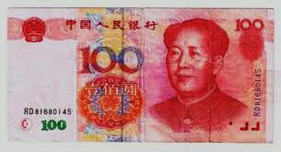
China adjusts
The RMB was undervalued in 2004-08
  by all three kinds of measures (very rare!):
  prices were low, even adjusted for income/cap;
  the trade and CA surpluses reached high levels;
  FX reserves were rising, reaching world-record levels.
China had adjusted by 2014:
  RMB, wages & prices rose => undervaluation ended.
  The trade surplus peaked in 2007 at 7% of GDP,
    then came down to 2% of GDP.
  Reserves peaked in 2014, then fell.

Slide 3
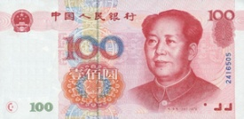
1. China’s RMB undervalued ≈ 25-36% in 2000-05
estimated by PPP adjusted for Balassa-Samuelson
Cross-section of 118 countries
Log of real exchange value of country’s currency
Log of real income
Frankel (2006): “On the Yuan: The Choice Between Adjustment Under a Fixed Exchange Rate
and Adjustment under a Flexible Rate,” Understanding the Chinese Economy, G.Illing, ed. (OUP).

Slide 4
Real appreciation of Chinese RMB 2005-2014
Dooley, Folkerts-Landau, Garber (2014)

Slide 5
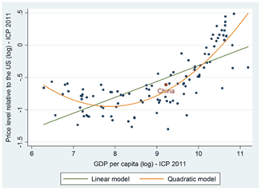
RMB undervaluation disappeared by 2011-14
estimated by PPP adjusted for Balassa-Samuelson
M.Kessler & A.Subramanian, PIIE, May 2014
“Is the Renminbi Still Undervalued? Not According to New PPP Estimates”
Benchmark years | GDP per capita (in PPP dollars) | RMB undervaluation (percent)
2005 | 4,802 | -34.5
2011 | 10,057 | -9.7

Slide 6
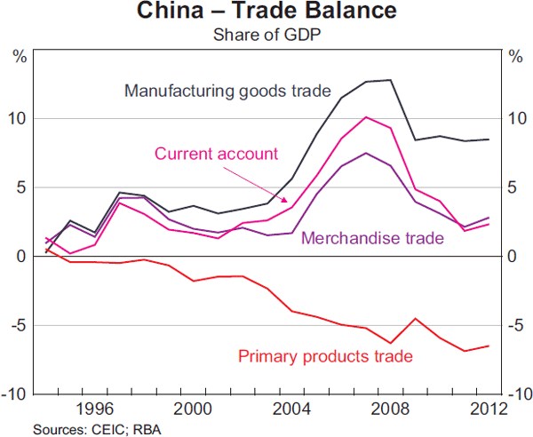
2. China’s trade & CA surpluses peaked in 2007,
and then fell to 2% of GDP.
Source: Reserve Bank of Australia (June 2013)
China runs a deficit in primary products, offset by a surplus in manufactures.

Slide 7
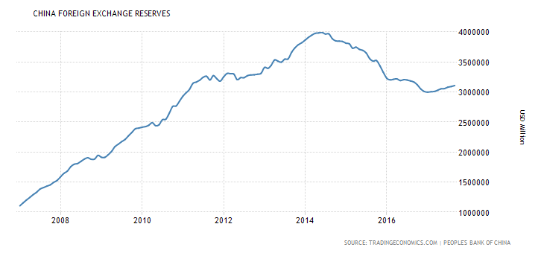
3. China’s forex reserves peaked in June 2014,
then fell by $ 1 tr. through Jan. 2017.
through Sept. 2017
PBoC stopped intervening to push down the RMB. The opposite.
Frankel, "Chinese currency manipulation not a problem," East Asia Forum, March 9, 2015.

Slide 8
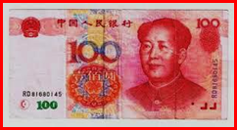
"Assessing China's Exchange Rate Regime," with Shang-Jin Wei, Economic Policy, 2007.
"The Renminbi Since 2005," in The US-Sino Currency Dispute: New Insights from Economics, Politics and Law, edited by S. Evenett (CEPR: London) 2010, 51-60.
"China Adjusts," Project Syndicate, March 23, 2012.
"Congress, China, and Currency Manipulation," China-US Focus, vol. 6, April 2015, 36-38.

Slide 9
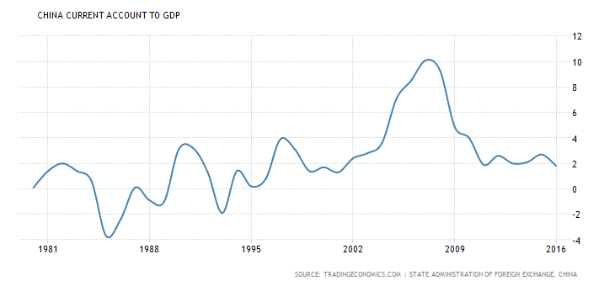
China’s Current Account peaked in 2007 at 10% of GDP and then fell to 2% of GDP.

Slide 10
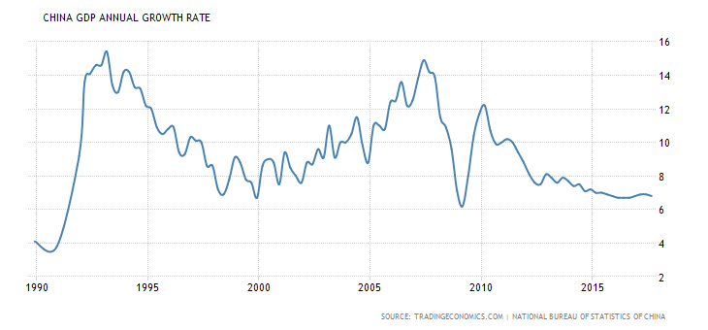
Slowdown, 2012-2017
China’s growth averaged 10% over 1980-2010,
then declined below 7%.
30 years of growth in Chinese GDP

