Slide 1
Panel on Tariffs and Trade Wars
Trump, Tariffs, and Trade Wars
Jeffrey Frankel
Harvard University
London International Macro Conference
London School of Economics
14-15 May, 2026

Slide 2
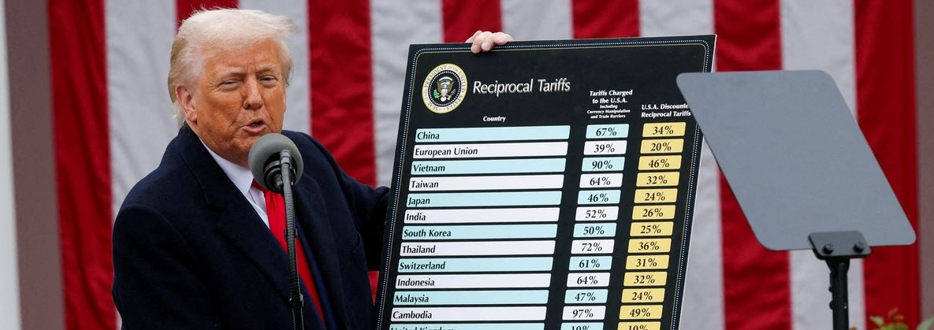
On April 2, 2025, he announced his long-awaited “reciprocal tariffs”
“Tariff” is Donald Trump’s favorite word. E.g., “To me, the world’s most beautiful word in the dictionary is tariffs. It’s my favorite word.” Oct. 16, 2022.
To give him credit, he has been more consistently in favor of tariffs than any other policy, in word as well as deed.

Slide 3

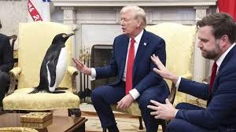
April 2 tariff targets included Heard & MacDonald Islands
which refused to be bullied.

Slide 4
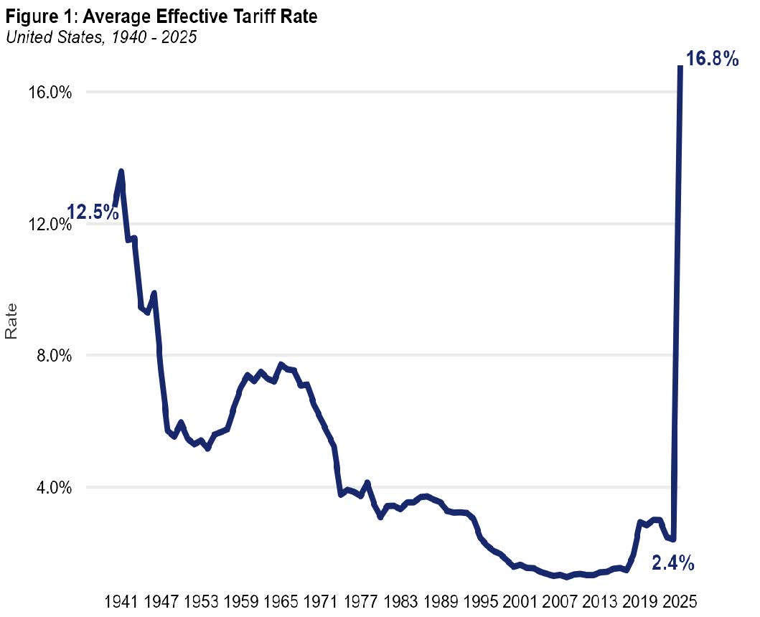
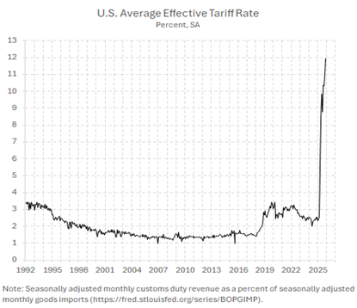
The average effective tariff on US imports has risen from 2 % to 18 %, the highest since the 1930, the highest since 194 s
The average effective US tariff shot up from 2.4 % to 16.8 %
Source: Pawel Skrzcpynski

Slide 5
We say Trump’s tariffs are unprecedented
The highest in 90 years
Imposed at a time of low US unemployment.
Used as an instrument for non-economic issues
  such as the trial of Bolsonaro in Brazil,
  forcing Colombia to accept deportees,
  asking China to stop drug exports,
  pressuring Canada or Denmark into territorial concessions.
But that used to be the norm: tariffs that were high & variable,
and subject to political vicissitudes,
  in 19th & early 20th centuries.
  1945-2001 was the exception.

Slide 6
Tariffs used to be important, not just economically but also politically
In 1773, American colonists threw 340 chests of tea into Boston Harbor, accelerating the start of the Revolution. They were protesting the nature of British taxes on tea imports.
In 1832, South Carolina declared states rights meant it could “nullify” federal law. It was protesting -- not Northern acts with regard to slavery – but rather the high federal tariffs of 1828 & 1832.
In 1846, Britain repealed the Corn Laws. It marked, not just the triumph of free trade, but the culmination of liberal Enlightenment-era ideals.
In 1930, a Republican congress & president enacted the Smoot-Hawley tariff, and others retaliated. The collapse of global trade worsened the Great Depression and the rise of fascism in Europe.

Slide 7
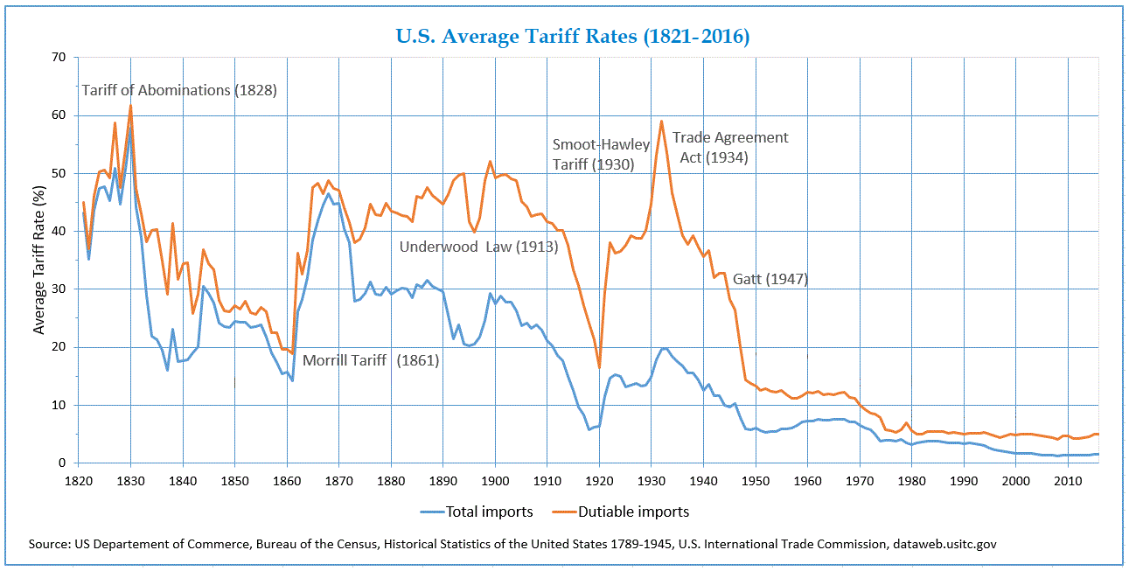
The Average US Tariff Rate peaked in 1828 & 1934.
It then came way down, under rounds of negotiations.

Slide 8
Following the 1934 Reciprocal Trade Agreements Act & 1948 GATT signing, multilateral trade negotiations brought tariffs way down.
Why multilateral? Why is unilateral liberalization so rare?
Two major possibilities:
1) Political economy.
Consumers’ interests are diffuse. It’s not worth their time to get informed. Firms’ interests are concentrated (Mancur Olsen, 1965) => lib. needs support of firms.
  But: many imports are inputs to production by firms. E.g., the auto sector can countervail steel.
  and Gautam Nair (2026) finds Walmart, etc., potently “represent” consumers against tariffs.
2) Many countries would not in fact gain from unilateral disarmament.
  They have some monopoly power, so the optimal tariff > 0
  in the non-cooperative equilibrium.
  Brander-Spencer (1985) strategic subsidies, e.g., for Boeing vs. Airbus.
  Both countries would be better off with a binding agreement not to subsidize.
“Incidental Representation: How Special Interests Can Advance the Public Good”

Slide 9
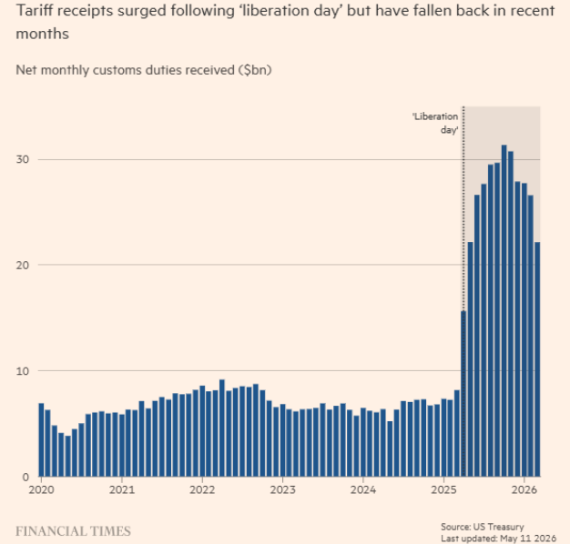
Tariff receipts surged following ‘liberation day’ but have fallen back in recent months
Feb.2026 - The Supreme Court ruling against the constitutionality of the Trump’s unilateral application of EEPA Act, effectively cut the weighted average applied tariff rate
on all imports from 14.9 %,
to 8.2 % in 2026 under the remaining Section 232 tariffs.
He added a new 10 % tariff on nearly all countries under Section 122.
May 2026: Trade Court ruled also against the new tariff.
Trump now has to refund the money to importing firms.
Together with the Iran War etc., the budget deficit is exploding.

Slide 10
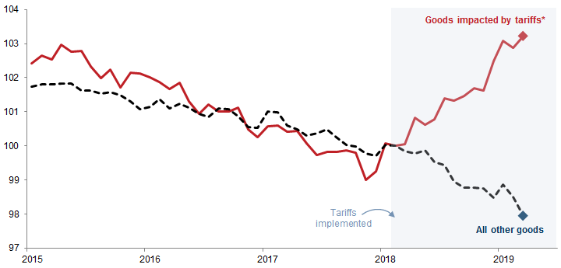
Tariffs imposed by Trump 1 in 2017 raised prices of the affected goods
Mary Amiti, Stephen J. Redding, and David E. Weinstein. 2019. "The Impact of the 2018 Tariffs on Prices and Welfare." Journal of Economic Perspectives 33 (4): 187–210.

Slide 11
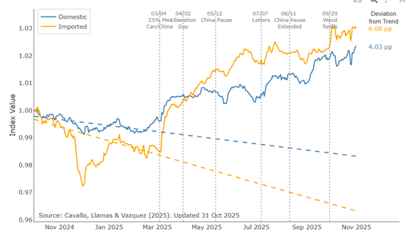
Trump 2 tariffs were partly passed through to consumers, starting April 2025
Retail price responses to the 2025 tariffs
not just to imports per se,
but also to prices of
domestic substitutes,
especially relative to trend.
Source: Alberto Cavallo, Paola Llamas & Franco Vazquez, “Tracking the Short-Run Price Impact of U.S. Tariffs,” HBS Working Paper, 2026. Data from 01/01/24 to 09/08/25.

Slide 12
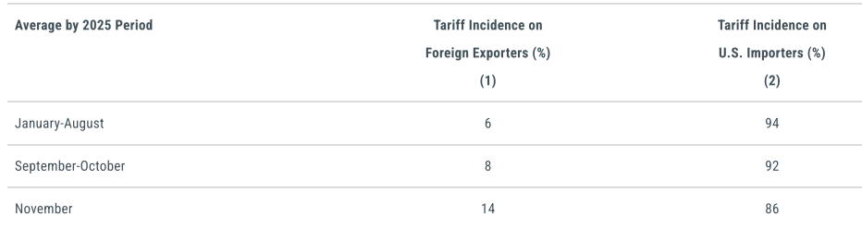
Mary Amiti, Chris Flanagan, Sebastian Heise, & David E. Weinstein.
“Who Is Paying for the 2025 US Tariffs?” FRBNY, Feb. 2026.
Sources: Authors’ calculations; U.S. Census Bureau, Foreign Trade Statistics. Notes: The results are estimated on a sample of monthly data at the 10-digit Harmonized Tariff Schedule (HTS)-country level from 2023m1 to 2025m11, with all variables in twelve-month log changes. The dependent variable is the log change in import prices (proxied by unit values), exclusive of tariffs (i.e., foreign export prices). The independent variable is the twelve-month log change in (1 + tariff rate). We interact this variable with a dummy variable equal to 1 for September/October 2025 and another dummy equal to 1 for November 2025. The regression includes HTS10 product fixed effects and country-date fixed effects.
About 90% of the costs from the tariffs imposed in 2025
were paid by U.S. importing households & businesses.
Only 4% paid was by foreign exporters in China or elsewhere.
US businesses absorb most of the cost, in the short run, out of profits.
The tariffs had contributed about 0.7 % points to the CPI by Sept 2025.

Slide 13
Question
If little or none of tariff incidence is falling on foreign exporters,
doesn’t that mean that the US has no monopoly power
in international trade, the optimal tariff is 0?
But do we believe that? We don’t normally think of the US as a small, price-taking country.
E.g., changes in the $ exchange rate are absorbed by the foreign exporter, no cost passed through to consumer in the 1st year.
Itskhoki & Mukhin, 2026, “The Optimal Macro Tariff”
the optimal tariff is small: 9%. Not 35%.
  But that is due to the effect of dollar liabilities.
  Trump tariff should still force Chinese firms to accept lower prices.

Slide 14
Do voters understand that tariffs hurt them?
Surveys find a majority oppose tariffs.
“65 % of Americans think Trump’s tariffs are hurting affordability … even a majority of Republicans” CFR: 2/18/2026 www.cfr.org/articles/cfr-poll-shows-americans-across-party-lines-tie-tariffs-to-affordability
7/10 Americans say Trump tariffs have cost them money
--“Exclusive survey finds negative economic impacts,” The Guardian: 3/13/2026 www.theguardian.com/us-news/2026/mar/13/trump-tariffs-poll
A majority of all voters (72%) say Trump’s tariffs have had a negative rather than a positive impact and 67% said tariffs aren’t the right solution for improving the economy -- The Harris Poll .

Slide 15
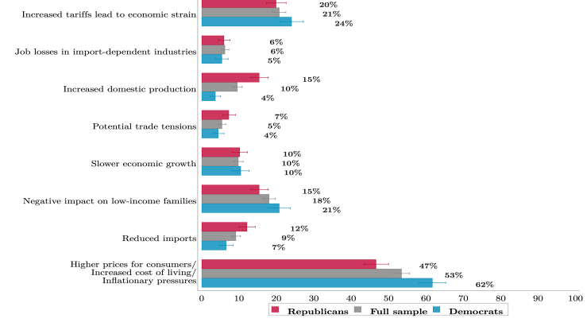
53% of Americans think tariffs raise the cost of living
“The 2025 US Tariffs: Perceptions, Understanding, and Policy Views”
Stefanie Stantcheva & Gregory Tham, October 2025

Slide 16
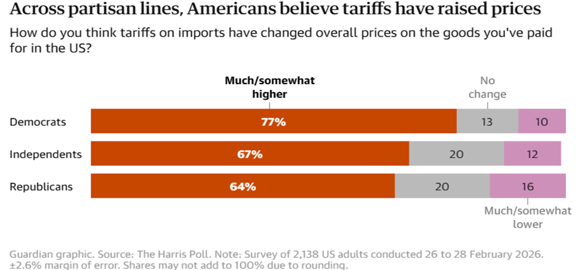
“Exclusive survey finds negative economic impacts felt across party lines as White House doubles down on tariffs,” The Guardian, 3/13/2026. www.theguardian.com/us-news/2026/mar/13/trump-tariffs-poll
A majority of Americans disapprove of Trump’s tariffs.
Partisan divide: A vast majority of Democrats (81%) & independents (68%) agreed
that tariffs aren’t the right solution for the economy, compared with 53% of Republicans.
Seven in 10 Americans say Trump tariffs have cost them more money,

Slide 17
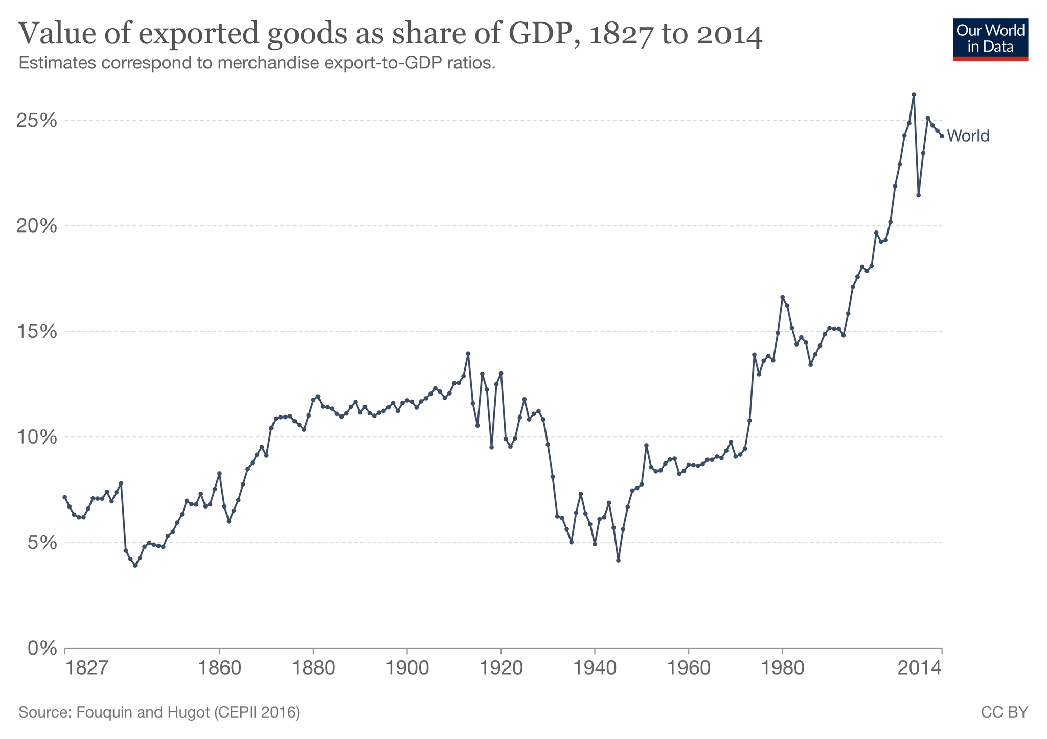
Appendix
World trade/GDP rose in 1945-2008.
Liberalization:
1945-2008
Inter-war
period:
1914-45
1st Age of Globalization: 1840-1914
Data: Our World in Data
Doug Irwin, 2020

Slide 18
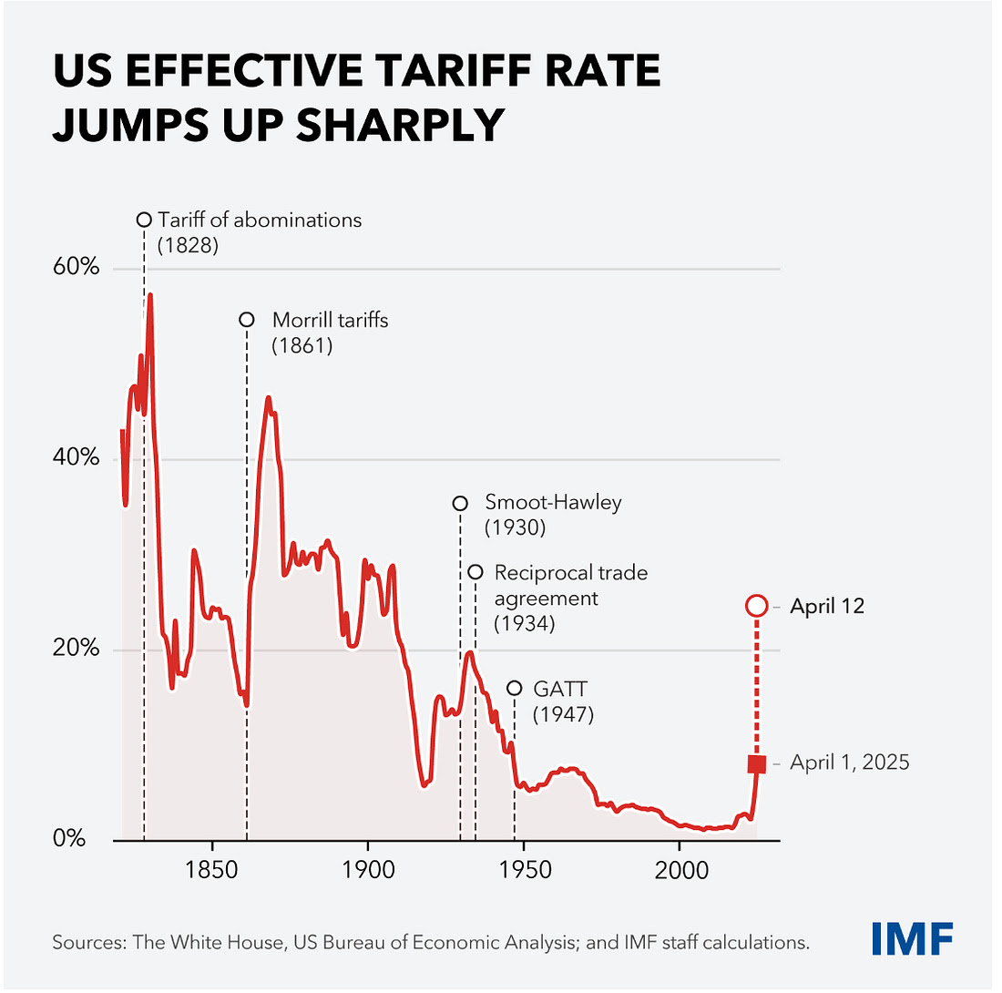
By April 12, Trump’s tariffs exceeded Smoot-Hawley

Slide 19
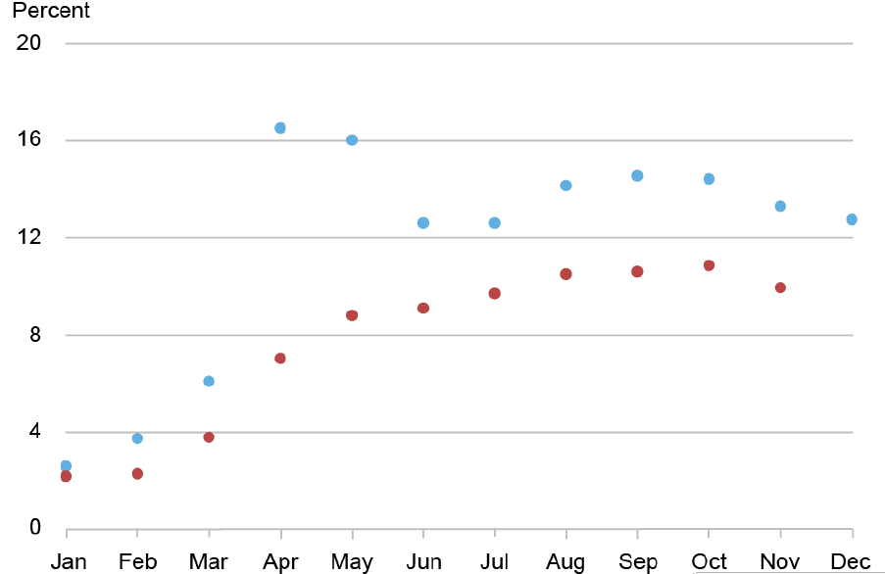
Applied tariffs rose more gradually in 2025 than proclaimed tariffs.

