Slide 1
Comments on “Macroprudential FX Regulations: Shifting the Snowbanks of FX Vulnerability” by
Toni Ahnert, Kristin Forbes,
Christian Friedrich & Dennis Reinhardt.
Jeffrey Frankel
Harvard Kennedy School
NBER Conference on Capital Flows, Currency Wars & Monetary Policy
Emmanuel Farhi & Sebnem Kalemli-Ozcan, Organizers,
Cambridge MA, April 5-6, 2018

Slide 2
Overview: Research on macro-prudential regulation
“Macroprudential” went viral after the Global Financial Crisis.
The reason: As central bankers re-discovered that they had an additional policy goal – financial stability – they needed additional policy instruments.
I devoted my final review of research in the IFM program in the NBER Reporter (2015) to international macroprudential policy.
We have had a lot of excellent work on the theory,
  incl. Javier Bianchi, & Enrique Mendoza (2013),
  Emmanuel Farhi & Ivan Werning (2010);
  and Anton Korinek & Olivier Jeanne (2010);
  among many others.
But most are rather abstract treatments:
  Often all foreign loans are the same. All macroprudential regulations are the same.

Slide 3
Overview, continued
The empirical side lagged behind.
  We should zoom in on detail that is granular enough to distinguish various macro-prudential tools from each other.
  Countries have experimented with such specific measures as
      Countercyclical bank reserve requirements,
      currency exposure limits,
      housing loan ceilings,
      and equity market margin requirements,
    often trying to vary them in a counter-cyclical way.
  I want to see humble dentists study how these policies
  have been implemented and what effects they have had.
    The answers might hold lessons for advanced countries.

Slide 4
Overview, continued
The body of such applied research is growing rapidly,
  as surveyed in the 2017 paper by Cerutti, Claessens, & Laeven,
    “The use & effectiveness of macroprudential policies: New evidence,” J.Fin.Stability.
But most has been:
  (i) undertaken at international agencies like the BIS & IMF,
    not by NBER members;
  and (ii) not yet published in leading journals.
I am happy Kristin is an exception --
  e.g., a paper for ISoM (with Fratzscher & Straub),
    “Capital-flow management measures: What are they good for?” ( JIE, 2015) --
  leading where I hope others will follow.
Others include:
  Federico, Végh & Vuletin, 2014, “Reserve requirement policy over the business cycle.”
  Kuttner & Shim, 2016, “Can non-interest rate policies stabilize housing markets? Evidence from a panel of 57 economies.”
  Other papers at a 2015 NBER conference in Istanbul organized by Sebnem.

Slide 5
After that prologue…
… the current paper by Ahnert, Forbes, Friedrich & Reinhardt is exactly the sort of thing that I have in mind.
I admire almost everything about it:
  choice of topic,
  choice of theoretical model,
  data set,
  and results.

Slide 6
(1) Choice of topic
Macroprudential FX regulations ≡ regulations that discriminate based on the currency denomination of a capital transaction.
  Vastly understudied, despite its importance.
  Distinct from capital controls -- the authors.
Currency mismatch was known to raise the danger of costly financial crises even before the East Asia crisis of 1997-98
  and certainly after it.
At the turn of the century, many EM countries seemed to have learned the lessons of the past crises and so reduced their shares of fx borrowing.
  Or at least their governments did.
  But the subject of this paper is private borrowing & lending.
    Here the problem is still with us.
  Currency mis-match in private loans was again a big source of trouble in countries like Hungary after 2008.

Slide 7
(1) Choice of topic, continued
The dangers of currency mismatch for the balance sheet: those who borrow in foreign currency suffer severe losses when the domestic currency devalues.
The prior causes of currency mismatch are less agreed.
My list of determinants includes:
  original sin,
  the illusory safety of an exchange rate peg,
  moral hazard, and
  a means of procrastination in adjusting to a sudden stop.
  Now, after reading this paper, we can add macroprudential forex regulation to the list of determinants.

Slide 8

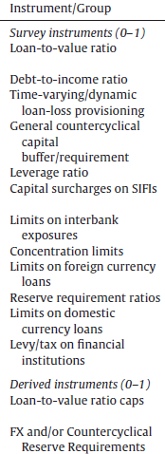
Limits on Foreign Currency loans and FX or countercyclical Reserve Requirements are used by EM & developing countries (2000-2013).
9%{
40%{
46%{
For each subgroup of countries, the frequency of use is the ratio of country-years using
a given instrument to the total number of country-years using a macroprudential policy.
Eugenio Cerutti, Stijn Claessens & Luc Laeven, 2017, “The use and effectiveness
of macroprudential policies: New evidence,” J.Fin.Stability (Table 2).

Slide 9
(2) The theoretical model
This application of the Holmstrom & Tirole (1997) model is new, at least to me.
It is as good a way as any to build in a fundamental difference between banks and other institutions:
  banks, and only they, can pay to acquire better information about the quality of the firms to which they lend.
The theory produces features of interest in their own right:
  “high-quality firms receive domestic funding from banks and lower-quality firms receive foreign funding (from either banks
  or investors, depending on the state of FX regulation).”

Slide 10
(2) The theoretical model, continued
What difference to the overall story follows from the choice of how to model what is different about banks?
  Perhaps less to the predicted effects on fx liabilities
  and more to the welfare implications.
  The paper suggests that diverting lending activity from banks to other institutions could harm growth: “tighter macroprudential FX regulations on banks could reduce TFP, as investors lend more indiscriminately and without the knowledge from banks’ screening activities.”
  My instinct: banks carry more systemic risk than other channels. The combination of banks & fx liabilities is particularly dangerous.
  The paper clearly recognizes the tradeoff in macropru FX regulation:
    reducing the cost of bank failure (when firms to which they have leant are hit by the balance sheet effect of currency depreciation), on the one hand,
    versus interfering with the efficiency of bank lending, on the other hand.
    The authors recognize shifting FX risk to non-banks might reduce systemic risk.
    But perhaps what makes banks different is that they are the payments system on which the economy depends,
      implying more emphasis on the systemic risk from banking failures.

Slide 11
(3) The data set
The authors put together a substantial data base on macroprudential fx regulations from four sources.
The numbers on the active use of fx regulations, mostly among EM economies, are revealing in themselves.
They show a strong increase in use during 2003-2007 and again during 2011-13 (Figures 1-3),
  particularly in the direction of tightening.
  These dates correspond closely to the two periods
  of strong inflows to EMs so far this century,
  suggesting the measures are used counter-cyclically.

Slide 12
Changes in FX regulations, mostly among EMs
Toni Ahnert; Kristin Forbes; Christian Friedrich; & Dennis Reinhardt (2018).
Figure 1: Cumulated changes in macroprudential FX regulations: by country group. This figure shows the aggregate number of changes in macroprudential regulations that have occurred in the sample (described in Section III), where changes include both loosening and tightening. The shading divides these actions into those undertaken by emerging economies (in purple) and advanced economies (in yellow)

Slide 13
And (4) the econometric results matching the theory surprisingly well:
Four major sets of conclusions.
FX regulations on banks
1. reduce banks’ fx exposure (substantially: by about 1/3)
1a. with no effect on banks’ local-currency borrowing;
1b. so total bank borrowing falls.
2. have the side-effect of shifting some fx exposure to other institutions (which rises by about 1/10).
2a. but with no effect on domestic-currency issuance of non-banks;
2b. so total non-bank borrowing rises.
2c. Importantly, the shifting is only a partial offset to banks’ exposure, so aggregate FX borrowing in the economy falls.

Slide 14
Four major sets of conclusions, continued:
FX regulations on banks:
3. reduce bank vulnerability to exchange rate changes,
where vulnerability is measured by returns on their stocks,
3a. but have less impact on others’ sensitivity to exchange rate changes.
4. The paper also distinguishes among kinds of fx regulations:
those targeting the liability side of bank balance sheets (discouraging them from raising FX funds) Vs., targeting the asset-side (discouraging banks from lending in FX to domestic residents )
  Bottom line: asset-side regulations are more successful in reducing
  a country’s overall balance-sheet vulnerability to exchange rates.
  You have to discourage those notorious Hungarian Swiss-franc mortgages.
All are interesting conclusions.
  Reasonable, but not a priori inevitable.

Slide 15
Suggestion
My only substantive suggestion:
it might be interesting to test whether the regulations are tightened & loosened in a counter-cyclical fashion.
Figure 3 says “yes” for 2002-14.

Slide 16
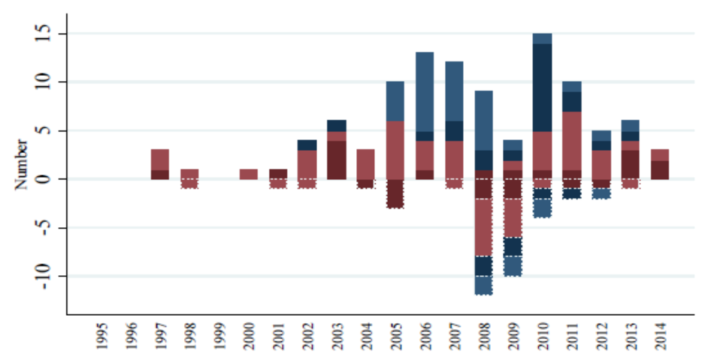

FX regulations were tightened particularly during 2003-07
& 2010-13, periods of capital inflow.
Ahnert, Forbes, Friedrich & Reinhardt (2018)
Figure 3: Tightening and Loosening of macroprudential FX regulations by category over time.
This figure shows the tightening (positive) and loosening (negative) of macroprudential FX measures from our dataset.
The shading divides the actions into those affecting bank assets (in blue) and those on bank liabilities (in red).

Slide 17
2 quibbles
I need to find something with which to take issue.
The presentation is very clear.
But I have two minor quibbles:
The text is a bit repetitive.
The snowbank analogy.

Slide 18

Pushing the snow back & forth

Slide 19
The snowbank analogy.
After a snowy winter in Boston I am deeply sympathetic:
  “the snow plow inevitably pushes a portion of the snow from the road into a pile in front of your driveway—blocking the area you carefully shoveled in the morning to get out your car.”
But is the analogy the most compelling?
  “macroprudential FX regulations on banks can also shift some vulnerability to currency movements to other sectors, mitigating some of the benefits.“
  Isn’t pushing snow around a less natural analogy than, say, squeezing a balloon?
  The snow bank is the obstacle that impedes the flow of auto traffic,
  just as regulation impedes foreign borrowing. In that case the snow corresponds to the regulation, not to the flow it impedes.
I question putting “snow-banks” in the title of the paper.
  I see as the primary finding of the paper that fx regulation succeeds in making banks + economy less exposed to exchange rate changes.
    The partial shifting of risk to non-banks seems only a secondary finding.
      though important.

Slide 20

But taking exception to one phrase in the title
is a small quibble to an excellent paper.

