Slide 1
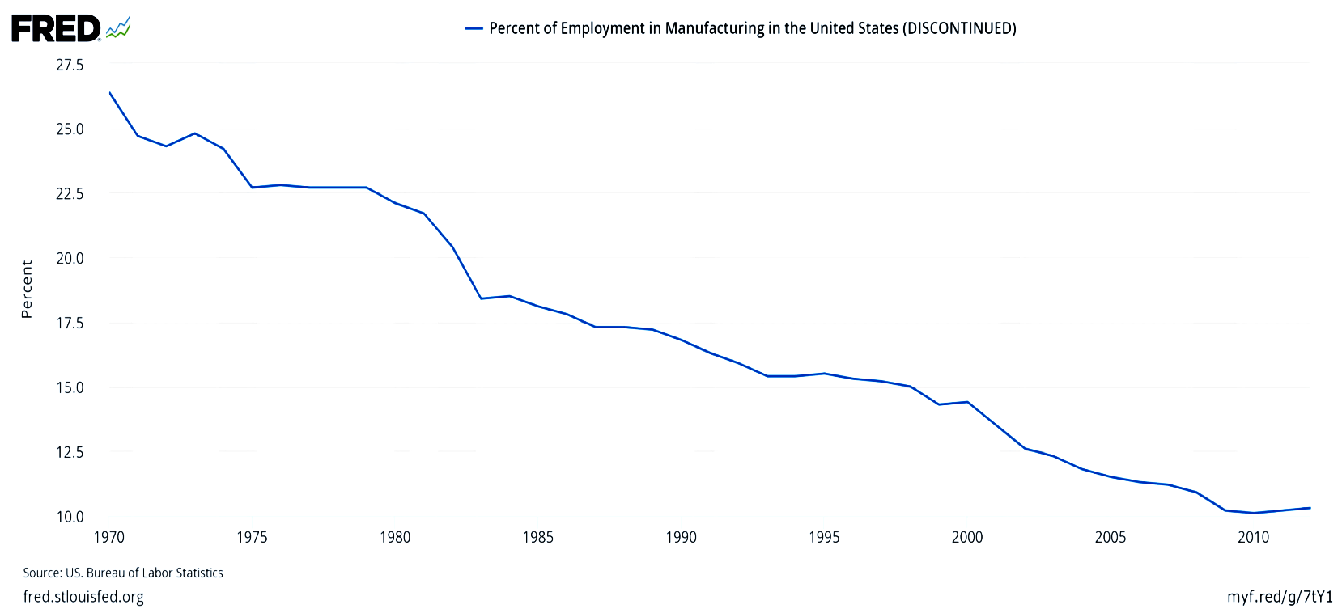
Lost manufacturing jobs
Prof. Jeffrey Frankel, Harvard Kennedy School
Leir Retreat Center, CT, 11/3-11/4
2017 NJIT Economic/Bubble Conference;

Slide 2
Consider long-term job loss in three sectors:
Manufacturing,
Coal, and
Agriculture.
What does international trade
have to do with US employment?
Not as much as you would think.

Slide 3
Long-term job loss in three sectors
Manufacturing employment has fallen steadily
as a share, from 32% of total in 1950,
  to 10% in 1950.
  Similar declines in other major industrialized countries.
  Manufacturing output has continued to rise.
  That means productivity has gone up a lot:
    It takes fewer workers to make an auto than 65 years ago,
By analogy, farm employment fell from 90% in 1790,
  to 2% today.
And coal miners have fallen from 800th in 1923,
  to 100th now.

Slide 4

Manufacturing jobs were 32% of the national total in 1950, and had declined to 10% by 2010.
Percent of employment in US manufacturing (1970-2012)
Those jobs are not coming back.

Slide 5
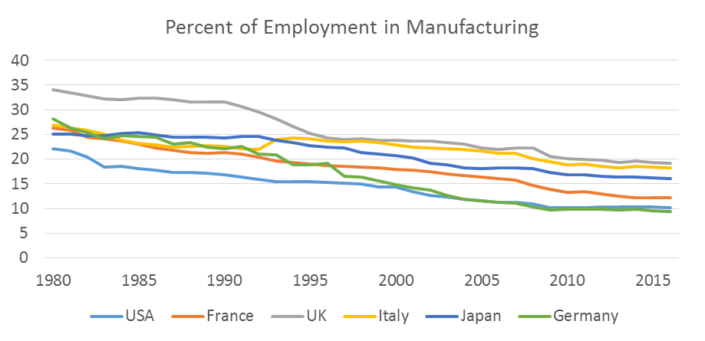
Similar declines in other major industrialized countries.
Source: Nick Sargen, “Trade Imbalances and Manufacturing Jobs: A Macro View,” 10/21/17.
For 2017 Conference on Financial Innovation & Stability, Leir Retreat Center.

Slide 6
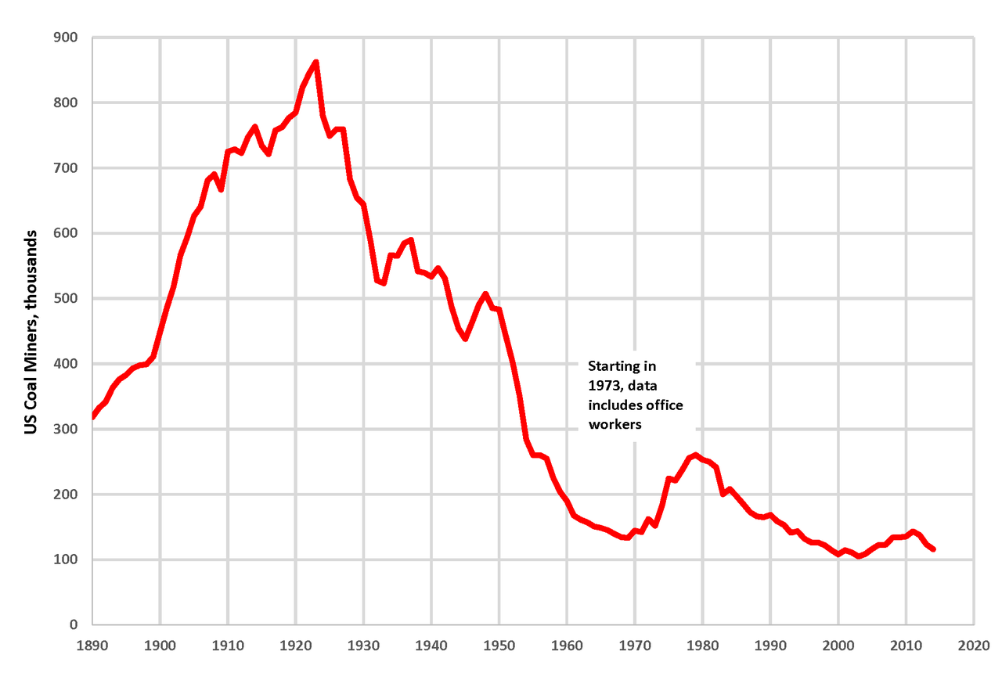
Similarly, we are not going back to the number of coal miners that were employed in 1923 (800th vs. 100th).
By Plazak - Own work, CC BY-SA 4.0, https://commons.wikimedia.org/w/index.php?curid=48261916

Slide 7
Bottom line of lost manufacturing jobs.
Analogously to lost ag and coal jobs,
they have been offset by jobs gained elsewhere, particularly services.
  with admittedly long and painful adjustment costs for some individuals & communities, for all 3.
The primary cause of the job shift is not trade
  but technological & productivity growth.
  Indeed, in the case of ag & coal, trade is a plus.

