Slide 1
Panel on “International Experiences from the USA & Canada,”
Seminar on Business Cycle Dating
Mexico City, Oct. 30-31, 2019
CIDE Centro de Investigación y Docencia Económicas,
(or Center for Research and Teaching in Economics).
Jeffrey Frankel
Harpel Professor of Capital Formation and Growth
Harvard Kennedy School, Harvard University
Views are the author’s alone, and not those of the NBER.

Slide 2

  The official status of the NBER dates is confirmed on the website of the Bureau of Economic Analysis of the US Department of Commerce:
“The designation of a recession is the province of a committee of experts at the National Bureau of Economic Research (NBER),
a private non-profit research organization.”

Slide 3
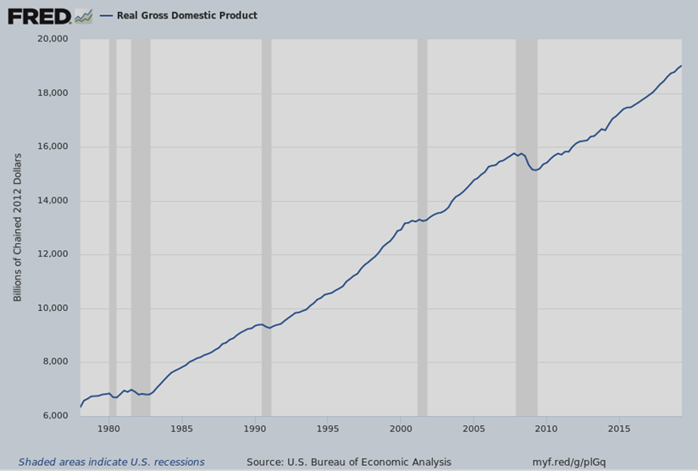
Figure 1: The NBER BCDC has declared
5 US recessions since 1978

Slide 4
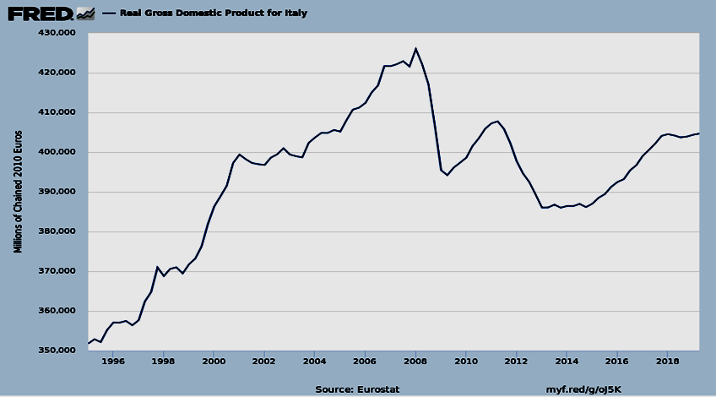
Figure 2: Italy had 3 separate recessions since 2008, according to the 2-quarter-negative-GDP rule even as GDP remained far below the 2009 peak.

Slide 5
Dates of the 10 business cycle turning points declared by the US NBER BCDC

Slide 6
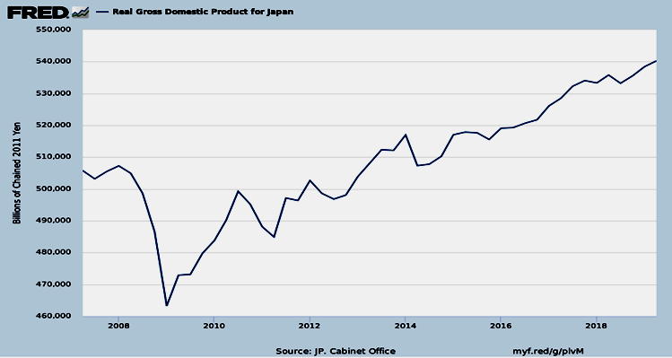
Fig.3: Japan had 6 or 7 recessions between 1993 & 2015, according to the 2-quarter-negative-GDP rule.
(Growth has averaged only 1% p.a. in recent decades.)
But Japan’s government panel does not follow that rule.

