Slide 1
“Successes and failures of the euro:
The first 20 years”
Prof. Jeffrey Frankel,
Harvard Kennedy School
Panel on the 20th Anniversary of the Euro
E51-345, Tang Center, MIT
11:30am-1pm, Thursday, Jan. 17, 2019

Slide 2
Views differed on the two sides of the Atlantic concerning the prospects for success of the euro.
American economists tended to be skeptical,
    E.g., Feldstein (1997),
on the grounds that the prospective members did not
meet the criteria for an Optimum Currency Area.
    E.g., Eichengreen (1992).
European countries lacked the necessary:
  degree of trade integration,
  cyclical correlation,
  labor mobility, and
  fiscal federalism.

Slide 3
Europe: We are going ahead anyway.
They de-emphasized the OCA criteria.
But they identified some other vulnerabilities
that had not received much attention in the academic literature.
The architects of Maastricht correctly identified the problem
of moral hazard in national fiscal policy,
  responding to concerns of German taxpayers.
  They tried hard to address the problem
    by adopting the Maastricht fiscal criteria,
    the so-called “no bail-out clause”,
    and later the Stability and Growth Pact.
A few European economists even flagged correctly the need for
pan-euro banking regulation if the project were to be successful.

Slide 4
Successes (four)
The transition from 11 individual currencies to the euro
in January 1999 was smooth.
The euro instantly became the world’s #2 international currency.
The incentive of being admitted to the club led to favorable reforms in many aspiring member countries,
  particularly outer-periphery countries joining subsequently to 2002.
The union survived the euro crisis intact with all 19 members (so far)
  contrary to predictions that Greece would have to drop out.

Slide 5
Failures (six)
The feared asymmetric shocks materialized.
  Ireland, for example, in 2004-06 needed a tighter monetary policy
  than the European Central Bank was prepared to set, because
  it was experiencing a housing bubble and economic overheating.
  Conversely, during 2009-2013, Ireland needed an easier monetary policy
  than the ECB was prepared to set, because it was in steep recession.
Large net capital flows to periphery countries during the 1st decade were viewed as signs of efficiency-improving financial integration.

Slide 6
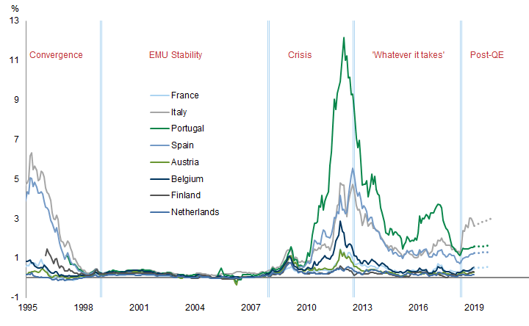
That high-debt countries did not have to pay penalty interest rates (1999-2007) should have been a signal that moral hazard had not been solved.
Figure 1: 10-year government bond yield spreads (relative to Germany) for selected EMU countries
Source:
Goldman Sachs
Global Investment Research,
Jan. 16, 2019

Slide 7
3. The fiscal rules proved un-enforceable.
Virtually all euro members soon violated the 3% deficit rule
  including Germany.
Governments repeatedly asserted that future fiscal targets would be met,
assertions that could only be maintained via over-optimistic forecasts.
  Frankel & Schreger (2013).
  Governments (1999-2008) never forecast a budget deficit > 3% GDP,
    even though they had them, often in successive years.
    See Figure 2.

Slide 8
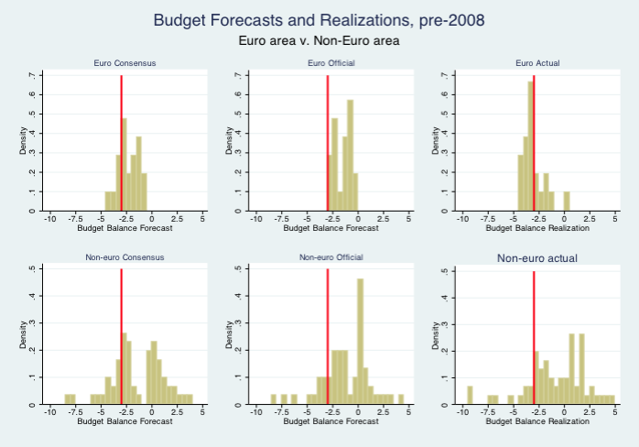
Fig. 2 -- In the euro countries which are subject to SGP rules,
the optimism bias was reflected in the practice of never officially forecasting next year’s budget deficit > 3% of GDP,
even though such deficits recurred.
Forecasts of budget balances and actual realizations, as % of GDP,
among euro-area countries, pre-2008
Private forecasts (Consensus Economics)
Official government forecasts
Actual realized budget balances
Source: Frankel & Schreger, 2016,
"Bias in Official Fiscal Forecasts: Can Private Forecasts Help?“ NBER WP 22349.

Slide 9
In some areas, the leaders really did score “own goals.”
4. Despite the global recession, the ECB mistakenly raised interest rates in July 2008 and again, twice, in 2011.
5. The Greek crisis (early 2010), was not handled well.
  The troika (ECB, EU Commission & IMF) might
  have contained the forest fire. Instead it spread.
  Mistake #1: Failure of European leaders to send Greece to the IMF promptly.
    They thought that the history of EM crises could not apply to a euro member.
  Mistake #2: Refusal to write down Greek debt in 2010,
  despite Debt Sustainability Analysis showing debt/GDP path to be explosive
    even with stringent fiscal austerity.

Slide 10
6. The emphasis on austerity was mistaken, applied especially to Greece but to other countries as well.
More specifically, the troika in 2010 and thereafter under-estimated
the fall in GDP that would follow from fiscal austerity in the periphery.
  Blanchard & Leigh (2013): the underestimation of the severity of the recessions took the form of underestimation of fiscal multipliers.
  See Figure 3.

Slide 11
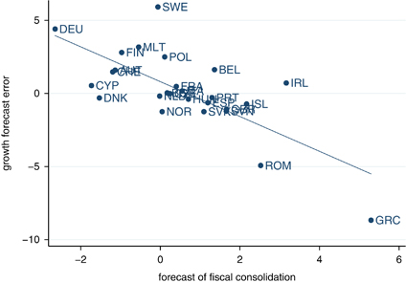



Fig. 3 -- The bigger the fiscal contraction, the bigger the GDP loss relative to what had been officially forecast, in the EU 2010-11.
=> True multipliers > than multipliers that IMF had been using.
Europe: Growth Forecast Errors vs. Fiscal Consolidation Forecasts
Note: Figure plots forecast error for real GDP growth in 2010 and 2011 relative to forecasts made in the spring of 2010 on forecasts of fiscal consolidation for 2010 and 2011 made in spring of year 2010; and regression line.
From Blanchard & Leigh, 2014, “Growth Forecast Errors and Fiscal Multipliers,” American Economic Review.

Slide 12
As a result, fiscal austerity did not achieve its financial goal of putting Greece & others onto sustainable debt paths,
even leaving aside the economic cost of the recession
and the political cost of associated populist anger.
To the contrary, the fall in GDP was greater than any fall in debt,
with the result that debt/GDP ratios rose at accelerated rates.
  See Figure 4.
Fatás & Summers (2017): fiscal austerity may have exacerbated debt/GDP paths not just in the short run but even in the long run.

Slide 13
Fig. 4: With austerity, debt/GDP ratios continued to rise sharply:
Declining GDP outweighed progress on reduction of budget deficits.
.

Slide 14
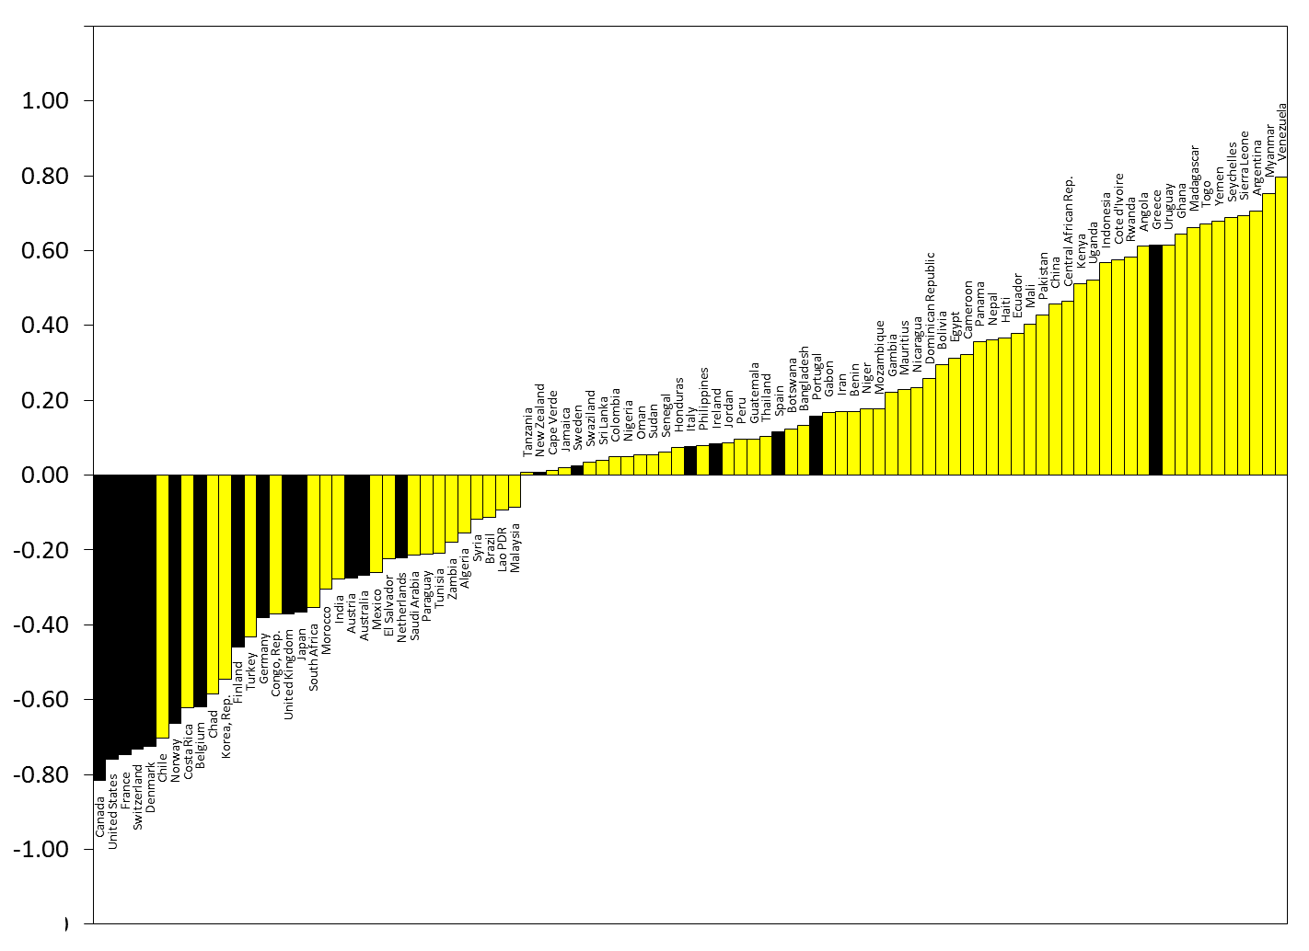
Bottom line: Since 2000, Greece & periphery have shown
pro-cyclical or destabilizing fiscal policy (positive correlation of G & GDP).
Figure 5: Correlations between cyclical components
of government spending & GDP, 2000-2016
Frankel (2017). Updated from Frankel, Vegh & Vuletin, 2013, “On Graduation from Fiscal Pro-cyclicality,” Journal of Development Economics. Thanks to Jose Andree Camarena Fonseca.
The cyclical components of spending and GDP were computed using a HP filter with λ = 6.25 and expressed as percentage deviations from the trend. For each country, the HP filter was applied exclusively to the common sample of the two variables
(i.e., considering only the years for which data for both were available) so that any start-/end-of-sample bias of the HP filter would apply symmetrically to both. In addition, forecasts in the out-years until 2022 were included in both series before applying the HP filter.

Slide 15
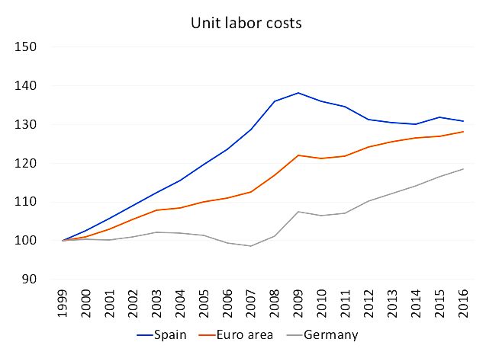

I will end with three observations on the “plus” side:
1) Spain & other periphery countries – via painful recessions – gradually brought their uncompetitive Unit Labor Costs back down.

Slide 16
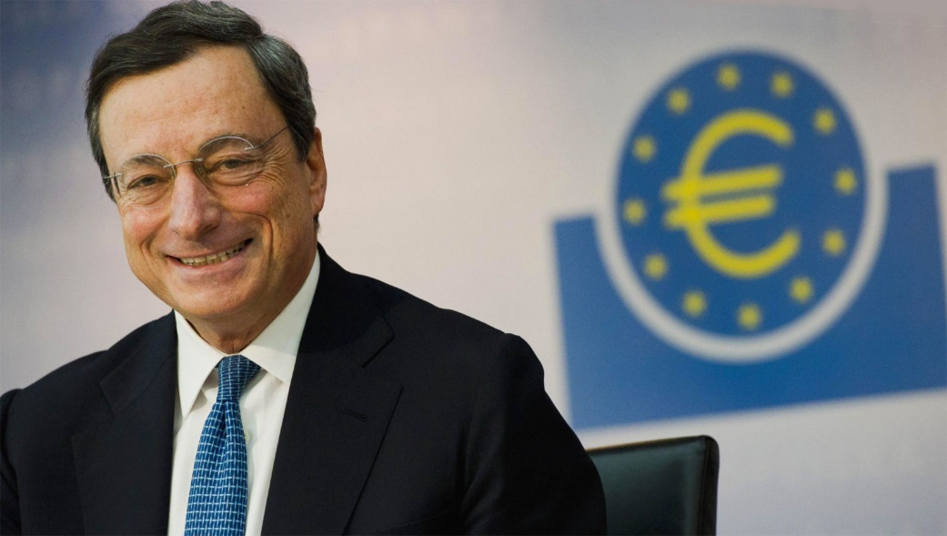
On the plus side:
2) ECB President Mario Draghi warrants top marks for successfully walking the tightrope between the German need for discipline and the Mediterranean need for accommodation
most famously for the brilliant sentence (July 2012),
that the ECB would do “whatever it takes.”
He will be hard to replace.
3) Public opinion polls in recent years
have shown the euro to be highly popular
(64% in Nov. 2018).
So there may be hope after all!

