Slide 1


An Economy That Works for All Americans
Jeffrey Frankel
Harpel Professor of Capital Formation and Growth
Harvard University
Bipartisan Program for Newly Elected Members of Congress
December 7, 2016

Slide 2
Current state of the economy:
The most recent stats as of 12/1/2016…
are surprisingly good:
  GDP growth in 3rd Quarter: 3.2 % or more.
  Employment:
    October continued the longest streak of total job growth on record:
    15 ½ million jobs added since early 2010.
    Unemployment rate down to 4.9%.
  Average hourly earnings: rose 2.8 % over the last 12 months,
  the fastest since the recovery began.
And the gains were widely shared:
  Median real family income: rose 5.2% in 2015, the fastest ever.
  Poverty rate: down to 13.5%
    from 14.8% in 2014,
    the largest drop since 1968.

Slide 3
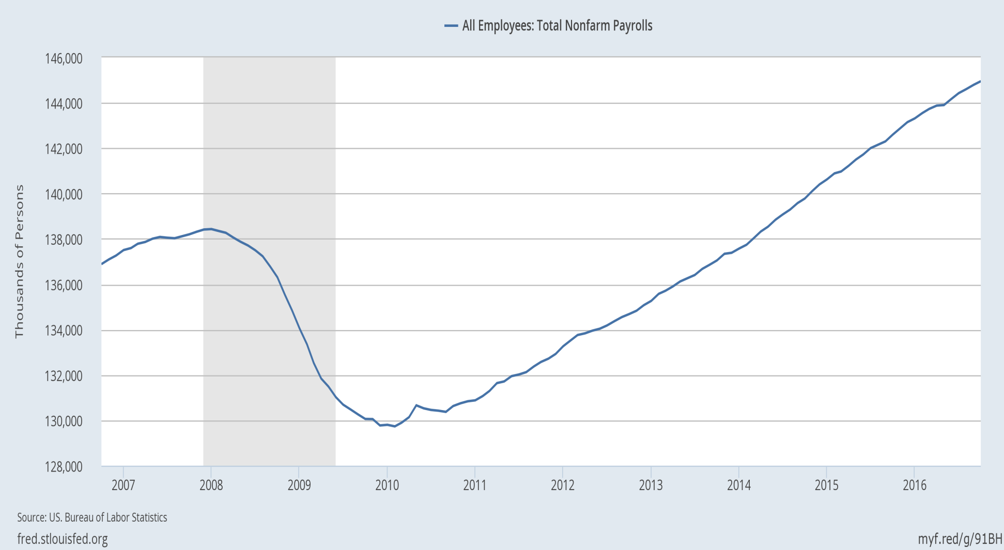
The economy has added 15 ½ million jobs since early 2010.

Slide 4
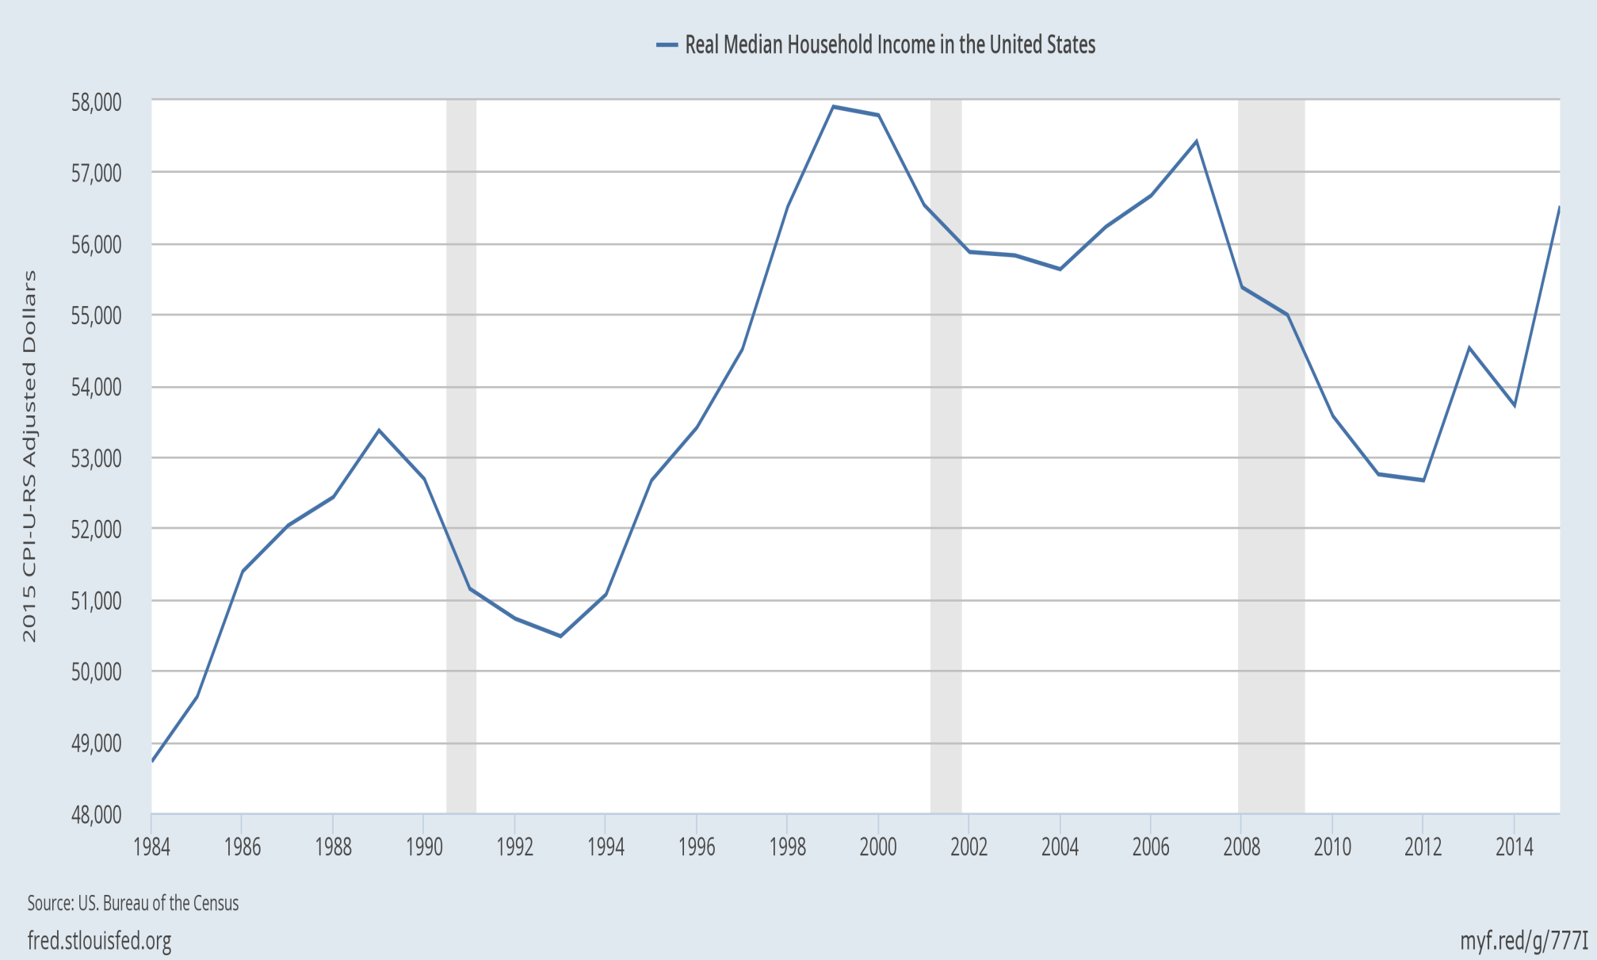
Real median family income is still below 2000!
But the longer-term trend has been worse:
|
2000
|
2007
|
2015

Slide 5

Manufacturing jobs were 32% of the national total in 1950, and had declined to 10% by 2010.
Percent of employment in US manufacturing (1970-2012)
Those jobs are not coming back.

Slide 6
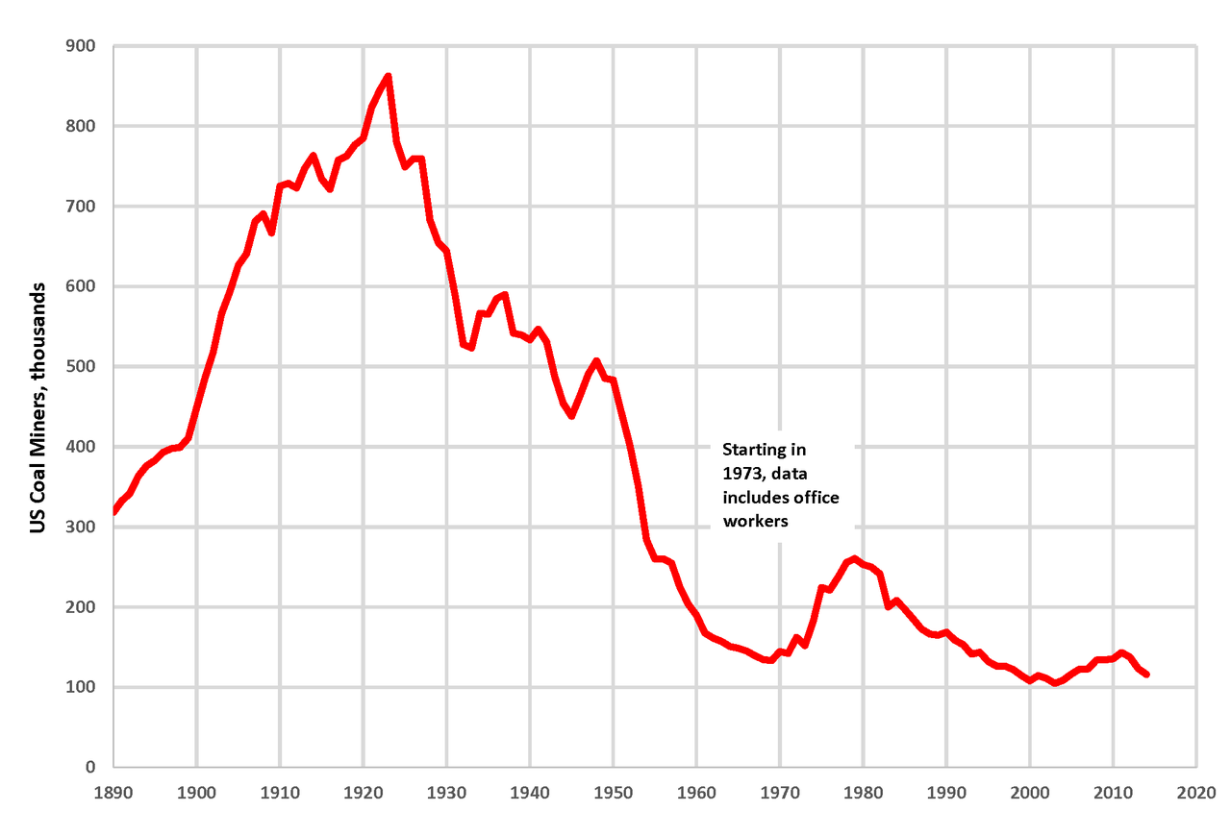
Similarly, we are not going back to the number of coal miners that were employed in 1923.
By Plazak - Own work, CC BY-SA 4.0, https://commons.wikimedia.org/w/index.php?curid=48261916

Slide 7
Some reasons for employment shifts
Trade?
It works in favor of the US agricultural and coal sectors.
  Even regulation has not been the big source of job loss in coal.
  Rather, in recent years, it has been cheap natural gas from fracking;
  and, before that, the shift from Appalachian underground mining to open-pit mining.
In the case of all 3 sectors, the biggest reason for the decline in jobs has not been trade, but rather productivity growth,
  particularly arising from technological progress.
  The demand for labor has shifted toward high-skill jobs.
  Meanwhile the supply of high-skilled workers has not kept up:
    education gains have lagged since 1981.
But good policies to share income gains more widely tend
to be the same, regardless the causes of rising inequality.

Slide 8

Widening gap between “skilled” & “unskilled” workers, defined by college graduation.
Jason Furman, CEA, Oct. 17, 2016, Fig.10.

Slide 9

The trend in years of education slowed during 1981-2012.
Average Years of Schooling at Age 30, U.S. Native-Born, by Year of Birth, 1876-1982
Trend
1906 – 1981
= 1876+30 to 1951+30.
Trend
1981 – 2012
= 1951+30 to 1982+30.
Jason Furman, CEA, Oct. 17, 2016, Fig.11.

Slide 10
Eight policies to promote
An Economy That Works for All Americans
Raise infrastructure spending.
Move toward universal pre-school education.
Continue to raise the number of Americans with health insurance.
Address the long-term rise in household debt.
Reform tax system (revenue-neutral: lower rates, but cut distorting deductions)
    Reform corporate income tax
    Reform personal income tax.
    Expand EITC and/or wage insurance.
    Abolish the carried interest deduction.
    Don’t eliminate the estate tax.
Allow fracking (but with careful regulation).
Keep US global economic leadership
  including abiding by trade agreements.

Slide 11
An Economy That Works for All Americans
Jeffrey Frankel
Harpel Professor of Capital Formation and Growth
Harvard University

Slide 12
Appendices
More on macroeconomic developments
  2009 turnaround from recession
  Budget deficit
  Trade deficit
  Output vs. employment in manufacturing
List of causes of rising US inequality
Addressing the long-term rise in household debt
  Housing debt;
  Auto debt;
  Student loans.

Slide 13
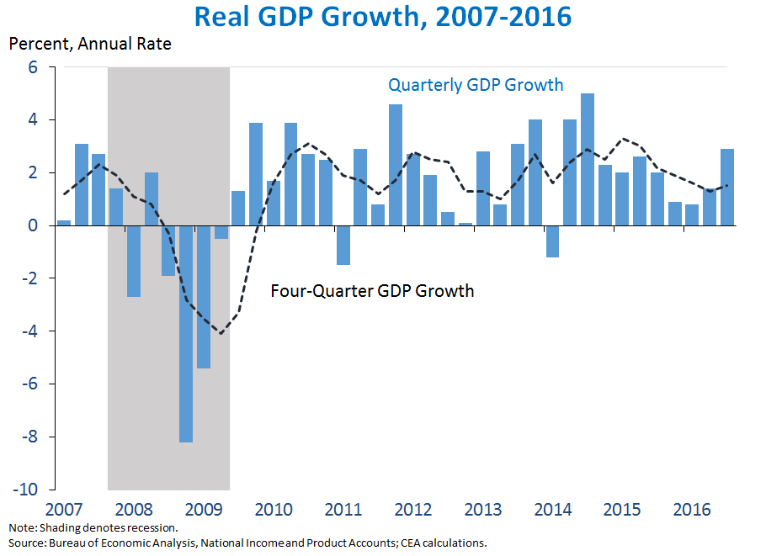
Appendix 1: More on macroeconomic developments
The economy turned around in June 2009,
but the recovery was slow and long.
https://www.whitehouse.gov/blog/2016/10/28/advance-estimate-gross-domestic-product-third-quarter-2016

Slide 14
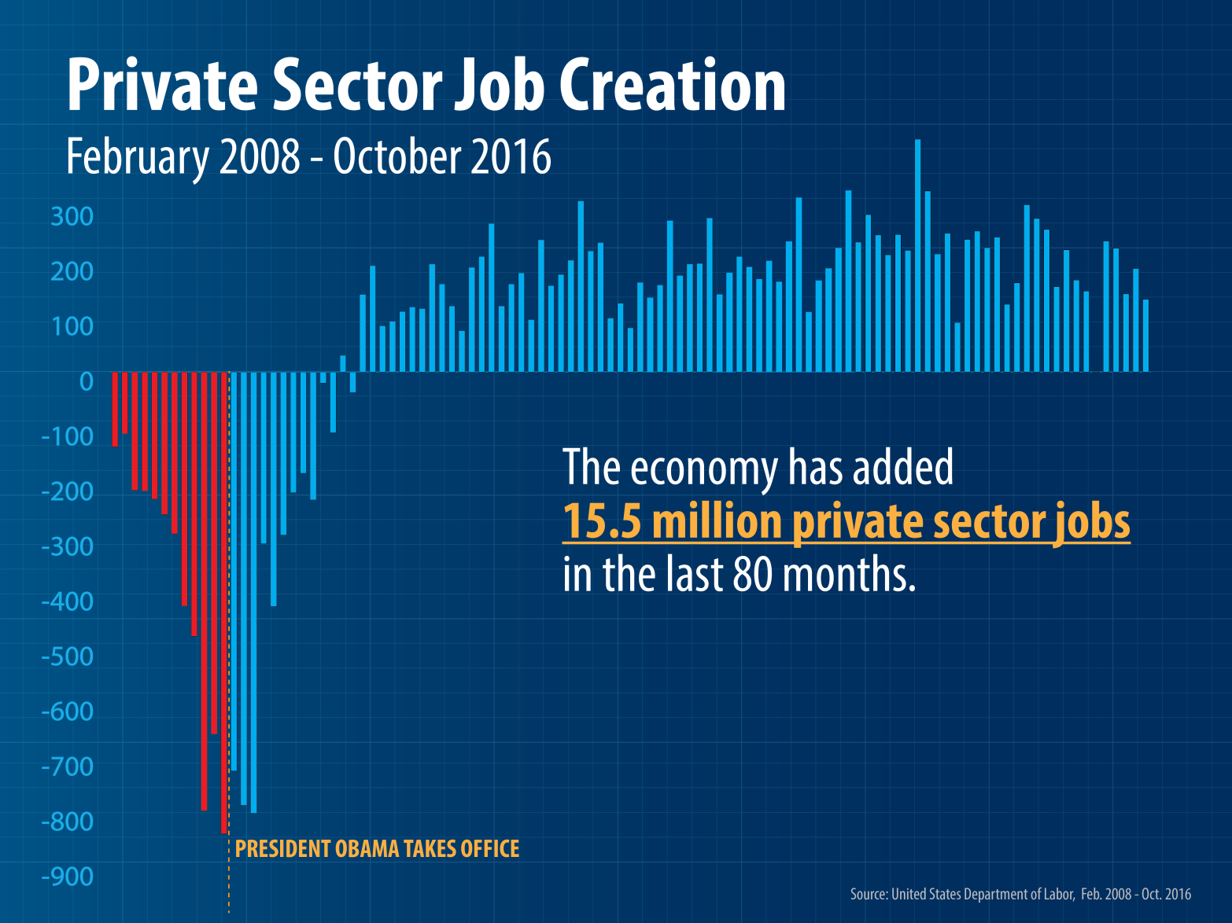
Employment growth has been steady since early 2010.

Slide 15
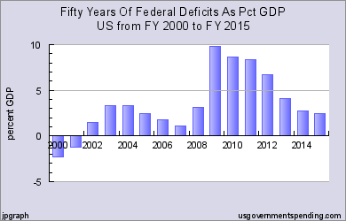
The budget deficit has come down since 2009.

Slide 16
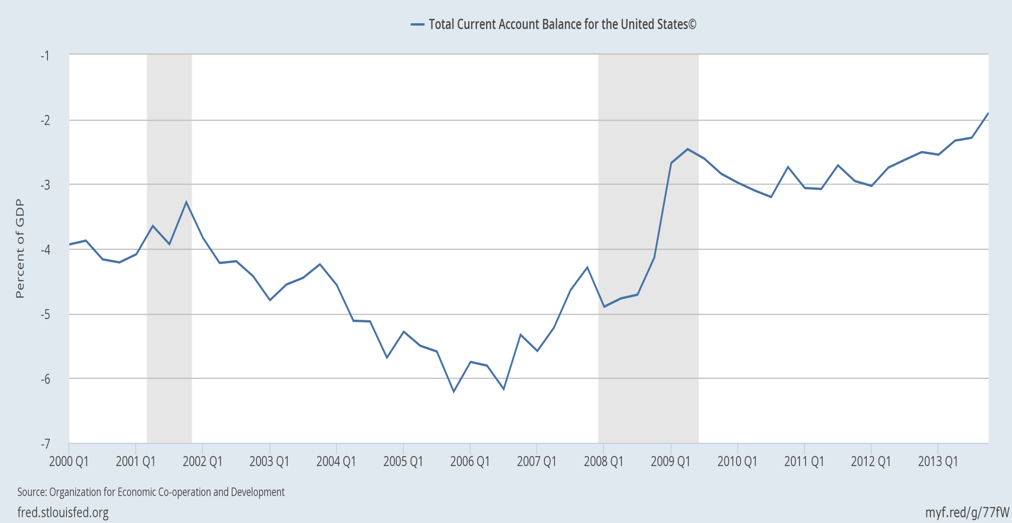
The trade deficit as a share of GDP has also narrowed.

Slide 17
Appendix 2: Why has inequality risen in the US?
  Trade probably does play a role, alongside other factors:
  technological change raising demand for skilled workers,
  outpacing education that raises the supply;
  “winner-take-all” labor markets,
  “assortative mating,”
  reduced corporate competition & higher rents,
  excessive executive compensation.
  Piketty: wealth accumulates faster than income.
  Possibly the decline in union power & minimum wages.

Slide 18
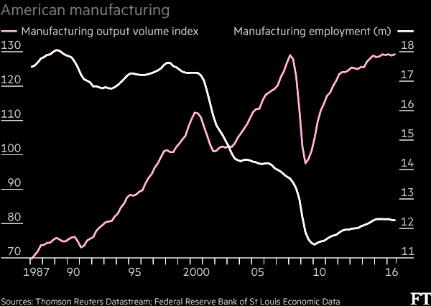
Manufacturing output rises as employment falls, showing productivity growth.
“What role for the workers in Trump’s American factory revival?” Financial Times, Nov. 23, 2016.

Slide 19
Appendix 3: Address the long-term rise in household debt: housing, auto, & student loans
Reduce the policy tilt toward getting American families
up to their eyeballs in mortgage debt they can’t afford.
  It led to 2007-09 financial crisis. And it drives up housing prices,
    without even much raising home ownership rates.
  Specific policies:
    Require a serious minimum down payment, as other countries do.
    Require “skin in the game,” on the part of mortgage-originators.
    Curtail tax deductibility of mortgage interest,
      which mainly benefits the well-off.
        It generally saves less than $200 for households earning $65,000.
      Reduce deductions at the upper end,
      especially if loan is used for something other than purchase of residence
        i.e., 2nd home or “cash out” for spending.
    Don’t repeat the mistake of Fannie Mae and Freddie Mac

Slide 20
Address household debt: housing, auto & student loans, continued
Auto dealers should not be exempted from
the Consumer Finance Protection Bureau.
Although most college educations are still a good deal, and worth going into debt for if that is the only way, some enterprises are bad deals.
    Especially some for-profit universities.
    Government should expand student grants & loans,
    but require that the college or university have a decent record regarding rates of graduation & employment.

