Slide 1


An Economy That Works for All Americans
Jeffrey Frankel
Harpel Professor of Capital Formation and Growth
Harvard University
Bipartisan Program for Newly Elected Members of Congress
December 7, 2016

Slide 2
Current state of the economy
The Fed will almost certainly raise interest rates December 14. Why?
The most recent stats are surprisingly strong:
  GDP growth in 3rd Quarter: 3.2 % or more.
  Employment:
    November continued the longest streak of total job growth on record:
    15.6 million jobs added since early 2010.
    Unemployment rate down to 4.6%, considered full employment.
  Average hourly earnings: rose 2.7 % so far this year.
And, for once, recent gains were widely shared:
  Median real family income: rose 5.2% in 2015, the fastest ever.
  Poverty rate: down to 13.5%
    from 14.8% in 2014, the largest drop since 1968.

Slide 3
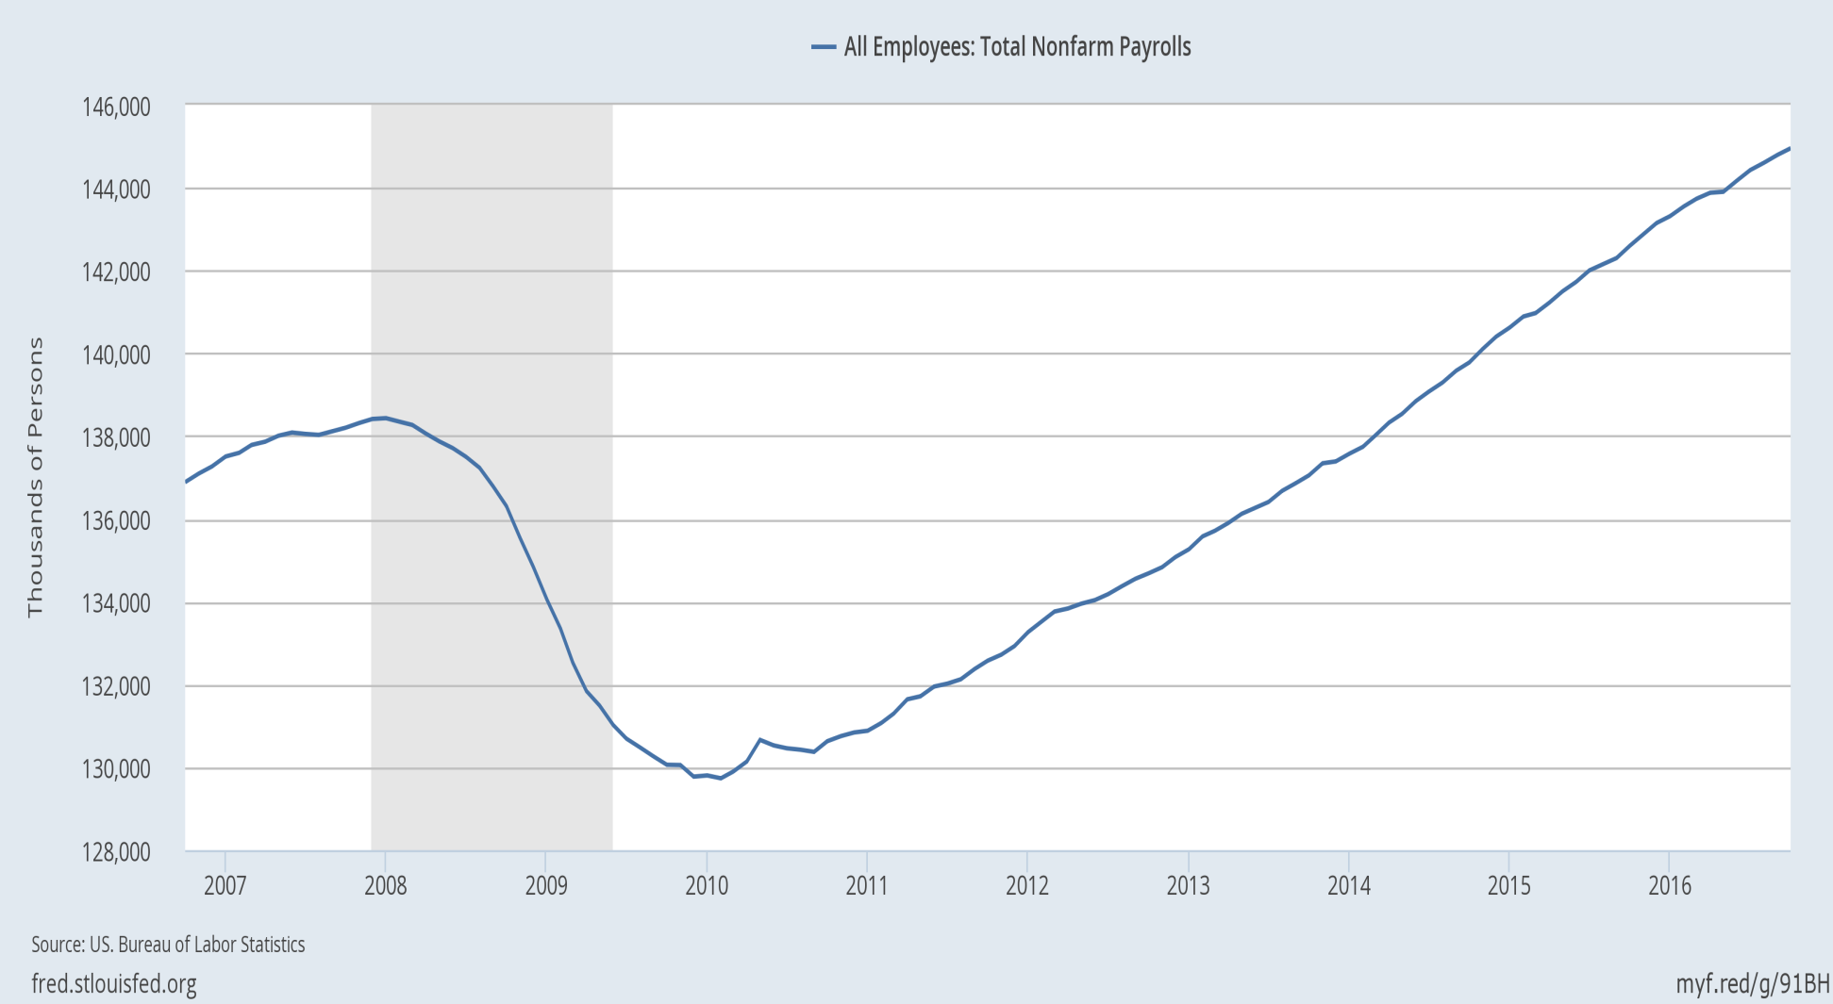
The economy has added 15 ½ million jobs since early 2010.

Slide 4
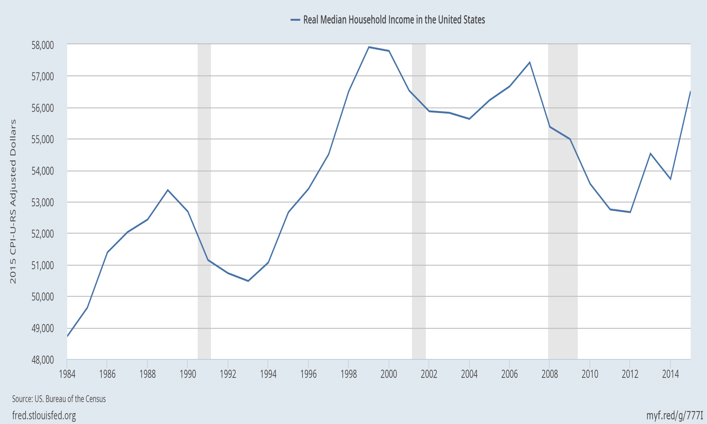
Real median family income is still below 2000!
But the longer-term trend is not good:
|
2000
|
2007
|
2015

Slide 5

Manufacturing jobs were 32% of the national total in 1950, and had declined to 10% by 2010.
Percent of employment in US manufacturing (1970-2012)

Slide 6
Long-term job loss in some sectors
Manufacturing employment has been falling as a share since 1950,
  conspicuously in such sectors as autos, steel, and apparel
    (though leaving viable cores today).
Due to international trade?
  Yes, in part, in some sectors.
  But trade has also created lots of other jobs.
Also, manufacturing output continues to rise, even as employment falls.
  That means productivity has gone up a lot:
    It takes fewer workers to produce one auto today than 65 years ago,
      not to mention that the cars are much higher-quality.
Those jobs are not coming back.
By analogy, farmers were 90% of national employment in 1790
  vs. 2% today.
Or consider coal miners.

Slide 7
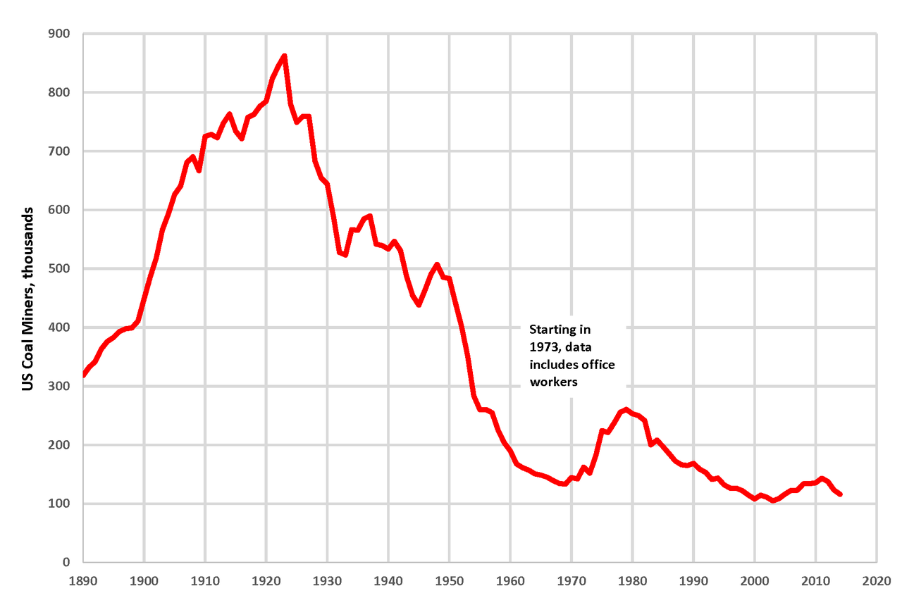
As with factory workers and farmers, we are not going back to the number of coal miners that were employed in 1923.
By Plazak - Own work, CC BY-SA 4.0, https://commons.wikimedia.org/w/index.php?curid=48261916

Slide 8
Some reasons for employment shifts
Trade? It works in favor of the US agricultural and coal sectors.
Even regulation has not been the big source of job loss in coal.
  Rather, in recent years, it has been cheap natural gas from fracking;
  and, before that, the shift from Appalachian underground mining
  to open-pit mining.
In the case of all 3 sectors, the biggest reason for the decline
in jobs has not been trade, but rather productivity growth,
  arising particularly from technological progress.
  The demand for labor has shifted toward high-skill jobs.
  Meanwhile the supply of high-skilled workers has not kept up:
    education gains have lagged since 1981.
But regardless the causes of rising inequality,
good policies can share income gains more widely.

Slide 9

Widening gap between “skilled” & “unskilled” workers, defined by college graduation.
Jason Furman, CEA, Oct. 17, 2016, Fig.10.

Slide 10

The trend in years of education slowed during 1981-2012.
Average Years of Schooling at Age 30, U.S. Native-Born, by Year of Birth, 1876-1982
Trend
1906 – 1981
= 1876+30 to 1951+30.
Trend
1981 – 2012
= 1951+30 to 1982+30.
Jason Furman, CEA, Oct. 17, 2016, Fig.11.

Slide 11
Eight policy proposals to promote
An Economy That Works for All Americans
Increase infrastructure spending.
Move toward universal pre-school education.
Continue to raise the number of Americans with health insurance.
Address the long-term rise in household debt.
  Institute wage insurance. Better than Trade Adjustment Assistance.
Reform the tax system
  Corporate income tax (stay revenue-neutral: lower rate, but cut distorting deductions)
  Reform personal income tax.
    Expand EITC
    Abolish the carried interest deduction.
  Don’t eliminate the estate tax.
Allow fracking (but with careful regulation).
Keep US global economic leadership
  including abiding by trade agreements.

Slide 12
An Economy That Works for All Americans
Jeffrey Frankel
Harpel Professor of Capital Formation and Growth
Harvard University

Slide 13
Appendices
Addressing the long-term rise in household debt
  (i) Housing debt;
  (ii) Auto debt;
  (iii) Student loans.
List of causes of rising US inequality
More on macroeconomic developments
  2009 turnaround from recession
  Budget deficit
  Trade deficit
  Output vs. employment in manufacturing

Slide 14
Appendix 1: Address the long-term rise in household debt: housing, auto, & student loans
(i) Reduce the policy tilt toward getting American families
up to their eyeballs in mortgage debt they can’t afford.
  It led to 2007-09 financial crisis. And it drives up housing prices,
    without even much raising home ownership rates.
  Specific policies:
    Require a serious minimum down payment, as other countries do.
    Require “skin in the game,” on the part of mortgage-originators.
    Curtail tax deductibility of mortgage interest,
      which mainly benefits the well-off.
        It generally saves less than $200 for households earning $65,000.
      Reduce deductions at the upper end,
      especially if loan is used for something other than purchase of residence
        i.e., 2nd home or “cash out” for spending.
    Don’t repeat the mistake of Fannie Mae and Freddie Mac

Slide 15
Address household debt: housing, auto & student loans, continued
(ii) Auto dealers should not have been exempted
from the Consumer Finance Protection Bureau.
  A rising share of sub-prime auto loans are now delinquent.
(iii) Although most college educations are a good deal, and worth going into debt for if that is the only way, some enterprises are bad deals.
    Especially some for-profit universities.
    Government should expand student grants & loans,
    but require that the school have a decent record
    regarding rates of graduation & employment.

Slide 16
Appendix 2: Why has inequality risen in the US?
  Trade probably does play a role, alongside other factors:
  technological change raising demand for skilled workers,
  outpacing education that raises the supply;
  “winner-take-all” labor markets,
  “assortative mating,”
  reduced corporate competition & higher rents,
  excessive executive compensation.
  Piketty: wealth accumulates faster than income.
  Possibly the decline in union power & minimum wages.

Slide 17
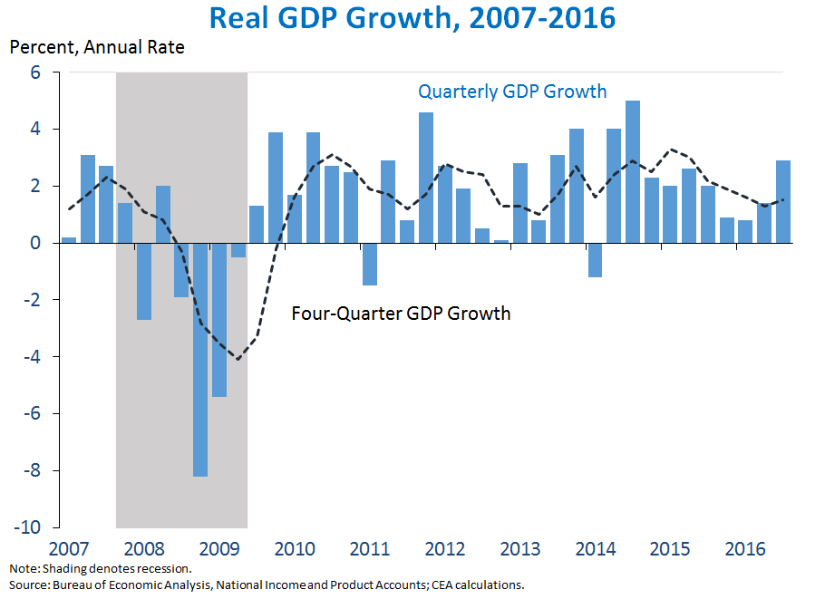
Appendix 3: More on macroeconomic developments
The economy turned around in June 2009,
but the recovery was slow and long.
https://www.whitehouse.gov/blog/2016/10/28/advance-estimate-gross-domestic-product-third-quarter-2016

Slide 18
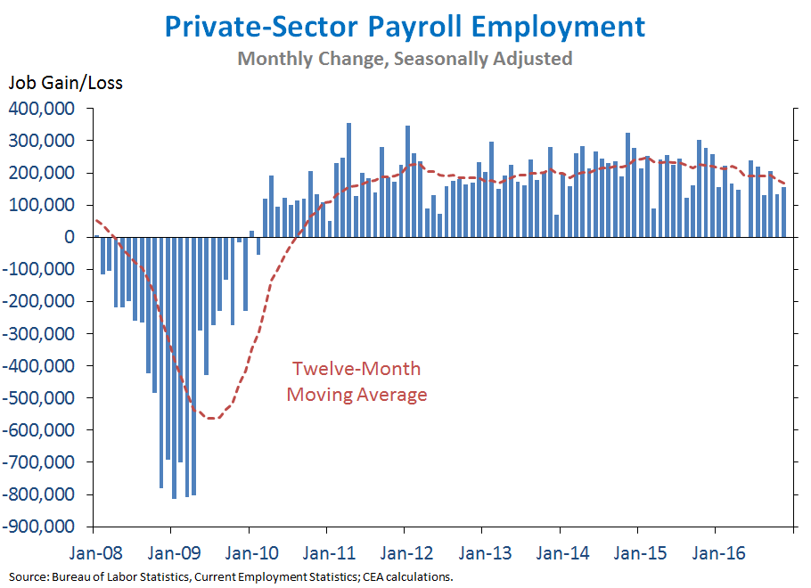
Employment growth has been steady since early 2010.
The private sector has added 15 ½ million jobs in the last 81 months.

Slide 19
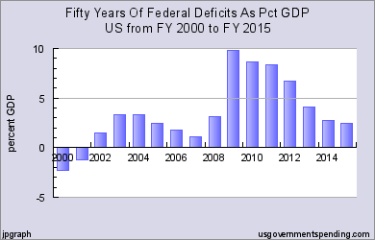
The budget deficit has come down since 2009.

Slide 20
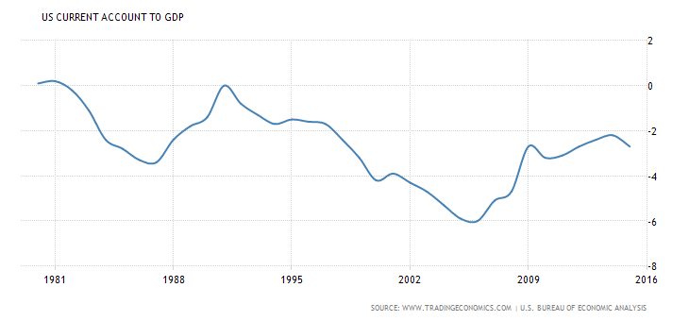
The trade deficit as a share of GDP has also narrowed.

Slide 21
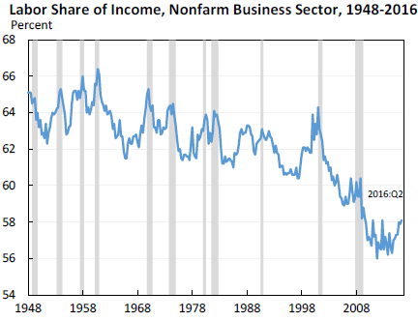
The share of US national income going to labor has declined since 2000.
Jason Furman, CEA, Oct. 17, 2016, Fig.13.

Slide 22
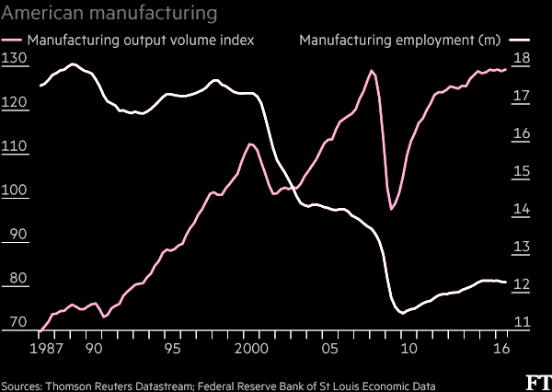
Manufacturing output rises as employment falls, showing productivity growth.
“What role for the workers in Trump’s American factory revival?” Financial Times, Nov. 23, 2016.

