Slide 1
Will fiscal stimulus overheat the US economy?
Jeffrey Frankel
Harpel Professor of Capital Formation & Growth
Harvard University
Panel on The Biden stimulus, the Federal Reserve, and the everything bubble
American Enterprise Institute
March 24, 2021

Slide 2
Question from AEI:
How likely will Biden’s $1.9 trillion relief package lead to US overheating & high inflation?
My bottom line:
  Overheating is very likely,
  if defined as GDP > potential.
  Rather less likely, if it is defined as
  inflation above what the Fed wants.

Slide 3
The basic Keynesian multiplier logic is simple
as laid out by Summers in his W.Post column, Feb. 4.
The multiplier is as high as 1.5 under recent conditions,
  i.e., when interest rates are close to 0.
Call the multiplier 1.0,
  since some of ARP transfers will be saved
  + long-term interest rates may rise.
    10-yr rate is already up to 1.7%.
1.0 x $1.9 trillion = $1.9 trillion = 9 % of GDP.
GDP at end-2020 ≈ 3 % below estimated potential.
=> 9% boost would put GDP 6 % above est. potential.

Slide 4
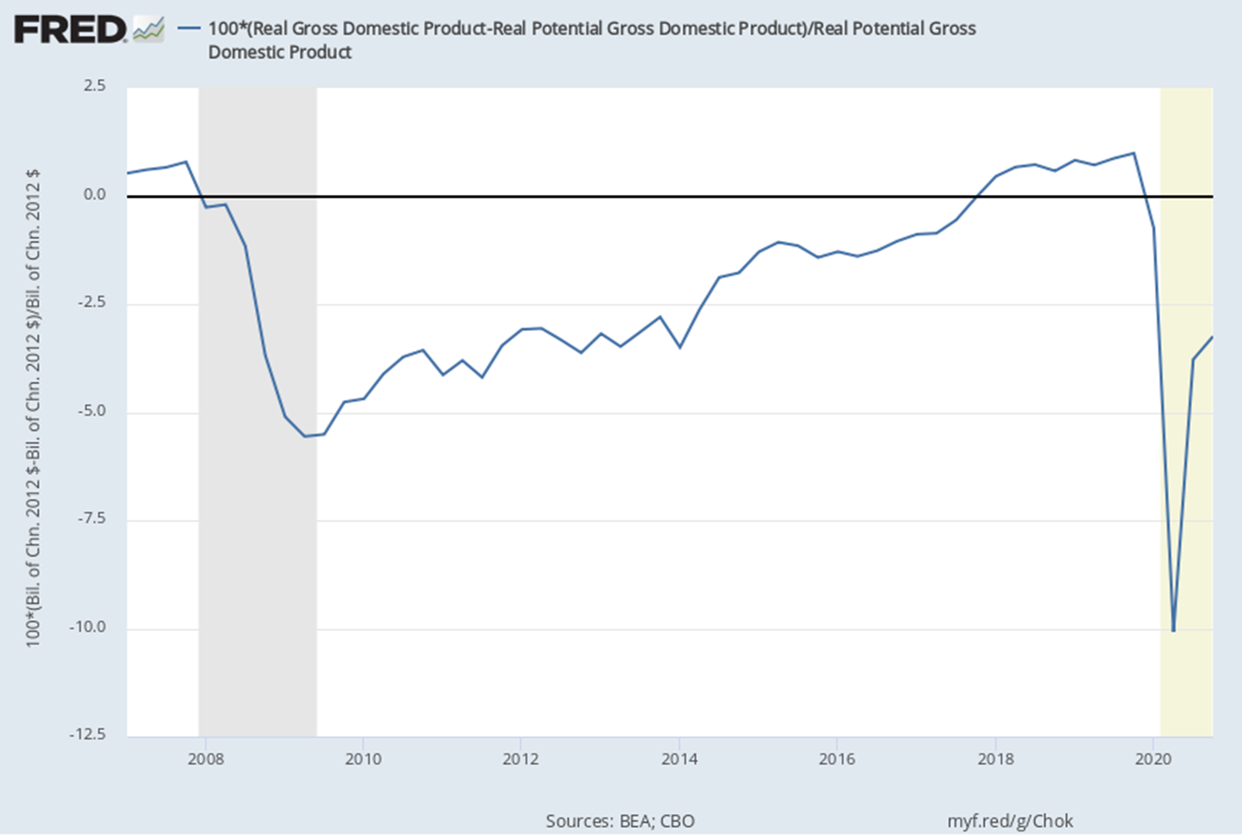
CBO-estimated output gap
GDP ≈ 1 % above potential in 2019.
GDP ≈ 10 % below potential, 2020 Q2.

Slide 5
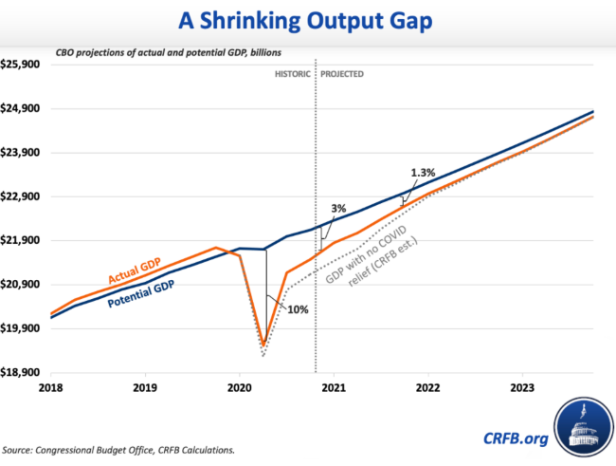
GDP ≈ 3 % below potential at end-2020.
Committee for a Responsible Federal Budget, Feb. 2, 2021

Slide 6
Major counterargument:
We may be underestimating potential GDP.
True, inflation did not rise much in 2018-19,
  when GDP was 1% above potential
    & unemployment fell as low as 3 ½ %.
But a better explanation is a flat Phillips curve.
After all, inflation also didn’t fall very much 2010-14,
  even though output was still below potential
    & unemployment was declining only slowly from its 10 % peak.
Hence my conclusion that, though 2022 GDP will rise above potential, it is less likely that inflation will rise above what the Fed wants.

Slide 7
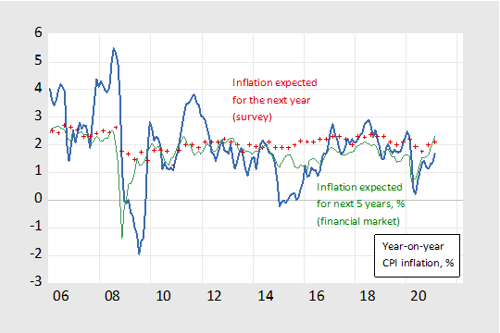
Well-anchored expectations keep inflation stable.
Source: Menzie Chinn, March 2021

Slide 8
Other possible downsides to so big an expansion.
National debt/GDP > 100%,
  highest since 1945.
  Unsustainable path, if interest rates rise.
  But less of an issue for US than other countries.
If the Fed succeeds in keeping interest rates low,
it may prolong the “everything bubble.”
The trade deficit will rise,
  which could exacerbate protectionism.. .
Much depends on how the money is spent.

Slide 9
The “mistake of 2009”
Obama’s $0.8 trillion stimulus was too little
  & too short-lived.
  It did help end the GFC recession in 2009 Q2;
  but the recovery was too slow.
  End
I’m not sure the mistake was Obama’s:
  It was the most he could get passed,
    given Republican opposition.
Regardless, Biden is making sure that the country
doesn’t repeat the mistake.

Slide 10
Will stimulus overheat the US economy?
Jeffrey Frankel
Harvard University
American Enterprise Institute
March 24, 2021

Slide 11
Appendix: Obama stimulus helped end recession in 2019.
But subsequent recovery was slow.
Obama inauguration
End of recession
Source: Macroeconomic Advisers www.macroadvisers.com

Slide 12
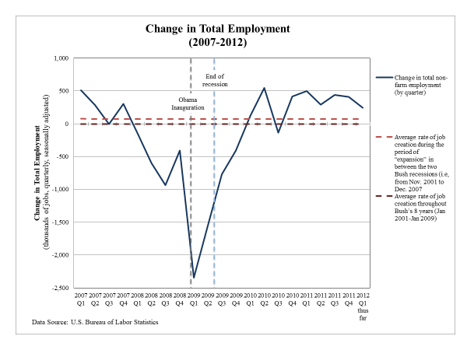
End of recession
Obama inauguration

