Slide 1


Will fiscal stimulus overheat the US economy?
Jeffrey Frankel
Harpel Professor of Capital Formation & Growth
Harvard University
Panel
US and EU fiscal policies: On different wavelengths
SAFE Policy Center, Frankfurt
April 22, 2021

Slide 2
Will the US economy overheat?
Reasons to think so:
  Biden’s $1.9 trillion relief package (American Rescue Plan)
  + infrastructure bill, $2.3 tr., 10 years (American Jobs Plan);
  coming on top of big transfers in 2020,
  + pent-up demand ($ 1 ½ - 2 trillion extra savings),
  + aggressive Fed stimulus.
My bottom line:
  US overheating is very likely,
  if defined as GDP > potential.
  Less likely, if it is defined as
  inflation above what the Fed wants.

Slide 3
The basic multiplier logic is simple
as laid out by Summers in his W. Post column, Feb. 4.
The Keynesian multiplier normally is high
when interest rates & inflation remain low.
Call the multiplier 1.0,
  since some of the transfers will again be saved
  & long-term interest rates may rise.
    10-yr rate has already risen since January, to 1.6%.
1.0 x $1.9 trillion = $1.9 trillion = 9 % of GDP.
GDP at end-2020 ≈ 3 % below estimated potential.
=> 9% boost would put GDP 6 % above est. potential.
Even a 0.5 multiplier would put us 1 % above potential.

Slide 4
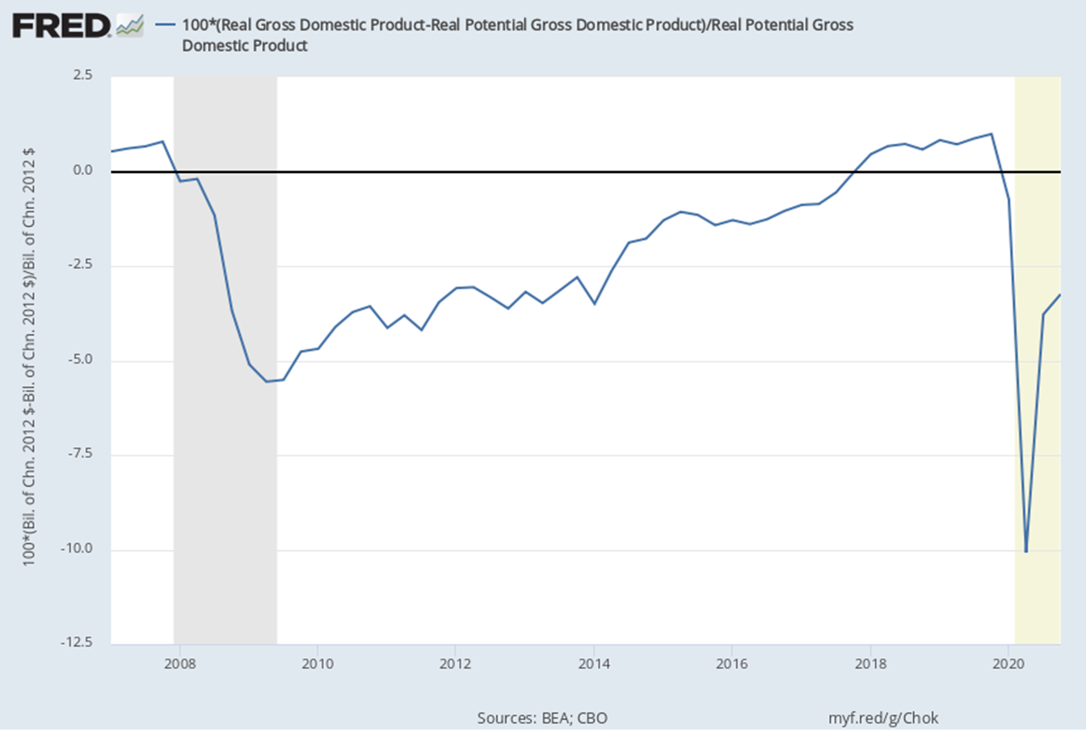
CBO-estimated output gap
GDP ≈ 1 % above potential in 2019.
GDP ≈ 10 % below potential, 2020 Q2.

Slide 5
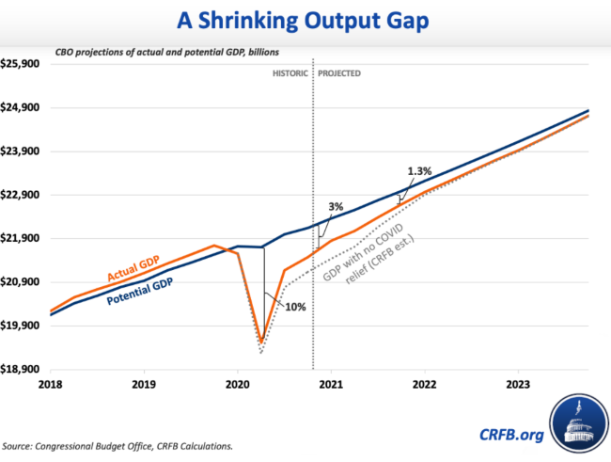
Stimulus puts GDP above potential by end-2021.
US GDP ≈ 3 % below
potential at end-2020.
}
Committee for a Responsible Federal Budget, Feb. 2, 2021

Slide 6
Planned 2021 stimulus in US >> in Eurozone or Japan.
OECD, March 9, 2021

Slide 7
Major counterargument:
We may be underestimating potential GDP.
<= inflation did not rise much in 2018-19,
  when GDP was 1% above potential
    & unemployment fell as low as 3 ½ %.
But a better explanation is a flat Phillips curve.
After all, inflation also didn’t fall very much 2010-14,
  even though output was still below potential,
    & unemployment was declining only slowly from its 10 % peak.
Hence my conclusion that, though 2022 GDP will rise above potential, it is less likely that inflation will rise above what the Fed wants.

Slide 8
Other possible downsides to so big an expansion, aside from inflation.
Net national debt/GDP > 100%,
  highest since 1945.
  Unsustainable path, if interest rates rise.
  But less of an issue for US than other countries
    especially EMDEs.
If the Fed succeeds in keeping interest rates low,
it may prolong asset market bubbles.
The trade deficit will rise,
  which could exacerbate protectionism.. .
Much depends on how the money is spent.
  Mostly, it looks to be well-spent,
  even though not all the “infrastructure” spending is really infrastructure.

Slide 9
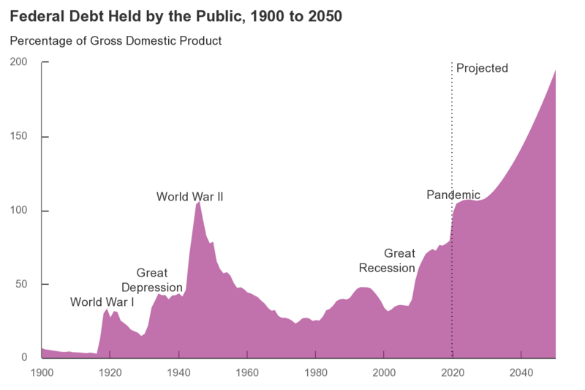
US debt/GDP was set to exceed 100% in 2021,
even before the Biden stimulus.
CBO, Sept. 2020

Slide 10
The “mistake of 2009”
Obama’s $0.8 trillion stimulus was too little
  & too short-lived.
  It did help end the GFC recession in 2009 Q2;
  but the recovery was too slow.
  En
I’m not sure it was Obama’s mistake:
  It was the most he could get through Congress,
    given Republican opposition.
Regardless, Biden is now making sure that the US
doesn’t repeat the mistake.

Slide 11

Will fiscal stimulus overheat the US economy?
Jeffrey Frankel
Harvard University

Slide 12
Appendix: Obama stimulus helped end recession in 2019.
But subsequent recovery was slow.
Obama inauguration
End of recession
Source: Macroeconomic Advisers www.macroadvisers.com

Slide 13
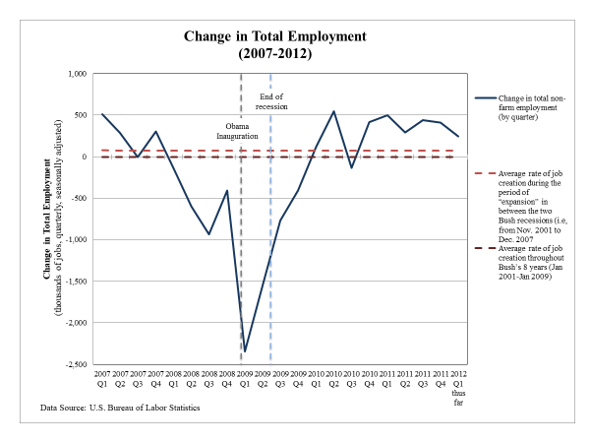
End of recession
Obama inauguration

Slide 14
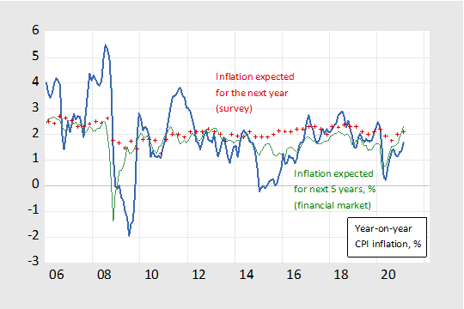
Well-anchored expectations keep inflation stable.
Source: Menzie Chinn, March 2021

Slide 15
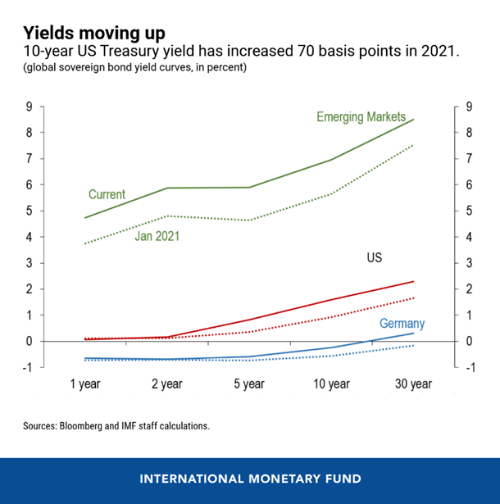
Long-term interest rates rose after Jan. 2021.
Adrian, et al, IMF, April 22, 2021
https://blogs.imf.org/2021/04/22/understanding-the-rise-in-us-long-term-rates/

Slide 16
Effect on other countries, 2021 Q2 – 2022 Q1
Laurence Boone, OECD, March 9, 2021.

