Slide 1
Fiscal Pro-cyclicality and Optimistic Forecasts
Jeffrey Frankel
Harpel Professor of Capital Formation & Growth Harvard University
Workshop on
Fiscal Policy and Adjustment: Issues and Policy Implications World Bank, May 9, 2018

Slide 2
Fiscal policy has two jobs (macroeconomicly).
Long run: keep enough budget discipline
on average to ensure debt is sustainable.
Medium run: keep fiscal policy counter-cyclical.
  Or, if counter-cyclical is too difficult,
  at least don’t allow it to be pro-cyclical.

Slide 3

Pro-cyclicality
Fiscal policy has historically tended
to be pro-cyclical in most developing countries, thereby worsening ups & downs in the economic cycle.
Correlation of income & spending mostly positive:
  Cuddington (1989), Gavin & Perotti (1997), Tornell & Lane (1999), Kaminsky, Reinhart & Végh (2004), Talvi & Végh (2005), Alesina, Mendoza & Oviedo (2006), Campante & Tabellini (2008), Ilzetski & Végh (2008), Medas & Zakharova (2009), Erbil (2011), Céspedes & Velasco (2014), Bova, Carcenac & Guerguil (2014), Avellan & Vuletin (2015).
Tax policy tends to be pro-cyclical as well:
  Végh & Vuletin (2015).

Slide 4
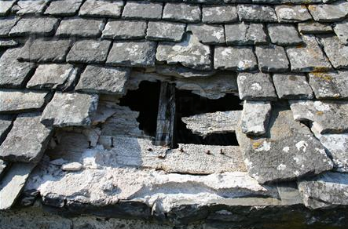
Why do leaders fail to take advantage of boom times to strengthen the budget?
People don’t see the need to “fix the hole
in the roof when the sun is shining.”
  They may see the mistake
  when the storm hits,
    but then it is too late.
My claim: Official forecasts
are over-optimistic in boom periods,
rationalizing the failure to act
  according to data from 33 countries.

Slide 5

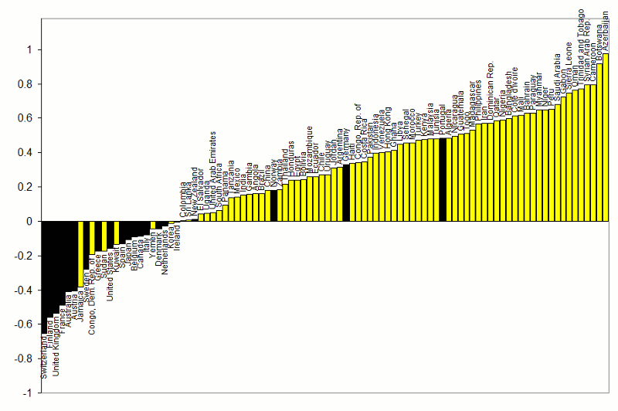



Correlations between Gov.t Spending & GDP
1960-1999
procyclical
“Grafico de Peñarol”
adapted from Kaminsky, Reinhart & Végh (2004)
}
countercyclical
G always used to be pro-cyclical
for most developing countries.

Slide 6

The procyclicality of fiscal policy, cont.
An important development --
some developing countries were able
to break the historic pattern after 2000:
  taking advantage of the boom of 2002-2008
    to run budget surpluses & build reserves,
  thereby earning the ability to expand
  fiscally in the 2008-09 crisis.
  Chile, Costa Rica, Botswana, Malaysia, S. Korea…
Subsequently, some went back to full pro-cyclicality,
  e.g., Argentina, Brazil, & Ecuador.
6
Notes:
6
keep

Slide 7

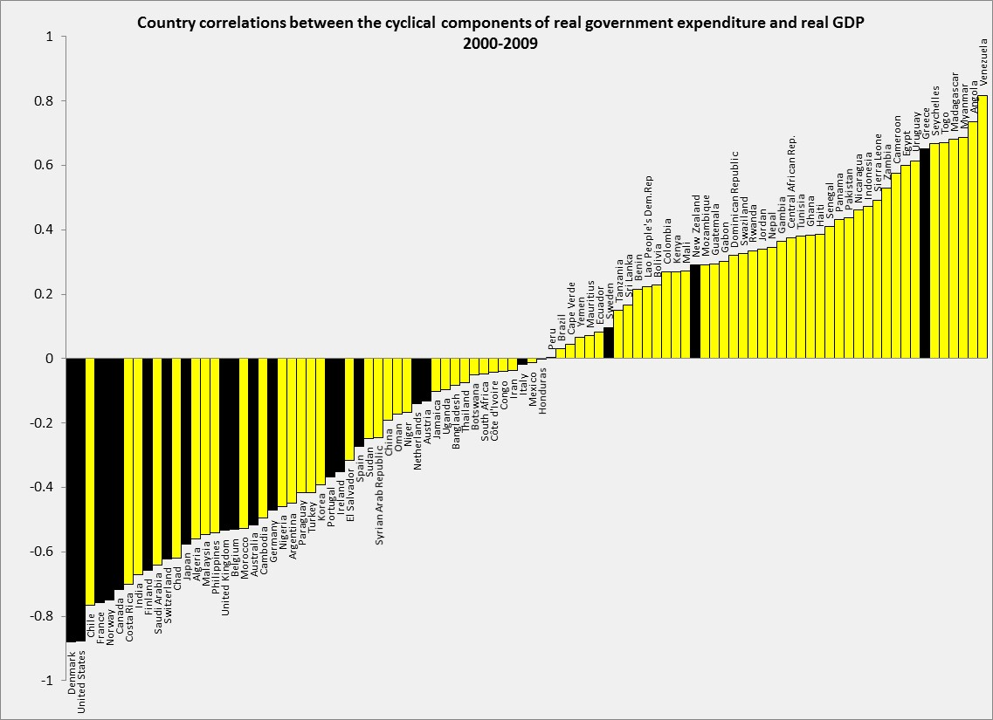



Correlations between Government spending & GDP
2000-2009
Adapted from Frankel, Végh & Vuletin (JDE, 2013)
In the decade 2000-2009,
about 1/4 developing countries
switched to countercyclical fiscal policy:
Negative correlation of G & GDP.
DEVELOPING: 43% (or 32 out of 75) countercyclical. Was 17% (or 13 out of 75) in 1960-99.
ADVANCED: 86% (or 18 out of 21) countercyclical. Was 80% (or 16 out of 20) in 1960-99.
Thanks to Guillermo Vuletin

Slide 8

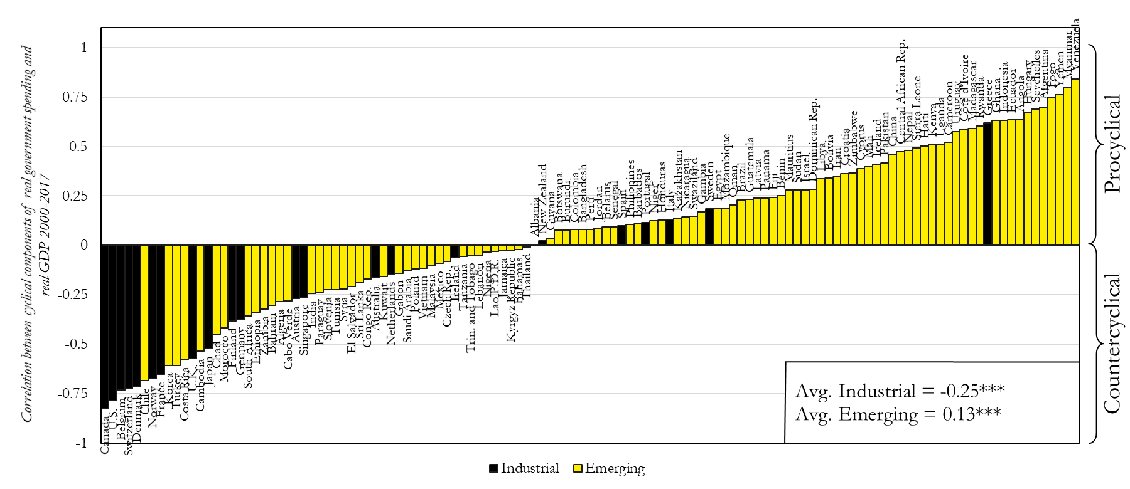



Update of Correlation (Govt spending, GDP):
2000-17
}
After 2010, back-sliding among some countries.
Thanks to Luis Morano.
Cyclical components of both real GDP and real Government Spending are calculated by Hodrick-Prescott filter,
using 6.25 as smoothing parameter and extracting the cyclical components from the series of the level.

Slide 9
Who achieves countercyclical fiscal policy?
Countries with “good institutions”
1960-2009
IQ
Corr(G,GDP)
Corr(G,GDP) = 0.81 – 1.02 (average IQ)
(.09)*** (.15)***
Frankel, Végh & Vuletin; JDE, 2013.
”On Graduation from Fiscal Procyclicality.”
Average Institutional Quality

Slide 10
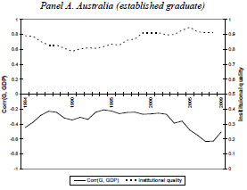
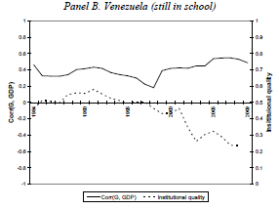
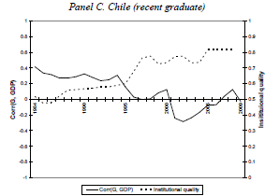



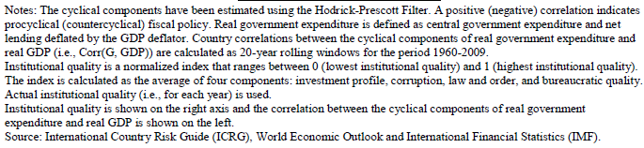
The quality of institutions varies, not just across countries, but also across time.
1984-2009
Worsened institutions;
More-cyclical spending.
Improved institutions;
Less-cyclical spending.
IQ
Good institutions;
Countercyclical spending
Corr
IQ
Corr
Corr
IQ
Frankel, Végh
& Vuletin, 2013.

Slide 11


Advanced countries can suffer pro-cyclicality too.
i) The euro periphery.
ii) The US.

Slide 12
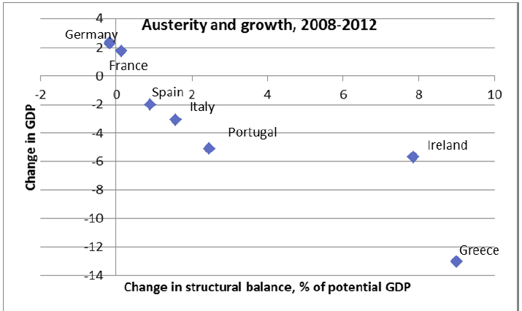



(i) Pro-cyclical fiscal policy in Europe:
When the euro crisis hit in 2009,
the bigger fiscal contractions went with the bigger recessions.
Source: P.Krugman, 10 May 2012.

Slide 13
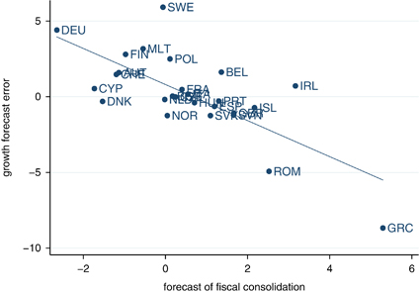
Effects of austerity were worse than the Troika had assumed.
Why? A different kind of over-optimism:
The evidence: the bigger the fiscal contraction, the bigger
the GDP loss relative to what had been officially forecast in 2010.
Europe: Growth Forecast Errors vs. Fiscal Consolidation Forecasts
Blanchard & Leigh, 2014, “Growth Forecast Errors and Fiscal Multipliers,”American Economic Review.
Note: Figure plots forecast error for real GDP growth in 2010 & 2011 relative to forecasts made in
the spring of 2010, on forecasts of fiscal consolidation for 2010 & 2011 made in spring of year 2010.

Slide 14
With austerity, debt/GDP ratios continued to rise sharply:
Declining GDP outweighed progress on reduction of budget deficits.
.

Slide 15

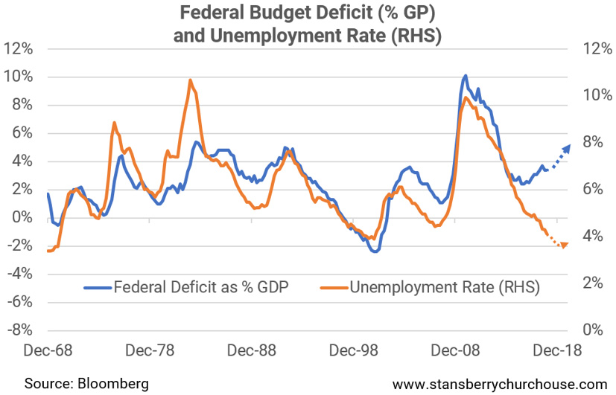
(ii) US fiscal policy
has turned strongly expansionary, for the 1st time since WWII
at a time when the economy is at full employment.
(% GDP)
BD
u
“This is how the world’s biggest economy goes broke…” Tama Churchouse, Feb.26, 2018

Slide 16
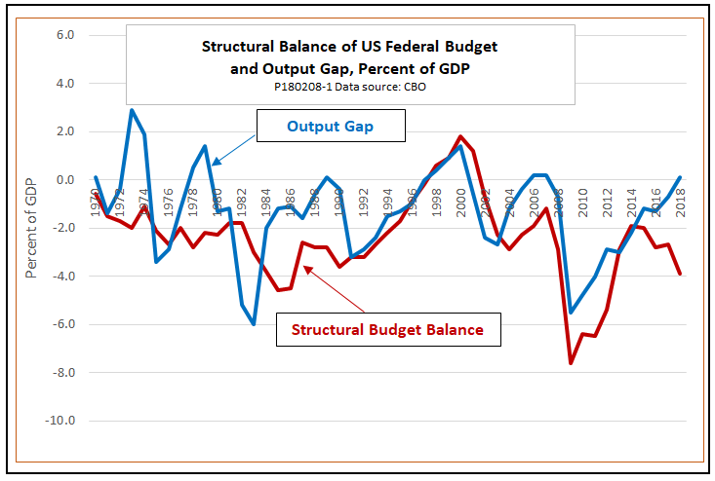
In Dec. 2017, the government cut taxes sharply although the US economy was already operating at its potential.
Ed Dolan, Feb. 8, 2018

Slide 17
American “fiscal conservatives” have behaved pro-cyclically before
 | Conservative leaders | Fiscal action: discipline or laxity? | Cyclicality?
Aug.1988 thru 1990 | G HW Bush | Promised “read my lips, no new taxes” | Boom, so pro-cyclical
Sept. 1990 | G HW Bush | Agreed with Congress to raise taxes & cut spending | Recession, so pro-cyclical
June 1993 | Congressional Republicans | Voted against Clinton’s budget balance law (extension of GHWB’s) | Boom, so pro-cyclical
May 2003 | G W Bush | More tax cuts and more spending. | Boom, so pro-cyclical.
Feb. 2009 | Congressional Republicans | Voted against Obama fiscal stimulus | Recession, so pro-cyclical
Dec. 2017 | Trump | Tax cut, followed by spending increase | Boom, so pro-cyclical

Slide 18
Three kinds of over-optimism
 | Belief | Optimistic policy action | Unintended consequence
Commodity exporters | Booms will continue into the future | Can afford to run deficits during boom. | Pro-cyclical fiscal policy.
Euro-crisis Troika | “Expansionary austerity” | Spending cuts would not hurt GDP much. | Debt/GDP ↑.
American fiscal conservatives | Supply side economics | Tax cuts will boost GDP a lot: Budget deficit ↓. | Budget deficit ↑.

Slide 19

How can countries avoid pro-cyclical fiscal policy?
What are “good institutions,” exactly?
Rules?
  Budget deficit ceilings (SGP) or debt brakes?
    Have been tried by many countries:
      > 97 IMF members.
      Usually fail.
  Rules for cyclically adjusted budgets?
    Countries can more likely stick with them. But…
Rules don’t address a major problem:
  Over-optimism in official forecasts
    of GDP growth rates, tax receipts & budgets.

Slide 20
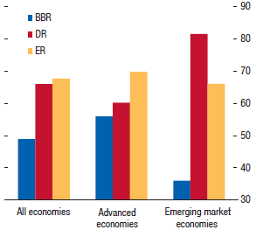

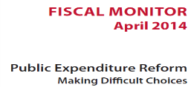

Countries with Balanced Budget Rules frequently violate them.
BBR: Balanced
Budget Rules
DR: Debt Rules
ER: Expenditure Rules
Compliance
< 50%
International Monetary Fund, 2014

Slide 21
Over-optimism in official forecasts
Statistically significant findings among 33 countries
  Frankel (2011, 2012).
Official forecasts on average
are overly optimistic, for:
  (1) budgets &
  (2) GDP .
The bias toward optimism is:
  (3) stronger the longer
  the forecast horizon;
  (4) greater in booms.

Slide 22
Implication of forecast bias for actual budgets
Can lead to pro-cyclical fiscal policy:
  If the boom is forecast to last indefinitely,
  there is no apparent need to retrench.
BD rules don’t help.
  The SGP worsens forecast bias
  for euro countries.
    Frankel & Schreger (2013)

Slide 23
The optimism bias
is significantly greater in booms
and at longer horizons
Budget balance forecast error as % of GDP
Variables | 1 year ahead | 2 years ahead | 3 years ahead
GDP gap | 0.093*** | 0.258*** | 0.289***
 | (0.019) | (0.040) | (0.063)
Constant | 0.201 | 0.649*** | 1.364***
 | (0.197) | (0.231) | (0.348)
Observations | 398 | 300 | 179
R² | 0.033 | 0.113 | 0.092
RMSE | 2.25 | 2.73 | 3.10
*** p<0.01
(Robust standard errors in parentheses, clustered by country.)
GDP gap is lagged so that it lines up with the year
in which forecast was made, not the year being forecast.
Frankel (2011) , Table 2

Slide 24

What institutions might help address the problem of bias in fiscal forecasts?
Evidence, e.g. from Europe, suggests that
fiscal rules are not the solution to the problem.
Evidence suggesting possible solutions:
  (1) Private sector forecasts can help.
  (2) The case of Chile’s fiscal institutions.

Slide 25
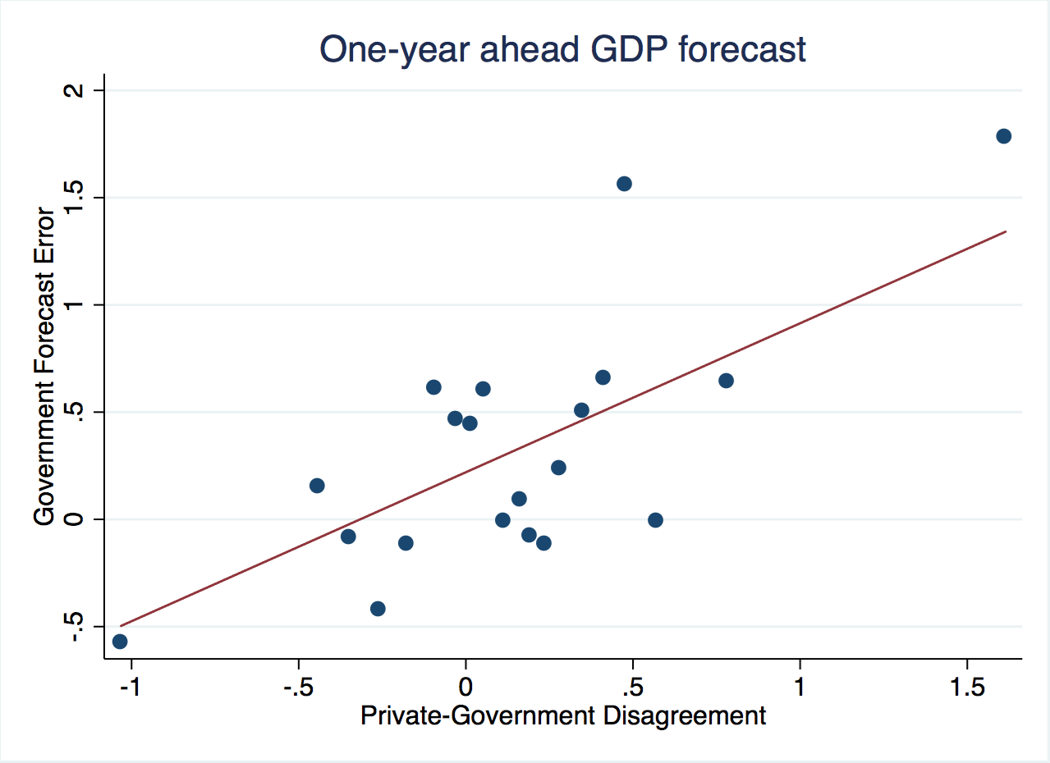
(1) Private forecasts can help
Frankel & Schreger (2016)
When official forecasts of GDP are more optimistic
than private forecasts, on average they are too optimistic.

Slide 26
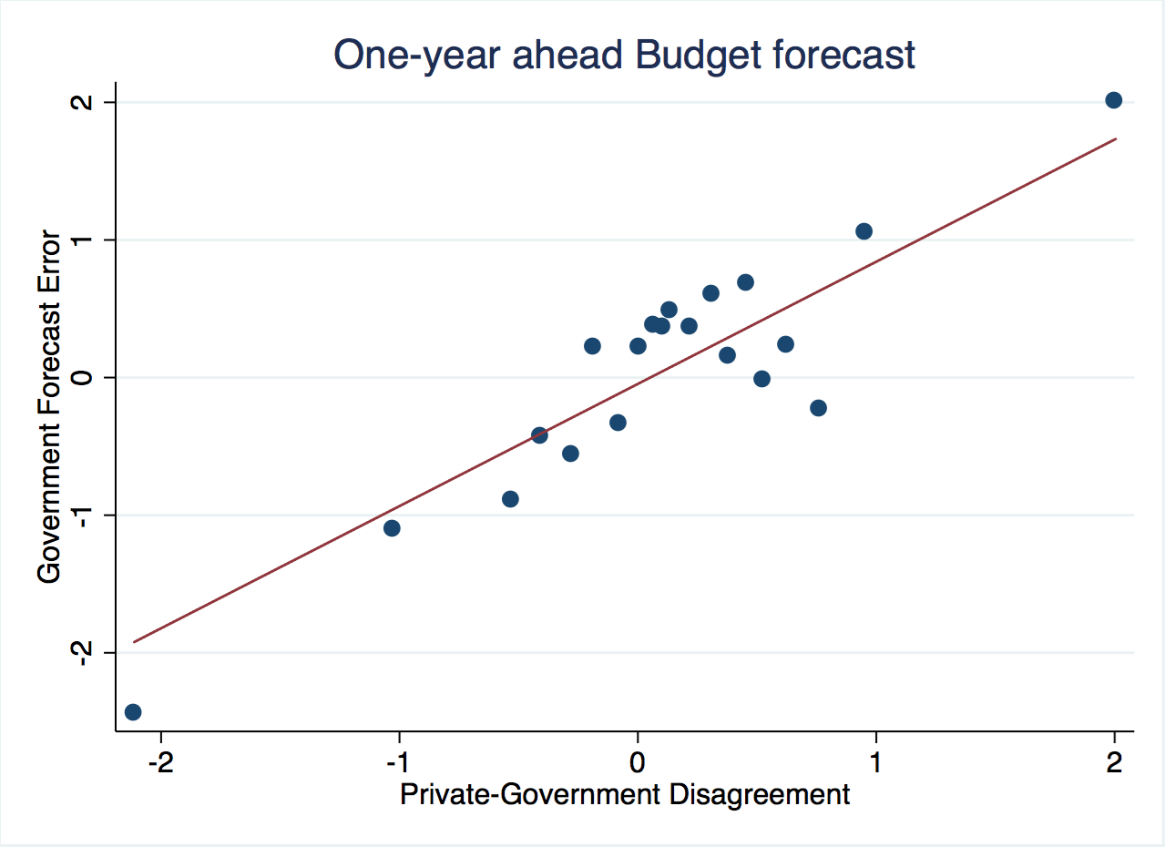
When official forecasts of budget balance are more optimistic
than private forecasts, on average they are too optimistic.
Frankel & Schreger (2016)

Slide 27
Frankel & Schreger (2016)
conclusions regarding private forecasts:
Incorporating private sector forecasts into the budget process could help countries stick to fiscal rules.
Official forecasters are more over-optimistic than private forecasters judged by average outcomes for budget balances & real GDP.
While euro area governments would never forecast violations
of the 3% deficit/GDP cap in the SGP during the period 1999-2009, private sector forecasters would.
Official forecasts could do better over time
by putting some weight on private forecasts.

Slide 28

(2) The case of Chile
Chile’s fiscal institutions appear to have overcome the problem of over-optimism - Frankel (2013)
In 2000 Chile instituted its structural budget rule.
The institution was formalized in law in 2006.
The structural budget surplus must…
  be targeted, at 0 as of 2008,
  where structural is defined by output &
  copper price equal to their long-run trend values.
I.e., in a boom the government can only spend increased revenues that are deemed permanent;
any temporary copper bonanzas must be saved.

Slide 29
Chilean fiscal institutions
Chile did not show bias toward optimism
in forecasts of the budget, growth or copper price.
The key innovation that allowed Chile
to achieve countercyclical fiscal policy:
  not just a structural budget rule in itself,
  but rather a regime that entrusts to two panels
  of independent experts estimation of
  the long-run trends of copper prices & GDP.

Slide 30
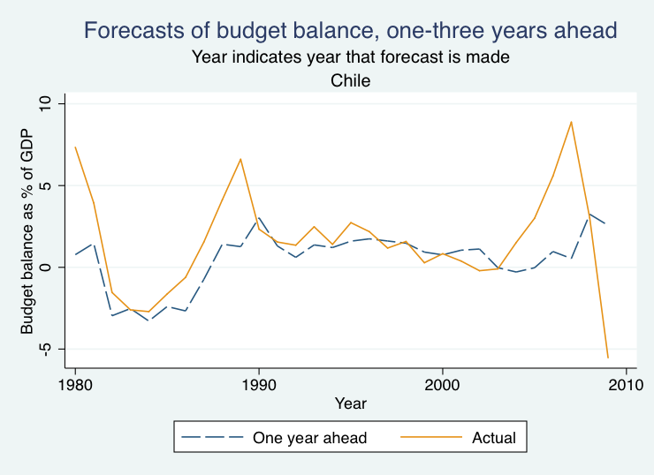

Unlike the rest of the panel of 33 countries,
Chile’s official forecasts were not over-optimistic.
Forecasts of budget balance vs. actual

Slide 31
The Pay-off
Chile’s fiscal position strengthened immediately:
  Public saving rose from 2.5 % of GDP in 2000 to 7.9 % in 2005
  allowing national saving to rise from 21 % to 24 %.
Government debt fell sharply as a share of GDP
and the sovereign spread gradually declined.
By 2006, Chile achieved a sovereign debt rating of A,
    several notches ahead of Latin American peers.
By 2007, it had become a net creditor.
By Dec. 2007, Chile’s sovereign rating had climbed to A+,
    ahead of some advanced countries.
=> It was able to respond to the 2008-09 recession
  via fiscal expansion.

Slide 32
List of relevant references by the author
“Bias in Official Fiscal Forecasts: Can Private Forecasts Help?”
with Jesse Schreger, NBER Working Paper 22349, 2016.
“On Graduation from Fiscal Pro-cyclicality,” with Carlos Végh & Guillermo Vuletin, Journal of Development Economics, 100, 1, 2013; pp. 32-47.
“A Solution to Fiscal Pro-cyclicality: The Structural Budget Institutions Pioneered by Chile,” in Fiscal Policy and Macroeconomic Performance, Luis Felipe Céspedes & Jordi Galí, eds. (Central Bank of Chile: Santiago), 2013, pp. 323-391.
"Over-optimistic Official Forecasts and Fiscal Rules in the Eurozone,"
with J. Schreger; Review of World Economy, 2013. .
"Over-optimism in Forecasts by Official Budget Agencies and Its Implications," Oxford Review of Economic Policy, 2011, 536-562.
“A Lesson From the South for Fiscal Policy in the US and Other Advanced Countries,” Comparative Economic Studies, 2011, 407-430.
“Snake-Oil Tax Cuts,” 2008, HKS RWP 08-056.

Slide 33


Appendices
Appendix I: More on pro-cyclical politicians in the US.
Appendix II: More on forecast bias
  Official forecasts
  Private forecasts
Appendix III: More on
the European case
Appendix IV: More on
delegation of forecasts.

Slide 34

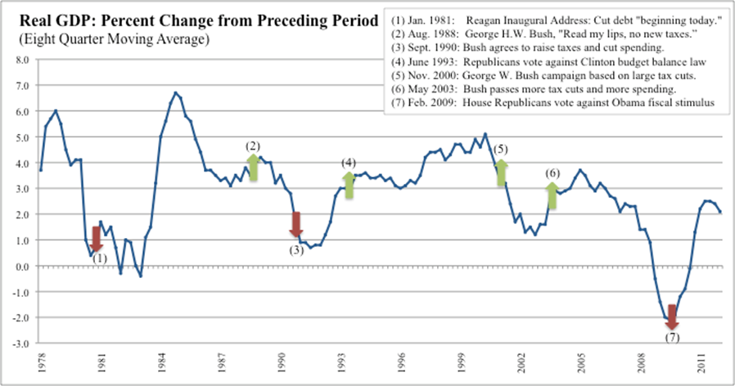
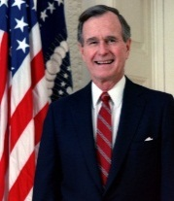
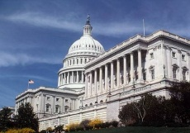
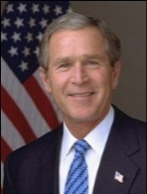
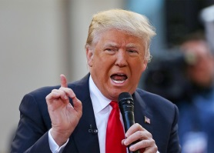


Through 3 cycles, some pursued austerity during recessions, followed by fiscal expansion when the economy was already expanding.
Appendix I: Pro-cyclical politicians in the US
(8) Dec.2017 tax cut at full empl.
(8)

Slide 35
The US 2017 Tax Act boosts real GDP in relation to real potential GDP in the near term, exacerbating excess demand in the economy 2018-2020.
Economic Effects of the 2017 Tax Act at a Glance -- CBO
% of potential
GDP
Excess Demand due to
The Budget and Economic Outlook: 2018 to 2028, US CBO, April 2018, Fig. B-1, p.116.
Potential GDP is CBO’s estimate of the maximum sustainable output of the economy. Excess demand exists when the demand for goods and services exceeds the amount that the economy can sustainably supply. The output gap is the difference between GDP and CBO’s estimate of potential GDP and is expressed as a percentage of potential GDP.

Slide 36
Appendix II:
More on bias in budget forecasts
(1) Bias in official forecasts
(2) Can private forecasts help?

Slide 37
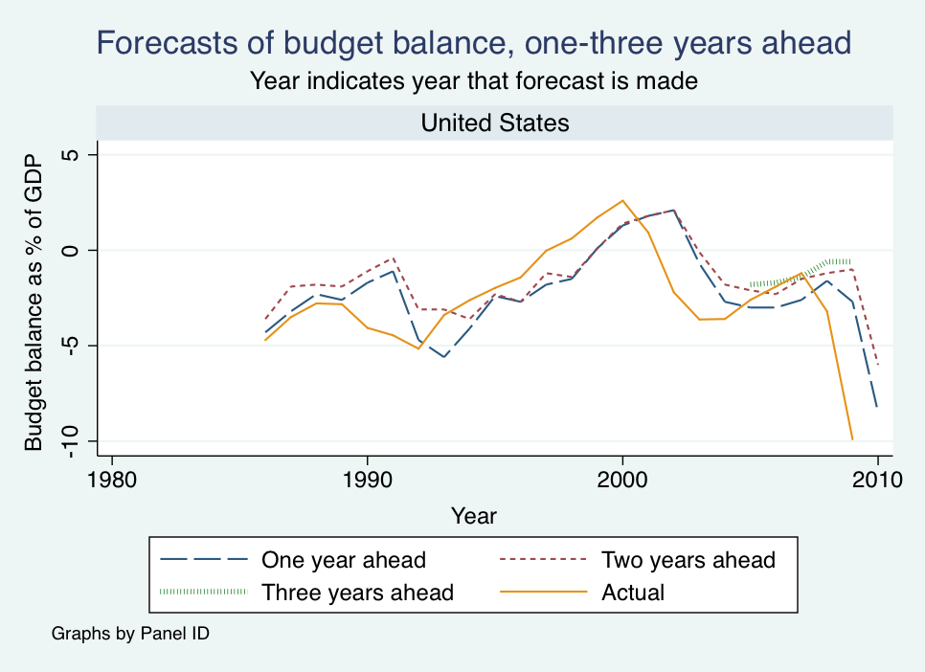
(1) More on bias in official forecasts
US official projections were over-optimistic on average.
F & Schreger, 2013

Slide 38
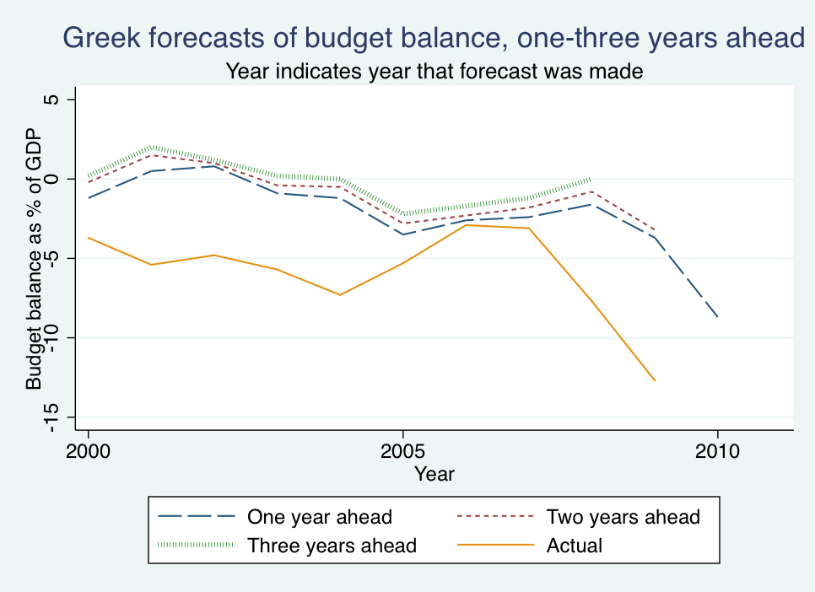
Greek official forecasts were always over-optimistic.
F & Schreger, 2013
Data from Greece’s Stability and Convergence Programs.

Slide 39
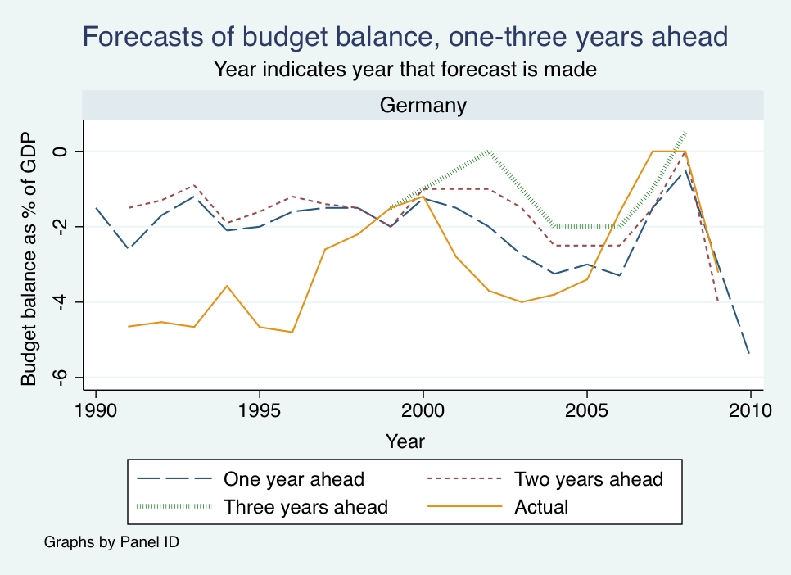

German forecasts were also usually too optimistic.

Slide 40
(2) New results using private sector forecasts,
from Consensus Economics
  Frankel & Schreger (2016)
The extension of the analysis helps answer two important questions.
When the time sample is short, results based on ex post realizations
can be too sensitive to particular historical outcomes:
Might earlier findings of over-optimism be explained by one historical event,
the severe 2008-09 crisis that everyone underestimated?
Private forecasts offer an alternative standard by which to judge performance
of official forecasts, less sensitive to historically volatile ex post outcomes.
If the reform proposal is that budget-makers should use
independent projections such as those by private forecasters,
it may be instructive to test whether private forecasters suffer
from optimism bias as badly as government forecasters.

Slide 41
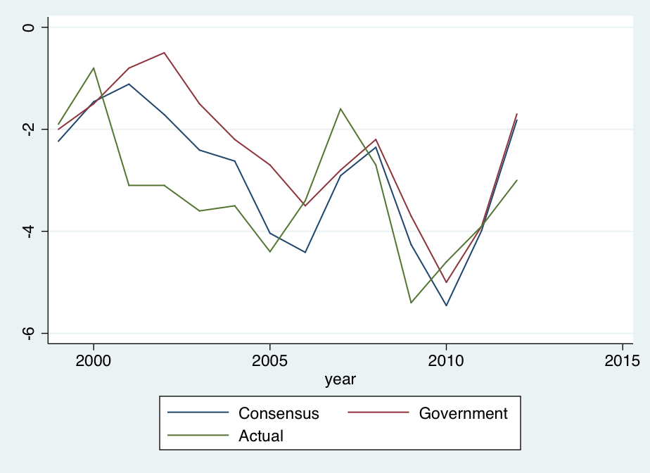
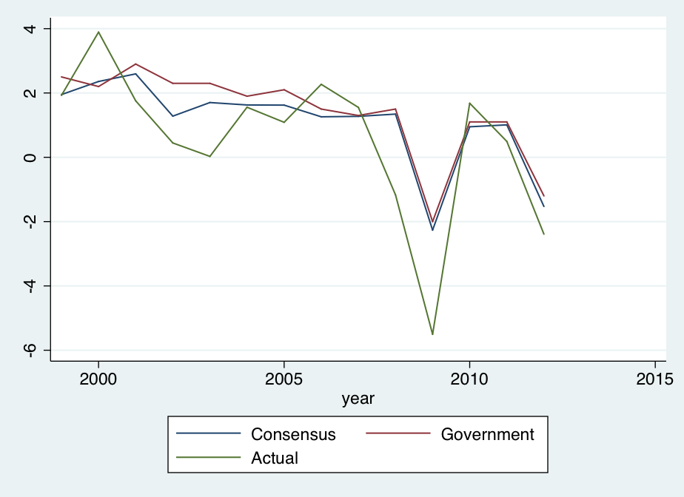

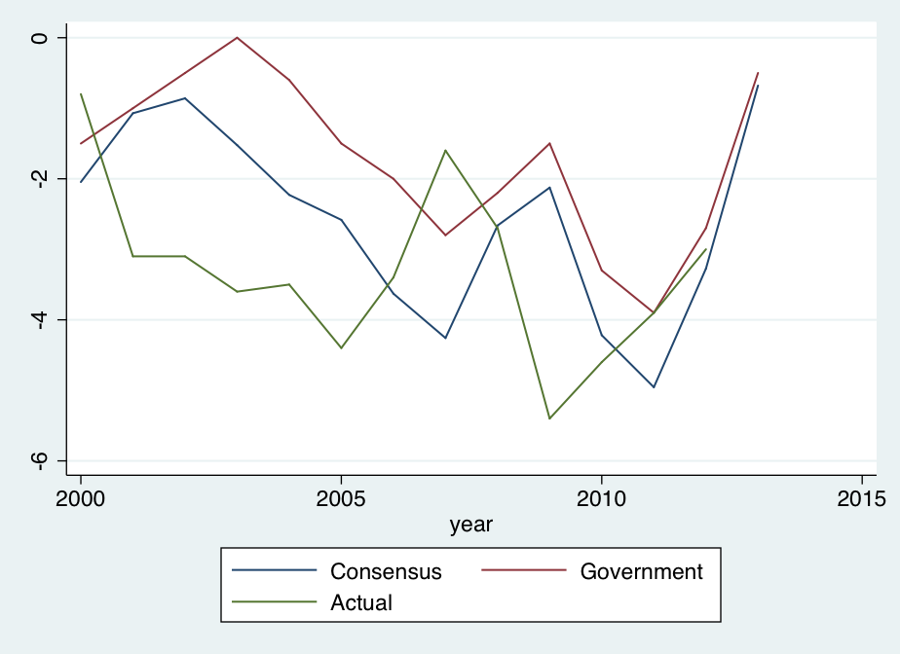
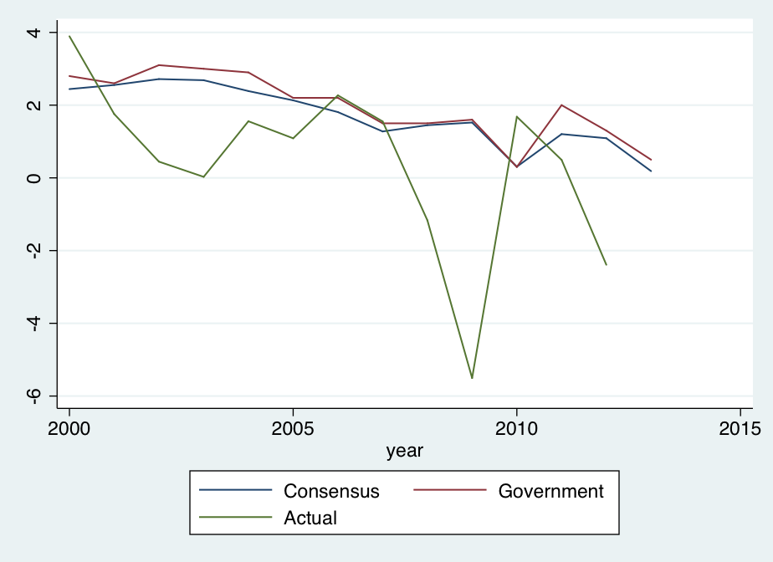
Italy is typical: Private forecasts more realistic than official forecasts
Fig.2: Budget Balance Forecasts
Fig.3: Real GDP Growth Forecasts
1-Year
Ahead
1-year
Ahead
2-Year Ahead
2-Year Ahead
Notes: Forecast year is year being forecast. Frankel & Schreger (June 2013)

Slide 42
Three main results from private forecasts,
for a sample of 26 countries (sample period up to 2013.)
Official forecasters are more over-optimistic than private forecasters on average, at the 1- & 2-year horizon for budget balances and at the 1- & 2-year horizon for real GDP forecasts.
While euro area governments were very reluctant to forecast violations of the 3% deficit/GDP cap in the SGP; private sector forecasters were not.
The difference between official forecast & private forecast
is positively correlated with the difference between
official forecast and ex post realization.
These results suggest that incorporating private sector forecasts into the budget process could help countries stick to fiscal rules,
by identifying over-optimism ex ante rather than just ex post.

Slide 43
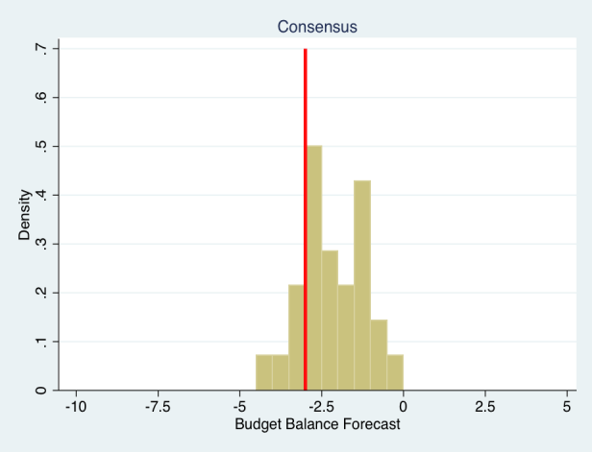
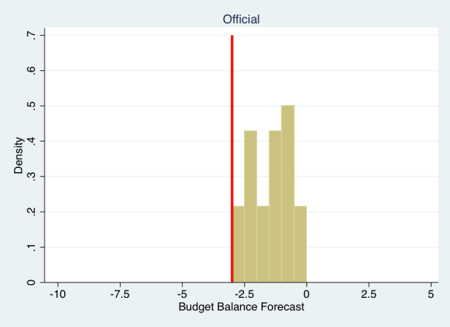
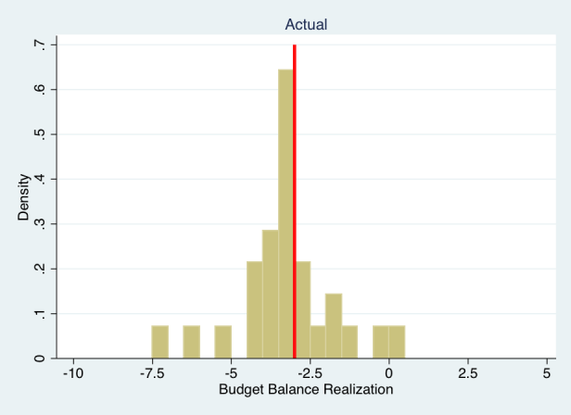
Budget forecasts & realizations in the euro area
2-years ahead, thru 2009
Frankel & Schreger
(2016), Figure 5
In the euro countries, which are subject to SGP rules,
the optimism bias took the form of never forecasting
next year’s budget deficit > 3% of GDP.
Private-sector forecasts surveyed by Consensus Forecasts are free to forecast budget deficits > 3% of GDP.

Slide 44
Frankel & Schreger (2016) Table III
Summary Statistics for Budget Balance Forecasts (% of GDP)
Two-year ahead forecasts (95 observations, 10 countries)
 | Mean | Standard Error
Official Minus Consensus | 0.478*** | (0.086)
Official Forecast Error | 1.060* | (0.541)
Consensus Forecast Error | 0.582 | (0.548)
Driscoll-Kraay Standard Errors with 2 year lag. Only includes countries with at least 6 years of data.
The official budget forecasts are over-optimistic on average.
The private forecasts from Consensus Economics are
significantly less over-optimistic than the official forecasts.

Slide 45
Frankel & Schreger (2016) Table IV
Summary Statistics for GDP Growth Forecasts
Two-year ahead forecasts (278 observations, 23 countries)
 | Mean | Standard Error
Official Minus Consensus | 0.135** | (0.048)
Official Forecast Error | 1.244 | (0.738)
Consensus Forecast Error | 1.110 | (0.736)
Driscoll-Kraay Standard Errors with 2 year lag. Only includes countries with at least 6 years of data.
As with the forecasts of budget balance,
the private forecasts of GDP growth are significantly
less over-optimistic than the official forecasts.

Slide 46
Official GDP Growth Forecast Errors
and Government-Private Disagreement
excluding 2008-09, to make sure the great recession isn’t driving the results
 | (1) Off. Error t+1 | (2) Off. Error t+1 | (3) Off. Error t+2 | (4) Off. Error t+2
Official-Consensus | 0.856*** | 0.845*** | 0.471** | 0.284*
 | (0.161) | (0.181) | (0.203) | (0.135)
Constant | -4.669*** | -1.855** | 1.595*** | 1.141
 | (0.124) | (0.764) | (0.020) | (0.702)
Observations | 272 | 272 | 232 | 232
R-squared | 0.416 | 0.594 | 0.424 | 0.593
Countries | 26 | 26 | 23 | 23
Year FE | Yes | Yes | Yes | Yes
Country FE | No | Yes | No | Yes
Off. Error t+1
The official-private difference in ex ante forecasts
is significantly correlated with the ex post official prediction error.
Frankel & Schreger (2016), Table VII

Slide 47
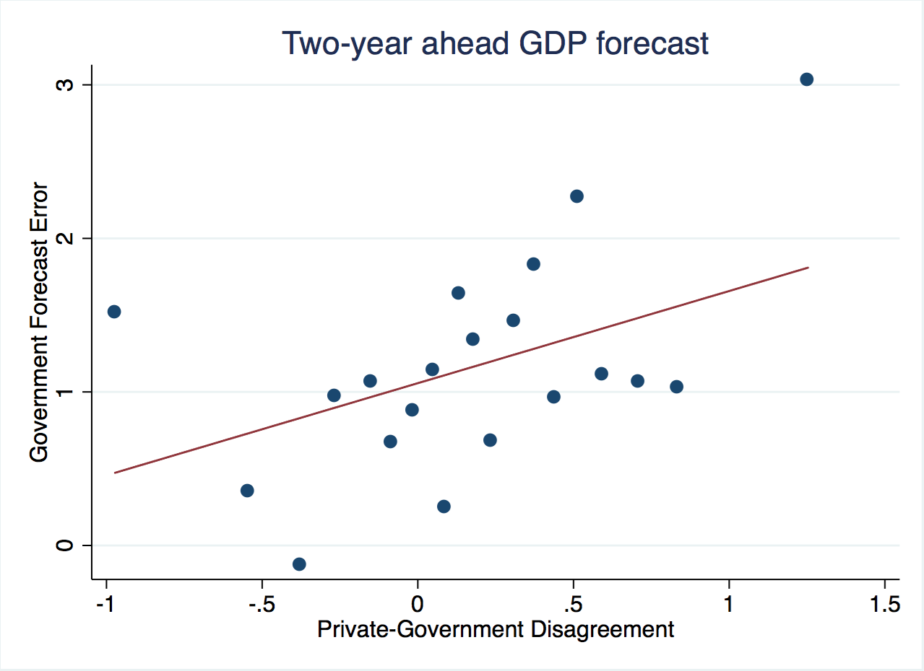
More results using private forecasts
Frankel & Schreger (2016)

Slide 48
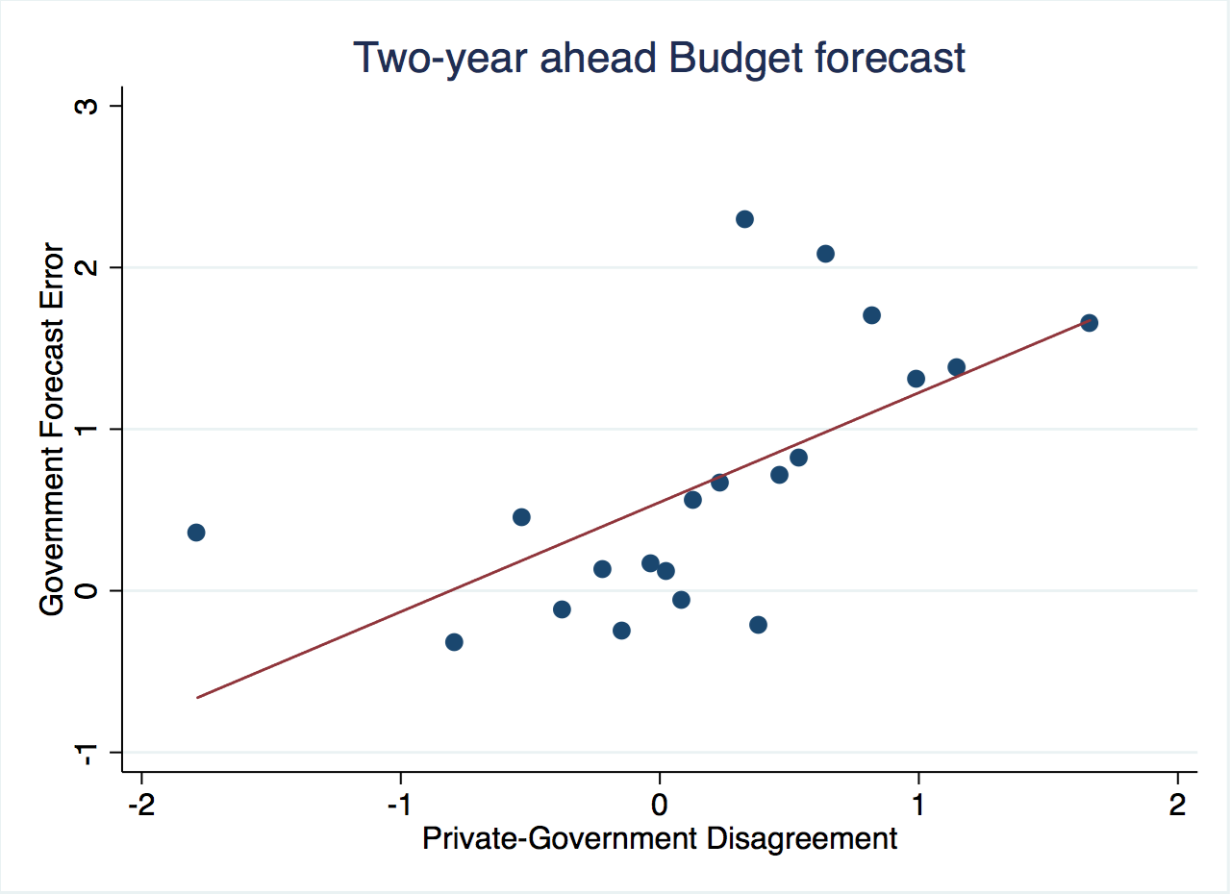
Frankel & Schreger (2016)

Slide 49
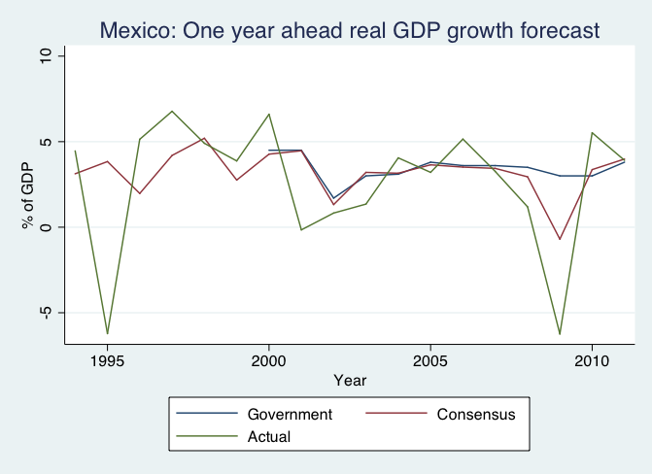
The private sector downgraded forecasts for Mexico
in response to the 2008-09 global crisis,
while government forecasters did not.

Slide 50
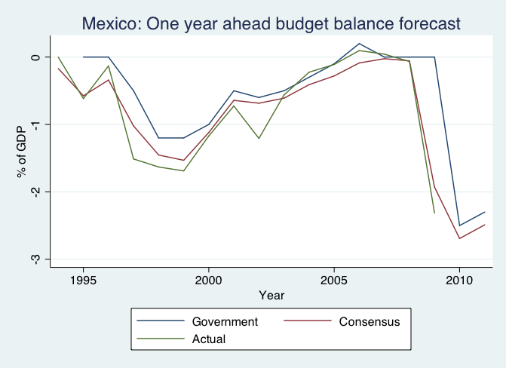
The private sector was also less optimistic
than government forecasters about Mexican budget prospects
especially in the 2009 global crisis.

Slide 51
Econometric findings regarding bias among EU countries in particular.
Appendix III: The Europe case
Euro countries, subject to the SGP,
  show even more optimism bias than others
    in growth forecasts, significant at 1 and 2-year horizons
  particularly when GDP is currently high.
  Forecasts of budget balance among euro countries also show extra bias when GDP is currently high.

Slide 52
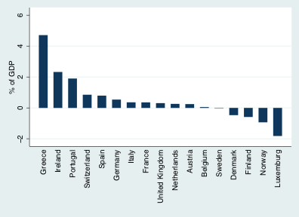
Most European official forecasts were over-optimistic.
Figure 1 (F&S, 2013):
Mean 1-year ahead budget forecast errors, European Countries,
Full Sample Period
For 17 Europeans, the bias is even higher than others, averaging:
0.5% at the 1-year horizon,
1.3% at the 2-year horizon,
2.4% at the 3-year horizon

Slide 53
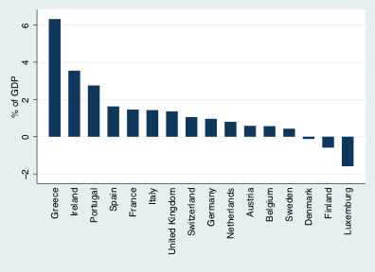
Figure 2 (F&S, 2013):
Mean 2-year ahead budget forecast errors, European Countries,
Full Sample Period

Slide 54
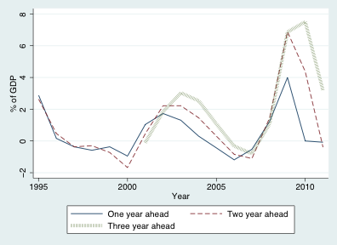
Figure 2 (F&S, 2013):
Mean Budget Forecast Errors, Europe, 1995-2011

Slide 55
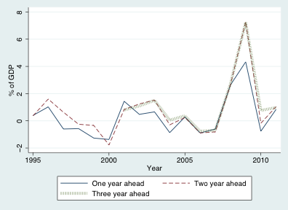
Figure 3 (F&S, 2013):
Mean GDP Growth Forecast Errors, Europe, 1995-2011

Slide 56
GDP growth rate forecast error,
full dataset. Frankel (2011), Table 5 (c)
Variables | 1 year ahead | 2 years ahead | 3 years ahead | 1 year ahead | 2 years ahead | 3 years ahead
SGP dummy | 0.379* | 0.780** | –0.555 | 0.192 | 0.221 | –1.067*
 | (0.199) | (0.352) | (0.529) | (0.215) | (0.410) | (0.549)
SGP*GDPgap |  |  |  | 0.148** | 0.516*** | 0.522***
 |  |  |  | (0.068) | (0.141) | (0.161)
Constant | 0.239 | 0.914*** | 2.436*** | 0.252 | 0.887*** | 2.444***
 | (0.168) | (0.318) | (0.643) | (0.168) | (0.330) | (0.642)
Observations | 369 | 282 | 175 | 368 | 282 | 175
Countries | 33 | 31 | 28 | 33 | 31 | 28
R² | 0.006 | 0.006 | 0.007 | 0.011 | 0.042 | 0.040
RMSE | 2.40 | 3.44 | 3.81 | 2.38 | 3.36 | 3.73
***p<0.01, **p<0.05, *p<0.1. (Robust standard errors in parentheses.) Random effects.
SGP ≡ dummy for countries subject to the SGP.
GDP gap ≡ GDP as deviation from trend.
All variables are lagged so that they line up with the year in which the forecast was made.

Slide 57
Budget balance forecast error,
full dataset. Frankel (2011), Table 3(c).
Variables | 1 year ahead | 2 years ahead | 3 years ahead | 1 year ahead | 2 years ahead | 3 years ahead
SGP dummy | 0.368 | 0.922*** | 0.625 | 0.182 | 0.331 | 0.066
 | (0.342) | (0.329) | (0.415) | (0.335) | (0.355) | (0.449)
SGP * GDP gap |  |  |  | 0.161** | 0.509*** | 0.544***
 |  |  |  | (0.065) | (0.147) | (0.148)
Constant | 0.245 | 0.530** | 1.235*** | 0.219 | 0.501* | 1.240***
 | (0.198) | (0.268) | (0.408) | (0.193) | (0.268) | (0.404)
Observations | 399 | 300 | 179 | 398 | 300 | 179
Countries | 33 | 31 | 29 | 33 | 31 | 29
R² | 0.018 | 0.023 | 0.008 | 0.029 | 0.080 | 0.076
RMSE | 2.113 | 2.701 | 3.130 | 2.122 | 2.614 | 3.011
***p<0.01, **p<0.05, *p<0.1. (Robust standard errors in parentheses.) Random effects.
SGP ≡ dummy for countries subject to the SGP.
GDP gap ≡ GDP as deviation from trend.
All variables are lagged so that they line up with the year in which the forecast was made.

Slide 58
More findings regarding systematic forecast errors in Europe
(Frankel & Schreger, 2013a).
Besides cyclicality (output gap), another determinant of government bias:
they over-forecast speed of disappearance of budget deficits.
 | (1) | (2) | (3)
VARIABLES | BBE_{t+1} | BBE_{t+2} | BBE_{t+3}
Surplus_{t}*BudgetBalance_{t} | -0.080 | -0.295** | -0.175
 | (0.057) | (0.108) | (0.171)
Deficit*BudgetBalance_{t} | -0.293*** | -0.363** | -0.558***
 | (0.064) | (0.134) | (0.180)
Output Gap_{t} | 0.651*** | 1.409*** | 1.812***
 | (0.113) | (0.281) | (0.452)
Constant | -0.150 | 0.459 | 0.932**
 | (0.169) | (0.274) | (0.404)
Observations | 243 | 210 | 164
R-2 | 0.213 | 0.344 | 0.374
Countries | 17 | 16 | 15
Year FE | No | No | No
(Robust s.e.is n parentheses, clustered at the country level.) ***, **, &* : significance at the level of 1, 5, and 10%, respectively.

Slide 59

5 econometric findings regarding official forecasts in Chile.
Frankel, 2013, “A Solution to Fiscal Pro-cyclicality: The Structural Budget Institutions Pioneered by Chile,” in Fiscal Policy and Macroeconomic Performance, Luis Felipe Céspedes & Jordi Galí, editors.
Appendix IV: More on delegation of forecasts
(1) The key macroeconomic input for budget forecasting in most countries: GDP. In Chile: the copper price.
(2) Real copper prices revert to trend in the long run.
But this is not always readily perceived:
  (3) 30 years of data are not enough
  to reject a random walk statistically; 200 years of data are needed.
  (4) Uncertainty (option-implied volatility) is higher
  when copper prices are toward the top of the cycle.
(5) Chile’s official forecasts are not overly optimistic.

Slide 60
Application of the innovation to other countries
Any country could adopt the Chilean mechanism.
Suggestion: give the panels institutional independence
  as is familiar from central banking:
    laws protecting them from being fired.
Open questions:
  How much of the structural budget calculations are
  to be delegated to the independent panels of experts?
    Minimalist approach: they compute only 10-year moving averages.
    Fiscal councils that act as outside checks (Debrun & Kinda, 2014):
      U.S. Congressional Budget Office (1974)
      Swedish Economic Policy Council (2008),
      U.K. Office of Budget Responsibility (2010).
    Can one guard against subversion of the institutions?

Slide 61
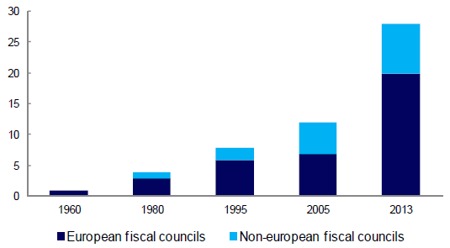
Number of Fiscal Councils
Xavier Debrun and Tidiane Kinda, 2014, “Strengthening Post-Crisis Fiscal Credibility: Fiscal Councils on the Rise—A New Dataset,” IMF WP 14/58, Fig. 1.

Slide 62
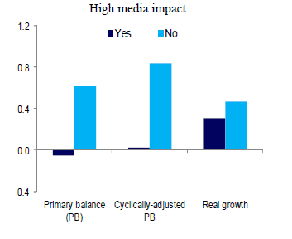
Fiscal councils are less likely to make over-optimistic budget forecasts (esp. cyclically adjusted) if they have high media visibility.
Mean Forecast Error and Fiscal Councils’ Characteristic
%
error
X. Debrun & T. Kinda, 2014, “Strengthening Post-Crisis Fiscal Credibility:
Fiscal Councils on the Rise—A New Dataset,” IMF WP 14/58, Fig. 5.

