Slide 1
Fiscal Procyclicality and
Over-optimism in Official Forecasts
Jeffrey Frankel
Harpel Professor, Harvard University
MAS Term Professor,
National University of Singapore, May 22, 2017

Slide 2
Main papers on which the presentation is based
1) Which countries succeed in running counter-cyclical fiscal policy?
“On Graduation from Fiscal Procyclicality,” with Carlos Vegh & Guillermo Vuletin, Journal of Development Economics, 2013.
2) A possible source of the problem: Are official forecasts biased ?
“Over-optimism in Forecasts by Official Budget Agencies and Its Implications," Oxford Review of Economic Policy, 2011.
3) Is the bias in government forecasts better or worse for countries subject to fiscal rules such as the Stability & Growth Pact?
“Over-optimistic Official Forecasts & Fiscal Rules in the Eurozone,"
with Jesse Schreger, Weltwirtschaftliches Archiv, 2013.
4) Possible solutions: Can private-sector forecasts do better?
“Bias in Official Fiscal Forecasts: Can Private Forecasts Help?”
with Jesse Schreger, Harvard Kennedy School, 2016.

Slide 3

Procyclicality
Fiscal policy has historically tended
to be pro-cyclical in a majority of countries,
especially developing countries, thereby worsening ups & downs in the economic cycle.
Correlation of income & spending mostly positive:
  Cuddington (1989), Gavin & Perotti (1997), Tornell & Lane (1999), Kaminsky, Reinhart & Vegh (2004), Talvi & Végh (2005), Alesina, Mendoza & Oviedo (2006), Campante & Tabellini (2008), Ilzetski & Vegh (2008), Medas & Zakharova (2009), Erbil (2011), Céspedes & Velasco (2014), Avellan & Vuletin (2015).
Tax policy tends to be procyclical as well:
  Vegh & Vuletin (AEJ-EP, 2015).

Slide 4

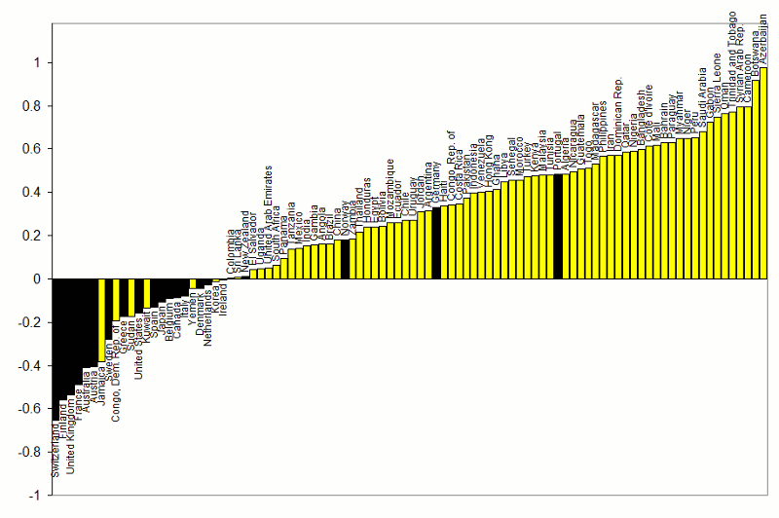



Correlations between Gov.t Spending & GDP
1960-1999
}
procyclical
Adapted from Kaminsky, Reinhart & Vegh (2004)
countercyclical
G always used to be pro-cyclical
for most developing countries.

Slide 5

The procyclicality of fiscal policy, cont.
An important development --
some developing countries were able to break
the historic pattern after 2000:
  taking advantage of the boom of 2002-2008
    to run budget surpluses & build reserves,
  thereby earning the ability to expand
  fiscally in the 2008-09 crisis.
  Chile, Botswana, Malaysia, Indonesia, Korea, China…
  How were they able to achieve counter-cyclicality?
5
Notes:
5
keep

Slide 6
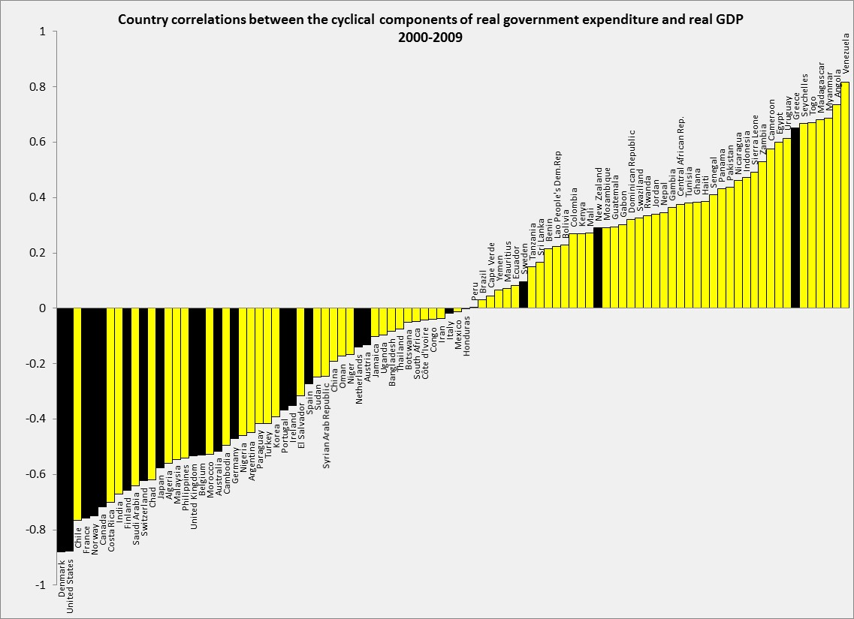
Correlations between Government spending & GDP
2000-2009
Adapted from Frankel, Vegh & Vuletin (JDE, 2013)
In the decade 2000-2009,
about 1/3 developing countries
switched to countercyclical fiscal policy:
Negative correlation of G & GDP.
DEVELOPING:
43% (or 32 out of 75) countercyclical. The figure was 17% (or 13 out of 75) in 1960-1999.
INDUSTRIAL:
86% (or 18 out of 21) countercyclical. The figure was 80% (or 16 out of 20) in 1960-1999.

Slide 7


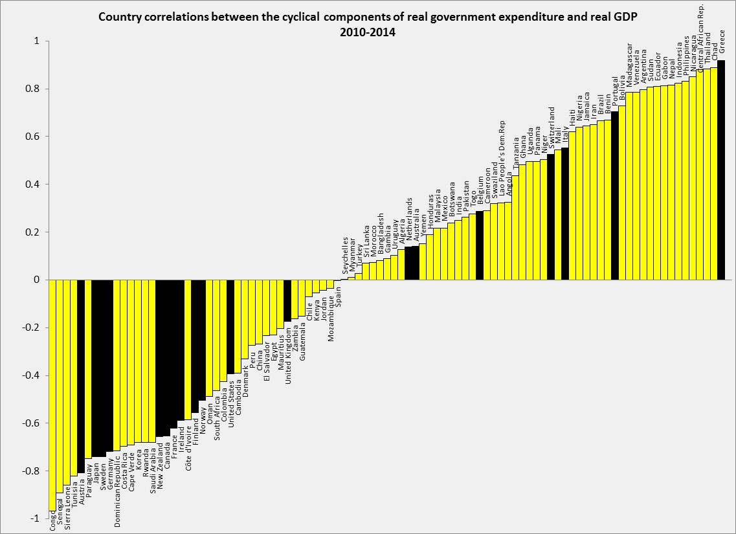


Update of Correlation (G, GDP): 2010-14
Back-sliding among some countries.
Thanks to Guillermo Vuletin
DEVELOPING: 37% (or 29 out of 76) pursue counter-cyclical fiscal policy.
INDUSTRIAL: 63% (or 12 out of 19) pursue counter-cyclical fiscal policy.

Slide 8
Who achieves countercyclical fiscal policy?
Countries with “good institutions”
IQ
”On Graduation from Fiscal Procyclicality,”
Frankel, Végh & Vuletin; J.Dev.Economics, 2013.

Slide 9
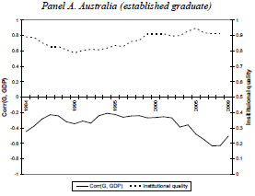
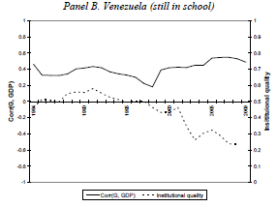
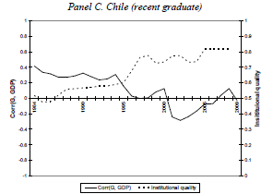



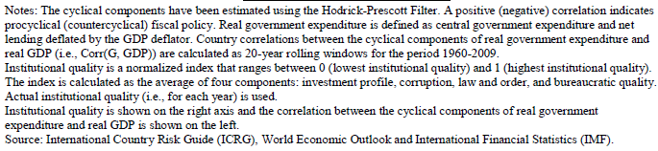
The quality of institutions varies, not just across countries, but also across time.
1984-2009
Worsened institutions;
More-cyclical spending.
Improved institutions;
Less-cyclical spending.
Good institutions;
Countercyclical spending
Frankel, Végh
& Vuletin, 2013.

Slide 10
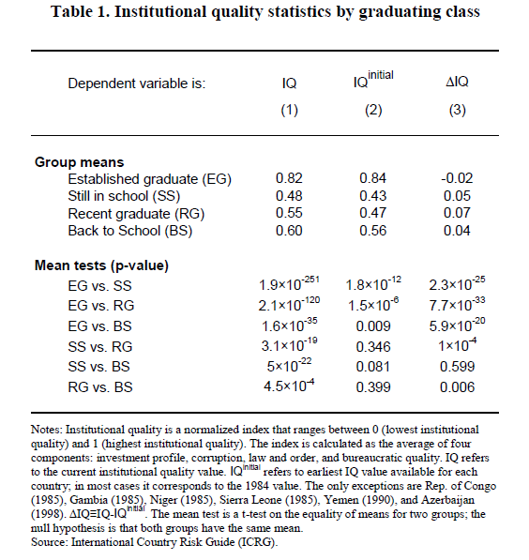
The countries
that graduated to countercyclical fiscal policy after 2000, statistically,
are those where institutional quality improved.
”On Graduation from
Fiscal Procyclicality,”
Frankel, Végh & Vuletin;
J. Dev. Econ., 2013.

Slide 11

How can countries avoid pro-cyclical fiscal policy?
What are “good institutions,” exactly?
Rules?
  Budget deficit ceilings (SGP) or debt brakes?
    Have been tried by many countries:
      97 IMF members, by 2013.
      Usually fail.
  Rules for cyclically adjusted budgets?
    Countries can more likely stick with them. But…
Rules don’t address a major problem:
  Over-optimism in official forecasts
    of GDP growth rates, tax receipts & budgets.

Slide 12
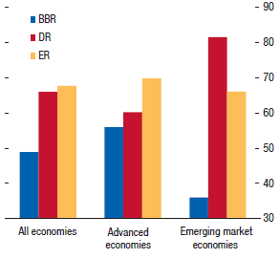

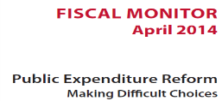

Countries with Balanced Budget Rules frequently violate them.
BBR: Balanced
Budget Rules
DR: Debt Rules
ER: Expenditure Rules
Compliance
< 50%
International Monetary Fund, 2014

Slide 13

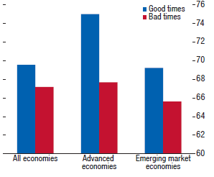
To expect countries to comply with the rules during recessions is particularly unrealistic
(and not even necessarily desirable).
Bad times: years when output gap < 0
International Monetary Fund, 2014

Slide 14
Over-optimism in official forecasts
Statistically significant findings among 33 countries
  Frankel (2011, 2012).
Official forecasts on average
are overly optimistic, for:
  (1) budgets &
  (2) GDP .
The bias toward optimism is:
  (3) stronger the longer the forecast horizon;
  (4) greater in booms.

Slide 15
Implication of forecast bias for actual budgets
Can lead to pro-cyclical fiscal policy:
  If the boom is forecast to last indefinitely,
  there is no apparent need to retrench.
BD rules don’t help.
  The SGP worsens forecast bias
  for euro countries.
      Frankel & Schreger (2013)

Slide 16
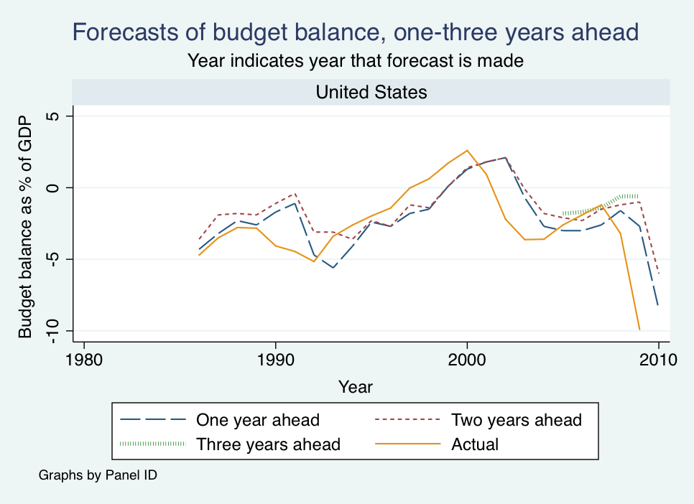

US official projections were over-optimistic on average.
F & Schreger, 2013

Slide 17
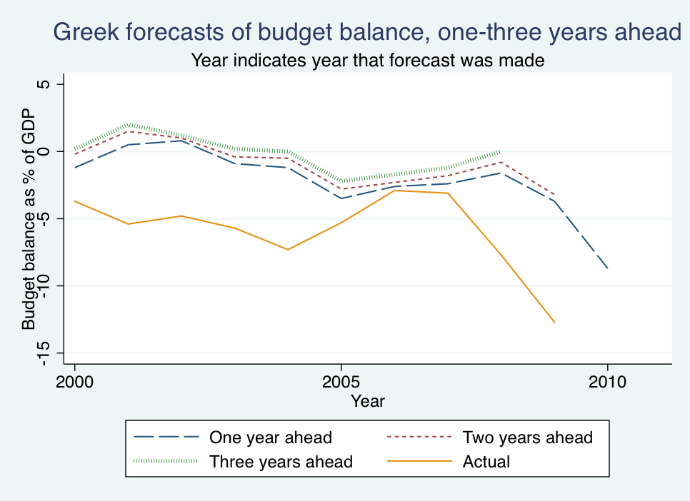
Greek official forecasts were always over-optimistic.
F & Schreger, 2013
Data from Greece’s Stability and Convergence Programs.

Slide 18
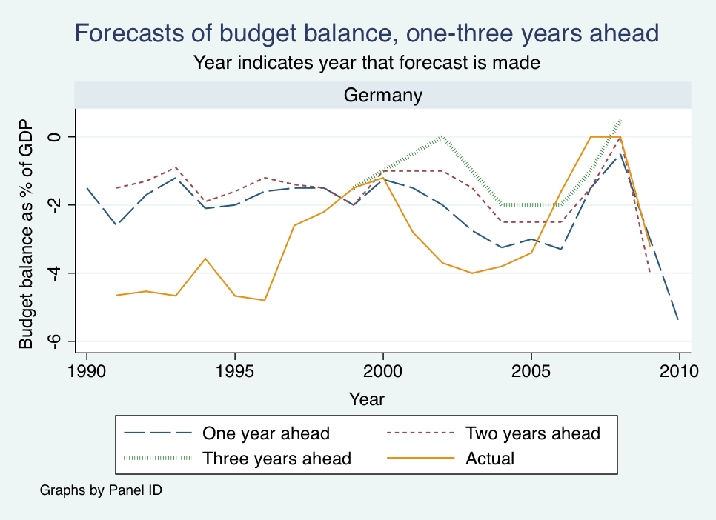

German forecasts were also usually too optimistic.

Slide 19
Table 2: Frankel (2011)
Budget balance forecast error as % of GDP, full dataset
Variables | 1 year ahead | 2 years ahead | 3 years ahead
GDP gap | 0.093*** | 0.258*** | 0.289***
 | (0.019) | (0.040) | (0.063)
Constant | 0.201 | 0.649*** | 1.364***
 | (0.197) | (0.231) | (0.348)
Observations | 398 | 300 | 179
R² | 0.033 | 0.113 | 0.092
RMSE | 2.25 | 2.73 | 3.10
*** p<0.01, ** p<0.05, * p<0.1.
(Robust standard errors in parentheses, clustered by country.)
Note: GDP gap is lagged so that it lines up with the year
in which the forecast was made, not the year being forecast.

Slide 20

Econometric findings regarding bias among EU countries in particular.
Euro countries, subject to the SGP,
  show even more optimism bias than others
    in growth forecasts, significant at 1 and 2-year horizons
  particularly when GDP is currently high.
  Forecasts of budget balance among euro countries also show extra bias when GDP is currently high.

Slide 21
GDP growth rate forecast error,
full dataset. Frankel (2011), Table 5 (c)
Variables | 1 year ahead | 2 years ahead | 3 years ahead | 1 year ahead | 2 years ahead | 3 years ahead
SGP dummy | 0.379* | 0.780** | –0.555 | 0.192 | 0.221 | –1.067*
 | (0.199) | (0.352) | (0.529) | (0.215) | (0.410) | (0.549)
SGP*GDPgap |  |  |  | 0.148** | 0.516*** | 0.522***
 |  |  |  | (0.068) | (0.141) | (0.161)
Constant | 0.239 | 0.914*** | 2.436*** | 0.252 | 0.887*** | 2.444***
 | (0.168) | (0.318) | (0.643) | (0.168) | (0.330) | (0.642)
Observations | 369 | 282 | 175 | 368 | 282 | 175
Countries | 33 | 31 | 28 | 33 | 31 | 28
R² | 0.006 | 0.006 | 0.007 | 0.011 | 0.042 | 0.040
RMSE | 2.40 | 3.44 | 3.81 | 2.38 | 3.36 | 3.73
***p<0.01, **p<0.05, *p<0.1. (Robust standard errors in parentheses.) Random effects.
SGP ≡ dummy for countries subject to the SGP.
GDP gap ≡ GDP as deviation from trend.
All variables are lagged so that they line up with the year in which the forecast was made.

Slide 22
Budget balance forecast error,
full dataset. Frankel (2011), Table 3(c).
Variables | 1 year ahead | 2 years ahead | 3 years ahead | 1 year ahead | 2 years ahead | 3 years ahead
SGP dummy | 0.368 | 0.922*** | 0.625 | 0.182 | 0.331 | 0.066
 | (0.342) | (0.329) | (0.415) | (0.335) | (0.355) | (0.449)
SGP * GDPgap |  |  |  | 0.161** | 0.509*** | 0.544***
 |  |  |  | (0.065) | (0.147) | (0.148)
Constant | 0.245 | 0.530** | 1.235*** | 0.219 | 0.501* | 1.240***
 | (0.198) | (0.268) | (0.408) | (0.193) | (0.268) | (0.404)
Observations | 399 | 300 | 179 | 398 | 300 | 179
Countries | 33 | 31 | 29 | 33 | 31 | 29
R² | 0.018 | 0.023 | 0.008 | 0.029 | 0.080 | 0.076
RMSE | 2.113 | 2.701 | 3.130 | 2.122 | 2.614 | 3.011
***p<0.01, **p<0.05, *p<0.1. (Robust standard errors in parentheses.) Random effects.
SGP ≡ dummy for countries subject to the SGP.
GDP gap ≡ GDP as deviation from trend.
All variables are lagged so that they line up with the year in which the forecast was made.

Slide 23
What institutions might help address the problem of bias in fiscal forecasts?
The evidence from the euro-zone and other countries suggests that fiscal rules are not the solution to the problem.
Two papers offer suggestions of possible answers:
  The use of private sector forecasts.
  The case of Chile’s fiscal institutions.

Slide 24
New research brings in private sector forecasts,
from Consensus Economics
  Frankel & Schreger (2016)
The extension of the analysis helps answer two important questions.
When the time sample is short, results based on ex post realizations
can be too sensitive to particular historical outcomes:
Might earlier findings of over-optimism be explained by one historical event,
the severe 2008-09 crisis that everyone underestimated?
Private forecasts offer an alternative standard by which to judge performance
of official forecasts, less sensitive to historically volatile ex post outcomes.
If the reform proposal is that budget-makers should use
independent projections such as those by private forecasters,
it may be instructive to test whether private forecasters suffer
from optimism bias as badly as government forecasters.

Slide 25
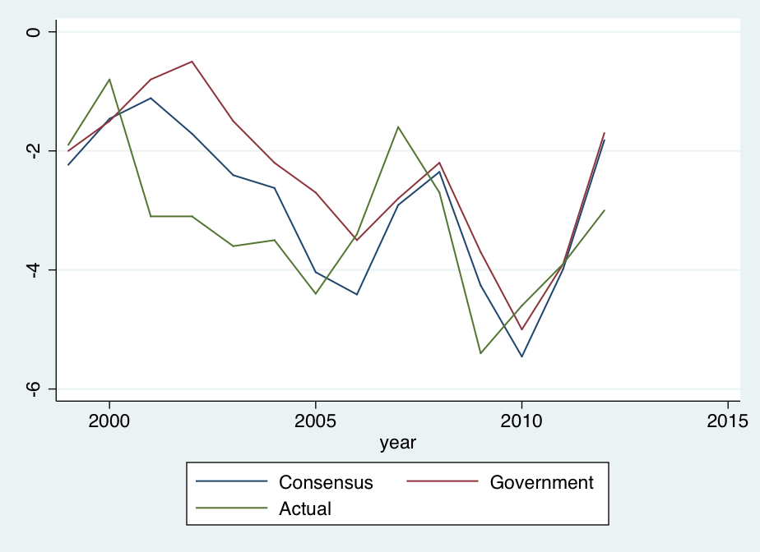
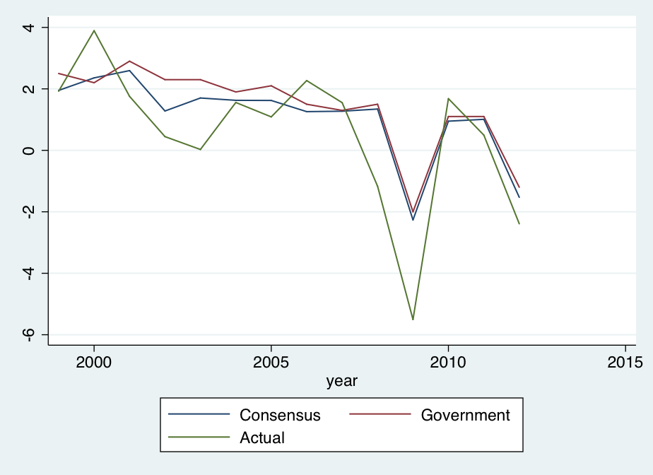

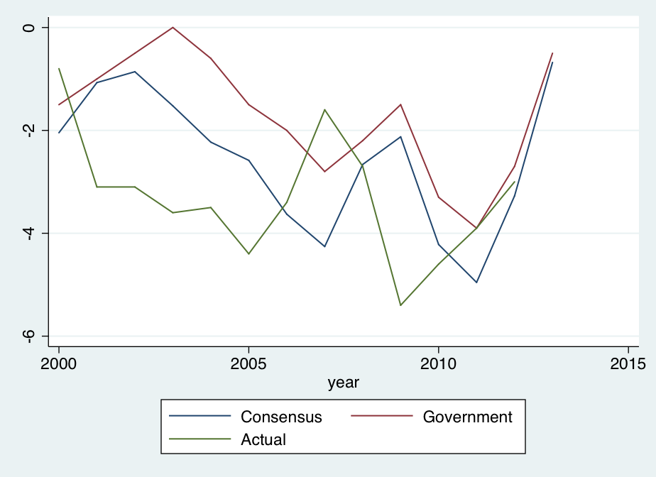
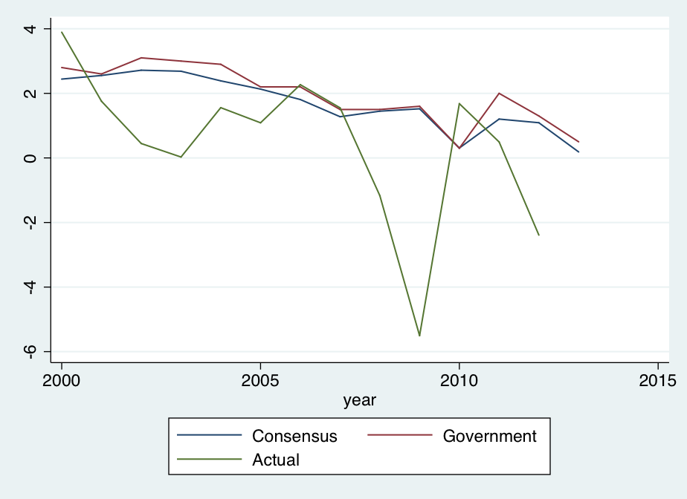
Italy is typical: Private forecasts more realistic than official forecasts
Fig.2: Budget Balance Forecasts
Fig.3: Real GDP Growth Forecasts
1-Year
Ahead
1-year
Ahead
2-Year Ahead
2-Year Ahead
Notes: Forecast year is year being forecast. Frankel & Schreger (June 2013)

Slide 26
We have three main new results,
for a sample of 26 countries (sample period up to 2013.)
Official forecasters are more over-optimistic than private forecasters on average, at the 1- & 2-year horizon for budget balances and at the 1- & 2-year horizon for real GDP forecasts.
While euro area governments were very reluctant to forecast violations of the 3% deficit/GDP cap in the SGP; private sector forecasters were not.
The difference between official forecast & private forecast
is positively correlated with the difference between
official forecast and ex post realization.
These results suggest that incorporating private sector forecasts into the budget process could help countries stick to fiscal rules,
by identifying over-optimism ex ante rather than just ex post.

Slide 27
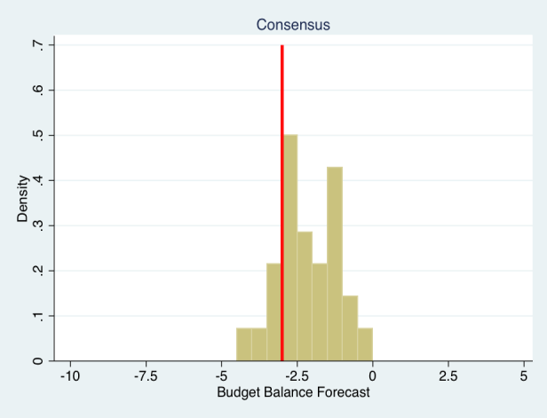
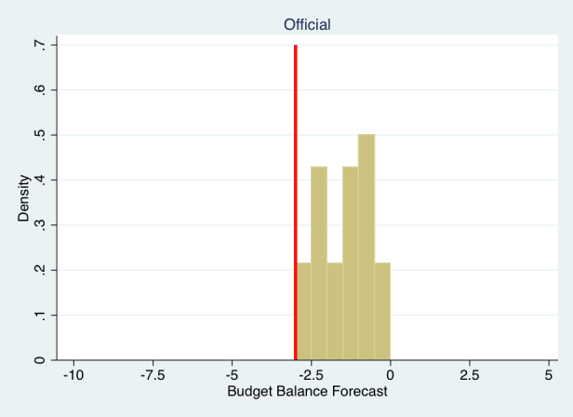
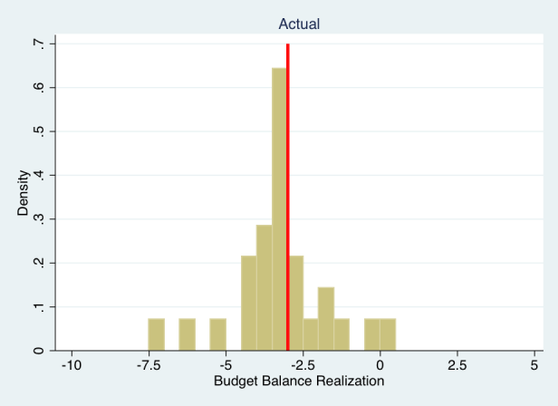
Budget forecasts & realizations in the euro area
2-years ahead, thru 2009
Frankel & Schreger
(2016), Figure 5
In the euro countries, which are subject to SGP rules,
the optimism bias took the form of never forecasting
next year’s budget deficit > 3% of GDP.
Private-sector forecasts surveyed by Consensus Forecasts are free to forecast budget deficits > 3% of GDP.

Slide 28
Frankel & Schreger (2016) Table III
Summary Statistics for Budget Balance Forecasts (% of GDP)
Two-year ahead forecasts (95 observations, 10 countries)
 | Mean | Standard Error
Official Minus Consensus | 0.478*** | (0.086)
Official Forecast Error | 1.060* | (0.541)
Consensus Forecast Error | 0.582 | (0.548)
Driscoll-Kraay Standard Errors with 2 year lag. Only includes countries with at least 6 years of data.
The official budget forecasts are over-optimistic on average.
The private forecasts from Consensus Economics are
significantly less over-optimistic than the official forecasts.

Slide 29
Frankel & Schreger (2016) Table IV
Summary Statistics for GDP Growth Forecasts
Two-year ahead forecasts (278 observations, 23 countries)
 | Mean | Standard Error
Official Minus Consensus | 0.135** | (0.048)
Official Forecast Error | 1.244 | (0.738)
Consensus Forecast Error | 1.110 | (0.736)
Driscoll-Kraay Standard Errors with 2 year lag. Only includes countries with at least 6 years of data.
As with the forecasts of budget balance,
the private forecasts of GDP growth are significantly
less over-optimistic than the official forecasts.

Slide 30
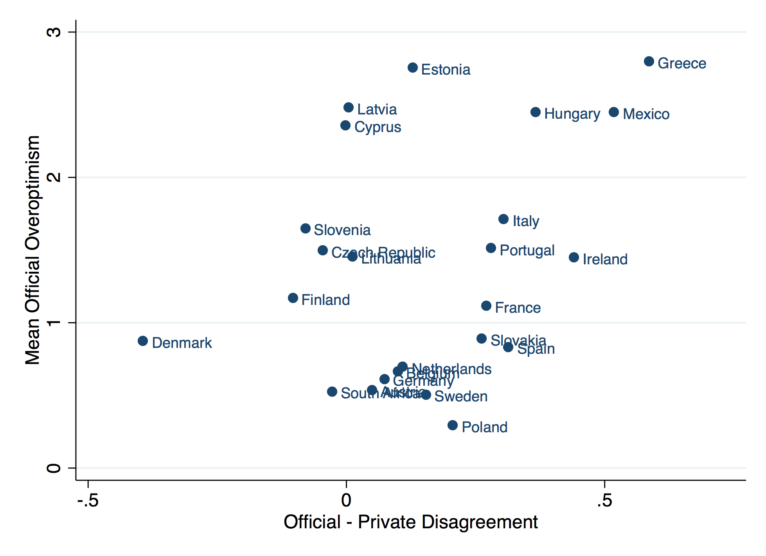
GDP Growth Forecasts, 2-Year Ahead)
Frankel & Schreger (2016), Figure 4
The official-private forecast difference is correlated with the official prediction error.

Slide 31
Official GDP Growth Forecast Errors
and Government-Private Disagreement
excluding 2008-09, to make sure the great recession isn’t driving the results
 | (1) Off. Error t+1 | (2) Off. Error t+1 | (3) Off. Error t+2 | (4) Off. Error t+2
Official-Consensus | 0.856*** | 0.845*** | 0.471** | 0.284*
 | (0.161) | (0.181) | (0.203) | (0.135)
Constant | -4.669*** | -1.855** | 1.595*** | 1.141
 | (0.124) | (0.764) | (0.020) | (0.702)
Observations | 272 | 272 | 232 | 232
R-squared | 0.416 | 0.594 | 0.424 | 0.593
Countries | 26 | 26 | 23 | 23
Year FE | Yes | Yes | Yes | Yes
Country FE | No | Yes | No | Yes
Off. Error t+1
The official-private difference in ex ante forecasts
is significantly correlated with the ex post official prediction error.
Frankel & Schreger (2016), Table VII

Slide 32
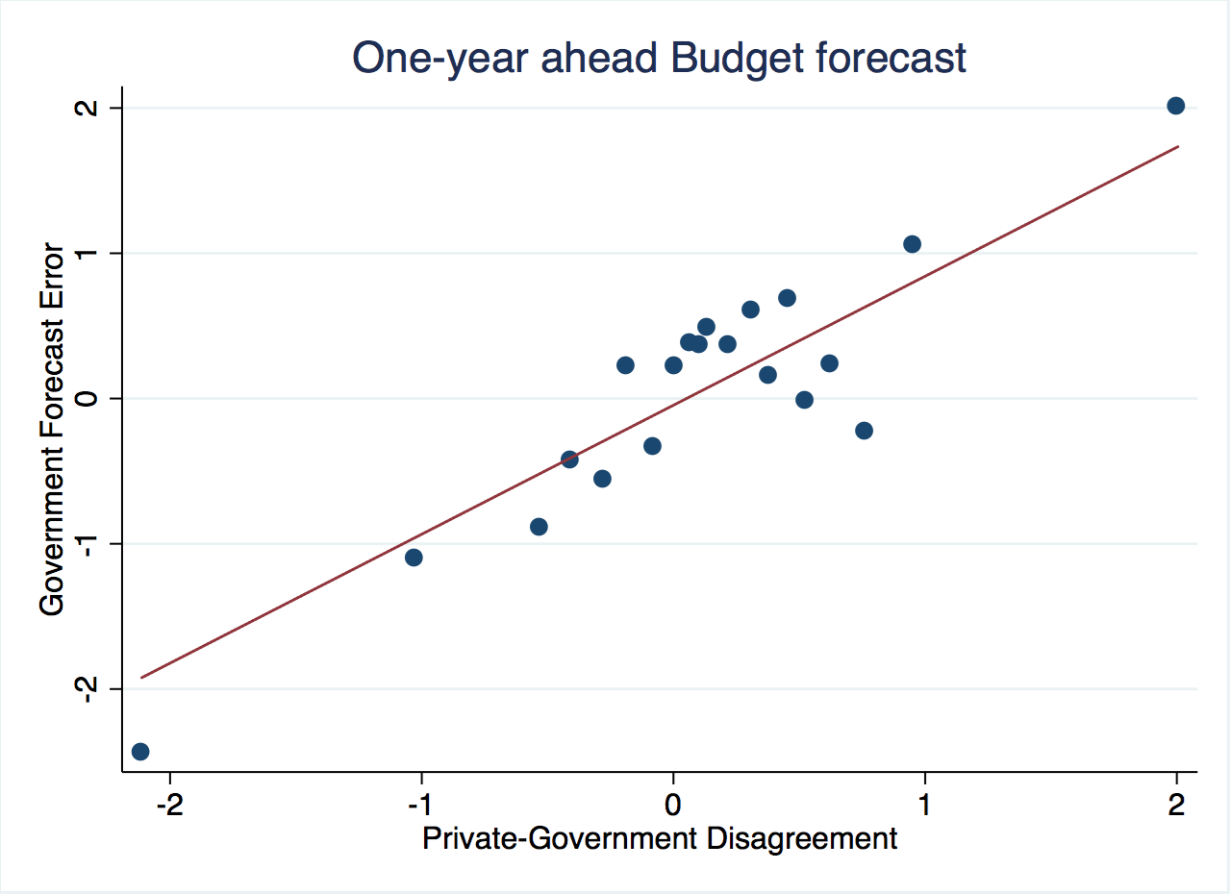
When official forecasts of budget balance are more optimistic
than private forecasts, they are too optimistic.

Slide 33
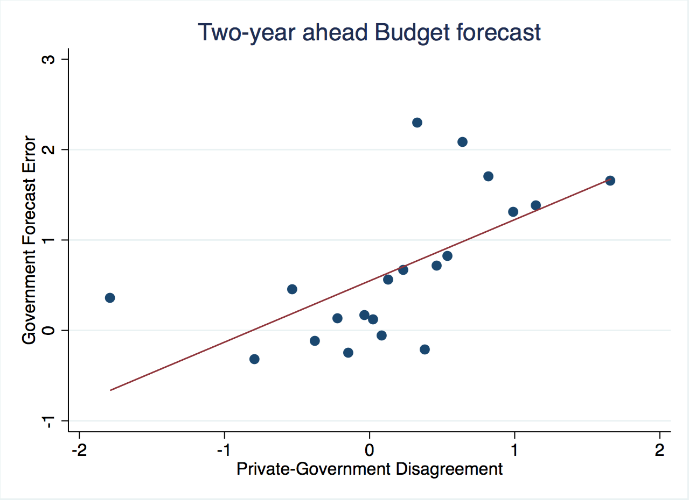

Slide 34
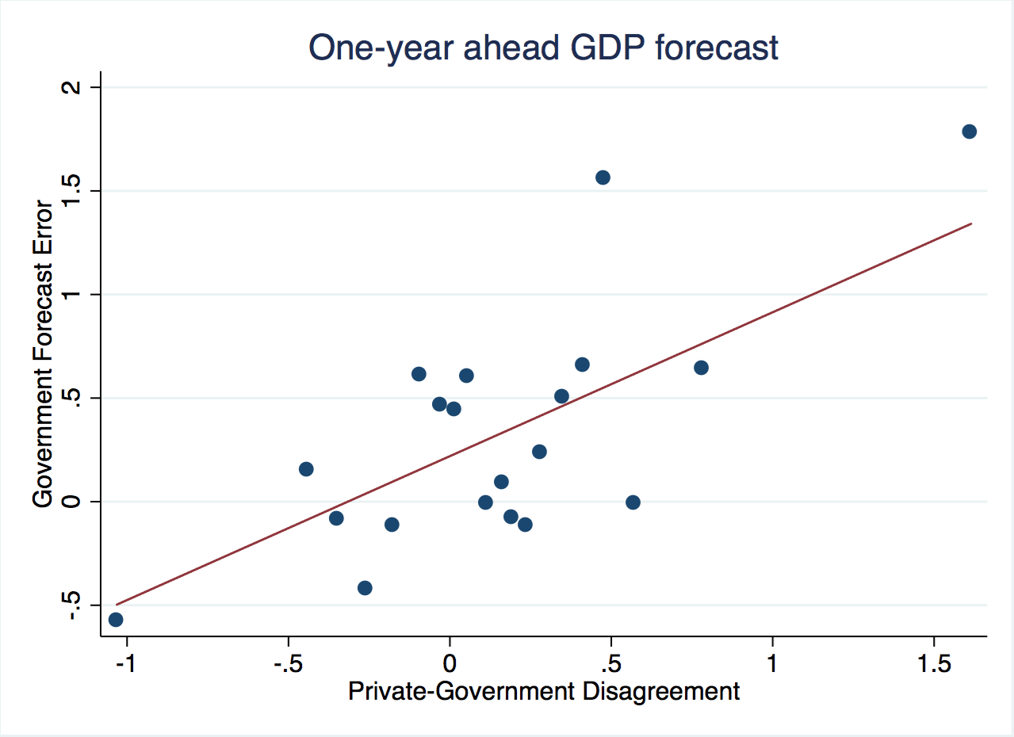
When official forecasts of GDP are more optimistic
than private forecasts, they are too optimistic.

Slide 35
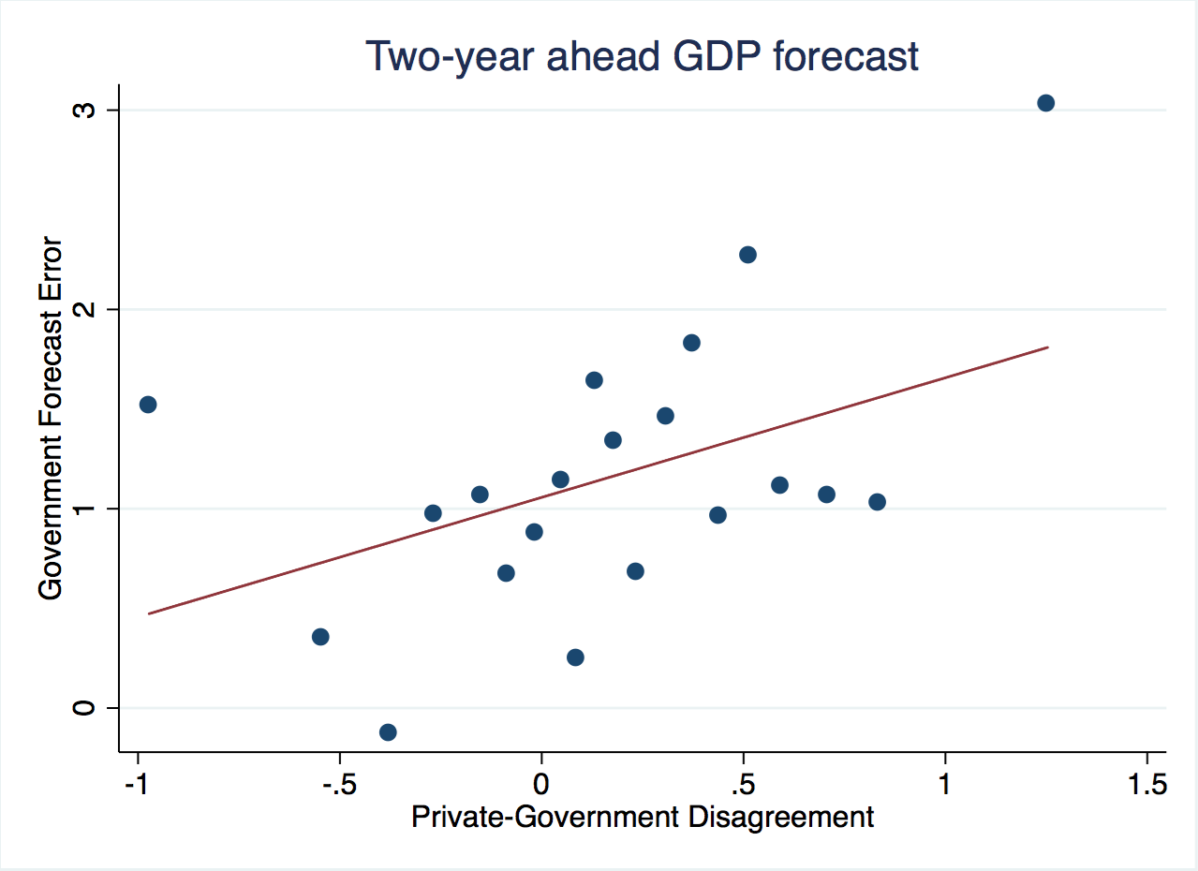

Slide 36
Conclusions regarding private forecasts
Incorporating private sector forecasts into the budget process could help countries stick to fiscal rules:
Official forecasters are more over-optimistic than private forecasters judged by outcomes for budget balances & real GDP.
While euro area governments were very reluctant to forecast violations of the 3% deficit/GDP cap in the SGP during the period 1999-2009, private sector forecasters were not.
The difference between official forecast & private forecast
is positively correlated with the difference between official forecast and ex post realization, i.e., the prediction error.

Slide 37


A possible solution: The case of Chile’s institutions
1st rule – Governments
must set a budget target,
2nd rule – The target is structural:
Deficits allowed only to the extent that
  (1) output falls short of trend, in a recession,
  (2) or the price of copper is below its trend.
3rd rule – The trends are projected by 2 panels
of independent experts, outside the political process.
  Result: Chile avoided the pattern of 32 other governments,
    where forecasts in booms were biased toward optimism.
Notes:
37

Slide 38
Chilean fiscal institutions
In 2000 Chile instituted its structural budget rule.
The institution was formalized in law in 2006.
The structural budget surplus must be…
  0 as of 2008 (was 1%, then ½ %, before; negative after),
  where structural is defined by output & copper price
  equal to their long-run trend values.
I.e., in a boom the government can only spend increased revenues that are deemed permanent;
any temporary copper bonanzas must be saved.

Slide 39
The Pay-off
Chile’s fiscal position strengthened immediately:
  Public saving rose from 2.5 % of GDP in 2000 to 7.9 % in 2005
  allowing national saving to rise from 21 % to 24 %.
Government debt fell sharply as a share of GDP
and the sovereign spread gradually declined.
By 2006, Chile achieved a sovereign debt rating of A,
    several notches ahead of Latin American peers.
By 2007 it had become a net creditor.
By 2010, Chile’s sovereign rating had climbed to A+,
    ahead of some advanced countries. Now AA-.
=> It was able to respond to the 2008-09 recession
  via fiscal expansion.

Slide 40
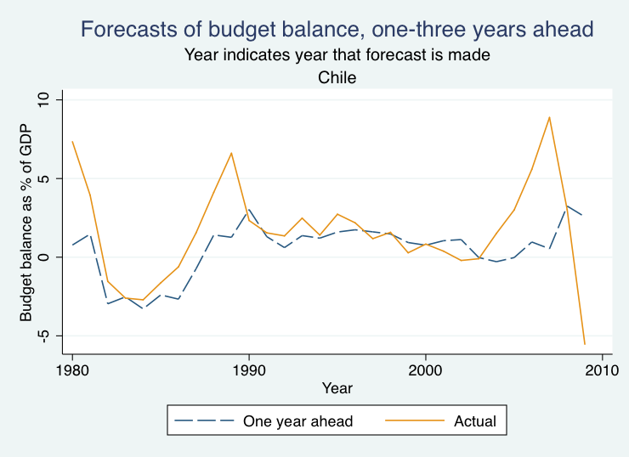

Chile’s official forecasts have not been over-optimistic.

Slide 41
In sum, Chile’s fiscal institutions appear to have overcome the problem of over-optimism:
Chile is not subject to the same bias toward over-optimism in forecasts of the budget, growth, or the all-important copper price.
The key innovation that has allowed Chile
to achieve countercyclical fiscal policy:
  not just a structural budget rule in itself,
  but rather the regime that entrusts to two panels
  of independent experts estimation of the long-run trends of copper prices & GDP.

Slide 42

Appendices
Appendix I: Pro-cyclical politicians in the US.
Appendix II: Mexican case
Appendix III: More on
the European case
Appendix IV: More on
the Chilean case.

Slide 43
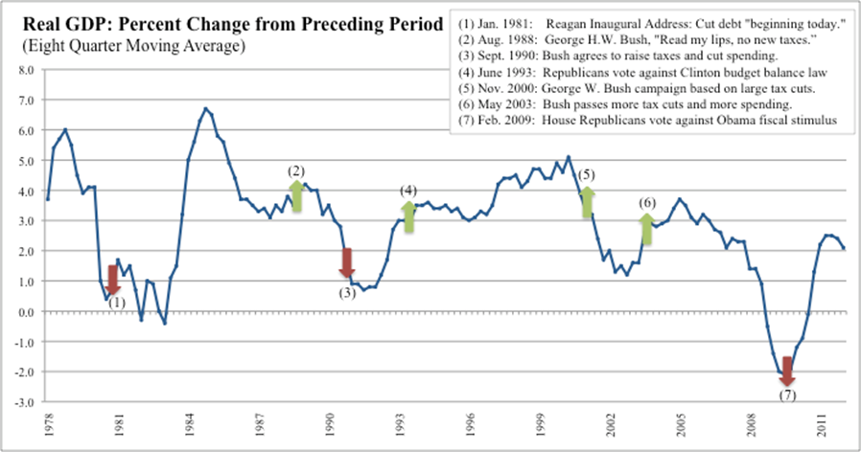
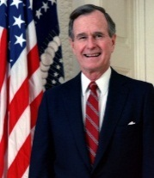
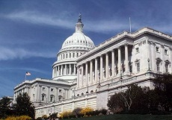
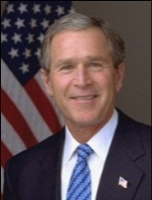


Through 3 cycles, some pursued austerity during recessions, followed by fiscal expansion when the economy was already expanding.
Appendix I: Pro-cyclical politicians in the US

Slide 44
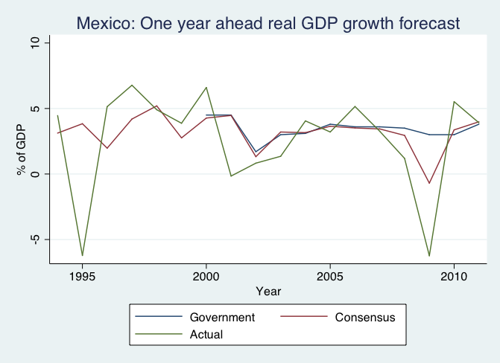
Appendix II:
The private sector downgraded forecasts for Mexico
in response to the 2008-09 global crisis,
while government forecasters did not.

Slide 45
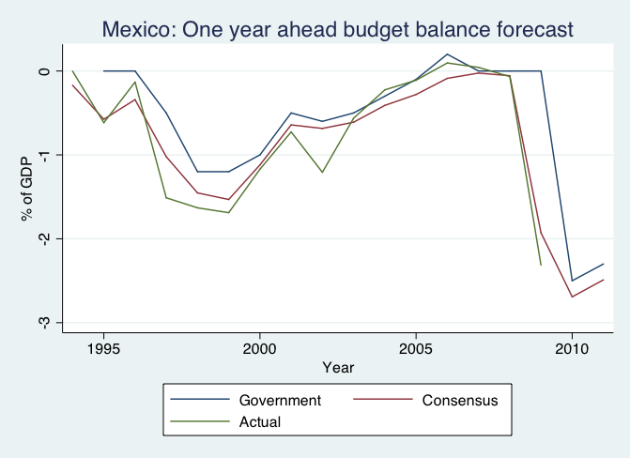
The private sector has also been less optimistic
than government forecasters about Mexican budget prospects
especially in the 2009 global crisis.

Slide 46
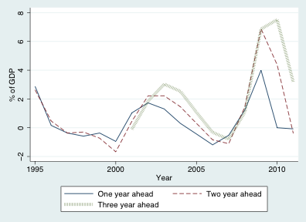
Appendix III: More on the Europe case
Figure 2 (F&S, 2013):
Mean Budget Forecast Errors, Europe, 1995-2011

Slide 47
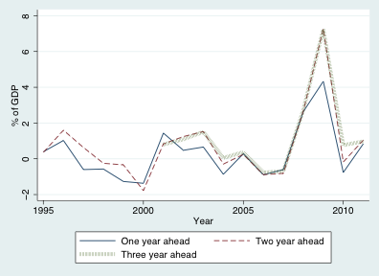
Figure 3 (F&S, 2013):
Mean GDP Growth Forecast Errors, Europe, 1995-2011

Slide 48
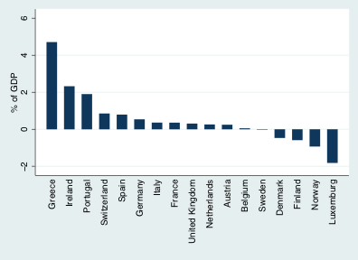
Most European official forecasts have been over-optimistic.
Figure 1 (F&S, 2013):
Mean 1-year ahead budget forecast errors, European Countries,
Full Sample Period
For 17 Europeans, the bias is even higher than others, averaging:
0.5% at the 1-year horizon,
1.3% at the 2-year horizon,
2.4% at the 3-year horizon

Slide 49
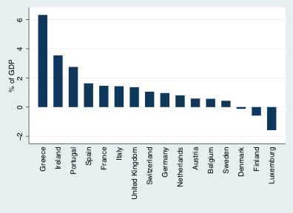
Figure 2 (F&S, 2013):
Mean 2-year ahead budget forecast errors, European Countries,
Full Sample Period

Slide 50
More findings regarding systematic forecast errors in Europe
(Frankel & Schreger, 2013a).
Besides cyclicality (output gap), another determinant of government bias:
they over-forecast speed of disappearance of budget deficits.
 | (1) | (2) | (3)
VARIABLES | BBE_{t+1} | BBE_{t+2} | BBE_{t+3}
Surplus_{t}*BudgetBalance_{t} | -0.080 | -0.295** | -0.175
 | (0.057) | (0.108) | (0.171)
Deficit*BudgetBalance_{t} | -0.293*** | -0.363** | -0.558***
 | (0.064) | (0.134) | (0.180)
Output Gap_{t} | 0.651*** | 1.409*** | 1.812***
 | (0.113) | (0.281) | (0.452)
Constant | -0.150 | 0.459 | 0.932**
 | (0.169) | (0.274) | (0.404)
Observations | 243 | 210 | 164
R-2 | 0.213 | 0.344 | 0.374
Countries | 17 | 16 | 15
Year FE | No | No | No
(Robust s.e.is n parentheses, clustered at the country level.) ***, **, &* : significance at the level of 1, 5, and 10%, respectively.

Slide 51

5 econometric findings regarding official forecasts in Chile.
Appendix IV: More on the Chilean case
(1) The key macroeconomic input for budget forecasting in most countries: GDP. In Chile: the copper price.
(2) Real copper prices revert to trend in the long run.
But this is not always readily perceived:
  (3) 30 years of data are not enough
  to reject a random walk statistically; 200 years of data are needed.
  (4) Uncertainty (option-implied volatility) is higher
  when copper prices are toward the top of the cycle.
(5) Chile’s official forecasts are not overly optimistic.
It has apparently avoided the problem of forecasts
that unrealistically extrapolate in boom times.

Slide 52
In 2008, the government of Chilean President Bachelet
& her Fin.Min. Velasco ranked very low in public opinion polls.
By late 2009, they were the most popular in 20 years. Why?
Evolution of approval and disapproval of four Chilean presidents
Presidents Patricio Aylwin, Eduardo Frei, Ricardo Lagos and Michelle Bachelet
Data: CEP, Encuesta Nacional de Opinion Publica, October 2009, www.cepchile.cl. Source: Engel et al (2011).

Slide 53
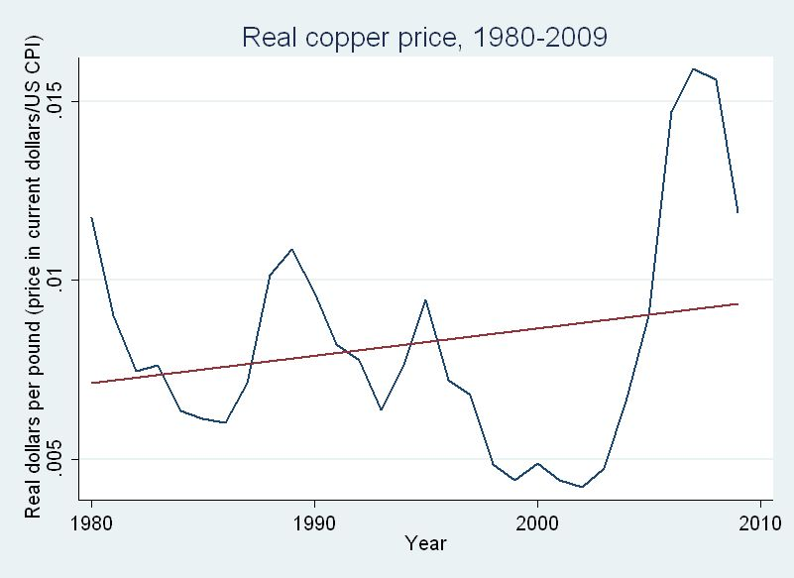
In 2008, with copper prices spiking up,
the government of President Bachelet had been
under intense pressure to spend the revenue.
  She & Fin.Min.Velasco held to the rule, saving most of it.
  Their popularity fell sharply.
When the recession hit and the copper price came back down, the government increased spending, mitigating the downturn.
  Bachelet & Velasco’s
  popularity reached
  historic highs by the time
  they left office

Slide 55
Application of the innovation to other countries
Any country could adopt the Chilean mechanism.
Suggestion: give the panels more institutional independence
  as is familiar from central banking:
    laws protecting them from being fired.
Open questions:
  How much of the structural budget calculations are
  to be delegated to the independent panels of experts?
    Minimalist approach: they compute only 10-year moving averages.
  Can one guard against subversion of the institutions (CBO) ?

Slide 56
More complete list of relevant references by the author
“Bias in Official Fiscal Forecasts: Can Private Forecasts Help?” with Jesse Schreger, NBER Working Paper 22349, 2016.
"Over-optimistic Official Forecasts and Fiscal Rules in the Eurozone," with J. Schreger; Review of World Economy (Weltwirtschaftliches Archiv) 149, 2, 2013. NBER WP 18283..
"Over-optimism in Forecasts by Official Budget Agencies and Its Implications," Oxford Review of Economic Policy 27, 4, 2011, 536-62. NBER WP 17239;
Summary in NBER Digest, Nov.2011.
“On Graduation from Fiscal Pro=cyclicality,” with Carlos Vegh & Guillermo Vuletin, Journal of Development Economics, 100, 1, 2013; pp. 32-47. NBER WP 17619. Summarized in VoxEU, 2011.
“A Solution to Fiscal Pro-cyclicality: The Structural Budget Institutions Pioneered by Chile,” in Fiscal Policy and Macroeconomic Performance, Luis Felipe Céspedes & Jordi Galí, eds. (Central Bank of Chile: Santiago), 2013, pp. 323-391.
“A Lesson From the South for Fiscal Policy in the US and Other Advanced Countries,” Comparative Economic Studies, 53, no.3, 2011, 407-30.
“Snake-Oil Tax Cuts,” 2008, EPI Briefing Paper 221. HKS RWP 08-056.

