Slide 1
Jeffrey Frankel
Harpel Professor of Capital Formation and Growth,
Harvard Kennedy School
Policy pro-cyclicality
Macro Policy Seminar
Harvard Economics Department,
December 3, 2019
Based on:
(i) ”On Graduation from Fiscal Procyclicality,”
with Végh & Vuletin; J.Dev.Ec., 2013.
(ii) “The Next Economic Crisis,”
AEI Retreat, Jackson Hole, Aug. 2018.

Slide 2
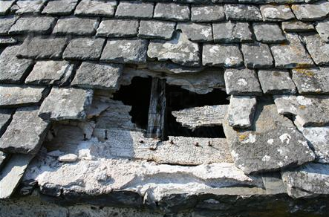
Policy pro-cyclicality: Introduction
People don’t see the need to “fix the hole
in the roof when the sun is shining.”
  They may see the mistake
  when the storm hits,
    but then it is too late.
Admittedly it is hard to get
counter-cyclical timing right;
but that is no excuse for pro-cyclical policy.
Three cases of pro-cyclicality:
  i) Developing countries, 1960-1999.
  ii) Some Euro countries, 2000-2018.
  iii) US politicians of a particular party, esp. 2018.

Slide 3
Countries that expand fiscally during a boom, feel they need austerity when the downturn comes.
Relationship between Real GDP after a Financial Crisis & Fiscal Space
Christina Romer & David Romer, 2019, "Fiscal Space and the Aftermath of Financial Crises: How It Matters and Why,” BPEA, Fig.4.
OECD countries with lower debt/GDP ratios “respond to financial distress with much more expansionary fiscal policy and suffer much less severe aftermaths” (1980–2017),
  driven partly by problems with sovereign market access,
  but even more so by choices of domestic & international policymakers despite easy market access.

Slide 4
Policy Pro-cyclicality
I) International perspective :
  Which countries are fiscally counter-cyclical?
  Those with “good institutions.”
  What specific institutions?
  Not rules. The problem is official forecasts.
II) Claim: US Republicans act pro-cyclically,
  with respect to fiscal policy,
  but also monetary policy
  and financial regulation.
III) Question: Do I need to re-think this, now that some Democrats
support fiscal & monetary expansion when unemployment ≈ 3 ½ %?
IV) Appendix: Elaboration on financial regulation
V) Appendix: What specific institutions prevent fiscal pro-cyclicality?
    Not fiscal rules.
    The problem is optimism bias in official forecasts.
    Chile’s fiscal institutions: Insulate official forecasts against political pressure.

Slide 5
I) An international perspective:
1. Which countries are fiscally counter-cyclical?
In the past, commodity-exporting developing countries
were the most pro-cyclical
  Literature:
    Cuddington (1989), Gavin & Perotti (1997), Tornell & Lane (1999), Kaminsky, Reinhart & Vegh (2004), Talvi & Végh (2005), Mendoza & Oviedo (2006), Alesina, Campante & Tabellini (2008), Ilzetski & Vegh (2008), Medas & Zakharova (2009), Medina (2010), Arezki, Hamilton & Kazimov (2011), Erbil (2011), Avellan & Vuletin (2015), Vegh & Vuletin (2015).
  But many achieved counter-cyclicality after 2000.
    J.Frankel, Carlos Végh & Guillermo Vuletin (2013)
    Luis Felipe Céspedes & Andrés Velasco (2014).
Meanwhile, some euro countries went from counter-cyclical
to pro-cyclical.

Slide 6

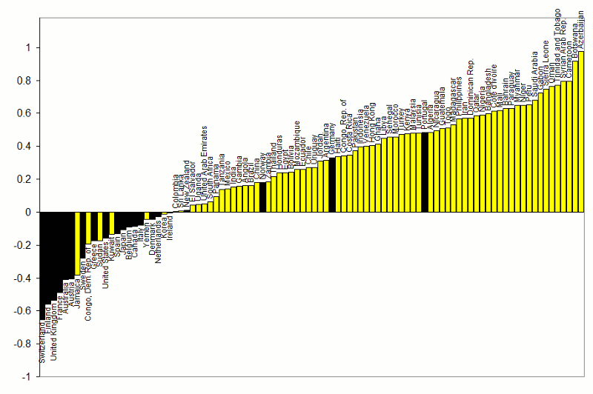

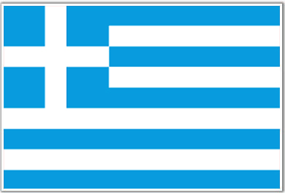

Correlations between Gov.t Spending & GDP
1960-1999
}
Pro-cyclical
Adapted from Kaminsky, Reinhart & Végh
(2004) “When it Rains, It Pours”
countercyclical
G always used to be pro-cyclical
for developing countries.
6

Slide 7

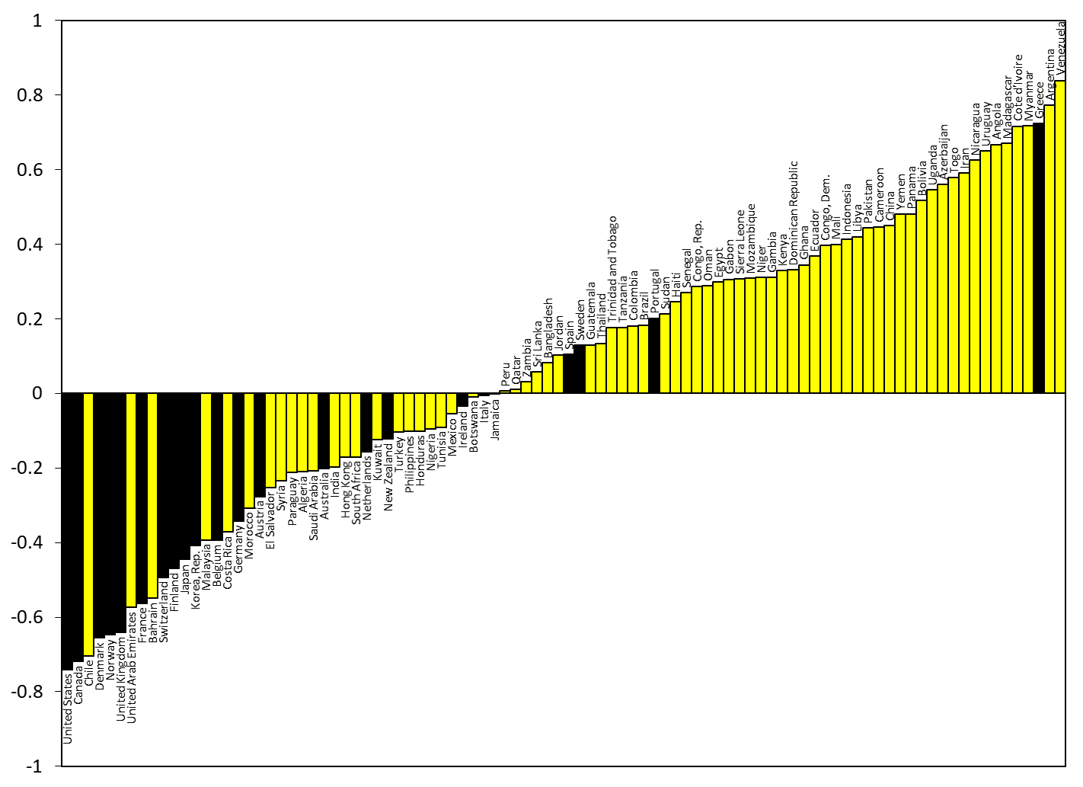

Correlations between Government spending & GDP
2000-2018
Updated from Frankel, Végh & Vuletin (JDE, 2013)
Thanks to Jose Andree Camarena & Guillermo Vuletin, World Bank, October 2019
After 2000,
about 1/4 developing countries
switched to countercyclical fiscal policy:
Negative correlation of G & GDP.
Cyclical components of real GDP & real Government Spending are calculated by Hodrick-Prescott filter, using 6.25 as smoothing parameter & extracting the cyclical components from the series of the level.

Slide 8
2. Who achieves counter-cyclical fiscal policy?
Countries with “good institutions”
”On Graduation from Fiscal Procyclicality,”
Frankel with Végh & Vuletin; J.Dev.Ec., 2013

Slide 9
3. What specific institutions help achieve fiscal counter-cyclicality?
Not budget rules. Most are violated.
They only worsen a fundamental problem:
Optimism bias in official forecasts. Three cases:
  Developing countries
    forecast that booms will last indefinitely, obviating any need for discipline.
    Frankel (2011) and Frankel & Schreger (2016).
  Eurozone members
    forecast that growth next year will bring budget deficits below 3% GDP.
    Frankel & Schreger (2013).
  Republican politicians
    forecast that tax cuts and deregulation will unleash miracle growth.
    Frankel (2008).
For a clue how to address the problem of optimism bias,
see Chile’s fiscal institutions (Appendix).
    Frankel (2013).

Slide 10
II) Claim: USG policy is currently pro-cyclical.
(1) Especially fiscal policy;
(2) But also macro-prudential policy;
(3) And monetary policy.

Slide 11
(1) Pro-cyclical fiscal policy
In 2018 we undertook the most radically pro-cyclical fiscal expansion since WWII
  Dec. 2017 tax cuts
    Corporate tax reform was needed.
    But should have been revenue-neutral.
  Rapid spending 2018 increases.
When the next recession comes, we may lack the “fiscal space” to respond, having already used up our ammunition.
  Or at least we may feel that way.

Slide 12
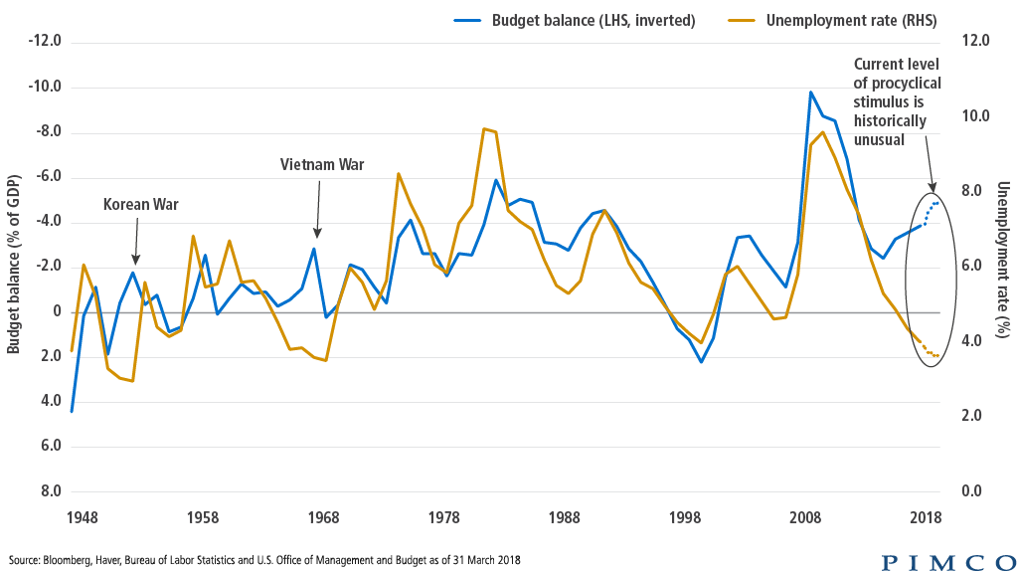
Fiscal policy, continued
Usually taxes fall & govt. spending rises in response to recessions.
In 2018, unprecedentedly in peacetime, fiscal policy turned
strongly expansionary at a time of full employment.

Slide 13
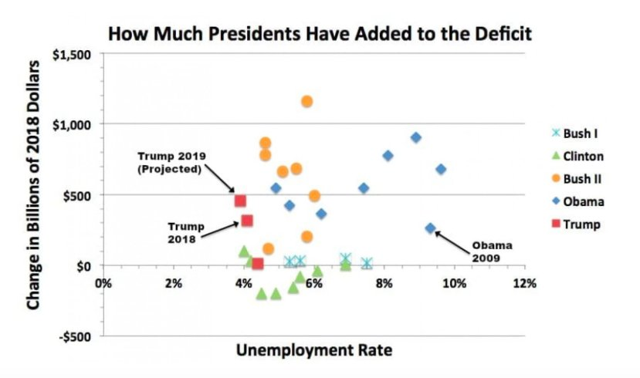
US fiscal policy was counter-cyclical under Clinton and Obama, not under the others.
Washington Post
“Trump hasn’t changed the Republicans. They never cared about the deficit,” Matt O’Brien, Feb. 23, 2018.

Slide 14
The top 9 pro-cyclical US fiscal policy efforts,
1980-2019
1980-81: Reagan’s speeches pledging to reduce the national debt “beginning today” came during a severe recession.
1988: Even as the economy neared the business cycle peak, candidate George H.W. Bush promised “Read my lips, no new taxes.”
1990: G.H.W. Bush summoned the courage to raise taxes & rein in spending (PAYGO) at precisely the wrong moment -- just as the US entered another recession.
1993-2000: Despite the most robust recovery in US history,
1993: every Republican congressperson voted against Clinton’s legislation to continue PAYGO etc.
2000: Even after 7 years of strong growth, with unemployment < 4%, G. W. Bush campaigned on tax cuts.

Slide 15
The top 9 pro-cyclical US policy efforts, 1980-2019 -- continued
2003: After his fiscal expansion had turned the inherited surpluses into deficits, GWB went for a new round of tax cuts & continued spending growth > Clinton’s.
  VP Cheney: “Reagan proved that deficits don’t matter.”
2007-09: When the worst recession since the Great Depression hit, Republican congressmen suddenly re-discovered the evil of deficits, deciding that retrenchment was urgent:
They voted against Obama’s fiscal stimulus in Feb. 2009.
2011: Subsequently, with a majority in the House, they successfully blocked further efforts by Obama when the stimulus ran out, despite still-high unemployment.
2017: Having re-taken the White House, Republicans
passed the $ trillion tax cut of December 2017,
even though unemployment ≈ 4%.

Slide 16
(2) Pro-cyclical financial regulation
The wrong way to do it: relax financial regulation at the height of financial booms
  and then tighten it in response to financial crashes.
  Exacerbates the swings.
Other countries do this better.
  E.g., Asians’ macroprudential policy is countercyclical:
    They raise bank reserve requirements and tighten homeowners’ loan-to-value ceilings in a boom,
    and loosen them when there is a financial downturn,
    rather than the other way around.
(See appendix for elaboration.)

Slide 17
(3) Pro-cyclical monetary policy
Nov. 15, 2010 -- Some Republican economists criticized the Fed for easy money (QE), warning of “currency debasement and inflation,”
  though unemployment = 9.9%.
  Boskin, Calomiris, Hassett, Holtz-Eakin, Malpass, Taylor…
Sept. 29, 2011 -- Donald Trump tweeted: “The Fed's reckless policies of low interest and flooding the market with dollars needs to be stopped or we will face record inflation.” Unemployment was still 9.0%.
Needless to say President Trump has sharply criticized the Fed for “high” interest rates since taking office,
    even though unemployment < 4%.
That is pushing for pro-cyclical monetary policy.

Slide 18
Pro-cyclical monetary policy
In past recessions, the Fed has responded by
cutting interest rates around 500 basis points,
  helping to moderate those recessions.
But it won’t be able to do it next time,
  if interest rates at the peak are only 200 basis points.
  Marty Feldstein favored more Fed tightening.
    July 26, 2018, in the WSJ: “raising the rate when the economy is strong will give the Fed room to respond in the next economic downturn with a significant reduction”.

Slide 19
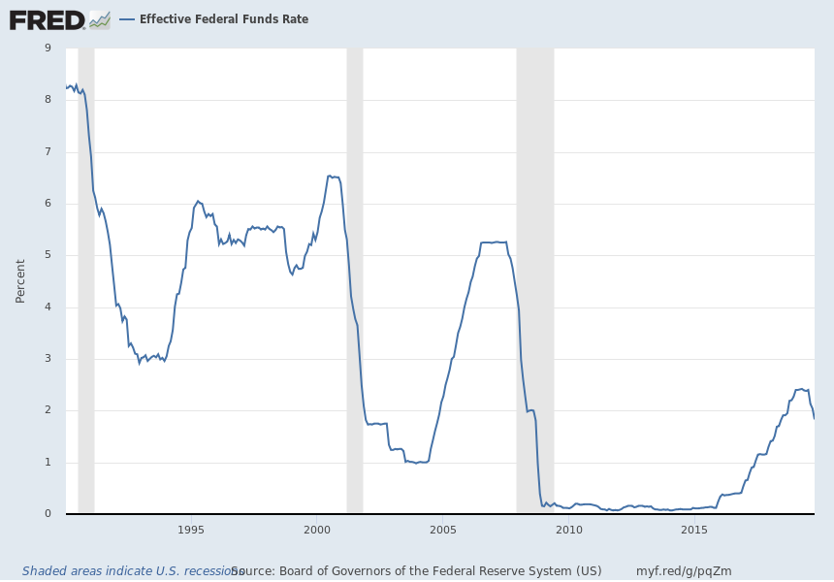
Monetary policy
The Fed responded to each of the last 7 recessions
by cutting the interest rate about 500 basis points. Next time?
-5.25 %pts
-5.50 %pts
-5.125 %pts
Gray shading indicates NBER recession. Data source: FRB, Nov. 2019.
Notes:
Source:
Board of Governors of the Federal Reserve System (US)
Release:
H.15 Selected Interest Rates
Units:
Percent, Not Seasonally Adjusted
Frequency:
Monthly
Averages of daily figures.The federal funds rate is the interest rate at which depository institutions trade federal funds (balances held at Federal Reserve Banks) with each other overnight. When a depository institution has surplus balances in its reserve account, it lends to other banks in need of larger balances. In simpler terms, a bank with excess cash, which is often referred to as liquidity, will lend to another bank that needs to quickly raise liquidity. (1) The rate that the borrowing institution pays to the lending institution is determined between the two banks; the weighted average rate for all of these types of negotiations is called the effective federal funds rate.(2) The effective federal funds rate is essentially determined by the market but is influenced by the Federal Reserve through open market operations to reach the federal funds rate target.(2)The Federal Open Market Committee (FOMC) meets eight times a year to determine the federal funds target rate. As previously stated, this rate influences the effective federal funds rate through open market operations or by buying and selling of government bonds (government debt).(2) More specifically, the Federal Reserve decreases liquidity by selling government bonds, thereby raising the federal funds rate because banks have less liquidity to trade with other banks. Similarly, the Federal Reserve can increase liquidity by buying government bonds, decreasing the federal funds rate because banks have excess liquidity for trade. Whether the Federal Reserve wants to buy or sell bonds depends on the state of the economy. If the FOMC believes the economy is growing too fast and inflation pressures are inconsistent with the dual mandate of the Federal Reserve, the Committee may set a higher federal funds rate target to temper economic activity. In the opposing scenario, the FOMC may set a lower federal funds rate target to spur greater economic activity. Therefore, the FOMC must observe the current state of the economy to determine the best course of monetary policy that will maximize economic growth while adhering to the dual mandate set forth by Congress. In making its monetary policy decisions, the FOMC considers a wealth of economic data, such as: trends in prices and wages, employment, consumer spending and income, business investments, and foreign exchange markets.The federal funds rate is the central interest rate in the U.S. financial market. It influences other interest rates such as the prime rate, which is the rate banks charge their customers with higher credit ratings. Additionally, the federal funds rate indirectly influences longer- term interest rates such as mortgages, loans, and savings, all of which are very important to consumer wealth and confidence.(2)References(1) Federal Reserve Bank of New York. "Federal funds." Fedpoints, August 2007.(2) Board of Governors of the Federal Reserve System. "Monetary Policy".
Board of Governors of the Federal Reserve System (US),
Effective Federal Funds Rate [FEDFUNDS],
retrieved from FRED,
Federal Reserve Bank of St. Louis;
https://fred.stlouisfed.org/series/FEDFUNDS,
November 21, 2019.

Slide 20
The historical pattern: Republicans push for easy money, even in booms
Republican President Nixon
  successfully pushed Fed Chairman Burns into an excessively easy monetary policy in the early 1970s, a time of high inflation.
  Abrams (2006).
Republican Presidents Ronald Reagan & George H.W. Bush
  tried aggressively to push Fed Chairmen Paul Volcker and Alan Greenspan into easier monetary policy, especially in election years.
  Bob Woodward, Maestro (2000).
  The White House made life unpleasant enough for inflation-slayer Volcker that he eventually declined to be reappointed, prompting Treasury Secretary James Baker to exult “We got the son of a bitch!” (p.24).
Democratic Presidents Carter, Clinton & Obama
  refrained from pushing the Fed into inflationary monetary policy.

Slide 21
Appendix 1: Financial regulation.
  Appendix 1a: The US should tighten financial regulation at the cyclical peak, not loosen it.
  Appendix 1b: Some EM countries do a better job of counter-cyclical macro-prudential policy.
Appendix 2: Institutions to achieve fiscal counter-cyclicality.

Slide 22
Appendix 1a: The US should tighten financial regulation at the cyclical peak, not loosen it.
Reinstate Obama’s fiduciary rule,*
which would have required professional financial advisers, in return for their fees, to put their clients’ interests first when advising them on assets invested through retirement plans.
Resume the good work that the Consumer Financial Protection Bureau* had been doing until now,
protecting households who take out
  pay-day loans*, student loans, & car loans*.
  And housing finance, where the 2007-08 crisis originated.
  Mortgage-originators, for example, should be required
  to “keep skin in the game” by risk-retention rules.
  Mortgages should have a 20% minimum down-payment.
I do not favor trying to smash banks into such small pieces as to solve the “too big to fail problem.”
* Would have been de-regulated in Financial Choice Act, passed only by House, June 2017.

Slide 23
Appendix on financial regulation, continued
Preserve Dodd-Frank.*
  Its key features – higher capital requirements for banks, the CFPB, SIFI designation, tough stress tests on banks, and enhanced transparency for derivatives – have strengthened the financial system considerably. Undermining or rescinding them would substantially increase the risk of an eventual recurrence of the 2007-2008 financial crisis.
  I agree with the objective of cutting banks’ paperwork burden,
    especially on small banks:
    Threshold for “too big to fail” stress-tests needed to be raised;
      $50 billion in assets was too low.
    But $250 billion threshold is probably too high.
  Don’t weaken the “living will” process,
  nor exempt non-banks from annual stress tests.
  To minimize the risk of another financial crisis, keep the supplementary leverage ratio placed on the largest banks
    as Lael Brainard says.
  Bank capital standards should, if anything, be further tightened.
* Would have been de-regulated in Financial Choice Act, 2017.

Slide 24
Emerging Market countries apply counter-cyclical macro-prudential tools, unlike the US.
  Appendix 1b: Some EM countries do a better job of counter-cyclical macro-prudential policy.
Banks: reserve requirements
Housing market:
    Maximum Loan/value ratio
    Maximum Debt service/income ratio

Slide 25
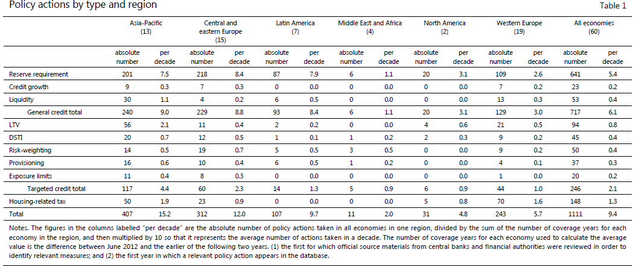
Asia-Pacific & other EM countries take macro-prudential actions more often than advanced countries do -- Kuttner & Shim (2016)
Kenneth Kuttner & Ilhyock Shim, “Can non-interest rate policies stabilize housing markets? Evidence from a panel of 57 economies,” J.Fin.Stability, 2016.

Slide 26
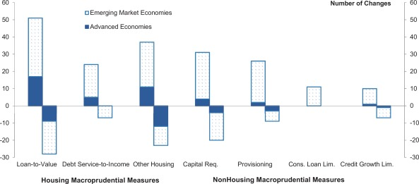
EM Economies apply macroprudential policies, unlike Advanced Economies
Ozge Akinci, Jane Olmstead-Rumsey, 2018, “How effective are macroprudential policies?
An empirical investigation,” Journal of Financial Intermediation.

Slide 27
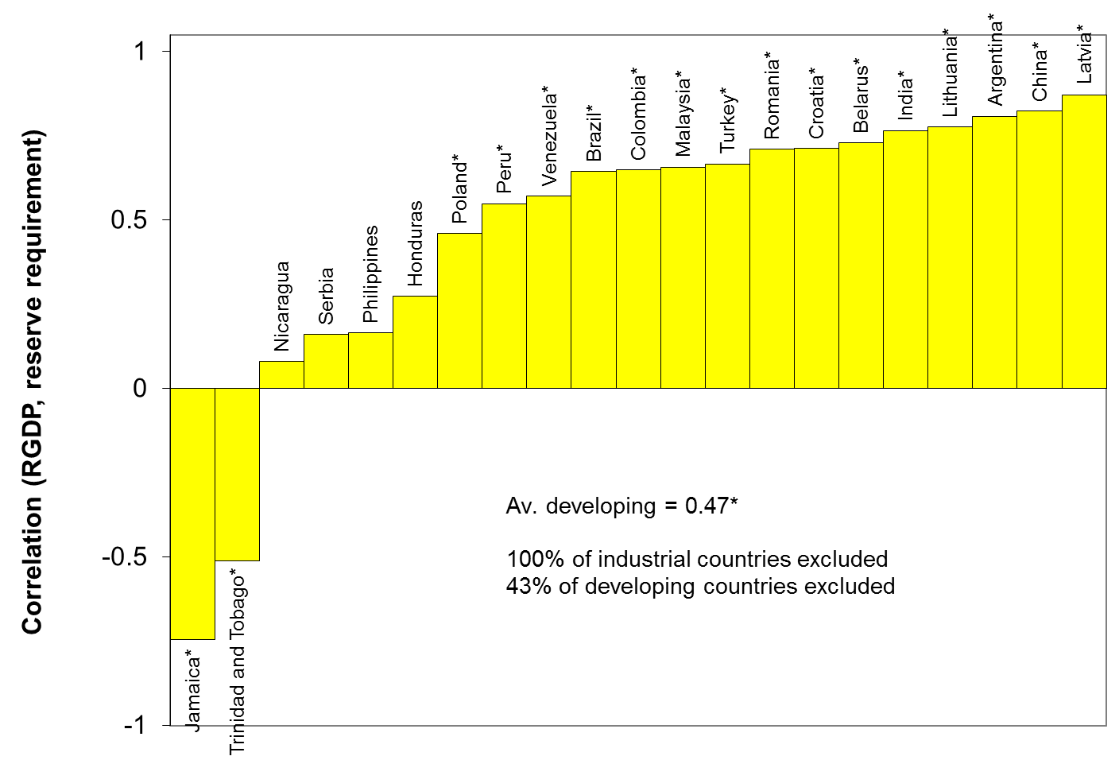
Emerging Market countries tend to tighten
bank reserve requirements counter-cyclically (2005-2011)
P. Federico, C. Végh, & G. Vuletin, "Reserve Requirement Policy over the Business Cycle," NBER WP 20612, 2014.

Slide 28
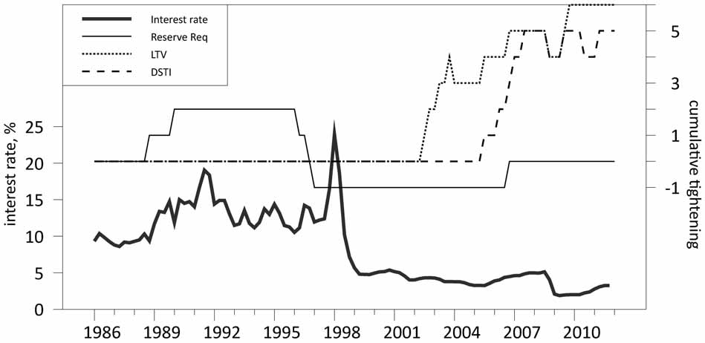
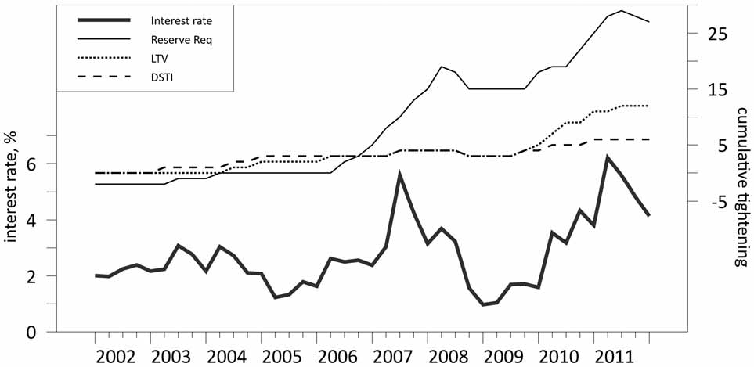
Korea & China tighten both reserve requirements & housing credit in booms
Interest rate and credit policies in Korea
Interest rate and credit policies in China
Kenneth Kuttner & Ilhyock Shim, “Can non-interest rate policies stabilize housing markets? Evidence from a panel of 57 economies,” J.Financial Stability, 2016.

Slide 29
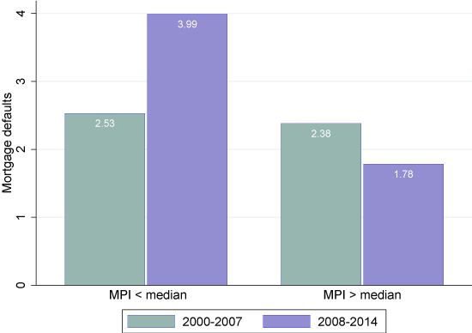
Countries with low MacroPrudential Indices suffered a big increase in mortgage defaults after 2008 financial crisis.
“Mortgage delinquency rates: A cross-country perspective,“
Irina Stanga, Razvan Vlahu, Jakob de Haan, 15 March 2018
https://voxeu.org/article/mortgage-delinquency-rates-cross-country-perspective

Slide 30
Appendix 2: Institutions to achieve fiscal counter-cyclicality
Institutions are not all dictated by history & geography.
  The quality of institutions varies, not just across countries, but also across time.
  Countries can choose good institutions in real time.
What institutions, specifically? Rules?
The optimism bias.
The example of Chile’s fiscal institutions.

Slide 31
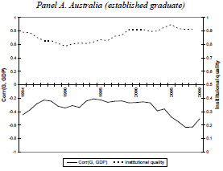
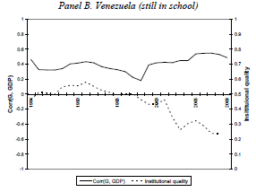
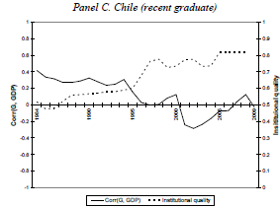



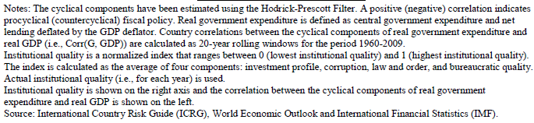
(i) The quality of institutions varies, not just across countries, but also across time.
1984-2009
Worsened institutions;
More-cyclical spending.
Improved institutions;
Less-cyclical spending.
Good institutions;
Countercyclical spending
Frankel, Végh
& Vuletin, 2013.

Slide 32

  (ii) What specific institutions can help?
Budget rules?
  Budget deficit ceilings or debt brakes?
    Have been tried by many countries:
      97 IMF members.
      Usually fail.
  Rigid Budget Deficit ceilings operate pro-cyclically.
  Phrasing the target in cyclically adjusted terms helps
  solve that problem in theory. But…
Rules don’t address a major problem:
  Bias in official forecasts
    of GDP growth rates, tax receipts & budgets.
  In practice, overly optimistic forecasts
  by official agencies render rules ineffective..

Slide 33
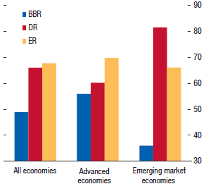

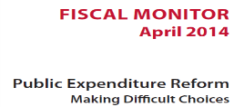

Countries with Balanced Budget Rules frequently violate them.
BBR: Balanced
Budget Rules
DR:
Debt Rules
ER: Expenditure Rules
Compliance
< 50%
International Monetary Fund, 2014

Slide 34

(iii) The optimism bias in official forecasts
People don’t see the need to “fix the hole
in the roof when the sun is shining.”
My claim: Bias in official forecasts
rationalize the failure to act.
  Over-optimistic forecasts by official agencies
  of GDP, tax revenue & budget balances.

Slide 35
Mistakes in GDP forecasts cause mistakes in tax revenue forecasts.
LAC country forecasts for 2016
Andrew Powell, IDB, Nov. 2017 LACEA, Buenos Aires.
“Fiscal Challenges in Latin America and the Caribbean.”

Slide 36
Over-optimism in official forecasts
Statistically significant bias among 33 countries,
  worse in booms.
    Frankel (2011); Frankel & Schreger (2016).
Logically leads to pro-cyclical fiscal policy:
  If the boom is forecast to last indefinitely,
  there is no need to retrench.
BD rules don’t help:
  Forecasts are even more biased in countries that have rules.
    Frankel & Schreger (2013).

Slide 37
The optimism bias
is significantly greater in booms
and at longer horizons.
Budget balance forecast error as % of GDP
Variables | 1 year ahead | 2 years ahead | 3 years ahead
GDP gap | 0.093*** | 0.258*** | 0.289***
 | (0.019) | (0.040) | (0.063)
Constant | 0.201 | 0.649*** | 1.364***
 | (0.197) | (0.231) | (0.348)
Observations | 398 | 300 | 179
R² | 0.033 | 0.113 | 0.092
RMSE | 2.25 | 2.73 | 3.10
*** p<0.01 (Robust standard errors in parentheses, clustered by country.)
GDP gap is lagged: it lines up with the year in which forecast was made, not the year being forecast.
Frankel (2011)

Slide 38

(iv) An institution that others might emulate:
The Chile model
Frankel (2013) concluded that the key feature was the delegation to independent committees of the responsibility to estimate long-run trends in the copper price & GDP,
    thus avoiding the systematic over-optimism that plagues official forecasts in 32 other countries.

Slide 39
Over-optimism in official forecasts
Statistically significant bias among 33 countries
  Worse in booms.
  Frankel (2011, 2013); Frankel & Schreger (2016).
Leads to pro-cyclical fiscal policy:
  If the boom is forecast to last indefinitely,
  there is no apparent need to retrench.
BD rules don’t help.
  Forecasts are even more biased
  in countries that have rules.
Solution?

Slide 40


The example of Chile’s fiscal institutions
1st rule – Governments
must set a budget target,
2nd rule – The target is structural:
Deficits allowed only to the extent that
  (1) output falls short of trend, in a recession, or
  (2) the price of copper is below its trend.
3rd rule – The trends are projected by 2 panels
of independent experts, outside the political process.
  Result: Chile avoided the pattern of 32 other governments,
    where forecasts in booms were biased toward optimism.
Notes:
40

Slide 41
Chilean fiscal institutions
In 2000 Chile instituted its structural budget rule.
The institution was formalized into law in 2006.
The structural budget surplus must be…
  0 as of 2008 (was higher before, lower after),
  where “structural” is defined by output & copper price
  equal to their long-run trend values.
I.e., in a boom the government can only spend increased revenues that are deemed permanent;
any temporary copper bonanzas must be saved.

Slide 42
The Pay-off
Chile’s fiscal position strengthened immediately:
  Public saving rose from 3 % of GDP in 2000 to 8 % in 2005
  allowing national saving to rise from 21 % to 24 %.
Government debt fell sharply as a share of GDP
and the sovereign spread gradually declined.
By 2006, Chile achieved a sovereign debt rating of A,
    several notches ahead of Latin American peers.
By 2007 it had become a net creditor.
By 2010, Chile’s sovereign rating had climbed to A+,
    ahead of some advanced countries.
=> It was able to respond to the 2008-09 recession.

Slide 43
Background writings by the author
FISCAL POLICY
  ”Snake-Oil Tax Cuts,” 2008, HKS RWP No. 08-056.
  “Over-optimism in forecasts by official budget agencies and its implications,” Oxford Rev. Ec. Policy, 2011, 27 (4), 536–562.
  “A Solution to Fiscal Procyclicality: The Structural Budget Institutions Pioneered by Chile,” 2013, in Fiscal Policy and Macroeconomic Performance, Luis Felipe Céspedes and Jordi Galí eds.(Banco de Chile).
  ”On Graduation from Fiscal Procyclicality,” with Carlos Végh & Guillermo Vuletin; J.Dev.Ec., 2013.
  “Over-optimistic official forecasts and fiscal rules in the eurozone,” with Jesse Schreger, Rev. of World Ec., 2013, 149 (2), 247–272.
  "Bias in Official Fiscal Forecasts: Can Private Forecasts Help?" with Jesse Schreger.
  NBER WP 22349, 2016.
MONETARY POLICY
  “The Pot Again Calls the Kettle Red: Republicans, Democrats, the Fed and QE2,” Nov. 15, 2010.
  “Should the Fed Be Constrained?” Cato Journal, 39, no.2, Summer, 2019.

