Slide 1

The Global Economy in the 21st Century
Jeffrey Frankel
Harpel Professor of Capital Formation and Growth, Harvard University
Conference celebrating
the 40th anniversary of Prometeia
Bologna, 26 November, 2015

Slide 2
My previous visit to Bologna:
In 1995, at the invitation of Prometeia, I came to address the topic: "The World Over the Next Twenty-five Years: Global Trade Liberalization and the Relative Growth of Different Regions"
25 years into the future seemed so far off; I thought nobody would be checking up on my predictions!
Some of what I said turned out right:
  Japan’s saving rate would fall, as the population aged.
  Countries that still had high unrealized growth potential included Chile, China and (less obviously) the Philippines.
Other predictions were less accurate:
  “A 1999 start date for EMU is too optimistic.”

Slide 3
"The World Over the Next Twenty-five Years: Global Trade Liberalization, and the Relative Growth of Different Regions"
Two major questions I tried to address in 1995:
  Would globalization continue?
    particularly with respect to international trade?
  Which economies would perform the best?
    and in particular, would China’s economy surpass the US?
Let us now consider how those questions look in 2015.
  (I) Global trade has slowed since 2008. Why?
  (II) China is slowing. Why?
  (III) Other Emerging Markets are at a delicate juncture.

Slide 4
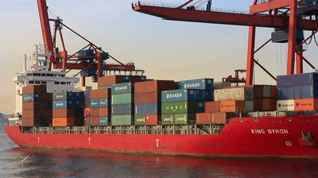
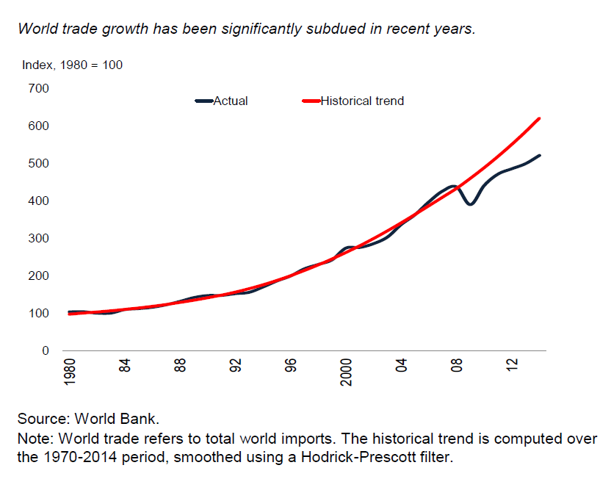
(I) Globalization
Growth in trade
was rapid during most of the post-war period.

Slide 5
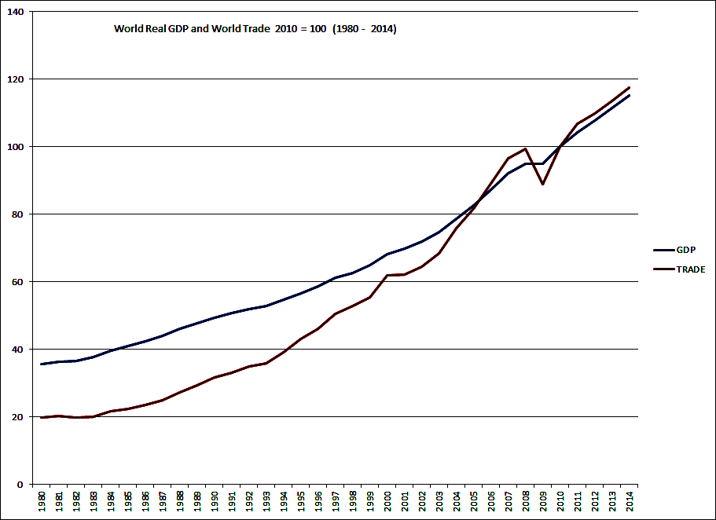
Trade always used to grow faster than GDP
-- about twice as rapidly.
World Trade & Real GDP, 1980 – 2014 (2010 = 100)

Slide 6
But, as I said 20 years ago: the trend of economic integration across national borders is not inevitable or irreversible,
  even if technological progress in transport
  and communication is one-directional.
  In the period 1914-1945, political forces worked to turn
  the clock back on globalization:
    tariff protection,
    discriminatory economic blocs,
    and war.
  They had the effects one would expect: Trade fell sharply.
  It could happen again.

Slide 7

When the Global Financial Crisis hit in 2008…
there was a fear that countries might revert to protectionism, as in the 1930s, and with similar results.
  The first two meetings of the new G-20 Leaders Summit pledged to refrain from imposing new protection,
    December 2008 in Washington
    and April 2009 in London.
  But many were skeptical of the rhetoric.
There was in fact no return to protectionism.
And yet both the economic downturn and the fall in trade turned out to be as bad as feared, or even worse!

Slide 8




Since 2008, global trade has indeed slowed.
Sept. 2015. p.16, Fig.5.B

Slide 9
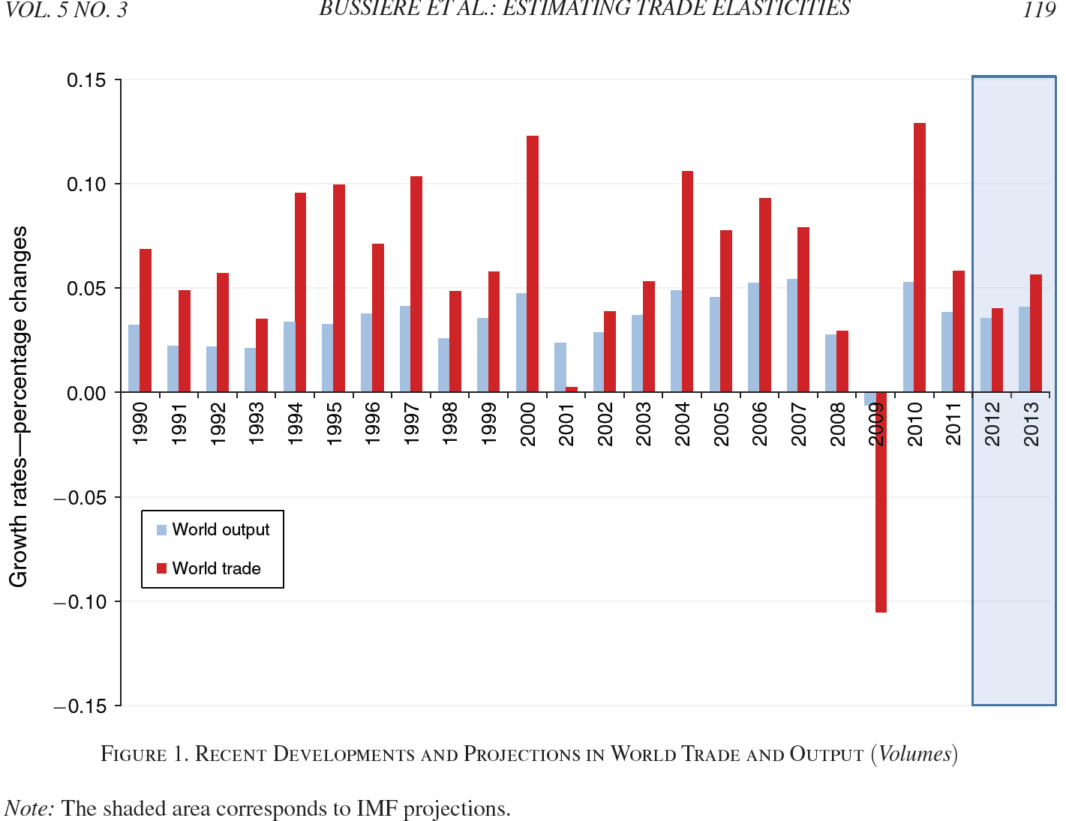
The 2008-09 collapse in global trade was bigger than could be explained by the fall in GDP.
2009
Bussière, Callegari, Ghironi, Sestieri & Yamano, 2013,
"Estimating Trade Elasticities: Demand Composition and the Trade Collapse of 2008-2009."

Slide 10


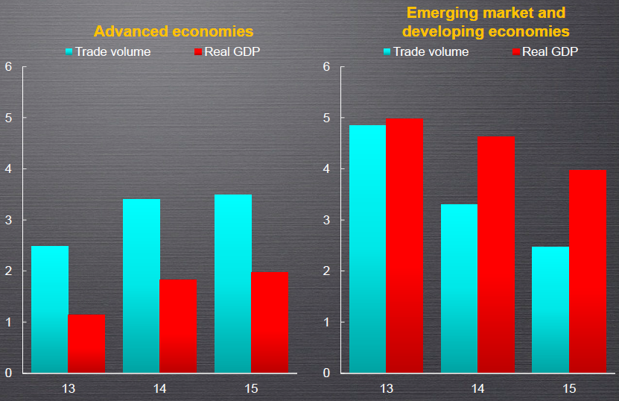


Trade still lags GDP, in particular, in EM economies.

Slide 11

Why has trade slowed so much?
Three explanations that were originally suggested in 2009 now seem wrong:
  Protectionism?
    It hasn’t happened.
  High prices for oil and therefore for transport?
    Oil prices fell by half subsequently.
  Trade credit froze up when financial markets did?
    Credit availability was subsequently restored.

Slide 12
Three (related) explanations remain
Global supply chains have matured
  Vertical specialization has largely run its course.
Physical investment spending has slowed
  which is trade-intensive.
The structure of China’s economy is shifting
  away from manufacturing, toward services;
  away from exports, toward domestic demand.

Slide 13
3. The structure of China’s economy is “rebalancing.”
China long had great success with manufacturing;
  growth was led by exports and investment.
But recently it has tried to move toward services,
  with growth led by consumer demand, appropriately.
  The leaders decided at the Third Plenum in 2013.
Services are less trade-intensive than manufacturing.

Slide 14

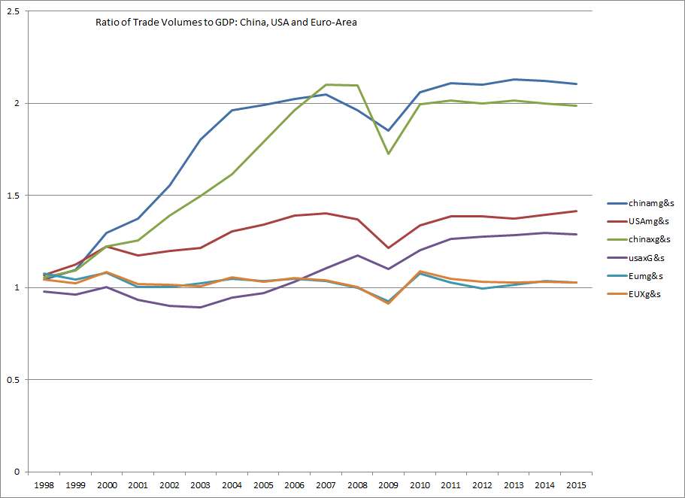



China’s exports & imports had risen especially fast, even relative to GDP, before 2008.
(Followed by the US. EU trade/GDP had been flat.)
1997=1

Slide 15
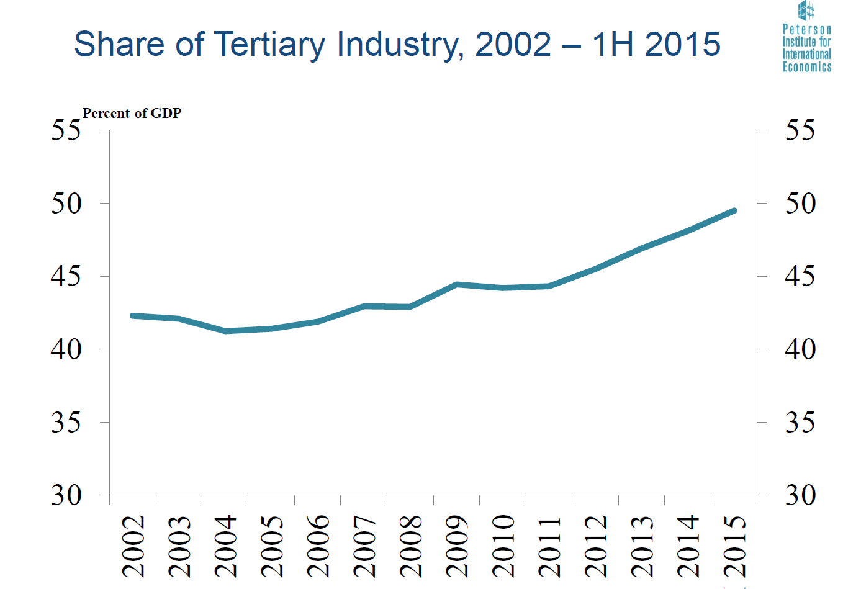
China is shifting into services, judging by the available data.
% of GDP
Source: Nicholas Lardy, PIIE

Slide 16
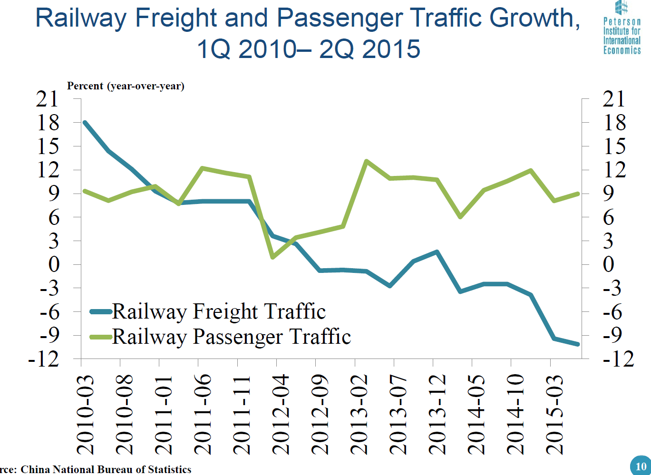
It’s good to look also at other data in China.
Railway data show that freight traffic is declining
(especially relative to passenger traffic).
% change
(year-over-year)
Source: Nicholas Lardy

Slide 17
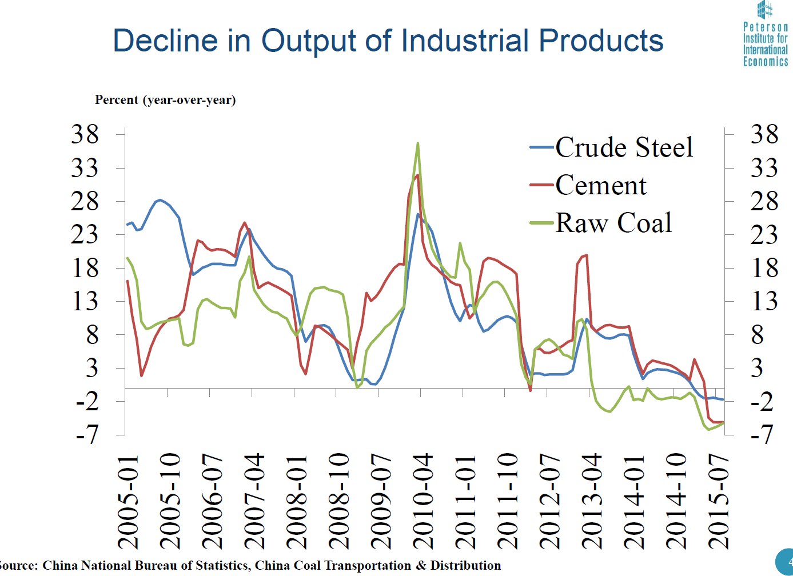
It’s good to look also at other data
Decline in China’s output of industrial products,
2010-2015
% change (year-over-year)
Source: Nicholas Lardy

Slide 18
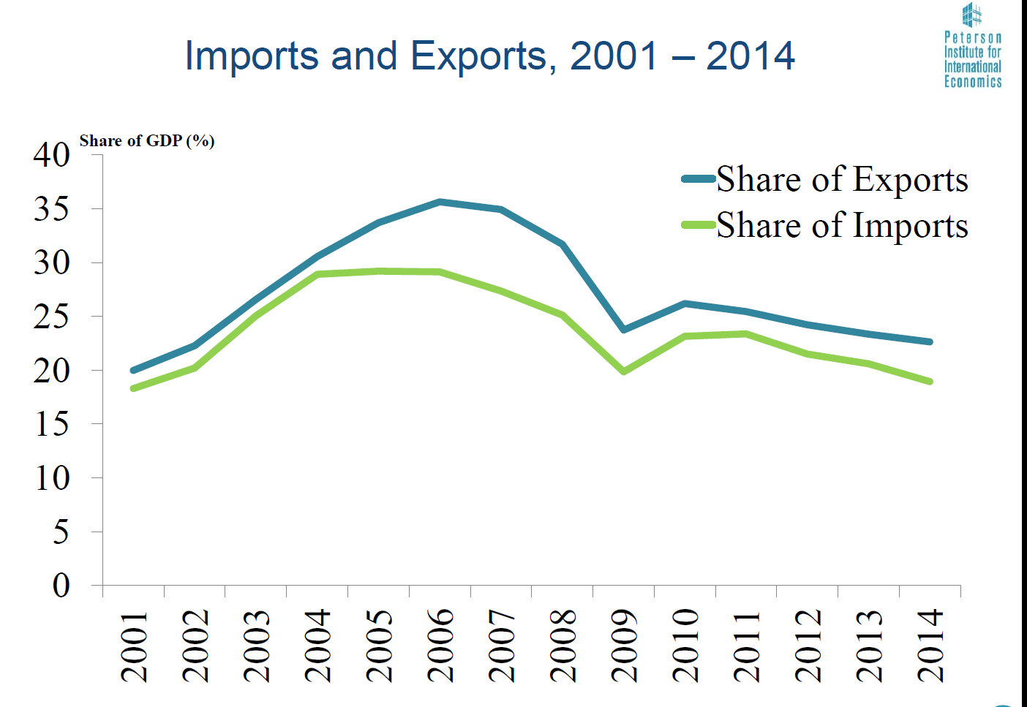
Trade’s relative importance in China has peaked, in part because services are less trade-intensive.
% of GDP
Source: Nicholas Lardy

Slide 19

(II) Chinese GDP
II.1 Did China catch up with US GDP in 2014?
II.2 China’s recent slow-down long-term.

Slide 20

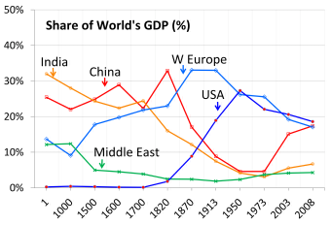
II.1 China’s catch-up with US GDP
China was the world’s largest economy two centuries ago, and appears headed for #1 again.
PPP basis
The global contribution by major economies from 1 AD to 2008 AD according to estimates
by Angus Maddison(2007), Contours of the World Economy I-2030AD, (Oxford Univ. Press).

Slide 21
Headlines about China’s economy one year ago:
Or is it already there?
China surpasses U.S. to become largest world economy FoxNews.com 12/6
…based on the latest 6-year update from the World Bank’s International Comparison Program.

Slide 22
The facts
On the one hand, China’s economic miracle is genuine:
  Growth ≈ 10% p.a. for 3 decades is historic.
  It took the UK 58 years to double income, starting from 1780
    US: 47 years, from 1839
    Japan: 35 years, from 1885
    Korea: 11 years, from 1966
  But it took China only around 8 years, from 1987 !
On the other hand, China is still poor:
  It ranks only midway among 190 countries (85th , just above Peru).
The claim to rival US in size comes from multiplying
a middle income-per-capita times 1.3 billion people.

Slide 23

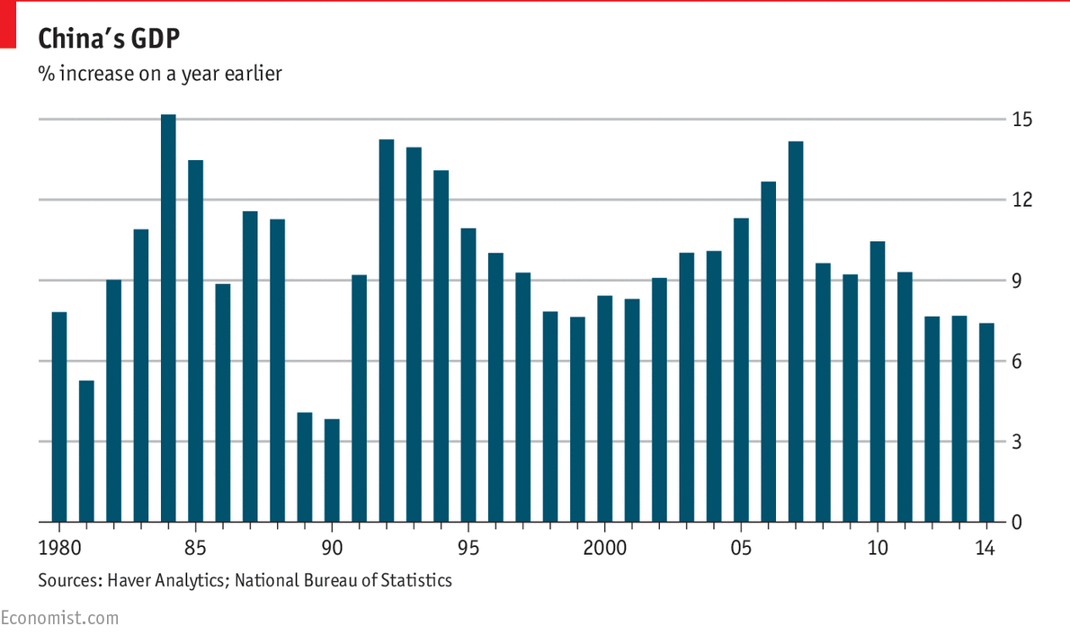
35 years of strong Chinese growth

Slide 24

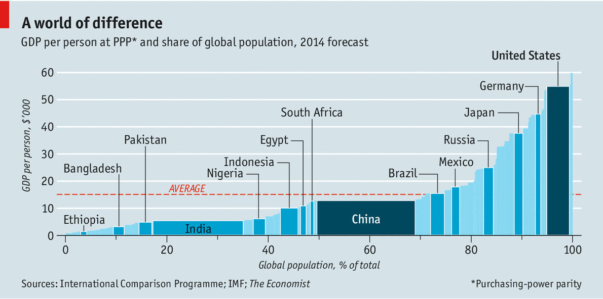



Measuring GDP The dragon takes wing
New data suggest the Chinese economy is bigger than previously thought May 3rd 2014 |
Korea
http://www.economist.com/news/finance-and-economics/21601568-new-data-suggest-chinese-economy-bigger-previously-thought-dragon

Slide 25
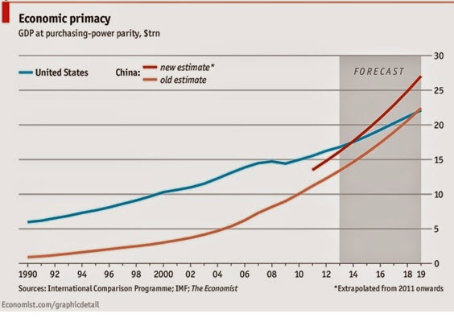
China’s GDP reportedly passed the US in 2014.
But I call that a mis-application of the PPP numbers
from the World Bank’s ICP project.

Slide 26

Use PPP rates to compare income per capita
Use actual exchange rates to compare GDP
e.g., to judge if:
  governments have successfully raised living standards;
  a country is rich enough to cut pollution;
  the currency is “undervalued,”
  given its income.
e.g., to judge:
  How big is the market,
  from the view of multinational companies?
  How big should a country’s quota be in the IMF?
  How many ships
  can its navy buy?
  How big is the global role
  for its currency?

Slide 27
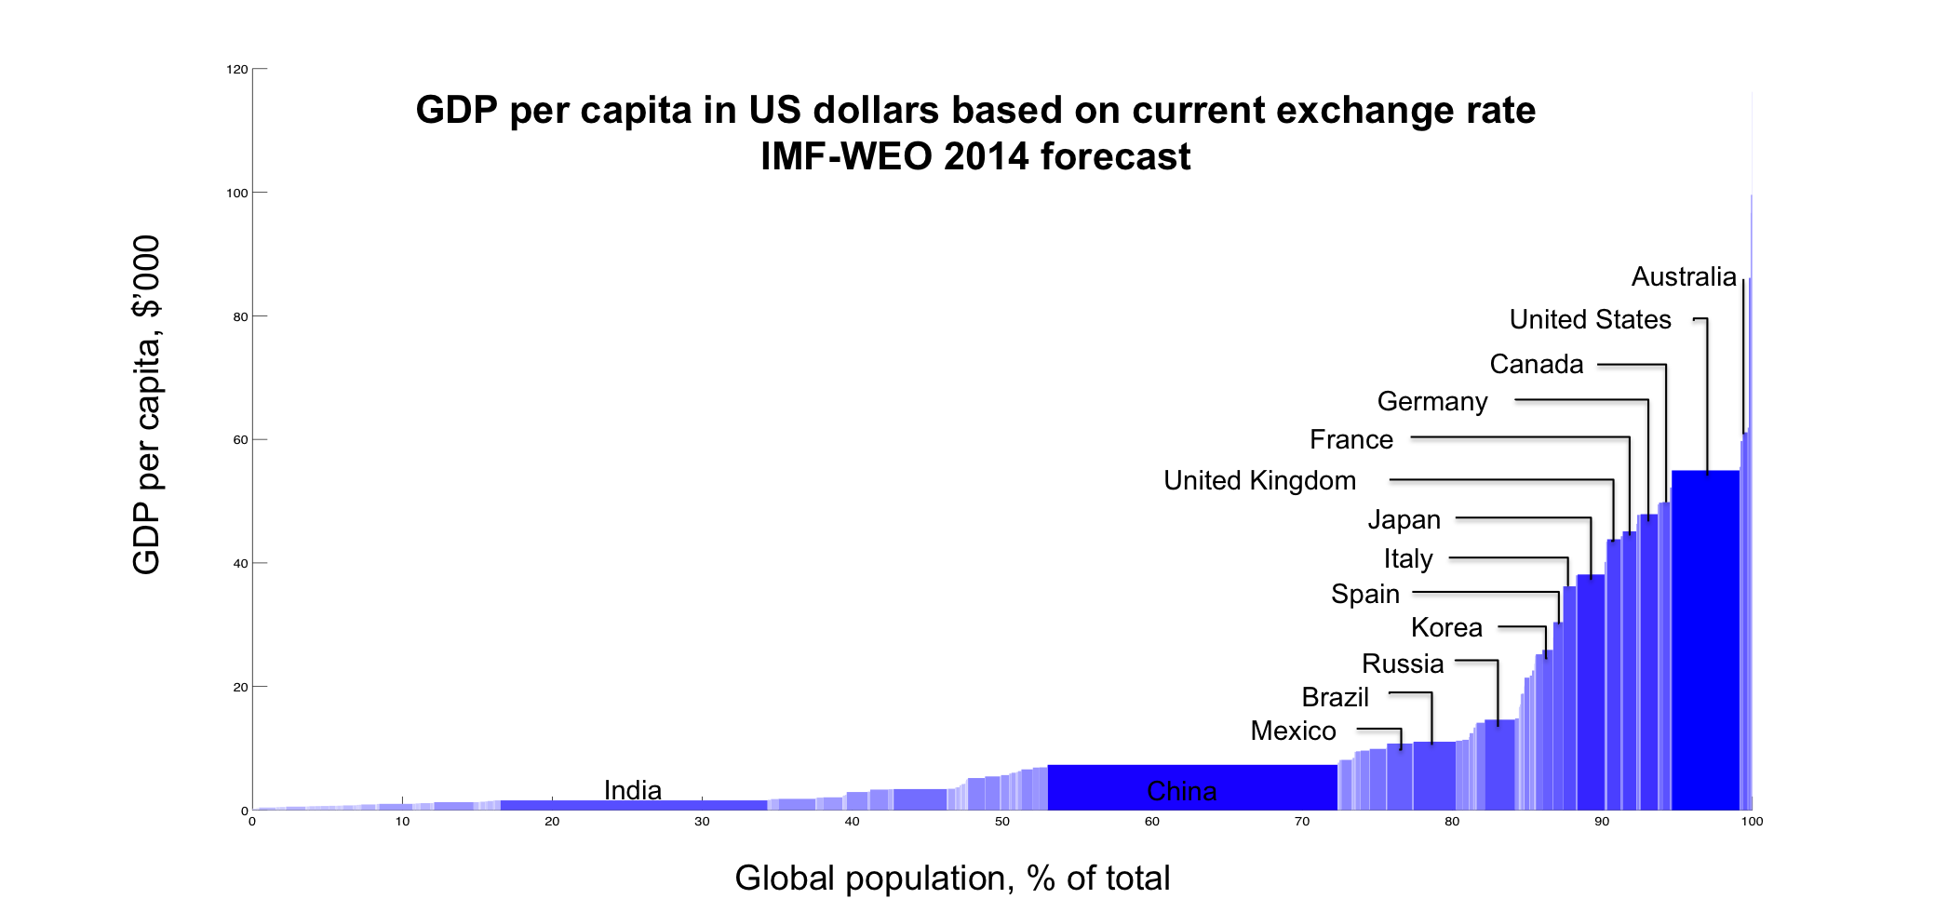
Measuring GDP
Using actual exchange rates gives a different answer:
The US is still 83% bigger than China.
2014 with IMF WEO forecast
Thanks to Qing Yu

Slide 28
China GDP reached US in 2014 only if measured in PPP terms.

Slide 29
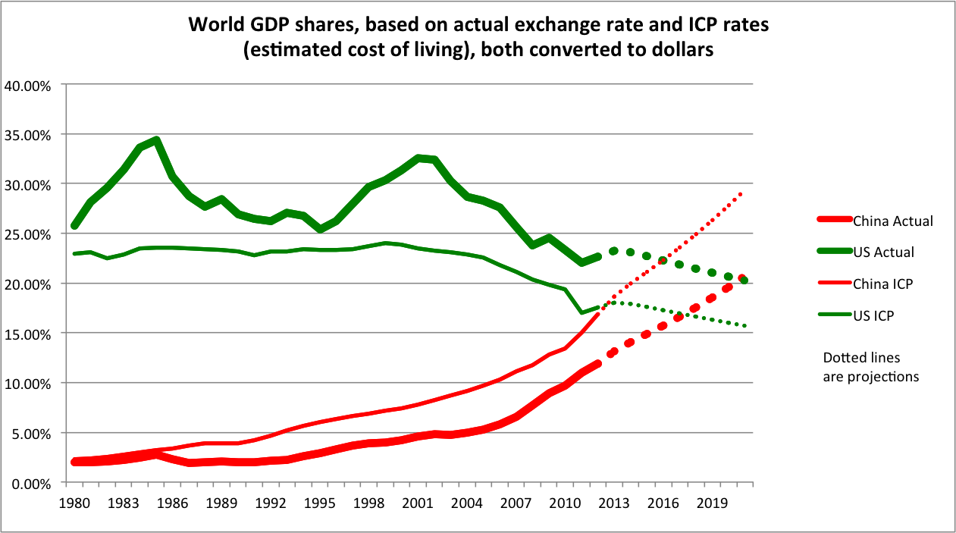
China has not yet overtaken the US.
Author’s
calculations.
(Thanks to Qing Yu.)
The cross-over won’t come before the 2020s.
In 2021 under aggressive projections: real growth differential = 5% & real appreciation = 3%.
In 2029, if the growth differential = 4% and there is no real appreciation.

Slide 30
II.2 China’s recent growth slowdown
Breathless reports in 2014 that the Chinese economy had overtaken the US economy as the world’s largest were followed in 2015 by breathless reports that its economy is failing.
  led by the bursting of a brief stock market bubble.
Is the current slowdown permanent?
  The slow-down from > 10% to < 7% ?
    Yes, that is likely permanent.
    What are the possible reasons?
Will it be worse than that?
  I.e., will transition to the slower path
  be a hard landing or soft landing?

Slide 31
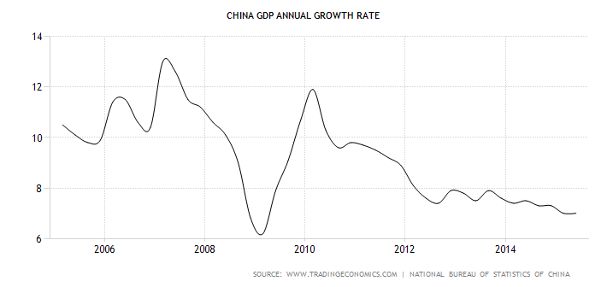
China: Real GDP is Slowing
China’s growth has slowed down
relative to its past double-digit rates.
Source: Nicholas Lardy, PIIE

Slide 32
China’s growth slow-down
Official “7%” may understate slowdown.
Reasons for long-term slowdown:
  Natural convergence (though far from complete)
    Technical catch-up,
    Capital/labor ratio,
    Rural urban migration,
    Rising costs of labor & land.
    Services have a lower rate of productivity growth
  Middle-income trap? e.g., Eichengreen, Park & Shin (2012)
  Regression to the mean: Pritchett & Summers (2014).
  Aging.

Slide 33
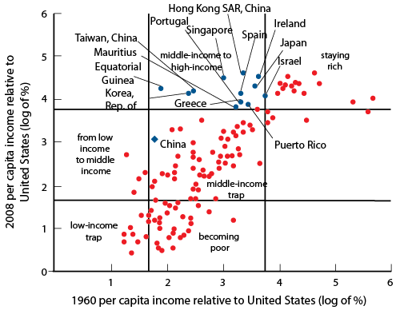
Is there a “middle-income growth trap”?
Eichengreen, B, D Park and K Shin (2011), “When Fast Economies Slow Down: International Evidence and Implications for China”,
NBER WP 16919.
“Formal evidence on growth slowdowns and middle-income traps has suggested that at per capita incomes of about US$16,700 in 2005 constant international prices, the growth rate of per capita GDP typically slows from 5.6 to 2.1%.”
“Avoiding middle-income growth traps,” Pierre-Richard Agénor, Otaviano Canuto, Michael Jelenic ,VoxEU, 21 Dec. 2012

Slide 34
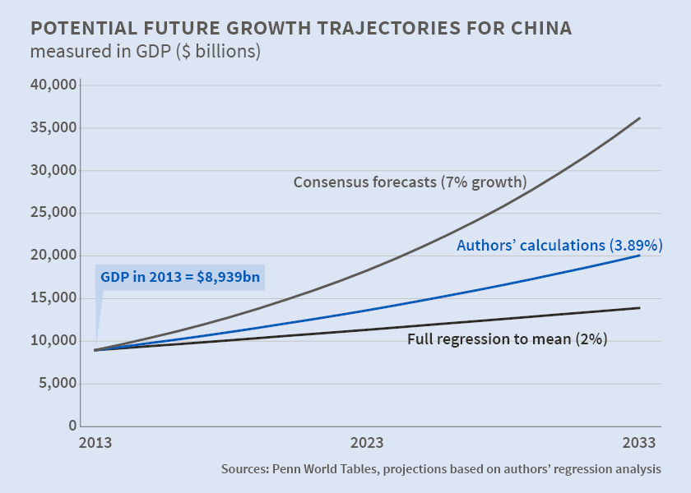
Pritchett & Summers (2014): “Regression to the mean” fits the data better than middle-income trap
“Asiaphoria Meets Regression to the Mean,” NBER WP No. 20573, Lant Pritchett and Lawrence Summers

Slide 35
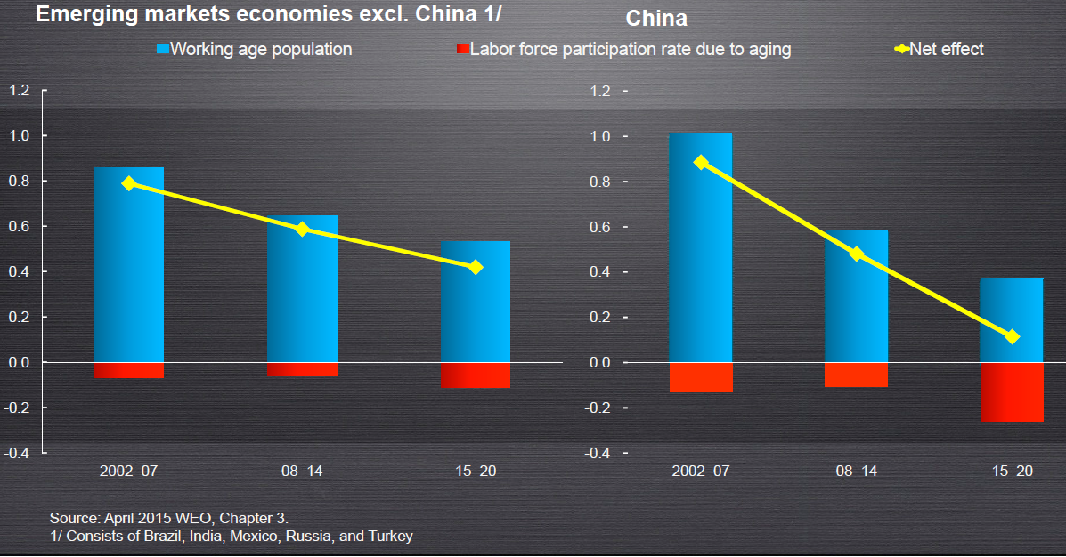

Demographic factors are reducing growth rate in China even more than in other countries

Slide 36
Transition to slower growth path
Hard landing or soft landing?
  High investment in heavy industry is unsustainable.
  Debt
    Leverage becomes unsustainable when growth slows.
    Bad loans in the shadow banking system.
    $-denominated loans especially problematic
      as in other Emerging Market countries.
Need to carry out reforms
  as decided at the Third Plenum of 2013:
    Rural land rights and hukou system
    Market orientation
    Environment.

Slide 37
  (III) Emerging Markets generally
To sharpen the question:
We currently have a divergence in the world economy,
  with US GDP strengthening
    relative to the rest of the world;
  and the Fed about to raise interest rates
    while other central banks ease their own monetary policies.
Are EMEs vulnerable to higher US interest rates?
  They have had plenty of advance warning.
  Which ones are most vulnerable?

Slide 38
After the currency crises of the late 1990s, many EM countries adopted stronger policies
In particular:
  More flexible exchange rates,
  Higher holdings of foreign exchange reserves,
  Smaller current account deficits,
  Less $-denominated debt,
  Less pro-cyclical fiscal policy.
As a result, were less vulnerable to the 2008-09 shock.
But there has been back-sliding since 2009:
  especially on debt.

Slide 39
Some EMEs reduced the pro-cyclicality of their fiscal policies after 2000
Fiscal policy was traditionally pro-cyclical:
  E.g., spending would rise in booms & fall in recessions.
  I.e., destabilizing.
  Especially among commodity-exporters.
After 2000, some achieved counter-cyclical fiscal policy
  Notably: Botswana, Chile,
  China, India, Korea, Malaysia…

Slide 40

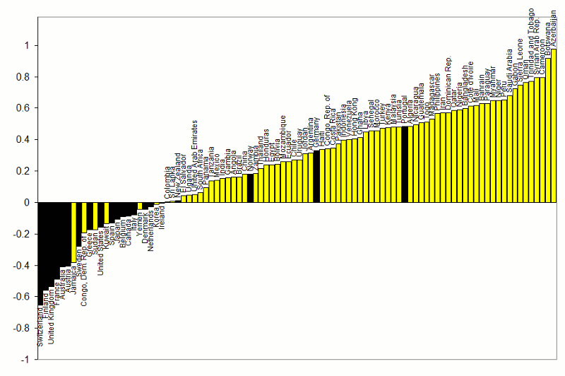


Correlations between government spending & GDP
1960-1999
}
procyclical
Adapted from Kaminsky, Reinhart & Vegh (2004)
countercyclical
G always used to be pro-cyclical
for most developing countries
(yellow)

Slide 41

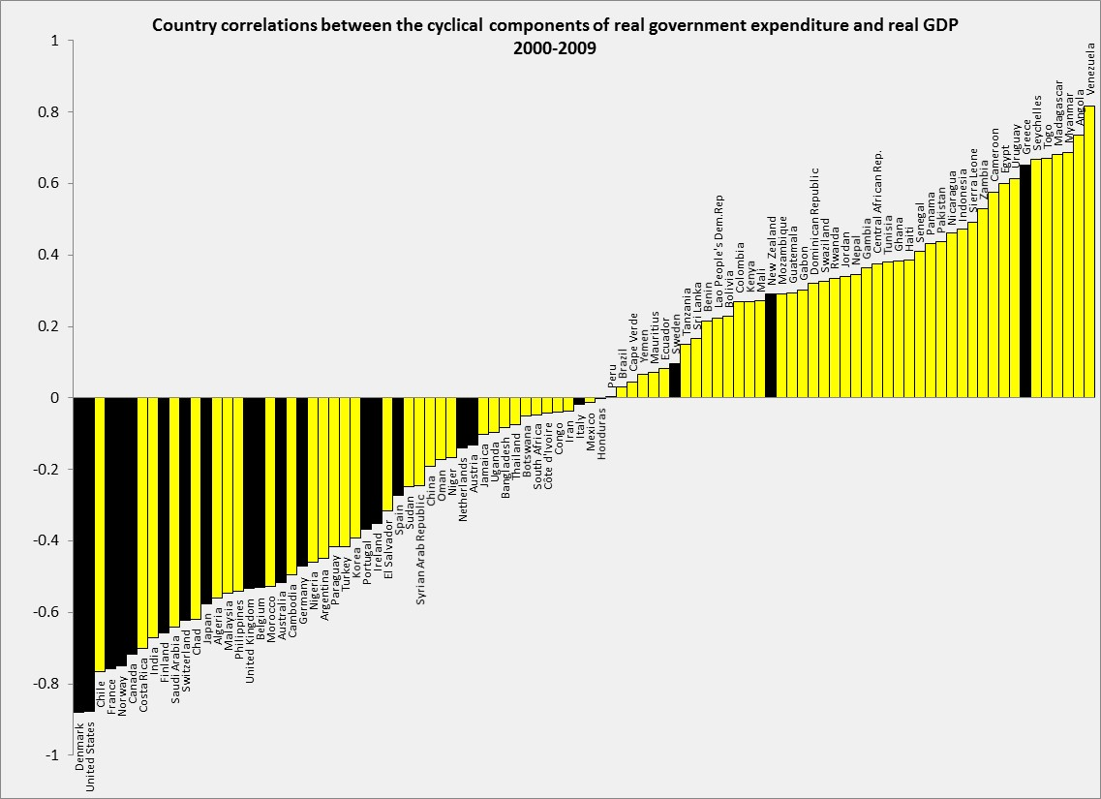

Correlations between government spending & GDP
2000-2009.
procyclical
Adapted from Frankel, Vegh & Vuletin
(JDE, 2013)
In the decade 2000-2009,
about 19 developing countries
switched to countercyclical fiscal policy:
Negative correlation of G & GDP.
countercyclical
DEVELOPING: 43% (= 32 /75) countercyclical. It was 17% (= 13/75) in 1960-1999.
INDUSTRIAL: 86% (= 18 / 21) countercyclical. It was 80% (= 16/20) in 1960-1999.

Slide 42
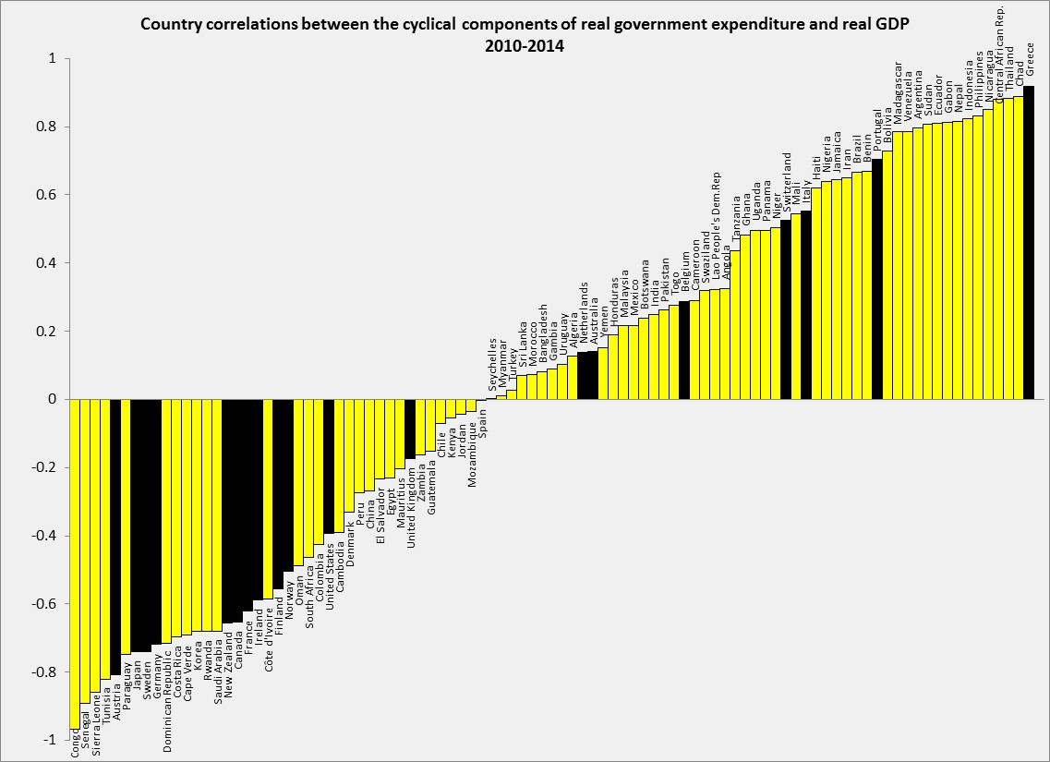




Update of Correlation (G, GDP): 2010-2014.
procyclical
countercyclical
Back-sliding among some after 2009
Thanks to Guillermo Vuletin
DEVELOPING: 37% (= 29 out of 76) pursue counter-cyclical fiscal policy.
INDUSTRIAL: 63% (or= 12 out of 19) pursue counter-cyclical fiscal policy.

Slide 43
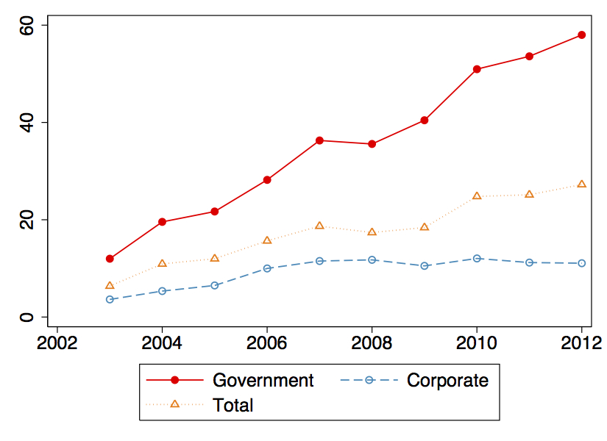
Currency composition in the post-2003 capital inflows shifted away from $-denomination, toward Local Currency.
Share of External Debt in LC
(Mean of 14 sample countries)
Wenxin Du & Jesse Schreger, Harvard U., Dec. 2014, “Sovereign Risk, Currency Risk, & Corporate Balance Sheets,” Fig.2, p.19 .

Slide 44
FX bond issuance by nonfinancial corporates
has increased since 2009, raising vulnerabilities.
Foreign Bond Issuance: Nonfinancial Corporates (US$ billion)
Sources: Dealogic; and IMF staff calculations.
Cubeddu, Iakova, & Sosa IMF, February 2015
Notes:
Some of the new issuance is by non-exporters, though they may have financial hedges or be multinational companies. Nonetheless, vulnerability to depreciation has increased.

Slide 45
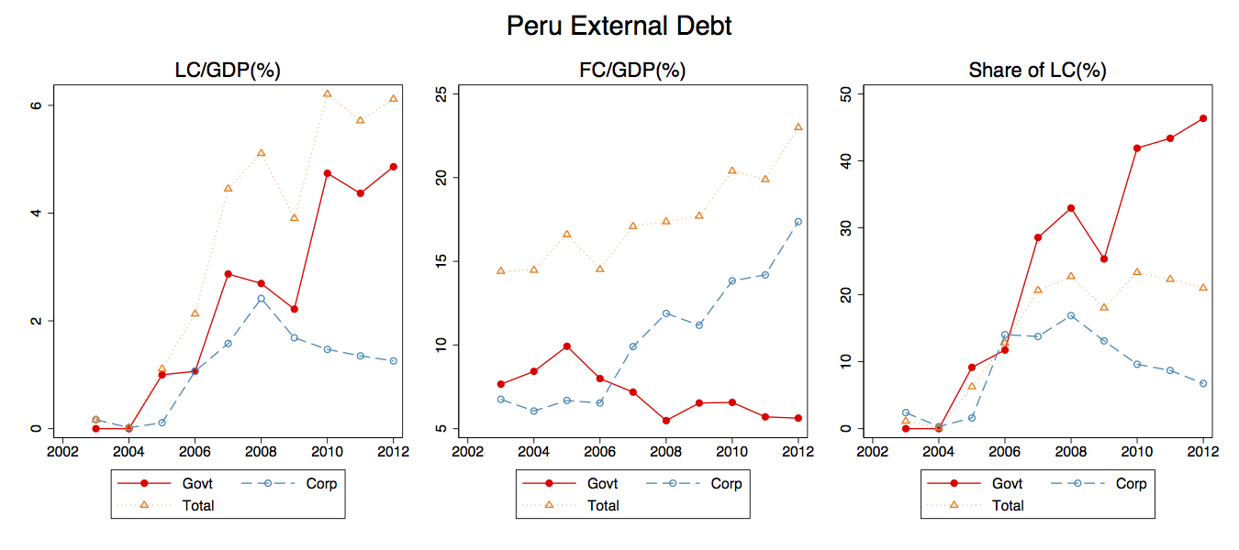


Corporate debt post-2008 swung back to $-denomination,
away from Local Currency, in some EMs.
Wenxin Du & Jesse Schreger, Harvard U., Sept. 2014,
“Sovereign Risk, Currency Risk, & Corporate Balance Sheets” p.18

Slide 46
But the central banks say they are ready, that the Fed should go ahead and get it over with!
If the ECB and other major central banks ease further at the same time that the Fed raises interest rates, shouldn’t the effect on EMs cancel out?
Those EMs with $-denominated debt
will be hit as the dollar appreciates.
Especially the commodity-exporters.

Slide 47
Jeffrey Frankel

Slide 48
Appendices
More on the pause in globalization
  Trying to explain trade slowdown since 2009
  Has globalization slowed in finance too?
More on China
  The shift from manufacturing into services.
  Slowdown.

Slide 49
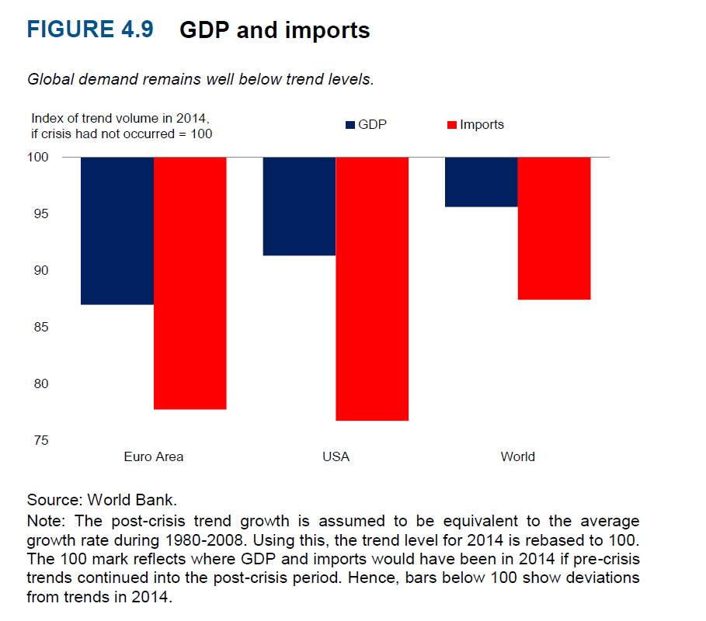
Appendix I.1: Trade has continued to run below trend, more so than GDP.
GDP and imports in Advanced Economies in 2014, relative to trend

Slide 50
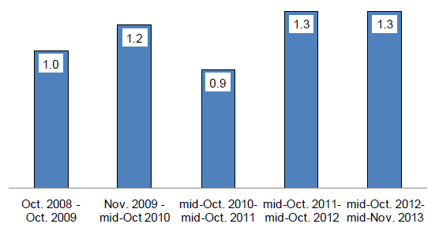
The WTO trade restrictiveness indicators –capturing border measures such as tariff increases, import licenses, or new customs controls- show a modest increase in the share of world trade covered by new import restricting measures since the Great Recession (Figure 13)….
These findings suggest that protectionist trade policies are playing a negligible (if any) role in explaining the reduction in the world trade elasticity and, hence, in the current trade slowdown…
Protectionist measures since 2009
Data source:
WTO
Cristina Constantinescu, Aaditya Mattoo, and Michele Ruta, 2015,
"The global trade slowdown: cyclical or structural?" IMF WP 15/6, January.

Slide 51
References on trade globalization slowdown
Abiad, A, P Mishra and P Topalova (2014), “How Does Trade Evolve in the Aftermath of Financial Crises?”, IMF Economic Review, 62: 213-247.
Boz, E, M Bussiere, and C Marsilli (2014), “Recent Slowdown in Global Trade: Cyclical or Structural”, VoxEU.org, 12 November.
Bussière, M., Callegari, Ghironi, Sestieri & Yamano, 2013, "Estimating Trade Elasticities: Demand Composition and the Trade Collapse of 2008-2009," American Economic Journal: Macroeconomics, 5, no.3, July, pp. 118-51. NBER WP 17712. VoxEU Summary, 2012.
Constantinescu, C, A Mattoo and M Ruta (2015) “The Global Trade Slowdown: Cyclical or Structural?”, IMF WP 15/6, January.
Escaith, H, N Lindenberg, and S Miroudot (2010) “International Supply Chains and Trade Elasticity in Times of Global Crisis,” WTO Staff Working Paper ERSD-2010-08.
Evenett, S J (2014), “The Global Trade Disorder: New GTA data”, VoxEU.org, 13 November.
Freund, C (2009), “The Trade Response to Global Downturns: Historical Evidence”, Policy Research Working Paper Series 5015, World Bank, Washington, DC.
Irwin, D (2002), “Long-Run Trends in World Trade and Income”, World Trade Review, 1:1, 89-100.
Lawrence, R. (2015) “Slowdown in World Trade,” HKS (slides), September.
World Bank (2015), “What Lies Behind the Global Trade Slowdown”, Chapter 4 in Global Economic Prospects, World Bank, Washington D.C.

Slide 52
Appendix I.2: Has the trend of financial globalization slowed too?
Measures such as the pattern of equity holdings have long shown increasing international integration.
September 2008 was a shock indeed.
  Even the most liquid and integrated of the world’s financial markets briefly became illiquid and segmented.
  Consider the covered interest differential:
  $ vs. € or ₤.
Some see signs of a more lasting pause in integration
  E.g., a retraction of gross cross-border capital flows.
  Increased home-ownership of government bonds
    attributed by Carmen Reinhart to “financial repression.”
    Especially in eurozone.

Slide 53

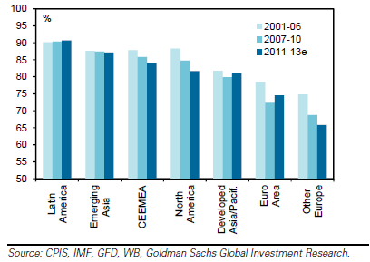

Home bias in equity holdings (most equities are held by domestic residents) is one illustration of the long-term trend toward increased integration

Slide 54
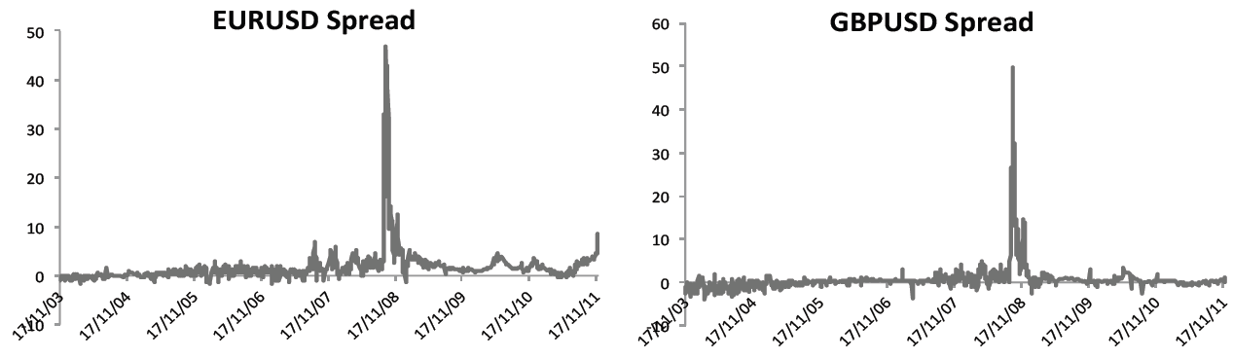

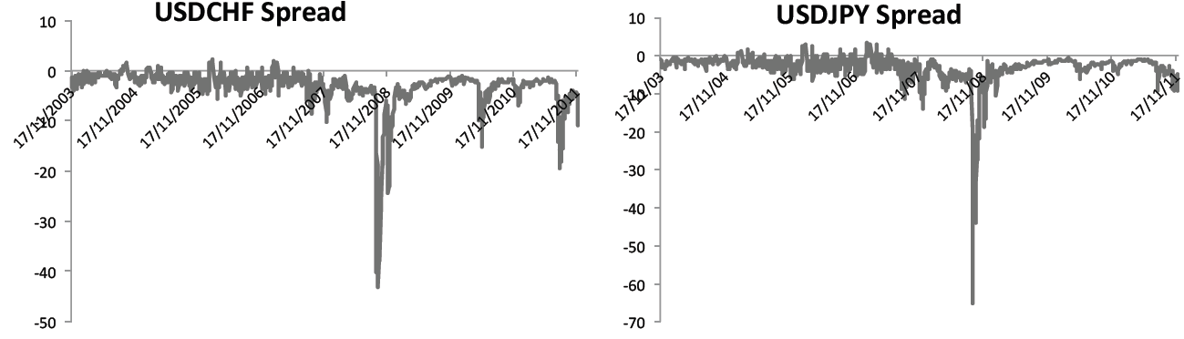

Surprisingly, Covered Interest Parity failed in late 2008, as money rushed to the $ as safe haven.
Covered interest differentials, using Overnight Index Swap interest rates, 2003-2011
Significant spread determinants are apparently counterparty risk & liquidity,
proxied by financial stock CDS, VIX, implied fx volatility, OIS bid-ask spreads & Fed swap lines.
Inês Isabel Sequeira de Freitas Serra, ”Covered Interest Parity,” NOVA – School of Business & Economics, Lisbon, Jan. 2012 http://run.unl.pt/handle/10362/9528

Slide 55
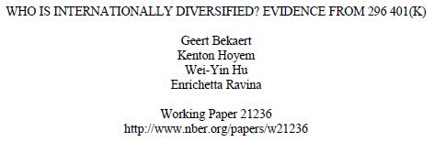
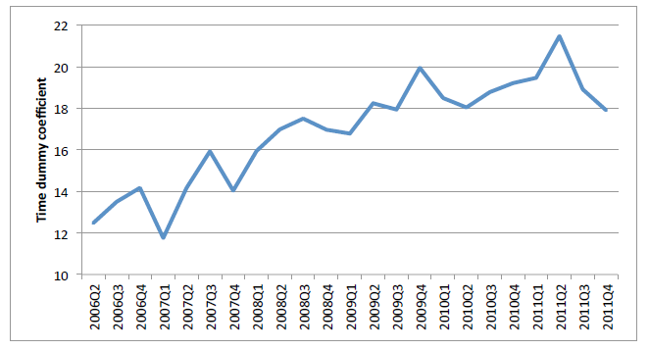
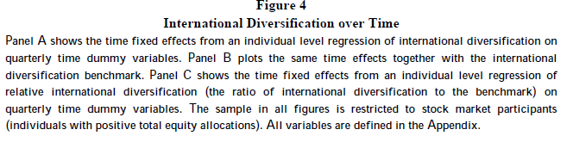
One measure of international diversification has apparently slowed in the US, in a sample of 3.8 million US 401(k) stock market investors

Slide 56
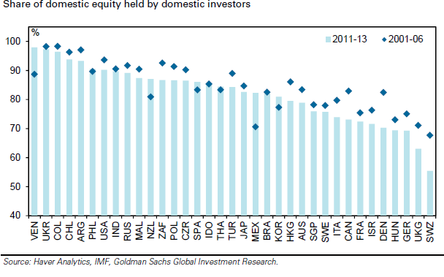
But in most countries, home bias in equity holdings has continued to decline.

Slide 57
Verdict on financial integration
Some aspects of financial integration did suffer very unexpected set-backs in 2008
and thereafter.
But there is no reason to think that the long-run trend has changed.

Slide 58
Appendix II: More on China
The shift from manufacturing into services.
Slowdown.
Both imply lower global demand for commodities

Slide 59
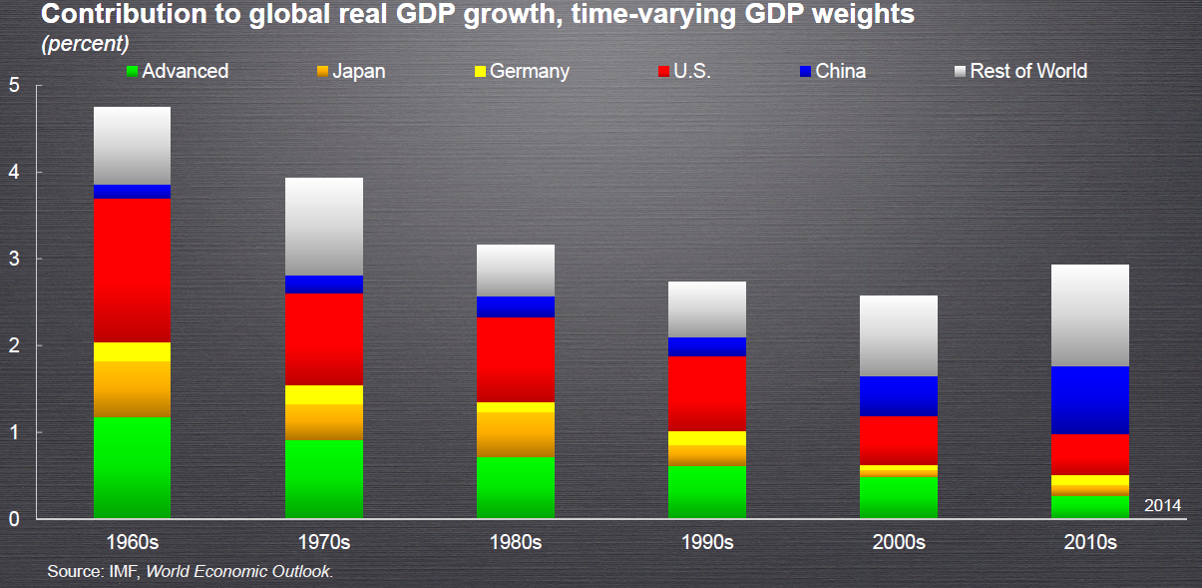
Since Asia is now a large share of the global economy, its growth rate matters more directly to all of us.

Slide 60
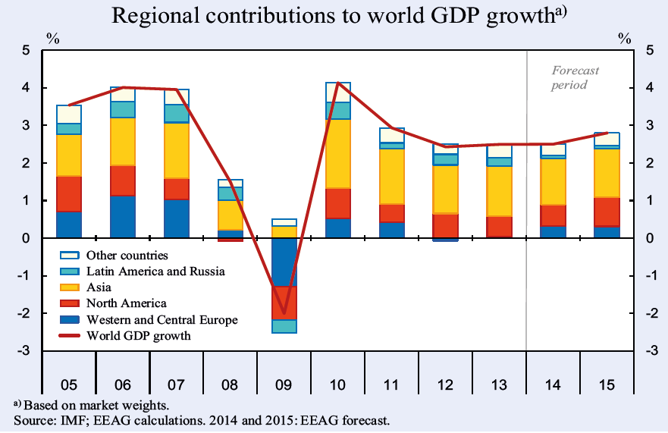
Asia’s contribution to growth this year will be less than in other recent years, but still more than other regions’.

Slide 61
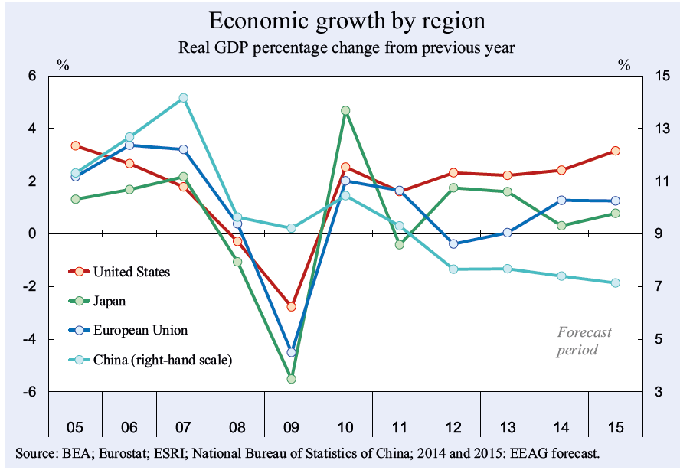
The decline in China’s growth rate
is greater than that of Europe or others.

Slide 62
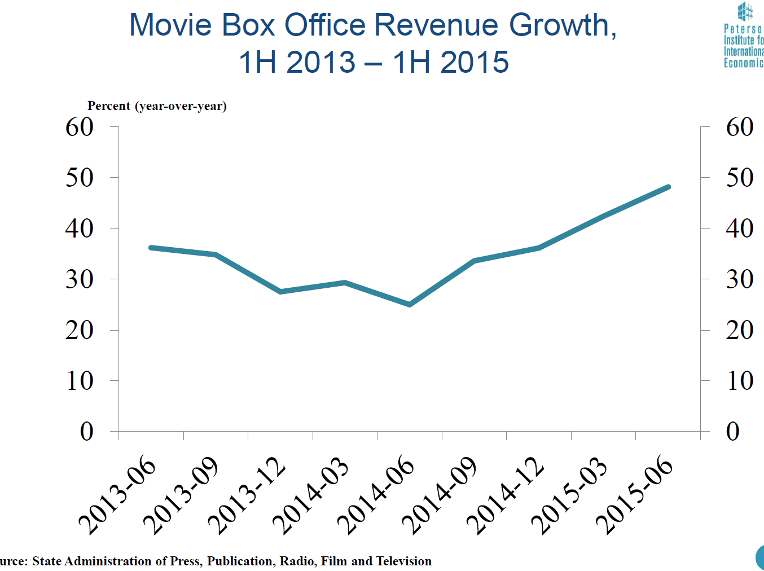
It’s good to look also at other data in China to verify the rising importance of services.
% change (year-over-year)
Source: Nicholas Lardy

Slide 63
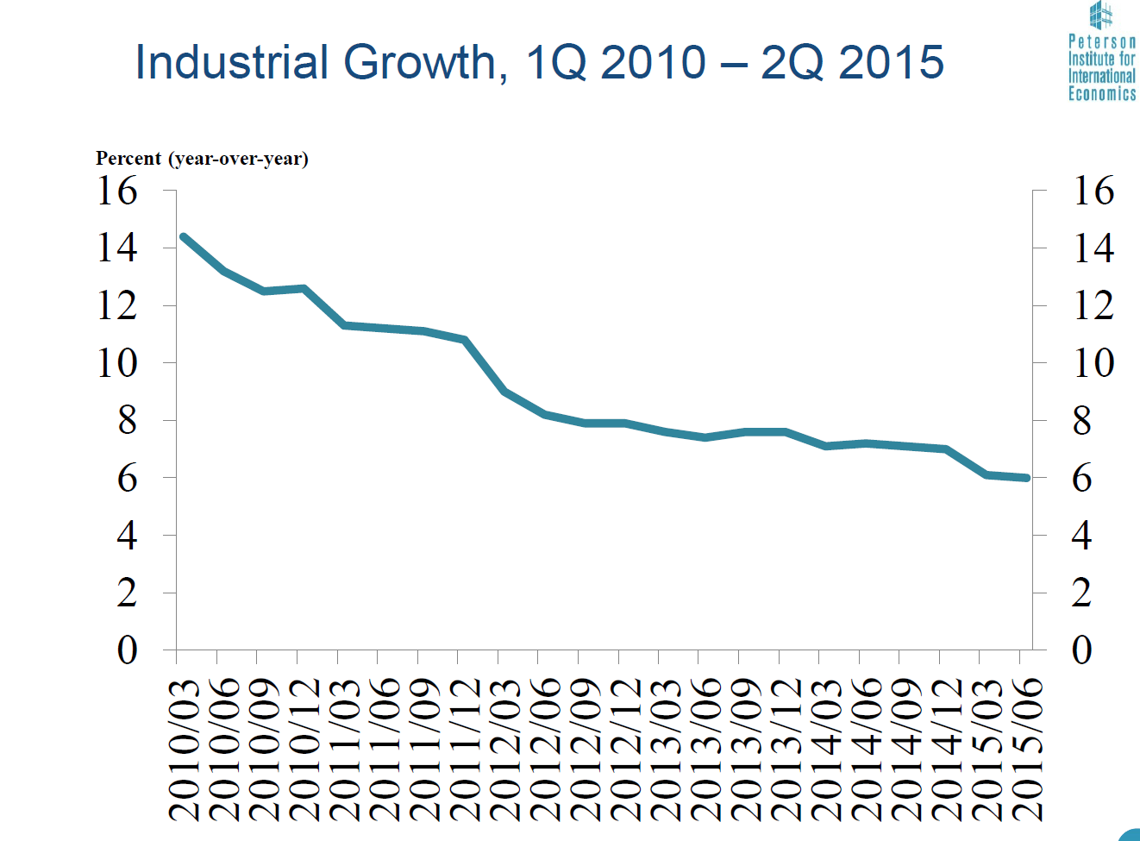
China: Industrial Output Growth
Source: Nicholas Lardy, PIIE

