Slide 1


Views on the Economy & The World:
Holes in the Roof
Jeffrey Frankel
Harpel Professor of Capital Formation & Growth
RCC at HARVARD EXECUTIVE PROGRAM
Harvard Faculty Club
May 7, 2018

Slide 2
The global economic outlook
The economy improved in most places in 2017.
But in 2018, clouds are re-appearing.
Countries have failed to fix holes in the roof.
1 Dangers for EM countries, external & local:
2 The return of EM foreign-currency corporate debt.
3 The return of pro-cyclical fiscal policy.
4 The return of trade barriers?
    Trade/GDP slowed during 2008-2016. 2017 was better;
    But now…trade wars?

Slide 3
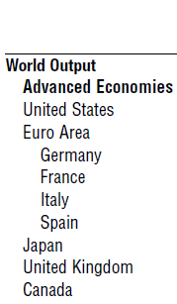
The economic situation improved substantially in 2017:
globally, growth up from 3.1% in 2015-16, to 3.8%;
in advanced economies, including even the eurozone…
`
IMF World Economic Outlook, April 2018.

Slide 4


…and in EM/Developing Economies.
IMF World Economic Outlook, April 2018.

Slide 5
China’s slowdown afte 2010 was unavoidable, but it avoided the feared hard landing
and even commodity exporters began to recover in 2017.
IMF World Economic Outlook, April 2018.

Slide 6
EMs suffered outflows 2014-16
partly due to the taper of Fed QE in 2013
& fall of commodity prices in 2014.
But some EM inflows returned in 2017.
IMF World Economic Outlook, April 2018.

Slide 7
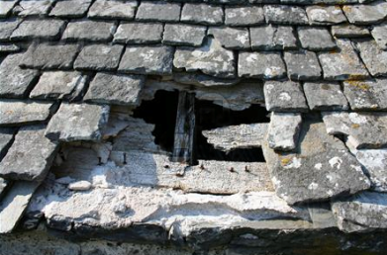
1. Some dangers for EM countries in 2018
External risks that may test EMs.
  “Risk off” environment, as in Global Fin. Crisis of 2008.
  Fed tightening, as in 1981, 1994, & 2013 taper tantrum.
  Global trade war, as in 1930s.
Local vulnerabilities.
  The return of $-denominated corporate debt.
  The return of pro-cyclical fiscal policy.
The lesson: Policy-makers should
take advantage of good weather
to “fix the holes in the roof.”

Slide 8
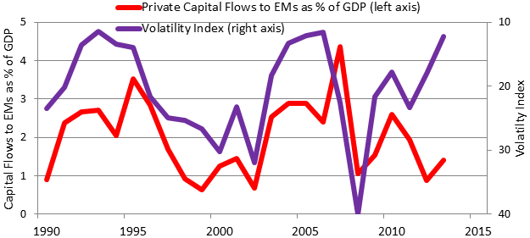
One possible external shock: “Risk on / risk off”
Flows to EMs fall when risk fears (VIX) are high, as in 2008.
(↓ in graph)
2008
GFC
Kristin Forbes, 2014 http://www.voxeu.org/article/understanding-emerging-market-turmoil
Notes: Data on private capital flows from IMF's IFS database, Dec. 2013. Capital flows are private financial flows to emerging markets
and developing economies. Volatility index measured by the Chicago Board's VIX or VXO at end of period. 2013 data are estimates.
See K.Forbes & F.Warnock (2012), “Capital Flow Waves: Surges, Stops, Flight and Retrenchment”, J. Int.Ec.

Slide 9
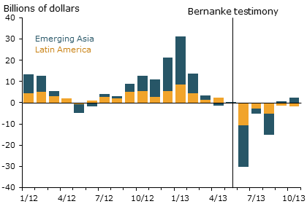
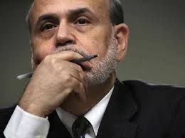
After Fed “taper talk” in May 2013, capital flows to Emerging Markets turned negative.
Another possible external shock: US interest rates
Jay Powell, 2013, “Advanced Economy Monetary Policy and Emerging Market Economies.”
Speech at the Federal Reserve Bank of San Francisco Asia Economic Policy Conference, Nov.
http://www.frbsf.org/economic-research/publications/economic-letter/2014/march/federal-reserve-tapering-emerging-markets/

Slide 10
May 2018: Has the test arrived?
Eurozone growth rate slowed by half in Q1.
The VIX rose sharply in February.
US interest rates are rising
  as the US economy hits full-employment
    April unemployment = 3.9%.
The dollar is up this year as well,
  in a return to the pattern of 2014-16,
  particularly against some EM currencies.
  E.g., Argentina,
    where the central bank May 4 had to raise the interest rate to 40%.

Slide 11
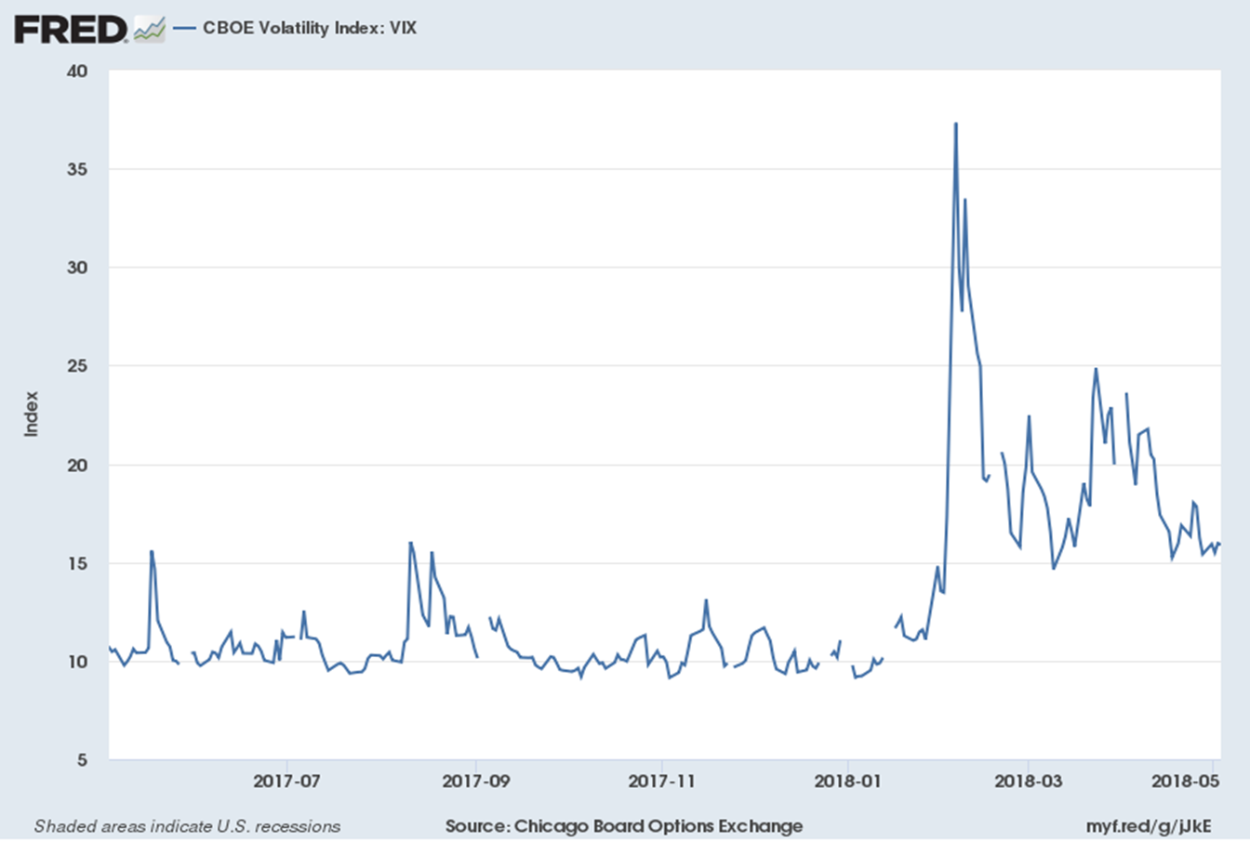
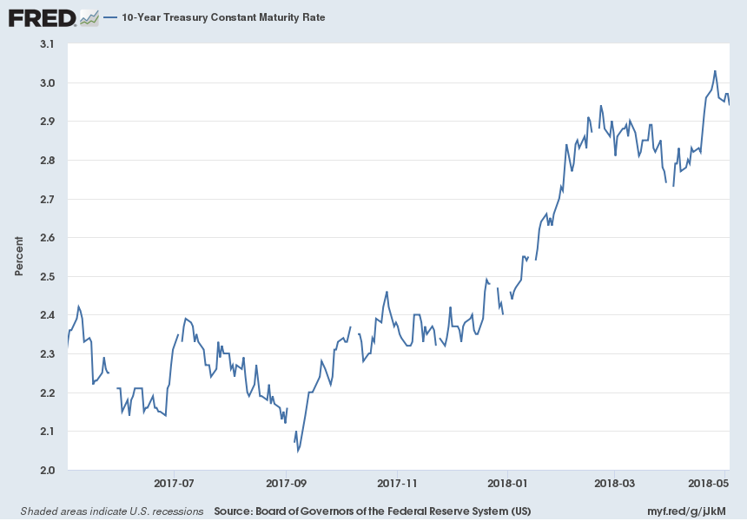
The VIX, unnaturally low in 2017, rose in February 2018…
CBOE volatility index, May 2017-May 2018
…as have US interest rates (10-year Treasury)…

Slide 12
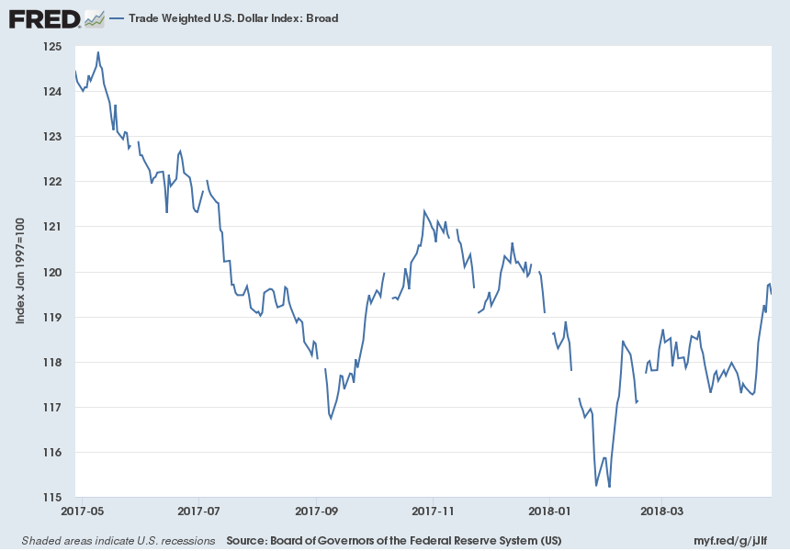
The dollar, which is still a safe haven, rose as well.
Trade-weighted US $ index (broad), May 2017-May 2018

Slide 13
  2. One vulnerability: The return of foreign-currency denominated corporate debt
After the currency crises of 1994-2002,
many EMs learned to reduce their vulnerabilities.
Central banks hold more forex reserves.
More flexible exchange rates.
Less $-denominated debt,
  to avoid the adverse balance-sheet effects
  from currency-mismatch + devaluation.

Slide 14
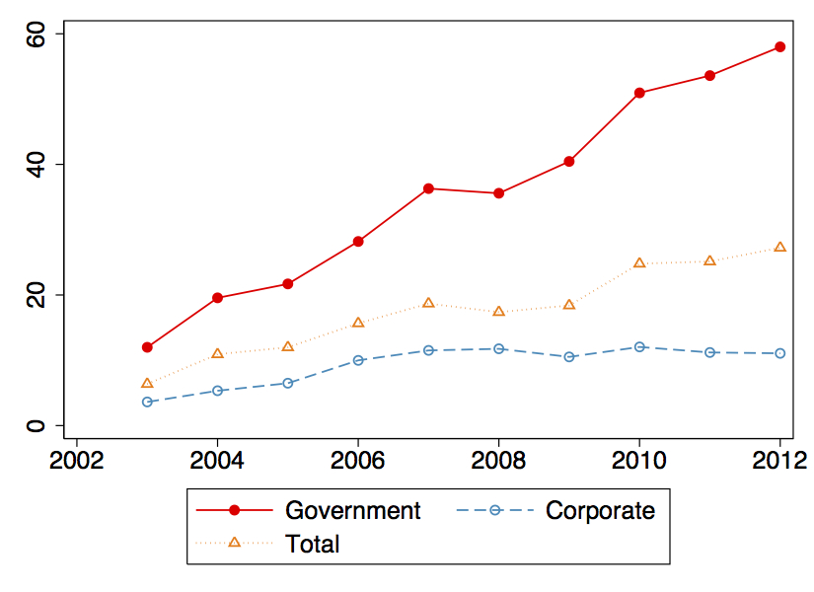
Currency composition in the post-2003 capital inflows shifted away from $-denomination, toward Local Currency.
Share of External Debt in LC
(Mean of 14 sample countries)
Wenxin Du & Jesse Schreger, Harvard Business School, 2016, “Sovereign Risk, Currency Risk, & Corporate Balance Sheets,” Fig.3.

Slide 15

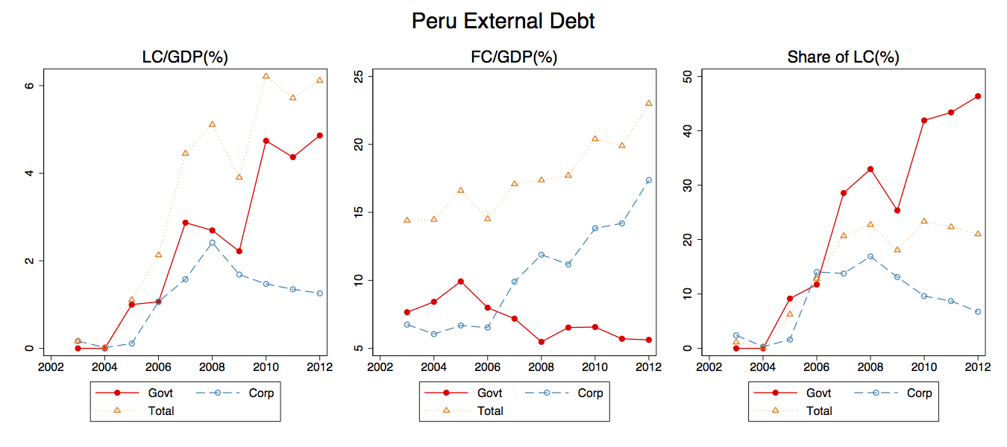

But corporate debt post-2008 swung back to $-denomination,
away from Local Currency, in some EMs.
Wenxin Du & Jesse Schreger, Harvard Business School, 2016,
“Sovereign Risk, Currency Risk, & Corporate Balance Sheets” Fig. A2.

Slide 16
FX bond issuance by nonfinancial corporates has increased in Latin America since 2009, raising vulnerabilities.
Foreign Bond Issuance: Nonfinancial Corporates (US$ billion)
Sources: Dealogic; and IMF staff calculations.
Cubeddu, Iakova, & Sosa IMF, February 2015
Notes:
Some of the new issuance is by non-exporters, though they may have financial hedges or be multinational companies. Nonetheless, vulnerability to depreciation has increased.

Slide 17

Why do leaders fail to take advantage of boom times to strengthen the budget?
3. Another vulnerability: pro-cyclical fiscal policy
People don’t see the need to “fix the hole
in the roof when the sun is shining.”
  They may see the mistake
  when the storm hits,
    but then it is too late.
Official forecasts
are over-optimistic
in boom periods,
rationalizing the failure to act,
  according to data from 33 countries.

Slide 18

Cyclicality of Fiscal Policy,
“What is the best fiscal policy,
Austerity or Stimulus?”
The question is as foolish
as the question,
“Should a driver turn left or right?”
It depends where he is in the road.
  Sometimes left is the answer, sometimes right.

Slide 19
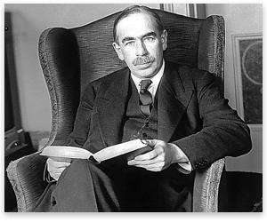
Cyclicality of Fiscal Policy, continued
Keynes favored counter-cyclical policy:
  fiscal stimulus when under conditions like the 1930s -- depressed income, high unemployment,
  low inflation, low interest rates –
  -- to moderate the downturn,
  but fiscal discipline
  during boom periods,
  -- to prevent over-heating
  -- & to maintain debt sustainability.
“The boom, not the slump, is the right time for austerity at the Treasury.” - John Maynard Keynes (1937)

Slide 20
Cyclicality of Fiscal Policy, continued
Keynesian policy (“fine tuning”) fell into disfavor
in part because it was hard to get the timing right:
  by the time fiscal stimulus became law,
  the recession would be over.
But that is no excuse for pro-cyclical fiscal policy.
Definition of pro-cyclical fiscal policy:
Governments raise spending (or cut taxes) in booms;
and are then forced to retrench in downturns,
thereby exacerbating upswings & downswings.

Slide 21

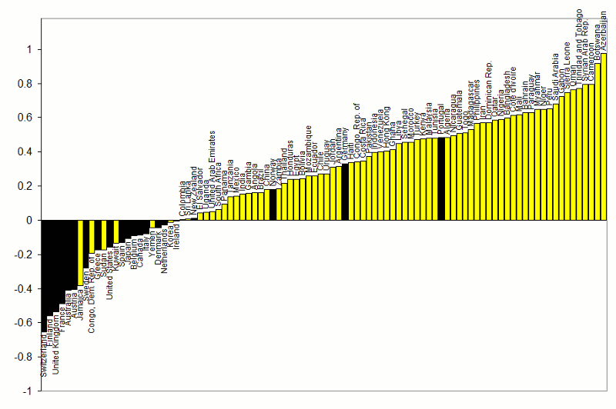



Correlations between Government Spending & GDP
1960-1999
procyclical
}
Adapted from Kaminsky, Reinhart & Vegh (2004)
countercyclical
G always used to be pro-cyclical
for most developing countries.

Slide 22

The procyclicality of fiscal policy, cont.
An important development --
some developing countries were able to break
the historic pattern after 2000:
  taking advantage of the boom of 2002-2008
    to run budget surpluses & build reserves,
  thereby earning the ability to expand
  fiscally in the 2008-09 crisis.
  Chile, Costa Rica, Botswana, Malaysia, S. Korea…
22
Notes:
22
keep

Slide 23

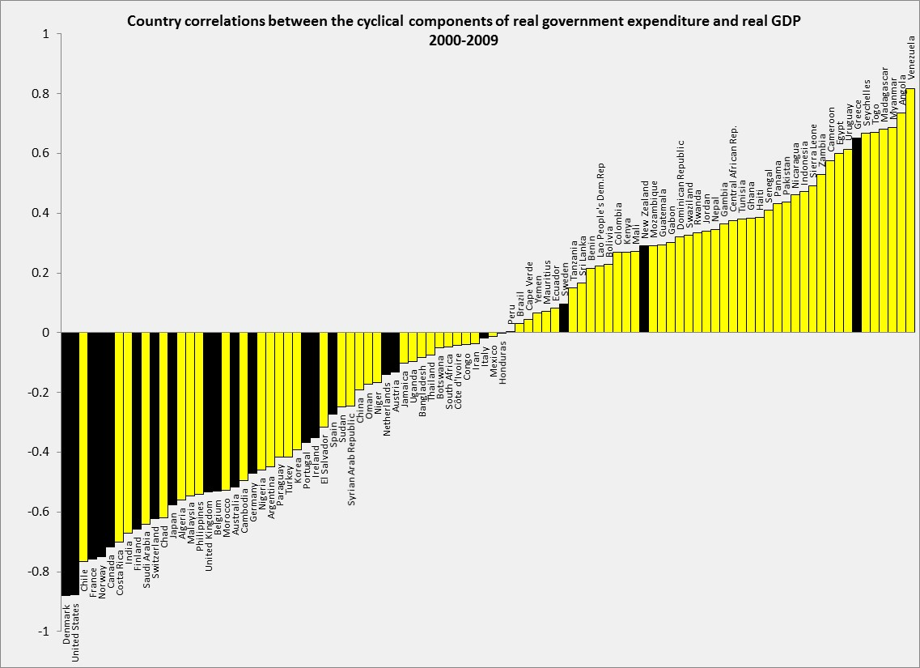



Correlations between Government spending & GDP
2000-2009
Adapted from Frankel, Vegh & Vuletin (JDE, 2013)
In the decade 2000-2009,
about 1/4 developing countries
switched to countercyclical fiscal policy:
Negative correlation of G & GDP.
DEVELOPING:
43% (or 32 out of 75) countercyclical. The figure was 17% (or 13 out of 75) in 1960-1999.
INDUSTRIAL:
86% (or 18 out of 21) countercyclical. The figure was 80% (or 16 out of 20) in 1960-1999.

Slide 24

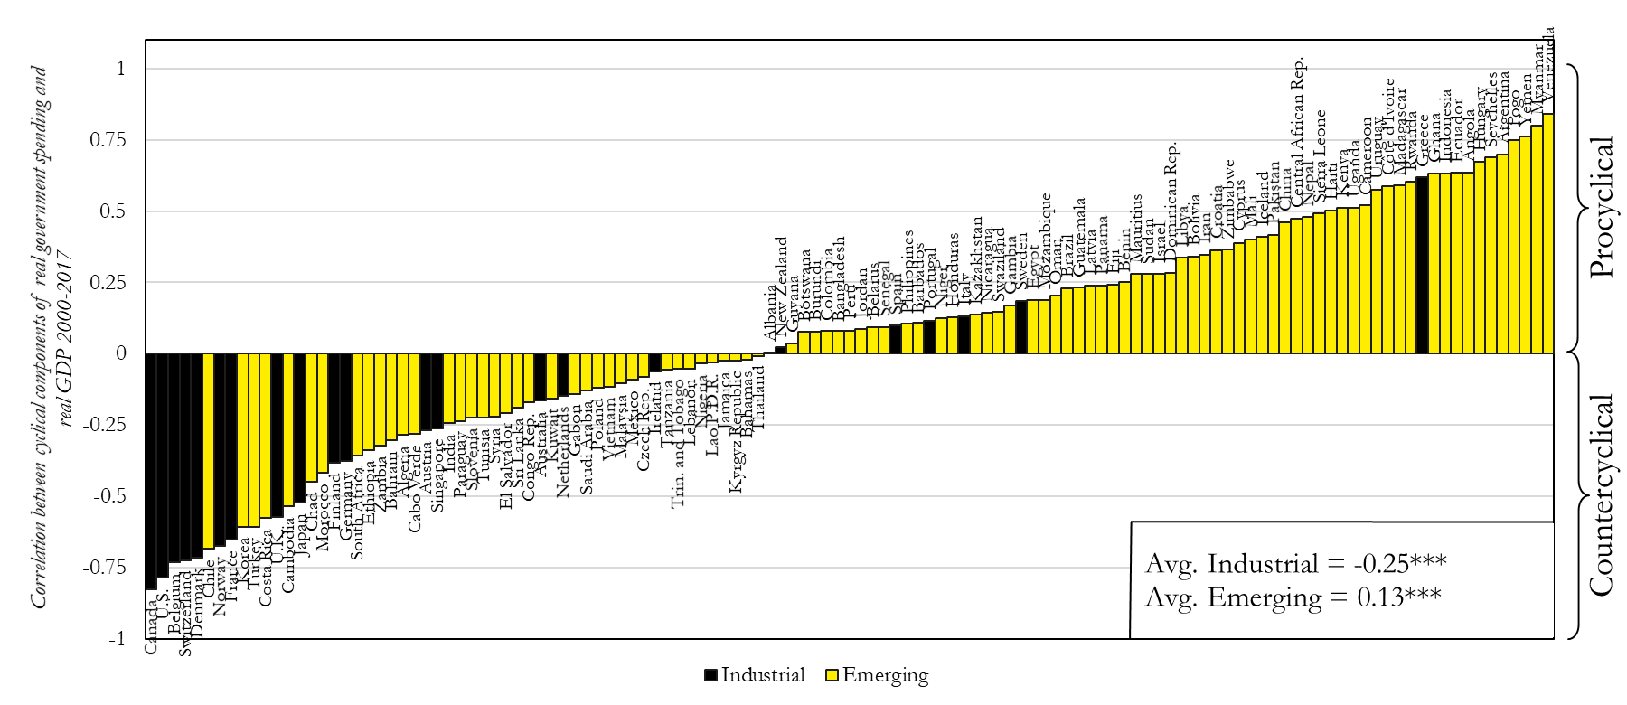



Update of Correlation (Govt spending, GDP):
2000-17
}
After 2010, back-sliding among some countries.

Slide 25


The problem with counter-cyclical fiscal policy:
Countries running big deficits even when the economy is strong, will be in trouble when the next down-turn comes.
No “fiscal space.”
Advanced countries can suffer pro-cyclical policy too.
i) The euro periphery.
ii) The US.

Slide 26
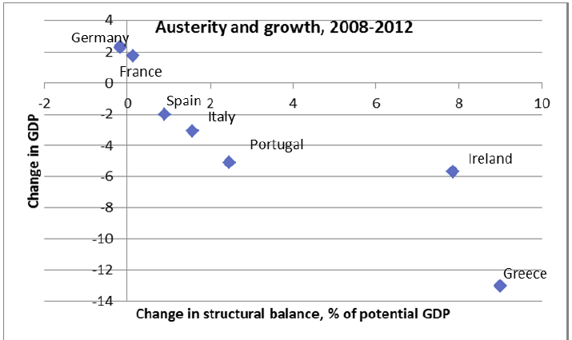


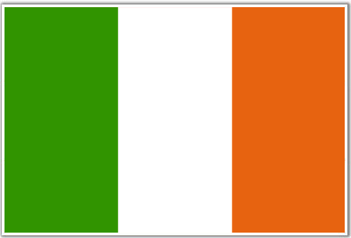
(i) Pro-cyclical fiscal policy in Europe:
When the euro crisis hit in 2009,
the bigger recessions went with the bigger fiscal contractions.
Source: P.Krugman, 10 May 2012.

Slide 27
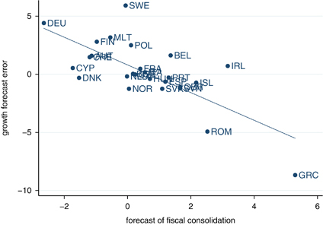
Effects of austerity were worse than the Troika had assumed.
Why? A different kind of over-optimism:
The evidence: the bigger the fiscal contraction, the bigger
the GDP loss relative to what had been officially forecast.
Europe: Growth Forecast Errors vs. Fiscal Consolidation Forecasts
O. Blanchard & D. Leigh, 2014, “Growth Forecast Errors and Fiscal Multipliers,” American Economic Review.
Note: Figure plots forecast error for real GDP growth in 2010 & 2011 relative to forecasts made in
the spring of 2010, on forecasts of fiscal consolidation for 2010 & 2011 made in spring of year 2010.

Slide 28
With austerity, debt/GDP ratios continued to rise sharply:
Declining GDP outweighed progress on reduction of budget deficits.
.

Slide 29

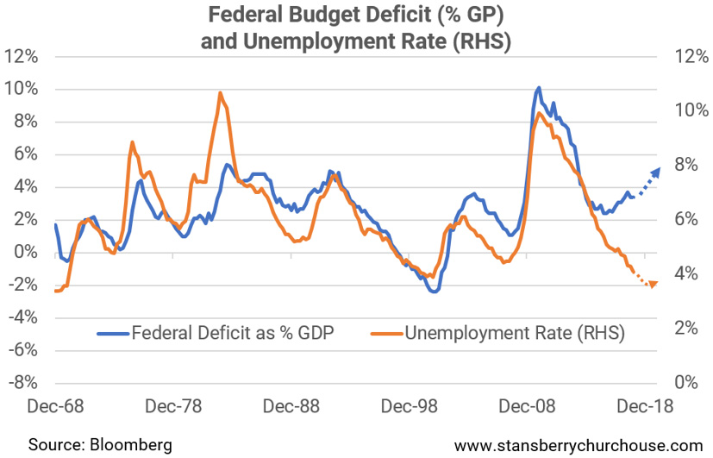
(ii) US fiscal policy
for the 1st time since WWII, has turned strongly expansionary
at a time when the economy is at full employment.
(% GDP)
“This is how the world’s biggest economy goes broke…” Tama Churchouse, Feb.26, 2018

Slide 30
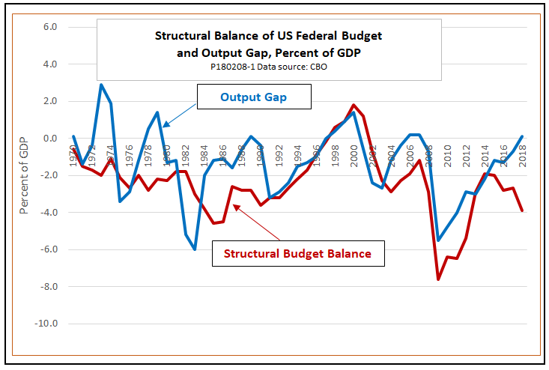
In Dec. 2017, the Republicans cut taxes sharply although the US economy was already operating at its potential.
Ed Dolan, Feb. 8, 2018

Slide 31
The US currently is showing the world how not to do it.
Pro-cyclical fiscal policy.
Reversal of financial regulation.
Unilateral protectionist threats.

Slide 32

THANK YOU
Prof. Jeffrey Frankel
Website: https://scholar.harvard.edu/frankel
Monthly column:
www.project-syndicate.org/columnist/jeffrey-frankel
twitter.com/JFrankelEcon

Slide 33
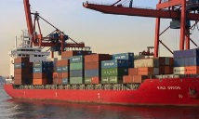
Appendices
Appendix 1: More on 2018 as a cyclical top.
Appendix 2: More on the case of Chile,
  overcoming fiscal pro-cyclicality
  from optimism bias in official forecasts
Appendix 3: The slowdown in trade

Slide 34
Appendix 1: More on 2018 as a cyclical top.
Economies are listed on the basis of economic size. The aggregated quarterly data are seasonally adjusted. 1Difference based on rounded figures for the current, January 2018 World Economic Outlook Update, and October 2017 World Economic Outlook forecasts. 2Excludes the Group of Seven (Canada, France, Germany, Italy, Japan, United Kingdom, United States) and euro area countries. 3For India, data and forecasts are presented on a fiscal year basis and GDP from 2011 onward is based on GDP at market prices with fiscal year 2011/12 as a base year. 4Indonesia, Malaysia, Philippines, Thailand, Vietnam.
IMF World Economic Outlook,
April 2018.

Slide 35
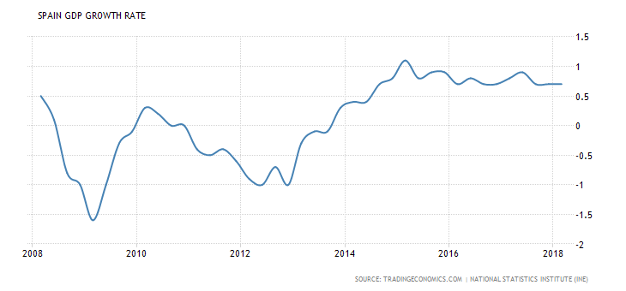
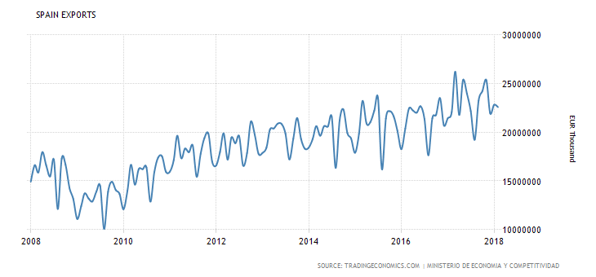
Spanish exports have led its recovery.

Slide 36
EM capital inflows recovered in 2017.
IMF World Economic Outlook, April 2018.

Slide 37
US equity markets are still high
IMF World Economic Outlook, April 2018.

Slide 38
Asian equity markets are also high.
IMF World Economic Outlook, April 2018.

Slide 39


Appendix 2: More on Chile’s fiscal institutions
1st rule – Governments
must set a budget target,
2nd rule – The target is structural:
Deficits allowed only to the extent that
  (1) output falls short of trend, in a recession,
  (2) or the price of copper is below its trend.
3rd rule – The trends are projected by 2 panels
of independent experts, outside the political process.
  Result: Chile avoided the pattern of 32 other governments,
    where forecasts in booms were biased toward optimism.
Notes:
39

Slide 40
Chilean fiscal institutions
In 2000 Chile instituted its structural budget rule.
The institution was formalized in law in 2006.
The structural budget surplus must be…
  0 as of 2008,
  where structural is defined by output & copper price
  equal to their long-run trend values.
I.e., in a boom the government can only spend increased revenues that are deemed permanent;
any temporary copper bonanzas must be saved.

Slide 41
The Pay-off
Chile’s fiscal position strengthened immediately:
  Public saving rose from 2.5 % of GDP in 2000 to 7.9 % in 2005
  allowing national saving to rise from 21 % to 24 %.
Government debt fell sharply as a share of GDP
and the sovereign spread gradually declined.
By 2006, Chile achieved a sovereign debt rating of A,
    several notches ahead of Latin American peers.
By 2007 it had become a net creditor.
By 2010, Chile’s sovereign rating had climbed to A+,
    ahead of some advanced countries. Now AA-.
=> It was able to respond to the 2008-09 recession
  via fiscal expansion.

Slide 42

The problem of over-optimism in official forecasts
Statistically significant findings among 33 countries
Official forecasts on average
are overly optimistic, for:
  (1) budgets &
  (2) GDP .
The bias toward optimism is:
  (3) stronger the longer the forecast horizon;
  (4) greater in booms.

Slide 43
Implication of forecast bias for actual budgets
Can lead to pro-cyclical fiscal policy:
  If the boom is forecast to last indefinitely,
  there is no apparent need to retrench.
BD rules don’t help.
  The SGP worsens forecast bias
  for euro countries

Slide 44
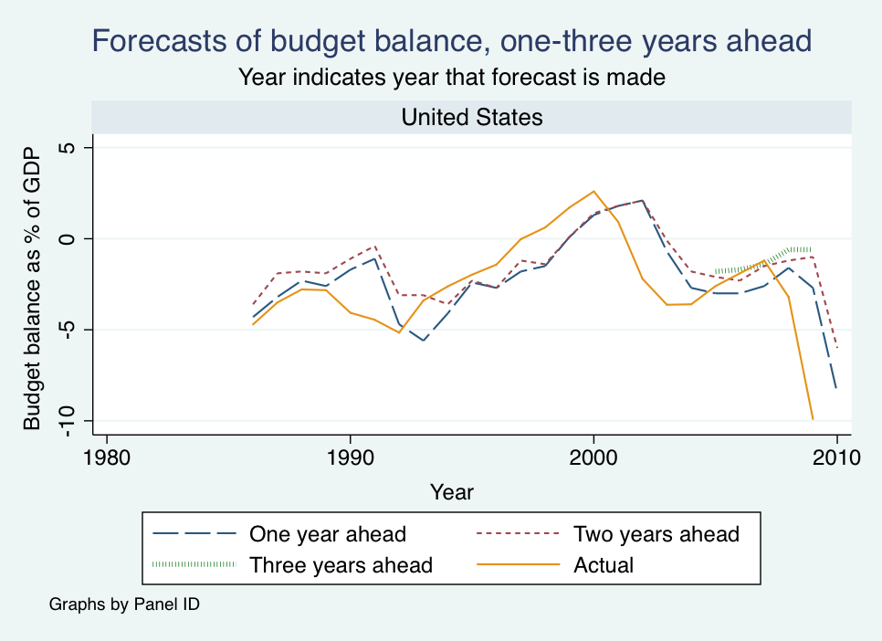

US official projections were over-optimistic on average.
F & Schreger, 2013

Slide 45
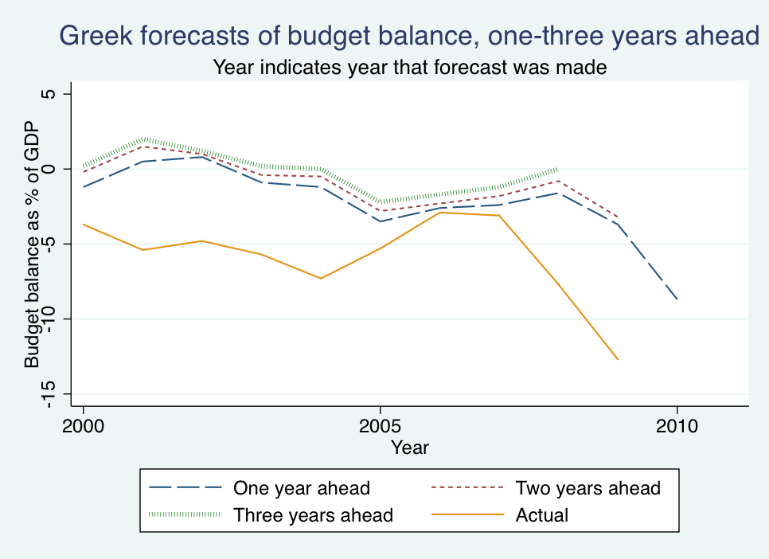
Greek official forecasts were always over-optimistic.
F & Schreger, 2013
Data from Greece’s Stability and Convergence Programs.

Slide 46
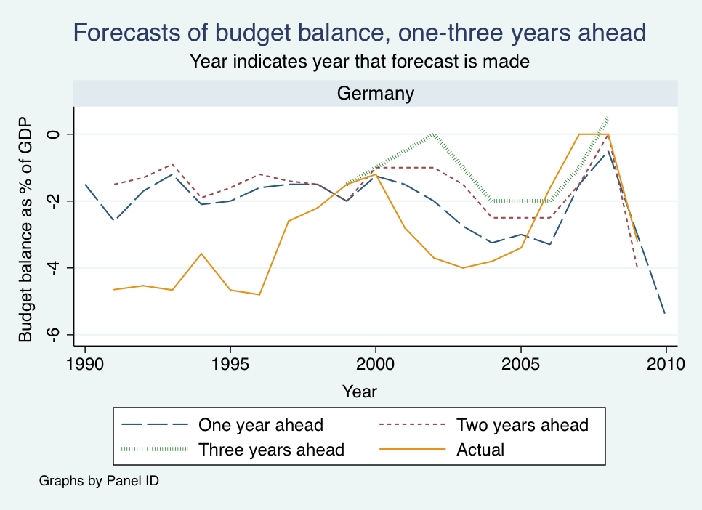

German forecasts were also usually too optimistic.

Slide 47
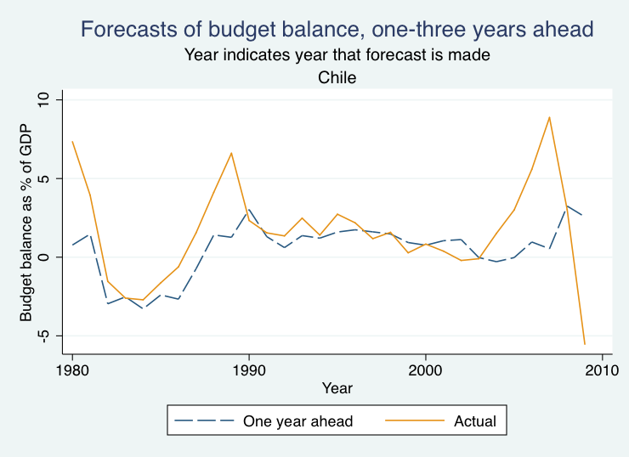

Chile’s official forecasts were not over-optimistic.

Slide 48
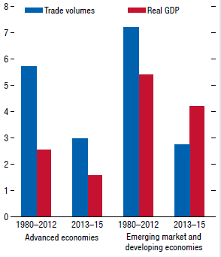
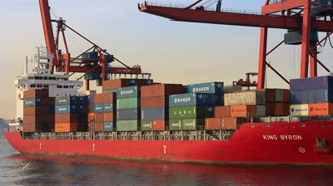
Trade used to grow twice as fast as GDP.
Since the 2008-09 recession, it has grown much more slowly.
Appendix 3. The trade slowdown
Emine Boz, Eugenio Cerutti,
& Sung Eun Jung (IMF, 2016).
Since the rebound from the great trade collapse of 2008–09, when world trade fell by much more than GDP, global trade growth has slowed notably, both in absolute terms and relative to world GDP growth. This slowdown has been more pronounced in emerging market and developing economies, where it intensified in 2015. See Hoekman 2015 for a compilation of studies analyzing the drivers behind the recent trade slowdown.

Slide 49
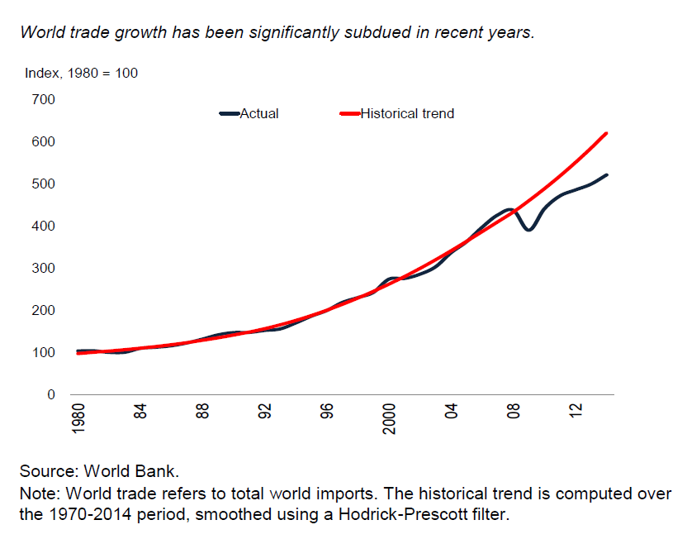
Growth in trade was rapid during most of the post-war period-- twice as fast as GDP.

Slide 50
But the trend of economic integration across
national borders is not inevitable or irreversible,
  even if technological progress in transport
  and communication is one-directional.
  In the period 1914-1945, political forces worked to turn
  the clock back on globalization:
    tariff protection,
    discriminatory economic blocs,
    and war.
  They had the effects one would expect: Trade fell sharply.
  It could happen again.

Slide 51
When the Global Financial Crisis hit in 2008…
there was a fear that countries might revert to protectionism, as in the 1930s, with similar results.
  The first two meetings of the new G-20 Leaders Summit
  in 2008 & 2009 pledged not to impose new protection.
The fall in trade turned out to be worse than feared.

Slide 52




Since 2008, global trade has indeed slowed.
Sept. 2015. p.16, Fig.5.B

Slide 53
Why has trade slowed so much?
Global supply chains have matured
  -- Vertical specialization has largely run its course.
Physical investment spending has slowed
  which is trade-intensive.
The structure of China’s economy is shifting
  away from manufacturing, toward services;
  away from exports, toward domestic demand.
iv. Protectionism?

Slide 54
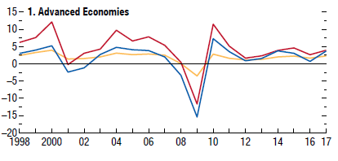
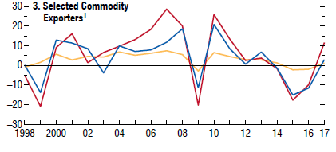
(ii) The slowdown in trade was correlated with a slowdown
in physical investment (which tends to be import-intensive).
%
%
IMF WEO,
Apr 2018.

Slide 55
(iii) The structure of China’s economy is “rebalancing.”
China long had great success with manufacturing;
  growth was led by exports and investment.
But since 2013 it has moved toward services,
  with growth led by consumer demand, appropriately.
Services are less trade-intensive than manufacturing.

Slide 56

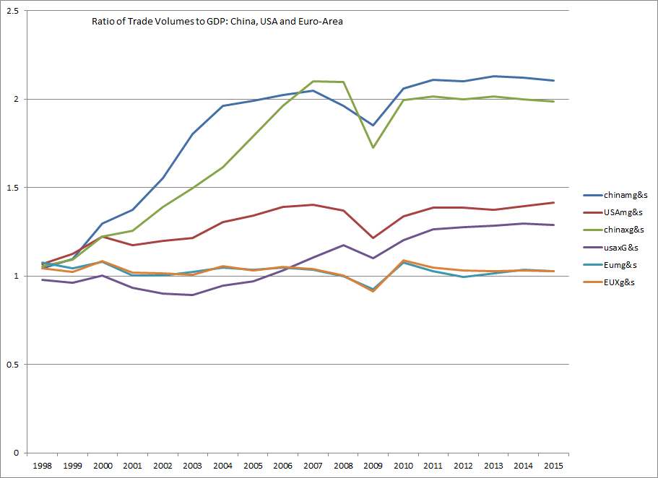



China’s exports & imports had risen especially fast, even relative to GDP, before 2008.
(Followed by the US. EU trade/GDP had been flat.)
1997=1

Slide 57
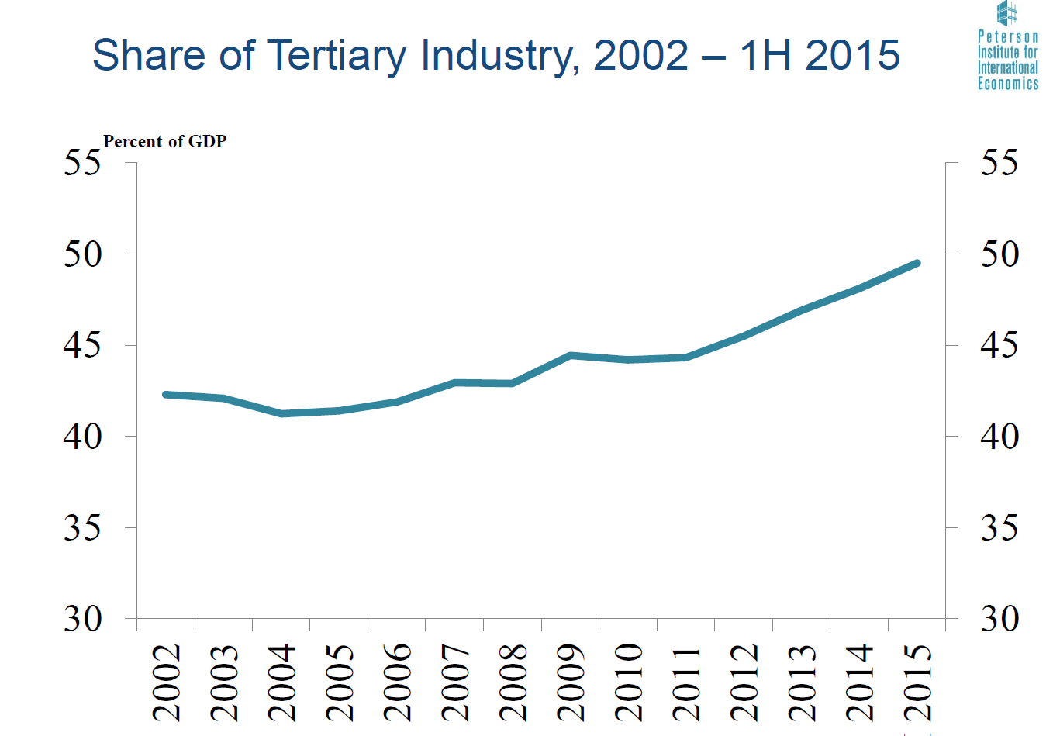
China is shifting into services, judging by the available data.
% of GDP
Source: Nicholas Lardy, PIIE

Slide 58
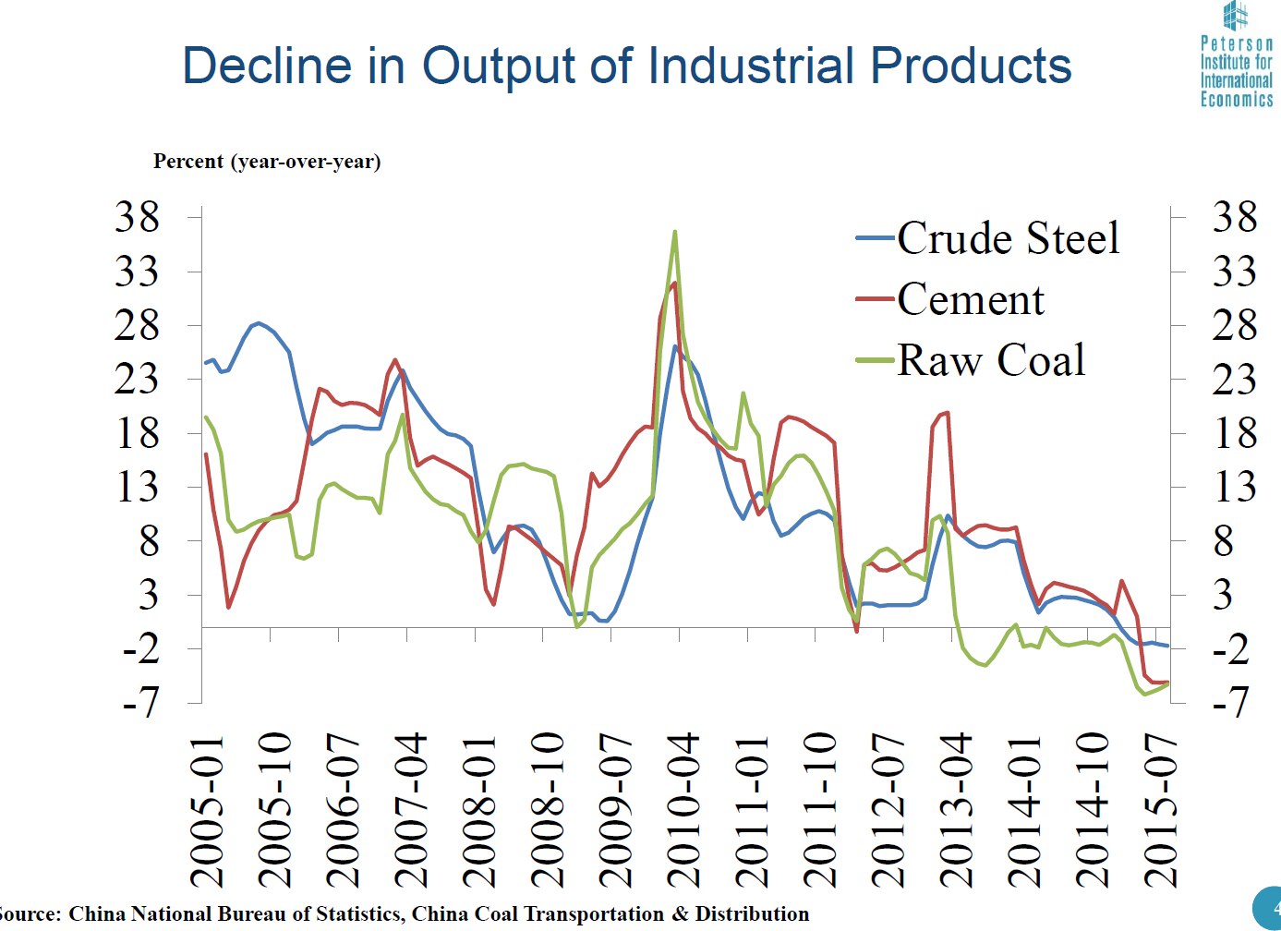
It’s good to look also at other data
Decline in China’s output of industrial products,
2010-2015
% change (year-over-year)
Source: Nicholas Lardy

Slide 59
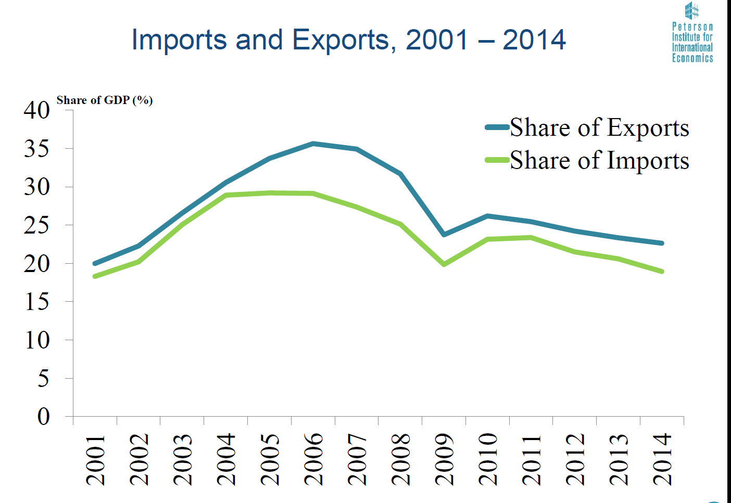
Trade’s relative importance in China has peaked, in part because services are less trade-intensive.
% of GDP
Source: Nicholas Lardy

Slide 60
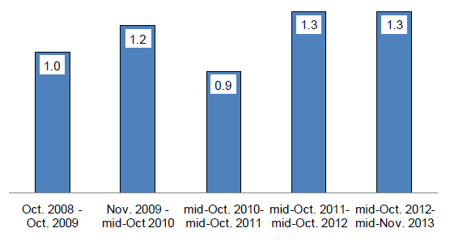
The WTO trade restrictiveness indicators – capturing border measures such as tariff increases, import licenses, or new customs controls- show a modest increase in the share of world trade covered by new import restricting measures since the Great Recession (Fig. 13)…. These findings suggest that protectionist trade policies are playing a negligible (if any) role … in the current trade slowdown…
Why has trade slowed so much? continued
(iv) Protectionist measures? They did not rise in the 2007-09 recession as much as they had in past recessions.
Data source:
WTO
Constantinescu, Mattoo, and Ruta, 2015,
"The global trade slowdown: cyclical or structural?" IMF WP 15/6.

Slide 61
But Trump’s 2018 policies could indeed turn the clock back on trade.
He is unlikely to get more than face-saving concessions,
but he may undermine the multilateral trading system for the long-term.

