Slide 1




A strategy so American workers won’t be left behind in the modern economy.
Presenter: Jeffrey Frankel
Conference on Rewriting the Rules of Globalization:
The Dangers of Trumpism and the Needed Response
Roosevelt House, March 3, 2017; 1:00 PM – Session III

Slide 2
“Is trade is a placeholder for broader economic anxieties?” Yes.
Causes of rising inequality:
Why has the modern economy left
the median worker behind?
An economy that works for all Americans:
What policies can help optimize growth
& equality, according to most economists?
III) The sensible political strategy.

Slide 3
(II) Ten causes of rising inequality in the US
  Trade probably does play a role, along with:
  technological change raising demand for skilled workers,
  outpacing education that raises the supply;
  “winner-take-all” labor markets,
  “assortative mating,”
  more corporate monopoly power (higher rents),
  and excessive executive compensation.
  Tax cuts for the rich in the early 1980s & 2000s.
  Piketty: wealth accumulates faster than income.
  Possibly the declines in union power & minimum wages.

Slide 4
(III) Some policies to optimize growth
& equality, widely favored by economists
Improve education, esp. universal pre-school education.
Expand the health-insured population: The Affordable Care Act
Infrastructure spending
Intelligent financial regulation: Dodd-Frank reform, fiduciary rule, etc.
Tax reform
  Make personal income tax system more progressive, not less.
    E.g., expand EITC & abolish the carried interest deduction.
  Keep the estate tax, make payroll taxes more progressive, etc.
  Tax gasoline & carbon.
Address the long-term rise in household debt:
Don’t get families up to their eyeballs in housing debt they can’t afford.
    E.g., require mortgage-originators to keep “skin in the game.”
Make auto dealers subject to the Consumer Finance Protection Bureau.
Make student loans contingent on the school’s rates of graduation & gainful employment.
Consider wage insurance, over Trade Adjustment Assistance.

Slide 5
III) Sensible strategy
Theorem: Free trade + helping the “losers”
can give the desired combination of GDP vs. equality.
Common response: But we don’t “compensate the losers.”
So we need to rethink globalization.
My response: What is on the ballot every 4 years?
  The choice between free trade vs. protectionism?
  Some unknown ideal rethought-globalization?
  The choice between that list of policies and their opposites?
Why do so many American workers vote against their interests?
  Because we fail to explain the policies to them.
  No.
  No.
  Yes. (D vs R).

Slide 7
If the economy is in such good shape, why has there been such discontent?
Appendices:
An Economy That Works for All Americans
One obvious answer:
The longer-term trend for typical Americans has not been good.
Since 2000, the gains have gone to those at the top.
The longer-term trend for the typical American has not been good:

Slide 8
Overview
Yes, ordinary Americans have been
left behind in the modern economy.
Ten reasons why US inequality has risen.
Ten policy proposals to help share a growing economic pie more equally.

Slide 9
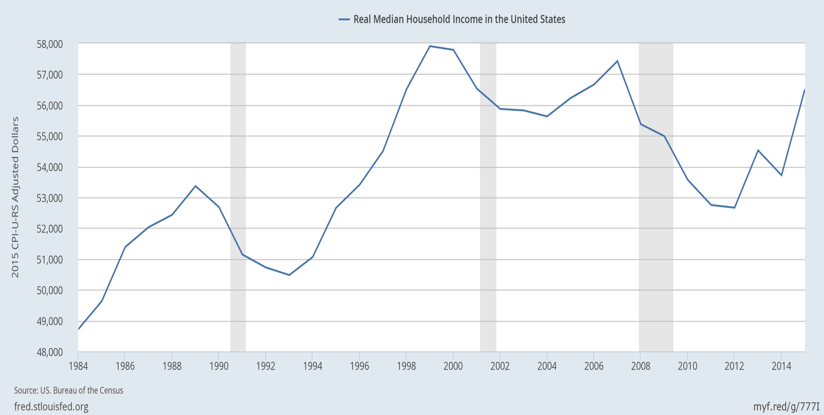
(I) Real median family income is still below 2000!
|
2000
|
2007
|
2015
even though median income rose 5.2% in 2015, the fastest ever;
and the poverty rate fell from 14.8% to 13.5%, the largest drop since 1968.

Slide 10
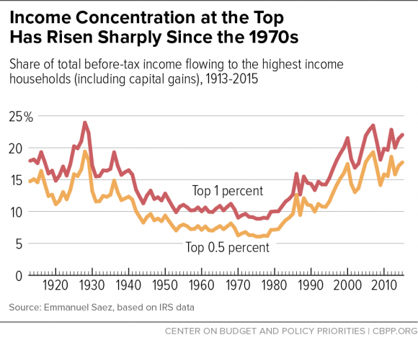
The share of US income going to the top has been rising since 1980, and is now back to the 1920s level.
Chad Stone et al, CBPP, Sept 30, 2016 www.cbpp.org/research/poverty-and-inequality/a-guide-to-statistics-on-historical-trends-in-income-inequality

Slide 11
(II) Why has inequality risen in the US? Ten reasons.
  Trade probably does play a role, along with:
  technological change raising demand for skilled workers,
  outpacing education that raises the supply;
  “winner-take-all” labor markets,
  “assortative mating,”
  more corporate monopoly power (higher “rents”),
  and “excessive” executive compensation.
  Piketty: wealth accumulates faster than income.
  Possibly the decline in union power & minimum wages.
  The tax cuts for the rich in early 1980s & 2000s.

Slide 12

1. Trade probably does play a role
Import competition has certainly hurt some workers,
  as in the clothing & steel industries.
But trade also has benefits:
  Imported goods lower costs to consumers,
  especially low-income consumers.
  Imported components keep costs low for US firms,
    e.g., allowing US autos to remain globally competitive.
  Exports create new jobs
    which tend to pay 12% more than average jobs.

Slide 13

Manufacturing jobs were 32% of the national total in 1950, and had declined to 10% by 2010.
Percent of employment in US manufacturing (1970-2012)
But it’s productivity growth:
manufacturing output has continued to rise.

Slide 14
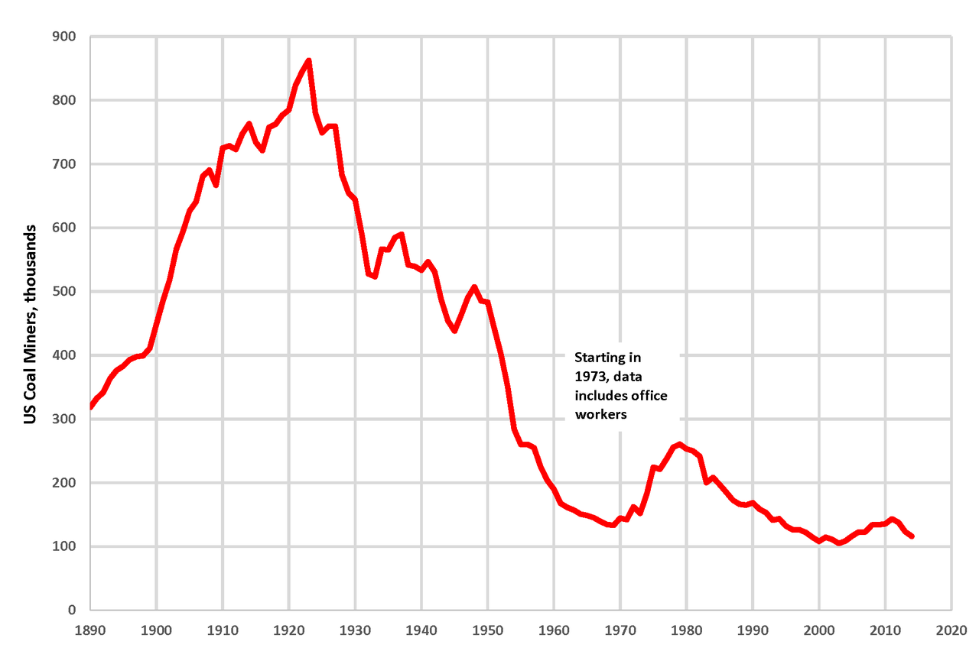
Similarly, we are not going back to the number of coal miners that were employed in 1923.
By Plazak - Own work, CC BY-SA 4.0, https://commons.wikimedia.org/w/index.php?curid=48261916

Slide 15

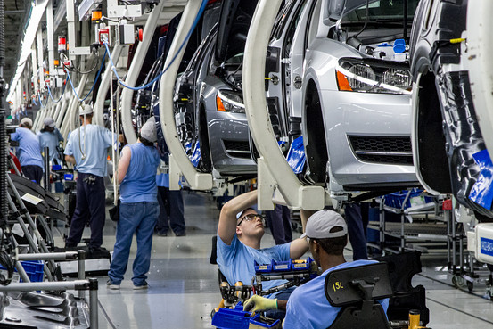
2. Technology raises demand for “skilled” vs. “unskilled” workers, as shown by widening wage gap.
Jason Furman, CEA, Oct. 17, 2016, Fig.10.

Slide 16


3. The trend in years of education slowed during 1981-2012.
Average Years of Schooling at Age 30, U.S. Native-Born, by Year of Birth, 1876-1982
Trend
1906 – 1981
= 1876+30 to 1951+30.
Trend
1981 – 2012
= 1951+30 to 1982+30.
Jason Furman, CEA, Oct. 17, 2016, Fig.11.

Slide 17

4. “Winner take all” labor markets
    Taylor Swift earned $170 million last year, making her
    the world’s highest paid celebrity (according to Forbes).

Slide 18

5. “Assortative mating”
    Crudely put: highly educated,
    highly paid, male professionals
    used to marry their secretaries,
    but now are more likely
    to marry highly educated & (relatively) highly paid women.
    The couple passes the advantages on to their children.

Slide 19
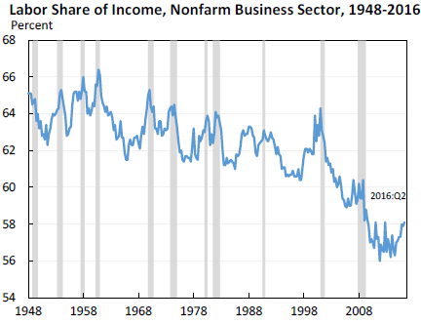
6. The share of US national income going to labor has declined since 2000 in part due to increased market power of firms, says Furman.
Jason Furman, CEA, Oct. 17, 2016, Fig.13.

Slide 20
7. Excessive compensation?
Many top-1%-ers are executives and/or in finance.
Composition of Top 1 Percent Income Share by Primary Occupation
Jason Furman, CEA, Oct. 17, 2016, Fig.4a.

Slide 21
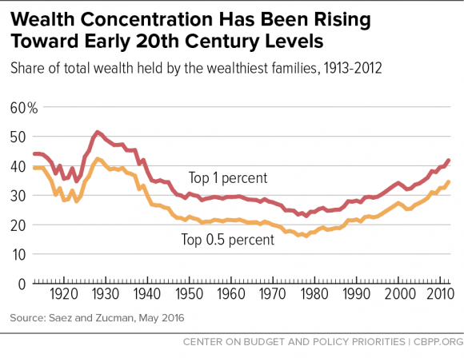

8. Supporting Piketty: The share of wealth at the top has also been rising.
Chad Stone et al, CBPP, Sept 30, 2016 www.cbpp.org/research/poverty-and-inequality/a-guide-to-statistics-on-historical-trends-in-income-inequality

Slide 22




What weights should we place on each of these factors in explaining increased inequality?
I don’t know.
Probably all merit some weight:
  Trade,
  technology, education,
  winner-take-all,
  assortative mating,
  rents, executive compensation,
  and wealth accumulation.
Surely one must diagnose the cause before
deciding on the corresponding remedy?
No, I don’t think one has to.

Slide 23
(III) Nine policy proposals to promote
An Economy That Works for All Americans
Expand, don’t reduce, the health-insured population.
Strengthen, don’t weaken, US financial regulation.
Address the long-term rise in household debt.
Reform the tax system
Put social security on a sound footing.
Increase infrastructure spending.
Improve education, esp. universal pre-school education.
Keep US global economic leadership.
Consider wage insurance.

Slide 24
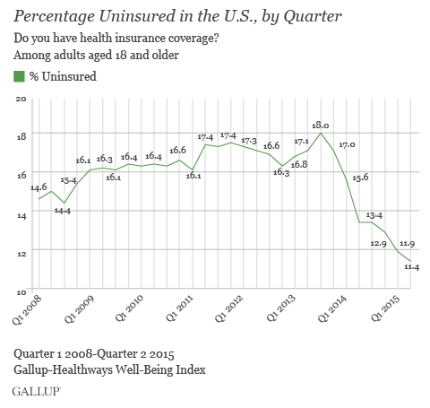
1. Keep the Affordable Care Act which has sharply reduced the percentage of Americans lacking health insurance, and is fully funded.

Slide 25
2. Retain intelligent financial regulation
Let the “fiduciary rule” on financial advisers
go into effect in April.
Don’t gut Dodd-Frank financial reform, esp. its:
  higher capital requirements for banks,
  tough stress tests on banks,
  designation of Systemically Important Fin. Institutions,
  enhanced transparency for derivatives, and
  the Consumer Financial Protection Bureau.

Slide 26
3: Address the long-term rise in household debt: housing, auto, & student loans
Reduce the policy tilt toward getting American families
up to their eyeballs in mortgage debt they can’t afford.
  It led to 2007-09 financial crisis.
    without even much raising home ownership rates.
  Specific policies:
    Require a serious minimum down payment, as other countries do.
    Require “skin in the game,” on the part of mortgage-originators.
    Curtail tax deductibility of mortgage interest,
      which mainly benefits the well-off.
        It generally saves less than $200 for households earning $65,000.
      Reduce deductions at the upper end,
      especially if loan is used other than for purchase of residence
        i.e., 2nd home or “cash out” for spending.
    Don’t repeat the mistake of privatized Fannie Mae & Freddie Mac.
  And it drives up housing prices

Slide 27
Address household debt: housing, auto & student loans, continued
Auto dealers should not have been exempted
from the Consumer Finance Protection Bureau.
  A rising share of sub-prime auto loans are now delinquent.
Although most college educations are still a good deal, and worth going into debt for if that is the only way, some enterprises are bad deals.
    In particular, a majority of for-profit universities.
    Government should expand student grants & loans,
    but tighten requirements that the college or university have a decent record regarding rates of graduation & gainful employment, not loosen them.

Slide 28
4. Reform the tax system
Reform the corporate income tax .
  Stay revenue-neutral:
  lower rate,
  but cut distorting deductions,
    e.g., oil subsidies & interest deductions.
Reform personal income tax to make it
more progressive, not regressive.
  E.g., expand EITC ,
  and abolish the carried interest deduction.
Don’t eliminate the estate tax.
The most efficient taxes are on energy:
  Gasoline & carbon taxes, as proposed by Feldstein & Mankiw.

Slide 29
5. Put social security on a sound footing
Gradually raise the retirement age. Meanwhile,
Make payroll taxes more progressive:
  Exempt low-income workers and
  raise the cap on payroll taxes (now at $117,000).
6. Increase infrastructure spending.
It’s good for growth
and creates jobs for construction workers
though we could have really used it 5-7 years ago,
when unemployment was twice as high.

Slide 30
The last 3 of the 9 policy proposals
Improve education,
esp. universal pre-school education.
Keep US global economic leadership,
including abiding by past trade agreements
and pursuing new ones… like TPP!
Consider wage insurance,
which compensates those who lose jobs (not just for trade)
and does not penalize taking a new job at lower wage.

Slide 31
An Economy That Works for All Americans
Jeffrey Frankel
Harpel Professor of Capital Formation and Growth
Harvard University

