Slide 1




A strategy so American workers won’t be left behind in the modern economy.
Presenter: Jeffrey Frankel
Conference on Rewriting the Rules of Globalization:
The Dangers of Trumpism and the Needed Response
Roosevelt House, March 3, 2017; 1:00 PM – Session III

Slide 2
“Is trade is a placeholder for broader economic anxieties?” Yes.
Why has the modern economy
left the median worker behind?
An economy that works for all Americans:
What policies can help optimize growth
& equality?
III) The sensible political strategy.

Slide 3
(I) Ten causes of rising inequality in the US
  Trade probably does play a role, along with:
  technological change raising demand for skilled workers,
  outpacing education that raises the supply;
  “winner-take-all” labor markets,
  “assortative mating,”
  more corporate monopoly power (higher rents),
  and excessive executive compensation.
  Also tax cuts for the rich in the early 1980s & 2000s.
  Piketty: wealth accumulates faster than income; and
  possibly the declines in union power & minimum wages.

Slide 4
(II) Some policies to optimize growth
& equality, widely favored by economists
Improve education, esp. universal pre-school education.
Expand the health-insured population: The Affordable Care Act
Infrastructure spending
Intelligent financial regulation: Dodd-Frank reform, fiduciary rule, etc.
Tax reform
  Make personal income tax system more progressive, not less.
    E.g., expand EITC & abolish the carried interest deduction.
  Keep the estate tax, make payroll taxes more progressive, etc.
  Tax gasoline & carbon.
Address the long-term rise in household debt:
Don’t get families up to their eyeballs in housing debt they can’t afford.
    E.g., require mortgage-originators to keep “skin in the game.”
Make auto dealers subject to the Consumer Finance Protection Bureau.
Make student loans contingent on the school’s rates of graduation & gainful employment.
Consider wage insurance, over Trade Adjustment Assistance.

Slide 5
(III) Sensible strategy
Theorem: Free trade + compensating the “losers”
can give growth without leaving the median worker behind.
Common response: But we don’t “compensate the losers.”
So we need to rethink globalization.
My response: What is on the ballot every 4 years?
  The choice between free trade vs. protectionism?
  Some unknown ideal rethought-globalization?
  The choice between that list of policies (II) and their opposites?
Why do so many American workers vote against their interests?
  Because we fail to explain the policies to them.
  No.
  No.
  Yes. (D vs R).

Slide 7
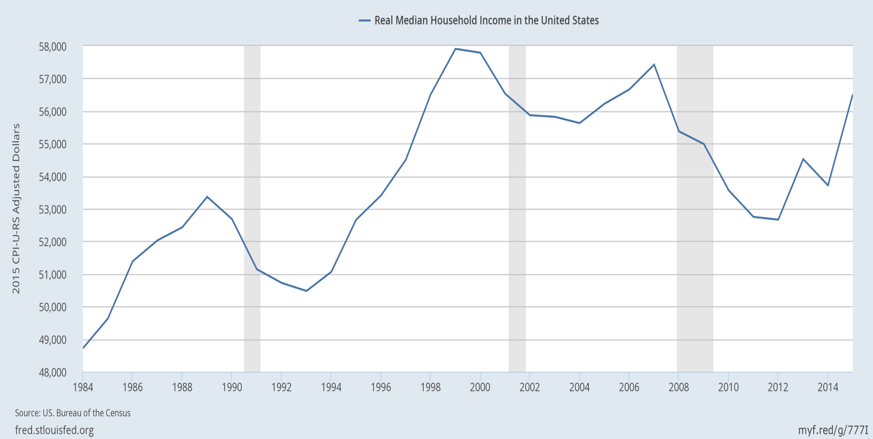
(I) Real median family income is still below 2000!
|
2000
|
2007
|
2015
even though median income rose 5.2% in 2015, the fastest ever;
and the poverty rate fell from 14.8% to 13.5%, the largest drop since 1968.

Slide 8
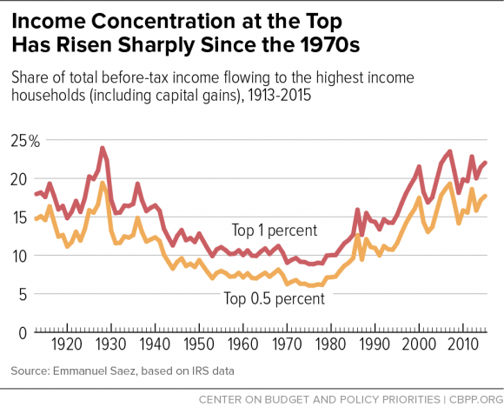
The share of US income going to the top has been rising since 1980, and is now back to the 1920s level.
Chad Stone et al, CBPP, Sept 30, 2016 www.cbpp.org/research/poverty-and-inequality/a-guide-to-statistics-on-historical-trends-in-income-inequality

Slide 9
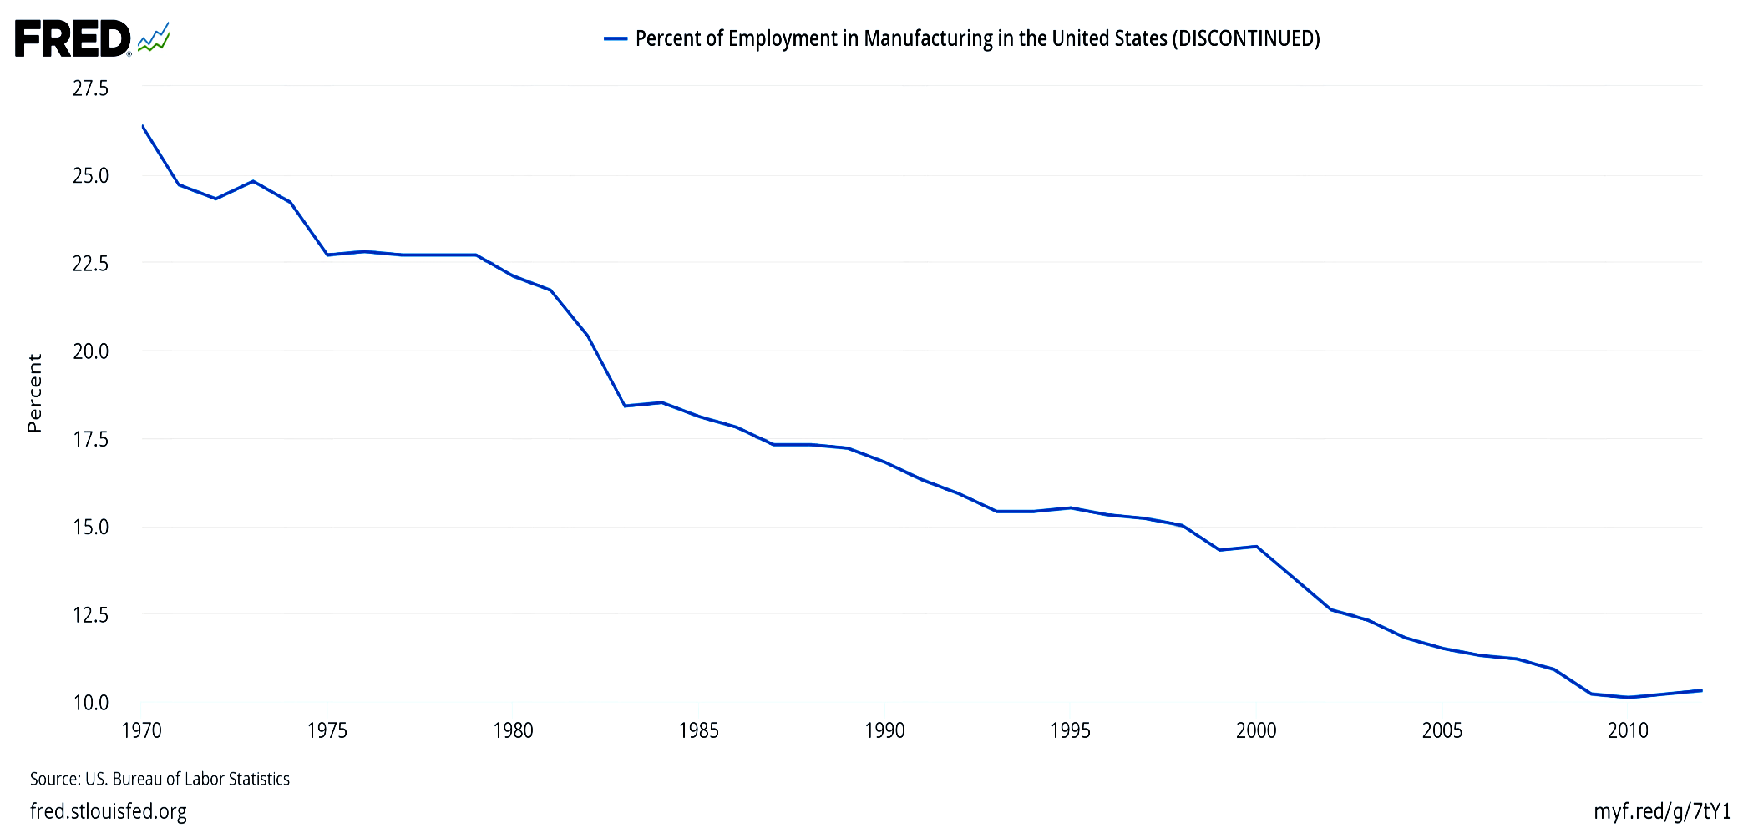
Manufacturing jobs were 32% of the national total in 1950, and had declined to 10% by 2010.
Percent of employment in US manufacturing (1970-2012)
But it’s productivity growth:
manufacturing output has continued to rise.

Slide 10
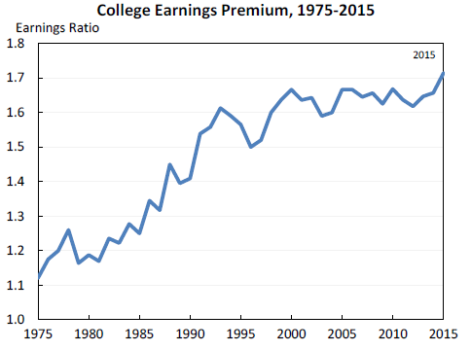
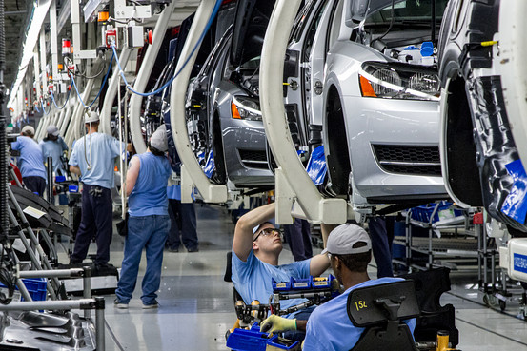
2. Technology raises demand for “skilled” vs. “unskilled” workers, as shown by widening wage gap.
Jason Furman, CEA, Oct. 17, 2016, Fig.10.

Slide 11
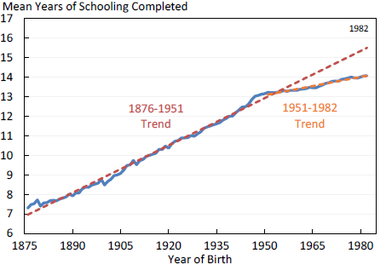
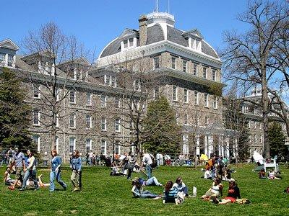
3. The trend in years of education slowed during 1981-2012.
Average Years of Schooling at Age 30, U.S. Native-Born, by Year of Birth, 1876-1982
Trend
1906 – 1981
= 1876+30 to 1951+30.
Trend
1981 – 2012
= 1951+30 to 1982+30.
Jason Furman, CEA, Oct. 17, 2016, Fig.11.

Slide 12
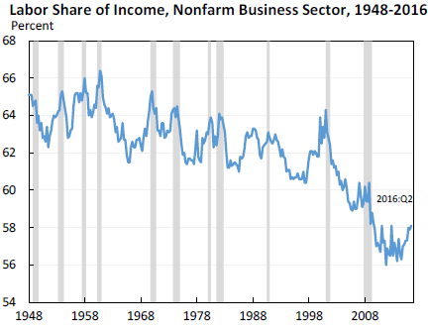
6. The share of US national income going to labor has declined since 2000 in part due to increased market power of firms, says Furman.
Jason Furman, CEA, Oct. 17, 2016, Fig.13.

